Slide 1
Performance-portability of the Albany multi-physics finite element code on the road to exascale
Jerry Watkins¹, Max Carlson^{1,2}, Irina Tezaur¹
¹ Sandia National Laboratories, Livermore, CA.
² University of Utah, Salt Lake City, UT.
Platform for Advanced Scientific Computing (PASC) 2021
Wednesday, July 7, 2021
SAND2021-7742PE

Slide 2
Outline
Motivation
Albany and its supporting tools
Case study: Albany Land Ice (ALI)
  Overview of ALI model
  Performance study
  Automated performance testing
  Automated parameter/performance tuning
Summary & future work

Slide 3
Outline
Motivation
Albany and its supporting tools
Case study: Albany Land Ice (ALI)
  Overview of ALI model
  Performance study
  Automated performance testing
  Automated parameter/performance tuning
Summary & future work

Slide 4
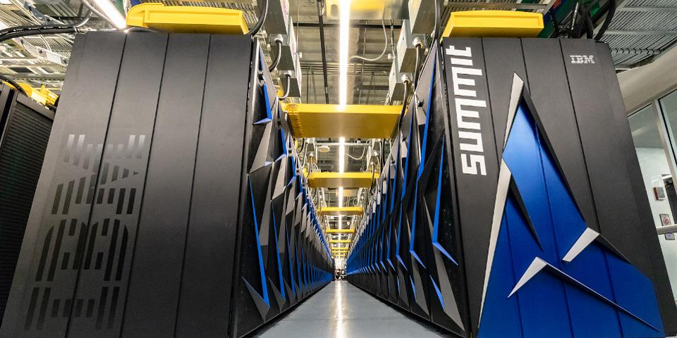
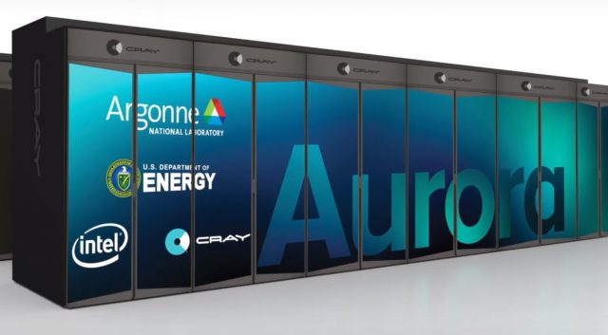
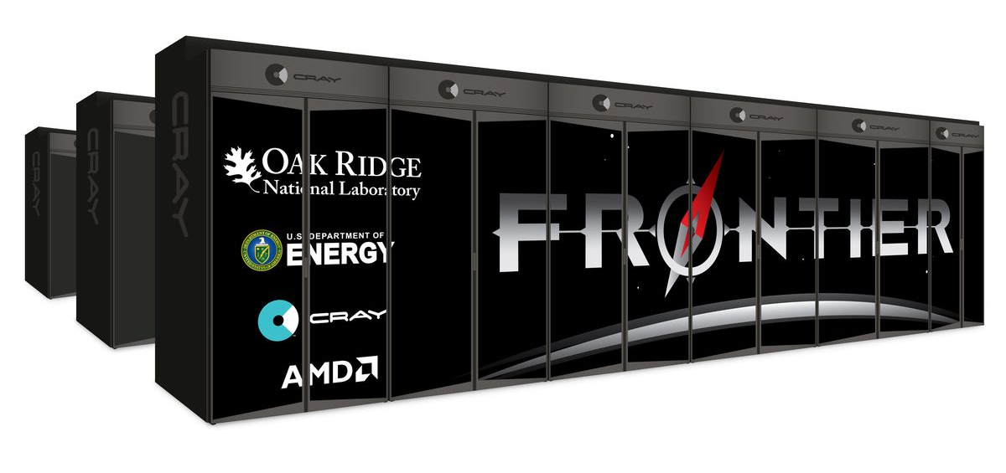

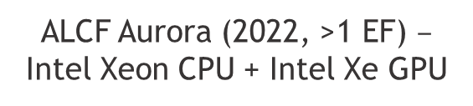
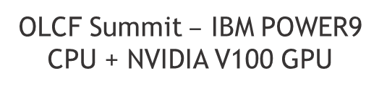
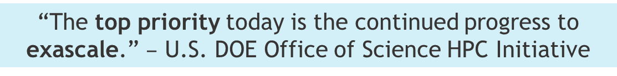

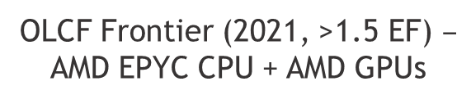
Motivation
The future is GPUs:
“The top priority today is the continued progress to exascale.” $–$ U.S. DOE Office of Science HPC Initiative
OLCF Summit $–$ IBM POWER9 CPU + NVIDIA V100 GPU
ALCF Aurora (2022, >1 EF) $–$ Intel Xeon CPU + Intel Xe GPU
OLCF Frontier (2021, >1.5 EF) $–$ AMD EPYC CPU + AMD GPUs
NERSC Perlmutter (2021) $–$
AMD EPYC CPU + NVIDIA A100 GPU
MPI-only
MPI+X
Current scientific software must adapt to changing HPC architectures
New scientific software must be designed to mitigate issues from changing HPC architectures
Performance portability: achieving a reasonable level of performance across a wide range of architectures using the same code base.
4

Slide 5
Outline
Motivation
Albany and its supporting tools
Case study: Albany Land Ice (ALI)
  Overview of ALI model
  Performance study
  Automated performance testing
  Automated parameter/performance tuning
Summary & future work

Slide 6
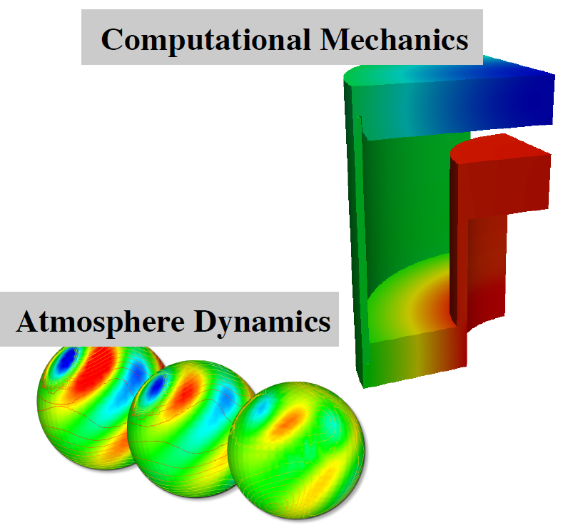
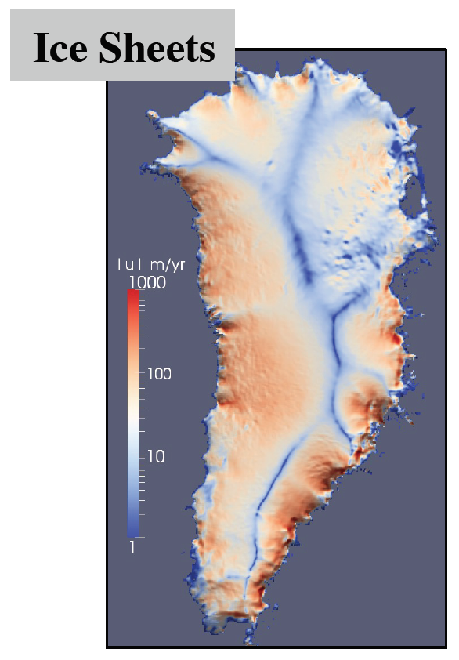
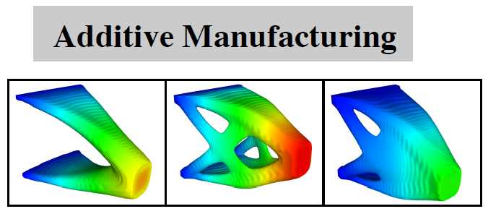

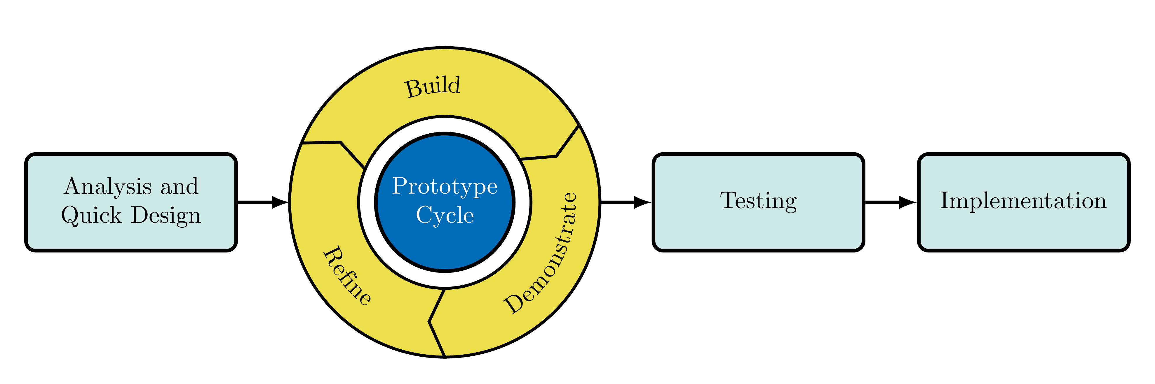
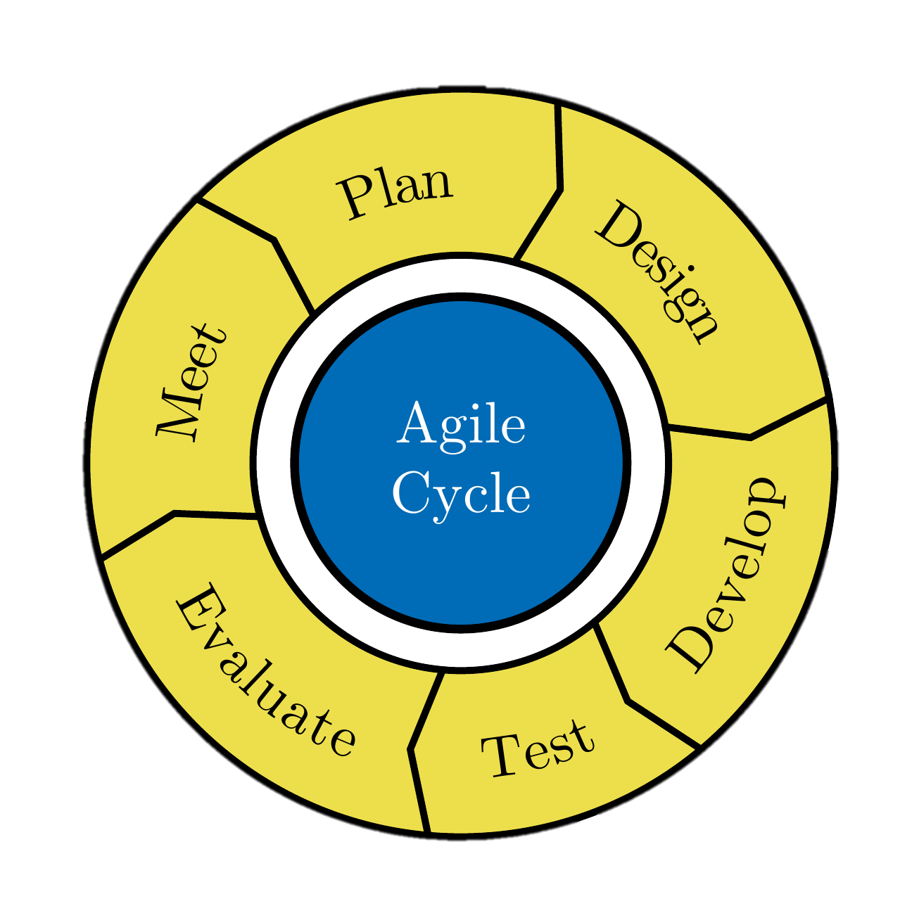

The Albany code base
Albany: open-source¹, parallel, C++, unstructured-grid multi-physics finite element code built for rapid application development from Trilinos² Agile Components
Funded entirely by applications residing within
Component Examples (package name)
Mesh tools (STK)
Discretization tools (Intrepid2)
Nonlinear solver (NOX)
Preconditioners (Ifpack2)
Linear solver (Belos)
Field DAG (Phalanx)
Automatic differentiation (Sacado)
Distributed memory linear algebra (Tpetra)
Shared memory parallelism (Kokkos)
Many more…
Both a “sand-box” and a production code
¹ https://github.com/SNLComputation/Albany. ² https://github.com/trilinos/Trilinos.

Slide 7

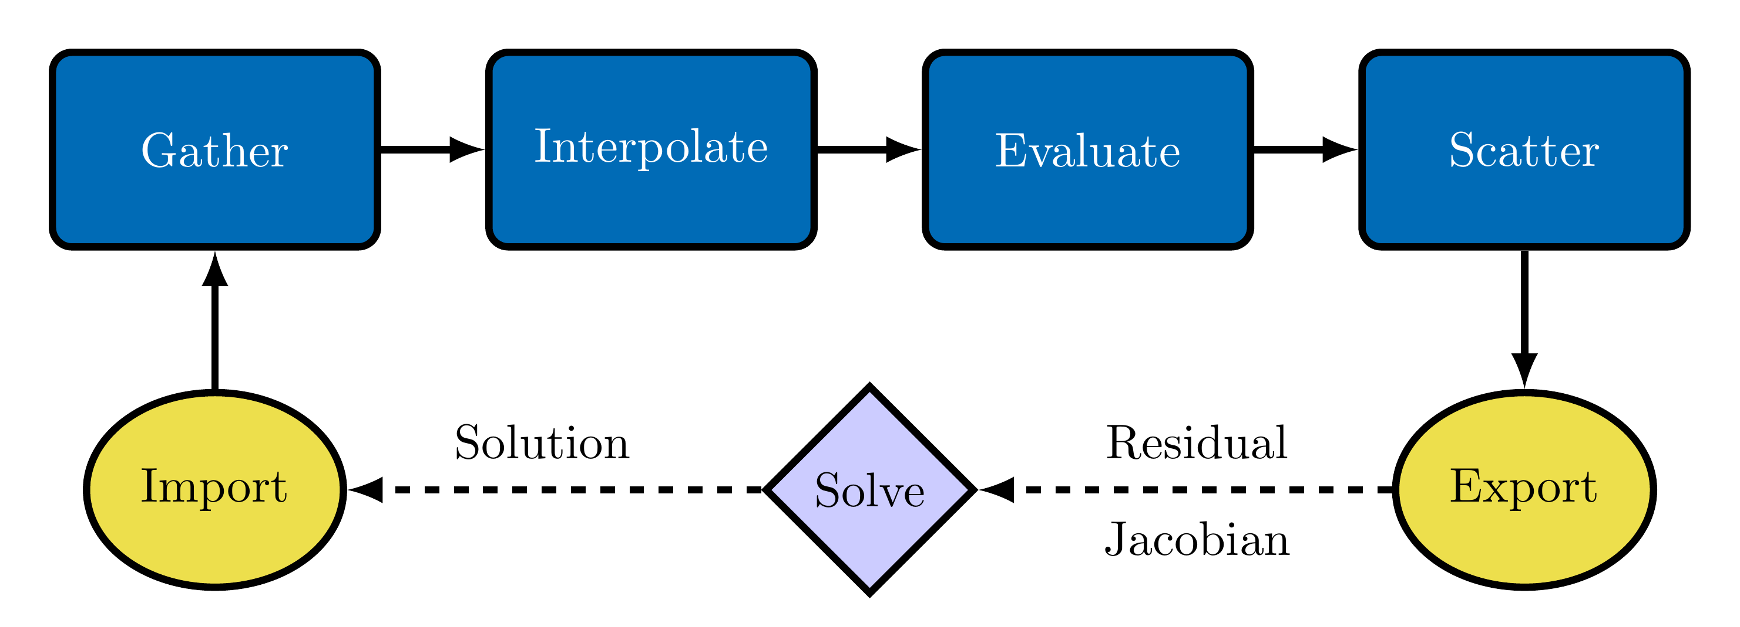
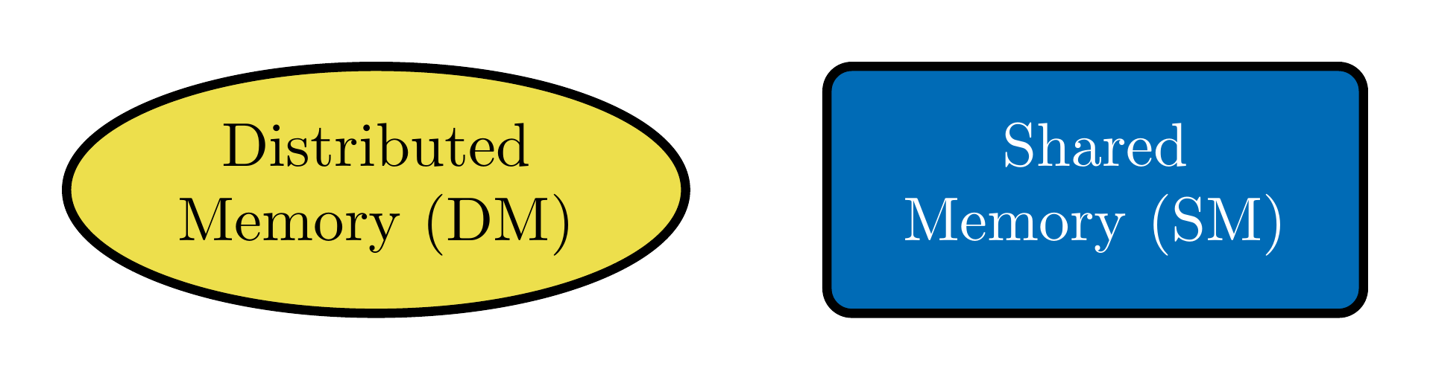
The Albany code base (cont’d)
Albany finite element assembly (FEA):
Tpetra manages distributed memory linear algebra (MPI+X)
Phalanx manages shared memory computations (X)
  Gather fills element local solution
  Interpolate solution/gradient to quad points
  Evaluate residual/Jacobian
  Scatter fills global residual/Jacobian
Albany provides the “glue” that connects components (via abstract interfaces).
Trilinos Packages
FEA Overview
Adding new PDEs requires just implementing a new Evaluate routine
Albany design highlights:
Piro manages the solve (e.g., Newton, time-stepper)
Jacobians (+ sensitivities, Hessians, etc.) obtained via automatic differentiation (Sacado)
Kokkos achieves performance portability using MPI+X
Memory Model

Slide 8
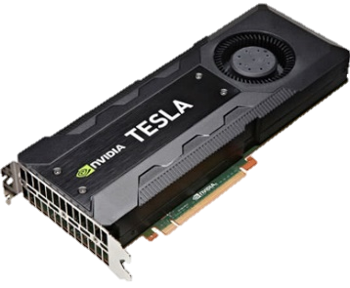
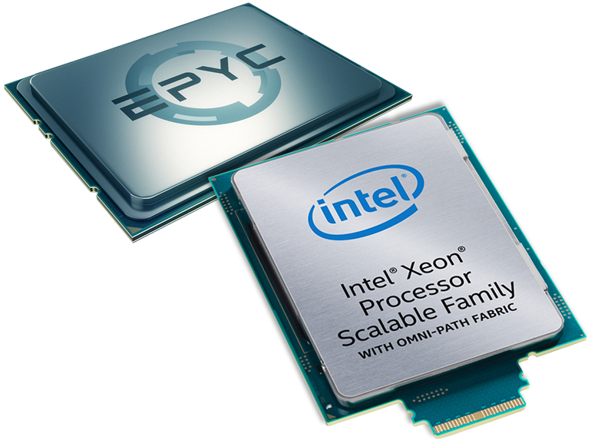


Albany supporting tools: Kokkos $–$ performance portability
Kokkos¹ is a C++ library that provides performance portability across multiple shared memory computing architectures
  Examples: Multicore CPU, NVIDIA GPU, Intel KNL and much more…
Abstract data layouts and hardware features for optimal performance on current and future architectures
Allows researchers to focus on application or algorithmic development instead of architecture specific programming
With Kokkos, you write an algorithm once for multiple hardware architectures. Template parameters are used to get hardware specific features.
¹https://github.com/kokkos/kokkos.

Slide 9


Albany supporting tools: Phalanx Evaluator $–$ templated Phalanx node
A Phalanx node (evaluator) is constructed as a C++ class
Each evaluator is templated on an evaluation type (e.g., residual, Jacobian)
The evaluation type is used to determine the data type (e.g., double, Sacado data types)
Kokkos RangePolicy is used to parallelize over cells over an Execution Space (e.g., Serial, OpenMP, CUDA)
Inline functors are used as kernels
MDField data layouts
  Serial/OpenMP $–$ LayoutRight (row-major)
  CUDA $–$ LayoutLeft (col-major)
typedef Kokkos::CUDA Execution Space;
template<typename EvalT, typename Traits>
void StokesFOResid<EvalT, Traits>::
evaluateFields(typename Traits::EvalData workset) {
Kokkos::parallel_for(
Kokkos::RangePolicy<ExeSpace>(0,workset.numCells),
*this);
}
template<typename EvalT, typename Traits>
KOKKOS_INLINE_FUNCTION
void StokesFOResid<EvalT, Traits>::
operator() (const int& cell) const{
for (int cell=0; cell < numCells; cell++) {
for (int node=0; node < numNodes; ++node){
Residual(cell,node,0)=0.;
}
}
for (int cell=0; cell < numCells; cell++) {
for (int node=0; node < numNodes; ++node) {
for (int qp=0; qp < numQPs; ++qp) {
Residual(cell,node,0) +=
Ugrad(cell,qp,0,0)*wGradBF(cell,node,qp,0) +
Ugrad(cell,qp,0,1)*wGradBF(cell,node,qp,1) +
force(cell,qp,0)*wBF(cell,node,qp);
}
}
}
}

Slide 10

Albany supporting tools: Phalanx Evaluator $–$ templated Phalanx node
A Phalanx node (evaluator) is constructed as a C++ class
Each evaluator is templated on an evaluation type (e.g., residual, Jacobian)
The evaluation type is used to determine the data type (e.g., double, Sacado data types)
Kokkos RangePolicy is used to parallelize over cells over an Execution Space (e.g., Serial, OpenMP, CUDA)
Inline functors are used as kernels
MDField data layouts
  Serial/OpenMP $–$ LayoutRight (row-major)
  CUDA $–$ LayoutLeft (col-major)
typedef Kokkos::CUDA ExeSpace;
template<typename EvalT, typename Traits>
void StokesFOResid<EvalT, Traits>::
evaluateFields(typename Traits::EvalData workset) {
Kokkos::parallel_for(
Kokkos::RangePolicy<ExeSpace>(0,workset.numCells),
*this);
}
template<typename EvalT, typename Traits>
KOKKOS_INLINE_FUNCTION
void StokesFOResid<EvalT, Traits>::
operator() (const int& cell) const{
for (int cell=0; cell < numCells; cell++) {
for (int node=0; node < numNodes; ++node){
Residual(cell,node,0)=0.;
}
}
for (int cell=0; cell < numCells; cell++) {
for (int node=0; node < numNodes; ++node) {
for (int qp=0; qp < numQPs; ++qp) {
Residual(cell,node,0) +=
Ugrad(cell,qp,0,0)*wGradBF(cell,node,qp,0) +
Ugrad(cell,qp,0,1)*wGradBF(cell,node,qp,1) +
force(cell,qp,0)*wBF(cell,node,qp);
}
}
}
}

Slide 11
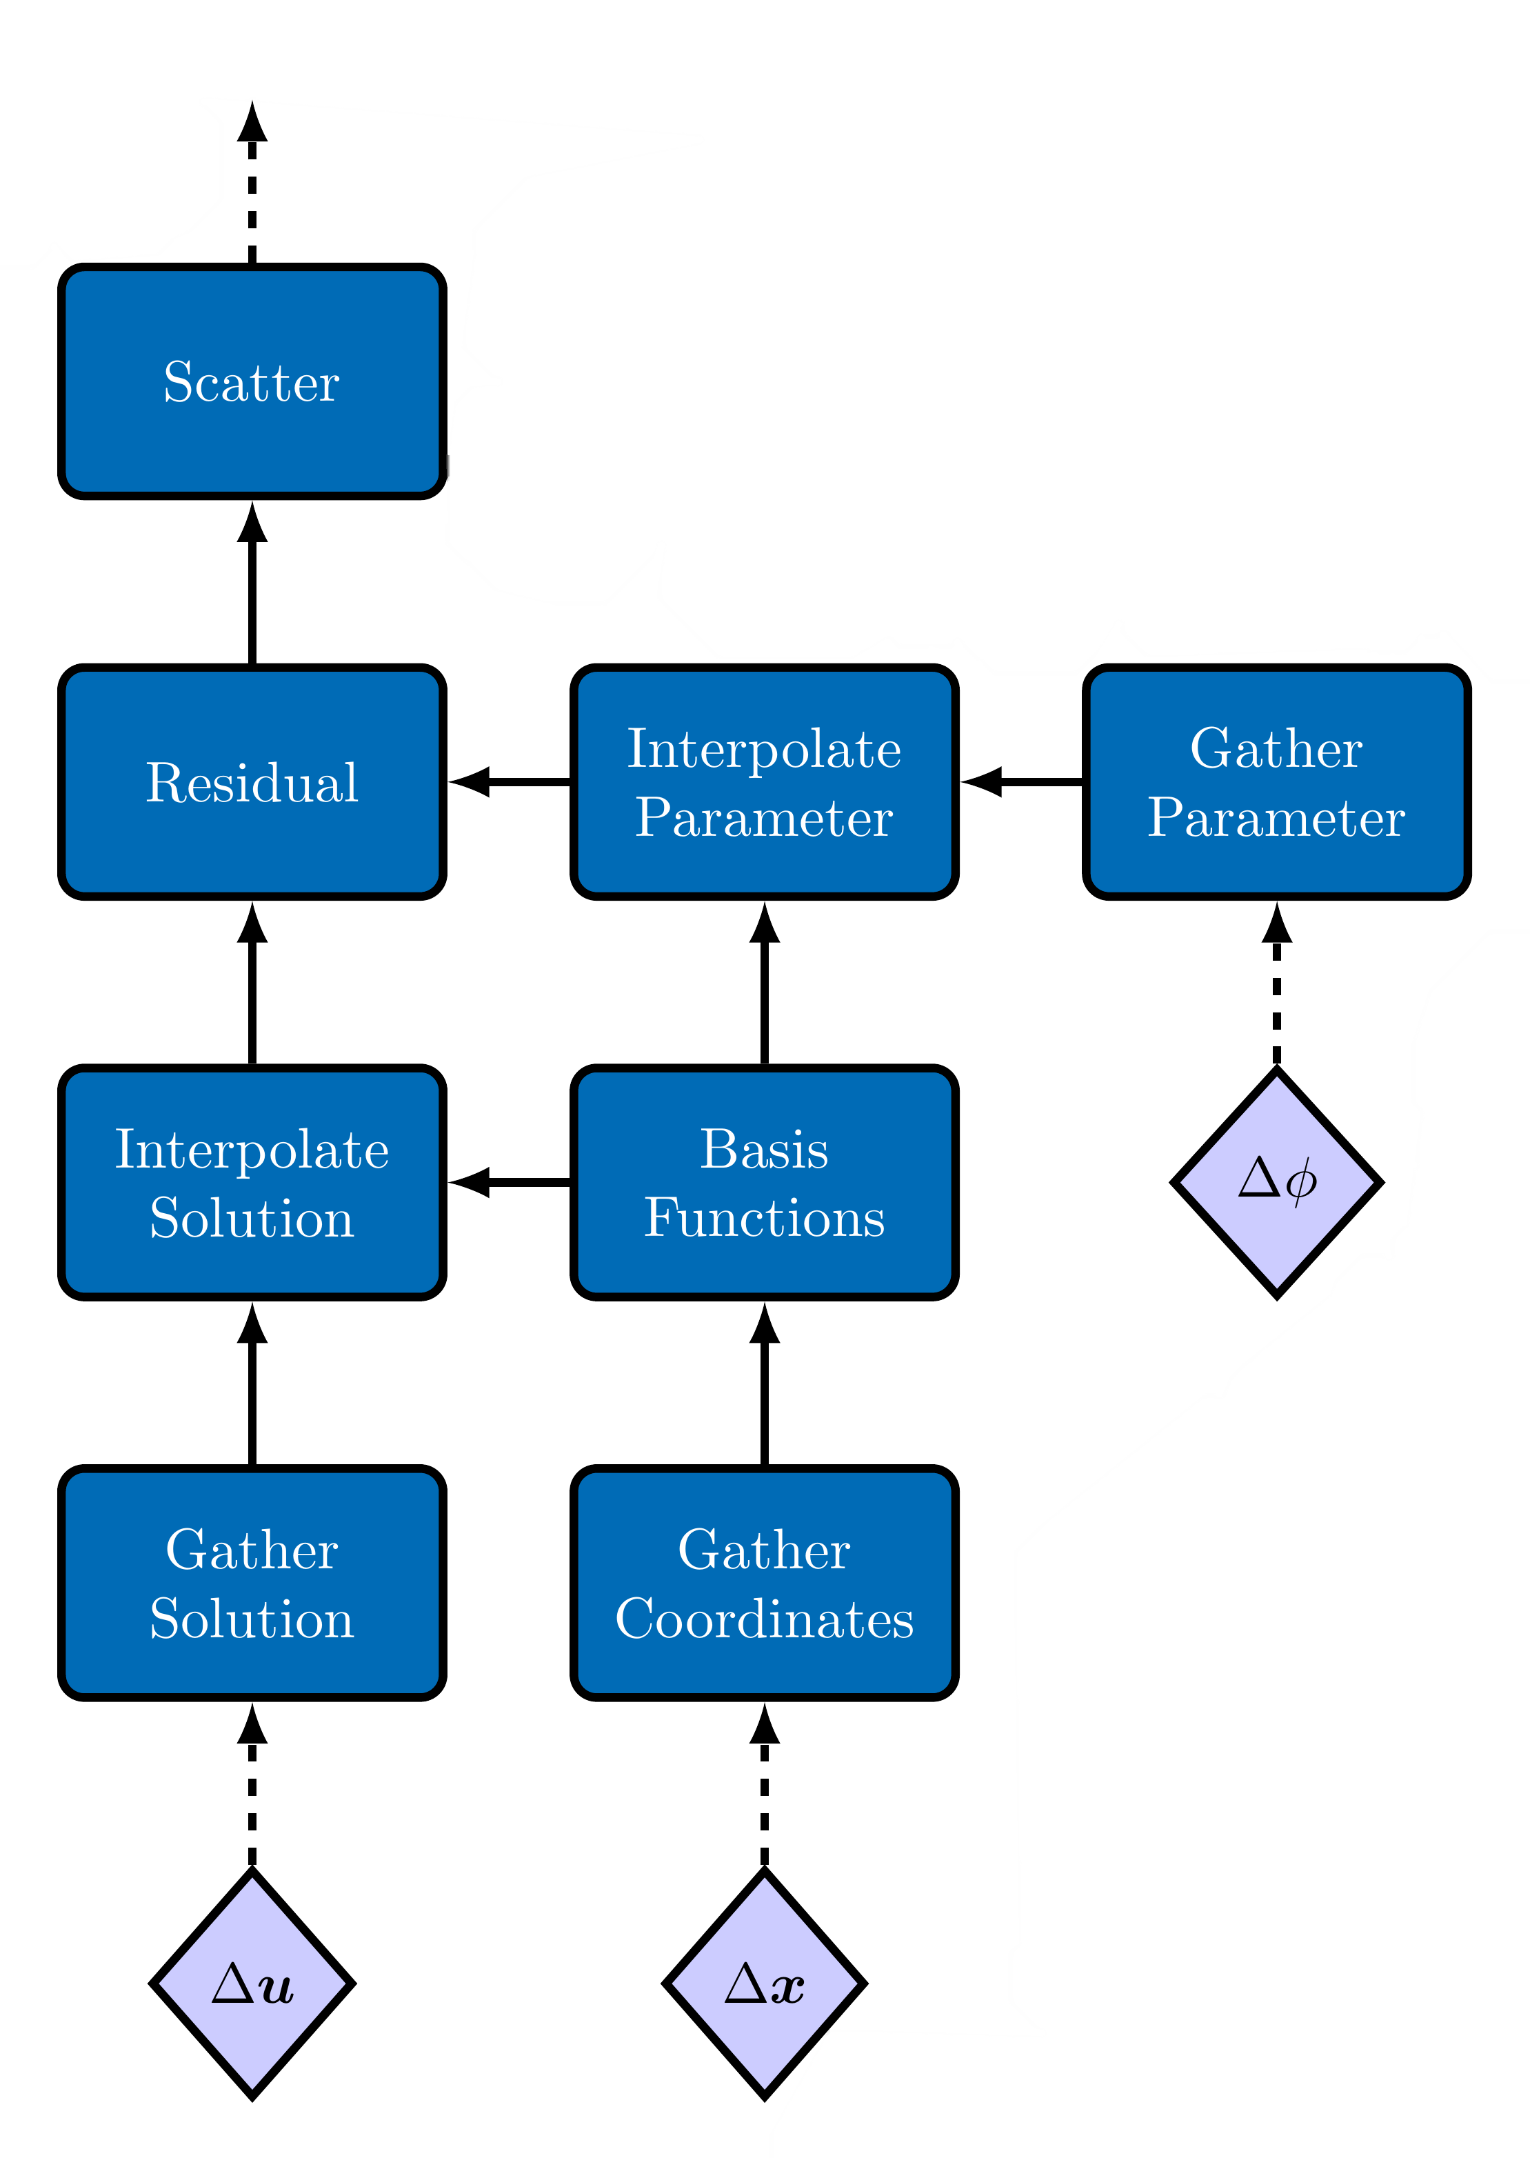
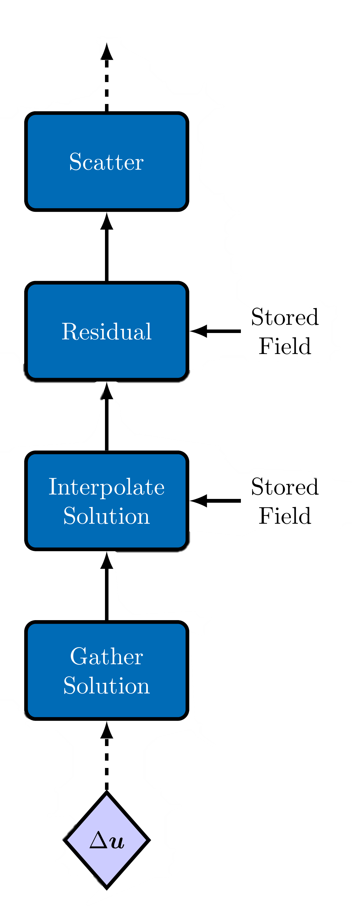
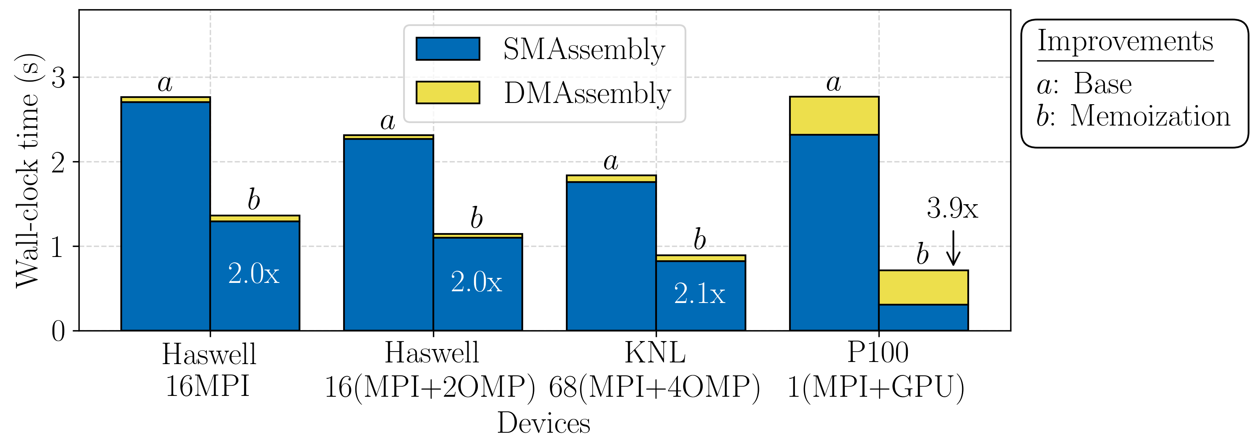

Albany supporting tools: Phalanx $–$ directed acyclic graph (DAG)
DAG Example (memoization)
DAG Example
Advantages:
Increased flexibility, extensibility, usability
Arbitrary data type support
Potential for task parallelism
Extension:
Performance gain through memoization
Disadvantage:
Performance loss through fragmentation
Single CPU socket or GPU

Slide 12
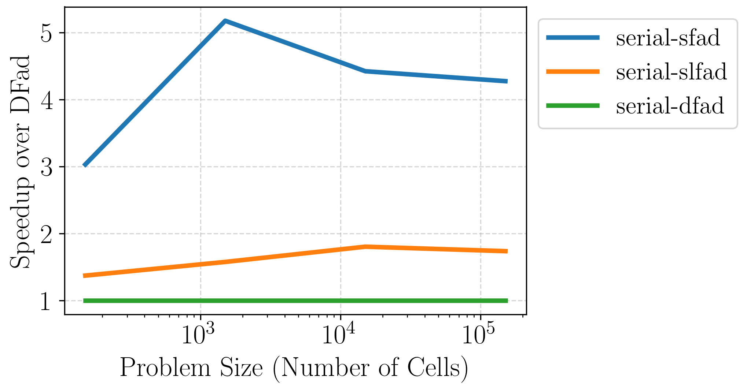
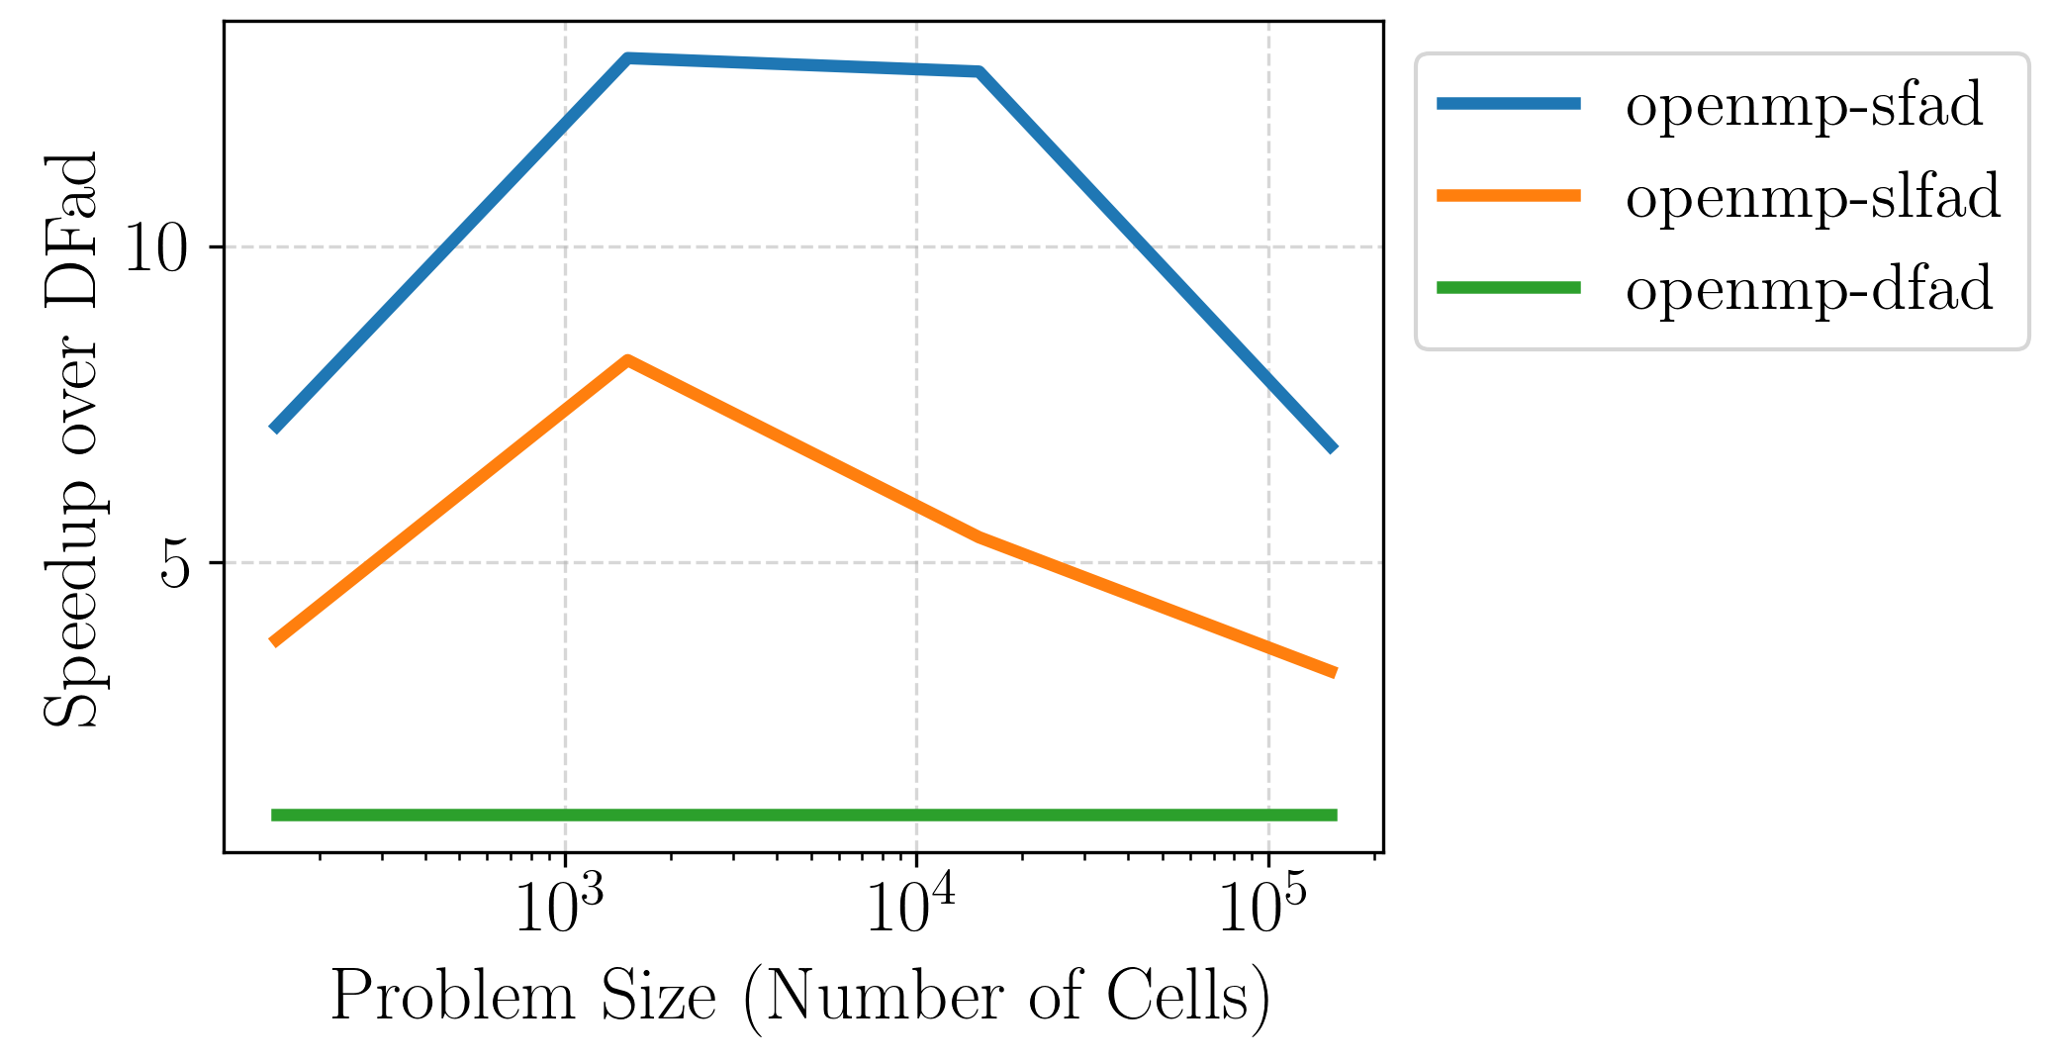
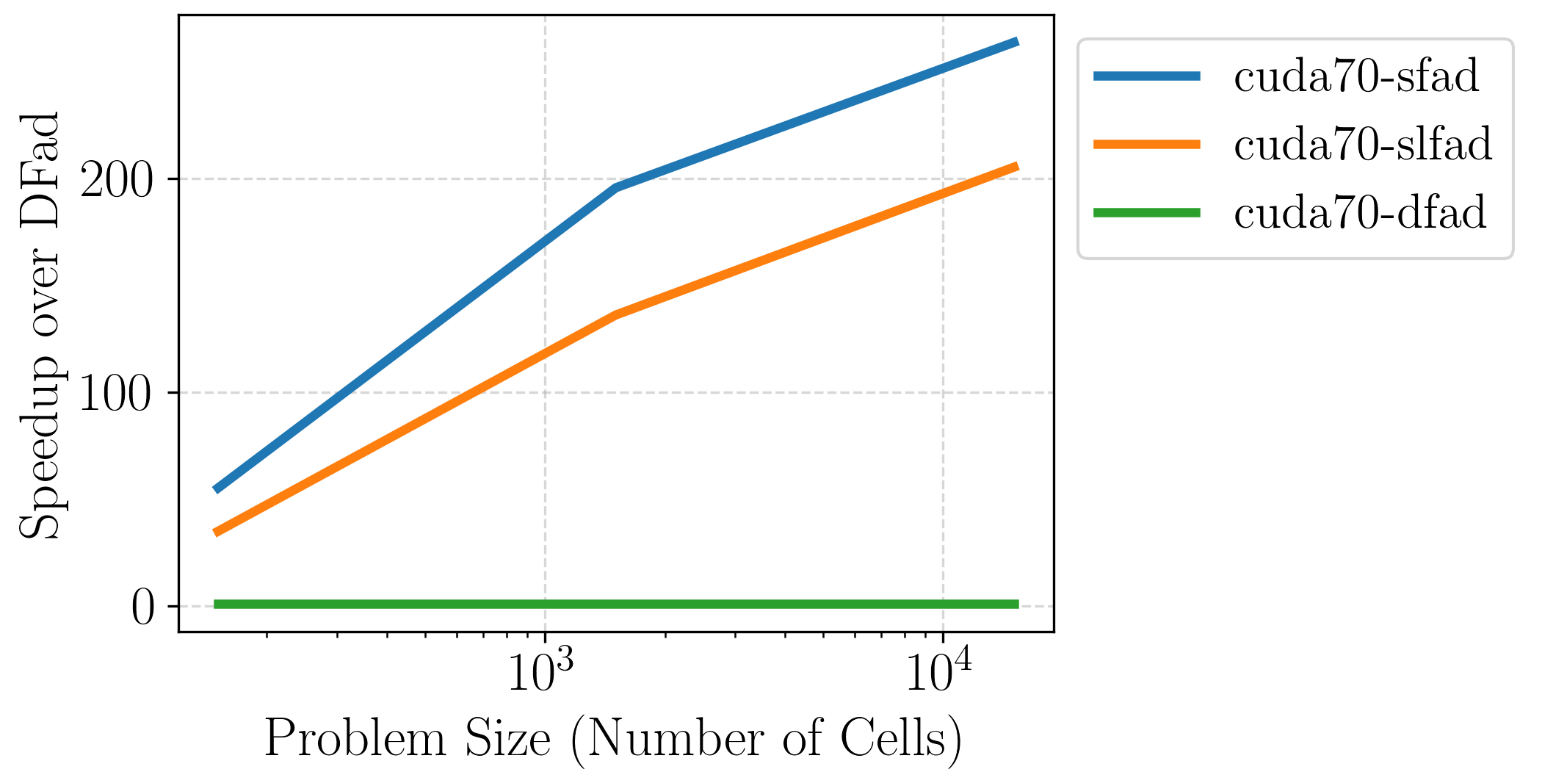

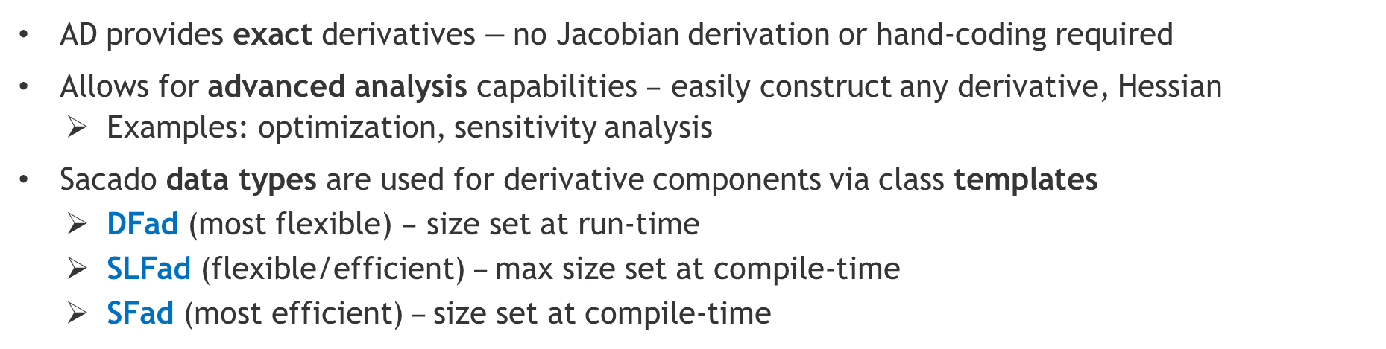
Albany supporting tools: Sacado $–$ automatic differentiation (AD)
AD provides exact derivatives $−$no Jacobian derivation or hand-coding required
Allows for advanced analysis capabilities $–$ easily construct any derivative, Hessian
  Examples: optimization, sensitivity analysis
Sacado data types are used for derivative components via class templates
  DFad (most flexible) $–$ size set at run-time
  SLFad (flexible/efficient) $–$max size set at compile-time
  SFad (most efficient) $–$size set at compile-time
There are significant speedups when derivative array sizes are known at compile time on GPU (50-250x)
Fad Type Comparison (Serial, OpenMP (12 threads), CUDA)
Size Example: Tetrahedral elements (4 nodes), 2 equations, ND = 4*2 = 8

Slide 13
Outline
Motivation
Albany and its supporting tools
Case study: Albany Land Ice (ALI)
  Overview of ALI model
  Performance study
  Automated performance testing
  Automated parameter/performance tuning
Summary & future work

Slide 14

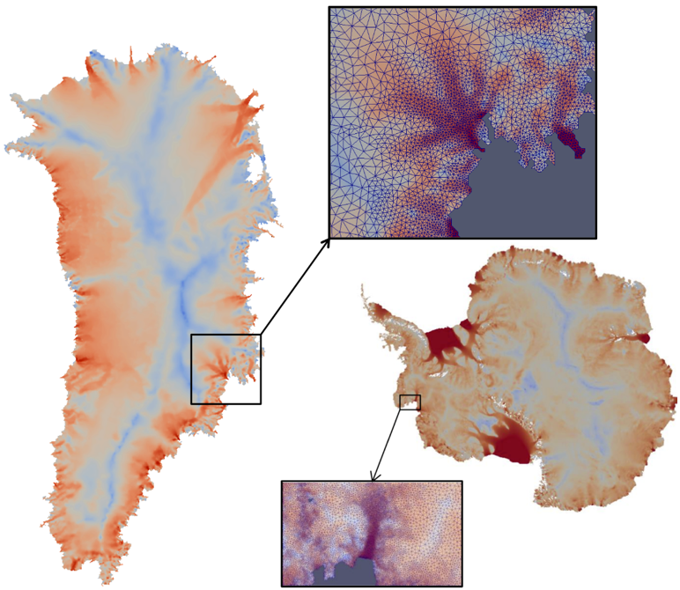
ProSPect project for land-ice modeling
  “ProSPect¹” = Probabilistic Sea Level Projections from Ice Sheet & Earth System Models (5 year SciDAC4 project, 2017-2022)
  Goal: to develop and support a robust and scalable land ice solver based on the “First-Order” (FO) Stokes equations $→$Albany Land Ice (ALI)
Requirements for Albany Land Ice (ALI):
  Unstructured grid meshes.
  Scalable, fast and robust.
  Verified and validated.
  Portable to new architecture machines.
  Advanced analysis capabilities: deterministic inversion, calibration, uncertainty quantification, sensitivity analysis.
As part of U.S. DOE E3SM² Earth System Model, solver will provide actionable predictions of 21st century sea-level change (including uncertainty bounds).
¹https://doe-prospect.github.io
²Energy Exascale Earth System Model

Slide 15
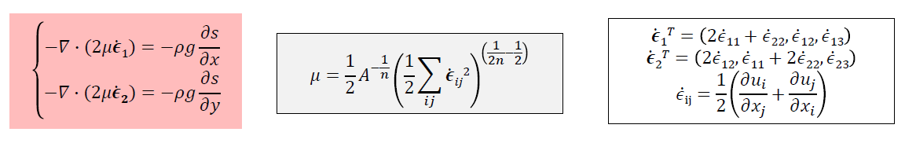
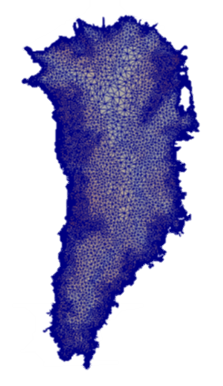

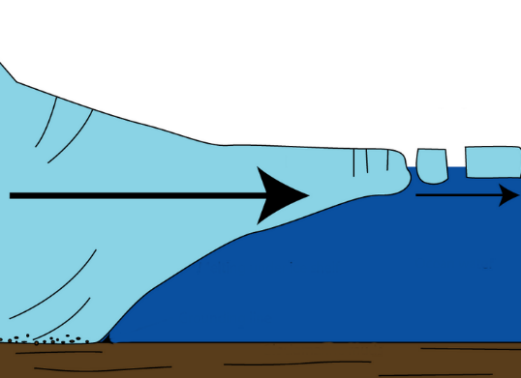
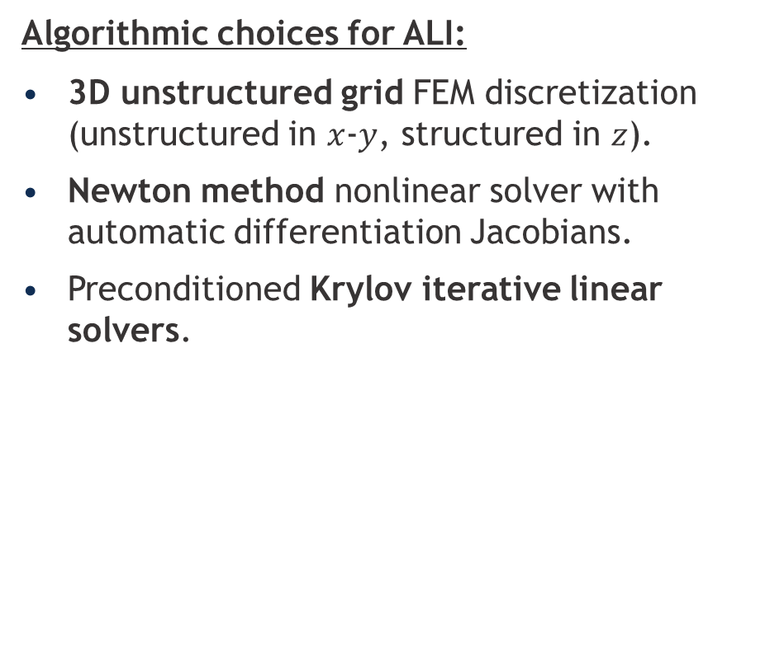
Albany Land Ice (ALI) model
Ice velocities given by the “First-Order” Stokes PDEs with nonlinear viscosity:
Glen’s Flow Law Viscosity
Algorithmic choices for ALI:
3D unstructured grid FEM discretization (unstructured in $x$-$y$, structured in $z$).
Newton method nonlinear solver with automatic differentiation Jacobians.
Preconditioned Krylov iterative linear solvers.
Implicit solver:
FEA = 50% CPU-time
Linear solve = 50% CPU-time
Ice sheet
* Finite Element Assembly

Slide 16
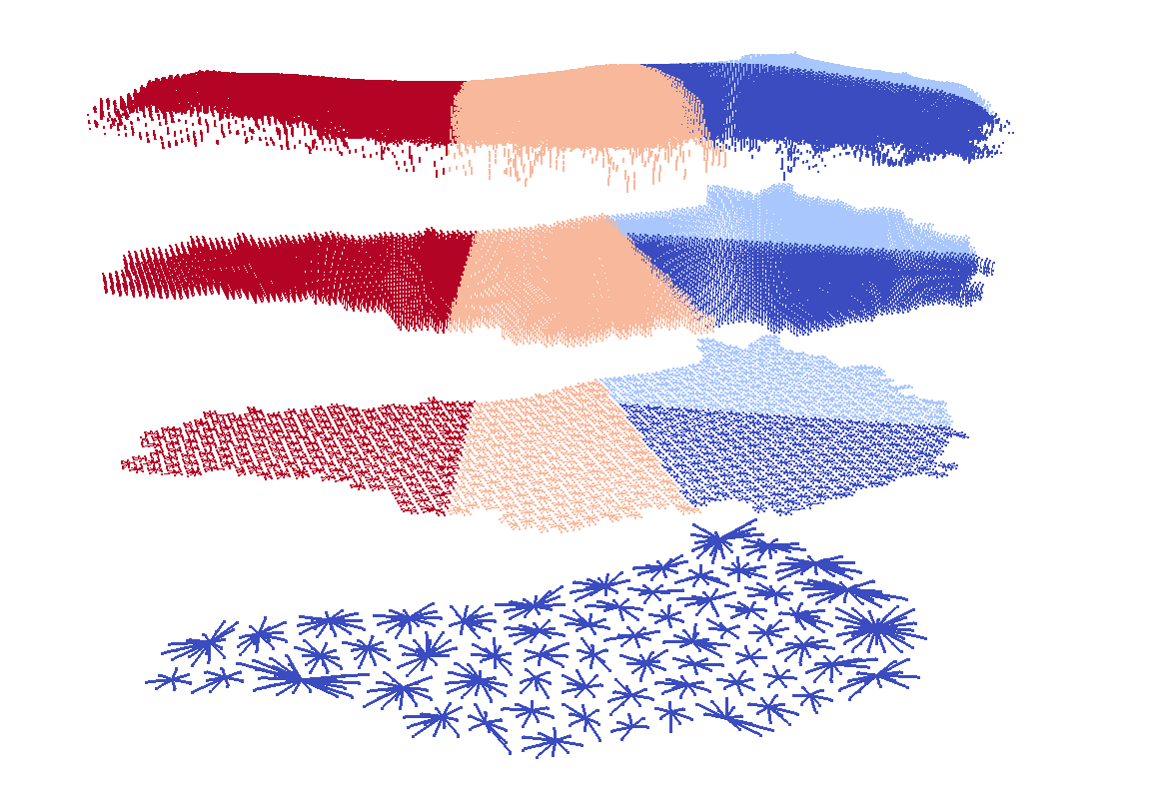
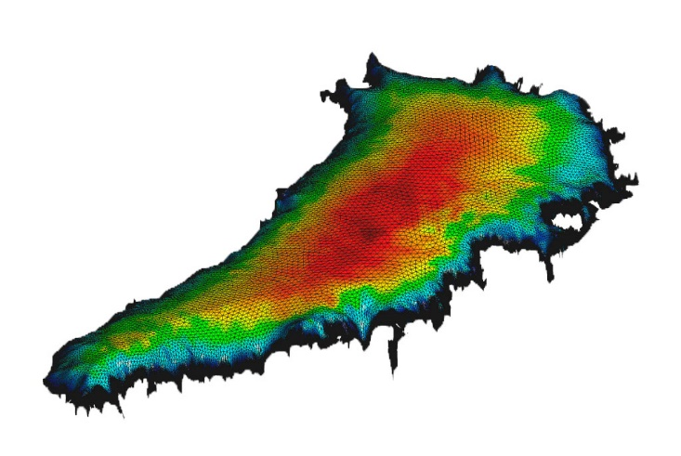
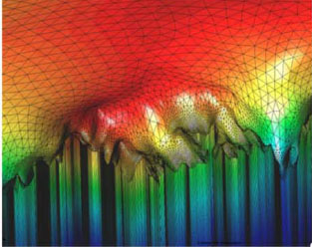


Specialized linear solvers
Problem: Ice sheet meshes are thin with high aspect ratios
Algebraic Structured MG
Algebraic Structured MG
Unstructured AMG
Solution: Matrix dependent semi-coarsening algebraic multigrid (MDSC-AMG)¹
First, apply algebraic structured multigrid to coarsen vertically
Second, apply SA-AMG on single layer
¹ See (Tezaur et al., 2015), (Tuminaro et al., 2016)
Status: Linear solve is ported to GPU but not optimized
Multigrid tuning for GPU is work in progress
Performance-portable block smoothers for fine grid coming soon (FY22)

Slide 17
Outline
Motivation
Albany and its supporting tools
Case study: Albany Land Ice (ALI)
  Overview of ALI model
  Performance study
  Automated performance testing
  Automated parameter/performance tuning
Summary & future work

Slide 18
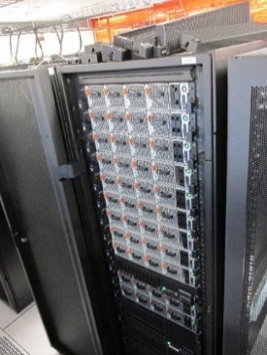
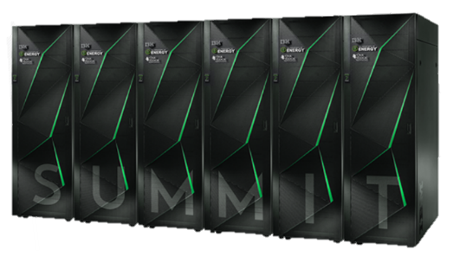
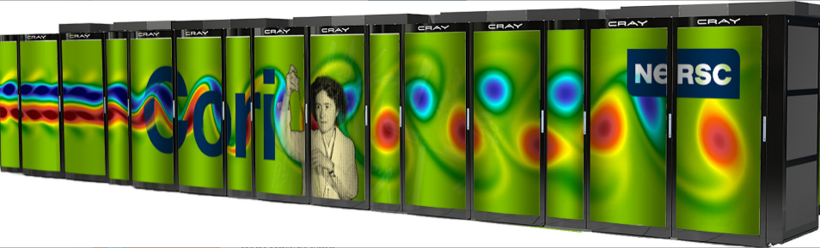
Performance study: Architectures
Performance-portability of ALI has been tested across multiple architectures: Intel Sandy Bridge, Intel Skylake, IBM POWER8, IBM POWER9, Keplar/Pascal/Volta/Ampere GPUs, KNL Xeon Phi
Architectures:
Cori (NERSC): 2,388 Haswell nodes [2 Haswell (32 cores)] 9,688 KNL nodes [1 Xeon Phi KNL (68 cores)] (Cray Aries)
Blake (SNL): 40 nodes [2 Skylake (48 cores)] (Intel OmniPath Gen-1)
Mayer (SNL): 43 nodes [2 ARM64 Cavium ThunderX2 (56 cores)] (Mx EDR IB)
Ride (SNL): 12 nodes [2 POWER8 (16 cores) + P100 (4 GPUs)] (Mx C-X4 IB)
Weaver (SNL): 10 nodes [2 POWER9 (40 cores) + V100 (4 GPUs)] (Mx EDR IB)
Summit (OLCF): 4600 nodes [2 P9 (22 cores) + V100 (6 GPUs)]
Kahuna (SNL): 4 nodes [2 Zen2 (64 cores) + A100 (1 GPU)] PCIe Gen 4
Mutrino (SNL): 100 Haswell nodes [2 Haswell (32 cores)],
100 KNL nodes [1 KNL (68 cores)]
Vortex (SNL): 72 nodes [2 POWER9 (44 cores) + V100 (4 GPUs)]
Future Targets: Aurora Intel GPU (ALCF), Frontier AMD GPU (OLCF), Perlmutter (NERSC)
Ride
Models:
2 models: MPI-only, MPI+GPU
  MPI+GPU: MPI ranks assigned a single core per GPU, CUDA UVM used for host to device communication

Slide 19

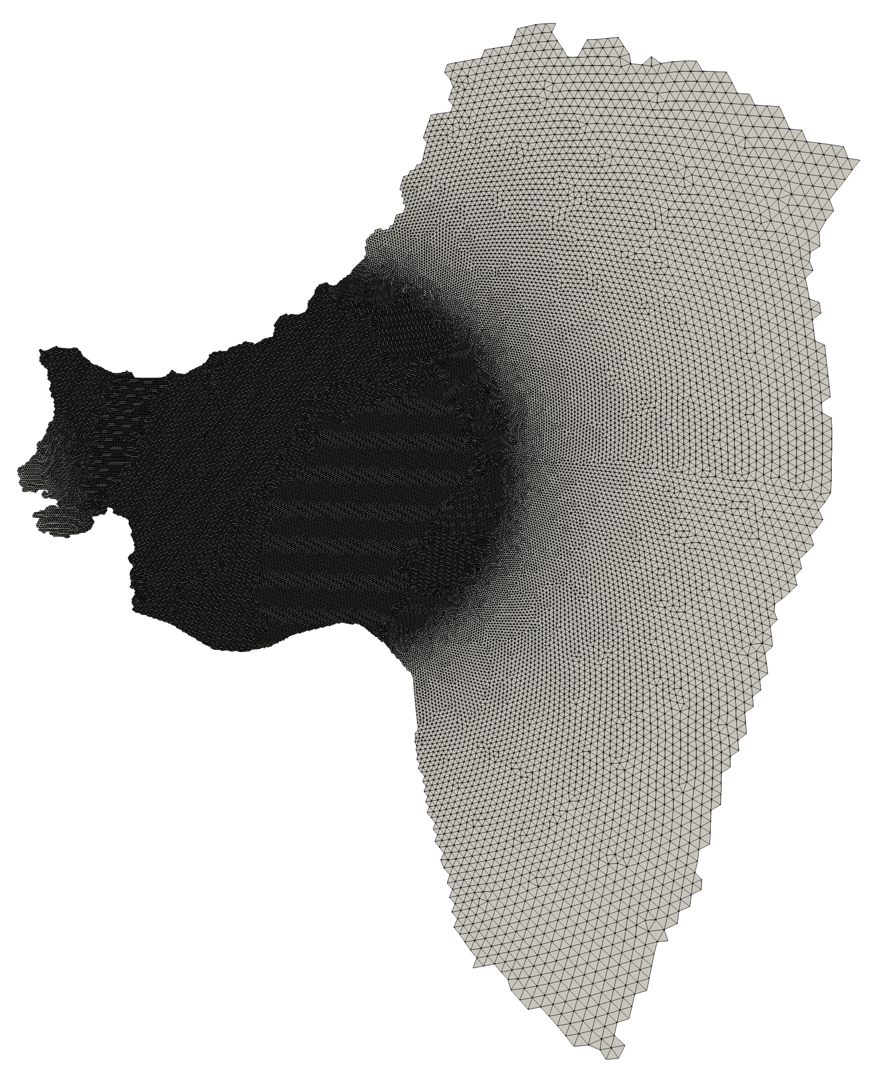
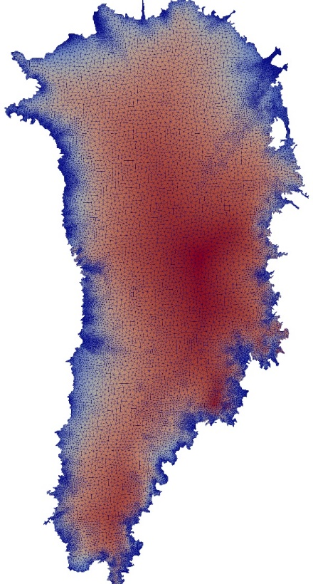
Performance study: Cases
Case 1: Antarctica’s Thwaites glacier
First-Order Stokes equations
1-10km variable resolution
1,395,680 wedge elements
100 evaluations of FEA + linear solve results
Strong scaling analysis
  32-core Haswell per node
  4 V100 GPUs per node
Case 2: Greenland ice sheet
First-Order Stokes equations (+ Enthalpy equation)
1km-7km variable resolution
14.4 million tetrahedral elements
FEA-only results (100 evaluations) highlighting recent performance improvements in Albany
Architectures:
Haswell
KNL
POWER9
V100 GPU

Slide 20
Performance study: Thwaites Glacier
11x speedup V100 over Haswell node
WIP: Reduce memory usage
  UVM degrades performance when using more than 87,230 Cells/GPU
1.6x speedup V100 over Haswell (4 nodes)
WIP: Optimize GPU solve
  Linear solve is 86% of total solve time on GPU!
  Linear solve needs block relaxation

Slide 21
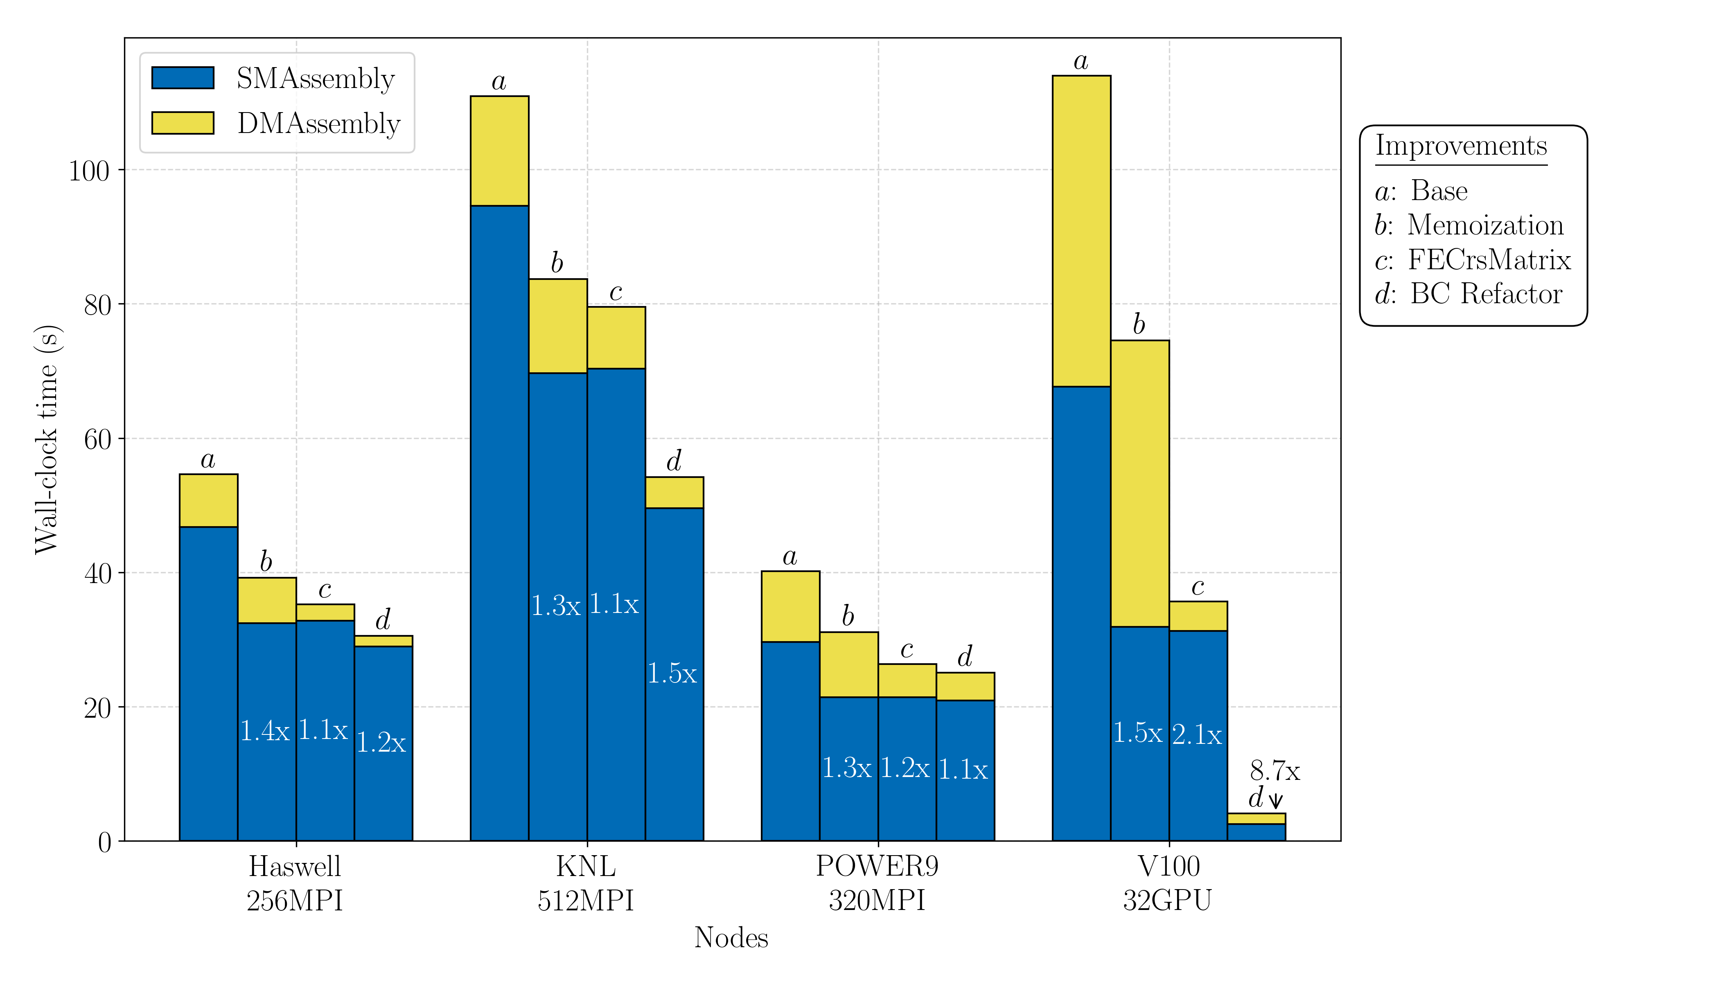

Performance study: Greenland Perf. Improvements
Implement Tpetra::FECrsMatrix
Original $−$ on-the-fly host memory allocations
Addressed by Tpetra via FECrsMatrix (2.1x) $–$ single memory allocation during setup
Refactor of boundary conditions
Boundary data converted to contiguous data structures
Kernels constructed for boundary conditions
8.7x speedup on GPU relative to original* with boundary kernels on host (StokesFO)
Refactor of Enthalpy equation
Kernels constructed using Kokkos
66x speedup on GPU relative to original* with all kernels on host
*Original: running on host with device transfers
Tpetra::FECrsMatrix: Luca Bertagna, Mauro Perego, Chris Siefert; Refactor: Max Carlson

Slide 22
Outline
Motivation
Albany and its supporting tools
Case study: Albany Land Ice (ALI)
  Overview of ALI model
  Performance study
  Automated performance testing
  Automated parameter/performance tuning
Summary & future work

Slide 23
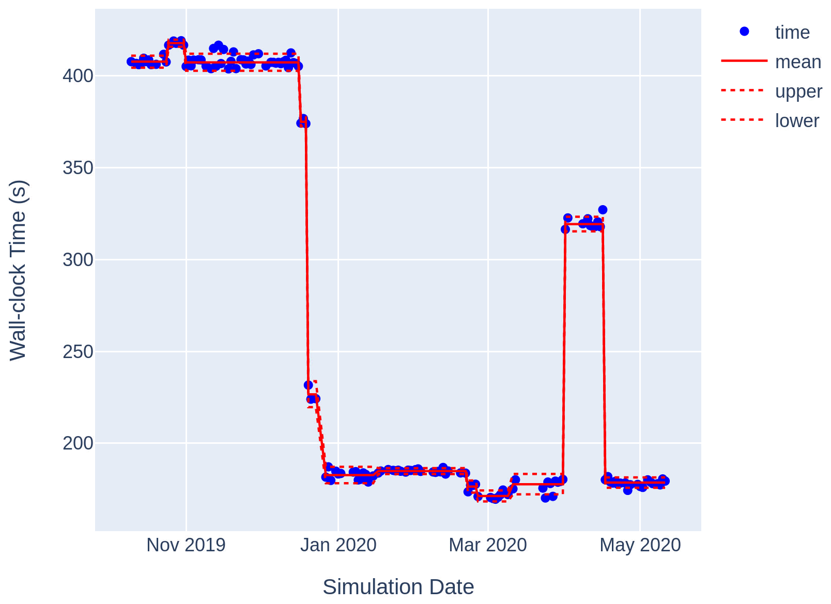
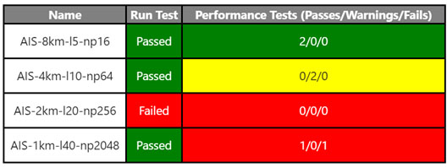
Performance testing: maintaining performance & portability
With Kyle Shan (Micron Technology, formerly Stanford U)
Nightly testing is needed to secure investments in performance & portability in evolving software
  Changes in code base could cause performance deterioration
  Performance improvements in one architecture could decrease performance in another
  Manual analysis is time consuming and imprecise
Figure below: Total simulation time for a 2-20km resolution Antarctica problem, executed nightly
Solution: changepoint detection algorithm automatically applied to nightly performance test data to identify/flag large changes in performance.
Infrastructure is provided in a Jupyter notebook, exported as html to a website (https://ikalash.github.io)
Daily email provides nightly performance test summary
Notes:
A generalized likelihood ratio test is used
Null hypothesis – ${\{x\}}_{i=1}^{n}$ belongs to a single distribution
Alternate hypothesis – there exists some $$such that ${\{x\}}_{i=1}^{ν−1}$ and ${\{x\}}_{i=ν}^{n}$ are separate distributions

Slide 24
Outline
Motivation
Albany and its supporting tools
Case study: Albany Land Ice (ALI)
  Overview of ALI model
  Performance study
  Automated performance testing
  Automated parameter/performance tuning
Summary & future work

Slide 25
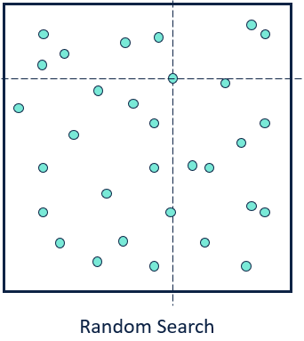
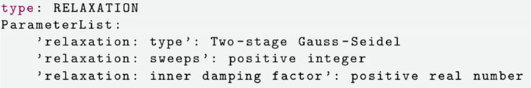
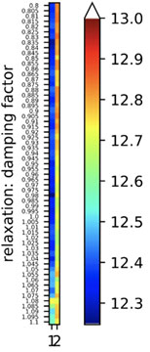
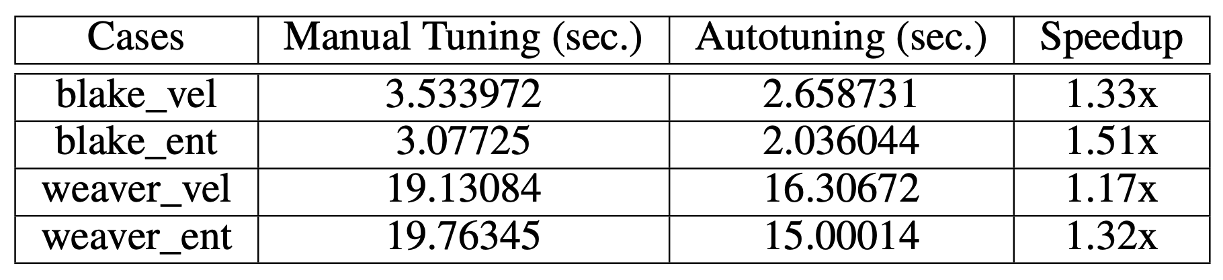
Automated parameter/performance tuning
Problem: hand-tuning solver parameters can be a long/painful process, does not translate b/w architectures.
Solution: create a framework for determining optimal parameter values to achieve best performance (smallest CPU time) on HPC systems using offline and real-time data.
Preliminary results: optimization over linear solver parameter space using random search for coarse resolution 3-20km mesh Greenland problem (100 iterations)
Parameters to optimize
Future work: more sophisticated algorithms for parameter optimization (e.g., Bayesian optimization)
CPU¹
GPU²
¹ 8 nodes, Skylake CPU
² 2 nodes, V100 GPU
With Carolyn Kao (Stanford U)
Notes:
CPU = 8 nodes, GPU = 2 nodes

Slide 26
Outline
Motivation
Albany and its supporting tools
Case study: Albany Land Ice (ALI)
  Overview of ALI model
  Performance study
  Automated performance testing
  Automated parameter/performance tuning
Summary & future work

Slide 27
Summary
HPC architectures are changing rapidly which poses a significant challenge for open-science
The Albany/Trilinos/Kokkos software stack offers an efficient way to meet this challenge for large scale finite element analysis
Albany Land Ice is currently being used to provide sea-level change predictions
Performance on next generation computing architectures is a work in progress
  11x speedup of V100 node over Haswell node for finite element assembly
  Performance on V100 is ~2x faster than on Haswell node for the full solve
Maintaining performance and portability is crucial for an active code base
  A change-point detection algorithm can help identify performance variation
Optimal solver parameters can be determined for a specific architecture automatically using black-box optimization algorithms
  A simple random grid search algorithm can improve performance by up to 1.5x.

Slide 28
Future work
Further optimizations of FEA (e.g., reduce memory footprint further)
Optimization of solver parameters
Block smoother for solver
Large-scale performance analysis – Summit, Perlmutter, Cori
More sophisticated autotuning algorithms
Optimization, MALI, E3SM
Finite Element Assembly:
Further optimization of FEA (e.g., reduce memory footprint)
Remove UVM (work in progress in Trilinos)
Linear Solver:
Block smoother for linear solver
Optimization of linear solver for GPU
More sophisticated auto-tuning algorithms (e.g., Bayesian optimization)
General:
Large-scale performance analysis on Cori, Summit and Perlmutter

Slide 29






Funding/Acknowledgements
Support for this work was provided by Scientific Discovery through Advanced Computing (SciDAC) projects funded by the U.S. Department of Energy, Office of Science (OS), Advanced Scientific Computing Research (ASCR) and Biological and Environmental Research (BER).
Computing resources provided by the National Energy Research Scientific Computing Center (NERSC) and Oak Ridge Leadership Computing Facility (OLCF).

