Slide 1
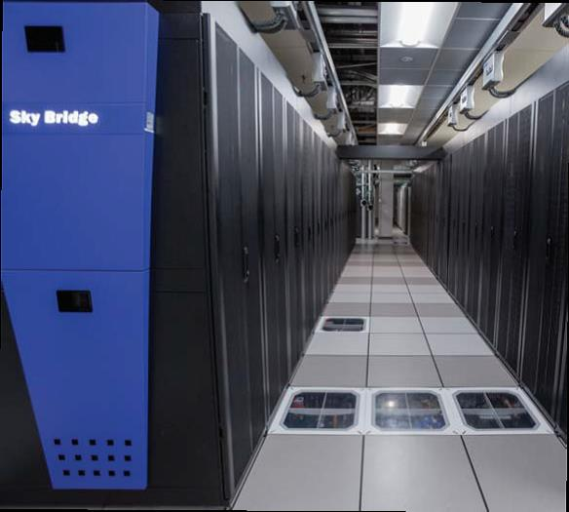
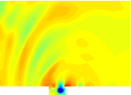
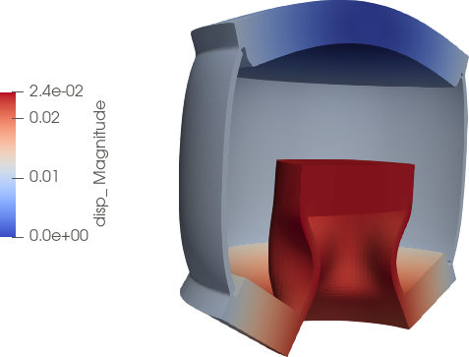
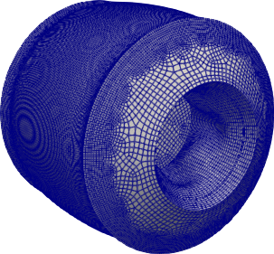
Preconditioned Least-Squares Petrov-Galerkin Reduced Order Models for Fluid and Solid Mechanics Problems
Payton Lindsay¹, Jeff Fike¹, Kevin Carlberg², Irina Tezaur¹
¹Sandia National Labs, ²Facebook Reality Labs
MMLDT-CSET2021
Wednesday, September 28, 2021
SAND2021-11141C

Slide 2
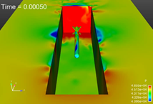
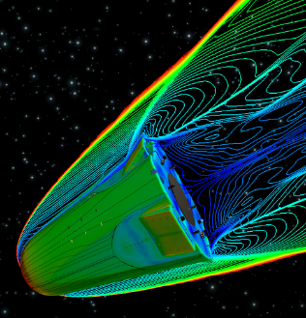
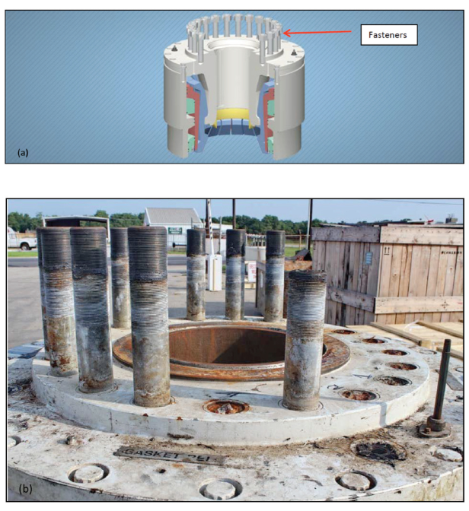
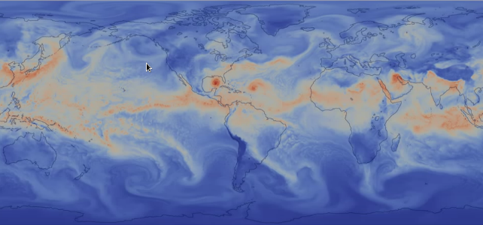

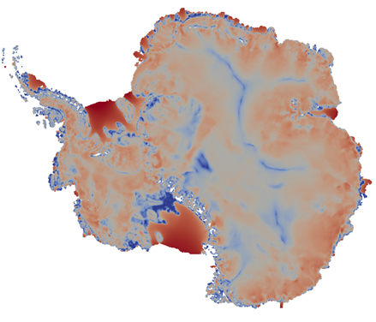
Motivation
Despite improved algorithms and powerful supercomputers, “high-fidelity” models are often too expensive for use in a design or analysis setting.
Sandia application areas in which this situation arises:
Captive-carry and re-entry environments: Large Eddy Simulations (LES) runs require very fine meshes and can take on the order of weeks.
Fastener failure modeling: modeling fastener behavior in a full system presents meshing and computational challenges, which limits the number of configurations that can be studied.
Climate modeling (e.g., land-ice, atmosphere): high-fidelity simulations too costly for uncertainty quantification (UQ); Bayesian inference of high-dimensional parameter fields is intractable.

Slide 3
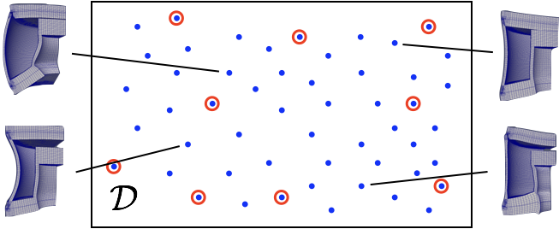



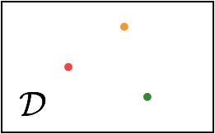


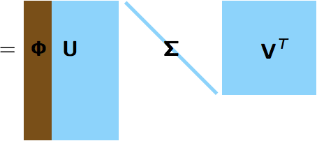



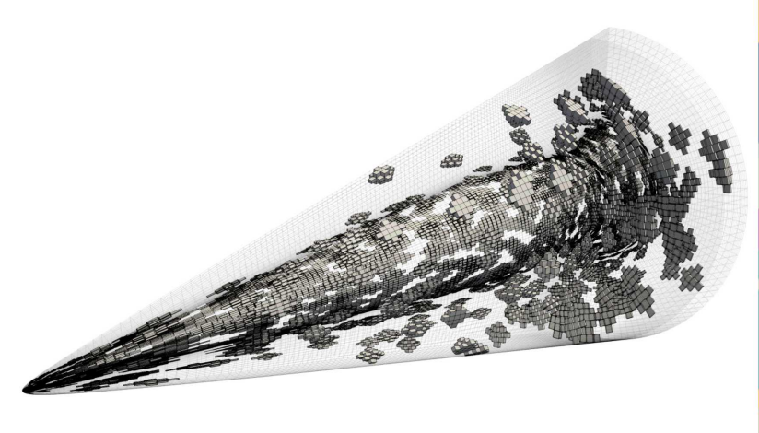
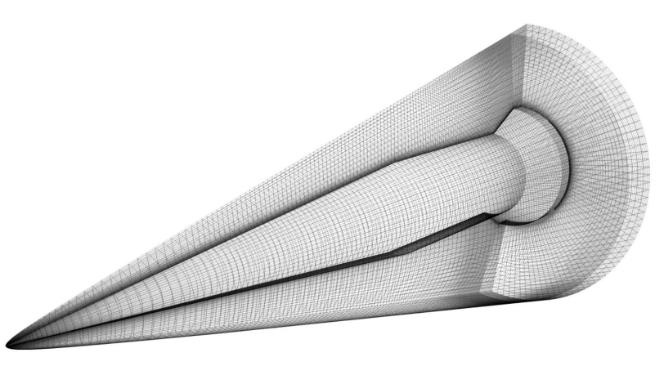
POD/LSPG* Approach to Model Reduction
Full Order Model (FOM) = Ordinary Differential Equation (ODE):
1. Acquisition
3. Reduction
Number of time steps
Choose ODE Temporal Discretization
Number of State Variables
Solve ODE at different design points
Reduce the number of unknowns
Save solution data
2. Learning
Proper Orthogonal Decomposition (POD):
Minimize
the Residual
Hyper-reduction/sample mesh
*Least-Squares Petrov-Galerkin Projection [K. Carlberg et al., 2011; K. Carlberg et al., 2017]

Slide 4
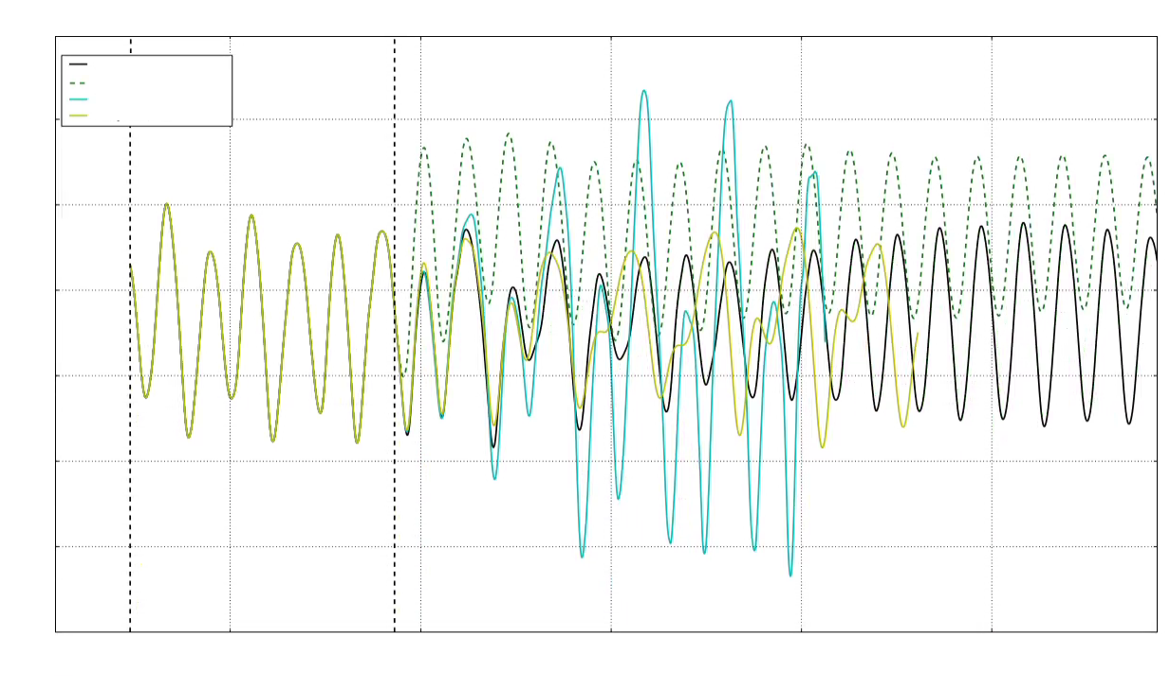
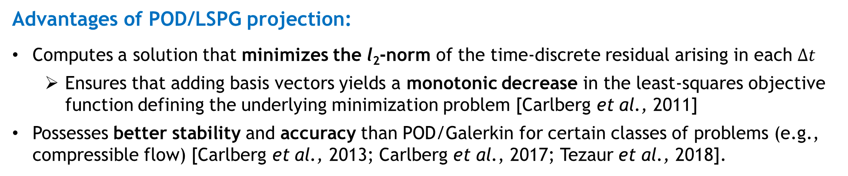

POD/LSPG Approach to Model Reduction
Advantages of POD/LSPG projection:
Computes a solution that minimizes the l₂-norm of the time-discrete residual arising in each $∆t$
  Ensures that adding basis vectors yields a monotonic decrease in the least-squares objective function defining the underlying minimization problem [Carlberg et al., 2011]
Possesses better stability and accuracy than POD/Galerkin for certain classes of problems (e.g., compressible flow) [Carlberg et al., 2013; Carlberg et al., 2017; Tezaur et al., 2018].
Room for improvement for realistic predictive applications:
Accuracy for predictive problems can be inadequate
Method may fail to converge for some realistic problems run in the predictive regime
Method may struggle when applied to problems with disparate scales [Washabaugh, 2016]
$−$ FOM
-- 1000 mode POD/LSPG ROM
$−$ 2000 mode POD/LSPG ROM
$−$ 3000 mode POD/LSPG ROM
Pressure
Reproductive
Predictive
Time
Solution: introduction of preconditioning into LSPG ROM formulation.

Slide 5
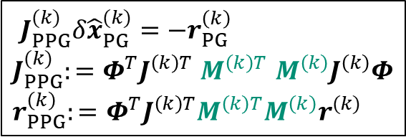

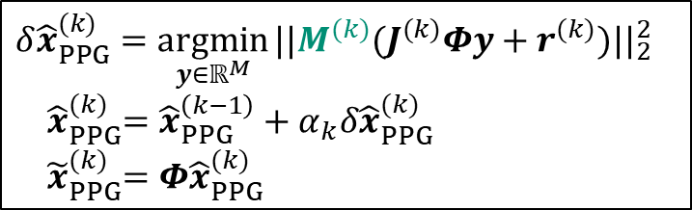

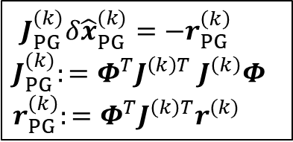
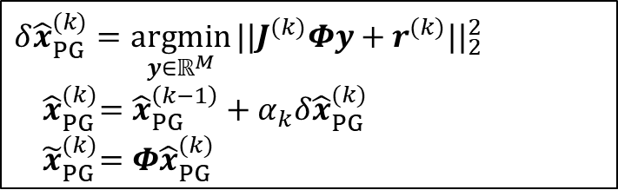
Preconditioned LSPG ROMs
LSPG Formulation:
Normal equations
$$δ{\hat{x}}_{PG}^{(k)}=\underset{y∈ℝ^{M}}{argmin}{||J^{(k)}{Φy+r^{(k)}||}_{2}^{2}}$$
${ \hat{x}}_{PG}^{(k)}=$ ${\hat{x}}_{PG}^{\left(k−1\right)}+α_{k}δ{\hat{x}}_{PG}^{(k)}$
${ \tilde{x}}_{PG}^{(k)}=$ $Φ{\hat{x}}_{PG}^{(k)}$
$J_{PG}^{(k)}δ{\hat{x}}_{PG}^{(k)}=−r_{PG}^{\left(k\right)}$
$J_{PG}^{(k)}:=Φ^{T}J^{\left(k\right)T}$ $J^{\left(k\right)}Φ$
$r_{PG}^{\left(k\right)}:=$ $Φ^{T}J^{\left(k\right)T}r^{(k)}$
$$\hat{x}=\underset{y∈ℝ^{M}}{argmin}{||r\left(Φy\right){||}_{2}^{2}}$$
Optimization problem
Gauss-Newton iteration
Preconditioned LSPG Formulation:
Normal equations
$$δ{\hat{x}}_{PPG}^{(k)}=\underset{y∈ℝ^{M}}{argmin}{||{M^{(k)}(J}^{(k)}{Φy+r^{(k)})||}_{2}^{2}}$$
${ \hat{x}}_{PPG}^{(k)}=$ ${\hat{x}}_{PPG}^{\left(k−1\right)}+α_{k}δ{\hat{x}}_{PPG}^{(k)}$
${ \tilde{x}}_{PPG}^{(k)}=$ $Φ{\hat{x}}_{PPG}^{(k)}$
$J_{PPG}^{(k)}δ{\hat{x}}_{PG}^{(k)}=−r_{PG}^{\left(k\right)}$
$J_{PPG}^{(k)}:=Φ^{T}J^{\left(k\right)T}$ ${M^{\left(k\right)T} M^{\left(k\right)}J}^{\left(k\right)}Φ$
$r_{PPG}^{\left(k\right)}:=$ $Φ^{T}J^{\left(k\right)T}M^{\left(k\right)T}M^{\left(k\right)}r^{(k)}$
$$\hat{x}=\underset{y∈ℝ^{M}}{argmin}{||Mr\left(Φy\right){||}_{2}^{2}}$$
Optimization problem
Gauss-Newton iteration

Slide 6
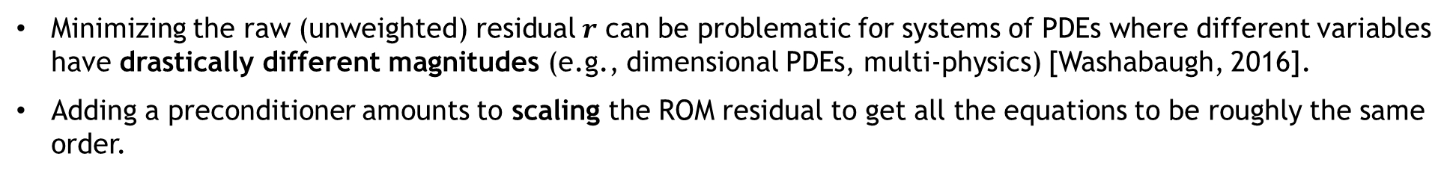
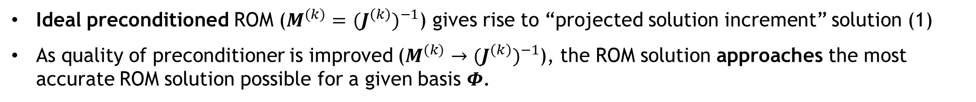

Preconditioned LSPG ROMs
Adding preconditioning to the POD/LSPG formulation can improve not only ROM efficiency but also ROM accuracy.
Ideal preconditioned ROM emulates projection of FOM solution increment onto POD basis.
Upper limit on ROM accuracy is obtained by taking solution increment computed by FOM, $δx^{(k)},$at each time step $k$ and projecting it onto the POD basis:
$$δ{\tilde{x}}^{(k)}=Φ{(Φ^{T}Φ)}^{−1}Φ^{T}δx^{(k)}$$
(1)
Ideal preconditioned ROM ($M^{(k)}=$ ${{(J}^{\left(k\right)})}^{−1}$) gives rise to “projected solution increment” solution (1)
As quality of preconditioner is improved ($M^{(k)}→$ ${{(J}^{\left(k\right)})}^{−1}$), the ROM solution approaches the most accurate ROM solution possible for a given basis $Φ$.
Preconditioning ensures all residual components are on approximately the same scale.
Minimizing the raw (unweighted) residual $r$ can be problematic for systems of PDEs where different variables have drastically different magnitudes (e.g., dimensional PDEs, multi-physics) [Washabaugh, 2016].
Adding a preconditioner amounts to scaling the ROM residual to get all the equations to be roughly the same order.

Slide 7

Numerical Examples: Albany and SPARC codes
multi-physics finite element code
SPARC³ Flow Solver
Open-source¹, parallel, C++ code
Component-based design for rapid development
Contains a wide variety of constitutive models for mechanical/thermo-mechanical problems.
Makes extensive use of libraries from the open-source Trilinos project², including preconditioners from the Ifpack library
Next-generation transonic and hypersonic C++ CFD code developed at Sandia
Simulates compressible flow
Used for analyses involving captive carry and reentry vehicles
Primary discretization is cell-centered finite volume method
Leverages libraries from the Trilinos project²
Problems tested: quasi-static mechanical and thermo-mechanical with prediction across material parameter space.
Problems tested: transient compressible laminar flow over an open cavity with prediction in time
¹https://github.com/SNLComputation/Albany/releases/tag/MOR_support_end ²https://github.com/trilinos/trilinos
³Sandia Parallel Aerodynamics and Reentry Code

Slide 8
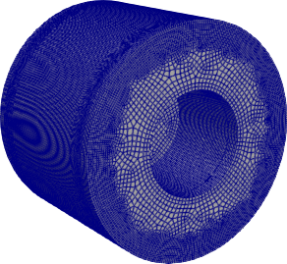
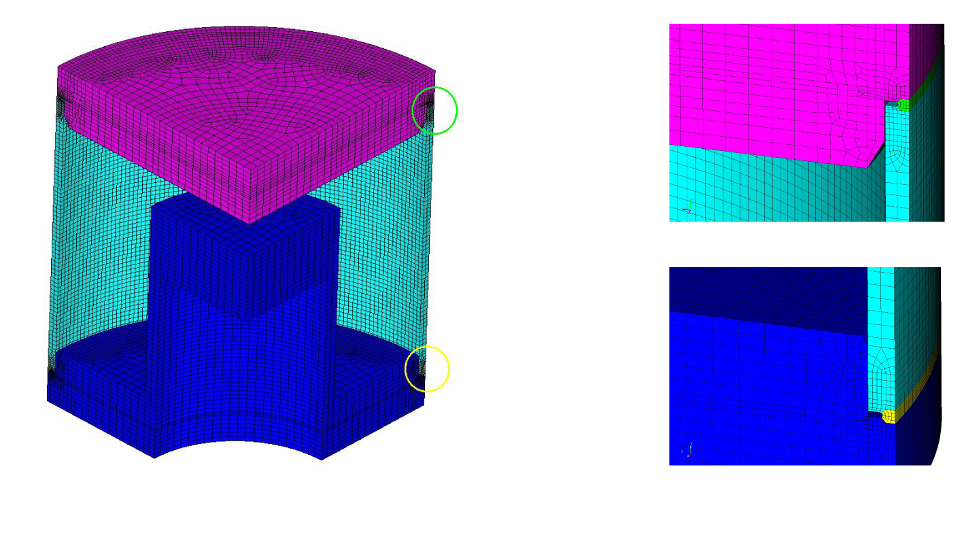
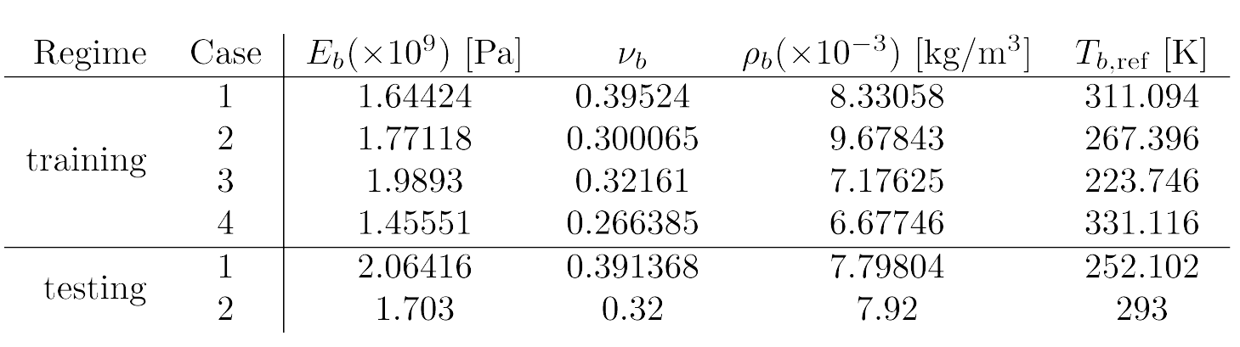
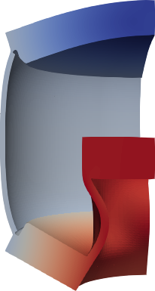
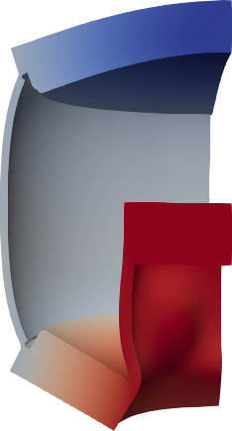

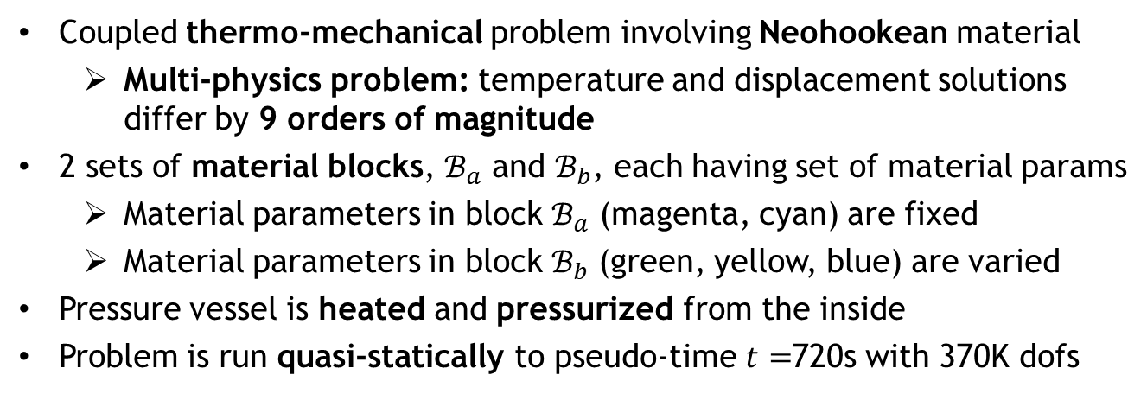
Thermo-Mechanical Pressure Vessel (Albany)
Table 1. Parameters in block $ℬ_{b}$ for thermo-mechanical pressure vessel problem.
Coupled thermo-mechanical problem involving Neohookean material
  Multi-physics problem: temperature and displacement solutions differ by 9 orders of magnitude
2 sets of material blocks, $ℬ_{a}$ and $ℬ_{b}$, each having set of material params
  Material parameters in block $ℬ_{a}$ (magenta, cyan) are fixed
  Material parameters in block $ℬ_{b}$ (green, yellow, blue) are varied
Pressure vessel is heated and pressurized from the inside
Problem is run quasi-statically to pseudo-time $t=$720s with 370K dofs
Testing 1
Testing 2
Training is performed for 4 sets of parameters; testing/prediction is performed for 2 sets of parameters (see Table 1)
[Lindsay et al., in prep.]

Slide 9
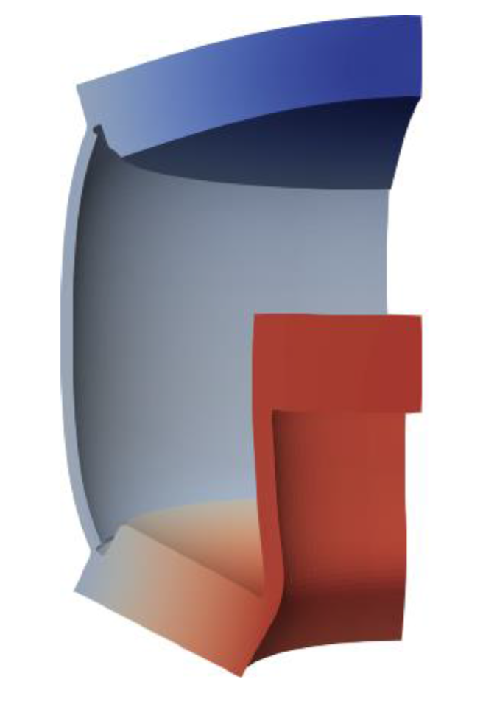
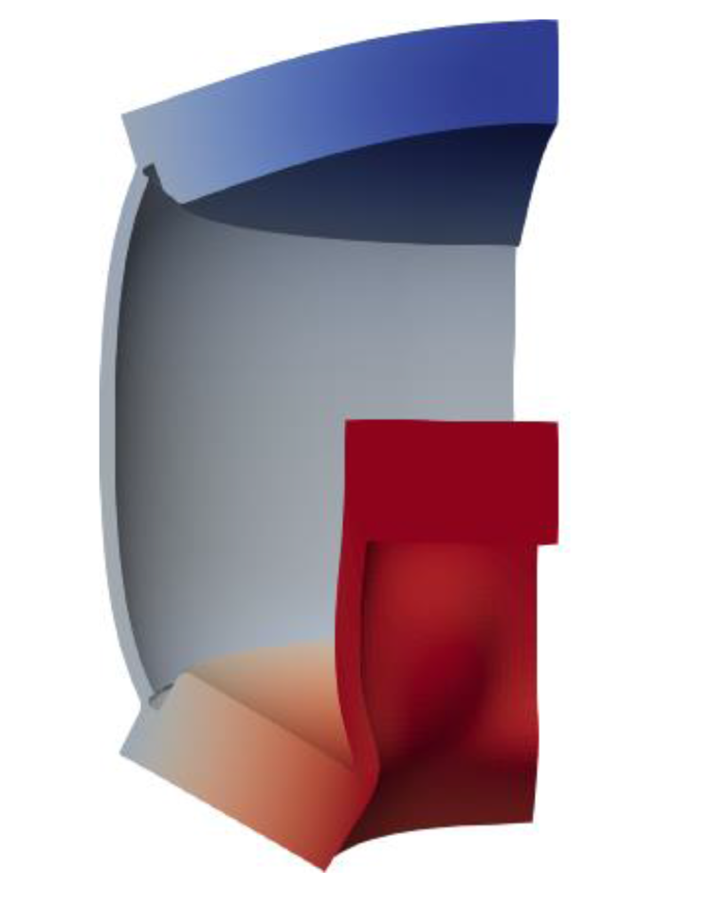
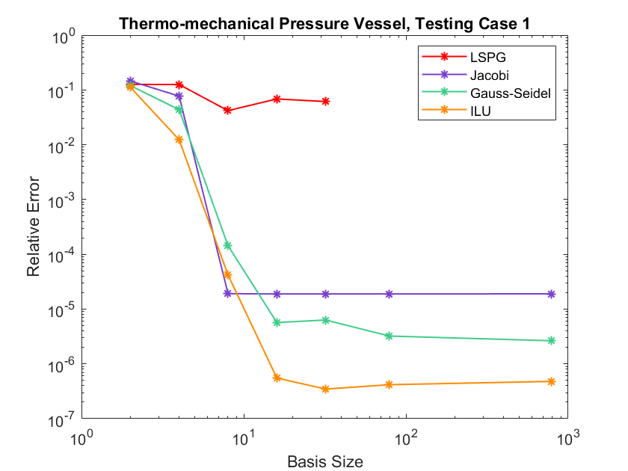
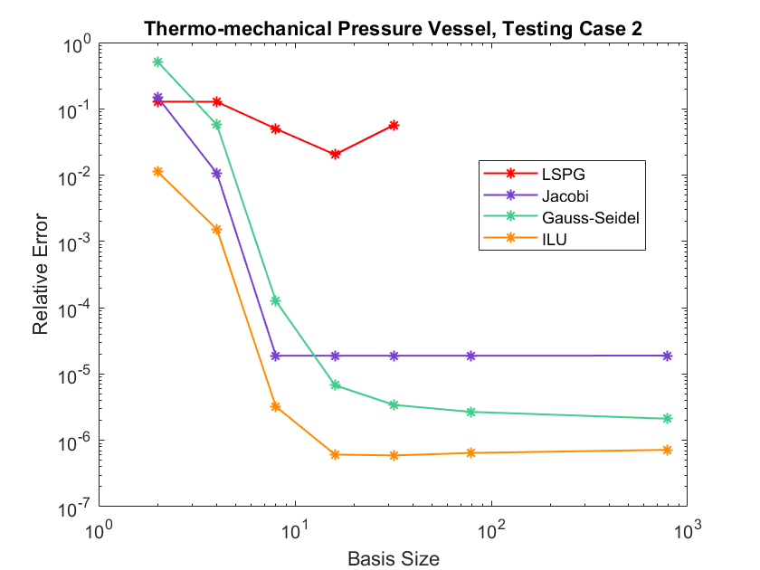
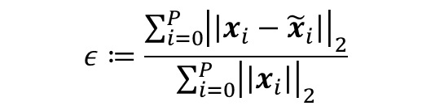
Thermo-Mechanical Pressure Vessel (Albany)
Global relative error:
$$ε≔\frac{\sum_{i=0}^{P}{{\left|\left|x_{i}−{\tilde{x}}_{i}\right|\right|}_{2}}}{\sum_{i=0}^{P}{{\left|\left|x_{i}\right|\right|}_{2}}}$$
Preconditioned LSPG ROMs are up to 5 orders of magnitude more accurate than LSPG ROMs.
LSPG ROMs do not converge for larger basis sizes.
Accuracy is improved by improving the preconditioner.
Seven basis sizes evaluated: 2,4,8,16, 32,79,790
PC-LSPG ROM
LSPG ROM
FOM

Slide 10
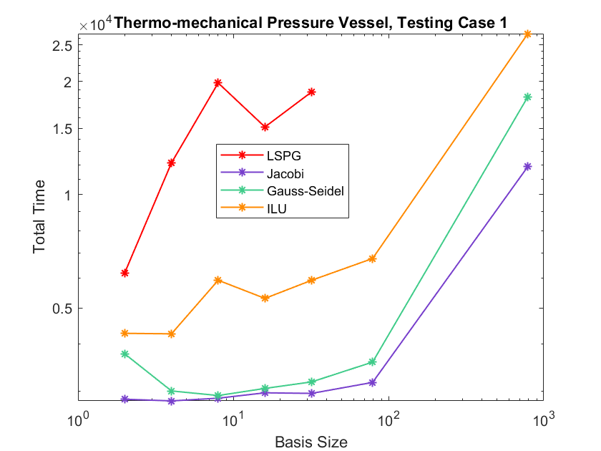
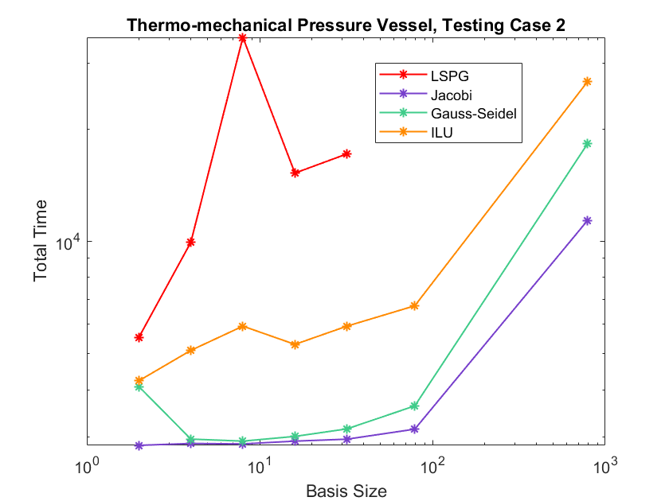
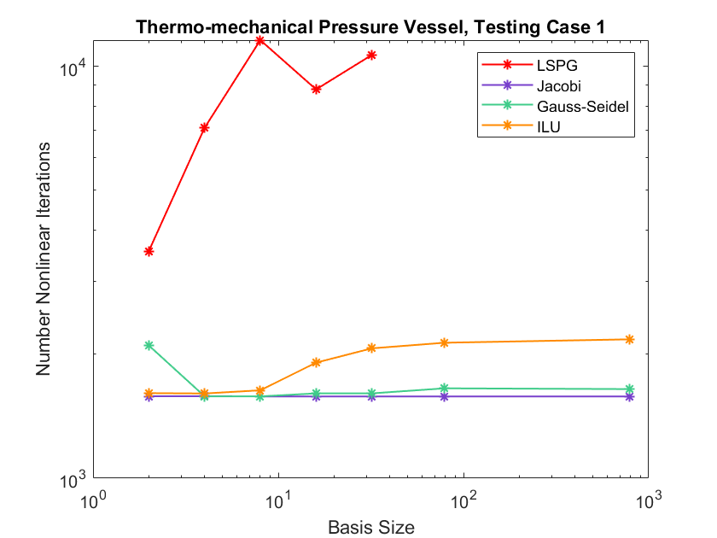
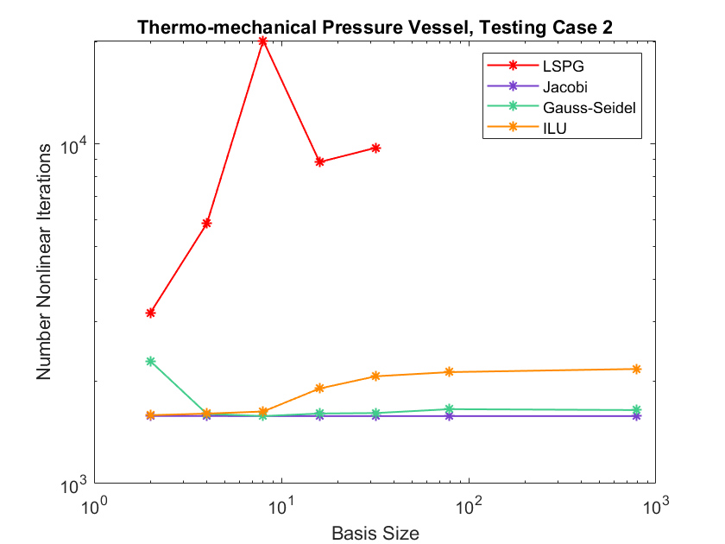
Thermo-Mechanical Pressure Vessel (Albany)
Preconditioned LSPG ROMs are up to 12x faster than vanilla LSPG ROMs
More sophisticated preconditioners lead to greater CPU times
Top figures: CPU times
Bottom figures: # nonlinear iterations
Speed-ups are largely due to reduction in # nonlinear iterations (by factor of >12x)

Slide 11
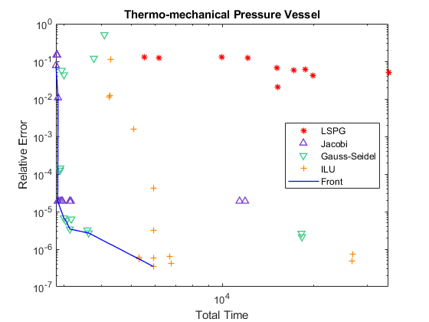
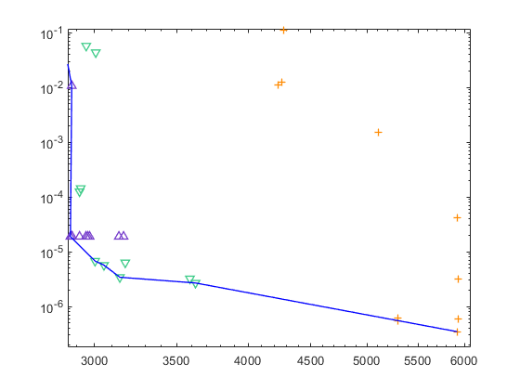
Thermo-Mechanical Pressure Vessel (Albany)
Pareto plot confirms competitiveness of preconditioned LSPG ROMs.

Slide 12
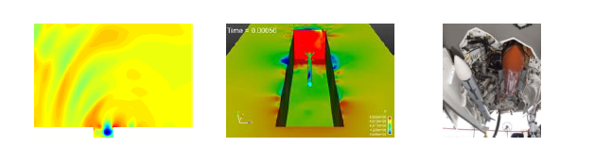
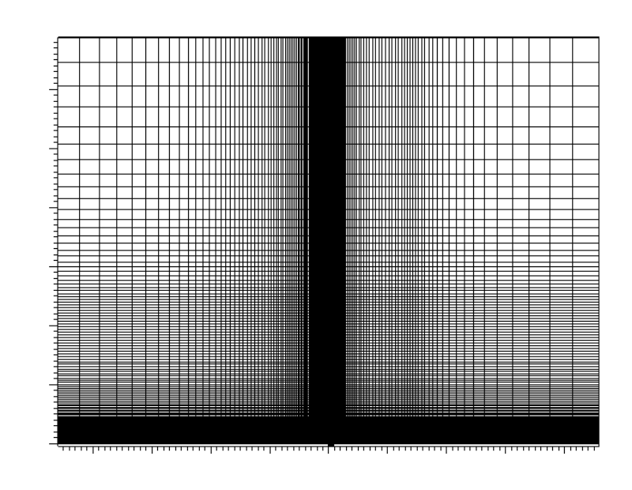


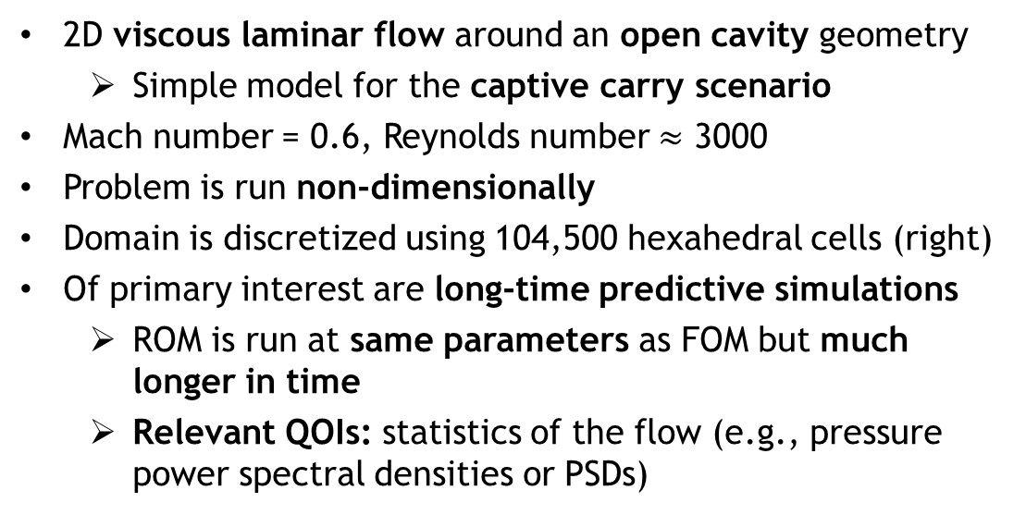
Compressible Cavity Flow (SPARC)
2D viscous laminar flow around an open cavity geometry
  Simple model for the captive carry scenario
Mach number = 0.6, Reynolds number $≈$ 3000
Problem is run non-dimensionally
Domain is discretized using 104,500 hexahedral cells (right)
Of primary interest are long-time predictive simulations
  ROM is run at same parameters as FOM but much longer in time
  Relevant QOIs: statistics of the flow (e.g., pressure power spectral densities or PSDs)
$y$-axis
$x$-axis
[Tezaur et al. 2017; Fike et al. 2018]

Slide 13
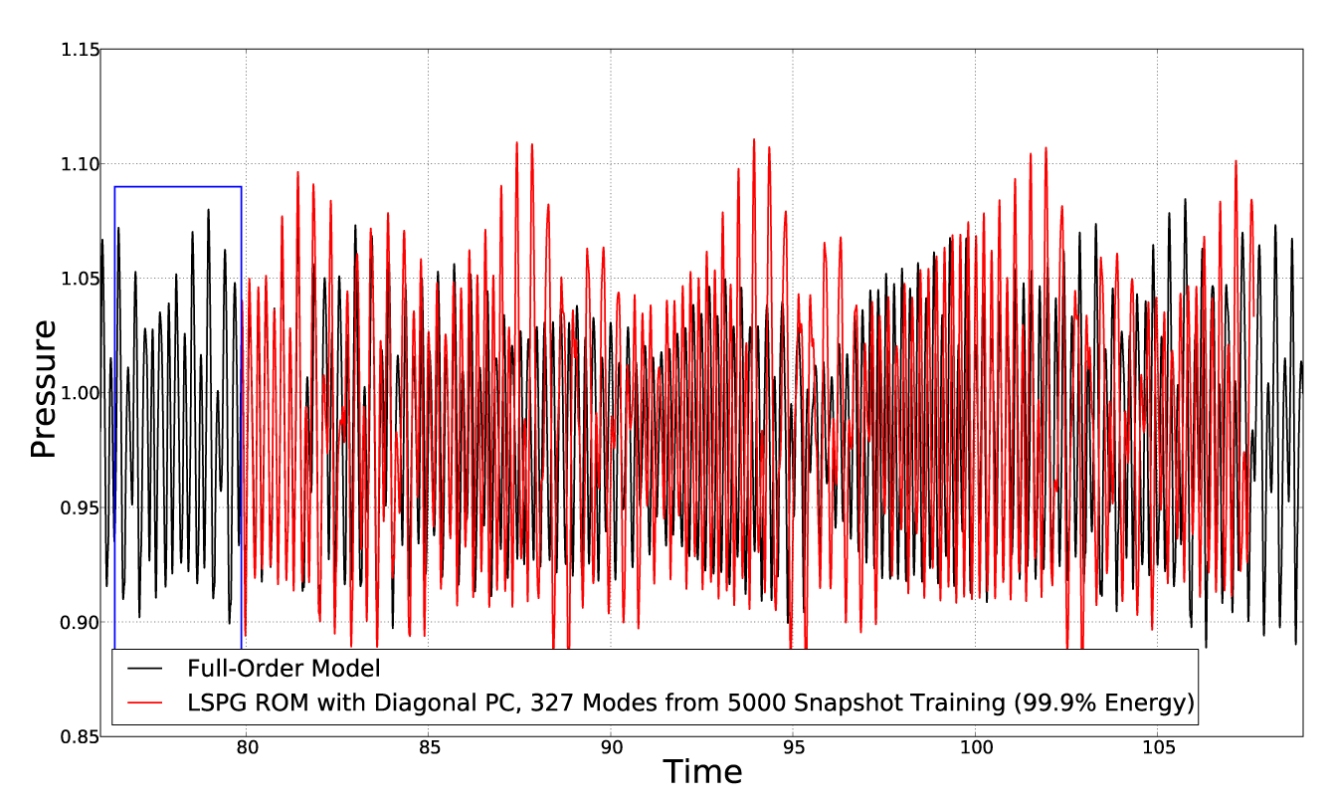
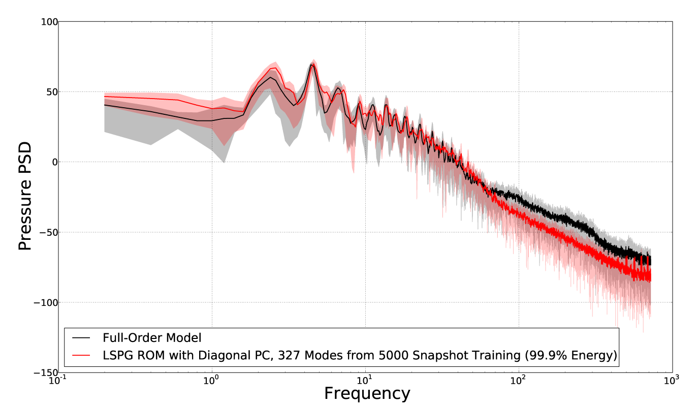
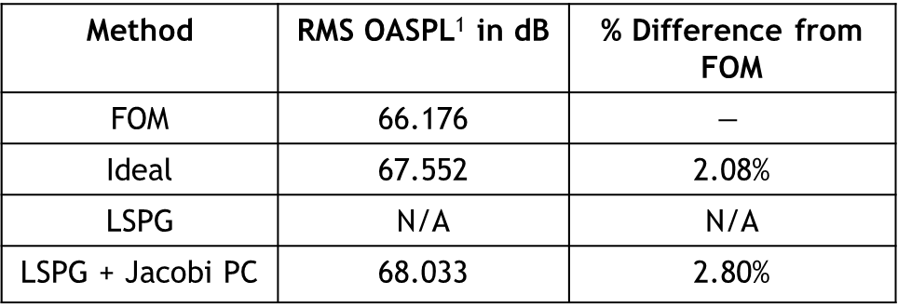
Compressible Cavity Flow (SPARC)
Figure top left: pressure time history for a point halfway up the downstream wall of the cavity for an LSPG ROM having 327 modes with a Jacobi preconditioner
Figure bottom left: pressure PSD for the signal in the top left figure (solid line is mean PSD, shaded regions indicate range of values used to construct the mean)
Preconditioned LSPG ROM captures well the pressure PSD, including its peaks (Rossiter modes) and the RMS OASPL¹
Vanilla LSPG ROM did not run successfully
Method | RMS OASPL¹ in dB | % Difference from FOM
FOM | 66.176 | $$−$$
Ideal | 67.552 | 2.08%
LSPG | N/A | N/A
LSPG + Jacobi PC | 68.033 | 2.80%
¹Overall sound pressure level

Slide 14
Summary & Future Work
Summary:
Adding preconditioning to the LSPG formulation gives rise to ROMs with improved accuracy and robustness, especially in the predictive regime
  Preconditioning attempts to emulate projection of FOM solution increment onto POD basis (the ROM “best-case scenario” for a given basis)
  Preconditioning ensures all components of residual being minimized are of the same magnitude
  Results on predictive (across parameter space) thermo-mechanical and predictive (in time) compressible flow problems are compelling
Ongoing/future work:
Two manuscripts on this work are in preparation
  P. Lindsay, J. Fike, K. Carlberg, I. Tezaur. “Preconditioned LSPG Reduced Order Models”, in prep.
  J. Fike, P. Lindsay, K. Carlberg, I. Tezaur. “Preconditioned Least-Squares Petrov-Galerkin Reduced Order Models for Compressible Flows”, in prep.
Application of preconditioned LSPG approach to more sophisticated problems relevant to Sandia’s mission spaces
  Preconditioning LSPG ROMs has been helpful for hypersonic aero, thermal/ablation and reacting hypersonic flow problems

Slide 15
Start of Backup Slides

Slide 16
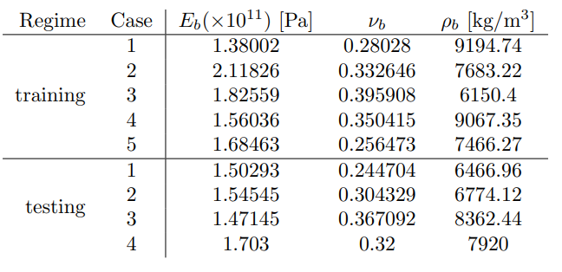
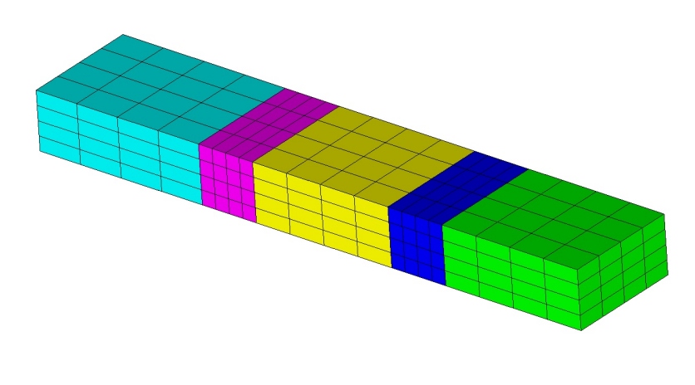
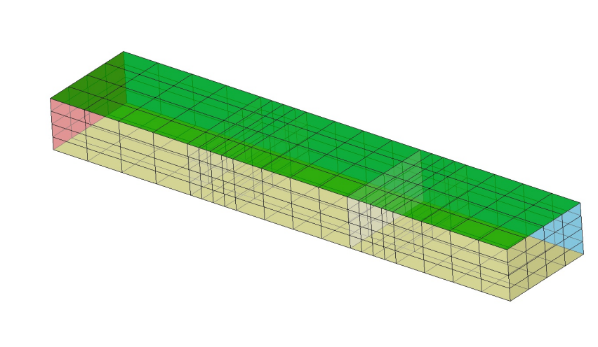
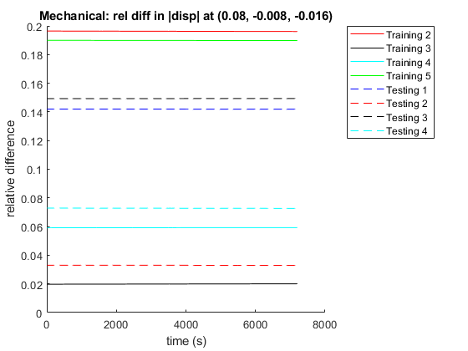



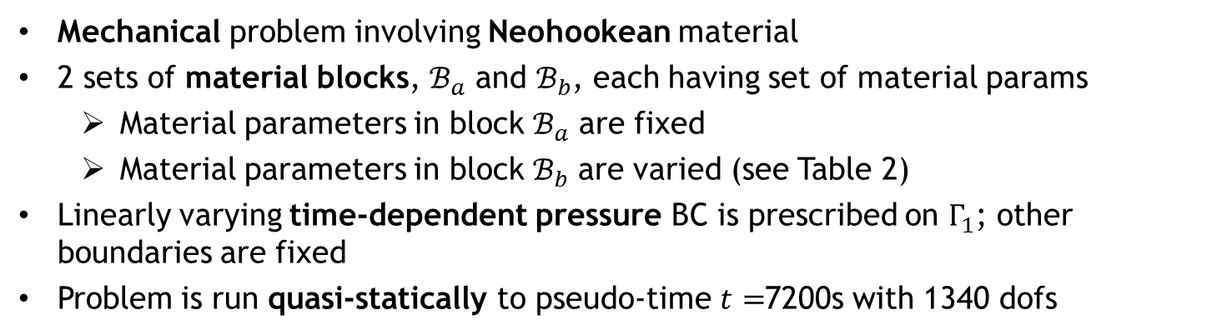

Mechanical Beam (Albany)
Table 2. Parameters in block $ℬ_{b}$ for mechanical beam problem.
$$ℬ_{b}$$
$ℬ_{a}$
$$Γ_{1}$$
Mechanical problem involving Neohookean material
2 sets of material blocks, $ℬ_{a}$ and $ℬ_{b}$, each having set of material params
  Material parameters in block $ℬ_{a}$ are fixed
  Material parameters in block $ℬ_{b}$ are varied (see Table 2)
Linearly varying time-dependent pressure BC is prescribed on $Γ_{1}$; other boundaries are fixed
Problem is run quasi-statically to pseudo-time $t=$7200s with 1340 dofs
Training is performed for 6 sets of parameters; testing/prediction is performed for 4 sets of parameters (see Table 2)
  Nontrivial variations in displacement (up to 20%) are observed with the parameter variations considered (right figure)
[Lindsay et al., in prep.]

Slide 17






Mechanical Beam (Albany)
Figure plots global relative error in approximate ROM solutions:
$$ε≔\frac{\sum_{i=0}^{P}{{\left|\left|x_{i}−{\tilde{x}}_{i}\right|\right|}_{2}}}{\sum_{i=0}^{P}{{\left|\left|x_{i}\right|\right|}_{2}}}$$
Preconditioners evaluated: Jacobi, Gauss-Seidel, ILU and ${{(J}^{\left(k\right)})}^{−1}$ (denoted by “Ideal”)
Nonlinear solver for unpreconditioned LSPG ROM did not converge for any of the basis sizes considered.
More sophisticated preconditioners deliver smaller errors.

Slide 18





Mechanical Beam (Albany)
Figure plots condition numbers of reduced Jacobian ($J_{PPG}^{(k)}$ or $J_{PG}^{(k)}$) for each ROM.
A moderate reduction in condition number is obtained through preconditioning strategies.
Most sophisticated ILU preconditioner gives rise to a reduced Jacobian with the smallest condition number.

Slide 19




Mechanical Beam (Albany)
Figures shows CPU-times for all ROMs considered
As expected, the projected solution increment is the most expensive to compute

Slide 20


Mechanical Beam (Albany)
The best preconditioner given error/CPU-time requirements can be inferred from Pareto plot shown here.

Slide 21





Thermo-Mechanical Beam (Albany)
Table 3. Parameters in block $ℬ_{b}$ for thermo-mechanical beam problem.
$$ℬ_{b}$$
$$Γ_{2}$$
$ℬ_{a}$
$$Γ_{1}$$
Coupled thermo-mechanical problem involving Neohookean material
2 sets of material blocks, $ℬ_{a}$ and $ℬ_{b}$, each having set of material params
  Material parameters in block $ℬ_{a}$ are fixed
  Material parameters in block $ℬ_{b}$ are varied (see Table 3)
Linearly varying time-dependent pressure and temperature BC is prescribed on $Γ_{1}$ and $Γ_{2}$, respectively; other boundaries are fixed
Problem is run quasi-statically to pseudo-time $t=$7200s with 2100 dofs
Training is performed for 6 sets of parameters; testing/prediction is performed for 4 sets of parameters (see Table 3)
  Significant variations in displacement (up to 60%) are observed with the parameter variations considered (right figure)
[Lindsay et al., in prep.]

Slide 22


Thermo-Mechanical Beam (Albany)

Slide 23


Thermo-Mechanical Beam (Albany)

Slide 24


Thermo-Mechanical Beam (Albany)

Slide 25


Thermo-Mechanical Beam (Albany)

Slide 26





Thermo-Mechanical Beam (Albany)
Figure plots condition numbers of reduced Jacobian ($J_{PPG}^{(k)}$ or $J_{PG}^{(k)}$) for each ROM.
Reduced Jacobians for regular LSPG ROM are very ill-conditioned ($>O\left({10}^{14}\right)$)
  Ill-conditioning is due to extreme differences in scale b/w displacement and temperature solutions (9 orders of magnitude)
Results demonstrate that simple preconditioning strategy can reduce condition numbers by as many as 10 orders of magnitude
As expected, projected solution increment reduced Jacobian has perfect condition number

Slide 27




Thermo-Mechanical Beam (Albany)
Figures shows CPU-times for all ROMs considered
In general, preconditioned LSPG ROMs achieve CPU-times smaller than unpreconditioned LSPG ROM
As expected, the projected solution increment is the most expensive to compute in general

Slide 28


Thermo-Mechanical Beam (Albany)
Pareto plot results confirm that there is a significant computational advantage in applying preconditioning

