Slide 1
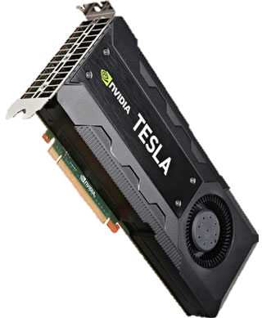
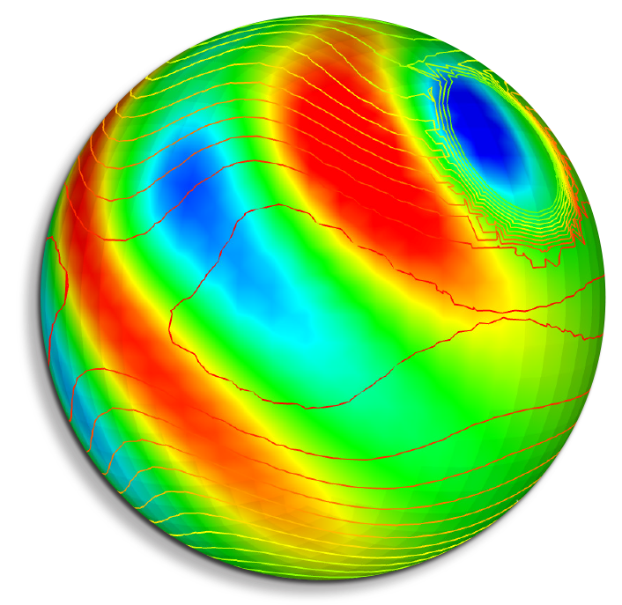

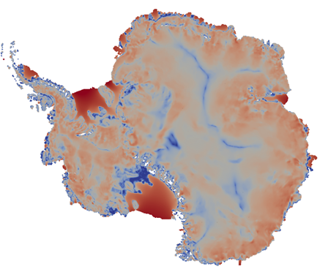
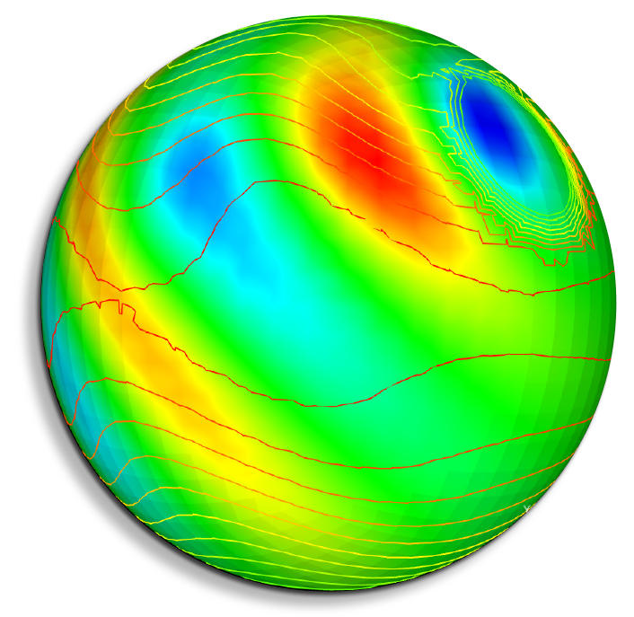
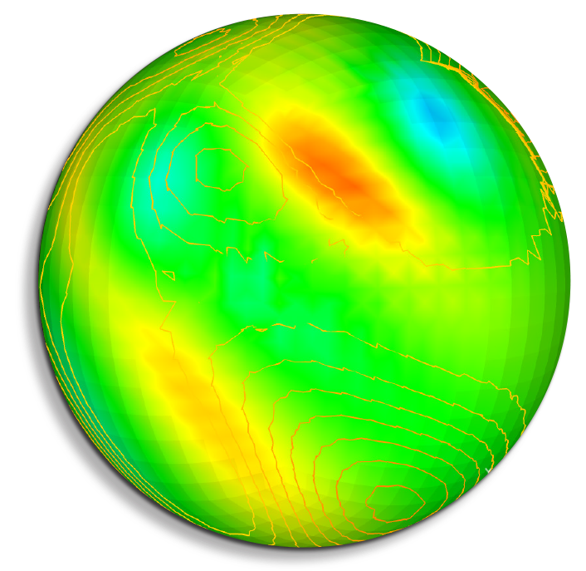
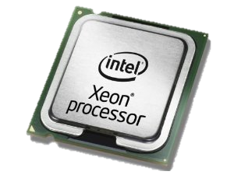

A Performance-Portable Implementation of the Finite Element Assembly in an Atmosphere & Land-Ice Code using the Kokkos Library
Irina Tezaur¹, Jerry Watkins^{1,2}, Irina Demeshko³
¹ Sandia National Laboratories, ² Stanford University, ³ Los Alamos National Laboratory
FEF 2017 Rome, Italy April 5-7, 2017
SAND2017-2917C

Slide 2
Outline
Motivation & Background
The Albany Multi-Physics Code
Performance-portability via Kokkos
Aeras Next-Generation Global Atmosphere Model & Project
  Results
FELIX Land-Ice Model & PISCEES Project
  Results
Summary/Conclusions
Ongoing/Future Work
Notes:
Water cycle: How do the hydrological cycle and water resources interact with the climate on local to global scales?
Biogeochemistry: How do biogeochemical cycles interact with global climate change?
Cryosphere-Ocean System: How do rapid changes in areas of the Earth where water exists as ice and snow interact with the climate system?

Slide 3
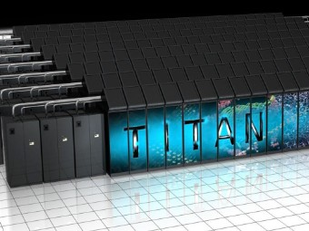
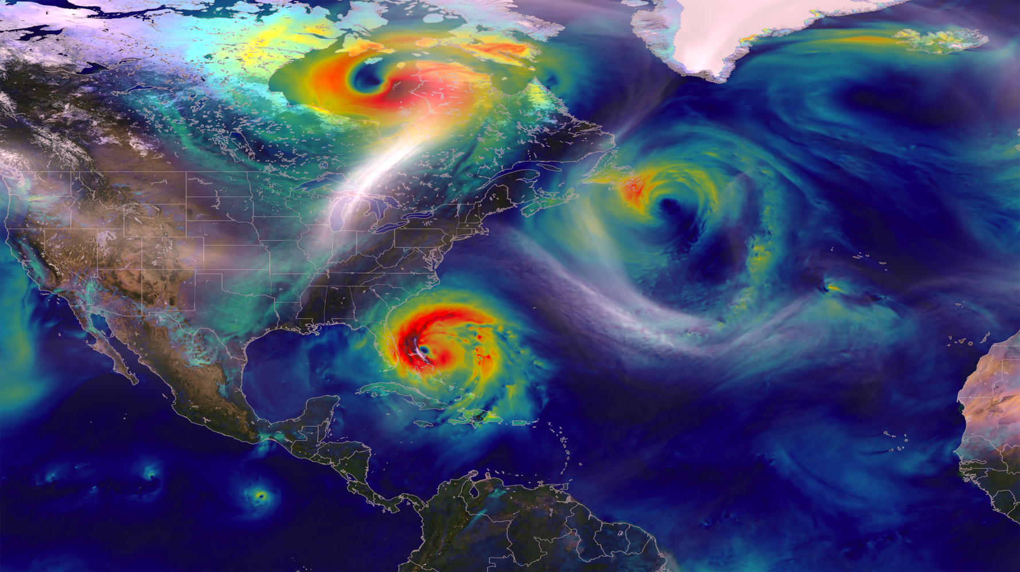
Motivation
Scientific models (e.g. climate models) need more computational power to achieve higher resolutions.
High performance computing (HPC) architectures are becoming increasingly more heterogeneous in a move towards exascale.
Climate models need to adapt to execute correctly & efficiently on new HPC architectures with drastically different memory models.
Notes:
Water cycle: How do the hydrological cycle and water resources interact with the climate on local to global scales?
Biogeochemistry: How do biogeochemical cycles interact with global climate change?
Cryosphere-Ocean System: How do rapid changes in areas of the Earth where water exists as ice and snow interact with the climate system?

Slide 4
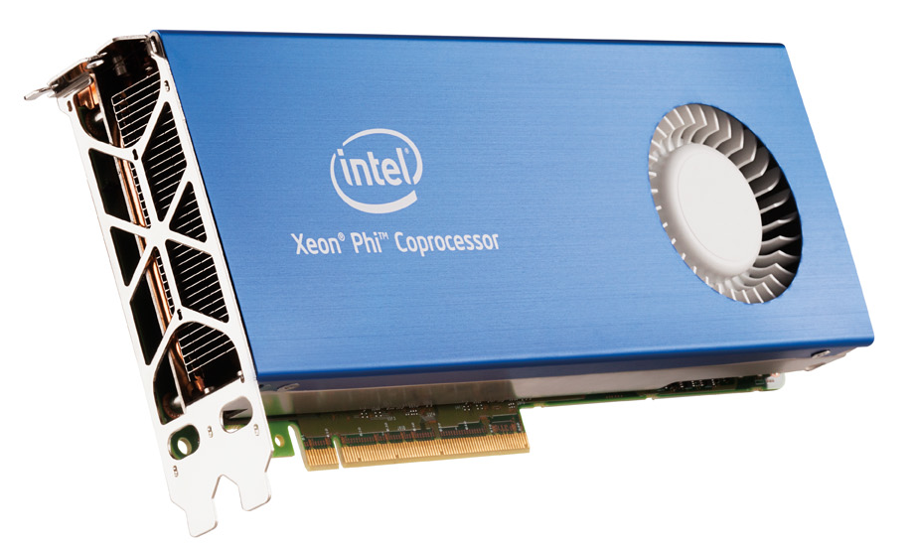
MPI+X Programming Model
HPC architectures are rapidly changing, but trends remain the same.
  Computations are cheap, memory transfer is expensive.
  Single core cycle time has improved but stagnated.
  Increased computational power achieved through manycore architectures.
  → MPI-only is not enough to exploit emerging massively parallel architectures.
Year | Memory Access Time | Single Core Cycle Time
1980s | ~100 ns | ~100 ns
Today | ~50-100 ns | ~1 ns
Approach: MPI+X Programming Model
MPI: inter-node parallelism.
X: intra-node parallelism.
  → Examples: X = OpenMP, CUDA, Pthreads, etc.

Slide 5


Earth System Models: CESM, DOE-ESM
An ESM has six modular components:
  Atmosphere model
  Ocean model
  Sea ice model
  Land ice model
  Land model
  Flux coupler
Land Surface
(ice sheet surface mass balance)
Ice Sheet (dynamics)
Atmosphere
Flux Coupler
Ocean
Sea Ice
Goal of ESM: to provide actionable scientific predictions of 21st century sea-level rise (including uncertainty).
Focus here is on two climate components developed at Sandia:
  Aeras global atmosphere model.
  FELIX land-ice model.
Implemented within the code

Slide 6
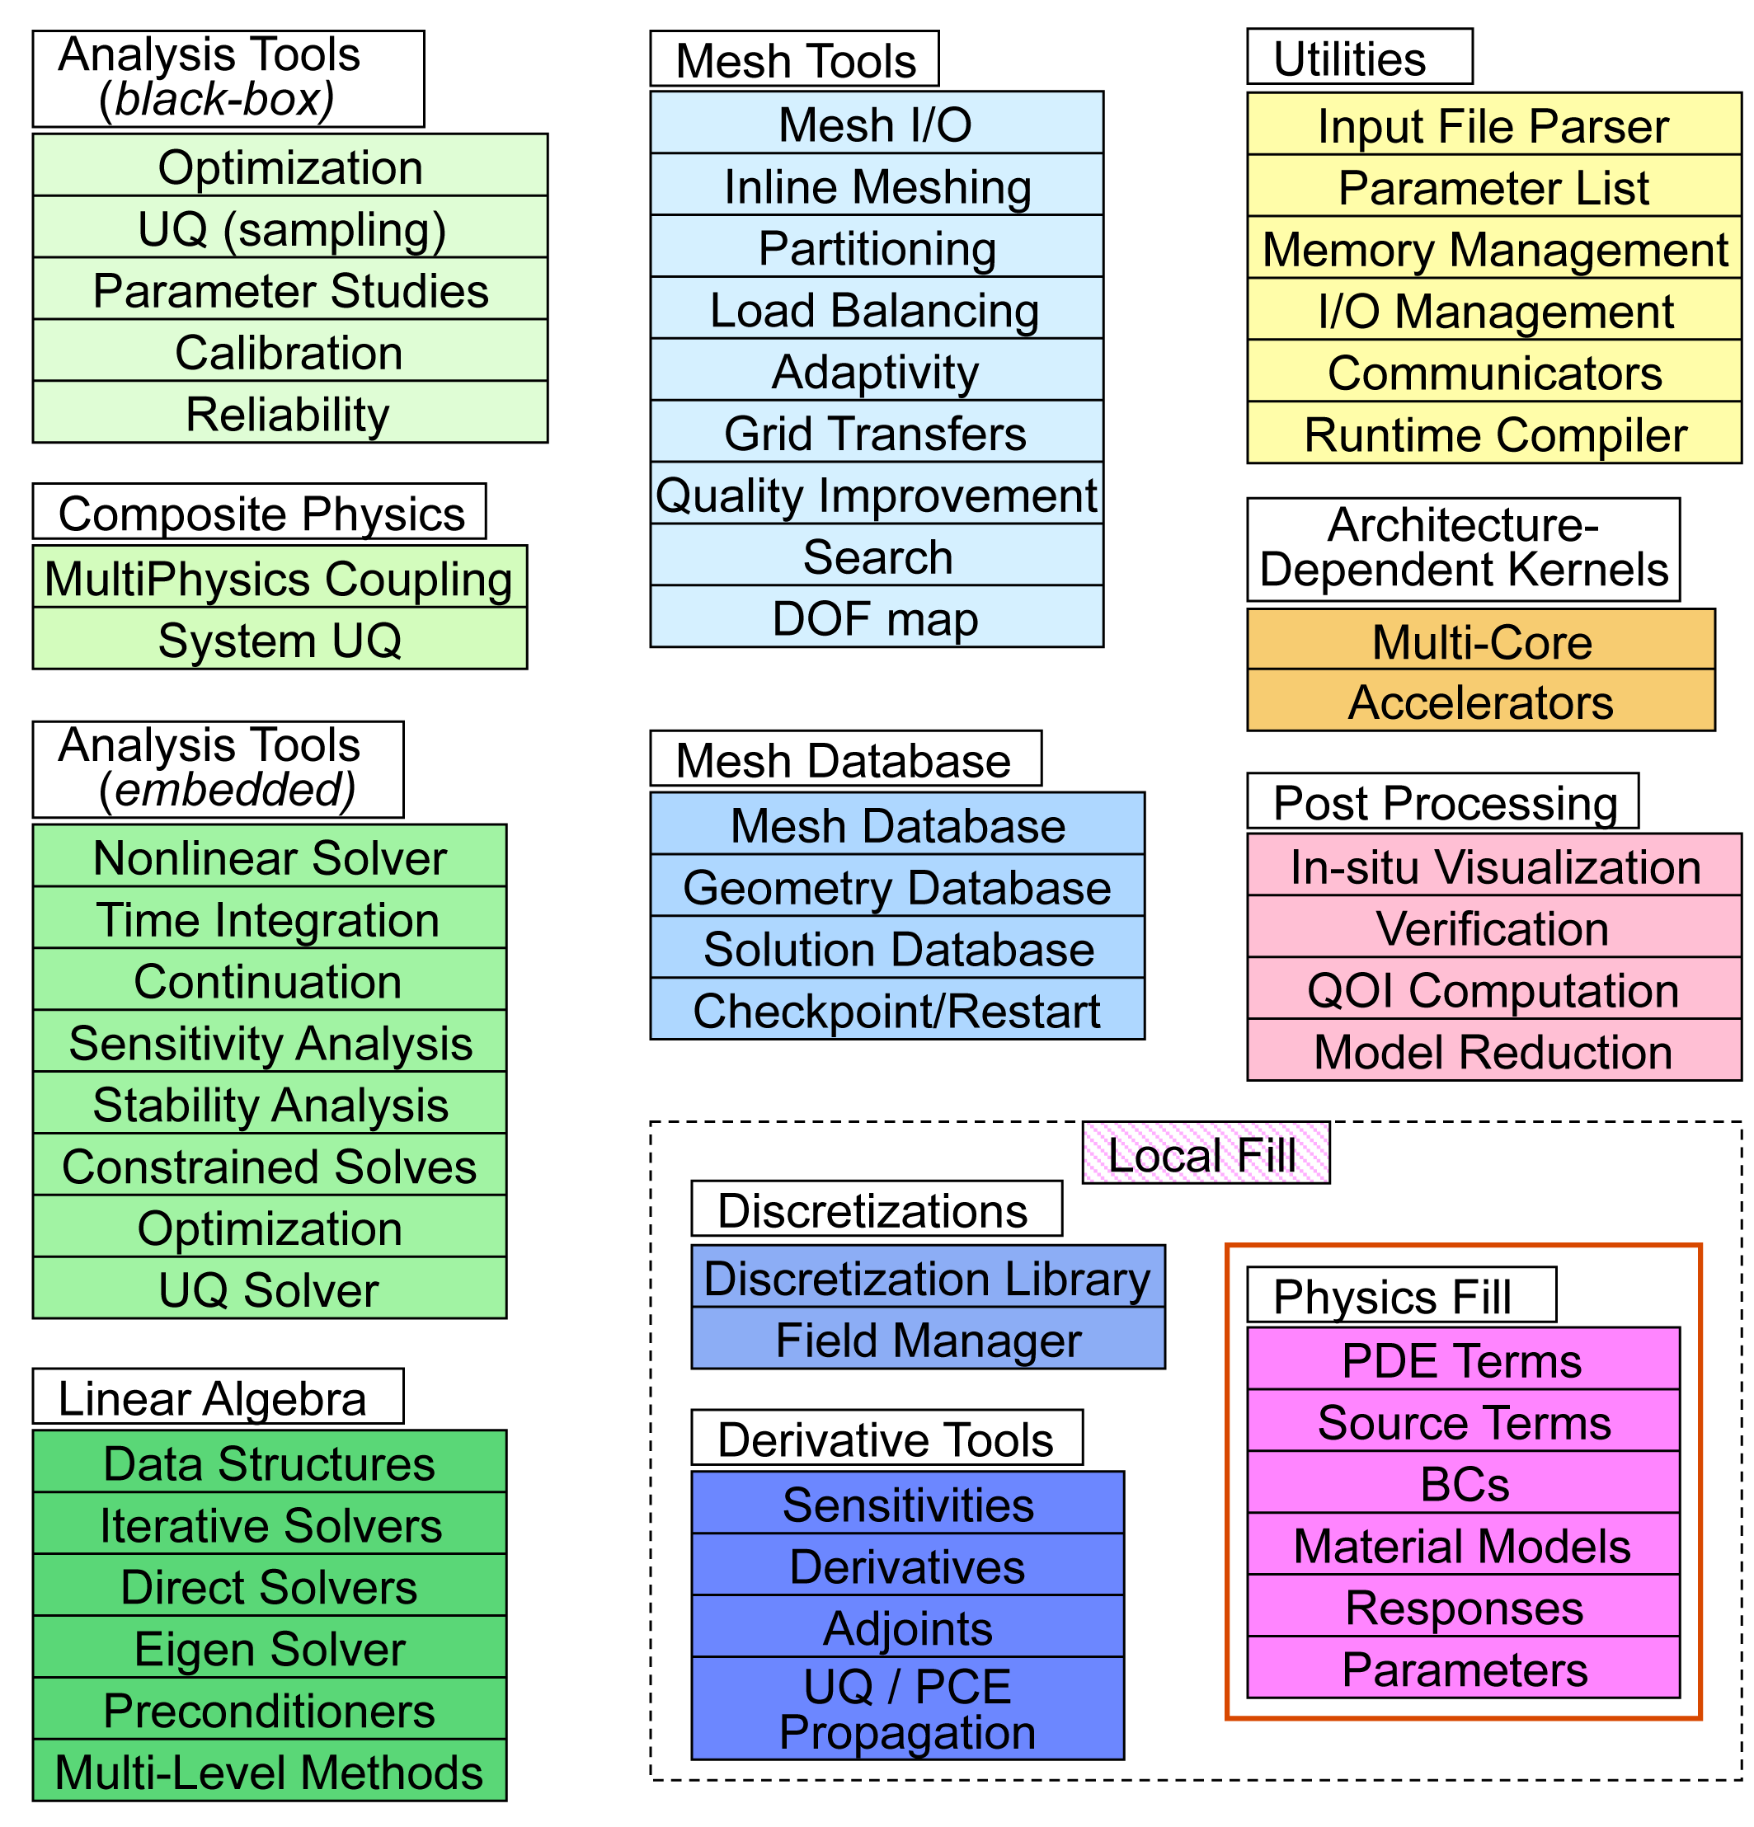
Multiphysics Code
Sandia open-source* parallel, C++, multi-physics finite element code.
Component-based design for rapid development of new physics & capabilities.
Extensive use of libraries from the open-source Trilinos project:
  Automatic differentiation.
  Discretizations/meshes, mesh adaptivity.
  Solvers, time-integration schemes.
  Performance-portable kernels.
Advanced analysis capabilities:
  Parameter estimation.
  Uncertainty quantification (DAKOTA).
  Optimization.
  Sensitivity analysis.
40+ packages; 120+ libraries
* https://github.com/gahansen/Albany.

Slide 7
Multiphysics Code
Sandia open-source* parallel, C++, multi-physics finite element code.
Component-based design for rapid development of new physics & capabilities.
Extensive use of libraries from the open-source Trilinos project:
  Automatic differentiation.
  Discretizations/meshes, mesh adaptivity.
  Solvers, time-integration schemes.
  Performance-portable kernels.
Advanced analysis capabilities:
  Parameter estimation.
  Uncertainty quantification (DAKOTA).
  Optimization.
  Sensitivity analysis.
This talk
40+ packages; 120+ libraries
* https://github.com/gahansen/Albany.

Slide 8
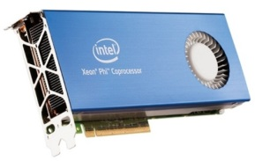
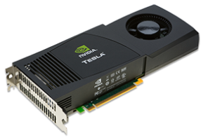
Performance-portability via Kokkos
We need to be able to run climate models on new architecture machines (hybrid systems) and manycore devices (multi-core CPU, NVIDIA GPU, Intel Xeon Phi, etc.) .
In Albany, we achieve performance-portability via Kokkos.
  Kokkos: C++ library and programming model that provides performance portability across multiple computing architectures.
    → Examples: Multicore CPU, NVIDIA GPU, Intel Xeon Phi, and more.
  Provides automatic access to OpenMP, CUDA, Pthreads, etc.
  Designed to work with the MPI+X programming model.
  Abstracts data layouts for optimal performance (“array of strucs” vs. struct of arrays”, locality).
With Kokkos, you write an algorithm once, and just change a template parameter to get the optimal data layout for your hardware.
→ Allows researcher to focus on algorithm development for large heterogeneous architectures.

Slide 9
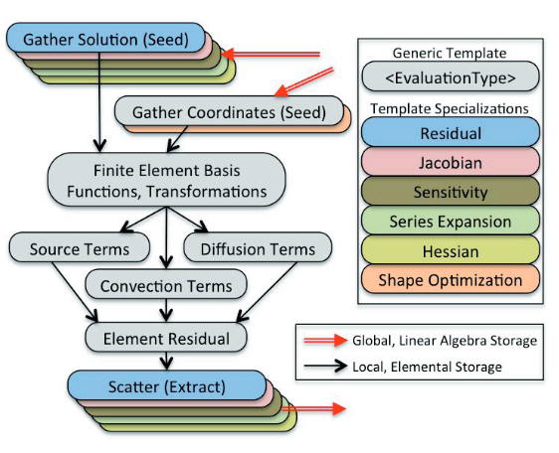
Albany Finite Element Assembly (FEA)
Gather operation extracts solution values out of global solution vector.
Physics evaluator functions operate on workset of elements, store evaluated quantities in local field arrays.
FEA relies on template based generic programming + automatic differentiation for Jacobians, tangents, etc.
Scatter operation adds local residual, Jacobian to global residual, Jacobian.
Albany performance-portability: focus on FEA.
Problem Type | % CPU time for FEA
Implicit | 50%
Explicit | 99%

Slide 10
Albany Finite Element Assembly (FEA)
Gather operation extracts solution values out of global solution vector.
Physics evaluator functions operate on workset of elements, store evaluated quantities in local field arrays.
FEA relies on template based generic programming + automatic differentiation for Jacobians, tangents, etc.
Scatter operation adds local residual, Jacobian to global residual, Jacobian.
Albany performance-portability: focus on FEA.
MPI-only FEA:
  Each MPI process has workset of cells & computes nested parallel for loops.
Problem Type | % CPU time for FEA
Implicit | 50%
Explicit | 99%

Slide 11
Albany Finite Element Assembly (FEA)
Gather operation extracts solution values out of global solution vector.
Physics evaluator functions operate on workset of elements, store evaluated quantities in local field arrays.
FEA relies on template based generic programming + automatic differentiation for Jacobians, tangents, etc.
Scatter operation adds local residual, Jacobian to global residual, Jacobian.
Albany performance-portability: focus on FEA.
MPI-only FEA:
  Each MPI process has workset of cells & computes nested parallel for loops.
MPI+X FEA:
  Each MPI process has workset of cells.
  Multi-dimensional parallelism with +X (X=OpenMP, CUDA) for nested parallel for loops.
Problem Type | % CPU time for FEA
Implicit | 50%
Explicit | 99%

Slide 12
MPI+X FEA via Kokkos
MPI-only nested for loop:
for (int cell=0; cell<numCells; ++cell)
for (int node=0; node<numNodes; ++node)
for (int qp=0; qp<numQPs; ++qp)
compute A;
MPI process n

Slide 13

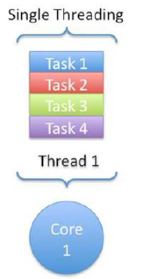
MPI+X FEA via Kokkos
Thread 1 computes A for
(cell,node,qp)=(0,0,0)
Multi-dimensional parallelism for nested for loops via Kokkos:
Thread 2 computes A for
(cell,node,qp)=(0,0,1)
for (int cell=0; cell<numCells; ++cell)
for (int node=0; node<numNodes; ++node)
for (int qp=0; qp<numQPs; ++qp)
compute A;
Thread N computes A for
(cell,node,qp)=(numCells,numNodes,numQPs)
MPI process n

Slide 14
MPI+X FEA via Kokkos
Thread 1 computes A for
(cell,node,qp)=(0,0,0)
Multi-dimensional parallelism for nested for loops via Kokkos:
Thread 2 computes A for
(cell,node,qp)=(0,0,1)
for (int cell=0; cell<numCells; ++cell)
for (int node=0; node<numNodes; ++node)
for (int qp=0; qp<numQPs; ++qp)
compute A;
Thread N computes A for
(cell,node,qp)=(numCells,numNodes,numQPs)
MPI process n
computeA_Policy range({0,0,0},{(int)numCells,(int)numNodes,(int)numQPs}, computeA_TileSize);
Kokkos::Experimental::md_parallel_for<ExecutionSpace>(range,*this);
* Unified Virtual Memory.
* Unified Virtual Memory.

Slide 15
MPI+X FEA via Kokkos
Thread 1 computes A for
(cell,node,qp)=(0,0,0)
Multi-dimensional parallelism for nested for loops via Kokkos:
Thread 2 computes A for
(cell,node,qp)=(0,0,1)
for (int cell=0; cell<numCells; ++cell)
for (int node=0; node<numNodes; ++node)
for (int qp=0; qp<numQPs; ++qp)
compute A;
Thread N computes A for
(cell,node,qp)=(numCells,numNodes,numQPs)
MPI process n
computeA_Policy range({0,0,0},{(int)numCells,(int)numNodes,(int)numQPs}, computeA_TileSize);
Kokkos::Experimental::md_parallel_for<ExecutionSpace>(range,*this);
ExecutionSpace defined at compile time, e.g.
  typedef Kokkos::OpenMP ExecutionSpace; //MPI+OpenMP
  typedef Kokkos::CUDA ExecutionSpace; //MPI+CUDA
  typedef Kokkos::Serial ExecutionSpace; //MPI-only

Slide 16
MPI+X FEA via Kokkos
Thread 1 computes A for
(cell,node,qp)=(0,0,0)
Multi-dimensional parallelism for nested for loops via Kokkos:
Thread 2 computes A for
(cell,node,qp)=(0,0,1)
for (int cell=0; cell<numCells; ++cell)
for (int node=0; node<numNodes; ++node)
for (int qp=0; qp<numQPs; ++qp)
compute A;
Thread N computes A for
(cell,node,qp)=(numCells,numNodes,numQPs)
MPI process n
computeA_Policy range({0,0,0},{(int)numCells,(int)numNodes,(int)numQPs}, computeA_TileSize);
Kokkos::Experimental::md_parallel_for<ExecutionSpace>(range,*this);
ExecutionSpace defined at compile time, e.g.
  typedef Kokkos::OpenMP ExecutionSpace; //MPI+OpenMP
  typedef Kokkos::CUDA ExecutionSpace; //MPI+CUDA
  typedef Kokkos::Serial ExecutionSpace; //MPI-only
Atomics used to scatter local data to global data structures
  Kokkos::atomic_fetch_add

Slide 17
MPI+X FEA via Kokkos
Thread 1 computes A for
(cell,node,qp)=(0,0,0)
Multi-dimensional parallelism for nested for loops via Kokkos:
Thread 2 computes A for
(cell,node,qp)=(0,0,1)
for (int cell=0; cell<numCells; ++cell)
for (int node=0; node<numNodes; ++node)
for (int qp=0; qp<numQPs; ++qp)
compute A;
Thread N computes A for
(cell,node,qp)=(numCells,numNodes,numQPs)
MPI process n
computeA_Policy range({0,0,0},{(int)numCells,(int)numNodes,(int)numQPs}, computeA_TileSize);
Kokkos::Experimental::md_parallel_for<ExecutionSpace>(range,*this);
ExecutionSpace defined at compile time, e.g.
  typedef Kokkos::OpenMP ExecutionSpace; //MPI+OpenMP
  typedef Kokkos::CUDA ExecutionSpace; //MPI+CUDA
  typedef Kokkos::Serial ExecutionSpace; //MPI-only
Atomics used to scatter local data to global data structures
  Kokkos::atomic_fetch_add
For MPI+CUDA, data transfer from host to device handled by CUDA UVM*.
* Unified Virtual Memory.

Slide 18
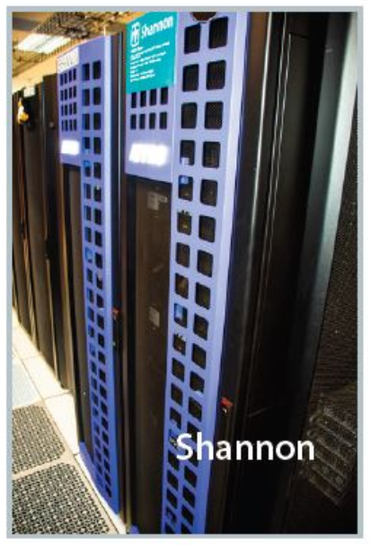
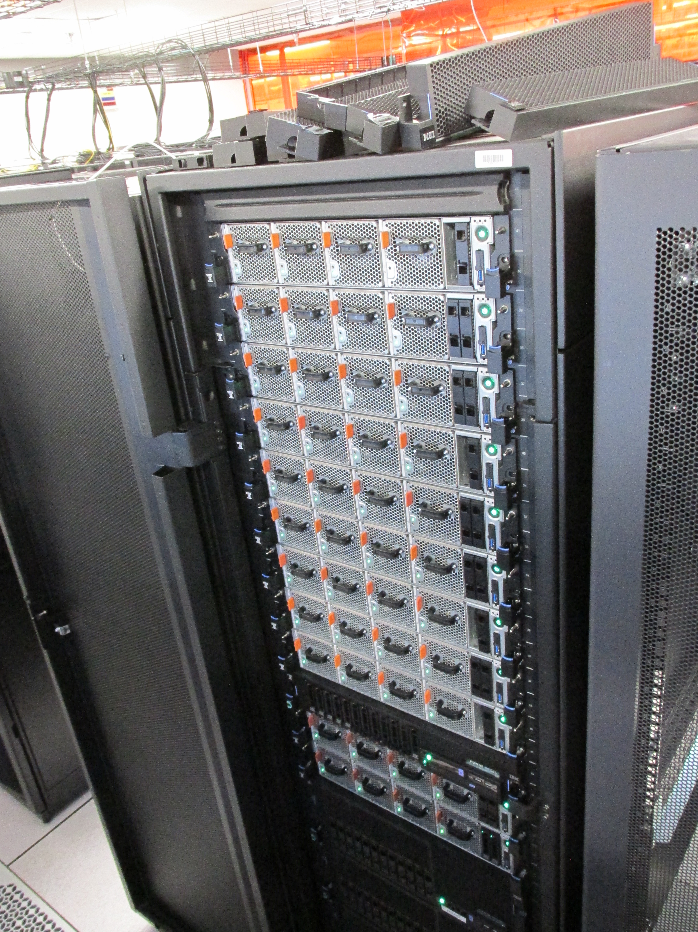
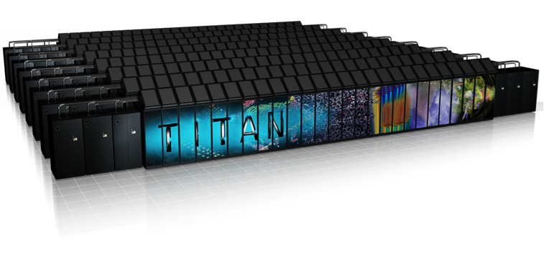
Computer Architectures
Performance-portability of FEA in Albany has been tested across multiple architectures: Intel Sandy Bridge, IBM Power8, Keplar/Pascal GPUs, KNL Xeon Phi
Shannon used for testing, performance tests
  10 nodes (dual-SandyBridge (16) + K80 dual-GPU)
Ride used for testing, performance tests
  12 nodes (dual-Power8 (16) + P100 quad-GPU)
Titan used for full length simulations, performance tests
  18,688 nodes (AMD Opteron (16) + K20 GPU)
Ride

Slide 19



Atmosphere Model & Project
LDRD
Energy &
Climate
Hydrostatic model
2D (x-z) &
3D
Aeras*
Sandia National Laboratories Lab-Directed Research and Development (LDRD)
2014-2016
Albany
SNL
Finite Element
Application Code Base
Increased complexity
Shallow water model
(2D)
Goal: demonstrate next-generation capabilities in an atmosphere model suitable for climate
*Greek for “air”
Next-generation features:
Performance portability via Kokkos.
Embedded Uncertainty Quantification.
Sandia LDRD project involving computational scientists, mathematicians, and climate scientists.
Led to follow-up BER project: Climate Model Development & Validation (CMDV) → key task is Spectral Element Method (SEM) dycore refactore using C++ and Kokkos.

Slide 20
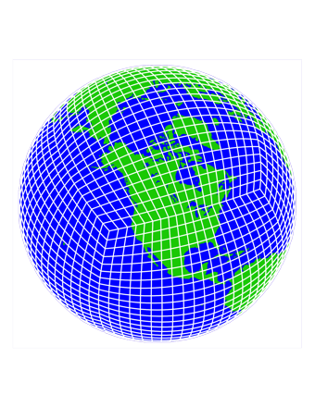
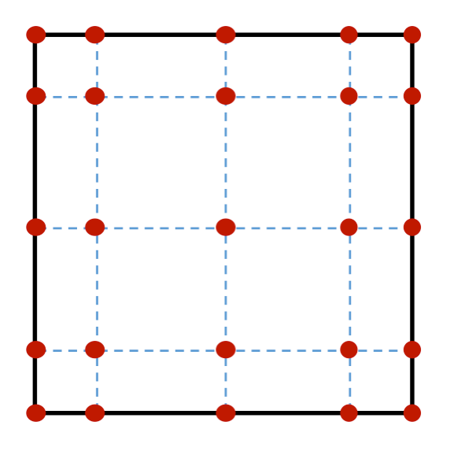
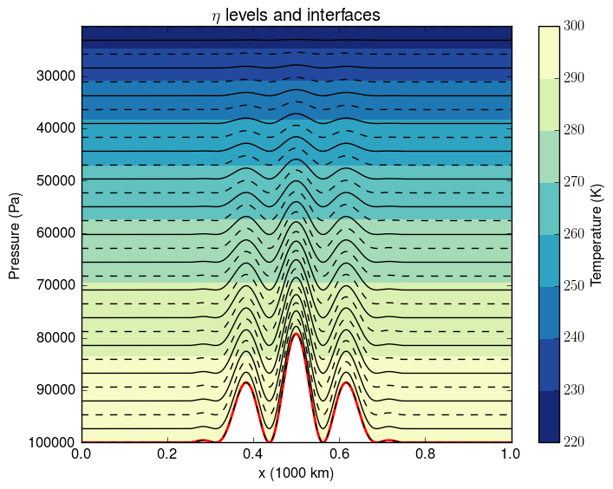
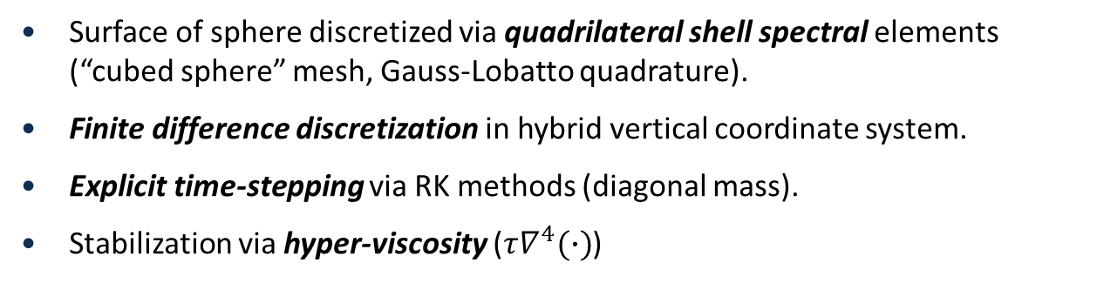
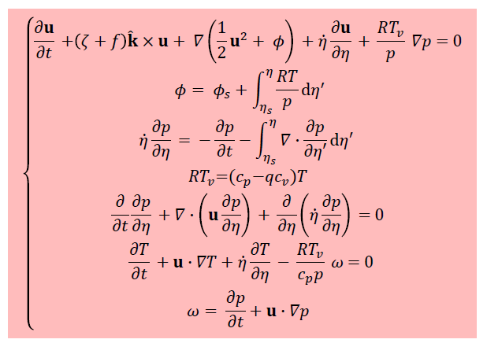
3D Hydrostatic Atmosphere Model
3D hydrostatic equations for atmosphere: Navier-Stokes-like model derived under hydrostatic fluid assumptions.
Surface of sphere discretized via quadrilateral shell spectral elements (“cubed sphere” mesh, Gauss-Lobatto quadrature).
Finite difference discretization in hybrid vertical coordinate system.
Explicit time-stepping via RK methods (diagonal mass).
Stabilization via hyper-viscosity ($τ∇^{4}(∙)$)

Slide 21
3D Hydrostatic Atmosphere Model
3D hydrostatic equations for atmosphere: Navier-Stokes-like model derived under hydrostatic fluid assumptions.
Explicit: FEA is 99% CPU-time
+ X parallelization over cells, nodes and levels.
Runs performed on Ride cluster at Sandia.
Surface of sphere discretized via quadrilateral shell spectral elements (“cubed sphere” mesh, Gauss-Lobatto quadrature).
Finite difference discretization in hybrid vertical coordinate system.
Explicit time-stepping via RK methods (diagonal mass).
Stabilization via hyper-viscosity ($τ∇^{4}(∙)$)

Slide 22
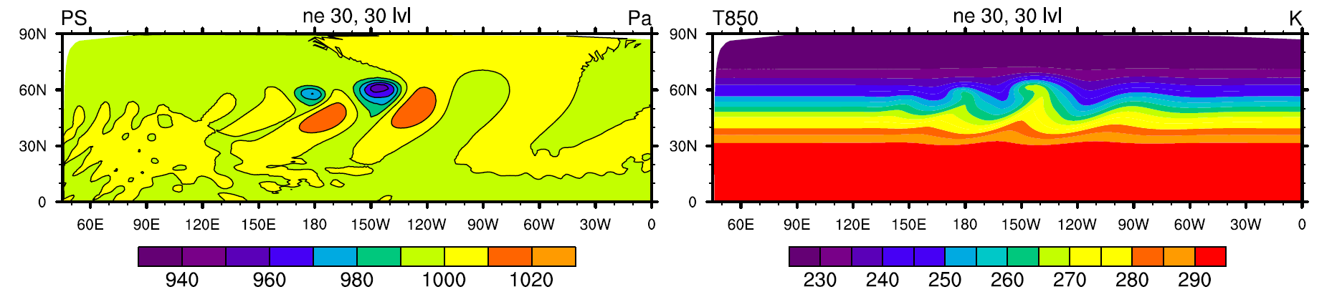
Baroclinic Instability Test Case
Meshes/parameters considered:
Mesh | Resolution | # Elements | Fixed dt | Hyperviscosity Tau
uniform_30 | 1° | 5,400 | 30 | 5.0e15
uniform_60 | 0.5° | 21,600 | 10 | 1.09e14
uniform_120 | 0.25° | 86,400 | 5 | 1.18e13
100 explicit RK4 iterations, 3rd order elements, 10 levels

Slide 23
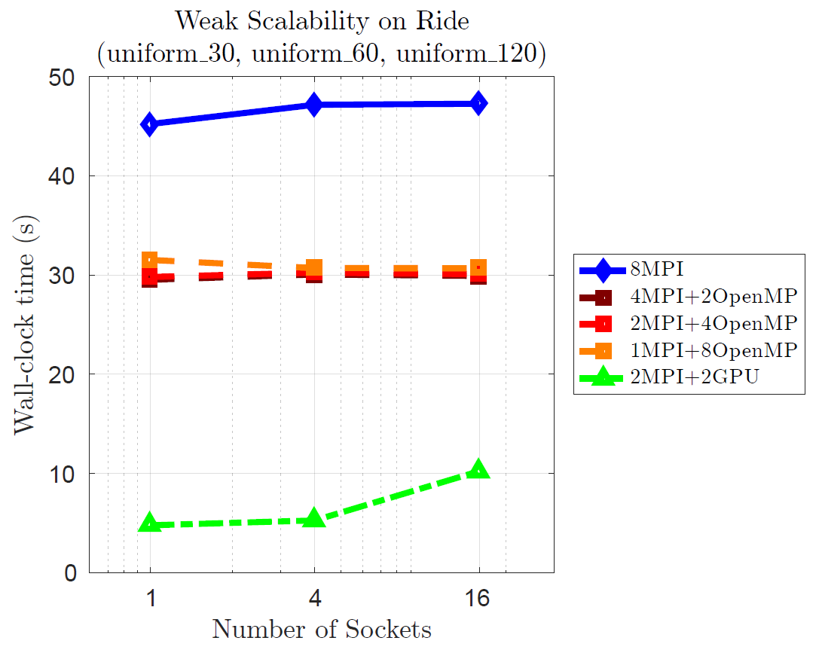
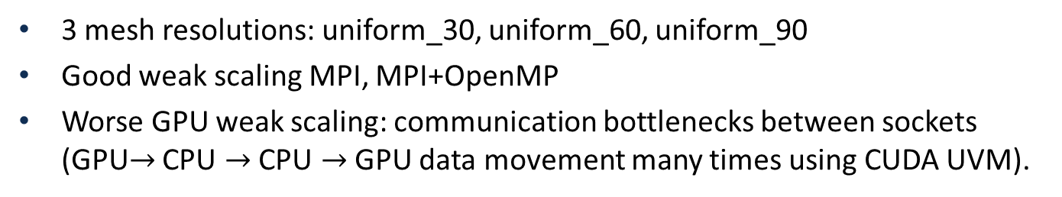
Weak Scalability (FEA)
Ride
Ride:
12 nodes (2 sockets/node)
8 Power8 cores/socket
2 P100 GPUs/socket
16GB/GPU
3 mesh resolutions: uniform_30, uniform_60, uniform_90
Good weak scaling MPI, MPI+OpenMP
Worse GPU weak scaling: communication bottlenecks between sockets (GPU$→$ CPU $→$CPU $→$GPU data movement many times using CUDA UVM).

Slide 24
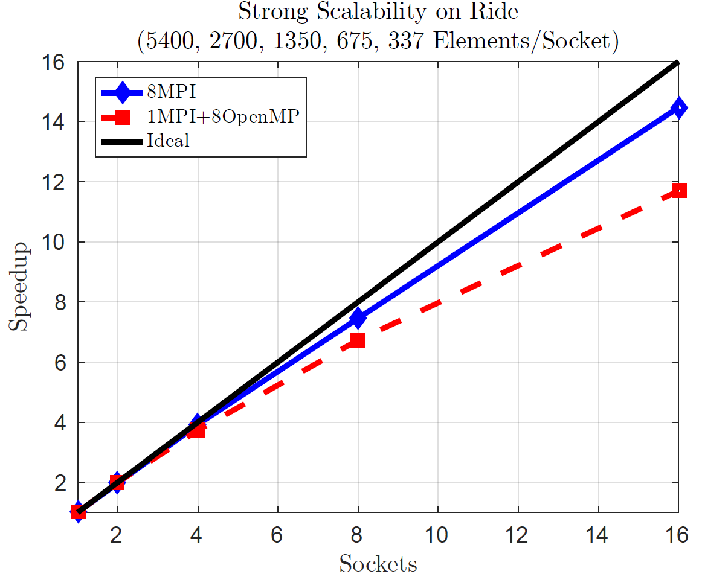
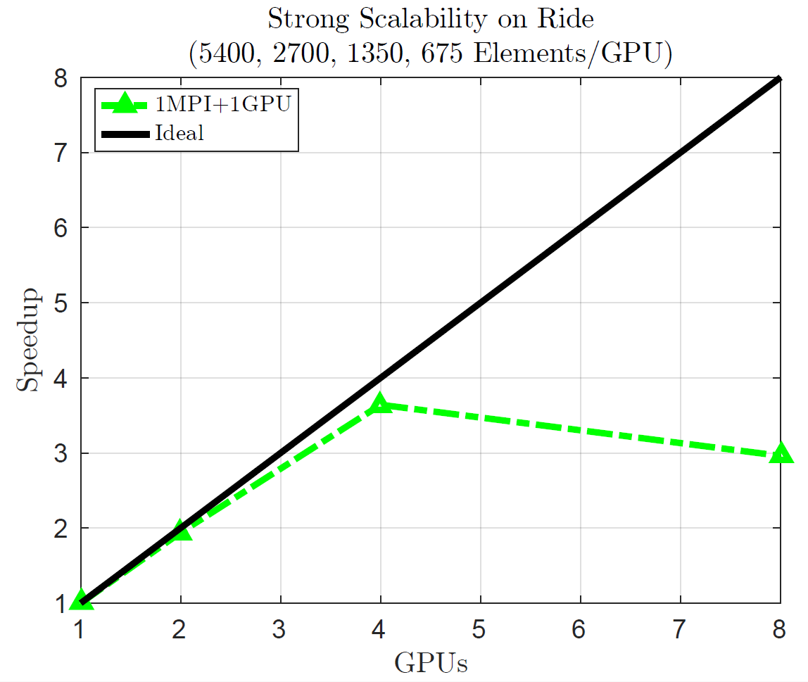
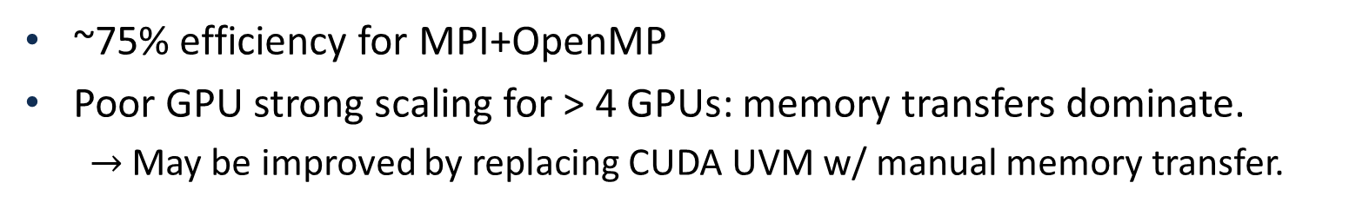
Strong Scalability (FEA)
GPU memory limit: 5400 elements/GPU
~75% efficiency for MPI+OpenMP
Poor GPU strong scaling for > 4 GPUs: memory transfers dominate.
  $→$May be improved by replacing CUDA UVM w/ manual memory transfer.

Slide 25











FELIX Land-Ice Solver & PISCEES Project
FSU FELIX
FSU
Finite Element
Full Stokes Model
PISCEES*
SciDaC Application Partnership
(DOE’s BER + ASCR divisions)
2012-2017
3 land-ice dycores developed under PISCEES
Albany/FELIX**
SNL
Finite Element
“First Order” Stokes Model
Increased fidelity
BISICLES
LBNL
Finite Volume
L1L2 Model
Goal: support DOE climate missions (sea-level rise predictions)
*Predicting Ice Sheet Climate & Evolution at Extreme Scales.
**Finite Elements for Land Ice eXperiments
Multi-lab/multi-university project involving mathematicians, climate scientists, and computer scientists.
Leverages software/expertise from SciDAC Institutes (FASTMath, QUEST, SUPER) and hardware from DOE Leadership Class Facilities.
25

Slide 26
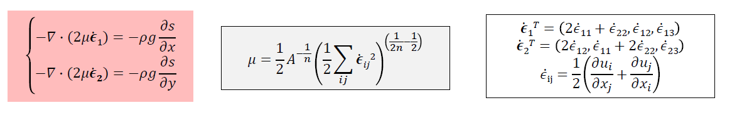
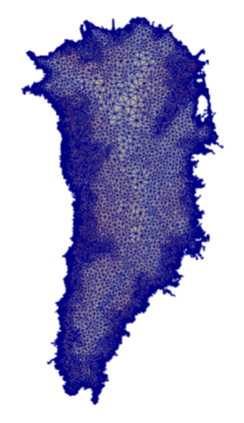
First-Order Stokes Land-Ice Model
Ice velocities given by the “First-Order” Stokes PDEs with nonlinear viscosity:
3D unstructured grid FEM discretization.
Newton method nonlinear solver with automatic differentiaton Jacobians.
Algebraic-multigrid* preconditioned Krylov linear solvers.
Advanced analysis capabilities: deterministic inversion, calibration, UQ.
As part of ACME DOE ESM, FELIX will be used to provide actionable predictions of 21st century sea-level rise.
* Previous talk by Ray Tuminaro.

Slide 27
First-Order Stokes Land-Ice Model
Ice velocities given by the “First-Order” Stokes PDEs with nonlinear viscosity:
3D unstructured grid FEM discretization.
Newton method nonlinear solver with automatic differentiaton Jacobians.
Algebraic-multigrid* preconditioned Krylov linear solvers.
Advanced analysis capabilities: deterministic inversion, calibration, UQ.
As part of ACME DOE ESM, FELIX will be used to provide actionable predictions of 21st century sea-level rise.
Implicit: FEA is 50% CPU-time
+ X parallelization over cells only.
Runs performed on Shannon cluster at Sandia and Titan supercomputer
* Previous talk by Ray Tuminaro.

Slide 28
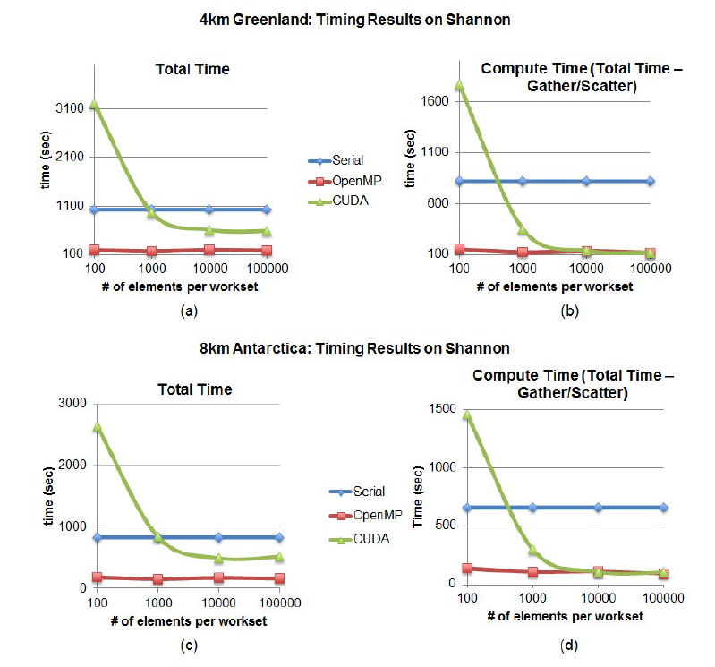
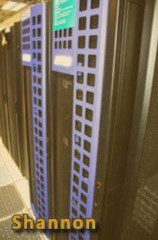
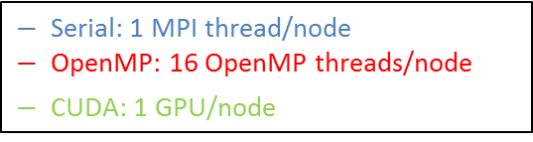
4km Greenland & 8km Antarctica on Shannon
4km Greenland
Shannon: 32 nodes
2 8-core Sandy Bridge Xeon E5-2670 @ 2.6GHz (HT deactivated)/node.
128GB DDR3 memory/node
2x NVIDIA K20x/node.
Total FEA Time
FEA Time – Gather/Scatter
8km Antarctica
Total FEA Time
FEA Time – Gather/Scatter
Max speedup over Serial for workset size > 1000
 | OpenMP | CUDA
Total FEA Time | 5.6x | 1.7x
FEA Time – Gather/Scatter | 7.2x | 6.7x
  “# of elements/workset” = threading index (allows for on-node parallelism)
1

Slide 29
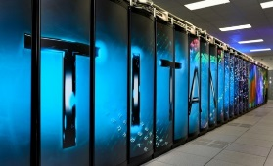
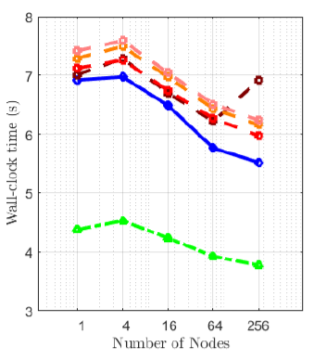
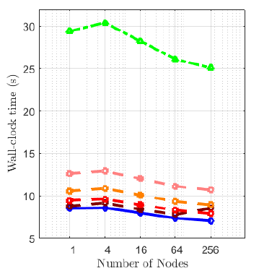
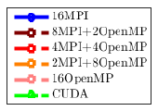
Greenland Weak Scalability on Titan
Weak scalability on Titan (16km, 8km, 4km, 2km, 1km Greenland)
Wall-clock Time: FEA
Wall-clock Time:
Total Time – Setup Time
Titan: 18,688 AMD Opteron nodes
16 cores per node
1 K20X Kepler GPUs/ node
32GB + 6GB memory/ node

Slide 30
Summary/Conclusions
A performance portable implementation of the Aeras next-generation global atmosphere model and FELIX land-ice model was created using Kokkos within the Albany code base.
With this implementation, the same code can run on devices with drastically different memory models (many-core CPU, NVIDIA GPU, Intel Xeon Phi, etc.).
Heterogeneous HPC architectures can now be utilized for climate research in Aeras and FELIX.
Performance studies show that further optimization is needed to fully utilize all resources.
More on performance-portability of Albany using Kokkos can be found here: https://github.com/gahansen/Albany/wiki/Albany-performance-on-next-generation-platforms

Slide 31
Ongoing/Future Work
Profiling using TAU and nvprof.
Methods for improving performance:
  Reduce excess memory usage.
  Utilize shared memory.
  Replace CUDA UVM with manual memory transfer.
  Improve performance of other sections of code besides FEA.
  Parallelize over nodes and quadrature points in addition to cells for FELIX.
Performance-portability of preconditioned iterative linear solve using Kokkos for implicit problems in Albany (e.g., FELIX).
Journal article on this work in preparation:
I. Demeshko, W. Spotz, J. Watkins, I. Tezaur, O. Guba, A. Salinger, R. Pawlowski, M. Heroux. "Towards performance-portability of the Albany finite element analysis code using the Kokkos library", J. HPC Appl. (in preparation).

Slide 32
Appendix: Parallelism on Modern Hardware
Year | Memory Access Time | Single Core Cycle Time
1980s | ~100 ns | ~100 ns
Today | ~50-100 ns | ~1 ns
Memory access time has remained the same.
Single core performance has improved but stagnated.
Computations are cheap, memory transfer is expensive.
More performance from multicore/manycore processors.

Slide 33
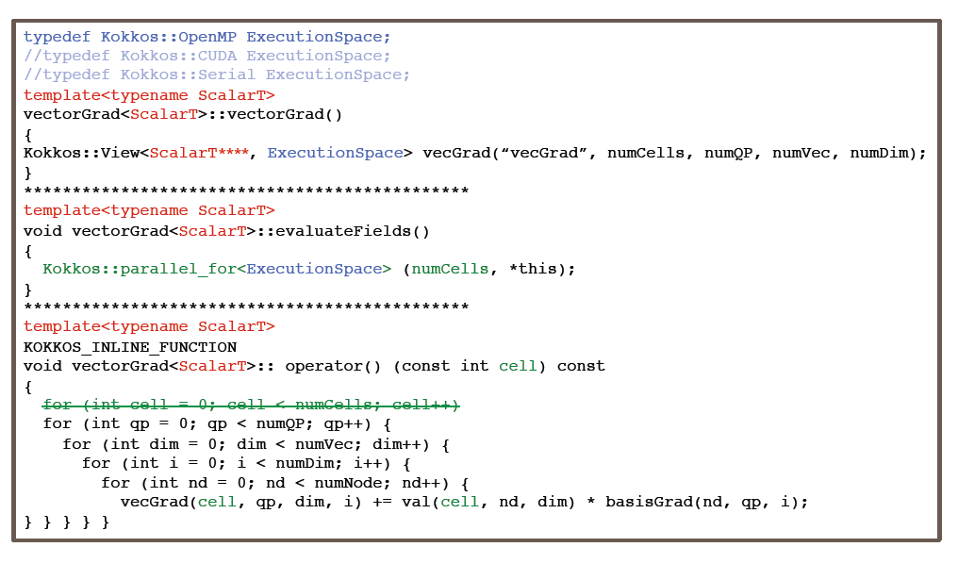
Appendix: Kokkos-ification of Finite Element Assembly (Example)
ExecutionSpace parameter tailors code for device (e.g., OpenMP, CUDA, etc.)

Slide 34
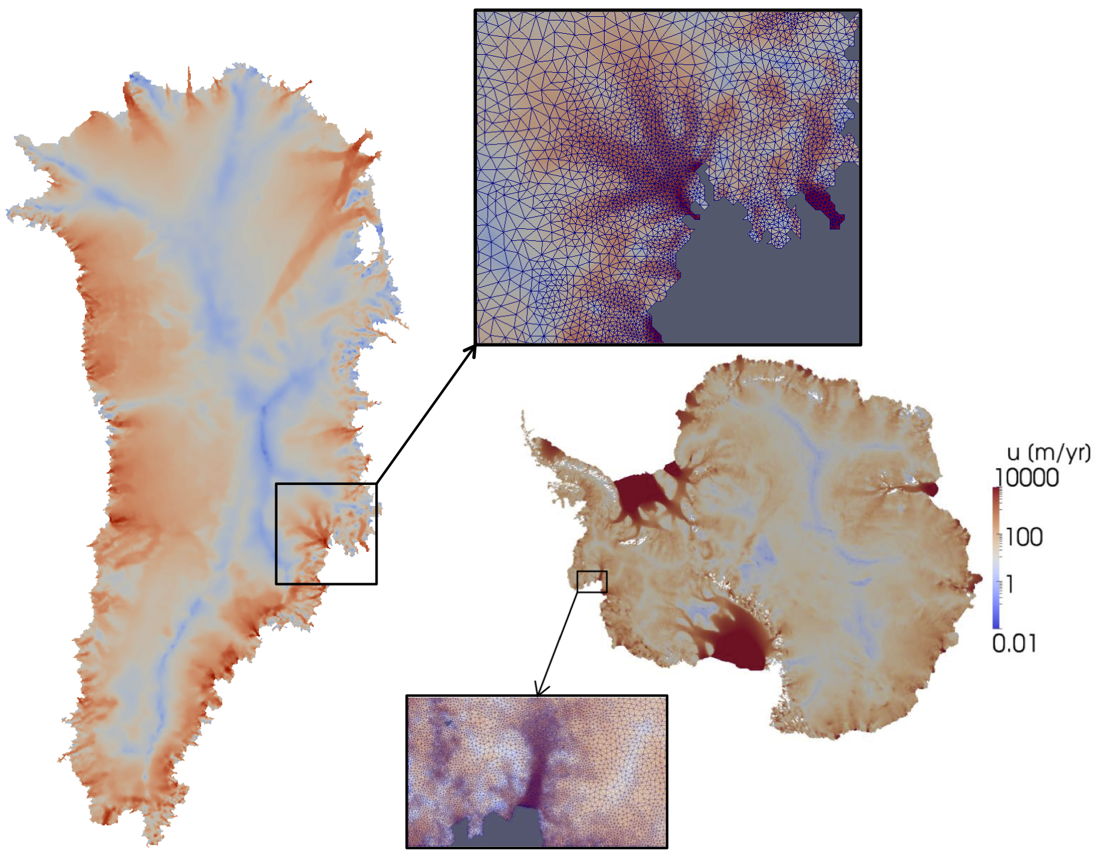

Appendix: PISCEES Land-Ice Project
Requirements for Albany/FELIX:
  Unstructured grid finite elements.
  Verified, scalable, fast, robust
  Portable to new/emerging architecture machines (multi-core, many-core, GPU)
  Advanced analysis capabilities: deterministic inversion, calibration, uncertainty quantification.
As part of ACME DOE earth system model, solver will provide actionable predictions of 21st century sea-level rise (including uncertainty).
*Finite Elements for Land Ice eXperiments
34
Notes:
Sandia’s role in PISCEES

