Slide 1
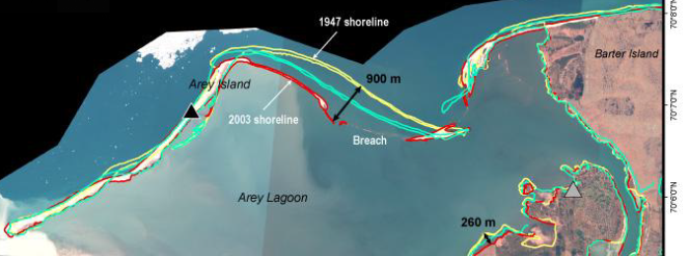
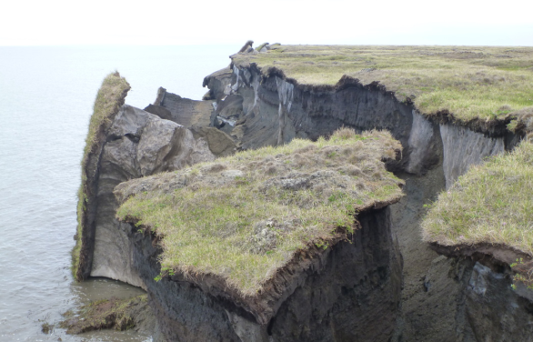
Development of a strongly-coupled thermo-mechanical model of permafrost for the simulation of Arctic coastal erosion d
Alejandro Mota, Jenn Frederick, Charles Choens, Diana Bull, Irina Tezaur g
Sandia National Laboratories, U.S.A.
Climate Modeling Seminar
SAND2020-5151C
Sandia National Laboratories, June 24, 2020

Slide 2
Outline
Motivation and background
The Arctic Coastal Erosion (ACE) project
Thermo-mechanical finite element model of permafrost
Numerical results
Summary
Ongoing/future work

Slide 3
Outline
Motivation and background
The Arctic Coastal Erosion (ACE) project
Thermo-mechanical finite element model of permafrost
Numerical results
Summary
Ongoing/future work

Slide 4
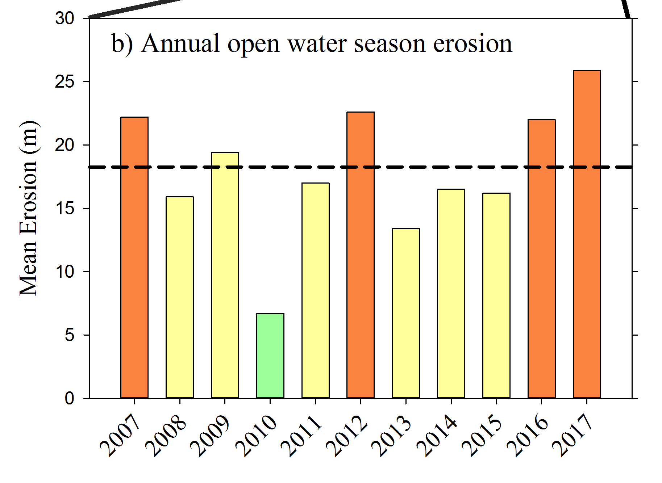
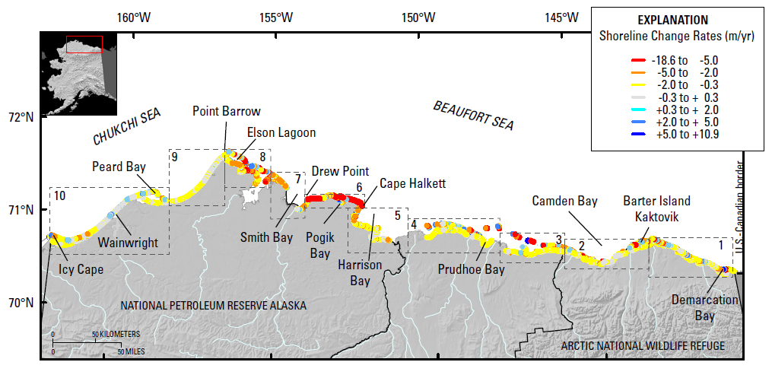
Motivation
The Arctic is warming at 2-3 times the rate of the rest of the U.S. resulting in accelerated rates of coastal erosion!
~200 m (~2 football fields in length) in a decade!
Since 1979 sea-ice has lost 51% in area and 75% in volume
  Increasing ice-free season
  Increasing wave energy and storm surge
Increasing sea water temperatures
Warming permafrost
  Coastal erosion rates in Alaskan Arctic among the highest in the world and accelerating.
Active DOD sites
Erosion is threatening:
  Coastal communities
  Coastal infrastructure
  Global carbon balance
Barrow
Wainwright
Oliktok
Barter Island
Bullen Point
Gibbs & Richmond, 2015.
4

Slide 5
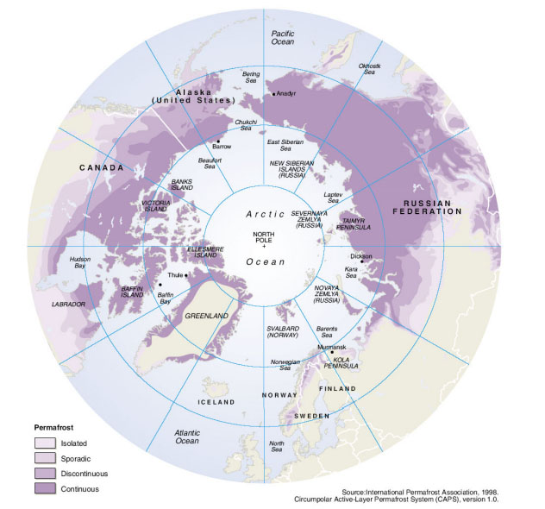
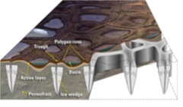
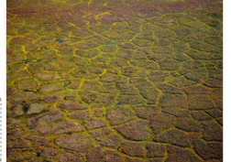
Permafrost erosion
What is permafrost?
Ground that remains frozen for 2 or more consecutive years.
Comprised of soil, rock, silt, clay and sand, held together by ice.
24% of ice-free land area in Northern Hemisphere and 85% of Alaska, Greenland, Canada and Siberia sits on top of permafrost.
Left: schematic illustrating formation of ice wedges and ice-wedge polygon landscapes. Right: map of permafrost distribution in Arctic
Brown et al. 1998.
Unique coastal permafrost erosion process in Arctic:
Predominant geomorphology: ice-wedge polygons
  Ice acts to bind unconsolidated soils in permafrost forming ice wedges.
  Ice wedges grow/expand up to ms wide and 10s meters deep.
Melting ice causes permafrost failure.
  Storm surges accelerate ice melt by delivering heat to ice/permafrost*.
Martin et al. 2009.
* Thermo-abrasion: permafrost material is warmed by ocean and removed by mechanical action of waves.

Slide 6
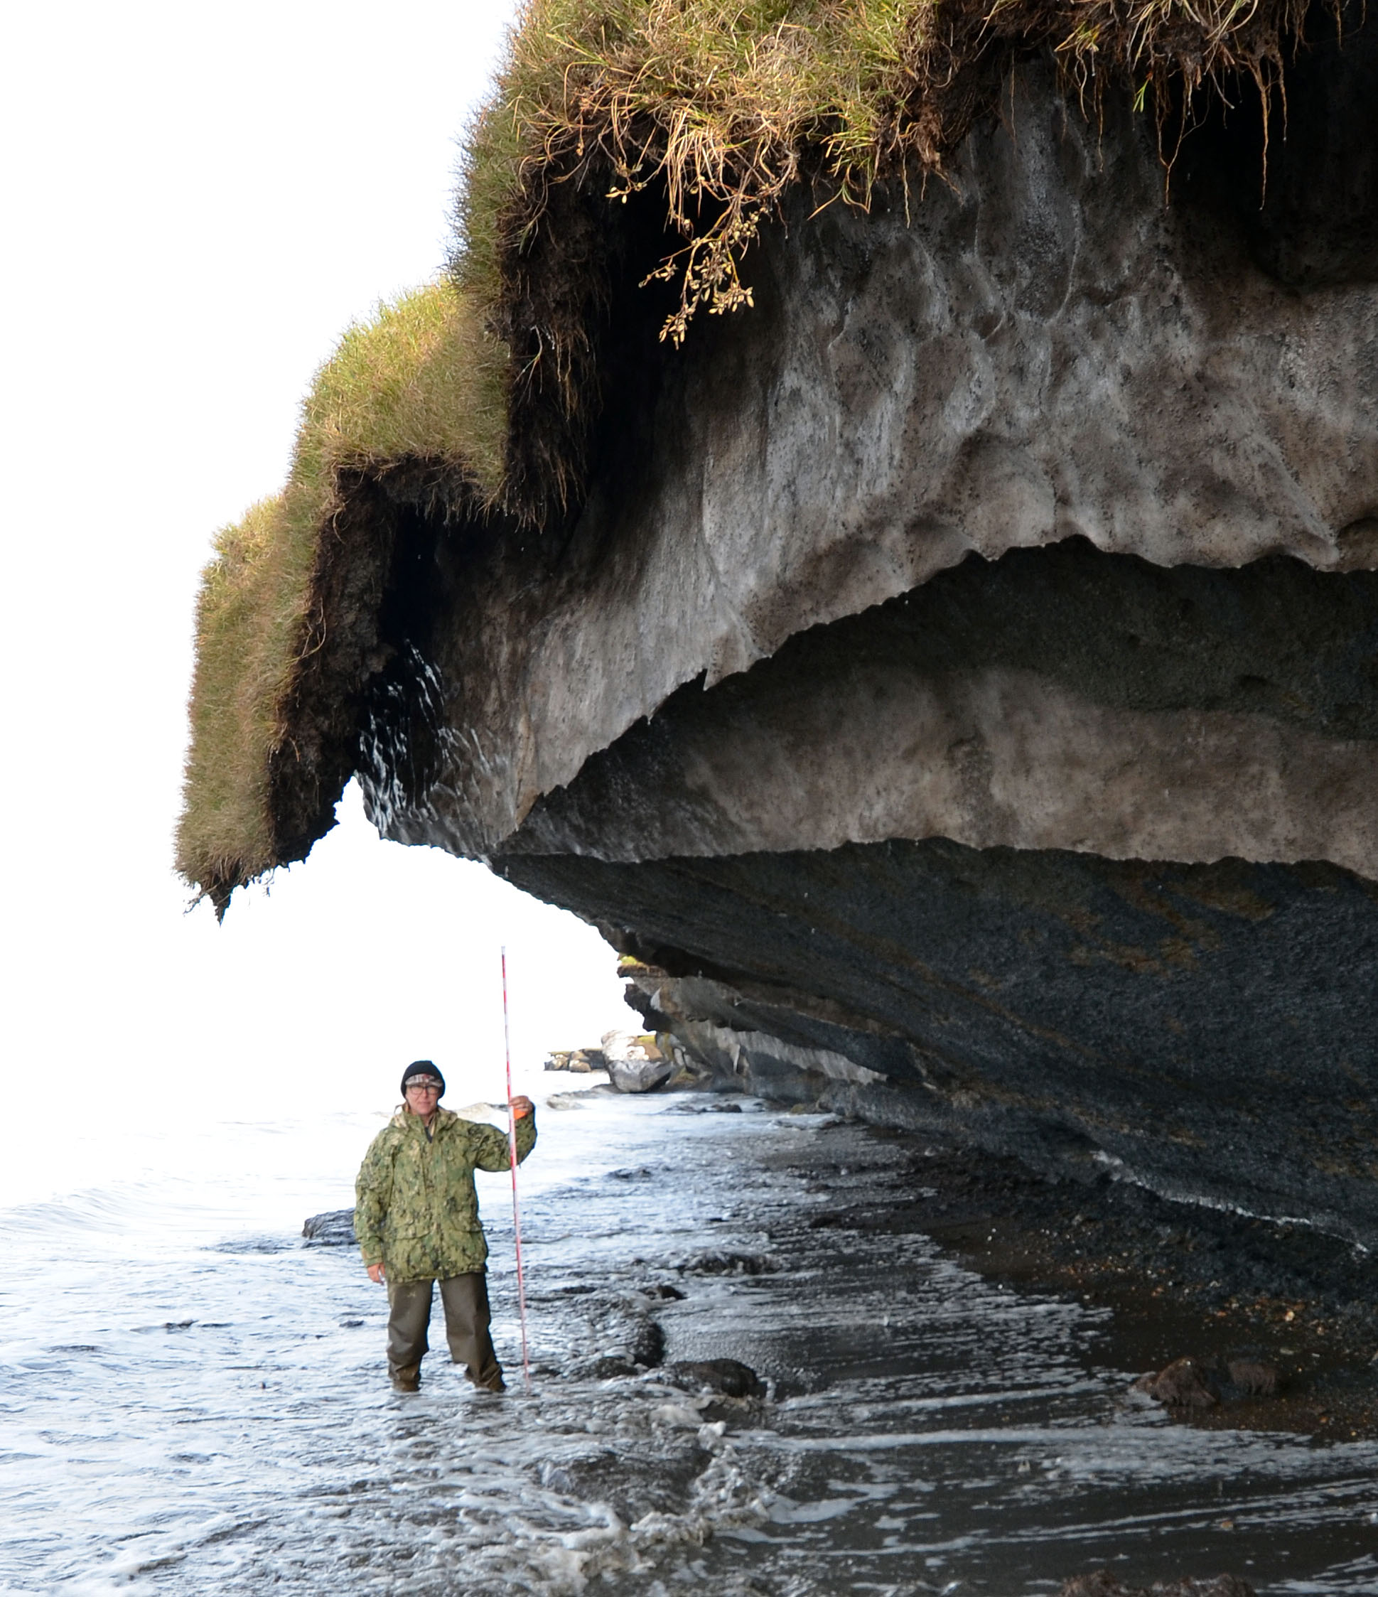
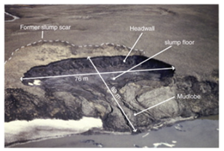
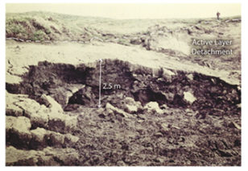
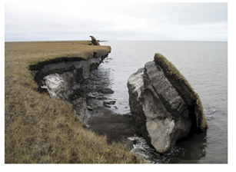
Permafrost failure mechanisms
Retrogressive thaw slumping: a slope failure characterized by thaw of exposed ground ice and slumping of thawed soil, typically caused by thermo-denundation*.
Active layer detachment: failures are translational landslides that occur in summer in thawing soil overlying permafrost, typically caused by thermo-denundation*.
Block failure: a niche (recess at bluff base) progresses landward until the overhanging material fails in a shearing or toppling mode known as block failure.
  Fallen blocks can disintegrate in the near-shore environment within 1-2 weeks!
Lantuit et al. 2008
Lantuit et al. 2008
Ravens et al. 2012
Retrogressive thaw slumping
Active layer detachment
Block failure
* Subaerial erosion triggered by thawing of permafrost bluffs that proceeds under the influence of gravity.
6

Slide 7
Permafrost failure mechanisms
Retrogressive thaw slumping: a slope failure characterized by thaw of exposed ground ice and slumping of thawed soil, typically caused by thermo-denundation*.
Active layer detachment: failures are translational landslides that occur in summer in thawing soil overlying permafrost, typically caused by thermo-denundation*.
Block failure: a niche (recess at bluff base) progresses landward until the overhanging material fails in a shearing or toppling mode known as block failure.
  Fallen blocks can disintegrate in the near-shore environment within 1-2 weeks!
Dominant failure mechanism in northern Alaska
Lantuit et al. 2008
Lantuit et al. 2008
Ravens et al. 2012
Retrogressive thaw slumping
Active layer detachment
Block failure
* Subaerial erosion triggered by thawing of permafrost bluffs that proceeds under the influence of gravity.
7

Slide 8
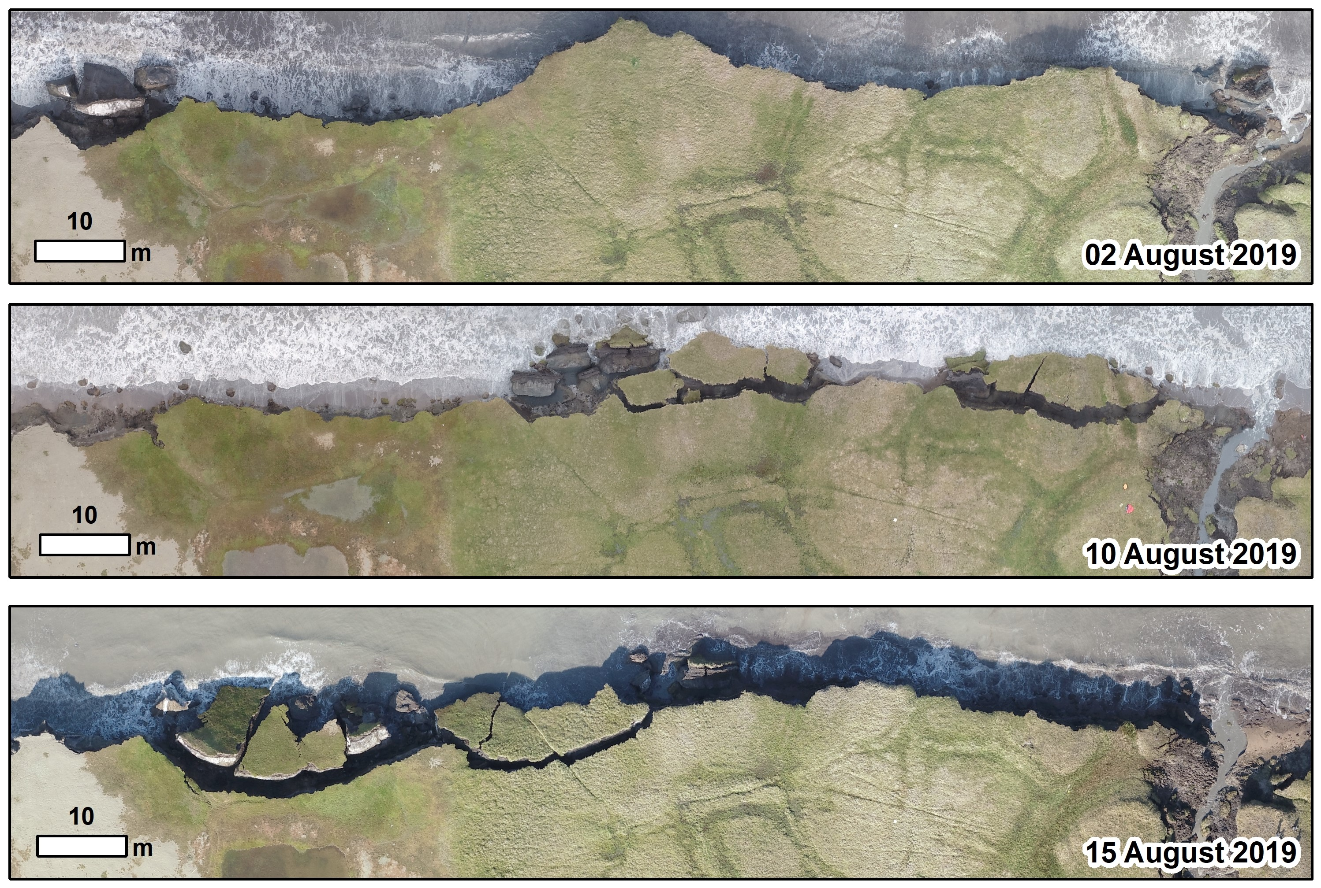
Example of bluff erosion during 2019 UAV surveys*
  Fallen blocks can disintegrate in near-shore environment within 1-2 weeks!
*Images courtesy of Ben Jones, UAF
8

Slide 9
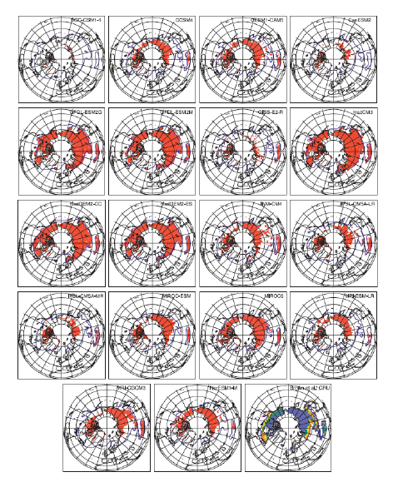
State-of-the-art in permafrost modeling
When this project began in 2017, tools to accurately predict Arctic coastal erosion did not exist!
Existing models* are primitive: trend projection, empirical relationships, 1D steady state heat flow,…
  Primarily thermal models (no mechanics/deformation)
  Most models assume particular type of erosion (e.g. block failure)
Efforts have been put towards integrating permafrost models into earth system models (ESMs): CLM, VAMPERS, CryoGrid3, ...
Modeling typically estimates BCs and does not account for geomorphologies or geophysics.
Comprehensive understanding of erosion dynamics in the Arctic has not yet emerged.
Koven et al. 2013
To obtain an accurate, predictive Arctic coastal erosion model, a coupling of the influences of evolving wave dynamics, thermodynamics and mechanics must be developed.
* See (Frederick et al. 2016), Chapter 5, for extensive overview.

Slide 10
Outline
Motivation and background
The Arctic Coastal Erosion (ACE) project
Thermo-mechanical finite element model of permafrost
Numerical results
Summary
Ongoing/future work

Slide 11

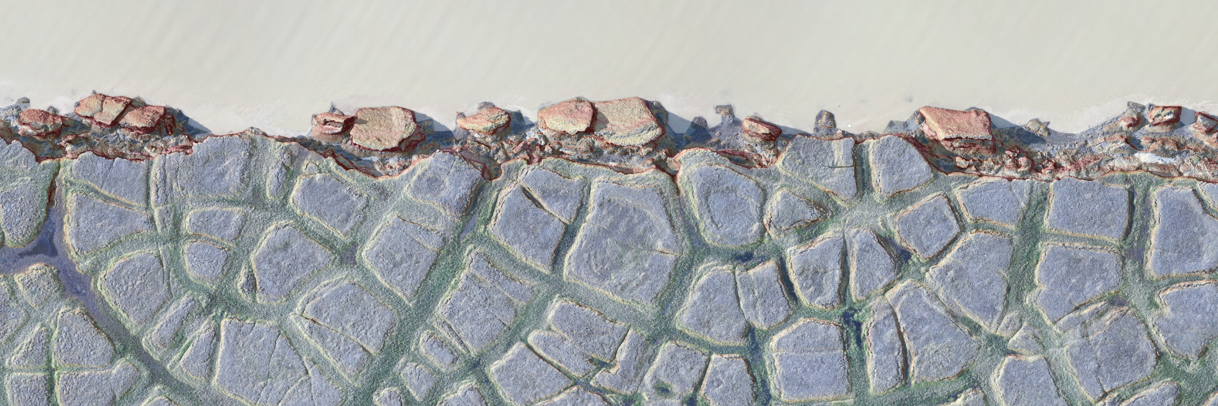
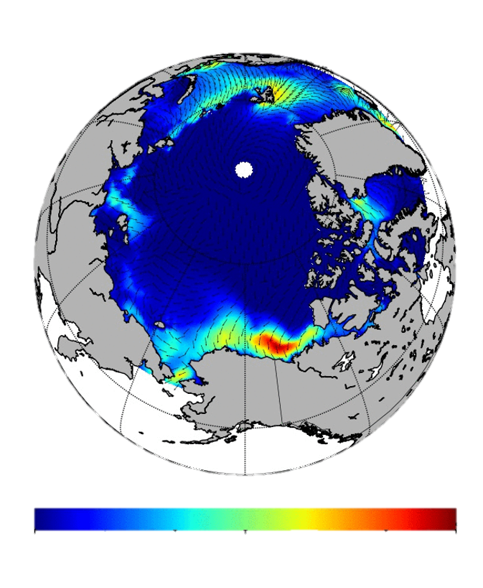
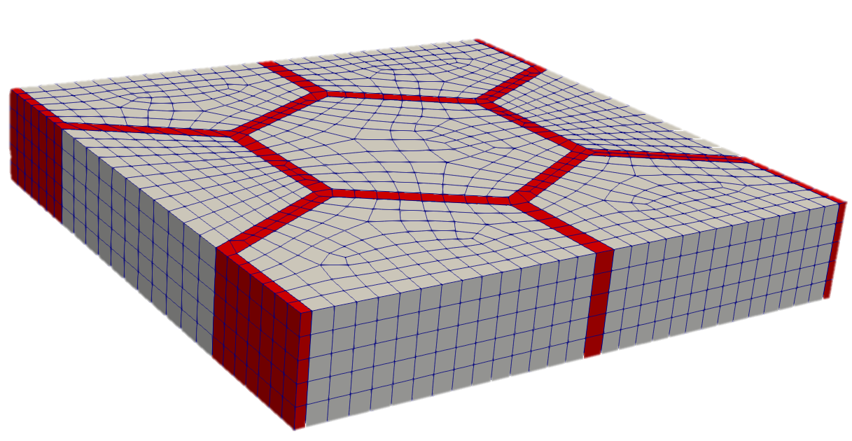

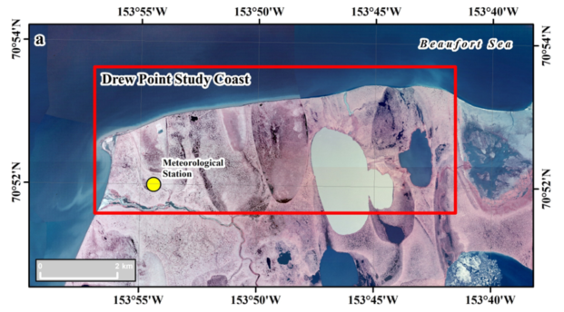
Proposed solution
Goal of the Arctic Coastal Erosion (ACE) project is to deliver a field-validated predictive model of thermo-abrasive erosion for the permafrost Arctic coastline
2018-2020
Multi-physics finite element model of an archetype of the coastline coupled with high-fidelity model of storm intensities
  Input variables define geomorphology & geophysics
  Plastic deformation model of material (J2 class)
  Geomechanical testing to determine coupled thermal-mechanical strength characteristics
  Time-varying ocean BCs (water level, temp, salinity)
  Eroded sediment and biogeochemical flux tracking
This talk
field measurements
Micro-scale Model
oceanographic model
10’s of meters & storm duration
thermo-chemical-mechanical terrestrial model
30m
5m
30m
Significant Wave Height (m)
0.0 0.5 1.0 1.5 2.0 2.5 3.0
ocean water
July 23rd 2017. 6am.
Ice wedge
WW3 polar stereographic model initially developed by NRL (Erick Rogers) and NOAA (Arun Chawla)
Permafrost
A “catalog” of micro-scale models that represent the statistical distributions of input variables along a ~10km stretch of coastline.
  Probability distribution functions of geomorphology and geophysics used to weight erosion output
    Will validate approach with decade long annual measurements at Drew Point.
  Evaluating ocean “exposure metrics” to represent time-varying ocean
2021+
Meso-scale Model
10’s of km’s & seasonal duration

Slide 12


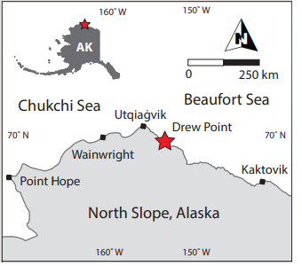


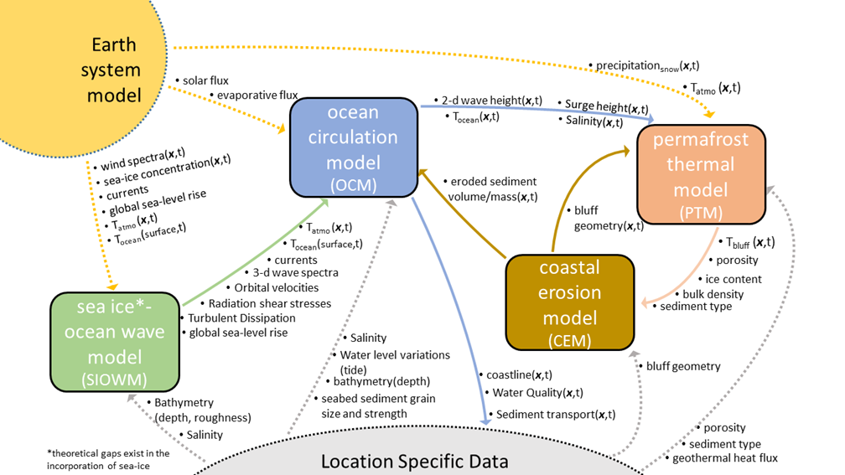
ACE Model Component Coupling
ACE project has many pieces!
Terrestrial model: thermo-mechanical coupled FEM model that can simulate transient niche development.
Oceanographic model: WW3 + SWAN + Delft3D wave models for providing oceanic BCs (ocean temp/height) to terrestrial model.
Geomechanical testing: for characterization of permafrost parameters in terrestrial model.
Field campaign: offshore oceanographic measurements, bathymetric survey, niche measurements, etc.
(Drew Point, Alaska)

Slide 13
ACE Model Component Coupling
ACE project has many pieces!
Terrestrial model: thermo-mechanical coupled FEM model that can simulate transient niche development.
Oceanographic model: WW3 + SWAN + Delft3D wave models for providing oceanic BCs (ocean temp/height) to terrestrial model.
Geomechanical testing: for characterization of permafrost parameters in terrestrial model.
Field campaign: offshore oceanographic measurements, bathymetric survey, niche measurements, etc.
This talk
(Drew Point, Alaska)

Slide 14
Outline
Motivation and background
The Arctic Coastal Erosion (ACE) project
Thermo-mechanical finite element model of permafrost
Numerical results
Summary
Ongoing/future work

Slide 15
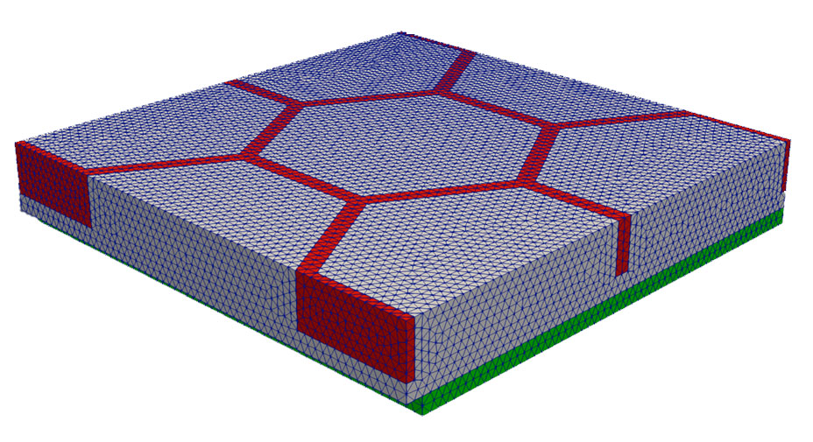
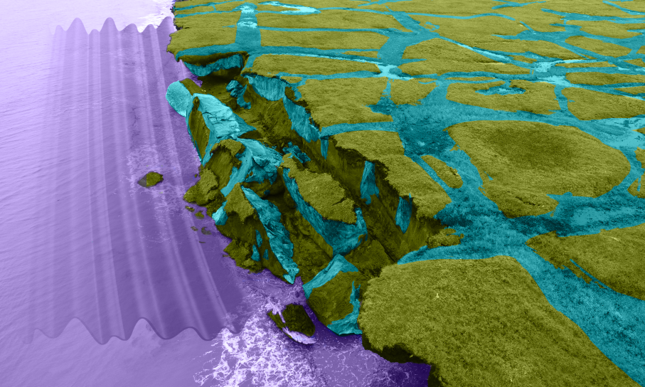
Anatomy of a canonical computational domain
Permafrost
30 m
30 m
Ice
Bluff face (exposed to ocean)
ocean water
5 m
Cryopeg*
* Layer of unfrozen ground that is perennially cryotic (forming part of the permafrost) in which freezing is prevented.

Slide 16
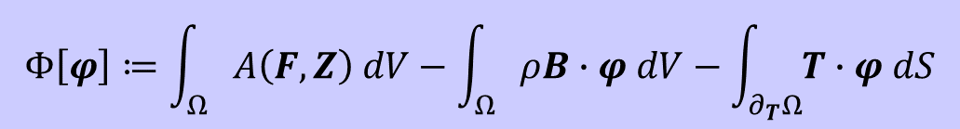
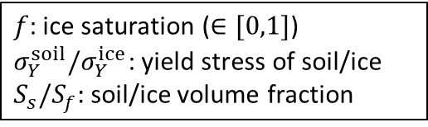
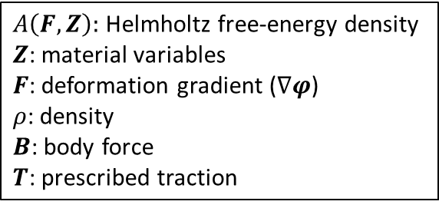
Mechanical model
Finite deformation variational formulation for solid mechanics problem obtained by minimizing the energy functional :
$A\left(F,Z\right):$ Helmholtz free-energy density
$Z$: material variables
$F$: deformation gradient ($∇φ$)
$ρ$: density
$B$: body force
$T$: prescribed traction
$$Φ\left[φ\right]≔\int_{Ω}{A\left(F,Z\right) dV−\int_{Ω}{ρB∙φ dV−\int_{∂_{T}Ω}{T∙φ dS}}}$$
Computes displacements and new computational geometry (following erosion)
J2 plasticity extended to large-deformation regime constitutive model for ice and permafrost
  Incorporates all mechanisms that lead to deformation, plastic flow and creep of polycrystalline materials like ice; minimal calibration parameters; simplest material model w/ plastic behavior.
Symmetry BCs
Symmetry boundary conditions on lateral sides
Yield stress: $σ_{0}\left(T\right)≔S_{s}σ_{Y}^{soil}+S_{f}f(T)σ_{Y}^{ice}$
$f$: ice saturation ($∈[0,1]$)
$σ_{Y}^{soil}{/σ}_{Y}^{ice}$: yield stress of soil/ice
$S_{s}/S_{f}:$soil/ice volume fraction
Used in erosion failure criteria
Symmetry BCs

Slide 17
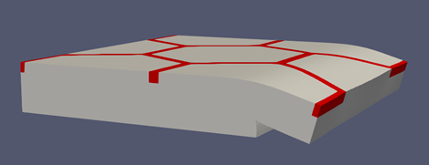
Erosion failure criteria
Erosion criterion: when material exposed to water reaches a critical exposure time.
Stress criterion: when material reaches a critical value of the yield stress.
Kinematic criterion: when material has tilted excessively, it is assumed to have fallen as part of block erosion.
Once failure criterion is reached, “failed” elements are removed from mesh.

Slide 18
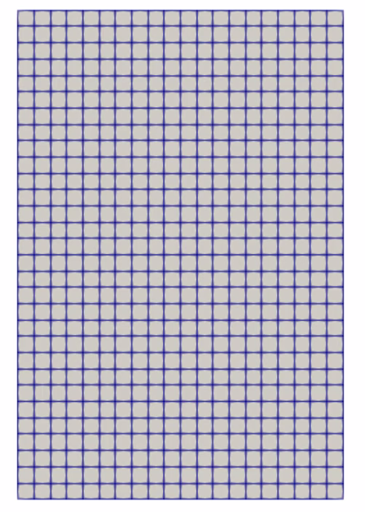
Erosion failure criteria
Erosion criterion: when material exposed to water reaches a critical exposure time.
Stress criterion: when material reaches a critical value of the yield stress.
Kinematic criterion: when material has tilted excessively, it is assumed to have fallen as part of block erosion.
Once failure criterion is reached, “failed” elements are removed from mesh.
Bluff face

Slide 19
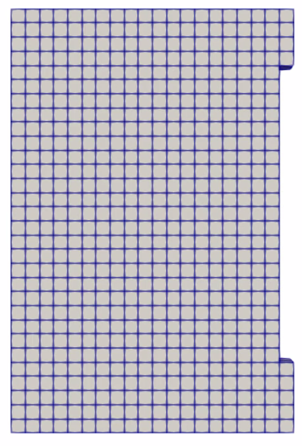
Erosion failure criteria
Erosion criterion: when material exposed to water reaches a critical exposure time.
Stress criterion: when material reaches a critical value of the yield stress.
Kinematic criterion: when material has tilted excessively, it is assumed to have fallen as part of block erosion.
Once failure criterion is reached, “failed” elements are removed from mesh.
Bluff face

Slide 20
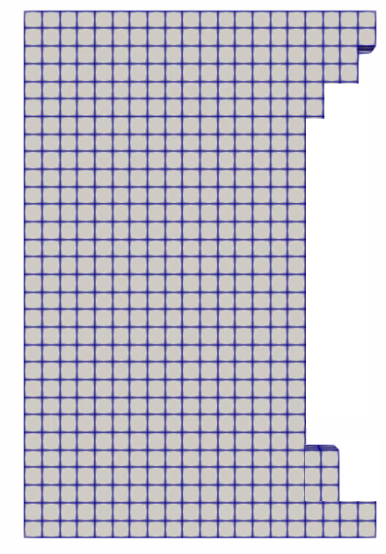
Erosion failure criteria
Erosion criterion: when material exposed to water reaches a critical exposure time.
Stress criterion: when material reaches a critical value of the yield stress.
Kinematic criterion: when material has tilted excessively, it is assumed to have fallen as part of block erosion.
Once failure criterion is reached, “failed” elements are removed from mesh.
Bluff face

Slide 21
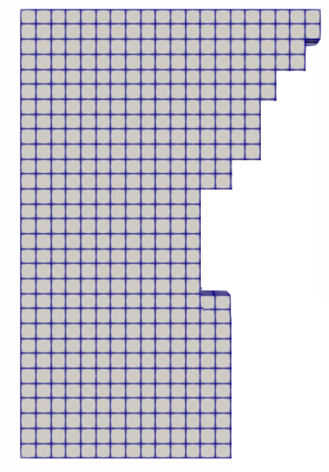
Erosion failure criteria
Erosion criterion: when material exposed to water reaches a critical exposure time.
Stress criterion: when material reaches a critical value of the yield stress.
Kinematic criterion: when material has tilted excessively, it is assumed to have fallen as part of block erosion.
Once failure criterion is reached, “failed” elements are removed from mesh.
Bluff face
Niche

Slide 22
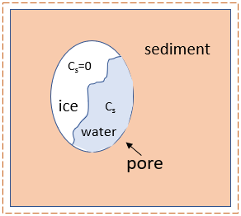
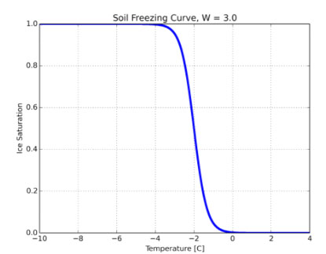

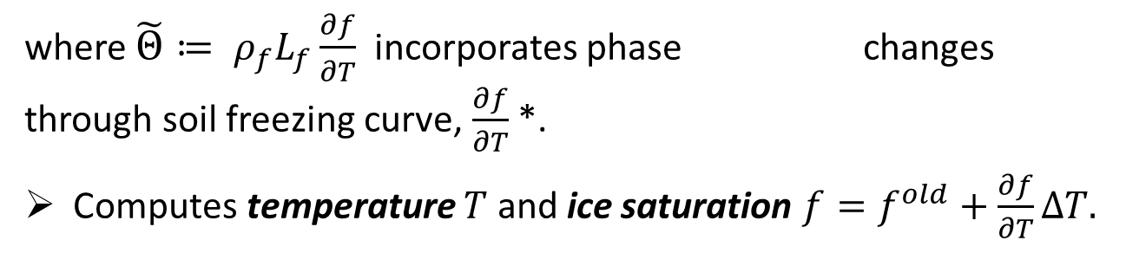
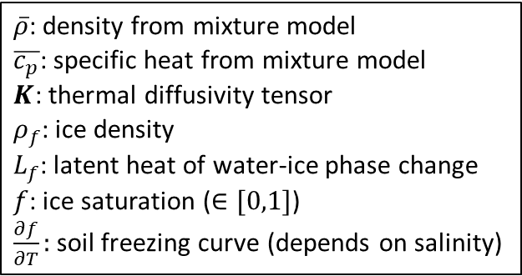
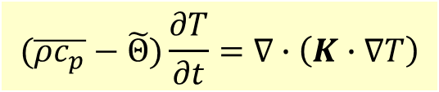
Thermal model
Transient heat conduction in a non-homogeneous porous media with water-ice phase change:
$\overline{ρ}$: density from mixture model
$\overline{c_{p}}$: specific heat from mixture model
$K$: thermal diffusivity tensor
$ρ_{f}$: ice density
$L_{f}$: latent heat of water-ice phase change
$f$: ice saturation ($∈[0,1]$)
$\frac{∂f}{∂T}:$soil freezing curve (depends on salinity)
$$(\overline{ρc_{p}}−\tilde{Θ})\frac{∂T}{∂t}=∇∙\left(K∙∇T\right)$$
where $\tilde{Θ}≔ ρ_{f}L_{f}\frac{∂f}{∂T}$ incorporates phase changes through soil freezing curve, $\frac{∂f}{∂T}$ *.
Computes temperature $T$ and ice saturation $f=f^{old}+\frac{∂f}{∂T}∆T.$
Permafrost control volume
Above
Soil freezing curve $\frac{∂f}{∂T}≠0$ only during phase change, which occurs in narrow temp zone (~-1C)
Boundary conditions (from wave model/data)
  Local geothermal heat flux from below
  Mean annual air temp from above
  Air/ocean temp at bluff face
Ice Saturation
Bluff face
Below
Temperature [C]
* Follows approach of (M. Ramos et al., 1996), (Z. Wang et al., 2011), etc: latent heat is energy source/sink for heat equation.

Slide 23
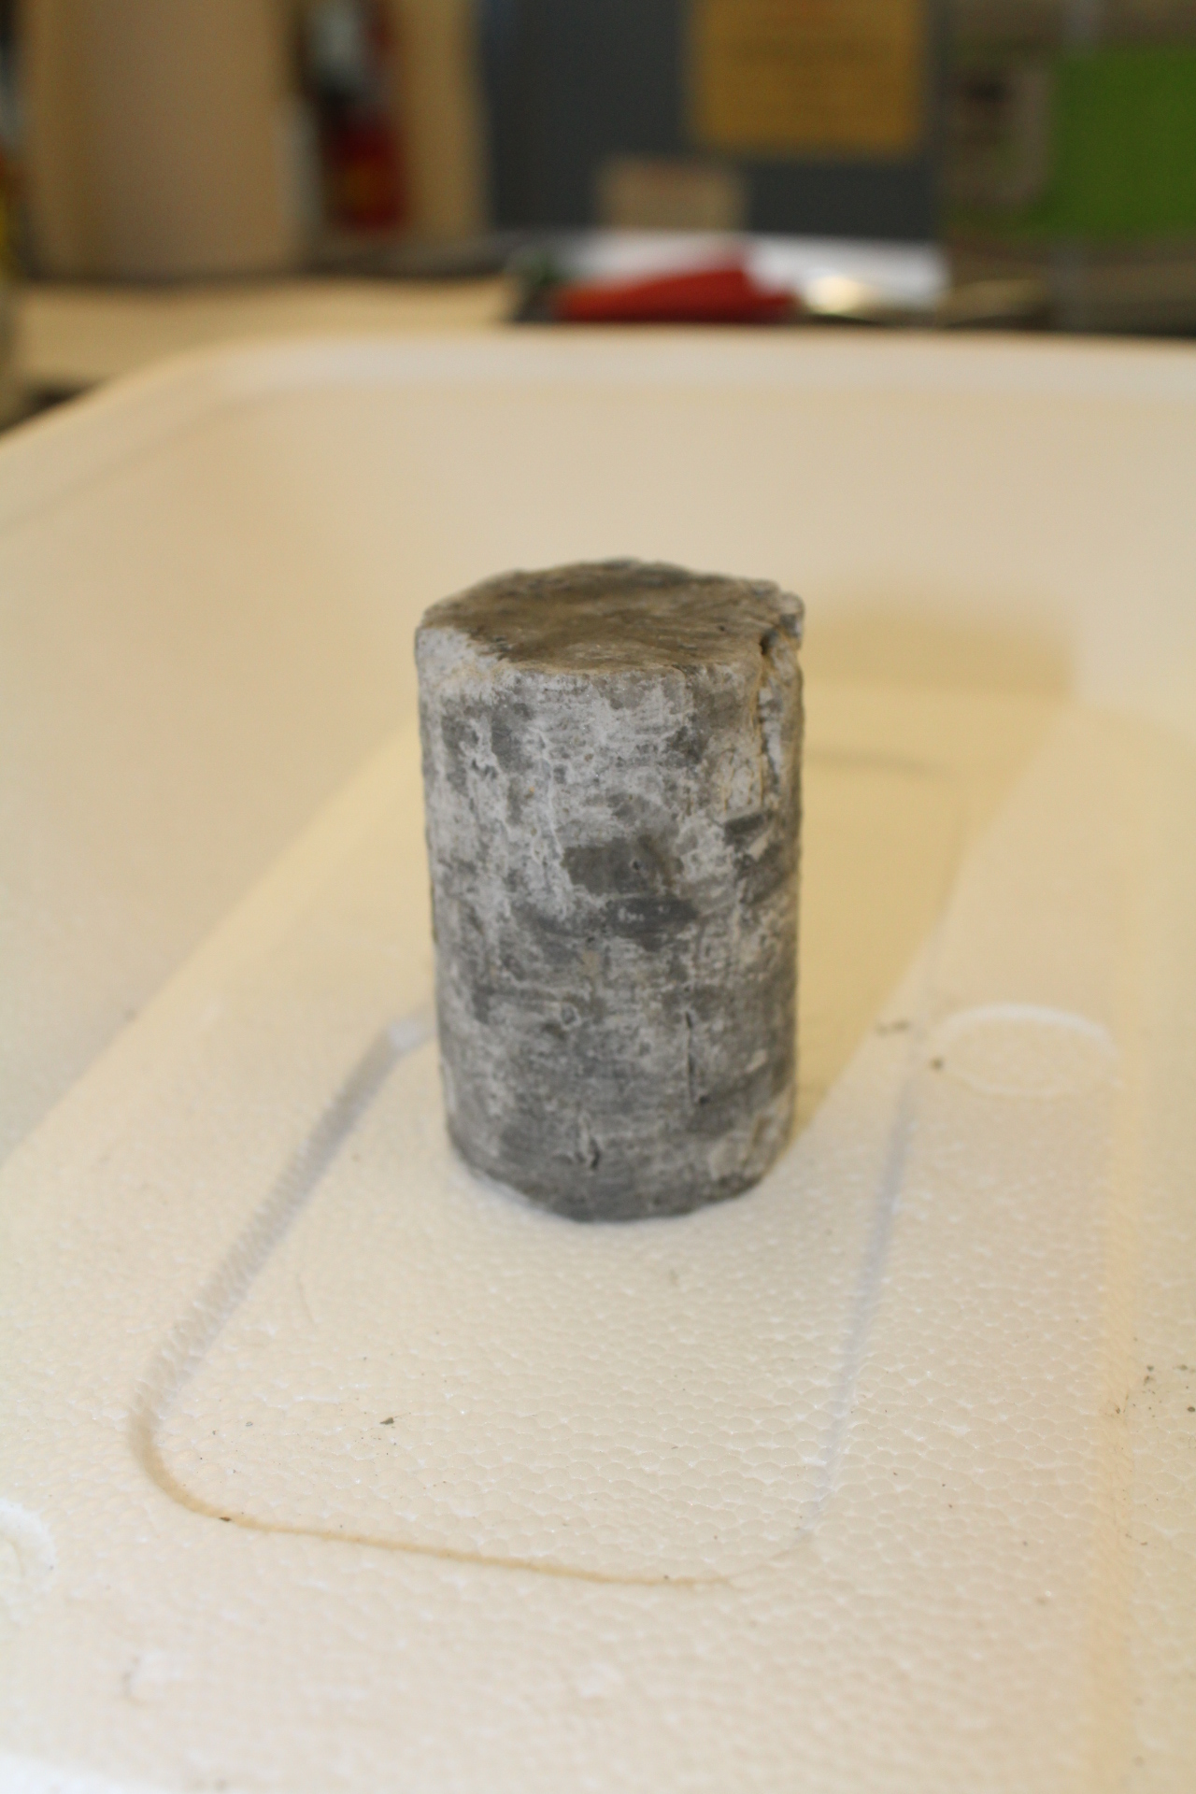
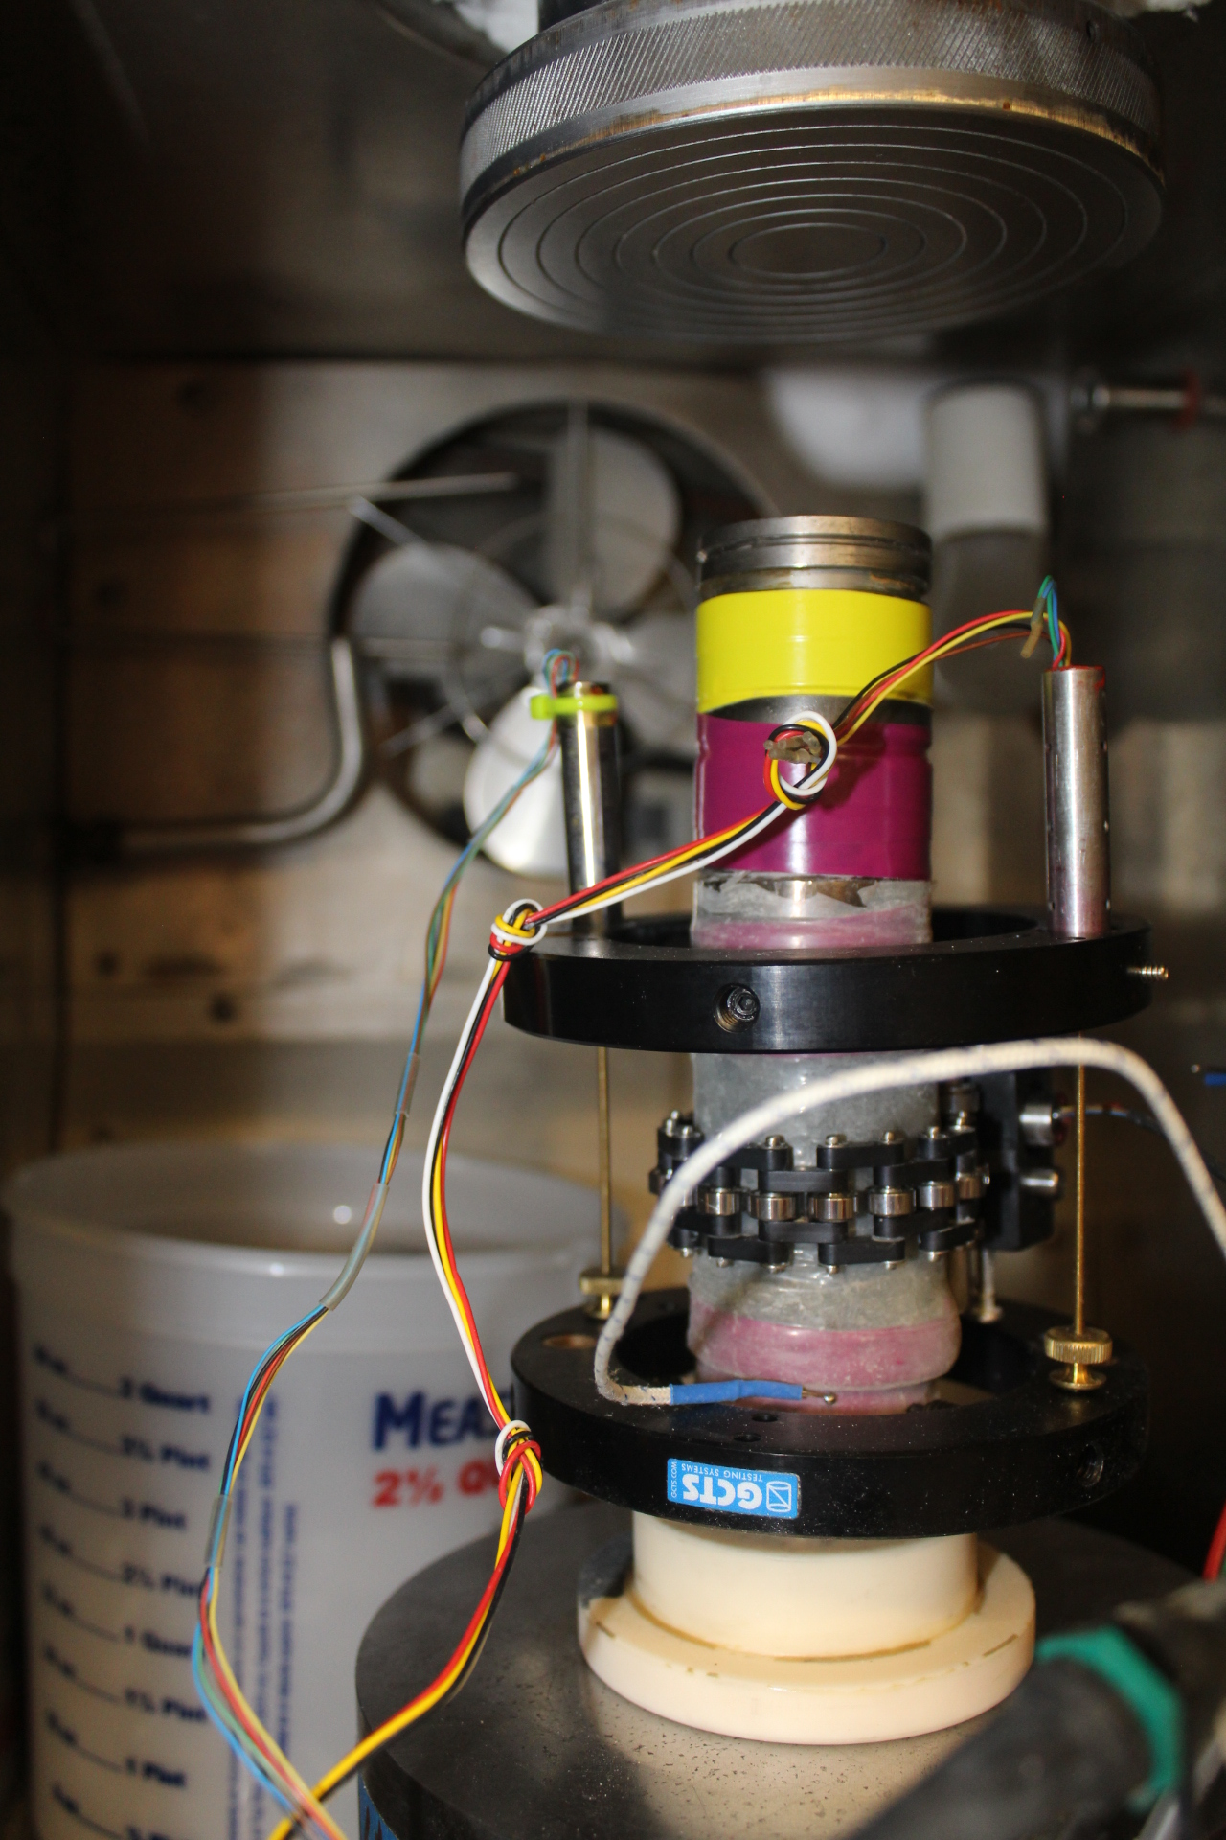
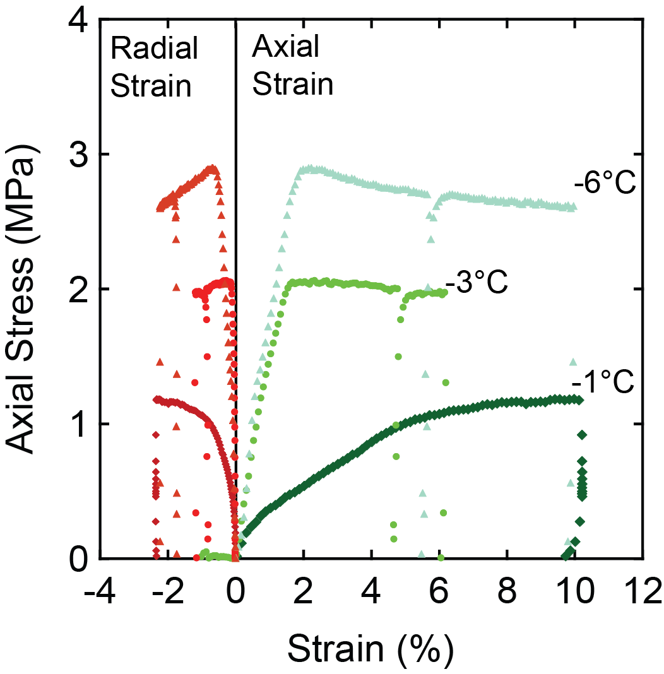
Parameters & inputs
Permafrost properties depend on ice content, unfrozen water content and frost susceptibility.
Few mathematical relationships exist that describe changes in tensile strength, shear strength and cohesion of ice/permafrost with changes in temperature.
Series of experiments (UCS¹, BTS², DT³) on frozen soil samples at different temps (-6C, -3C, -1C) and ice content from Drew Point, AK were performed at SNL’s Geomechanics Laboratory to estimate:
  Strength: 1-3 MPa
  Young’s modulus: 0.01-0.16 GPa
  Poisson’s ratio: 0.1-0.35
  Porosity values: 40-95%
y=-1.872*x
R²=0.3908
BTS (MPa)
Lots of noise in data!
IceVolFrac
¹ Unconfined compressive test. ² Brazilian tensile tests. ³ Direct tensile tests.

Slide 24
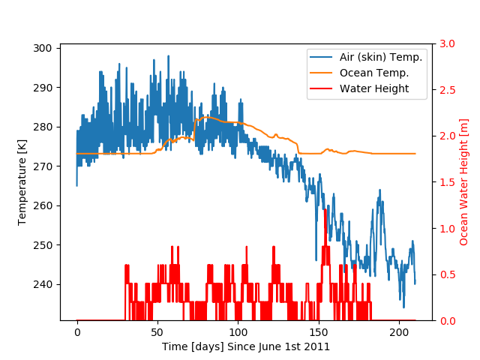
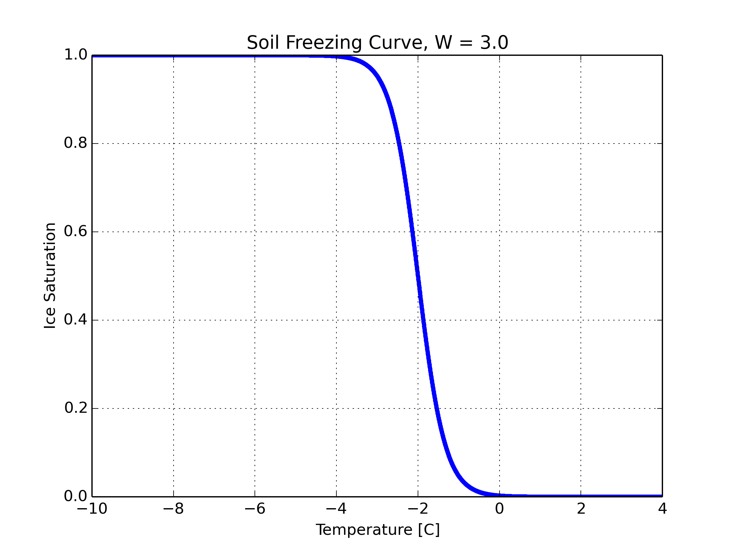
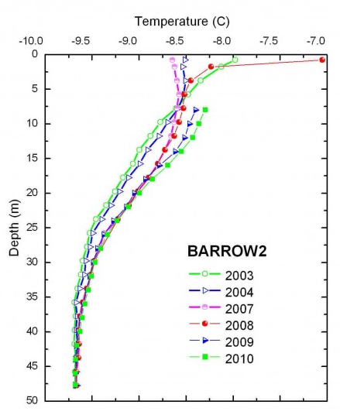
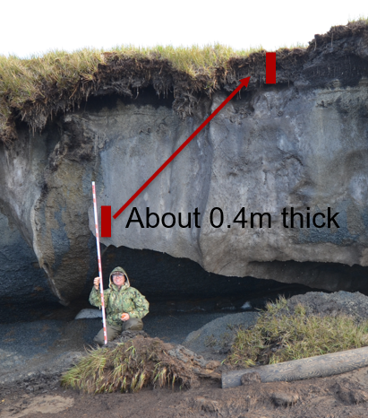
Parameters & inputs
BC Data for Drew Point
Parameters estimated from laboratory data:
Elastic modulus, Poisson’s ratio, yield strength
Sand/silt/clay fractions with depth
Porosity with depth
Parameters from literature:
Ice/water/sediment densities, thermal conductivities, heat capacities
Freezing curve/width as function of sediment type
Bluff salinity with depth
W
Parameters estimated from observational data at Drew Point, AK:
Skin temp w/ time, initial bluff temp (USGS weather station data)
Geothermal heat flux (borehole at Barrow, AK)
Polygon dimension, ice wedge thickness and depth, bluff height, living organic layer thickness (Aug. 2019 field campaign)
Parameters from wave model (WW3+SWAN+Delft3D):
Ocean temperature, salinity and sea-level w/ time (for thermal BCs)
Deep borehole

Slide 25

Coupled thermo-mechanical formulation
Potential key advantages:
Tightly coupled strength and thermo-chemical states
Failure modes develop from constitutive relationships in FEM model (no empirical relationships!)
3D unsteady heat flow can include chemistry
Thermal:
Inputs: geometry, sediment type, ice volume, water volume, pore size, salinity
Outputs: temperature field, ice saturation
Eroded geometry
Ice saturation
Mechanical:
Inputs: ice saturation, strength relationship as function of thermal state, stress-strain relationships of permafrost and ice
Outputs: displacements, eroded geometry
Unique characteristic of coupled model: coupling happens at the level of material model

Slide 26
Outline
Motivation and background
The Arctic Coastal Erosion (ACE) project
Thermo-mechanical finite element model of permafrost
Numerical results
Summary
Ongoing/future work

Slide 27

Finite element implementation within Albany
The thermo-mechanical Arctic Coastal Erosion (ACE) model is implemented within the LCM project in Sandia’s open-source parallel, C++, multi-physics, finite element code, Albany.
https://github.com/ SNLComputation/LCM
Component-based design for rapid development.
Contains a wide variety of constitutive models.
Extensive use of libraries from the open-source Trilinos project.
  Use of the Phalanx package to decompose complex problem into simpler problems with managed dependencies.
  Use of the Sacado package for automatic differentiation.
Coupled to the DOE’s Energy Exascale Earth System Model (E3SM) through Albany Land-Ice (ALI) component.
All software available on GitHub.
https://github.com/trilinos/trilinos

Slide 28
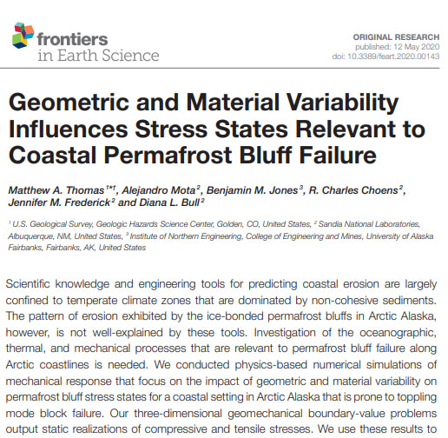
Mechanics-only simulation*
From recently-published Frontiers in Earth Science special issue.
* M. Thomas et al. Frontiers in Earth Science 8, April 2020.
Notes:
First, I will present some results for a mechanics-only simulation that is summarized in a manuscript shown here that was recently published in a special issue of “Frontiers in Earth Science: Cryospheric Sciences”. These were performed before the coupled thermo-mechanical model was ready.

Slide 29
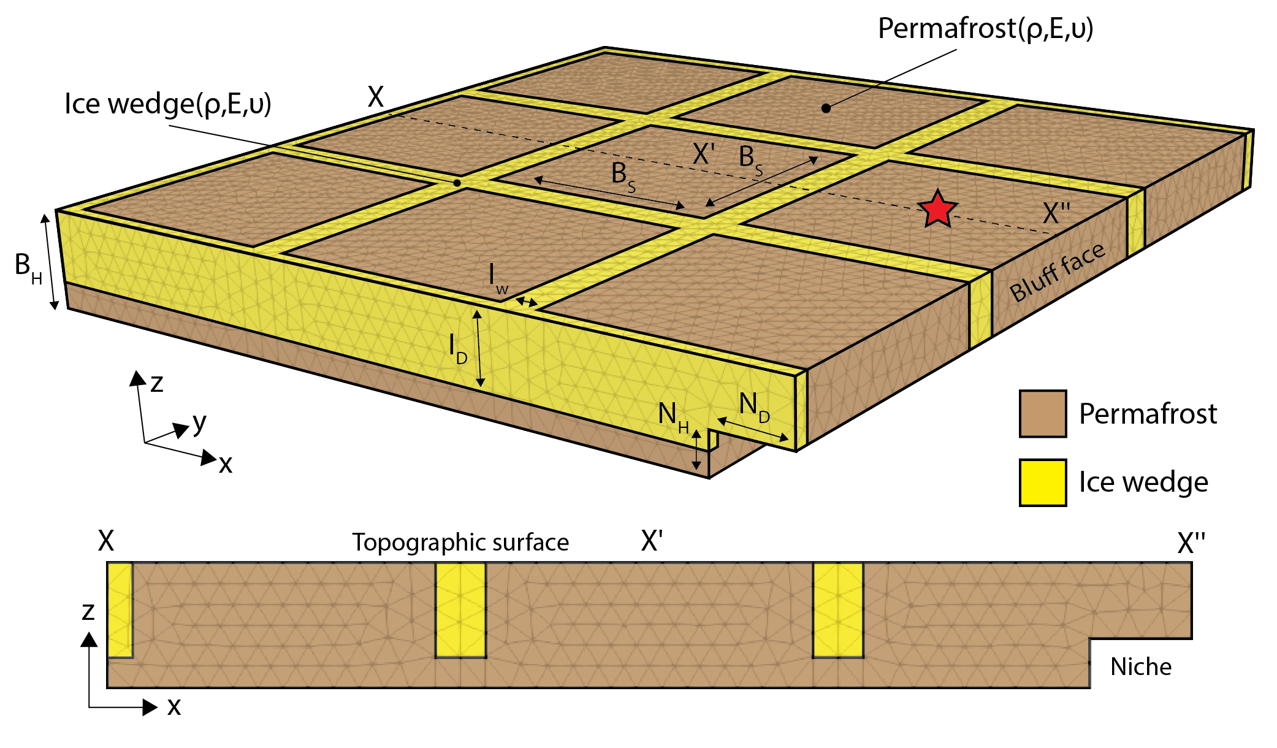
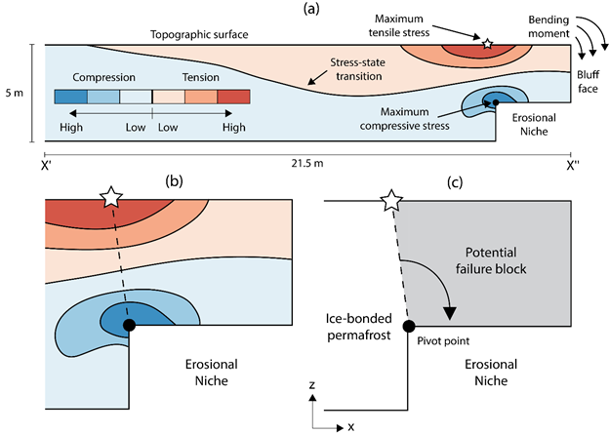
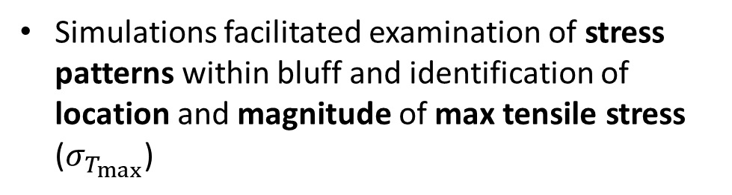
Mechanics-only simulation*
3D elastic mechanics-only simulations assessed impact of bluff geometry and material variability on stress states leading up to bluff failure
  Only load is gravitational.
Simulations facilitated examination of stress patterns within bluff and identification of location and magnitude of max tensile stress ($σ_{T_{max}}$)
* M. Thomas et al. Frontiers in Earth Science 8, April 2020.

Slide 30
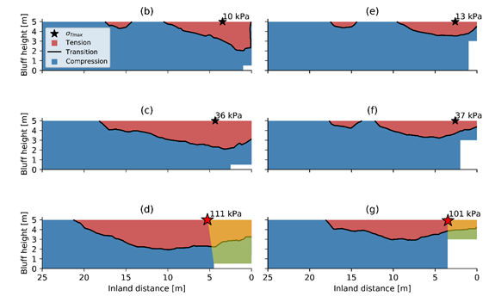
Mechanics-only simulation*: main takeaways
Niche dimension affects location and magnitude of simulated max tensile stress ($σ_{T_{max}}$) more than the bluff height, ice wedge polygon size, ice wedge geometry, bulk density and Poisson’s ratio
Inland extent of niche was advanced for 6 erosional niche heights from 0.1-3 m
Taller and narrower erosional niches promote smaller failure masses compared to those with shorter and deeper niches
Lower bound for tensile stress from lab measurements: 100 kPa
Orange/green shading highlights potential failure areas.
* M. Thomas et al. Frontiers in Earth Science 8, April 2020.

Slide 31
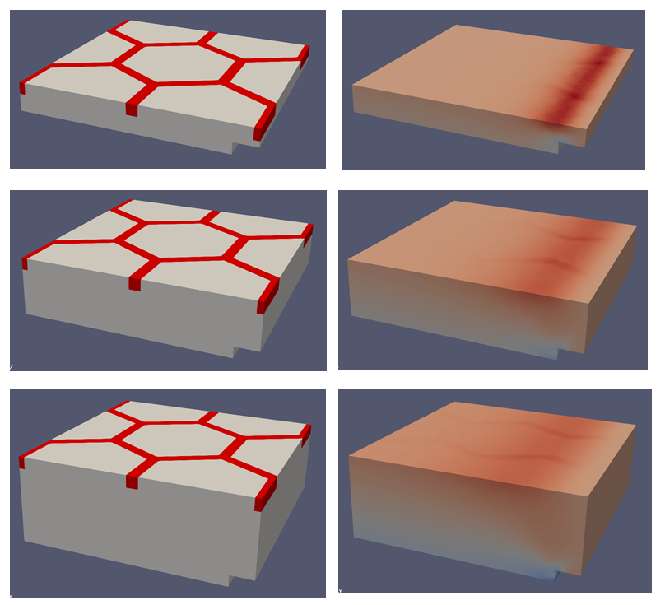
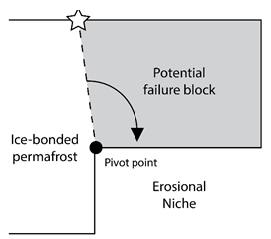
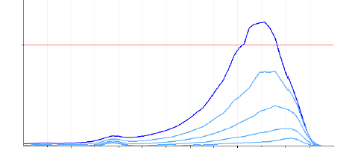

Mechanics-only simulation*: main takeaways
Taller and narrower erosional niches promote smaller failure masses compared to those with shorter and deeper niches
As niche advances into the block, an overhanging section in the block acts as cantilever.
Highest tensile stresses develop on top surface where cantilever meets rest of block
100
50x exaggeration
(1,1) stress component (kPa)
0 2 4 6 8 10 12 14 16 18 20 24 26
Distance from back (m)
* M. Thomas et al. Frontiers in Earth Science 8, April 2020.

Slide 32



Mechanics-only simulation*: main takeaways
It has been observed that failure can occur along tension cracks in ice wedge polygon centers.
Simulations suggest tension cracks can form within the range of niche depths/heights considered here.
Even relatively shallow vertical cracks can concentrate strain within ice-bonded permafrost bluffs.
$F_{D}$: fracture depth
* M. Thomas et al. Frontiers in Earth Science 8, April 2020.

Slide 33

Thermo-mechanical coupling: cuboid problem
Cuboid is comprised of block of ice material, wedged between two blocks of permafrost material.
Cuboid subjected to simultaneous heating and stretching from the top
Cuboid is affixed to the bottom and with symmetry boundary conditions on the sides.
Temperature is initialized to 265K.
permafrost
ice
permafrost
3.0 m
1.0 m
1.0 m

Slide 34





Thermo-mechanical coupling: cuboid problem
Temp = 280 K
Disp = 0.2 m
$−$ Ice Saturation
$−$ Water Saturation
permafrost
ice
permafrost
Plots (right) show quantities along vertical line as a function of $z$ in the ice block
3.0 m
Temp
$−$ Temperature
1.0 m
1.0 m

Slide 35


Thermo-mechanical coupling: cuboid problem
Temp = 280 K
Disp = 0.2 m
$−$ Ice Saturation
$−$ Water Saturation
4 days
permafrost
ice
permafrost
Plots (right) show quantities along vertical line as a function of $z$ in the ice block
3.0 m
Temp
$−$ Temperature
1.0 m
1.0 m

Slide 36


Thermo-mechanical coupling: cuboid problem
Temp = 280 K
Disp = 0.2 m
$−$ Ice Saturation
$−$ Water Saturation
24 days
permafrost
ice
permafrost
Plots (right) show quantities along vertical line as a function of $z$ in the ice block
3.2 m
Temp
$−$ Temperature
<1.0 m
<1.0 m

Slide 37


Thermo-mechanical coupling: cuboid problem
Temp = 280 K
Disp = 0.2 m
$−$ Ice Saturation
$−$ Water Saturation
226 days
permafrost
ice
permafrost
Plots (right) show quantities along vertical line as a function of $z$ in the ice block
3.2 m
Temp
$−$ Temperature
<1.0 m
<1.0 m

Slide 38



Thermo-mechanical coupling: cuboid problem
permafrost
ice
permafrost
3.0 m
$$σ_{33}$$
Temp
1.0 m
1.0 m
As cuboid is heated and stretched at top, heat propagates down, melting ice and causing failure.

Slide 39


Thermo-mechanical coupling: 2.5D slice
Computational domain is 2.5D cross-section of archetypal 3D bluff geometry
Time period: May-Dec. 2011
Air (skin) temperature from ASR dataset at 3hr resolution
Ocean temp & height from WW3+SWAN at 20 min resolution
Ice-free period: July-Oct.
Material properties: from laboratory experiments
2D bluff cross section
3 m
Our initial verification study uses real oceanic/ atmospheric BC data but assumes material is ice only.
bluff face
water level
0 – 1.2 m
2 m

Slide 40







Thermo-mechanical coupling: 2.5D slice
Figure above: z-displacement scaled 20K$×$ for $h=0.2$m resolution mesh
Monolithic thermo-mechanical model simulates ~22 days and performs 26 erosion steps. Formation of small niche is observed.

Slide 41







Thermo-mechanical coupling: 2.5D slice
Figure above: $σ_{xx}$ for $h=0.2$m resolution mesh
As erosion proceeds, highest tensile stress occurs around corners, suggesting this is where cracks will initiate.

Slide 42






Thermo-mechanical coupling: 2.5D slice
Figure above: temperature for $h=0.2$m resolution mesh
Atmospheric and oceanic boundary conditions are driving the melting of the ice

Slide 43
Thermo-mechanical coupling: 2.5D slice
Figure above: temperature for $h=0.2$m resolution mesh
Atmospheric and oceanic boundary conditions are driving the melting of the ice

Slide 44


Thermo-mechanical coupling: 2.5D slice
Spurious oscillations due to an unresolved boundary layer $→$ finer mesh or stabilization needed
Figure above: temperature for $h=0.2$m resolution mesh
Atmospheric and oceanic boundary conditions are driving the melting of the ice

Slide 45




Thermo-mechanical coupling: 2.5D slice
Some issues to resolve:
Results are very mesh dependent.
For finer mesh resolutions, “teeth” patterns are observed in the eroded geometry.
  These do not seem to be physical and need to be understood.
Regardless of the mesh resolution, simulations do not make it past ~22 days.
  Nonlinear solver struggles and fails, likely due to large differences in scales between the mechanical and thermal equations.
  Sequential thermo-mechanical coupling approach is expected to alleviate this difficulty.
    Sequentially coupled solver will be dynamic.
$h=0.2$ meters
$h=0.05$ meters

Slide 46
Outline
Motivation and background
The Arctic Coastal Erosion (ACE) project
Thermo-mechanical finite element model of permafrost
Numerical results
Summary
Ongoing/future work

Slide 47


Summary
We have developed a thermo-mechanical coupled FEM model, ACE, that can simulate transient niche development and permafrost erosion within Albany.
The model was calibrated using data from a series of experiments on frozen soil samples from Drew Point, Alaska that were performed at SNL’s Geomechanics Laboratory to estimate, as well as observational data collected at the same location.
The model incorporates boundary conditions from the WW3+SWAN+Delft3D wave models and observational data from an August 2019 field campaign at Drew Point, Alaska.
30m
30m
5m
z
x
y

Slide 48
Outline
Motivation and background
The Arctic Coastal Erosion (ACE) project
Thermo-mechanical finite element model of permafrost
Numerical results
Summary
Ongoing/future work

Slide 49



Ongoing/future work
Near term:
Resolve numerical difficulties with ACE thermo-mechanical model.
  Mitigating approach: sequential coupling between mechanics and thermal equations
Integrate chemical transport into ACE model.
Realistic erosion calculations using ACE model and Drew Point data.
Tuning/sensitivity studies to determine sensitivity ranges at Drew Point.
Validation runs to illustrate model skill using FY18-19 data from Drew Point.
Longer term:
Use ACE model to understand coastal processes in the Arctic.
Infer statistical meso-scale model and relevant physics-based parameterizations from ACE micro-model, towards integration into ESMs.
  ACE is member of the newly-funded DOE sponsored InteRFACE project* focused on coastal processes in Arctic.
* Interdisciplinary Research for Arctic Coastal Environments

Slide 50
References
[1] J. Frederick, M. Thomas, D. Bull, C. Jones, J. Robers. “The Arctic Coastal Erosion Problem”. Sandia National Laboratories Report, SAND2016-9762, 2016.
[2] A. Gibbs, B. Richmond. “National assessment of shoreline change – historical shoreline change along the north coast of Alaska, U.S.-Canadian border to Icy Cape”. U.S. Geological Survey Open-File Report, 2015-1048, 2015.
[3] P. Martin et al. “Wildlife response to environmental Arctic change: predicting future habitats of Arctic Alaska”. Report to WildREACH: Predicting Future Habitats of Arctic Alaska Workshop, Farbanks, Alaska, 2008.
[4] J. Brown and O. Ferrians and J. Heginbottom, E. Melnikov. “Circum-Arctic map of permafrost and ground conditions. Boulder, CO: National Snow and Ice Data Center, Digital Media, 1998.
[5] H. Lantuit, W. Pollard. Fifty years of coastal erosion and retrogressive thaw slump activity on Herschel Island, southern Beaufort Sea, Yukon Territory, Canada. Geomorphology, 95, 84-102, 2008.
[6] T. Ravens, B. Jones, J. Zhang, C. Arp, J. Schmutz. “Process-based coastal erosion modeling for Drew Point, North Slope, Alaska”. Journal of Waterway, Port, Coastal, and Ocean Engineering, 138, 2, 122-130, 2012.
[7] C. Koven, J. Riley, A. Stern. “Analysis of permafrost thermal dynamics and response to climate change in the CMPI5 Earth system models”. J Climate, 26, 1877-2900, 2009.
[8] M. Thomas, A. Mota, B. Jones, C. Choens, J. Frederick, D. Bull. “Bluff geometry and material properties influence stress rates relevant to coastal permafrost block failure”. Frontiers in Earth Science 8, 2020.
[9] A. Mota, J. Frederick, D. Bull, I. Tezaur. “Thermo-chemo-mechanical coupling for Arctic Coastal Erosion”, in preparation.

Slide 51


Acknowledgements
Research Team
SNL: D. Bull (PI), J. Frederick, A. Mota, C. Choens, I. Tezaur, L. Criscenti
USGS: M. Thomas, B. Jones
UAF: J. Kasper, E. Brown
Integral Consulting: C. Jones, C. Flanary
U Texas: J. McClelland, E. Bristol, C. Connolly

Slide 52
Start of Backup Slides

Slide 53

Potential impacts
3D model capable of predicting erosion from the material’s constitutive relationships capturing all types of deformation (block & denudation) leading to:
  Data-driven understanding of the characteristics that cause erosion
  A tool to guide military and civil infrastructure investments
  An improved understanding of coastal food web impacts and carbon-climate feedbacks
Redistributed eroded sediment in the environment enables:
  Prediction of deposition locations
  Estimates of fluxes (biogeochemical, toxins, etc.)
PC: Andrew Burton, NPR
Approach for moving from mechanistic micro-scale to stochastic meso-scale model sets stage for integration into global climate models built upon parametric analyses of input variables

Slide 54

Oceanography in Mechanistic Model
WW3
SWAN
Wave set-up conditions 2-way coupled with circulation
Delft3D
Circulation and thermodynamic mixing 2-way coupled with waves
ice cover
temperature (surface and ocean)
surface winds
solar radiation
persistent currents
capture set-up (storm surge and runup)
wave energy inclusive of induced current effects
capture induced currents in nearshore
ability to model mixing of temperature and salinity clines
Development of wave field in the Arctic to develop nearshore BCs
high resolution near shore environment
Potential Key Advances
  Inclusion of ice coverage for fetch limited wave growth
  Knowledge of wave energy along broad coastline
  Set-up determination inclusive of bathymetry and wave energy
  Ability to accurately predict temperature at bluff face through mixing of clines in the ocean
WW3 polar stereographic model initially developed by NRL (Erick Rogers) and NOAA (Arun Chawla)

Slide 55



Multi-scale approach
Micro-Scale Model | Meso-Scale Model | Macro-Scale Model
10’s of meters & storm duration | 10’s of kilometers & monthly duration | 100’s of kilometers & annual (+) durations
One set of input variables defining the geomorphology and geophysics of the terrestrial model. | A number of micro-scale models that represent the stochastic distributions of input variables along a confined coastline. | A number of meso-scale models that represent the diversity of coastline types (delta, exposed bluffs, lagoons, etc.) along the AK coastline.
  Working towards a series of fully coupled studies to determine terrestrial model sensitivities to:
    Height of water on bluff face
    Exposure time of bluff face to water
    Temperature of water
    Salinity of water

Slide 56
Multi-scale approach
Micro-Scale Model | Meso-Scale Model | Macro-Scale Model
10’s of meters & storm duration | 10’s of kilometers & monthly duration | 100’s of kilometers & annual (+) durations
One set of input variables defining the geomorphology and geophysics of the terrestrial model. | A number of micro-scale models that represent the stochastic distributions of input variables along a confined coastline. | A number of meso-scale models that represent the diversity of coastline types (delta, exposed bluffs, lagoons, etc.) along the AK coastline.
This talk
  Working towards a series of fully coupled studies to determine terrestrial model sensitivities to:
    Height of water on bluff face
    Exposure time of bluff face to water
    Temperature of water
    Salinity of water
Notes:
-Q for Alejandro: what timescales are we looking at? How big of a geometry would we run? I think 1 summer or 1 month with microscale model, to simulate Drew Point (how big?) – correct?
- Q: is there plan for integration into global ESM/global calculations?
- Q for Alejandro: plans for upscaling?

