Slide 1
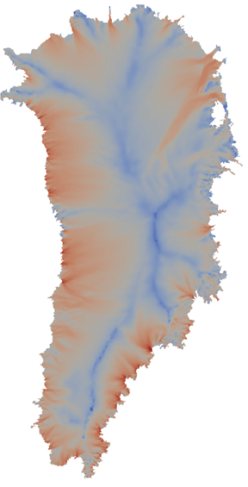
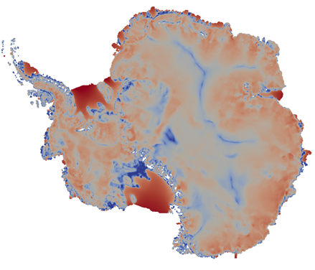
Land-Ice and Atmospheric Modeling at Sandia: the Albany/FELIX and Aeras Solvers
Irina K. Tezaur
Org. 8954
Quantitative Modeling & Analysis Department
Sandia National Laboratories
Livermore, CA
Wednesday, December 9, 2015
8300 Climate Kickoff

Slide 2



Earth System Models: CESM, DOE-ESM
An ESM has six modular components:
  Atmosphere model
  Ocean model
  Sea ice model
  Land ice model
  Land model
  Flux coupler
Land Surface
(ice sheet surface mass balance)
Ice Sheet (dynamics)
Atmosphere
Flux Coupler
Ocean
Sea Ice
Goal of ESM: to provide actionable scientific predictions of 21st century sea-level rise (including uncertainty).
Land Ice Model passes:
Elevation
Revised land ice distribution
Oceanic heat and moisture fluxes (icebergs)
Revised sub-shelf geometry
Climate Model passes:
Surface mass balance (SMB)
Boundary temperatures
Sub-shelf melting

Slide 3
Earth System Models: CESM, DOE-ESM
(Albany/FELIX)
An ESM has six modular components:
  Atmosphere model
  Ocean model
  Sea ice model
  Land ice model
  Land model
  Flux coupler
Land Surface
(ice sheet surface mass balance)
Ice Sheet (dynamics)
Atmosphere
Flux Coupler
Ocean
(Aeras)
Sea Ice
Goal of ESM: to provide actionable scientific predictions of 21st century sea-level rise (including uncertainty).
Land Ice Model passes:
Elevation
Revised land ice distribution
Oceanic heat and moisture fluxes (icebergs)
Revised sub-shelf geometry
Climate Model passes:
Surface mass balance (SMB)
Boundary temperatures
Sub-shelf melting

Slide 4



The Albany Code Base and Trilinos Libraries
The Albany/FELIX and Aeras solvers are implemented in a Sandia (open-source*) parallel C++ finite element code called…
“Agile Components”
Discretizations/meshes
Solver libraries
Preconditioners
Automatic differentiation
Many others!
Started by A. Salinger
Parameter estimation
Uncertainty quantification
Optimization
Bayesian inference
Land Ice Physics Set (Albany/FELIX code)
Other Albany Physics Sets (e.g., LCM)
Configure/build/test/documentation
Atmosphere Physics Set (Aeras code)
Use of Trilinos components and Albany code base has enabled rapid code-development: codes born parallel, scalable, robust and equipped with advanced analysis / next generation capabilities
*Open-source code available on github: https://github.com/gahansen/Albany.

Slide 5










PISCEES Project for Land-Ice Modeling
FSU FELIX
FSU
Finite Element
Full Stokes Model
PISCEES*
SciDaC Application Partnership
(DOE’s BER + ASCR divisions)
2012-2017
3 land-ice dycores developed under PISCEES
Albany/FELIX
SNL
Finite Element
“Higher-Order” Stokes Model
Increased fidelity
BISICLES
LBNL
Finite Volume
L1L2 Model
*Predicting Ice Sheet Climate & Evolution at Extreme Scales.
Multi-lab/multi-university project involving mathematicians, climate scientists, and computer scientists.
Leverages software/expertise from SciDAC Institutes (FASTMath, QUEST, SUPER) and hardware from DOE Leadership Class Facilities.
Sandia staff: Irina Tezaur, Andy Salinger, Mauro Perego, Ray Tuminaro, John Jakeman, Mike Eldred.

Slide 6
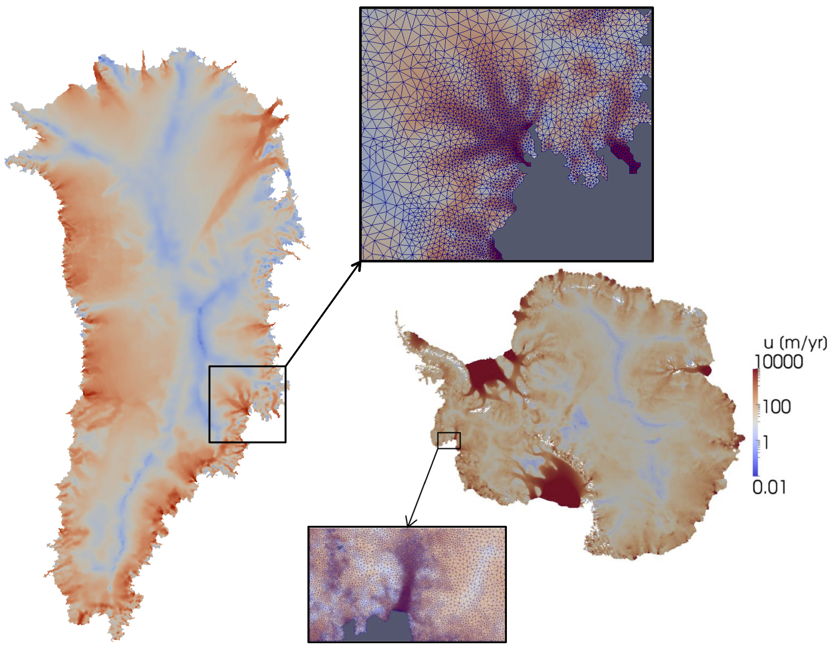

PISCEES Project for Land-Ice Modeling
  Sandia’s Role in the PISCEES Project: to develop and support a robust and scalable land ice solver based on the “First-Order” (FO) Stokes equations $→$Albany/FELIX*
Requirements for Albany/FELIX:
  Unstructured grid finite elements.
  Verified, scalable, fast, robust
  Portable to new/emerging architecture machines (multi-core, many-core, GPU)
  Advanced analysis capabilities: deterministic inversion, calibration, uncertainty quantification.
As part of ACME DOE-ESM, solver will provide actionable predictions of 21st century sea-level rise (including uncertainty).
*Finite Elements for Land Ice eXperiments

Slide 7
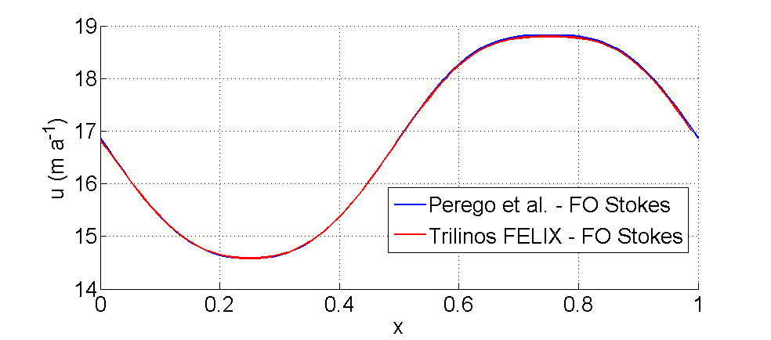
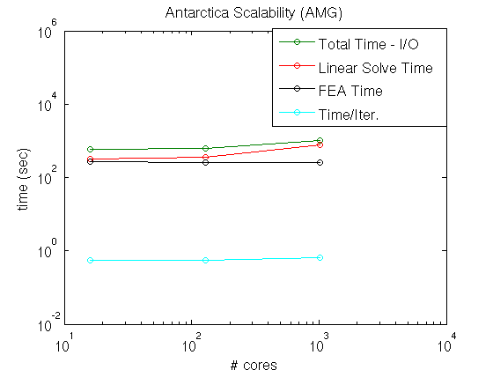
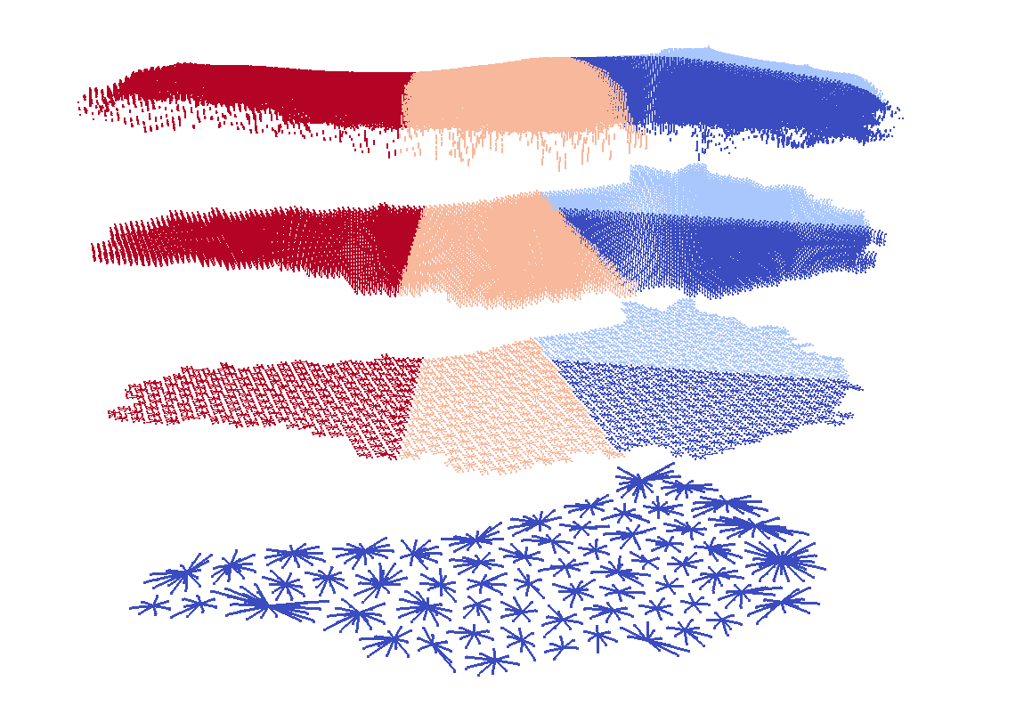
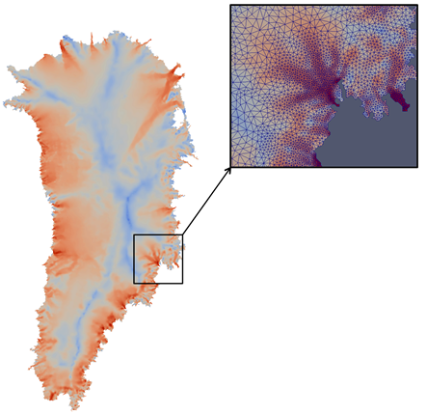
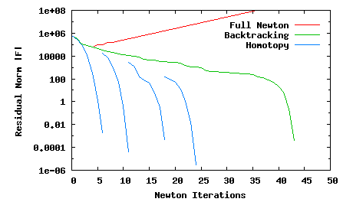


PISCEES Project for Land-Ice Modeling
  Component-based code development approach (Trilinos, Albany) has enabled rapid development of production-ready ice-sheet climate application solver.
Verified
Scalable & fast multi-level linear solver (to 1.12B dofs, 16K cores)
Unstructured grids with real data
Robust non-linear solver with automatic differentiation and homotopy continuation

Slide 8
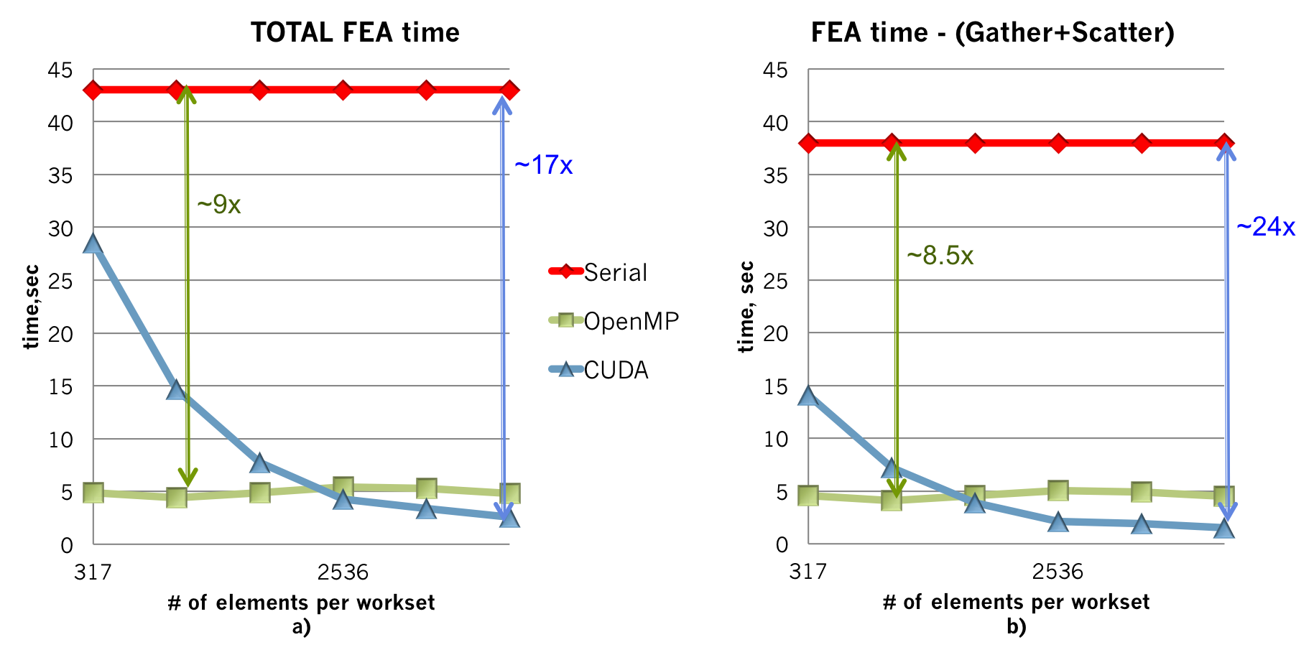


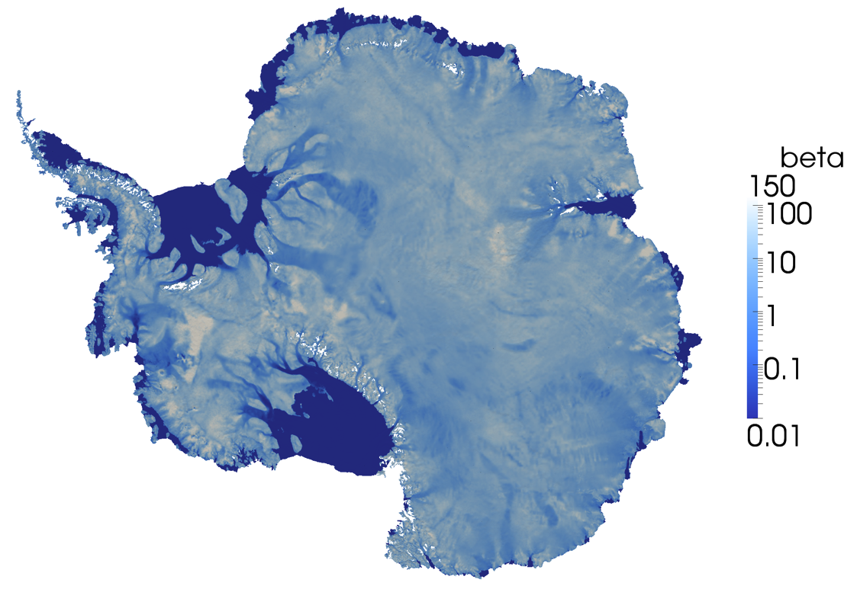
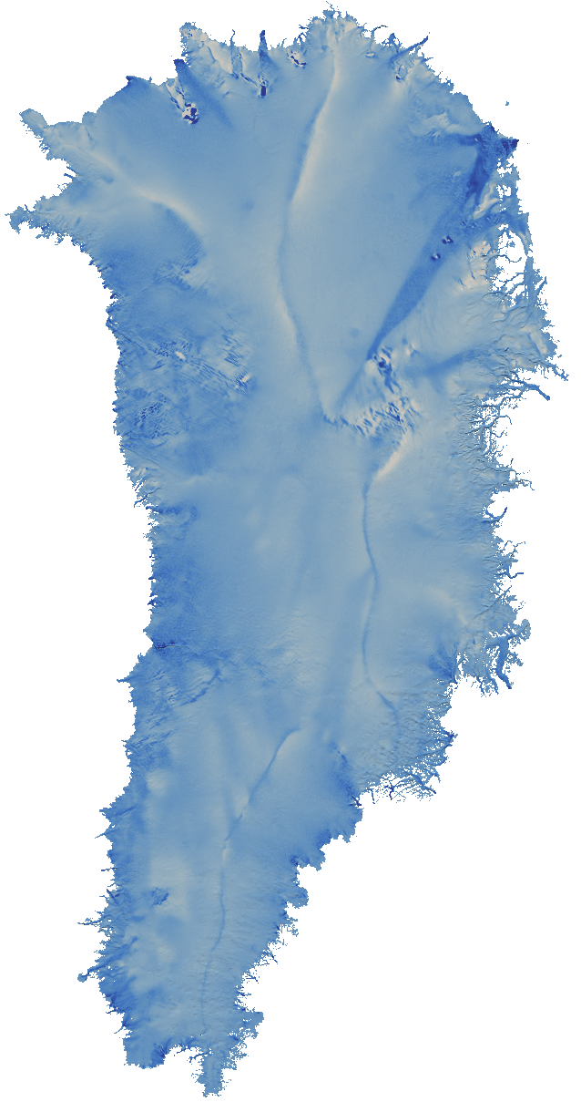
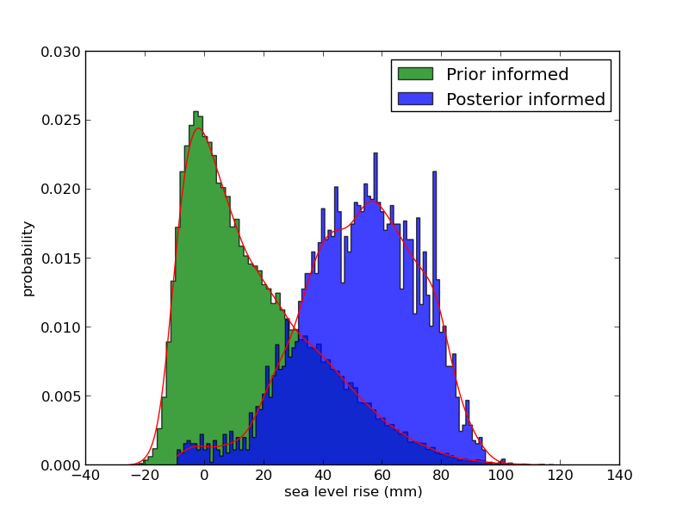
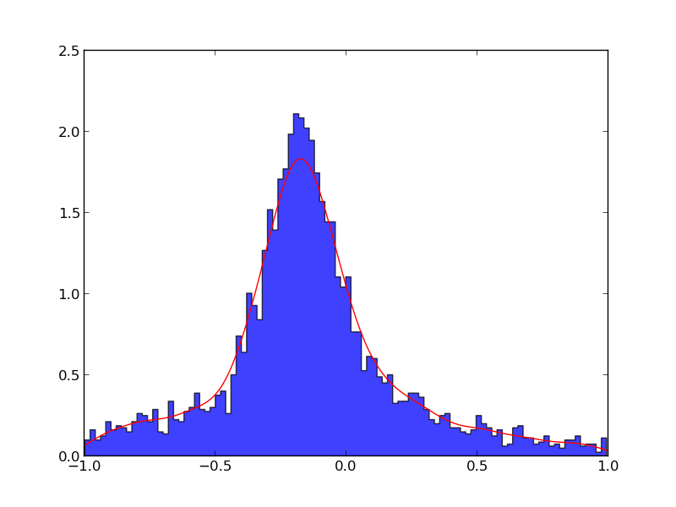
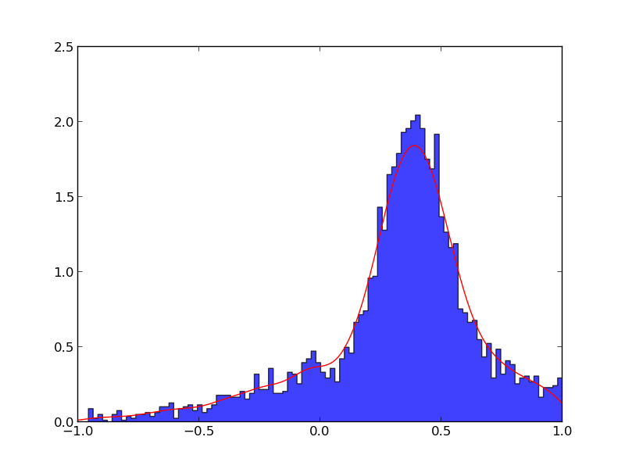

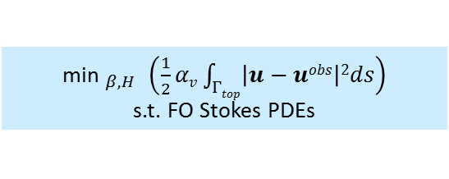
PISCEES Project for Land-Ice Modeling
  Solver is equipped with advanced analysis and next-generation capabilities.
Performance portability to new architecture machines (multi-core, many-core, GPUs) using Kokkos Trilinos library and programming model.
Adjoint-based PDE-constrained optimization for ice sheet initialization
${\text{min} }_{β,H}$ $\left(\frac{1}{2}αv\int_{Γtop}{\left|u−uobs\right|2ds}\right)$
s.t. FO Stokes PDEs
Objective: find ice sheet initial state that matches observations, matches present-day geometry and is in “equilibrium” with climate forcings.
Uncertainty quantification algorithms and workflow for sea-level rise is being developed
We have inverted for up to 1.6M parameters.
Step 1: Bayesian Calibration
Step 2: Uncertainty propagation

Slide 9

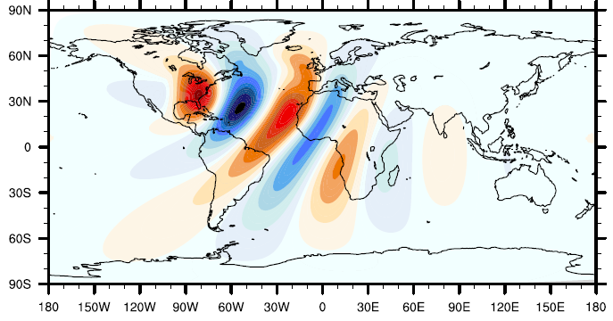
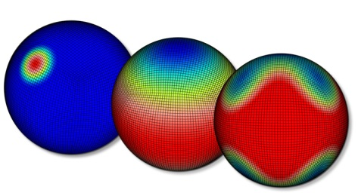
Aeras Next-Generation Atmosphere Model
LDRD project (FY14-16) aimed to develop a new, next generation atmospheric dynamical core using Trilinos/Albany that promotes machine-portability and enable uncertainty quantification.
Shallow water, X-Z hydrostatic, 3D hydrostatic, non-hydrostatic equations.
Spectral element discretization, explicit time-stepping.
Next-generation capabilities: built-in sensitivity analysis, concurrent ensembles for UQ, performance-portability.
Run time for shallow water equations within factor of 2 of HOMME (Higher-Order Methods Modeling Environment).
Sandia staff: Bill Spotz, Irina Tezaur, Andy Salinger, Pete Bosler, Oksana Guba, Irina Demeshko, Mark Taylor, Tom Smith.

Slide 10
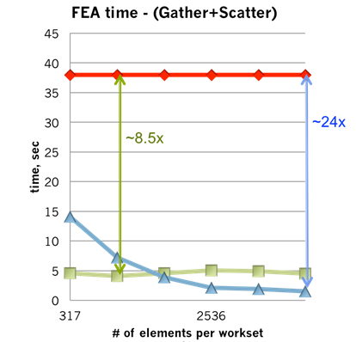
Aeras Next-Generation Atmosphere Model
Sensitivity calculations:
utilizes built-in automatic differentiation Albany capability
Concurrent ensembles for UQ: allows computation of several models concurrently using abstract data types.
Sensitivity with respect to mountain height on shallow water test case
Performance portability: single code base for serial, threads, GPUs, etc.
~2x increase in computational efficiency for large enough sample size
Aeras is first demonstration of concurrent ensemble capability
hardware-appropriate speedups

Slide 11
Follow-Up Funding?
SciDAC4 call expected to come out in Fall of 2016.
  Plan to apply for subsequent land-ice and atmospheric funding.
Advancing X-cutting Ideas for Computational Climate Science (AXICCS) Workshop in Rockville, MD – January 2016: http://www.csm.ornl.gov/workshops/AXICCS/index.html
  Rumored to be pre-cursor to SciDAC4 call.
  Several white papers have been submitted.
Other ideas for subsequent funding are welcome!

