Slide 1
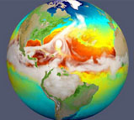
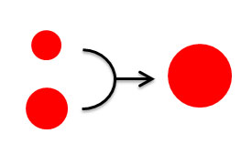

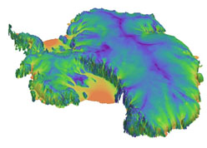
Verification and Testing Infrastructure and Demonstrations
Irina Tezaur¹, Hui Wan², Andreas Wilke³, Dick Easter², Jian Sun², Jason Sarich³, Kai Zhang², Luke van Roekel⁴, LeAnn Conlon⁴, Jamil Gafur⁴, Rachel Scanza², Lance Rayborn², Richard Easter², Vince Larson⁵
¹ SNL, ² PNNL, ³ ANL, ⁴ LANL, ⁵ U Wisconsin
E3SM All-Hands Meeting November 19-21, 2019
Sandia National Laboratories is a multi-mission laboratory managed and operated by National Technology and Engineering Solutions of Sandia, LLC., a wholly owned subsidiary of Honeywell International, Inc., for the U.S. Department of Energy’s National Nuclear Security Administration under contract DE-NA0003525.
SAND2019-13937C
Notes:
Q: did I leave anyone off???

Slide 2

Motivation
This talk is on the tools/workflow created under the CMDV-SM verification subtask, which aims to create/enable a culture of testing/verification in the E3SM.
Purpose of verification: instill confidence in numerical simulations
    Demonstrate that simulations represent the intended mathematical model rather than numerical artifacts or coding bugs
    Test against analytic or trusted solutions
    Confirm convergence of algorithms at theoretical rates
    Detect changes over time (regression)
Status quo in (much of) E3SM
  Verification & validation not sufficiently distinguished
    Mostly focus on validation (matching observations)
    Most developers do some verification
      Usually limited coverage and not formalized
      Usually not isolated or localized – always case-based
      Not preserved to re-confirm correctness after modifications

Slide 3

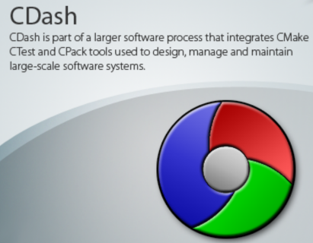

Our efforts under CMDV-SM
Work with model developers to define/formulate appropriate verification (unit and unit-like) tests for their models
Create workflow and corresponding infrastructure for performing verification and presenting verification results
  cmdv-test-runner: python-based tool for running verification tests.
  cron/Jenkins: tools for automating running of tests nightly, weekly, etc.
  CDash: web-based software server for displaying/storing testing results.
  Jupyter (notebooks): tool for writing documentation for verification tests and post-processing results.
Create concrete demonstrations of the above testing/ documentation infrastructure on MAM and CLUBB, Ocean Mixing, etc.

Slide 4
Verification test formulation
Formulating a verification test can present a number of challenges:
  Requires interest/involvement from component developers.
  Requires knowledge of what is in the code.
  Requires understanding of mathematical concepts, e.g. convergence.

Slide 5
Verification test formulation
Formulating a verification test can present a number of challenges:
  Requires interest/involvement from component developers.
  Requires knowledge of what is in the code.
  Requires understanding of mathematical concepts, e.g. convergence.
Ideally tests would be written as code is being developed (e.g., SCREAM)

Slide 6
Verification test formulation
Formulating a verification test can present a number of challenges:
  Requires interest/involvement from component developers.
  Requires knowledge of what is in the code.
  Requires understanding of mathematical concepts, e.g. convergence.
Ideally tests would be written as code is being developed (e.g., SCREAM)
Tests should be small (subroutine, kernel, small set of kernels).

Slide 7
Verification test formulation
Formulating a verification test can present a number of challenges:
  Requires interest/involvement from component developers.
  Requires knowledge of what is in the code.
  Requires understanding of mathematical concepts, e.g. convergence.
Ideally tests would be written as code is being developed (e.g., SCREAM)
Tests should be small (subroutine, kernel, small set of kernels).
Examples of what IS a verification test:
  Check mathematical properties (convergence rate, divergence free, conservation of mass, etc.), compare to theory.

Slide 8
Verification test formulation
Formulating a verification test can present a number of challenges:
  Requires interest/involvement from component developers.
  Requires knowledge of what is in the code.
  Requires understanding of mathematical concepts, e.g. convergence.
Ideally tests would be written as code is being developed (e.g., SCREAM)
Tests should be small (subroutine, kernel, small set of kernels).
Examples of what IS a verification test:
  Check mathematical properties (convergence rate, divergence free, conservation of mass, etc.), compare to theory.
Examples of what IS NOT a verification test:
  Perform a run and compare to observational data (this is validation!).
  Arbitrary parameter tunings to match expected data/solution.

Slide 9
Verification test formulation
Formulating a verification test can present a number of challenges:
  Requires interest/involvement from component developers.
  Requires knowledge of what is in the code.
  Requires understanding of mathematical concepts, e.g. convergence.
Ideally tests would be written as code is being developed (e.g., SCREAM)
Tests should be small (subroutine, kernel, small set of kernels).
Examples of what IS a verification test:
  Check mathematical properties (convergence rate, divergence free, conservation of mass, etc.), compare to theory.
Examples of what IS NOT a verification test:
  Perform a run and compare to observational data (this is validation!).
  Arbitrary parameter tunings to match expected data/solution.
Once test is formulated, test driver must be created, which can be done by hand or using available tools, e.g. kgen.
Notes:
fortran to python (F2PY): In my memory, F2PY was the tool Peter Caldwell and Sean Santos used to drive the Fortran code of MG2 (the cloud microphysics parameterization in E3SMv1) for verification (convergence) tests.

Slide 10
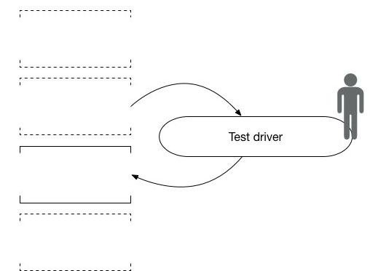
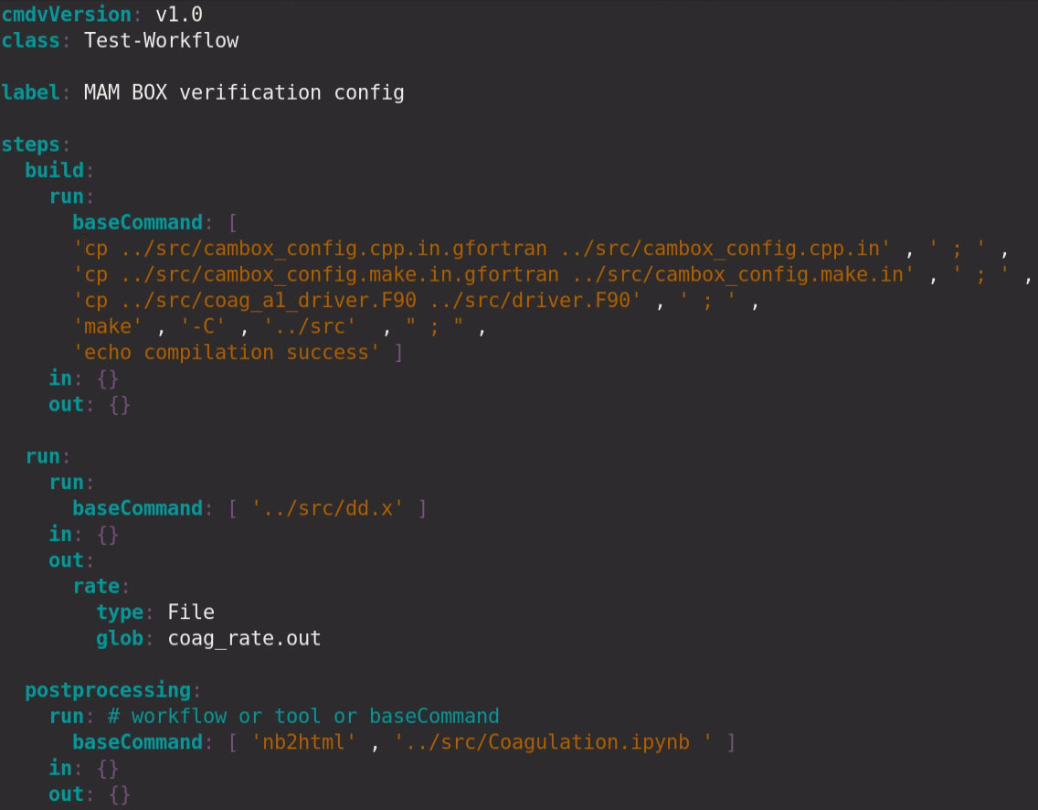
Running the tests: cmdv-test-runner
Python-based tool to discover, build, run, post-process verification tests
  Discovers tests in current directory
  Compiles and runs tests according to workflow file
  Reports results
Discover
One step workflow executing one command:
./cmdv-test-runner --test mam_box.verification.test.yaml
Build
Execute
Post-
process
Can be executed within Docker container.
Documentation and examples can be found here:
Sample input yaml file: mam_box.verification.test.yaml
https://github.com/E3SM-Project/CMDV-testing/wiki
Notes:
- Have Andreas fill this slide in!!

Slide 11


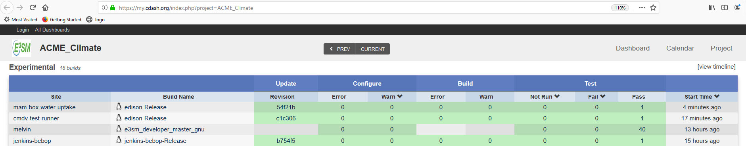
Automation of test execution (cron/Jenkins) and results archival (CDash)
Execution of tests can be automated using cron or Jenkins.
We have created cron/Jenkins jobs on NERSC, ANL, SNL machines that run cmdv-test-runner (self-tests, MAM water uptake tests) nightly and post results to the ACME_Climate CDash site.
  Future work: extend workflow to automatically run and post-to-CDash additional test results.
Notes:
Question:
Is Bebop the name of the ANL machine where tests are run?

Slide 12
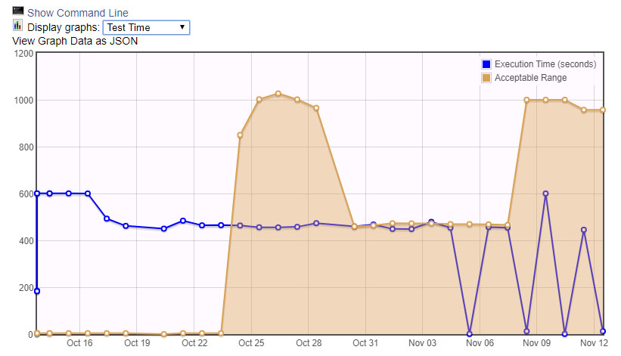
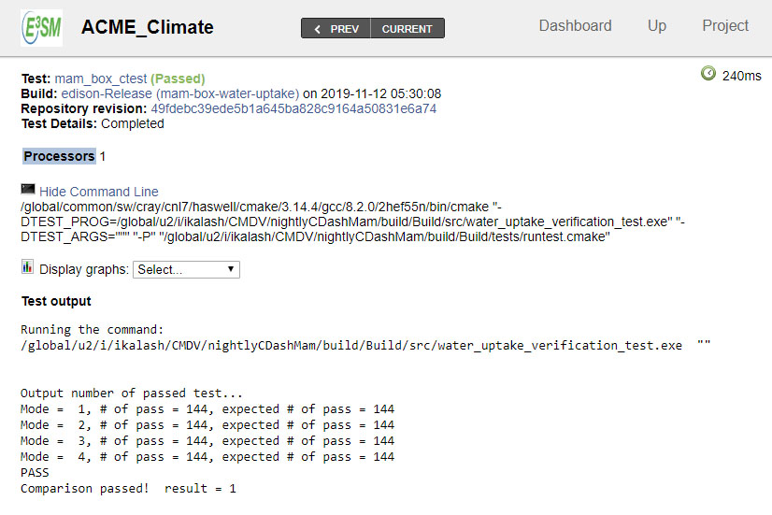
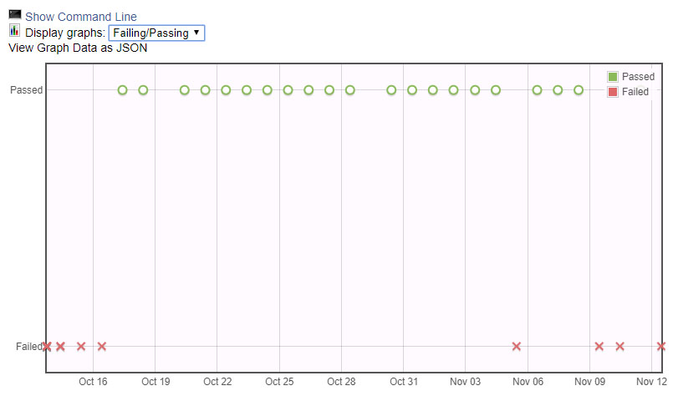
Automation of test execution (cron/Jenkins) and results archival (CDash)
https://my.cdash.org/index.php?project=ACME_Climate
Notes:
Question:
Is Bebop the name of the ANL machine where tests are run?

Slide 13

Documentation/post-processing: Jupyter notebooks
Common tool for writing documentation and post-processing/re-generating verification results.
Documentation to new/existing users of various E3SM components and template for writing verification/unit tests.
The following can be embedded within a Jupyter notebook:
  LaTex
  Python
  Matlab
  Julia
  …

Slide 14
Documentation/post-processing: Jupyter notebooks
HTML versions of Jupyter notebooks are linked from E3SM github.io page: https://e3sm-project.github.io/CMDV-testing/
We have Jupyter notebooks for the following components:
  HOMME: Shallow Water TC1
  Albany Land-Ice (ALI): FO Stokes MMS TC
  MPAS-Ocean: comparison b/w cmix and PALM LES runs
  Modal Aerosol Model (MAM): water uptake, condensation, coagulation
  Cloud Layers Unified By Binormals (CLUBB): clipping in atm. physics
  Misc Unit Tests: subroutines in global_verif_summary.F90
Jupyter source code can be found in the CMDV-Verification repo https://github.com/E3SM-Project/CMDV-verification
  Binder support coming soon.
Future work: add on-the-fly creation of (some) of the Jupyter notebooks as a part of automated verification workflow.

Slide 15
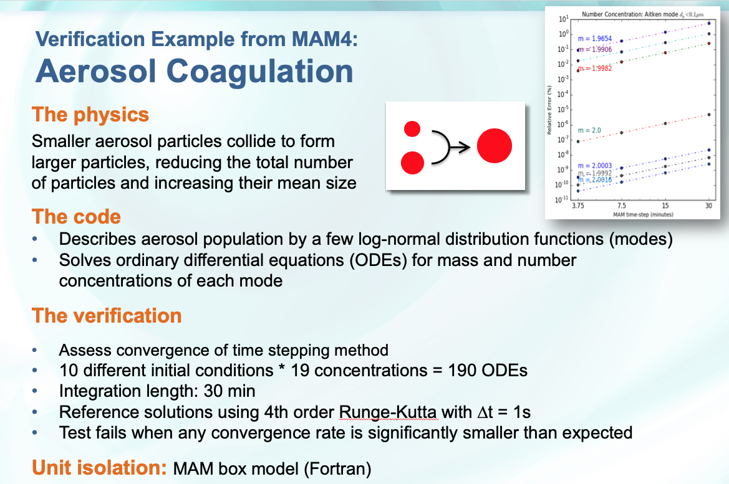



End-to-end verification workflow
Formulate test
Identify target code
Create test driver
Reporting and
documentation
Automate setup
and execution
#! /bin/csh
module load intel
make clean
cp coag_b1_driver.F90 driver.F90
make
echo compilation finished...
echo running code
#cd test_output ; rm dd.x ; ln -s ../dd.x .
./dd.x
echo test compiled here
#cd ../ ; cp test_output/coag_delNum_delMass.out .
echo main output is coag_delNum_delMass.out
echo now running python script to generate graphics and R2. /share/apps/python/anaconda3/bin/python coag_dq_da.py
echo convergence diagrams saved.
Notes:
Test driver creation, by hand, kgen, fortran to python (F2PY , part of numpy)
https://sysbio.ioc.ee/projects/f2py2e/

Slide 16
Verification example from MAM: Aerosol Coagulation
https://e3sm-project.github.io/CMDV-testing/Coagulation.html
R. Scanza, R. Easter (PNNL)
The physics
Smaller aerosol particles collide to form larger particles, reducing the total number of particles and increasing their mean size
The code
Describes aerosol population by a few log-normal distribution functions (modes)
Solves ordinary differential equations (ODEs) for mass and number concentrations of each mode
The verification
Assess convergence of time stepping method
10 different initial conditions * 19 concentrations = 190 ODEs
Integration length: 30 min
Reference solutions using 4th order Runge-Kutta with ∆t = 1s
Test fails when convergence rates is significantly < expected
Unit isolation: MAM box model (Fortran)
Notes:
In addition:
Two parts
Quantify error in coefficients of the equations
Assess convergence of time stepping method

Slide 17
Verification example from MAM: Aerosol Water Update
Wet particle
J. Sun, K. Zhang, H. Wan (PNNL)
Dry particle
The physics
Aerosol particles absorb water and grow in size
The code
Assumes quartic relationship between air humidity and particle wet radius
Calculates wet radius (a root of quartic function) using analytical expression
Expects 1 real-and-physical root
The verification
Verifies the analytical expression and its implementation
Calculates wet radius for 576 different combinations of humidity, particle composition, and dry radius
Reference solutions using root-finding by bisection
Test fails if relative difference between any pair of MAM and reference solutions exceeds 1E-15 (machine precision)
Unit isolation: MAM box model (Fortran)
https://e3sm-project.github.io/CMDV-testing/wateruptake/verification.html

Slide 18
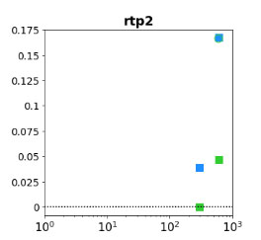
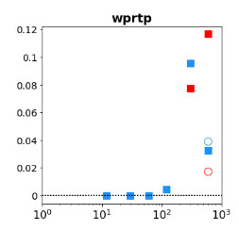
Verification example from CLUBB:
Clipping in Stand-Alone Model
L. Rayborn (PNNL)
The physics
CLUBB (Cloud Layers Unified By Binormals) is a parameterization of clouds and turbulence for the representation of cloud macrophysics, shallow convection, and turbulence.
The code
Solution “clipping” is introduced to avoid non-physical quantities (e.g., negative densities).
Clipping is in general non-conservative, but there are conservative variants (e.g., hole filling)
The verification
Quantify magnitude of clipping terms in CLUBB's 13 prognostic eqns. using BOMEX TC.
Evaluate various clipping schemes in CLUBB.
Magnitude of clipping term for each scheme is compared to max physical term in each budget; test fails if magnitude > threshold.
Unit isolation: clipping BOMEX unit test.
https://e3sm-project.github.io/CMDV-testing/CLUBB_clipping_test.html

Slide 19
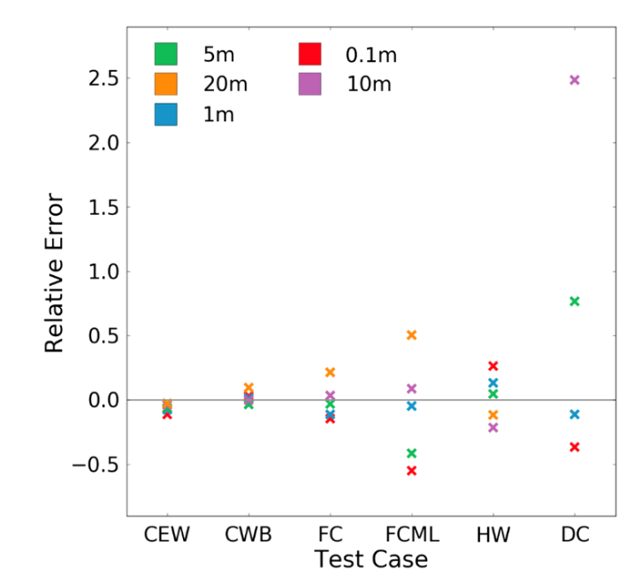
Verification example from MPAS-O:
K-Profile Parameterization
https://e3sm-project.github.io/CMDV-testing/palm_cvmix_compare.html
L. Van Roekel, L. Conlon, J. Gafur (LANL)
The physics
The K-Profile Parameterization (KPP) represents small scale (below the grid scale) vertical turbulent fluxes of heat, salt, and momentum in the ocean.
The code
KPP does not contain any prognostic equations, but utilizes diagnostic equations and scaling relationships to parameterize turbulent fluxes.
KPP is known to not exhibit convergence with vertical resolution, but is robust to time step variation.
No known analytic solutions for comparison in most cases.
Relative error he across test cases and resolution
The verification
Utilize a large eddy simulation as a baseline to verify the temperature tendency and entrainment depth (figure) returned by KPP, critical quantities for the ocean simulation.
Unit isolation: CVMix module and MPAS-Ocean vertical mixing interface.

Slide 20
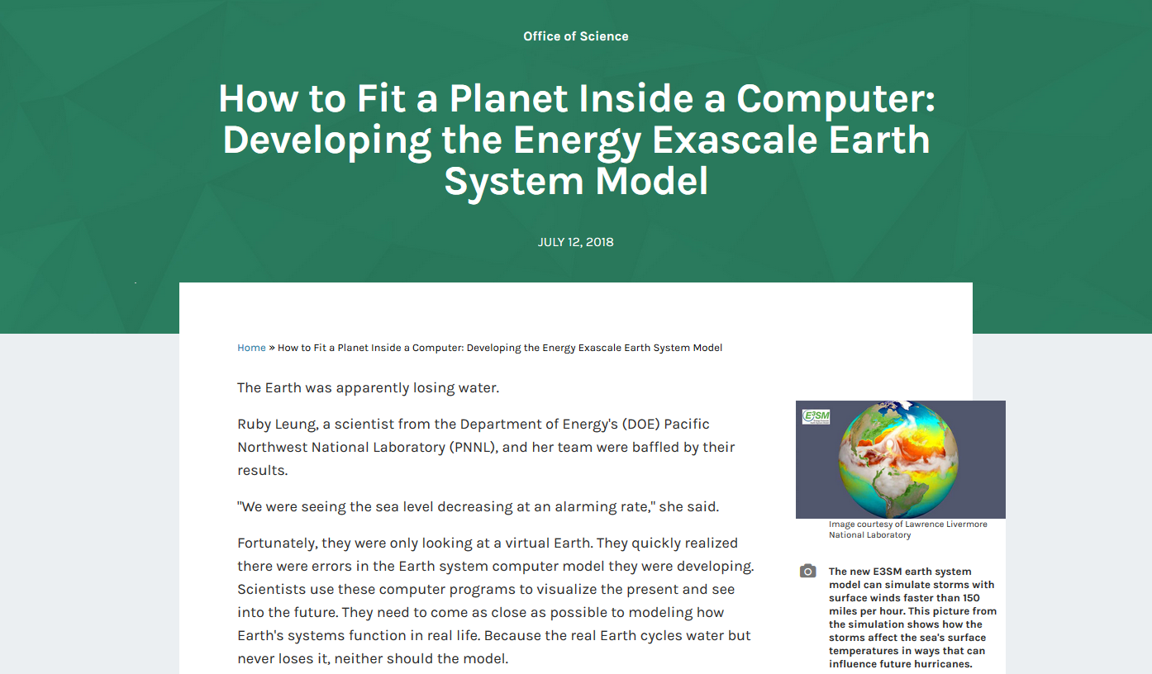
Success story #1
A critical issue with water conservation in E3SM was uncovered!
https://www.energy.gov/science/articles/how-fit-planet-inside-computer-developing-energy-exascale-earth

Slide 21

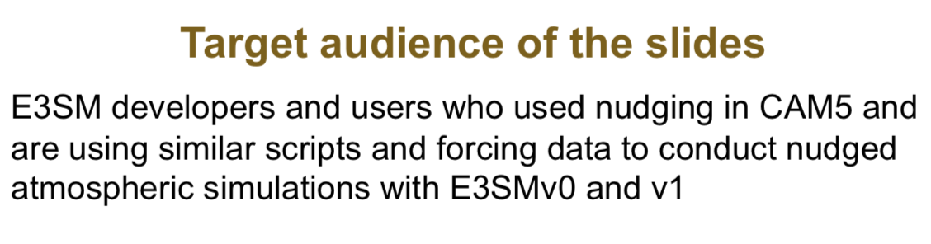
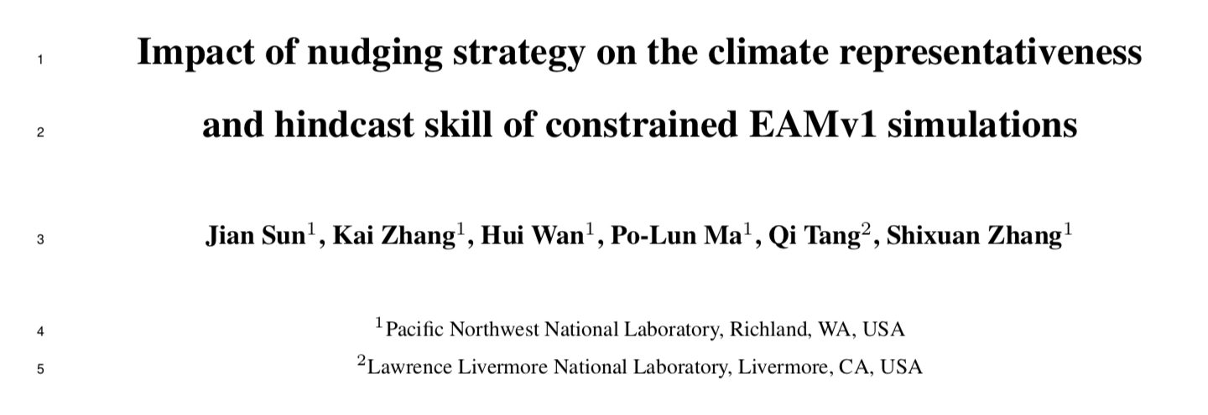
Success story #2
Issues in the implementation and use of nudging* in E3SM were uncovered!
A more flexible implementation was developed.
Journal article accepted by JAMES
*Data assimilation technique used in sensitivity studies/validation of EAM simulations.
Notes:
Nudging = data assimilation technique in aerosol-climate simulations
Can quantify model sensitivities in precipitation and cloud forcing
Convection, temperature, wind nudging
From Hui’s email:
1. About a year ago, Kai noticed that the nudged simulations he conducted using EAMv1 was giving unexpected results. After some investigation, he realized that the implementation of nudging in this new version was different from what he was (and many others were) used to in CAM5. The new implementation was not as flexible or comprehensive, and the design was also a bit different. There existed comments in the code that provided some explanation of the new implementation but there was no separate user guide about it. As a result, most of the users and developers were unaware of those changes. This was the background of that slide deck which Kai distributed to the E3SM mailing list, and I took screenshots of the first 2 pages of their slides for our 2nd "success story".
2. The inconveniences in the new code motivated Kai and Jian to revise the implementation in EAMv1. In that process, they also conducted a comprehensive evaluation of the characteristics of the nudged simulations, as well as the sensitivities of the results to how the nudged simulations were configured at run time (for example, which model-simulated fields to nudge, how to deal with the fact that the externally specified constraining data has a lower time resolution than the model's time step, etc.) Based on Kai's experience, they described two types of anticipated applications of the nudging capability: (1) to carry out sensitivity experiments for the evaluation (validation) of the simulated long-term statistics, using nudging to increase the signal-to-noise ratio of the results so that one can use shorter simulations and hence save computer time; (2) to steer the model-simulated atmospheric flow to evolve like the observations at shorter time scales to facilitate model evaluation (validation) from a more deterministic perspective. In that paper, they evaluated the model results in both scenarios and made recommendations on how to configure the nudged simulations in either case.

Slide 22
Ongoing & future work
Expand testing framework:
Evaluate and integrate or support for kgen, ctest
Explore using E3SM configuration/software environment to setup/tests on supported machines
Outreach and documentation:
Expand testing documentation, hold cmdv-test-runner tutorial (TBD).
Deploy testing workflow on other projects, e.g.,
  RRTMCP (radiative transport)
  Land model (FATES)
  DEMSI
Recommendations for future success:
Requiring common testing tools (e.g., ctest) would simplify workflow.
Documentation & verification should be done as code is developed.
Liaison from each targeted component/project is critical to creating meaningful tests!
Starting CY20: monthly Verification Interest Group concall (POC: Hui Wan)
  SCREAM
  EAGLES
  Other components?
Notes:
https://acme-climate.atlassian.net/wiki/spaces/NGDSA/pages/968786603/Roadmap+Year+2+Software+and+Algorithms+NGD

Slide 23
Backup Slides
Notes:
https://acme-climate.atlassian.net/wiki/spaces/NGDSA/pages/968786603/Roadmap+Year+2+Software+and+Algorithms+NGD

Slide 24
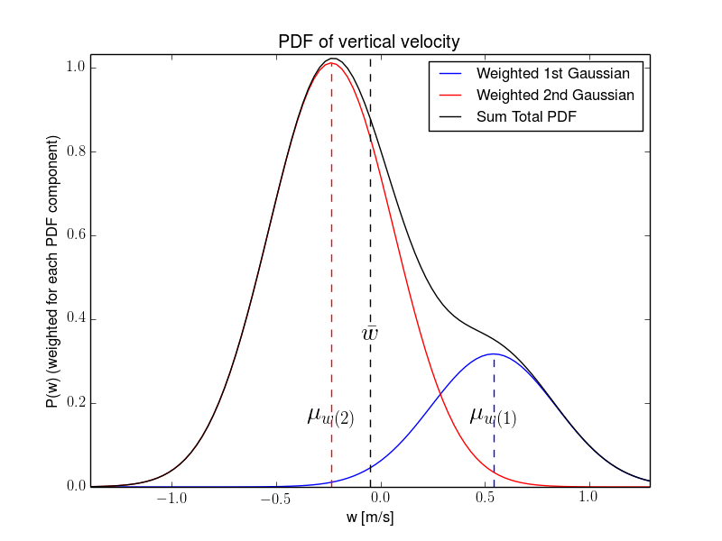
Verification example from CLUBB:
Turbulence Closure
V. Larsen (U Wisconsin)
The physics
CLUBB’s subgrid PDF is used to diagnose cloud fraction within a grid box.
CLUBB’s PDF shape is a double Gaussian (sum of 2 Gaussian components).
The code
Parameterizes the mean and variance of each Gaussian component in terms of the mean and variance over the entire grid box.
The verification
Tests whether the aforementioned algebra is correct.
More specifically, for a variety of selected inputs, the test uses CLUBB code to parameterize the component means and variances, and then checks whether the original grid mean and variance can be recovered.
Unit isolation: CLUBB PDF subroutine (Fortran).

Slide 25
Verification example from MAM: Condensation and evaporation
H2SO4 and other gases
J. Sun, R. Easter, K. Zhang, H. Wan (PNNL)
Condensation
The physics
Gas phase chemical species condense to or evaporate from
aerosol particles and change their sizes
The code
Solves ordinary differential equations (ODEs) for mass
concentrations of related gases and aerosol species
The verification
Multiple tests for the numerical methods
                Gauss-Hermite Quadrature for Mass Transfer Coefficients
                Time integration of ODEs
                Additional tests for code implementation
                E.g., Impact of rounded or non-standard values for various parameters
Unit isolation: MAM box model (Fortran)
Evaporation
See also poster by Sun et al.
https://e3sm-project.github.io/CMDV-testing/condensation/gauss_hermite_accuracy/verification.html

