Slide 1
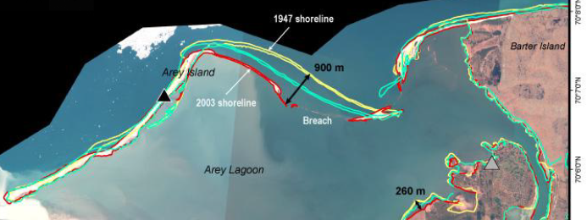
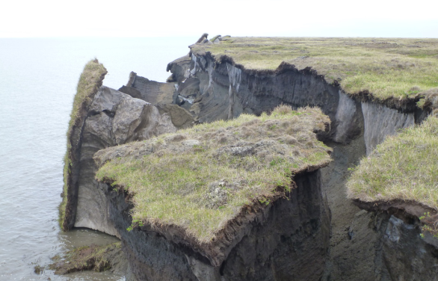
A thermo-mechanical model of permafrost for the simulation of Arctic coastal erosion d
Jenn Frederick, Alejandro Mota, Irina Tezaur, Diana Bull g
Sandia National Laboratories, U.S.A.
USNCCM2021
SAND2021-8654C
July 28, 2021

Slide 2
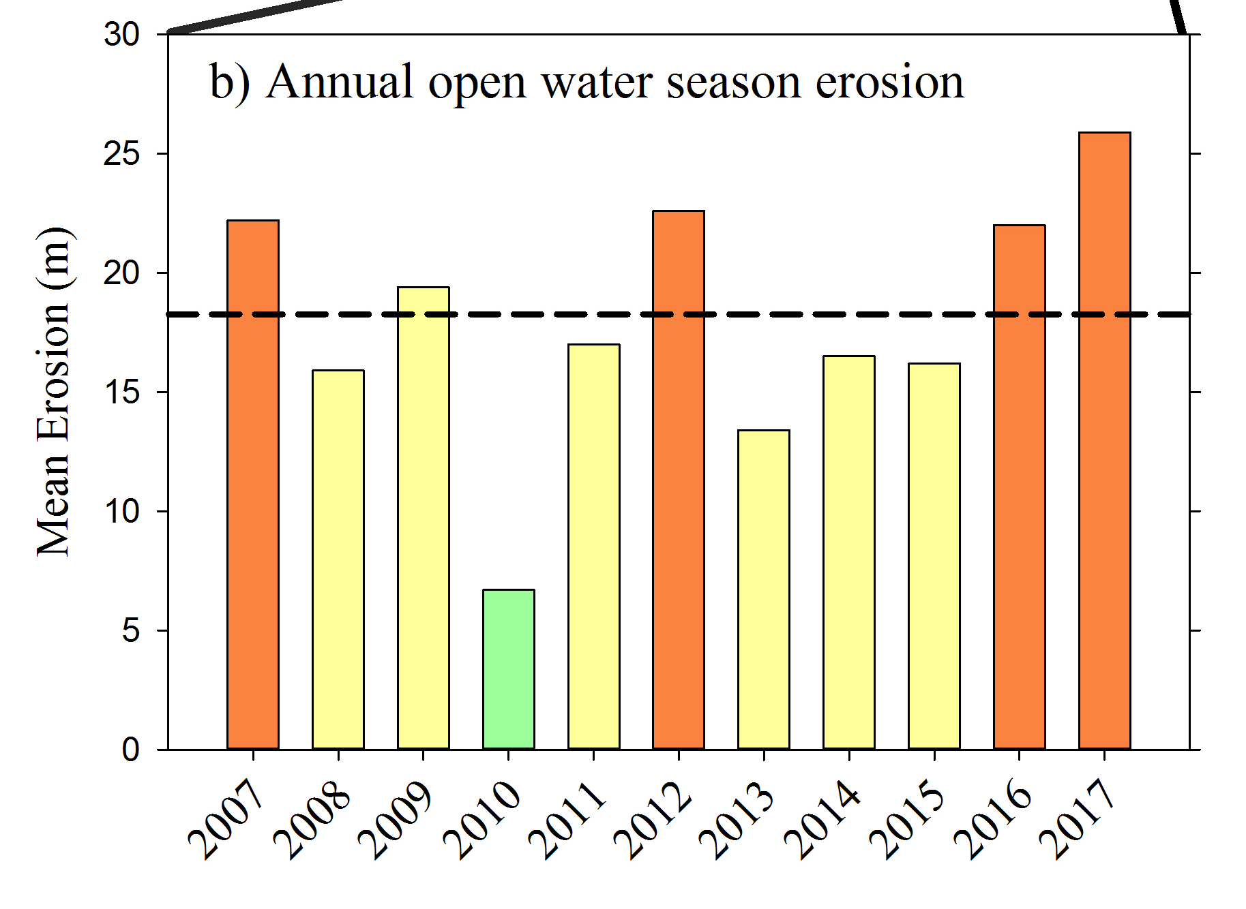
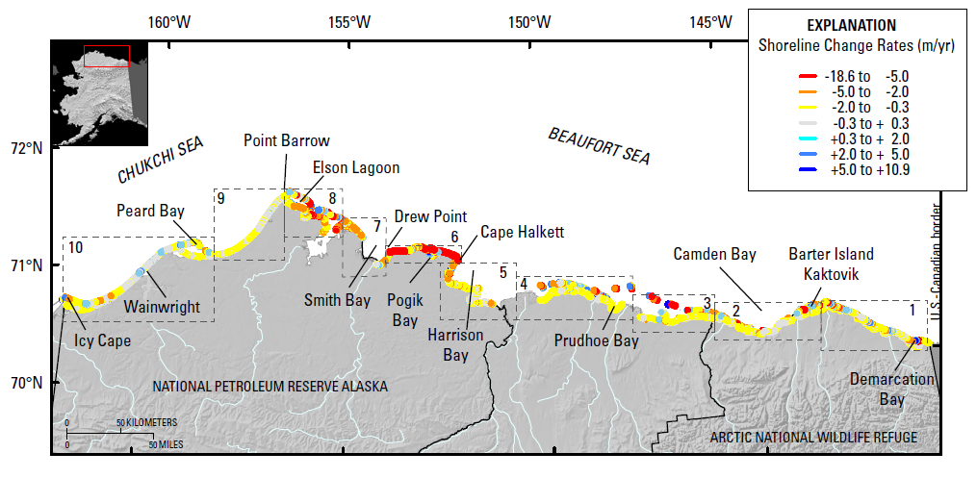
Motivation
The Arctic is warming at 2-3 times the rate of the rest of the U.S. resulting in accelerated rates of coastal erosion!
Certain locations lost ~200 m (~2 football fields in length) b/w 2007-2017!
Primary culprit is loss of Arctic sea ice: since 1979 sea ice has lost 51% in area and 75% in volume
  Increasing ice-free season
  Increasing wave energy and storm surge
  Increasing sea water temperatures
Erosion is threatening:
Coastal communities: threatened with displacement
Coastal infrastructure: active DoD sites, including toxic waste sites, in northern Alaska
Global carbon balance: permafrost stores greenhouse gases (CO₂, CH₄, NO₂).
Active DOD sites
Barrow
Wainwright
Oliktok
Barter Island
Bullen Point
Gibbs & Richmond, 2015.
2

Slide 3
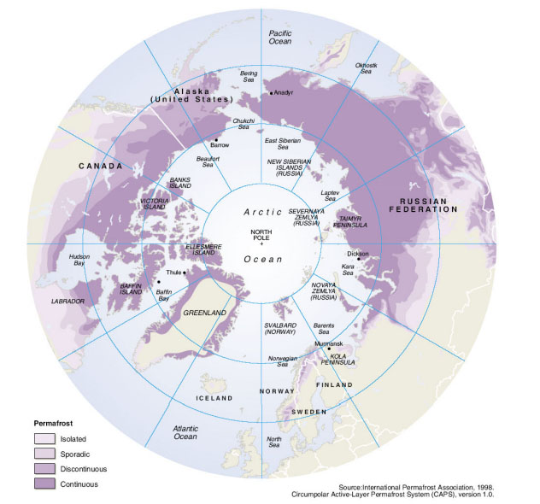
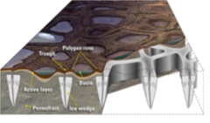
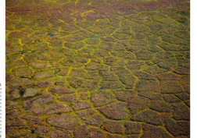
Permafrost erosion
What is permafrost?
Ground, comprised of soil, rock, silt, clay and sand, held together by ice, that remains frozen for 2+ consecutive years.
24% of ice-free land area in Northern Hemisphere and 85% of Alaska, Greenland, Canada and Siberia sits on top of permafrost.
Left: schematic illustrating formation of ice wedges and ice-wedge polygon landscapes. Right: map of permafrost distribution in Arctic
Brown et al. 1998.
Unique coastal permafrost erosion process in Arctic:
Predominant geomorphology: ice-wedge polygons
  Ice acts to bind unconsolidated soils in permafrost forming ice wedges.
  Ice wedges grow/expand up to ms wide and 10s meters deep.
  Melting of ice wedges causes permafrost failure.
Martin et al. 2009.

Slide 4
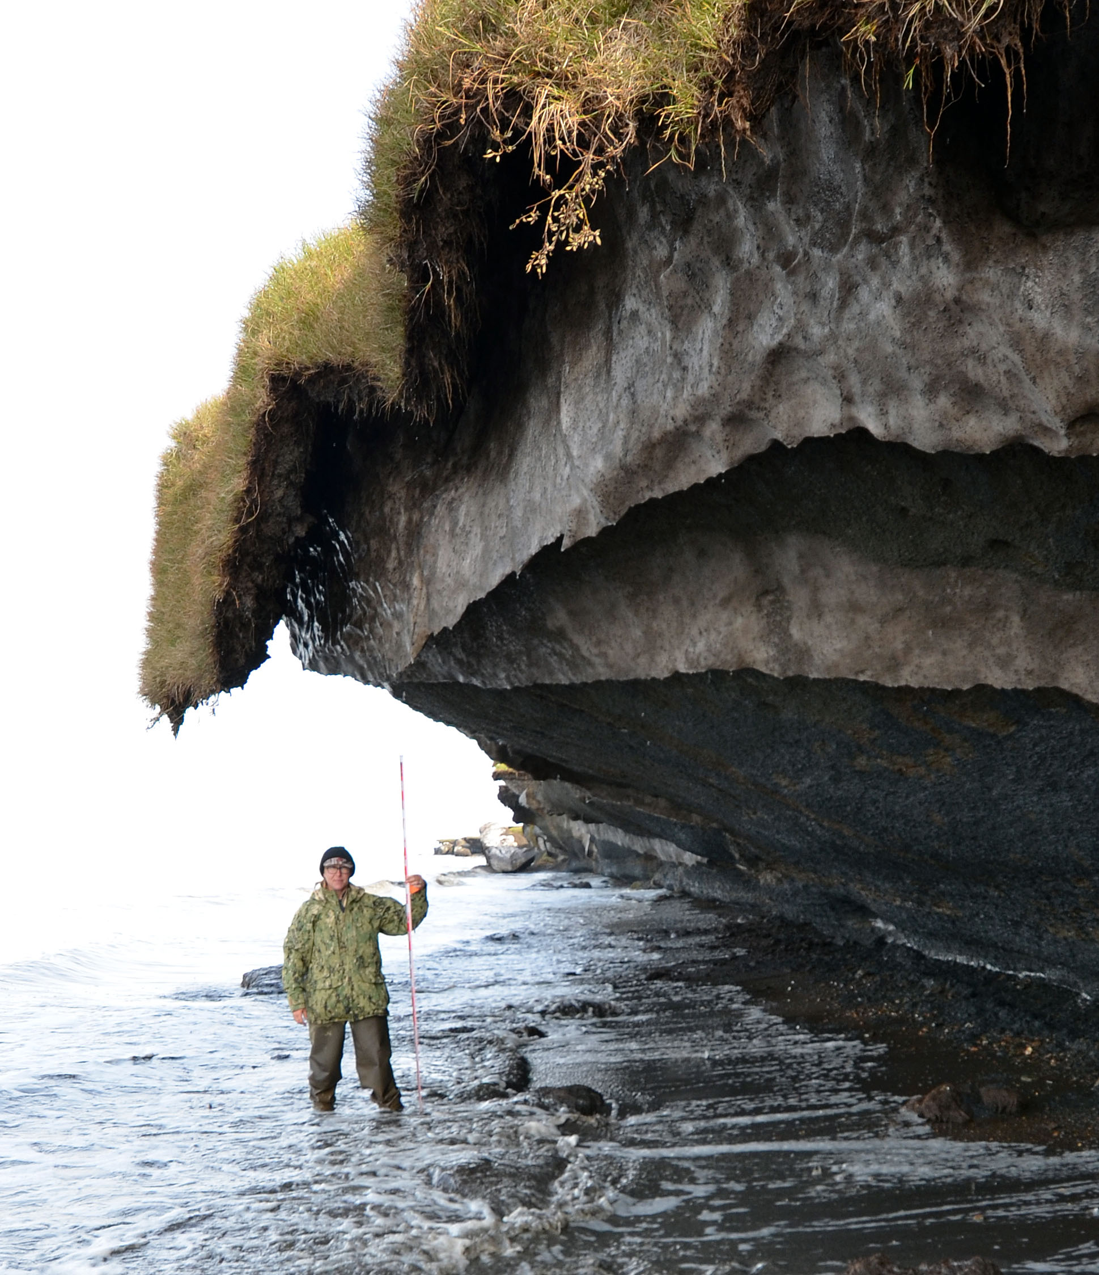
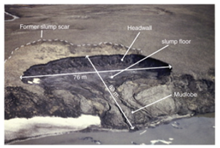
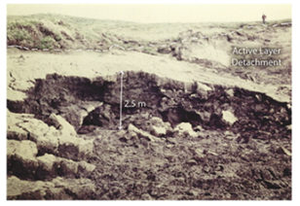
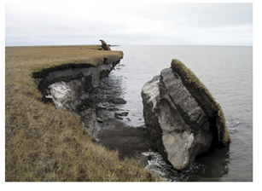
Permafrost failure mechanisms
Retrogressive thaw slumping: a slope failure characterized by thaw of exposed ground ice and slumping of thawed soil, typically caused by thermo-denundation¹.
Active layer detachment: failures are translational landslides that occur in summer in thawing soil overlying permafrost, typically caused by thermo-denundation¹.
Block failure: a niche (recess at bluff base) progresses landward until the overhanging material fails in a shearing or toppling mode known as block failure, caused by thermo-abrasion².
  Fallen blocks can disintegrate in the near-shore environment within 1-2 weeks!
Lantuit et al. 2008
Lantuit et al. 2008
Ravens et al. 2012
Retrogressive thaw slumping
Active layer detachment
Block failure
¹Thawing of permafrost bluffs that proceeds under the influence of gravity. ²Undercutting of permafrost bluff by warming ocean.
4

Slide 5
Permafrost failure mechanisms
Retrogressive thaw slumping: a slope failure characterized by thaw of exposed ground ice and slumping of thawed soil, typically caused by thermo-denundation¹.
Active layer detachment: failures are translational landslides that occur in summer in thawing soil overlying permafrost, typically caused by thermo-denundation¹.
Block failure: a niche (recess at bluff base) progresses landward until the overhanging material fails in a shearing or toppling mode known as block failure, caused by thermo-abrasion².
  Fallen blocks can disintegrate in the near-shore environment within 1-2 weeks!
Dominant failure mechanism in northern Alaska
Lantuit et al. 2008
Lantuit et al. 2008
Ravens et al. 2012
Retrogressive thaw slumping
Active layer detachment
Block failure
¹Thawing of permafrost bluffs that proceeds under the influence of gravity. ²Undercutting of permafrost bluff by warming ocean.
5

Slide 6
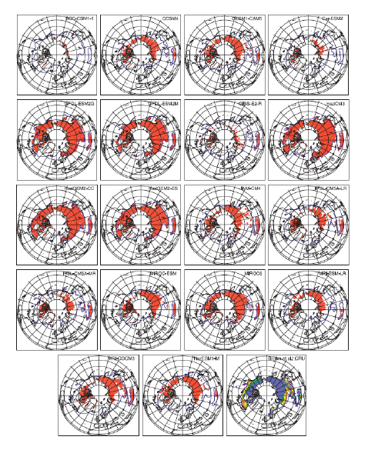
State-of-the-art in permafrost modeling
Models and tools to accurately predict Arctic coastal erosion are lacking!
Most existing models* (including Earth System Model-, or ESM-, coupled models) are primitive:
  Most models were based on trend projection and/or empirical relationships
  Limited PDE-based models: primarily thermal models, e.g., 1D steady state heat flow (no mechanics/deformation)
  Most models assumed a particular type of erosion (e.g., block failure)
  Models did not include realistic boundary conditions and did not account for permafrost geomorphologies or geophysics.
Premise behind the Arctic Coastal Erosion (ACE) project/model: an accurate, predictive Arctic coastal erosion model must couple the influences of evolving wave dynamics, thermodynamics & mechanics.
Koven et al. 2013
* See (Frederick et al. 2016), Chapter 5, for extensive overview.

Slide 7



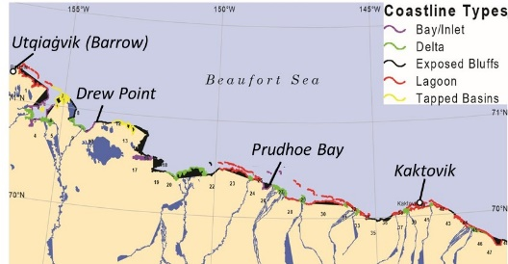
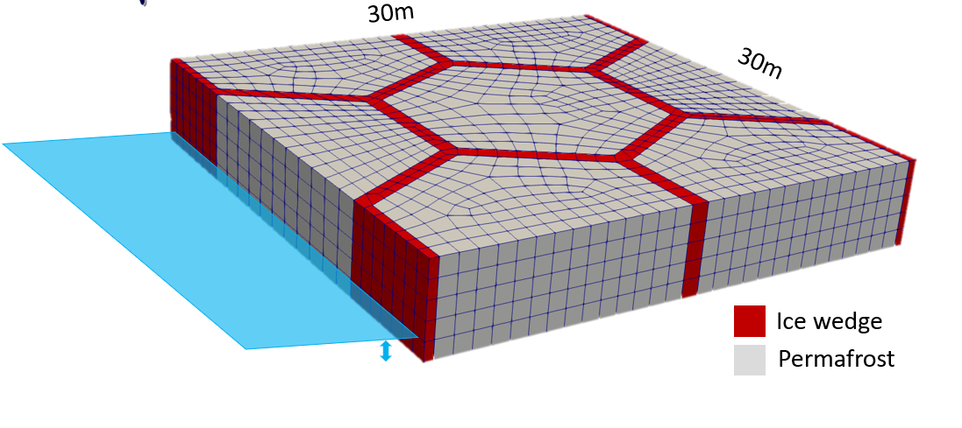
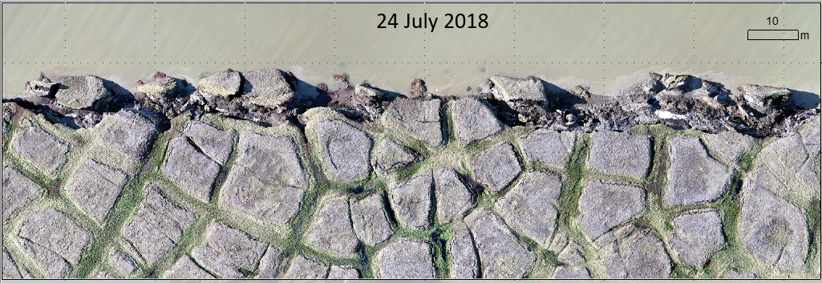
Proposed solution: a multi-scale approach
Goal of the Arctic Coastal Erosion (ACE) project is to deliver a field-validated predictive model of thermo-abrasive erosion for the permafrost Arctic coastline
Micro-Scale Model | Meso-Scale Model | Macro-Scale Model
10’s of meters & storm duration | 10’s of kilometers & monthly duration | 100’s of kilometers & annual (+) durations
One set of input variables defining the geomorphology and geophysics of the terrestrial model. | A number of micro-scale models that represent the stochastic distributions of input variables along a confined coastline. | A number of meso-scale models representing different coastline types (delta, exposed bluffs, lagoons, etc.) along the AK coastline.
This talk
Coupling of 3D heat transfer + mechanics-based plastic deformation
Wave circulation BCs representing time-varying realizations of individual storm events.
Longer term vision: upscale micro-scale model to meso- and macro-scales
Create “catalog” of smaller-scale models for diff. Arctic locations, use catalog to derive (physics-based) statistical parameterizations of things like aggregate retreat rates

Slide 8
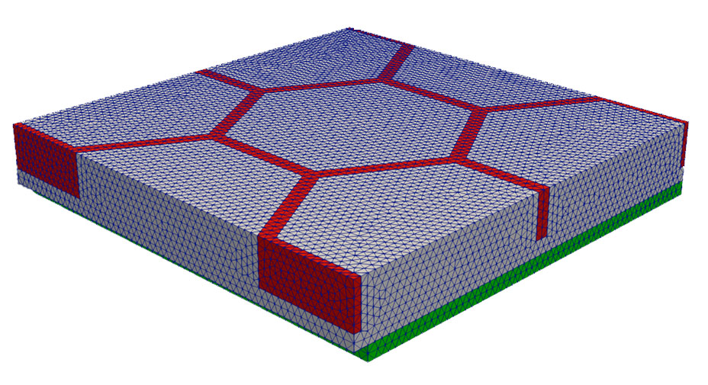
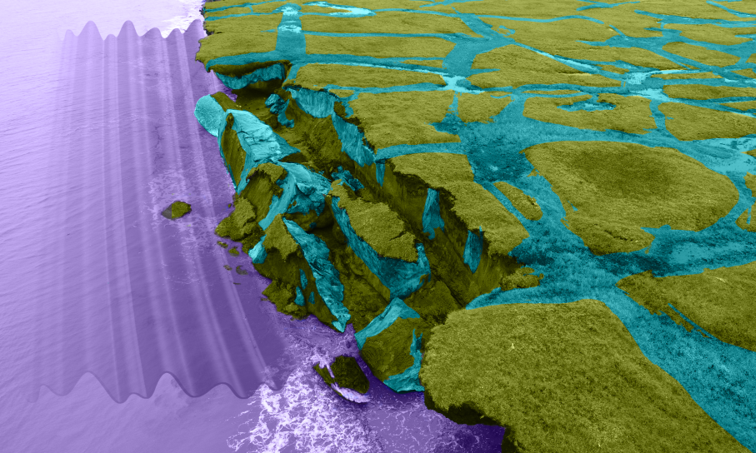
Anatomy of a canonical computational domain
Permafrost
30 m
30 m
Ice
Bluff face (exposed to ocean)
ocean water
5 m
Cryopeg*
* Layer of unfrozen ground that is perennially cryotic (forming part of the permafrost) in which freezing is prevented.

Slide 9
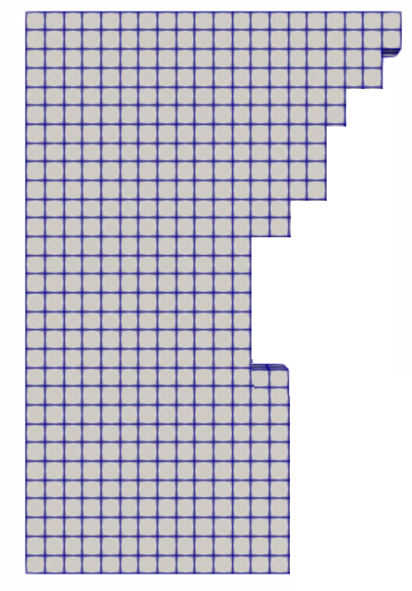

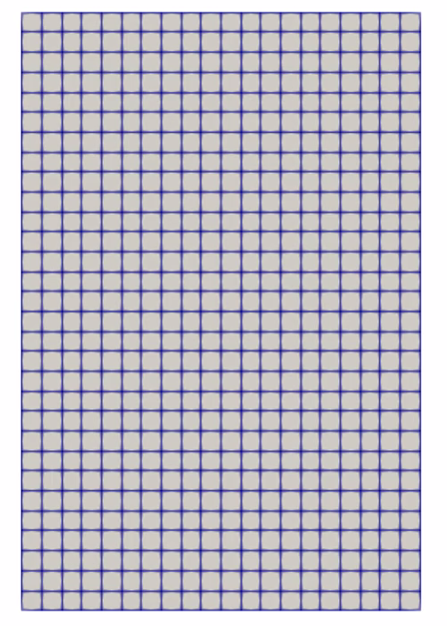
Coupled thermo-mechanical formulation
Failure modes come from constitutive relationships in FEM model (no empirical relationships!)
Thermal & mechanical problems can use different time-steppers (e.g., implicit-explicit coupling)
Elements are removed from the mesh, to simulate erosion
Thermal:
Inputs: geometry, sediment type, ice volume, water volume, pore size, salinity
Outputs: temperature field, ice saturation
Eroded geometry
Ice saturation
Model takes in realistic oceanic, atmospheric & geothermal heat flux boundary conditions (BCs) from wave model & observational data
Tightly coupled strength + thermal states: coupling happens at the level of the material model
Mechanical:
Inputs: ice saturation, strength relationship as function of thermal state, stress-strain relationships of permafrost and ice
Outputs: displacements, eroded geometry

Slide 10
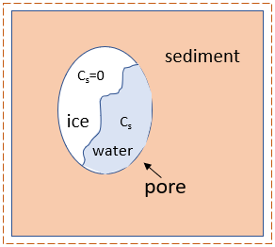
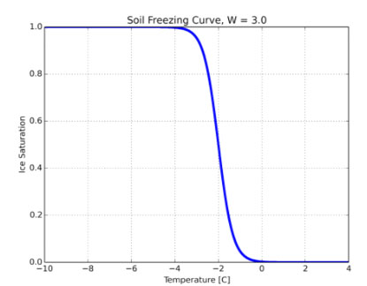

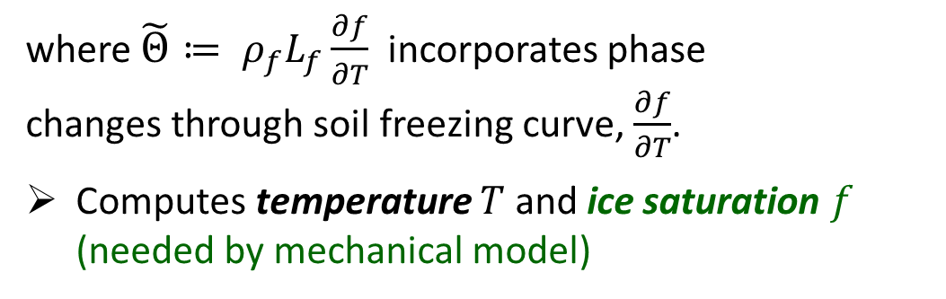
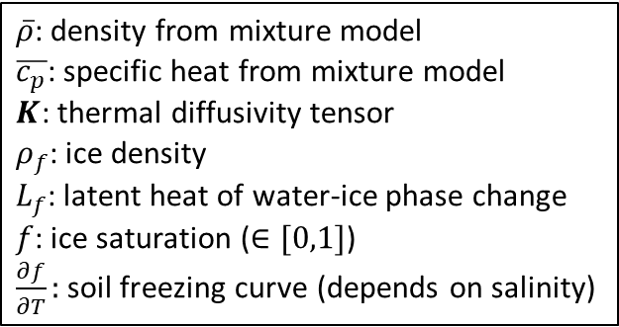
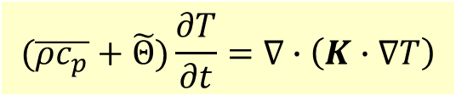
Thermal model
Transient heat conduction in a non-homogeneous porous media with water-ice phase change:
$\overline{ρ}$: density from mixture model
$\overline{c_{p}}$: specific heat from mixture model
$K$: thermal diffusivity tensor
$ρ_{f}$: ice density
$L_{f}$: latent heat of water-ice phase change
$f$: ice saturation ($∈[0,1]$)
$\frac{∂f}{∂T}:$soil freezing curve (depends on salinity)
$$(\overline{ρc_{p}}+\tilde{Θ})\frac{∂T}{∂t}=∇∙\left(K∙∇T\right)$$
where $\tilde{Θ}≔ ρ_{f}L_{f}\frac{∂f}{∂T}$ incorporates phase changes through soil freezing curve, $\frac{∂f}{∂T}$.
Computes temperature $T$ and ice saturation $f$ (needed by mechanical model)
Permafrost control volume
Soil freezing curve $\frac{∂f}{∂T}≠0$ only during phase change, which occurs in narrow temp zone (~-1C)
Above
Boundary conditions (from wave model/data)
  Local geothermal heat flux from below¹
  Mean annual air temp from above²
  Air²/ocean³ temp at bluff face
Ice Saturation
Bluff face
Below
Temperature [C]
¹ Data from borehole at Barrow, AK. ² USGS weather station data. ³ From WaveWatch3+SWAN+Delft3D model.

Slide 11
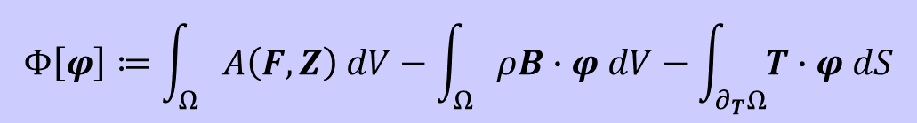
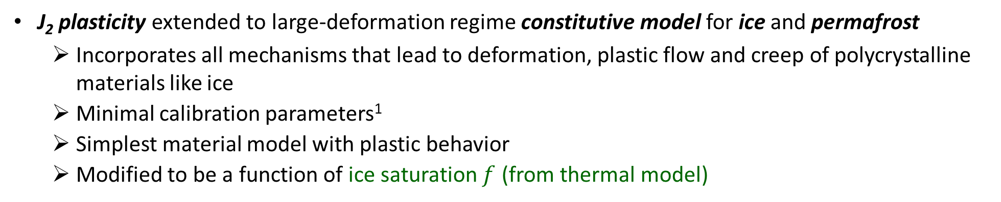
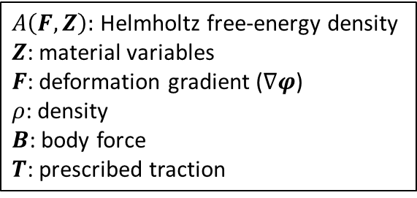
Mechanical model
Finite deformation time-dependent variational formulation for solid mechanics problem obtained by minimizing the energy functional:
$A\left(F,Z\right):$ Helmholtz free-energy density
$Z$: material variables
$F$: deformation gradient ($∇φ$)
$ρ$: density
$B$: body force
$T$: prescribed traction
$$Φ\left[φ\right]≔\int_{Ω}{A\left(F,Z\right) dV−\int_{Ω}{ρB∙φ dV−\int_{∂_{T}Ω}{T∙φ dS}}}$$
Computes displacements and new computational geometry (following erosion)
J₂ plasticity extended to large-deformation regime constitutive model for ice and permafrost
  Incorporates all mechanisms that lead to deformation, plastic flow and creep of polycrystalline materials like ice
  Minimal calibration parameters¹
  Simplest material model with plastic behavior
  Modified to be a function of ice saturation $f$ (from thermal model)
Symmetry BCs
Boundary conditions:
  Symmetry BCs on lateral sides
  Wave pressure Neumann BC on bluff face² (from wave model).
Bluff face
Symmetry BCs
¹ Determined by laboratory tests on frozen soil samples from targeted location. ² Partenscky, 1988.

Slide 12
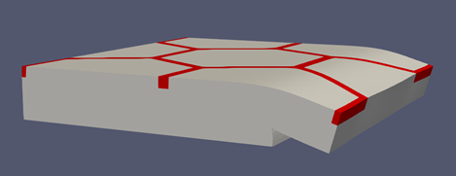
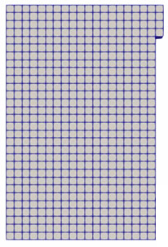
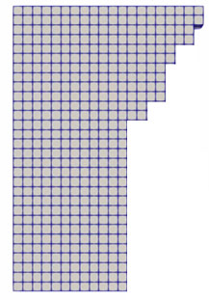
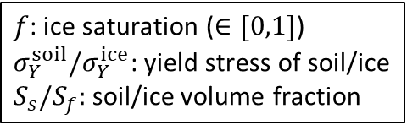

Erosion failure criteria
$f$: ice saturation ($∈[0,1]$)
$σ_{Y}^{soil}{/σ}_{Y}^{ice}$: yield stress of soil/ice
$S_{s}/S_{f}:$soil/ice volume fraction
Sub-grid scale erosion criterion: when material is exposed to water, thermal parameters are modified proportional to water force.
Stress criterion: removes material when it reaches a critical value of the yield stress
$σ_{0}\left(T\right)≔S_{s}σ_{Y}^{soil}+S_{f}f(T)σ_{Y}^{ice}$
Kinematic criterion: when material has tilted excessively, it is assumed to have fallen as part of block erosion.
Once failure criterion is reached, “failed” elements are removed from mesh.
Bluff face
Niche

Slide 13
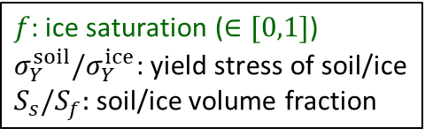

Erosion failure criteria
$f$: ice saturation ($∈[0,1]$)
$σ_{Y}^{soil}{/σ}_{Y}^{ice}$: yield stress of soil/ice
$S_{s}/S_{f}:$soil/ice volume fraction
Sub-grid scale erosion criterion: when material is exposed to water, thermal parameters are modified proportional to water force.
Stress criterion: removes material when it reaches a critical value of the yield stress
$σ_{0}\left(T\right)≔S_{s}σ_{Y}^{soil}+S_{f}f(T)σ_{Y}^{ice}$
Kinematic criterion: when material has tilted excessively, it is assumed to have fallen as part of block erosion.
Once failure criterion is reached, “failed” elements are removed from mesh.
Erosion happens in the mechanics problem but is influenced by the thermal problem.
Bluff face
Niche

Slide 14

Finite element implementation within Albany
The thermo-mechanical Arctic Coastal Erosion (ACE) model is implemented within the LCM project in Sandia’s open-source parallel, C++, multi-physics, finite element code, Albany.
https://github.com/ SNLComputation/LCM
Component-based design for rapid development.
Contains a wide variety of constitutive models.
Extensive use of libraries from the open-source Trilinos project.
  Use of the Phalanx package to decompose complex problem into simpler problems with managed dependencies.
  Use of the Sacado package for automatic differentiation.
Coupled to the DOE’s Energy Exascale Earth System Model (E3SM) through Albany Land-Ice (ALI) component.
All software available on GitHub.
https://github.com/trilinos/trilinos

Slide 15
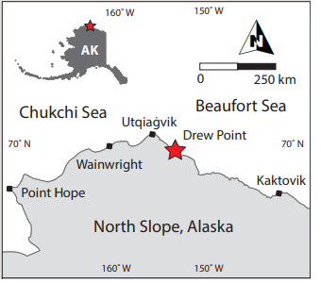
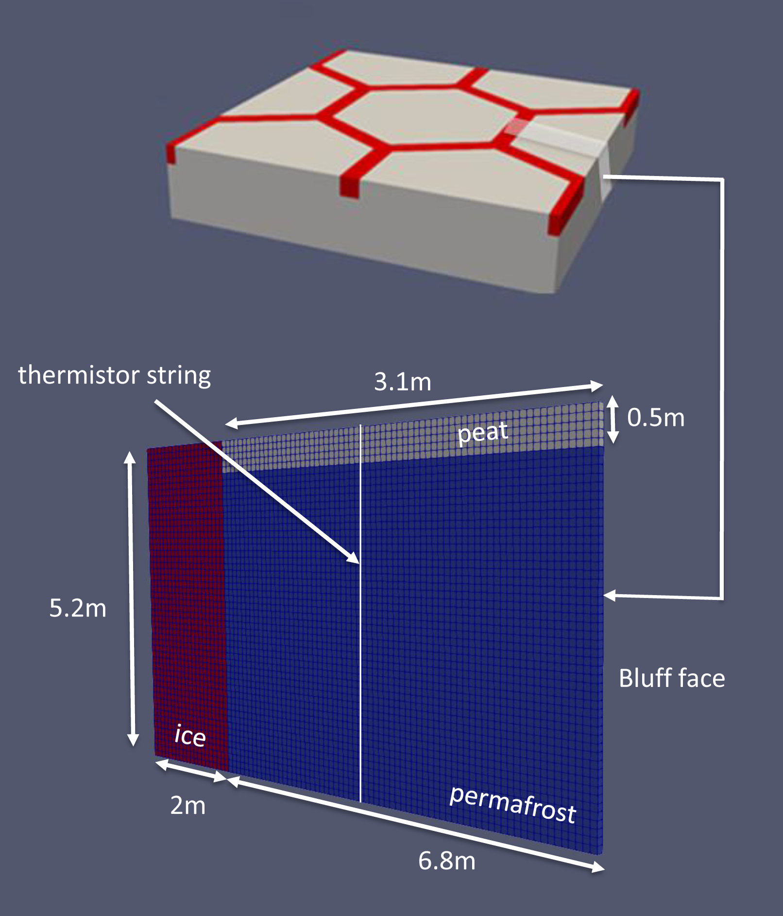
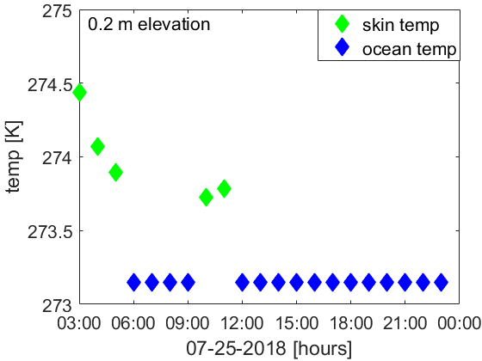
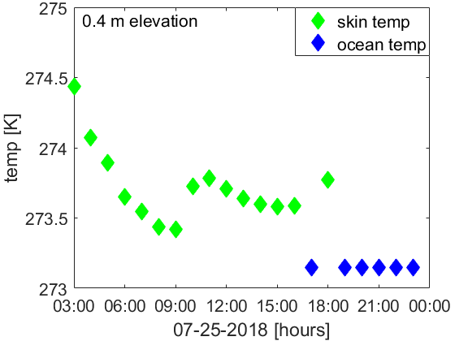
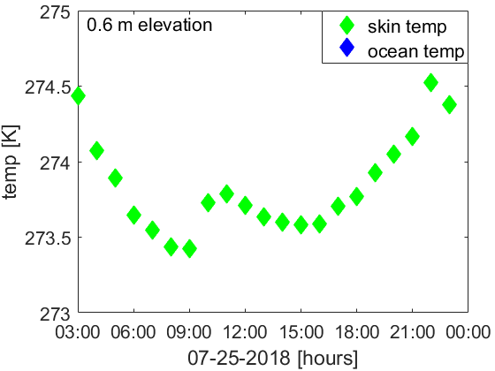
2.5D slice at Drew Point, Alaska*
Computational domain is 2.5D cross-section of archetypal 3D bluff geometry discretized using a uniform hex grid.
  Slice of permafrost is exposed to realistic BC data occurring at Drew Point, Alaska in July 2018 (pseudorealistic problem)
Initial temperature field obtained from vertical thermistor string placed into DP1-1 ice core at Drew Point.
Material properties determined from laboratory experiments on frozen soil samples from Drew Point, Alaska
Implicit Newmark for mechanical, explicit forward Euler for thermal (stable $Δt = 1$hour)
* For details, see: Frederick, Mota, Tezaur, Bull, J. Comput. Appl. Math. 2021.

Slide 16
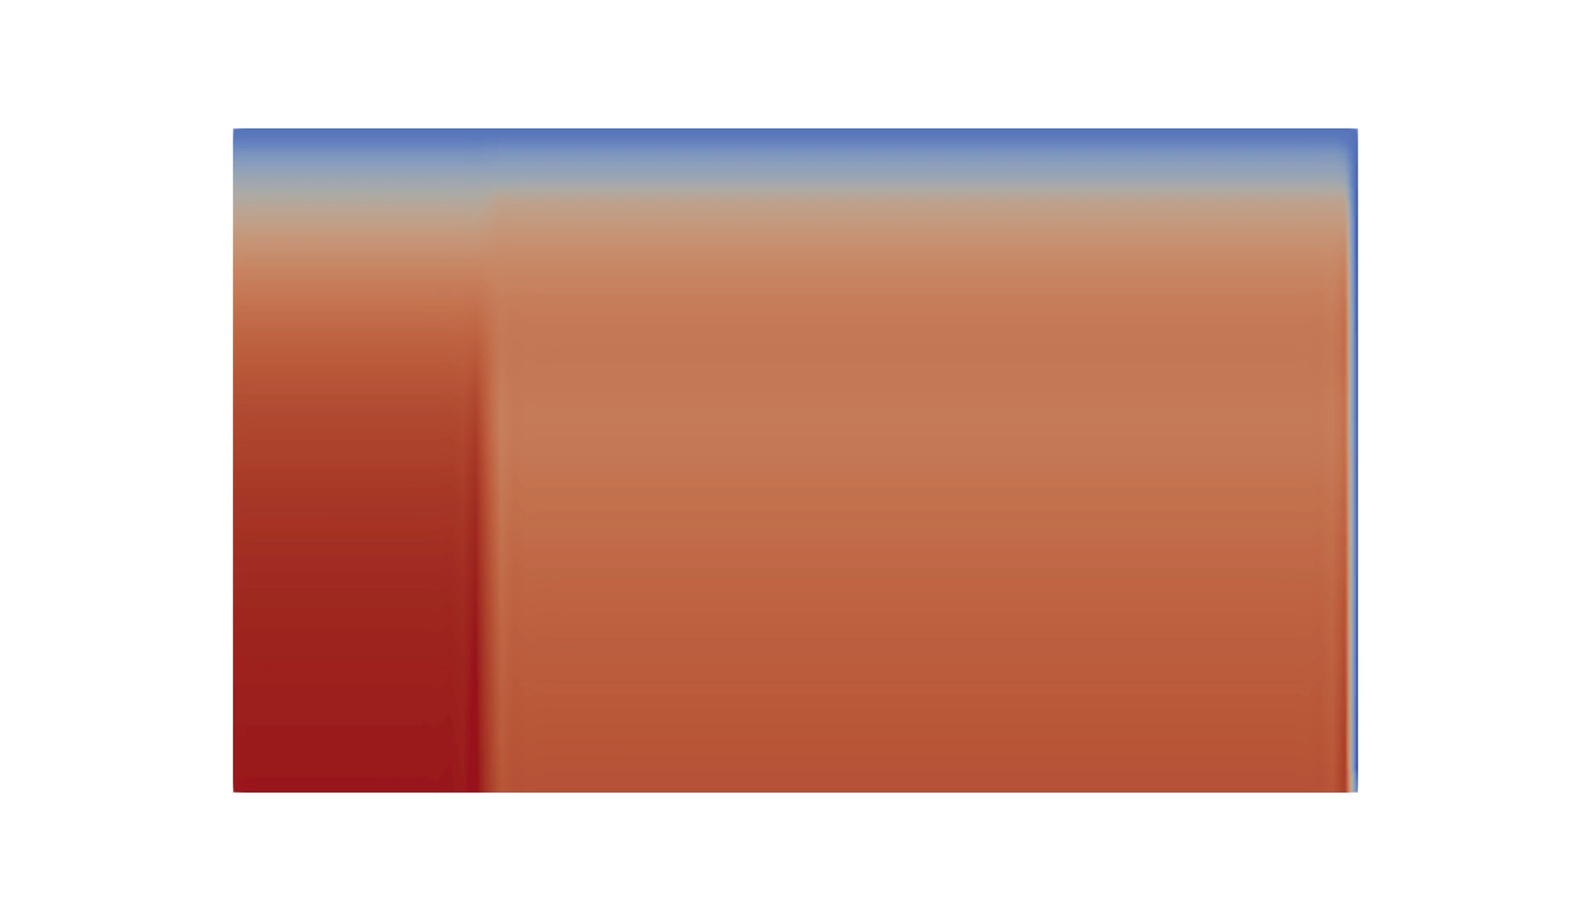
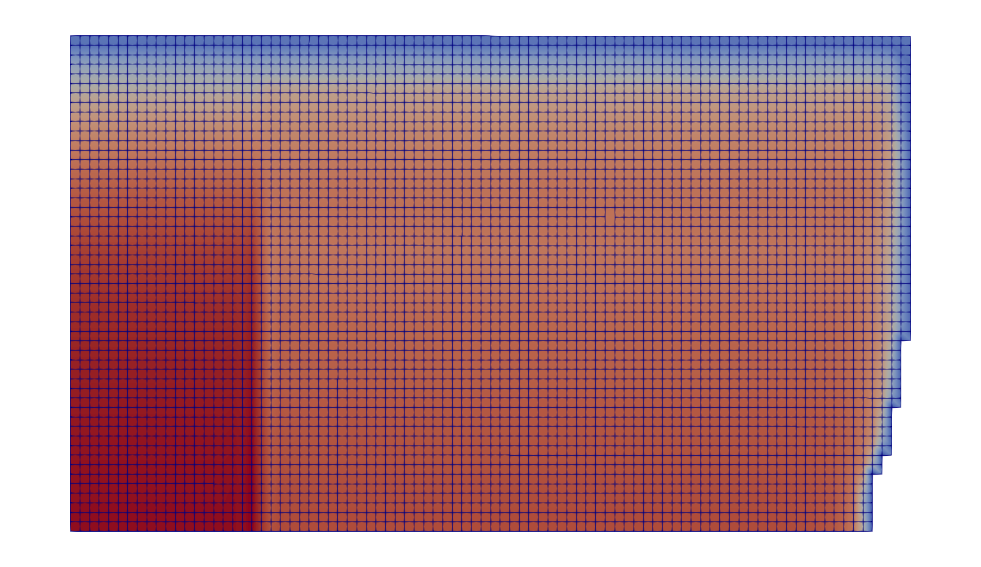
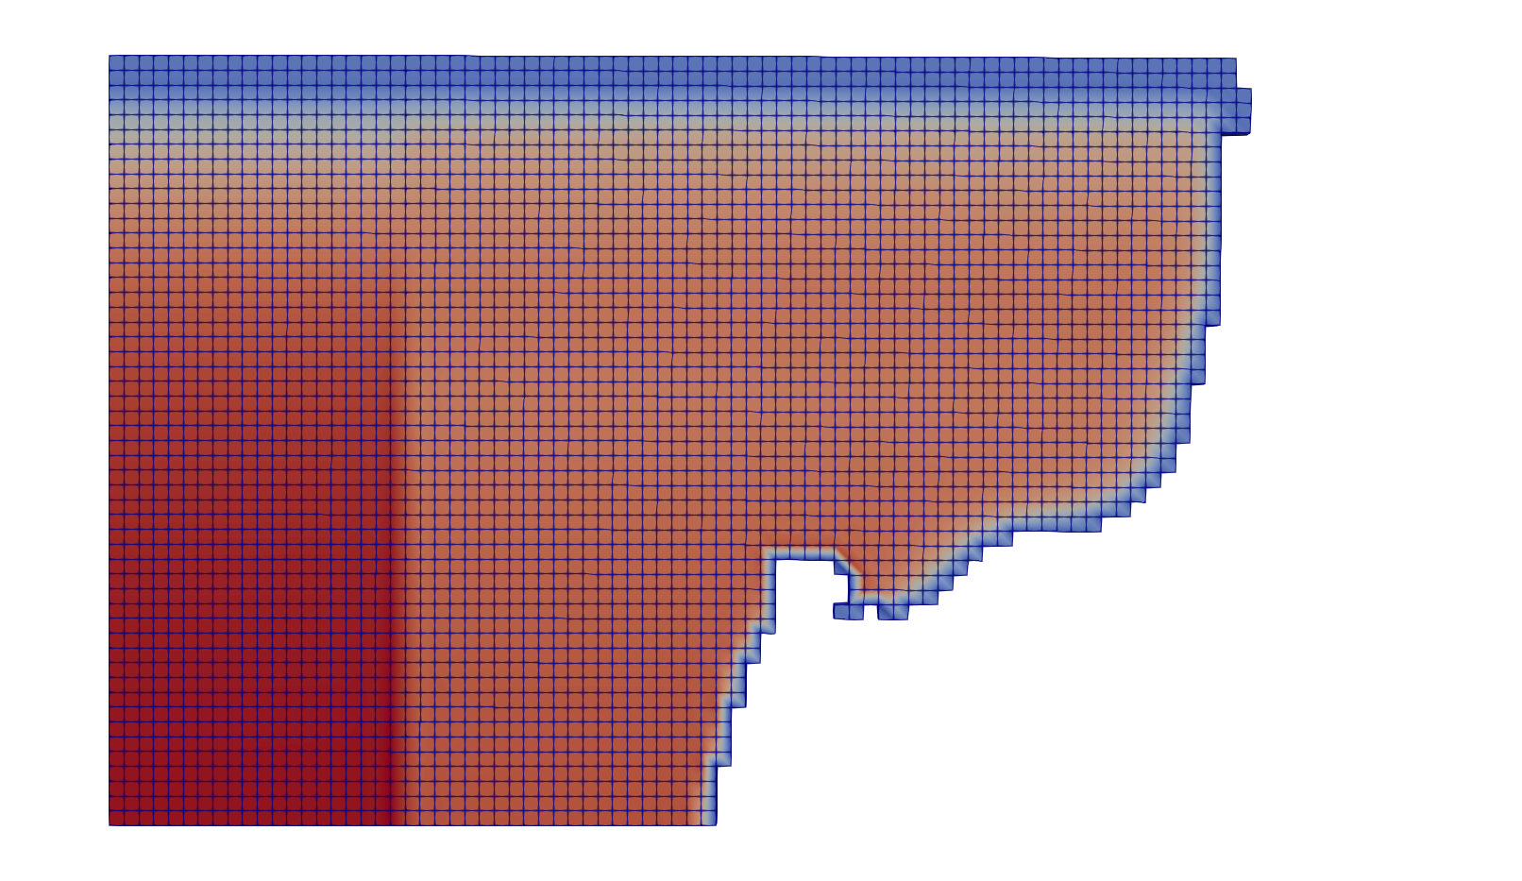
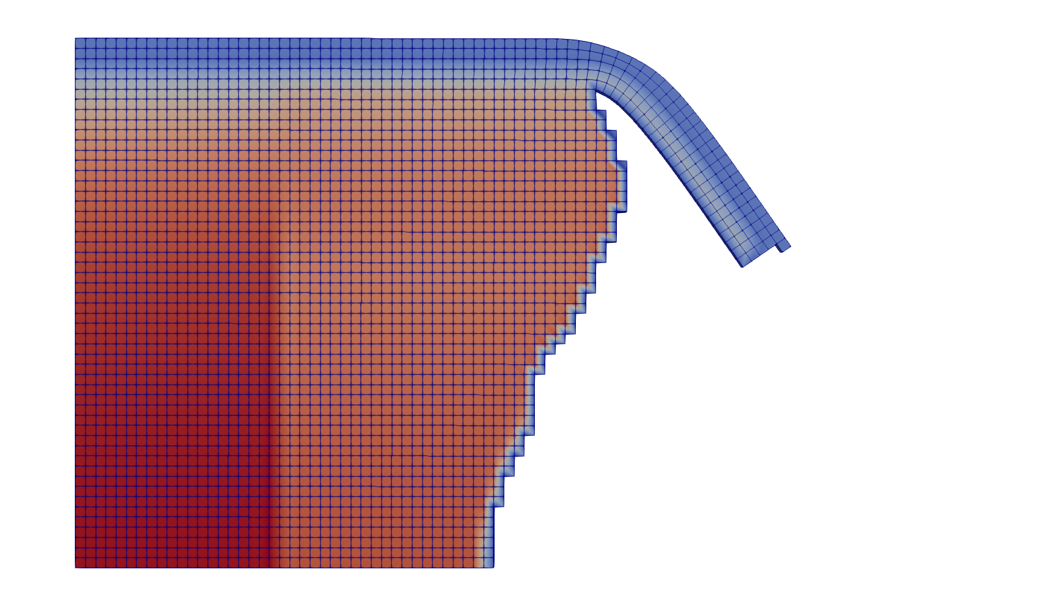
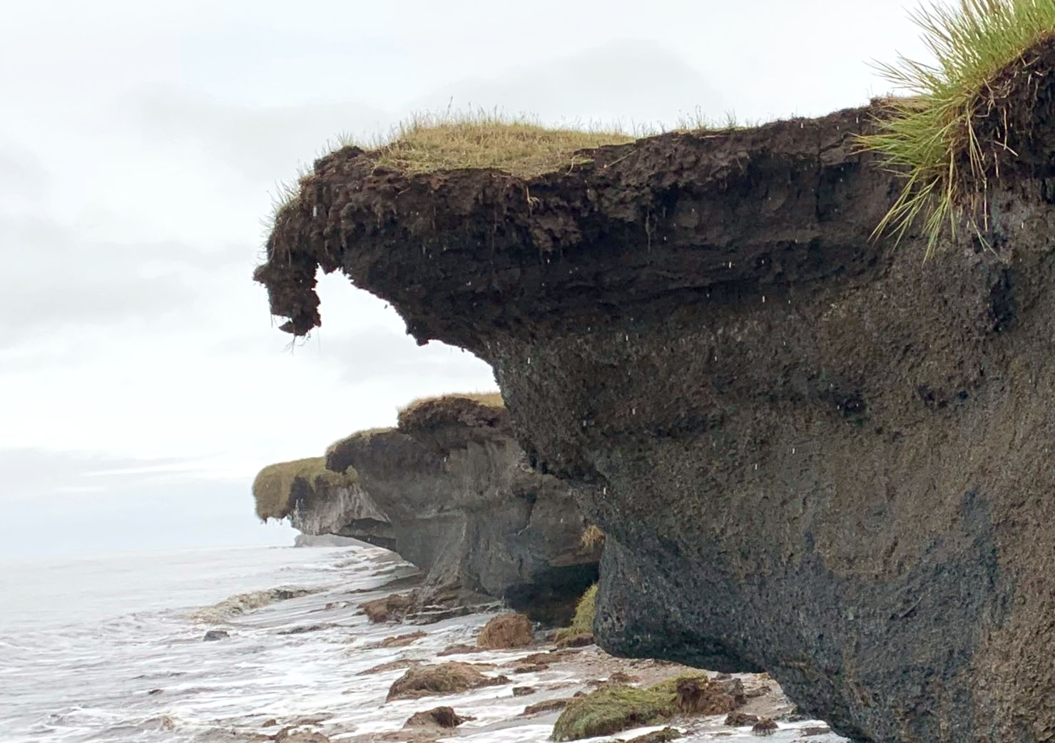
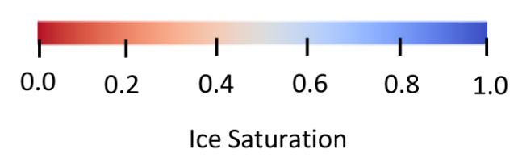
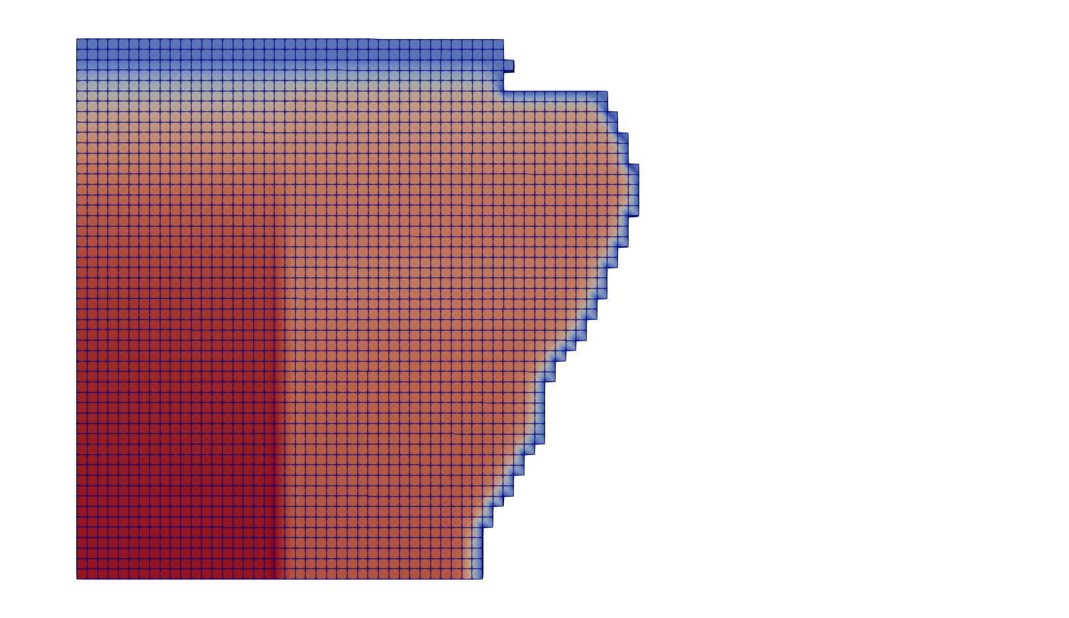



2.5D slice at Drew Point, Alaska*
$t≈8$days
Simulation showing niche progression beginning at the bluff toe and block failure/collapse event*
Peat
0.5m
~3m deep niche forms before a block collapse event similar to observed collapse at Drew Point, Alaska in early fall 2018.
$t≈39$days
5.2m
Bluff face (exposed to ocean)
Niche formation
$t≈39$days
Ice wedge
Permafrost
Overhanging peat material
Once niche advanced far enough, tension crack development in response to niche formation is observed
6.8m
Qualitative comparison to observations
$t≈39$days
Thermal denudation simultaneously with realistic niche geometry development.
Block failure!
* For details, see: Frederick, Mota, Tezaur, Bull, J. Comput. Appl. Math. 2021.

Slide 17
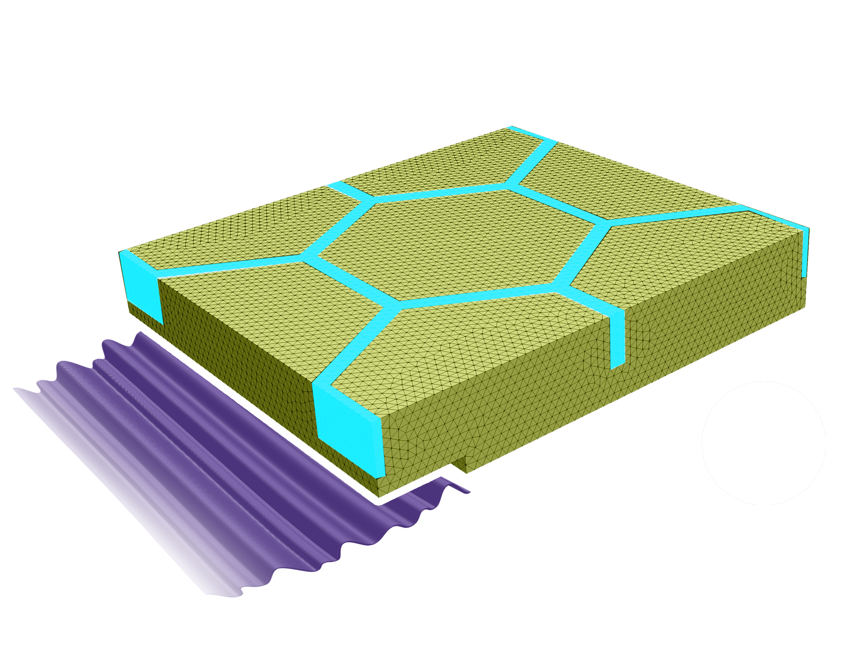
Summary
We have developed a thermo-mechanical coupled FEM model, ACE, that can simulate transient niche development and permafrost erosion within Albany.
The model was calibrated using data from a series of experiments on frozen soil samples from Drew Point, Alaska that were performed at Sandia’s Geomechanics Laboratory, as well as observational data collected at the same location.
The model incorporates boundary conditions from the WW3+SWAN+Delft3D wave models and observational data from field campaigns at Drew Point, Alaska.
30m
30m
5m
z
x
y

Slide 18
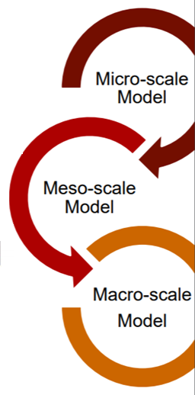

Ongoing/future work
Near term:
Quantitative validation study in which the ACE model predictions are compared to available observational data collected during the 2018-2019 summer seasons at Drew Point, Alaska (2.5D slice + 3D).
Further calibration and sensitivity studies using a range of environmental, geomorphological and numerical parameters.
Longer term:
Integrate chemical transport into thermal model.
Infer statistical meso-/macro-scale models and relevant physics-based parameterizations from ACE micro-model, towards integration into ESMs.
  ACE is member of the newly-funded DOE sponsored InteRFACE project* focused on coastal processes in Arctic.
* Interdisciplinary Research for Arctic Coastal Environments

Slide 19
References
[1] J. Frederick, M. Thomas, D. Bull, C. Jones, J. Roberts. “The Arctic Coastal Erosion Problem”. Sandia National Laboratories Report, SAND2016-9762, 2016.
[2] A. Gibbs, B. Richmond. “National assessment of shoreline change – historical shoreline change along the north coast of Alaska, U.S.-Canadian border to Icy Cape”. U.S. Geological Survey Open-File Report, 2015-1048, 2015.
[3] P. Martin et al. “Wildlife response to environmental Arctic change: predicting future habitats of Arctic Alaska”. Report to WildREACH: Predicting Future Habitats of Arctic Alaska Workshop, Farbanks, Alaska, 2008.
[4] J. Brown and O. Ferrians and J. Heginbottom, E. Melnikov. “Circum-Arctic map of permafrost and ground conditions. Boulder, CO: National Snow and Ice Data Center, Digital Media, 1998.
[5] H. Lantuit, W. Pollard. Fifty years of coastal erosion and retrogressive thaw slump activity on Herschel Island, southern Beaufort Sea, Yukon Territory, Canada. Geomorphology, 95, 84-102, 2008.
[6] T. Ravens, B. Jones, J. Zhang, C. Arp, J. Schmutz. “Process-based coastal erosion modeling for Drew Point, North Slope, Alaska”. Journal of Waterway, Port, Coastal, and Ocean Engineering, 138, 2, 122-130, 2012.
[7] C. Koven, J. Riley, A. Stern. “Analysis of permafrost thermal dynamics and response to climate change in the CMPI5 Earth system models”. J Climate, 26, 1877-2900, 2009.
[8] M. Thomas, A. Mota, B. Jones, C. Choens, J. Frederick, D. Bull. “Bluff geometry and material properties influence stress rates relevant to coastal permafrost block failure”. Frontiers in Earth Science 8, 2020.
[9] J. Frederick, A. Mota, D. Bull, I. Tezaur. “Thermo-chemo-mechanical coupling for Arctic Coastal Erosion”, J. Comput. Appl. Math. 2021 (in press).
[10] D. Bull, C. Flanary, C. Jones, J. Frederick, A. Mota, I. Tezaur, J. Kasper, E. Brown, B. Jones, M. Jones, E. Bristol, C. Choens, C. Connoly, J. McClelland. "Arctic Coastal Erosion: Modeling and Experimentation". Sandia National Laboratories report, SAND2020-10223, 2020.

Slide 20
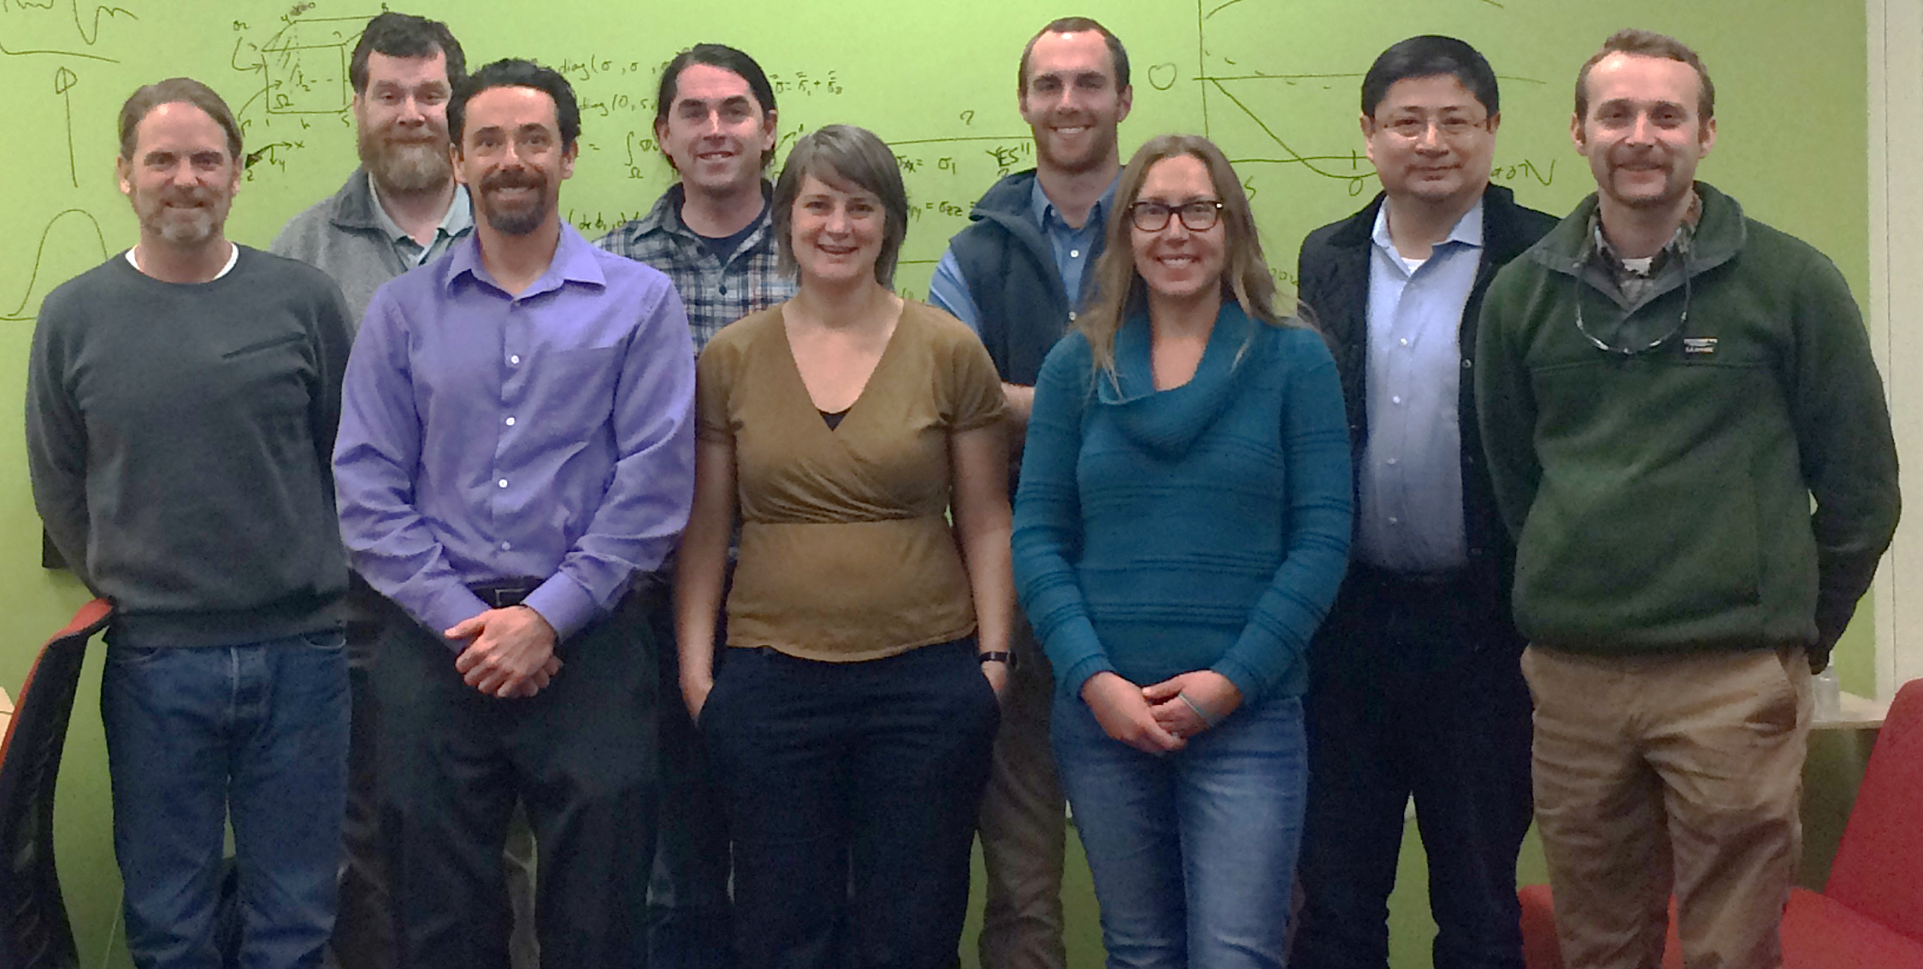

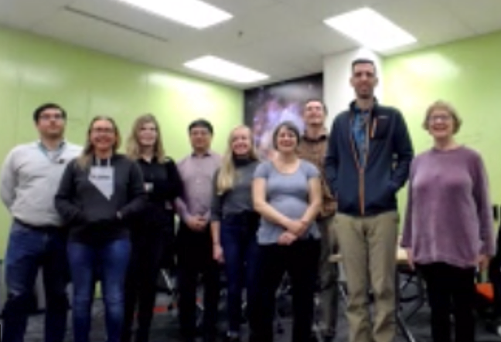
Acknowledgements
Research Team
SNL: D. Bull (PI), J. Frederick, A. Mota, C. Choens, I. Tezaur, L. Criscenti
USGS: M. Thomas, B. Jones
UAF: J. Kasper, E. Brown
Integral Consulting: C. Jones, C. Flanary
U Texas: J. McClelland, E. Bristol, C. Connolly

Slide 21
Start of Backup Slides

Slide 22
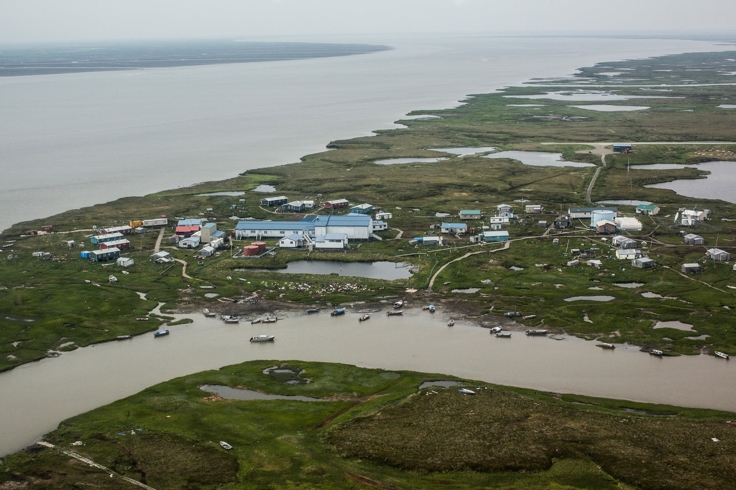
Potential impacts
3D model capable of predicting erosion from the material’s constitutive relationships capturing all types of deformation (block & denudation) leading to:
  Data-driven understanding of the characteristics that cause erosion
  A tool to guide military and civil infrastructure investments
  An improved understanding of coastal food web impacts and carbon-climate feedbacks
Redistributed eroded sediment in the environment enables:
  Prediction of deposition locations
  Estimates of fluxes (biogeochemical, toxins, etc.)
PC: Andrew Burton, NPR
Approach for moving from mechanistic micro-scale to stochastic meso-scale model sets stage for integration into global climate models built upon parametric analyses of input variables

Slide 23

Example of bluff erosion during 2019 UAV surveys*
  Fallen blocks can disintegrate in near-shore environment within 1-2 weeks!
*Images courtesy of Ben Jones, UAF
23

Slide 24




ACE Model Component Coupling
ACE project has many pieces!
Terrestrial model: thermo-mechanical coupled FEM model that can simulate transient niche development.
Oceanographic model: WW3 + SWAN + Delft3D wave models for providing oceanic BCs (ocean temp/height) to terrestrial model.
Geomechanical testing: for characterization of permafrost parameters in terrestrial model.
Field campaign: offshore oceanographic measurements, bathymetric survey, niche measurements, etc.
(Drew Point, Alaska)

Slide 25
ACE Model Component Coupling
ACE project has many pieces!
Terrestrial model: thermo-mechanical coupled FEM model that can simulate transient niche development.
Oceanographic model: WW3 + SWAN + Delft3D wave models for providing oceanic BCs (ocean temp/height) to terrestrial model.
Geomechanical testing: for characterization of permafrost parameters in terrestrial model.
Field campaign: offshore oceanographic measurements, bathymetric survey, niche measurements, etc.
This talk
(Drew Point, Alaska)

Slide 26

Oceanography in Mechanistic Model
WW3
SWAN
Wave set-up conditions 2-way coupled with circulation
Delft3D
Circulation and thermodynamic mixing 2-way coupled with waves
ice cover
temperature (surface and ocean)
surface winds
solar radiation
persistent currents
capture set-up (storm surge and runup)
wave energy inclusive of induced current effects
capture induced currents in nearshore
ability to model mixing of temperature and salinity clines
Development of wave field in the Arctic to develop nearshore BCs
high resolution near shore environment
Potential Key Advances
  Inclusion of ice coverage for fetch limited wave growth
  Knowledge of wave energy along broad coastline
  Set-up determination inclusive of bathymetry and wave energy
  Ability to accurately predict temperature at bluff face through mixing of clines in the ocean
WW3 polar stereographic model initially developed by NRL (Erick Rogers) and NOAA (Arun Chawla)

Slide 27





Proposed solution
Goal of the Arctic Coastal Erosion (ACE) project is to deliver a field-validated predictive model of thermo-abrasive erosion for the permafrost Arctic coastline
2017-2022
Multi-physics finite element model of an archetype of the coastline coupled with high-fidelity model of storm intensities
  Input variables define geomorphology & geophysics
  Plastic deformation model of material (J2 class)
  Geomechanical testing to determine coupled thermal-mechanical strength characteristics
  Time-varying ocean BCs (water level, temp, salinity)
  Eroded sediment and biogeochemical flux tracking
This talk
field measurements
Micro-scale Model
oceanographic model
10’s of meters & storm duration
thermo-chemical-mechanical terrestrial model
30m
5m
30m
Significant Wave Height (m)
0.0 0.5 1.0 1.5 2.0 2.5 3.0
ocean water
July 23rd 2017. 6am.
Ice wedge
WW3 polar stereographic model initially developed by NRL (Erick Rogers) and NOAA (Arun Chawla)
Permafrost
A “catalog” of micro-scale models that represent the statistical distributions of input variables along a ~10km stretch of coastline.
  Probability distribution functions of geomorphology and geophysics used to weight erosion output
    Will validate approach with decade long annual measurements at Drew Point.
  Evaluating ocean “exposure metrics” to represent time-varying ocean
2023+
Meso-scale Model
10’s of km’s & seasonal duration

Slide 28
Multi-scale approach
Micro-Scale Model | Meso-Scale Model | Macro-Scale Model
10’s of meters & storm duration | 10’s of kilometers & monthly duration | 100’s of kilometers & annual (+) durations
One set of input variables defining the geomorphology and geophysics of the terrestrial model. | A number of micro-scale models that represent the stochastic distributions of input variables along a confined coastline. | A number of meso-scale models that represent the diversity of coastline types (delta, exposed bluffs, lagoons, etc.) along the AK coastline.
  Working towards a series of fully coupled studies to determine terrestrial model sensitivities to:
    Height of water on bluff face
    Exposure time of bluff face to water
    Temperature of water
    Salinity of water

Slide 29





Parameters & inputs
BC Data for Drew Point
Parameters estimated from lab experiments:
Elastic modulus, Poisson’s ratio, yield strength
Sand/silt/clay fractions with depth
Porosity with depth
Parameters from literature:
Ice/water/sediment densities, thermal conductivities, heat capacities
Freezing curve/width as function of sediment type
Bluff salinity with depth
Parameters estimated from observational data at Drew Point, AK:
Air temp w/ time, initial bluff temp (USGS weather station data)
Geothermal heat flux (borehole at Barrow, AK)
Polygon dimension, ice wedge thickness and depth, bluff height, living organic layer thickness (Aug. 2019 field campaign)
Parameters from wave model (WW3+SWAN+Delft3D):
Ocean temperature, salinity and sea-level w/ time (for thermal and wave pressure mechanical BCs)
Deep borehole

Slide 30

Parameters & inputs
Permafrost properties depend on ice content, unfrozen water content and frost susceptibility.
Few mathematical relationships exist that describe changes in tensile strength, shear strength and cohesion of ice/permafrost with changes in temperature.
Series of experiments (UCS¹, BTS², DT³) on frozen soil samples at different temps (-6C, -3C, -1C) and ice content from Drew Point, AK were performed at SNL’s Geomechanics Laboratory to estimate:
  Strength: 1-3 MPa
  Young’s modulus: 0.01-0.16 GPa
  Poisson’s ratio: 0.1-0.35
  Porosity values: 40-95%
y=-1.872*x
R²=0.3908
BTS (MPa)
Lots of noise in data!
IceVolFrac
¹ Unconfined compressive test. ² Brazilian tensile tests. ³ Direct tensile tests.

Slide 31

Mechanics-only simulation*
From 2020 article published in special issue of Frontiers in Earth Science.
* M. Thomas et al. Frontiers in Earth Science 8, April 2020.

Slide 32



Mechanics-only simulation*
3D elastic mechanics-only simulations assessed impact of bluff geometry and material variability on stress states leading up to bluff failure
  Only load is gravitational.
Simulations facilitated examination of stress patterns within bluff and identification of location and magnitude of max tensile stress ($σ_{T_{max}}$)
* M. Thomas et al. Frontiers in Earth Science 8, April 2020.

Slide 33

Mechanics-only simulation*: main takeaways
Niche dimension affects location and magnitude of simulated max tensile stress ($σ_{T_{max}}$) more than the bluff height, ice wedge polygon size, ice wedge geometry, bulk density and Poisson’s ratio
Inland extent of niche was advanced for 6 erosional niche heights from 0.1-3 m
Taller and narrower erosional niches promote smaller failure masses compared to those with shorter and deeper niches
Lower bound for tensile strength from lab measurements: 100 kPa
Orange/green shading highlights potential failure areas.
* M. Thomas et al. Frontiers in Earth Science 8, April 2020.

Slide 34




Mechanics-only simulation*: main takeaways
Taller and narrower erosional niches promote smaller failure masses compared to those with shorter and deeper niches
As niche advances into the block, the overhanging section in the block acts as cantilever.
Highest tensile stresses develop on top surface where cantilever meets rest of block
100
50x exaggeration
(1,1) stress component (kPa)
0 2 4 6 8 10 12 14 16 18 20 24 26
Distance from back (m)
* M. Thomas et al. Frontiers in Earth Science 8, April 2020.

Slide 35



Mechanics-only simulation*: main takeaways
It has been observed that failure can occur along tension cracks in ice wedge polygon centers.
Simulations suggest tension cracks can form within the range of niche depths/heights considered here.
Even relatively shallow vertical cracks can concentrate strain within ice-bonded permafrost bluffs.
$F_{D}$: fracture depth
* M. Thomas et al. Frontiers in Earth Science 8, April 2020.

Slide 36

Thermo-mechanical coupling: cuboid problem
Cuboid is comprised of block of ice material, wedged between two blocks of permafrost material.
Cuboid subjected to simultaneous heating and stretching from the top
Cuboid is affixed to the bottom and with symmetry boundary conditions on the sides.
Temperature is initialized to 265K.
permafrost
ice
permafrost
3.0 m
1.0 m
1.0 m

Slide 37





Thermo-mechanical coupling: cuboid problem
Temp = 280 K
Disp = 0.2 m
$−$ Ice Saturation
$−$ Water Saturation
permafrost
ice
permafrost
Plots (right) show quantities along vertical line as a function of $z$ in the ice block
3.0 m
Temp
$−$ Temperature
1.0 m
1.0 m

Slide 38


Thermo-mechanical coupling: cuboid problem
Temp = 280 K
Disp = 0.2 m
$−$ Ice Saturation
$−$ Water Saturation
4 days
permafrost
ice
permafrost
Plots (right) show quantities along vertical line as a function of $z$ in the ice block
3.0 m
Temp
$−$ Temperature
1.0 m
1.0 m

Slide 39


Thermo-mechanical coupling: cuboid problem
Temp = 280 K
Disp = 0.2 m
$−$ Ice Saturation
$−$ Water Saturation
24 days
permafrost
ice
permafrost
Plots (right) show quantities along vertical line as a function of $z$ in the ice block
3.2 m
Temp
$−$ Temperature
<1.0 m
<1.0 m

Slide 40


Thermo-mechanical coupling: cuboid problem
Temp = 280 K
Disp = 0.2 m
$−$ Ice Saturation
$−$ Water Saturation
226 days
permafrost
ice
permafrost
Plots (right) show quantities along vertical line as a function of $z$ in the ice block
3.2 m
Temp
$−$ Temperature
<1.0 m
<1.0 m

Slide 41



Thermo-mechanical coupling: cuboid problem
permafrost
ice
permafrost
3.0 m
$$σ_{33}$$
Temp
1.0 m
1.0 m
As cuboid is heated and stretched at top, heat propagates down, melting ice and causing failure.

