Slide 1
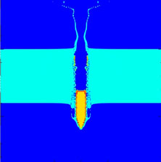
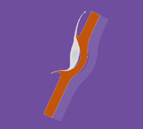
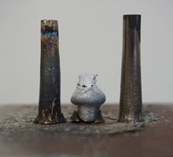
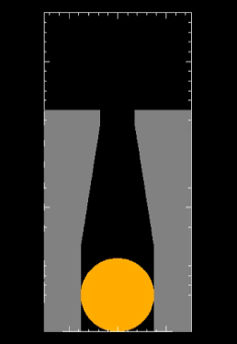
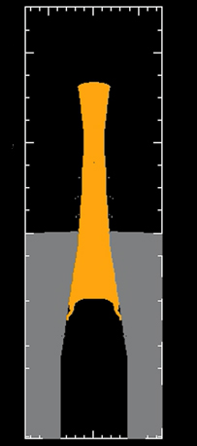
XFEM Development in the ALEGRA Code
Tom Voth, Irina Tezaur, John Niederhaus
Sandia National Laboratories
ALEGRA Winter Workshop December 10-12, 2019
SAND2019-14900PE

Slide 2
Summary of CY2019 progress
A focus on XFEM robustness!
Revisit algorithms and assumptions to improve XFEM robustness:
Mass conservation equation/density update (T. Voth)
Void insertion (T. Voth)
Ensure solvability of contact linear system (I. Tezaur)
Assess state of 2D XFEM code with ARL problems of interest (J. Neiderhaus)
Notes:
What is Alexa:
Shock Hydrodynamics physics with range of materials.
Designed from inception to be portably performant (KOKKOS; MPI-X)
Adaptive Lagrangian: contrast to fixed-topology Lagrangian (or ALE) which can get into bad places

Slide 3
Summary of CY2019 progress
A focus on XFEM robustness!
Revisit algorithms and assumptions to improve XFEM robustness:
Mass conservation equation/density update (T. Voth)
Void insertion (T. Voth)
Ensure solvability of contact linear system (I. Tezaur)
Assess state of 2D XFEM code with ARL problems of interest (J. Neiderhaus)
Notes:
What is Alexa:
Shock Hydrodynamics physics with range of materials.
Designed from inception to be portably performant (KOKKOS; MPI-X)
Adaptive Lagrangian: contrast to fixed-topology Lagrangian (or ALE) which can get into bad places

Slide 4
Mass conservation equation
XFEM mass conservation used UFEM constant volume fraction assumption:
Volume fraction is assumed to be unchanged during Lagrangian Step
Final (end of Lagrangian step) material volume is simply the product of element volume and material volume fraction.
Density update is then identical to that for UFEM:
$$ρ^{n+1}=ρ^{n}V_{e}^{n}/V_{e}^{n+1}$$
Issues include:
Required scaling remap intersection volumes (and masses, momentum, etc).
Can (often?) results in artificial compression or expansion of materials and bad states.
But, there’s a better, more consistent way…
Notes:
Alegra also has the isentropic compression algorithm but this is only applicable to elements with more than one material. XFEM, by design, has only one material per element and hence constant volume fraction was thought tho be the correct choice at the time.
- Note, constant volume fraction algorithm results in density change for a material to be a change of total element volume from n -> n+1

Slide 5
Mass conservation equation (cont’d)
Discard constant volume fraction assumption all together.
Final material volume is given the interface description at the end of the Lagrangian step and easily computed.
$$ρ^{n+1}=ρ^{n}V_{e,mat}^{n}/V_{e,mat}^{n+1}$$
Density update then becomes:
Result is elimination of artificial compression / expansion and more robust material state updates.
Uncovered an algorithmic issue with void insertion for XFEM
Notes:
Note: Now density update is a function of the ratio of material filled regions of the element (not of the total element volumes).

Slide 6
Summary of CY2019 progress
A focus on XFEM robustness!
Revisit algorithms and assumptions to improve XFEM robustness:
Mass conservation equation/density update (T. Voth)
Void insertion (T. Voth)
Ensure solvability of contact linear system (I. Tezaur)
Assess state of 2D XFEM code with ARL problems of interest (J. Neiderhaus)
Notes:
What is Alexa:
Shock Hydrodynamics physics with range of materials.
Designed from inception to be portably performant (KOKKOS; MPI-X)
Adaptive Lagrangian: contrast to fixed-topology Lagrangian (or ALE) which can get into bad places

Slide 7
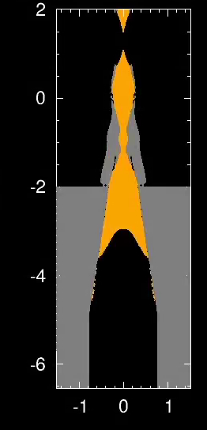
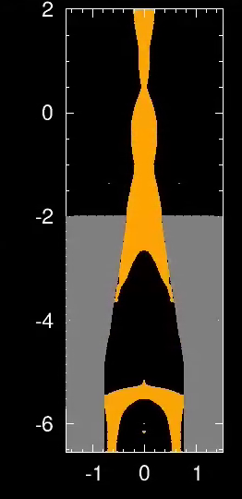
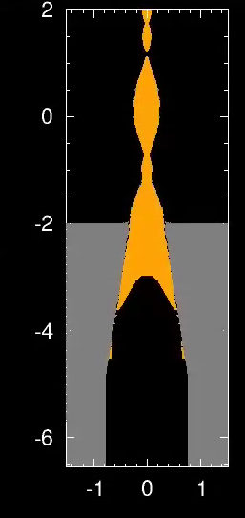
Void insertion impacts robustness
without void insert
with void insert
UFEM
XFEM
UFEM
Notes:
UFEM and XFEM are quite similar (when donor, first order, advection is used).
However Void Insertion is necessary for material model robustness. VI for XFEM needs to be addressed.
- Not terribly surprising given the high velocities here. I’d expect XFEM to become more important at lower velocities such that, for example, XFEM might better capture effect of going from strength dominated to hydro dominated behavior.
XFEM only has donor advection.
UFEM results with donor vs higher-order advection indicate significant importance of remap order.
Previous XFEM tests did not indicate need for HO scheme as XFEM captures velocity discontinuities accurately. This problem may make us rethink that conclusion. HO remap for XFEM should be considered again.

Slide 8
Void insertion
UFEM void Insertion algorithm was unchanged for XFEM:
UFEM algorithm adapted for XFEM.
Happens during Lagrangian step, reducing material volume and inserting void to take up remaining element volume.
… but XFEM computes interfaces at the start (end) of the Lagrangian (Remap) step:
Used to prevent material interpenetration (contact enforcement).
Used for material by material remap.
… and XFEM algorithms (remap and contact) assume the interface description does not change during the Lagrangian step (deformations allowed but material/master-element description is unchanged)

Slide 9
Void insertion (cont’d)
However, void insertion violates XFEM’s unchanged interface assumption:
Void is added that is not “known” to XFEM. Innocuous by itself.
“Fractured” material in cell does not know its volume has changed (interface location has not been changed).
As “fractured” material state has changed but XFEM is unaware of its volume change, we have a mass source/sink.
Why did this (appear) to work (e.g. we’re conserving mass)?
As noted, XFEM has been enforcing constant volume fraction through the Lagrangian step (CONSTANT VOLUME FRACTION algorithm).
Void insertion scales volume fraction to insert void.
Remap volumes (swept or intersected) scaled to ensure remapped volumes same as those computed with volume fraction (constant plus void insertion mods) at the end of the Lagrangian step. Results in conservation and hides Void Insertion “bug”.

Slide 10
Void insertion (cont’d)
Requirements for fix?
Void insertion cannot be part of the Lagrangian step.
Void insertion must occur while enrichments are in flux / being created and before interfaces are finalized.
Fixed by moving XFEM’s occurrence of void insertion to during remap step and before next Lagrangian step.
Approach suggested by M. Wong (original author of void insertion code).
Essentially hijack UFEM’s void insertion clean-up that occurs after remap.
Void insertion for XFEM now only happens in remap where interface description is allowed to change.

Slide 11
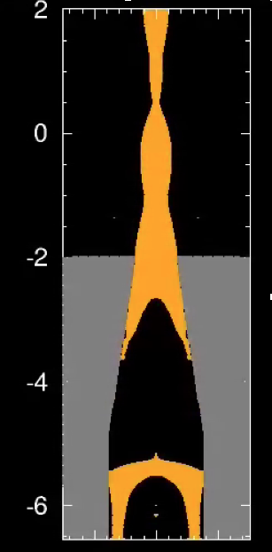
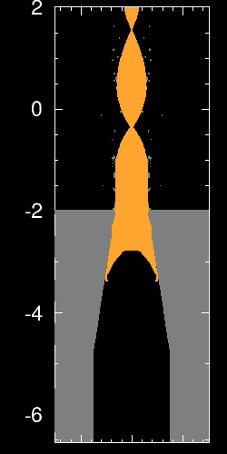
Void insertion (cont’d)
XFEM results for DTE problem …
… without void Insertion.
… with void Insertion.

Slide 12
Summary of CY2019 progress
A focus on XFEM robustness!
Revisit algorithms and assumptions to improve XFEM robustness:
Mass conservation equation/density update (T. Voth)
Void insertion (T. Voth)
Ensure solvability of contact linear system (I. Tezaur)
Assess state of 2D XFEM code with ARL problems of interest (J. Neiderhaus)
Notes:
What is Alexa:
Shock Hydrodynamics physics with range of materials.
Designed from inception to be portably performant (KOKKOS; MPI-X)
Adaptive Lagrangian: contrast to fixed-topology Lagrangian (or ALE) which can get into bad places

Slide 13
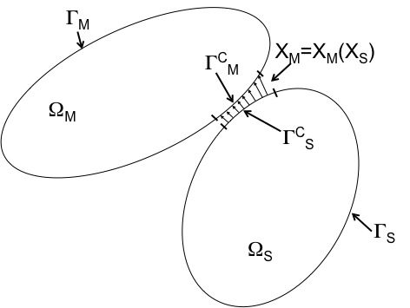
XFEM contact problem
Contact constraint enforces gap rate to be zero when inter-penetration between two surfaces is detected (right figure):
$$g_{rate}=Gv^{n+1/2}=0$$
Contact constraint is enforced via Lagrange multipliers $λ$, which gives rise to a KKT system for momentum balance + contact constraint:
$$Ma^{n}+f^{int}+f^{ext}+G^{T}λ=0$$
$$Gv^{n+1/2}=0$$
To be solvable, the discretization must satisfy the inf-sup (LBB) condition.
The XFEM contact implementation in ALEGRA does not ensure a priori satisfaction of the inf-sup condition!
This is one source of robustness issues with XFEM!

Slide 14
Discrete inf-sup (LBB) condition*
$$Ma^{n}+f^{int}+f^{ext}+G^{T}λ=0$$
$$Gv^{n+1/2}=0$$
Three conditions for discrete inf-sup stability:
The mass matrix $M$ must be non-singular.
□ The constraint matrix $G$ cannot have more rows than the mass matrix $M$.
□ The constraint matrix $G$ must have full row rank (contact constraints must be linearly independent).
* Necessary (but not always sufficient) condition for inf-sup stability at the continuous level.

Slide 15
Discrete inf-sup (LBB) condition*
$$Ma^{n}+f^{int}+f^{ext}+G^{T}λ=0$$
$$Gv^{n+1/2}=0$$
Three conditions for discrete inf-sup stability:
☑ The mass matrix $M$ must be non-singular.
☑ The constraint matrix $G$ cannot have more rows than the mass matrix $M$.
☒ The constraint matrix $G$ must have full row rank (contact constraints must be linearly independent).
* Necessary (but not always sufficient) condition for inf-sup stability at the continuous level.

Slide 16
Lin. dept. constraints are a real problem!
Sandwich Problem
There are 140 singular/near-singular matrices out of 2659 total matrices. --> Matrix matrix31.mm is singular with rank deficiency 2 and condition number Inf. ----> Matrix matrix31.mm has duplicate rows! ------> Identical Rows: 19 30 --> Matrix matrix32.mm is near-singular with rank deficiency 1 and condition number 1e16. --> Matrix matrix37.mm is near-singular with rank deficiency 1 and condition number 5e16.
....
$$GM^{−1}G^{T}y=Gv^{∗}$$

Slide 17
Lin. dept. constraints are a real problem!
Sandwich Problem
There are 140 singular/near-singular matrices out of 2659 total matrices. --> Matrix matrix31.mm is singular with rank deficiency 2 and condition number Inf. ----> Matrix matrix31.mm has duplicate rows! ------> Identical Rows: 19 30 --> Matrix matrix32.mm is near-singular with rank deficiency 1 and condition number 1e16. --> Matrix matrix37.mm is near-singular with rank deficiency 1 and condition number 5e16.
....
$$GM^{−1}G^{T}y=Gv^{∗}$$
Two remedies explored simultaneously:
Develop algorithm to detect and remove on-the-fly linearly dependent and nearly-linearly dependent constraints ($→$ QR algorithms!)
Understand cause of linearly dependent constraints ($→$ bug in skinning alg.) and eliminate them at the source

Slide 18
Lin. dept. constraints are a real problem!
Sandwich Problem
There are 140 singular/near-singular matrices out of 2659 total matrices. --> Matrix matrix31.mm is singular with rank deficiency 2 and condition number Inf. ----> Matrix matrix31.mm has duplicate rows! ------> Identical Rows: 19 30 --> Matrix matrix32.mm is near-singular with rank deficiency 1 and condition number 1e16. --> Matrix matrix37.mm is near-singular with rank deficiency 1 and condition number 5e16.
....
$$GM^{−1}G^{T}y=Gv^{∗}$$
Two remedies explored simultaneously:
Develop algorithm to detect and remove on-the-fly linearly dependent and nearly-linearly dependent constraints ($→$ QR algorithms!)
Understand cause of linearly dependent constraints ($→$ bug in skinning alg.) and eliminate them at the source
On-the-fly detection algorithm expected to be needed to deal with nearly linearly dependent constraints

Slide 19
Lin. dept. constraints are a real problem!
Sandwich Problem
There are 140 singular/near-singular matrices out of 2659 total matrices. --> Matrix matrix31.mm is singular with rank deficiency 2 and condition number Inf. ----> Matrix matrix31.mm has duplicate rows! ------> Identical Rows: 19 30 --> Matrix matrix32.mm is near-singular with rank deficiency 1 and condition number 1e16. --> Matrix matrix37.mm is near-singular with rank deficiency 1 and condition number 5e16.
....
$$GM^{−1}G^{T}y=Gv^{∗}$$
Two remedies explored simultaneously:
Develop algorithm to detect and remove on-the-fly linearly dependent and nearly-linearly dependent constraints ($→$ QR algorithms!)
Understand cause of linearly dependent constraints ($→$ bug in skinning alg.) and eliminate them at the source ($→$TODO)
On-the-fly detection algorithm expected to be needed to deal with nearly linearly dependent constraints

Slide 20
Full QR algorithm for contact solve
Basic Idea: (1) perform QR decomposition on $M^{−1/2}G^{T};$ (2) remove linearly dept./nearly-linearly dept. constraints from $R;$ (3) solve upper triangular full-rank system given by $\tilde{R}$.

Slide 21
Sandwich problem
 | Aztec tol = 1e-5 | Aztec tol = 1e-6 | Aztec tol = 1e-7 | Aztec tol = 1e-8 | Aztec tol = 1e-9 | Aztec tol = 1e-10 | Aztec tol = 1e-11
No QR | died | died | died | died | died | died | finished
Full QR, qr tol = 1e-6 | finished | finished | finished | finished | not run | not run | not run
QR algorithm makes XFEM solver much more robust!

Slide 22
Sandwich problem
 | Aztec tol = 1e-5 | Aztec tol = 1e-6 | Aztec tol = 1e-7 | Aztec tol = 1e-8 | Aztec tol = 1e-9 | Aztec tol = 1e-10 | Aztec tol = 1e-11
No QR | died | died | died | died | died | died | finished
Full QR, qr tol = 1e-6 | finished | finished | finished | finished | not run | not run | not run
QR algorithm makes XFEM solver much more robust!
 | # cycles | # linear iters | # of “numerical loss of precision”s
No QR, Aztec tol = 1e-11 | 3571 | 185,435 | 751
Full QR, qr tol = 1e-6, Aztec tol = 1e-5 | 3511 | 37,723 | 11
Moreover, there are 5$×$ fewer linear iterations* w/ QR!
* Note that the current implementation of QR in ALEGRA uses a direct solver. Results with iterative solver are shown here for illustrative purposes.

Slide 23
Full QR algorithm for contact solve
Basic Idea: (1) perform QR decomposition on $M^{−1/2}G^{T};$ (2) remove linearly dept./nearly-linearly dept. constraints from $R;$ (3) solve upper triangular full-rank system given by $\tilde{R}$.
☺ Pro: contact system will be nonsingular, with smaller condition number*.
* $κ(\tilde{R})$ $≤$ $\sqrt{κ(GM^{−1}G^{T})}$.

Slide 24
Full QR algorithm for contact solve
Basic Idea: (1) perform QR decomposition on $M^{−1/2}G^{T};$ (2) remove linearly dept./nearly-linearly dept. constraints from $R;$ (3) solve upper triangular full-rank system given by $\tilde{R}$.
☺ Pro: contact system will be nonsingular, with smaller condition number*.
☹ Con: computing QR decomp. is expensive – total CPU time may go up.
* $κ(\tilde{R})$ $≤$ $\sqrt{κ(GM^{−1}G^{T})}$.

Slide 25
Hybrid QR algorithm to reduce CPU time
1: Form original contact system given by $GM^{−1}G^{T}$.
2: Try to solve this system using Amesos (Trilinos direct solver).
3: If Amesos solve fails (which will happen if $GM^{−1}G^{T}$ is exactly singular), ‘’’’perform QR to identify/remove linearly dependent constraints and llllsolve resulting system given by ${\tilde{R}}_{1}.$
If we solve this using Amesos as well, we remove the linear solver tolerance parameter.

Slide 26
Hybrid QR algorithm to reduce CPU time
1: Form original contact system given by $GM^{−1}G^{T}$.
2: Try to solve this system using Amesos (Trilinos direct solver).
3: If Amesos solve fails (which will happen if $GM^{−1}G^{T}$ is exactly singular), ‘’’’perform QR to identify/remove linearly dependent constraints and llllsolve resulting system given by ${\tilde{R}}_{1}.$
If we solve this using Amesos as well, we remove the linear solver tolerance parameter.
Discussion:
😐 Exact linear dependencies are removed.
Algorithm can be extended to remove near linear dependencies.
☺ CPU time comparable to or lower than CPU time with no QR.
☺ By using direct solve, Aztec linear solver tolerance parameter is no llllllonger required.

Slide 27
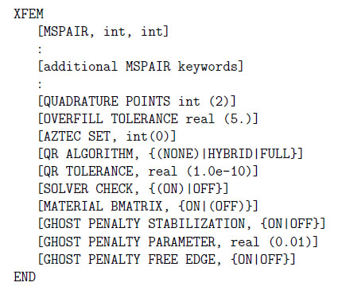
Usage of QR algorithms in ALEGRA
Two new run-time options have been added to allow the user to specify which QR algorithm to use, and the QR tolerance parameter (see discussion beginning on p. 331 of the ALEGRA User Manual).
Note: AztecOO (Trilinos direct solver) is currently not a valid option with full or hybrid QR; if Aztec sublist is present in an input file using full or hybrid QR, the following error will be thrown:
ERROR: UnsDynamics::Check_Errors_And_Set_Values
AZTECOO is not a valid option when using full or hybrid qr for contact solve! The solver that is used is Amesos.
By using Amesos (Trilinos direct solver), we take the linear solver tolerance out of the equation!
Please see Cup and Sandwich Training problems (Benchmarks/Training/AlegraXFEM) for example of full and hybrid QR usage, respectively.

Slide 28
Summary of CY2019 progress
A focus on XFEM robustness!
Revisit algorithms and assumptions to improve XFEM robustness:
Mass conservation equation/density update (T. Voth)
Void insertion (T. Voth)
Ensure solvability of contact linear system (I. Tezaur)
Assess state of 2D XFEM code with ARL problems of interest (J. Neiderhaus)
Notes:
What is Alexa:
Shock Hydrodynamics physics with range of materials.
Designed from inception to be portably performant (KOKKOS; MPI-X)
Adaptive Lagrangian: contrast to fixed-topology Lagrangian (or ALE) which can get into bad places

Slide 29
Test cases, November 2019
For testing of XFEM after (a) change to density update and (b) addition of QR factorization algorithms.
Oblique plate slap (2 materials, metal)
Oblique cylinder impact on layered target (3 materials, metal and polymer)
APM2 onto layered aluminum (4/5? Materials, all metal)
PTI with cover plate (3 materials, including ceramic)
These are all still at relatively coarse resolution, but could be refined for further testing.

Slide 30
Oblique plate slap problem
Test originally created by Bob Doney
Plates inclined in opposite directions at 2.5° each
Both plates are aluminum
EOS, strength, void insertion with force fracture
Simulation should allow recoil and separation (and sliding, if plates are not inclined symmetrically).
225K elements
v = 1 km/s
$→$Last attempt to run this problem was in 2014! Persistently failed with Aztec iterations > maximum.

Slide 31
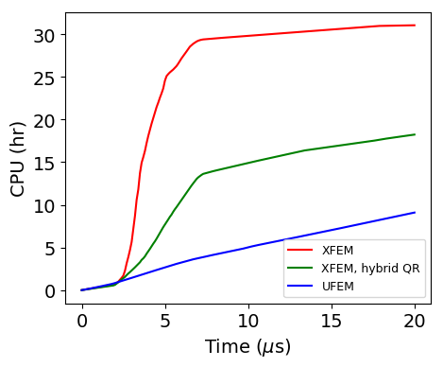
Oblique plate slap problem results
All XFEM runs fail with element inversion at intial contact time unless discard is added for all material volfrc < 1e-4.
Force fracture and phase control provide 3% speedup (used on all runs shown here).
Hybrid QR provides near 2$×$ speedup over regular XFEM.
Did not run full QR.
Ran on 16 cores.

Slide 32
Oblique plate slap problem results: movies
UFEM
XFEM
XFEM, hybrid QR

Slide 33
Oblique plate slap problem results: final frame
UFEM
XFEM
XFEM, hybrid QR

Slide 34
Oblique cylinder impact on layered target
Tungsten
Adjacent plates inclined 25°
EOS and strength
Simulation should allow recoil and separation due to difference in shock impedance of two target plate materials
148K elements
Lexan
Copper
v = 2.4 km/s
$→$Last studied extensively in ALEGRA in November of 2009!!! Abandoned because of interface ordering issues, and never revived after automatic priorities were added.

Slide 35
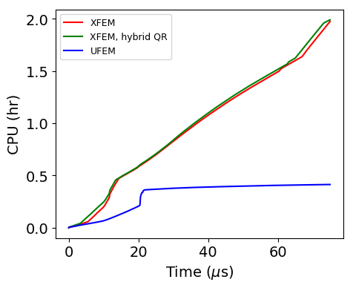
Oblique cylinder impact results
All XFEM runs are successful after modern syntax is added (auto priorities, Aztec contact solver, no enforcement tolerances, etc.).
Force fracture and phase control are necessary to allow UFEM simulation to run to completion. Not needed for XFEM!
Hybrid QR provides no speedup for this problem.
Ran on 8 cores.

Slide 36
Oblique cylinder impact results: movies
UFEM
XFEM, hybrid QR

Slide 37
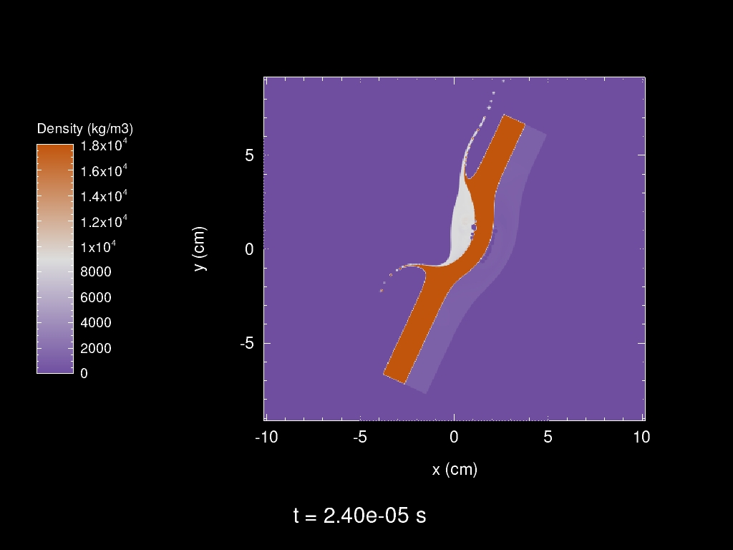
Oblique cylinder impact results: density at 24 $μ$s
UFEM
XFEM
XFEM, hybrid QR

Slide 38
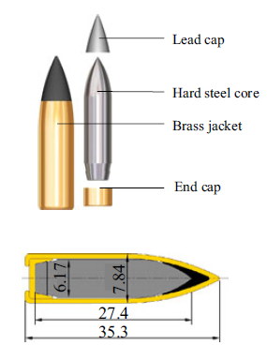
APM2 impact on layered aluminum
APM2 round
(0.30 cal / 7.62mm)
Normal impact of APM2 round.
Two 20-mm-thick Al plates, no adhesion.
Axisymmetric r-z coordinates
4 materials, 5 material ID’s.
Jacket should separate from core and remain in the plates.
83K elements
Layered aluminum
v = 0.9 km/s
Forrestall et al, 2010
https://doi.org/10.1007/s11340-009-9262-5
$→$Last studied extensively in ALEGRA in 2014.
$→$apm2-xfem test is still in the repo, TDD status currently.

Slide 39
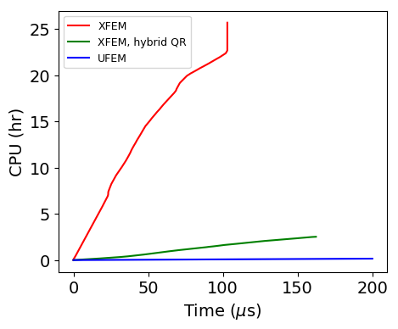
APM2 impact results
XFEM simulations fail with element inversion persistently.
With force fracture, phase control, and discard for volfrc < 1.e-4, the failure is deferred late enough to see the desired behavior.
Hybrid QR provides both speedup and apparently better stability.
Regular and hybrid simulations ran on different days on cee-compute007 – load might have played a role.
Ran on 16 cores.

Slide 40
APM2 impact results: movies
UFEM
XFEM, hybrid QR

Slide 41
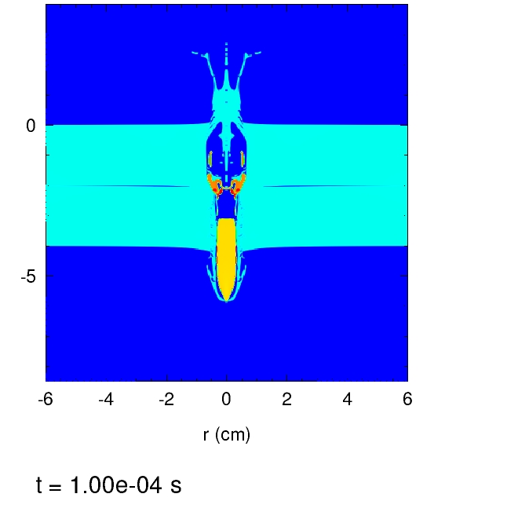
APM2 impact results: frame at 100 $μ$s
UFEM
XFEM
XFEM, hybrid QR

Slide 42
Summary
CY2019 XFEM improvements:
Discovered and resolved issue with density update
Discovered and resolved issue with void insertion
Discovered issue with singularity of XFEM contact solve, and implemented several remedies.
CY2019 Results:
Fixes resulted in robustness improvements and reduced CPU times for 2D XFEM simulations.
With this year’s improvements, we are now able to run 2D XFEM cases that were abandoned years ago!!

Slide 43
Ongoing/future work involving XFEM
Work in progress (WIP):
Continue evaluation of XFEM on test cases of interest to ARL
Journal article on XFEM for multi-material Eulerian SM in ALEGRA
QR algorithms for ensuring discrete inf-sup stability and their connection to various regularization algorithms in optimization is one novel contribution.
Possible future work:
Continue XFEM performance improvements
Higher-order remap for XFEM intersection remap
Move 2D robustness/accuracy improvements to 3D
Fix bug in skinning algorithm.
Computational improvements to full/hybrid QR implementations:
Switch to sparse QR library – QR will scale like $O{(N}^{2})$ vs. $O{(N}^{3})$
Modify hybrid QR logic to perform QR more often (e.g. when contact system is ill-conditioned but not exactly singular)

Slide 44
Backup Slides

Slide 45
Motivation for XFEM higher-order remap
XFEM, No QR, Oct. 2019 Code
UFEM, Oct. 2019 Code
“Sticking” projectile behavior in XFEM solution (left) is due to first-order remap algorithm in XFEM.
Would be remedied by implementing higher-order remap.

Slide 46
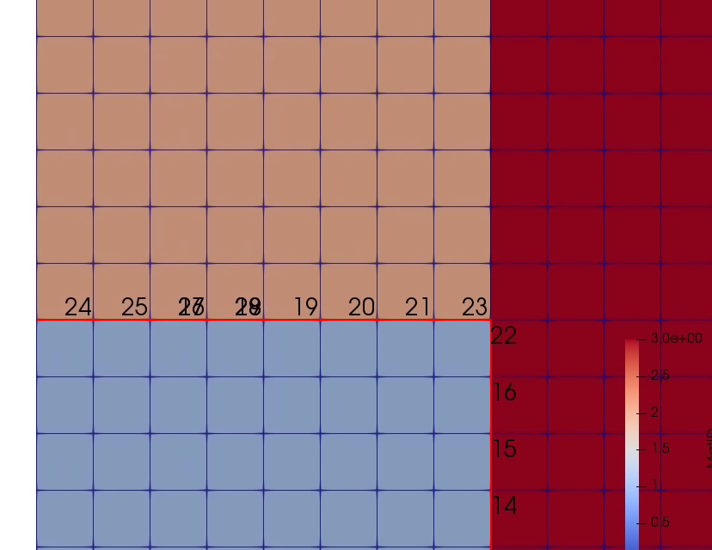
Identifying cause of linearly dependent constraints: skinning algorithm
 | Sandwich | Cup
QR with qr tol = 1e-10 | 27, 29 | 48, 51, 56, 58
QR with qr tol = 1e-5 | 26, 27, 28, 29, 38 | 48, 51, 55, 56, 57, 58, 59
Tuples of identical/near identical constraints (* = identical constraints) | {18, 29}*, {17, 27, 26} | {46, 48}, {50, 51, 57, 58}, {49, 55, 56}

Slide 47
Identifying cause of linearly dependent constraints: skinning algorithm
 | Sandwich | Cup
QR with qr tol = 1e-10 | 27, 29 | 48, 51, 56, 58
QR with qr tol = 1e-5 | 26, 27, 28, 29, 38 | 48, 51, 55, 56, 57, 58, 59
Tuples of identical/near identical constraints (* = identical constraints) | {18, 29}*, {17, 27, 26} | {46, 48}, {50, 51, 57, 58}, {49, 55, 56}

Slide 48
Identifying cause of linearly dependent constraints: skinning algorithm
The culprit is the skinning algorithm, which adds redundant and nonsensical constraints.
 | Sandwich | Cup
QR with qr tol = 1e-10 | 27, 29 | 48, 51, 56, 58
QR with qr tol = 1e-5 | 26, 27, 28, 29, 38 | 48, 51, 55, 56, 57, 58, 59
Tuples of identical/near identical constraints (* = identical constraints) | {18, 29}*, {17, 27, 26} | {46, 48}, {50, 51, 57, 58}, {49, 55, 56}

Slide 49
Identifying cause of linearly dependent constraints: skinning algorithm
The culprit is the skinning algorithm, which adds redundant and nonsensical constraints.
 | Sandwich | Cup
QR with qr tol = 1e-10 | 27, 29 | 48, 51, 56, 58
QR with qr tol = 1e-5 | 26, 27, 28, 29, 38 | 48, 51, 55, 56, 57, 58, 59
Tuples of identical/near identical constraints (* = identical constraints) | {18, 29}*, {17, 27, 26} | {46, 48}, {50, 51, 57, 58}, {49, 55, 56}
Fixing skinning algorithm is longer-term endeavor.

