Slide 1
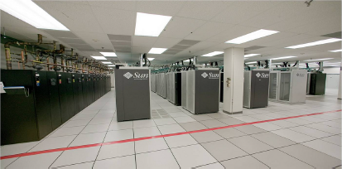
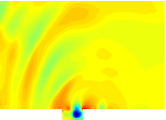
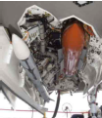
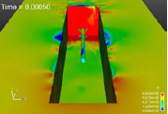
Stability-preserving projection-based model order reduction for compressible flows
Irina K. Tezaur¹, Matt Barone¹, Jeff Fike¹, Maciej Balajewicz², Srini Arunajatesan¹,
Bart van Bloemen Waanders¹, Earl Dowell³
¹ Sandia National Laboratories, Livermore CA and Albuquerque, NM
² University of Illinois Urbana-Champaign ³ Duke University
UCB/LBL Applied Math Seminar Dec. 6, 2017
Sandia National Laboratories is a multi-mission laboratory managed and operated by National Technology and Engineering Solutions of Sandia, LLC., a wholly owned subsidiary of Honeywell International, Inc., for the U.S. Department of Energy’s National Nuclear Security Administration under contract DE-NA0003525.
SAND2017-4018 PE

Slide 2
Outline
Motivation.
Projection-based model order reduction.
3. Targeted application: compressible cavity flow.
4. Approaches for building a priori stable ROMs.
  (a) Energy-stable linearized compressible flow ROMs.
  (b) Energy-stable nonlinear compressible flow ROMs.
5. Approaches for stabilizing a posteriori unstable ROMs.
  (a) Eigenvalue reassignment (Linear Time-Invariant systems).
  (b) Basis rotation (nonlinear compressible flow).
Summary/perspectives.
7. Ongoing/future work.

Slide 3
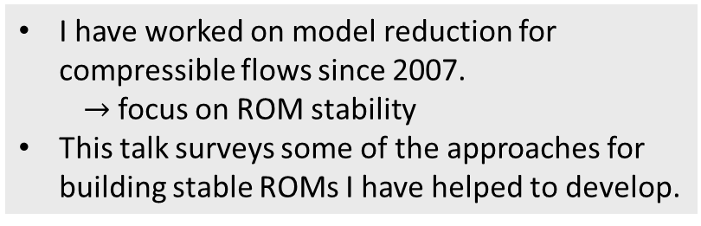
Outline
I have worked on model reduction for compressible flows since 2007.
  $→$focus on ROM stability
This talk surveys some of the approaches for building stable ROMs I have helped to develop.
Motivation.
Projection-based model order reduction.
3. Targeted application: compressible cavity flow.
4. Approaches for building a priori stable ROMs.
  (a) Energy-stable linearized compressible flow ROMs.
  (b) Energy-stable nonlinear compressible flow ROMs.
5. Approaches for stabilizing a posteriori unstable ROMs.
  (a) Eigenvalue reassignment (Linear Time-Invariant systems).
  (b) Basis rotation (nonlinear compressible flow).
Summary/perspectives.
7. Ongoing/future work.

Slide 4
Outline
Motivation.
Projection-based model order reduction.
3. Targeted application: compressible cavity flow.
4. Approaches for building a priori stable ROMs.
  (a) Energy-stable linearized compressible flow ROMs.
  (b) Energy-stable nonlinear compressible flow ROMs.
5. Approaches for stabilizing a posteriori unstable ROMs.
  (a) Eigenvalue reassignment (Linear Time-Invariant systems).
  (b) Basis rotation (nonlinear compressible flow).
Summary/perspectives.
7. Ongoing/future work.

Slide 5
Motivation
Despite improved algorithms and powerful supercomputers, “high-fidelity” models are often too expensive for use in a design or analysis setting.

Slide 6
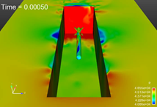
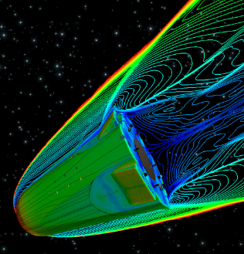
Motivation
Despite improved algorithms and powerful supercomputers, “high-fidelity” models are often too expensive for use in a design or analysis setting.
Application areas in which this situation arises:
Captive-carry and re-entry environments: Large Eddy Simulations (LES) runs require very fine meshes and can take on the order of weeks.

Slide 7
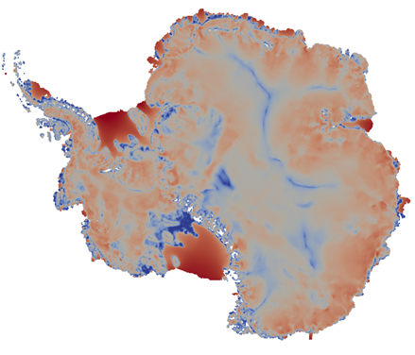
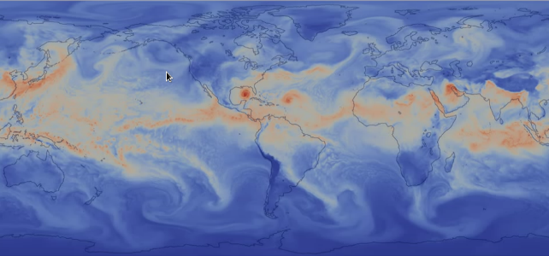
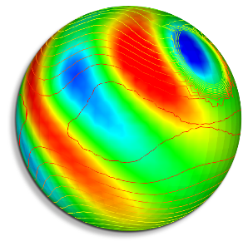
Motivation
Despite improved algorithms and powerful supercomputers, “high-fidelity” models are often too expensive for use in a design or analysis setting.
Application areas in which this situation arises:
Captive-carry and re-entry environments: Large Eddy Simulations (LES) runs require very fine meshes and can take on the order of weeks.
Climate modeling (e.g., land-ice, atmosphere): high-fidelity simulations too costly for uncertainty quantification (UQ); Bayesian inference of high-dimensional parameter fields is intractable.

Slide 8
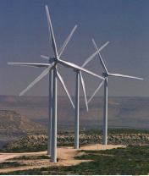
Motivation
Despite improved algorithms and powerful supercomputers, “high-fidelity” models are often too expensive for use in a design or analysis setting.
Application areas in which this situation arises:
Captive-carry and re-entry environments: Large Eddy Simulations (LES) runs require very fine meshes and can take on the order of weeks.
Climate modeling (e.g., land-ice, atmosphere): high-fidelity simulations too costly for uncertainty quantification (UQ); Bayesian inference of high-dimensional parameter fields is intractable.
Wind plant simulations: wind turbines need to be controlled in real-time to attain optimal energy capture for wind plant system.

Slide 9
Surrogate models for time-critical prediction
Surrogate low-dimensional models can enable time-critical prediction and many-query analyses (e.g., design, optimization, control, UQ).

Slide 10
Surrogate models for time-critical prediction
Surrogate low-dimensional models can enable time-critical prediction and many-query analyses (e.g., design, optimization, control, UQ).
Three flavors of “surrogate models” for time-critical prediction:
  Data-fit models (e.g., response surfaces, Kriging): directly model I/O map
    Upsides: easy to implement, low complexity
    Downsides: blind to problem physics, impractical for large-dimensional input spaces
  2. Lower-fidelity/reduced-physics models (e.g., coarse mesh, Euler vs. Navier-Stokes)
    Upsides: physics-based, no training required, easy to implement in existing codes.
    Downsides: evaluation times generally not fast enough for time-critical problems, may have inconsistency with higher fidelity models.
  3. Projection-based reduced order models (ROMs): approximately solve state dd equations, then compute outputs
    Upsides: physics-based, can be evaluated in real or near-real time.
    Downsides: intrusive to implement, robustness across wide range of parameters not guaranteed

Slide 11
Surrogate models for time-critical prediction
Surrogate low-dimensional models can enable time-critical prediction and many-query analyses (e.g., design, optimization, control, UQ).
Three flavors of “surrogate models” for time-critical prediction:
  Data-fit models (e.g., response surfaces, Kriging): directly model I/O map
    Upsides: easy to implement, low complexity
    Downsides: blind to problem physics, impractical for large-dimensional input spaces
  2. Lower-fidelity/reduced-physics models (e.g., coarse mesh, Euler vs. Navier-Stokes)
    Upsides: physics-based, no training required, easy to implement in existing codes.
    Downsides: evaluation times generally not fast enough for time-critical problems, may have inconsistency with higher fidelity models.
  3. Projection-based reduced order models (ROMs): approximately solve state dd equations, then compute outputs
    Upsides: physics-based, can be evaluated in real or near-real time.
    Downsides: intrusive to implement, robustness across wide range of parameters not guaranteed
This talk

Slide 12
Outline
Motivation.
Projection-based model order reduction.
3. Targeted application: compressible cavity flow.
4. Approaches for building a priori stable ROMs.
  (a) Energy-stable linearized compressible flow ROMs.
  (b) Energy-stable nonlinear compressible flow ROMs.
5. Approaches for stabilizing a posteriori unstable ROMs.
  (a) Eigenvalue reassignment (Linear Time-Invariant systems).
  (b) Basis rotation (nonlinear compressible flow).
Summary/perspectives.
7. Ongoing/future work.

Slide 13
Offline/online strategy
Three underlying mathematical premises of projection-based model order reduction (MOR):

Slide 14
Offline/online strategy
Compression
Three underlying mathematical premises of projection-based model order reduction (MOR):
  Compression: solution of governing parametric PDE or system of PDEs lies in a subspace of significantly lower dimension.

Slide 15
Offline/online strategy
High-fidelity simulator
Data collection
Compression
Offline
projection (dimension reduction)
Reduced Order Model (ROM)
Three underlying mathematical premises of projection-based model order reduction (MOR):
  Compression: solution of governing parametric PDE or system of PDEs lies in a subspace of significantly lower dimension.
  Offline training: subspace can be identified/learned offline via training simulation and high-fidelity model can be reformulated with respect to this subspace.

Slide 16
Offline/online strategy
High-fidelity simulator
Data collection
Compression
Offline
projection (dimension reduction)
Online
Reduced Order Model (ROM)
Real-time analysis
Three underlying mathematical premises of projection-based model order reduction (MOR):
  Compression: solution of governing parametric PDE or system of PDEs lies in a subspace of significantly lower dimension.
  Offline training: subspace can be identified/learned offline via training simulation and high-fidelity model can be reformulated with respect to this subspace.
  Online prediction: identified parametric ROMs are capable of providing new solutions at a fraction of the computational cost.

Slide 17
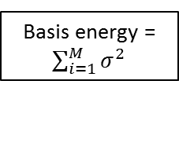
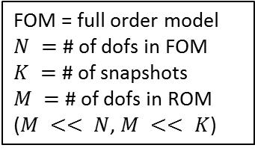
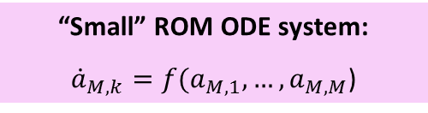
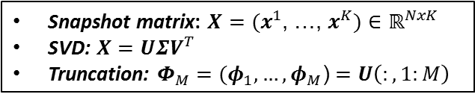
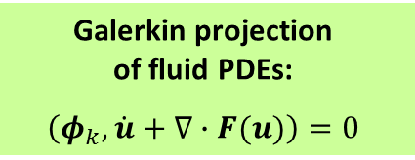
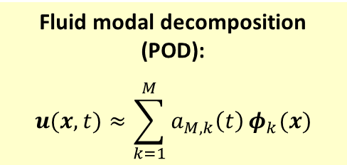
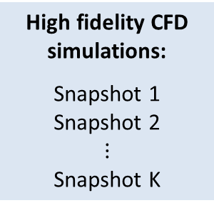
Proper Orthogonal Decomposition (POD)/
Galerkin method to model reduction
High fidelity CFD simulations:
Snapshot 1
Snapshot 2
$$⋮$$
Snapshot K
Fluid modal decomposition (POD):
$$u(x,t)≈\sum_{k=1}^{M}{a_{M,k}\left(t\right)}φ_{k}(x)$$
Galerkin projection
of fluid PDEs:
$$\left(φ_{k},\dot{u}+∇∙F(u)\right)=0$$
Step 1
Step 2
Snapshot matrix: $X=(x^{1}$, …, $x^{K})$ $∈ℝ^{NxK}$
SVD: $X=UΣV^{T}$
Truncation: $Φ_{M}=(φ_{1}, …, φ_{M}$) $=U\left(:,1:M\right)$
Basis energy = $\sum_{i=1}^{M}{σ^{2}}$
FOM = full order model
$N =$ # of dofs in FOM
$K =$ # of snapshots
$M =$ # of dofs in ROM
($M << N$, $M << K$)
“Small” ROM ODE system:
${\dot{a}}_{M,k}=f(a_{M,1},…,a_{M,M}$)

Slide 18
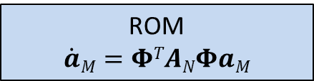
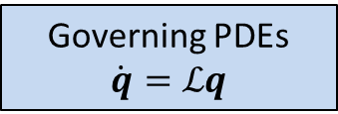
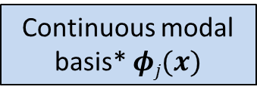
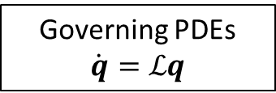
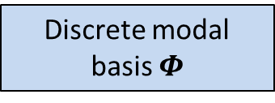
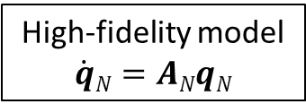
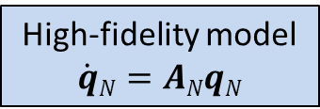
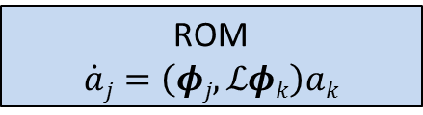
Continuous vs. discrete Galerkin projection
Continuous Projection
Discrete Projection
Governing PDEs
$$\dot{q}=ℒq$$
Governing PDEs
$$\dot{q}=ℒq$$
If PDEs are linear or have polynomial non-linearities, projection can be calculated in offline stage of MOR.
High-fidelity model
$$\dot{q}N=ANqN$$
High-fidelity model
$$\dot{q}N=ANqN$$
Continuous modal basis* $φj(x)$
Discrete modal basis $Φ$
Projection of governing PDEs (numerical integration)
Projection of FOM
(matrix operation)
ROM
$$\dot{a}j=\left(φj,ℒφk\right)ak$$
ROM
$$\dot{a}M=ΦTANΦaM$$
* Continuous function space defined using e.g., finite elements.

Slide 19
Continuous vs. discrete Galerkin projection
Continuous Projection
Discrete Projection
Governing PDEs
$$\dot{q}=ℒq$$
Governing PDEs
$$\dot{q}=ℒq$$
If PDEs are linear or have polynomial non-linearities, projection can be calculated in offline stage of MOR.
High-fidelity model
$$\dot{q}N=ANqN$$
High-fidelity model
$$\dot{q}N=ANqN$$
Continuous modal basis* $φj(x)$
Discrete modal basis $Φ$
Projection of governing PDEs (numerical integration)
Projection of FOM
(matrix operation)
Most of my ROM work
ROM
$$\dot{a}j=\left(φj,ℒφk\right)ak$$
ROM
$$\dot{a}M=ΦTANΦaM$$
* Continuous function space defined using e.g., finite elements.

Slide 20
Outline
Motivation.
Projection-based model order reduction.
3. Targeted application: compressible cavity flow.
4. Approaches for building a priori stable ROMs.
  (a) Energy-stable linearized compressible flow ROMs.
  (b) Energy-stable nonlinear compressible flow ROMs.
5. Approaches for stabilizing a posteriori unstable ROMs.
  (a) Eigenvalue reassignment (Linear Time-Invariant systems).
  (b) Basis rotation (nonlinear compressible flow).
Summary/perspectives.
7. Ongoing/future work.

Slide 21
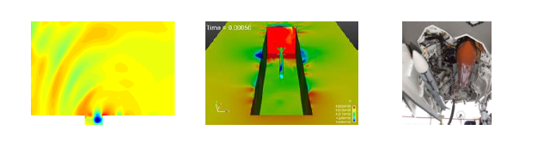
Targeted application: compressible flow
We are interested in the compressible captive-carry problem.

Slide 22
Targeted application: compressible flow
We are interested in the compressible captive-carry problem.
Of primary interest are long-time predictive simulations: ROM run at same parameters as FOM but much longer in time.

Slide 23
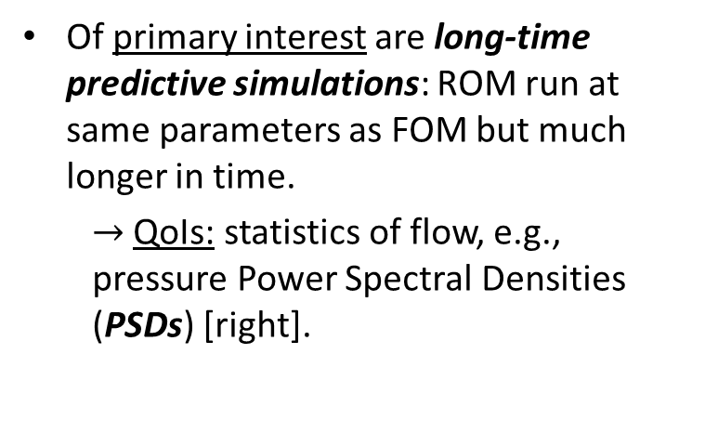
Targeted application: compressible flow
We are interested in the compressible captive-carry problem.
Of primary interest are long-time predictive simulations: ROM run at same parameters as FOM but much longer in time.
  $→$ QoIs: statistics of flow, e.g., pressure Power Spectral Densities (PSDs) [right].

Slide 24
Targeted application: compressible flow
We are interested in the compressible captive-carry problem.
Of primary interest are long-time predictive simulations: ROM run at same parameters as FOM but much longer in time.
  $→$ QoIs: statistics of flow, e.g., pressure Power Spectral Densities (PSDs) [right].
Secondary interest: ROMs robust w.r.t. parameter changes (e.g., Reynolds, Mach number) for enabling uncertainty quantification.

Slide 25
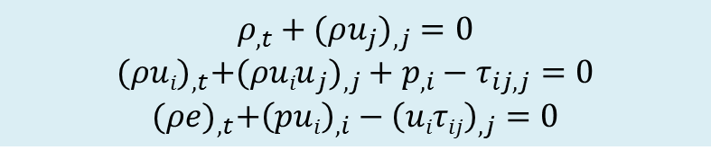
Targeted application: compressible flow
Compressible flow equations:
$$ρ_{,t}+({ρu_{j})}_{,j}=0$$
$${(ρui)}_{,t}+{(ρuiu}_{j})_{,j}+p_{,i}−τ_{ij,j}=0$$
$${(ρe)}_{,t}+{\left(pui\right)}_{,i}−{\left(uiτij\right)}_{,j}=0$$

Slide 26
Targeted application: compressible flow
Compressible flow equations:
$$ρ_{,t}+({ρu_{j})}_{,j}=0$$
$${(ρui)}_{,t}+{(ρuiu}_{j})_{,j}+p_{,i}−τ_{ij,j}=0$$
$${(ρe)}_{,t}+{\left(pui\right)}_{,i}−{\left(uiτij\right)}_{,j}=0$$
Majority of fluid ROMs in literature are for incompressible flow.

Slide 27
Targeted application: compressible flow
Compressible flow equations:
$$ρ_{,t}+({ρu_{j})}_{,j}=0$$
$${(ρui)}_{,t}+{(ρuiu}_{j})_{,j}+p_{,i}−τ_{ij,j}=0$$
$${(ρe)}_{,t}+{\left(pui\right)}_{,i}−{\left(uiτij\right)}_{,j}=0$$
Compressible flow solutions can exhibit the following complex features:
  Sharp boundary layers.
  Turbulence/chaotic dynamics.
  Shocks.
Majority of fluid ROMs in literature are for incompressible flow.

Slide 28
Targeted application: compressible flow
Compressible flow equations:
$$ρ_{,t}+({ρu_{j})}_{,j}=0$$
$${(ρui)}_{,t}+{(ρuiu}_{j})_{,j}+p_{,i}−τ_{ij,j}=0$$
$${(ρe)}_{,t}+{\left(pui\right)}_{,i}−{\left(uiτij\right)}_{,j}=0$$
Compressible flow solutions can exhibit the following complex features:
  Sharp boundary layers.
  Turbulence/chaotic dynamics.
  Shocks.
Desired numerical properties of ROMs:
  Consistency (w.r.t. the continuous PDEs).
  Stability: if full order model (FOM) is stable, ROM should be stable.
  Convergence: requires consistency and stability.
  Accuracy (w.r.t. FOM).
  Efficiency.
  Robustness (w.r.t. time or parameter changes).
Majority of fluid ROMs in literature are for incompressible flow.

Slide 29
Targeted application: compressible flow
Compressible flow equations:
$$ρ_{,t}+({ρu_{j})}_{,j}=0$$
$${(ρui)}_{,t}+{(ρuiu}_{j})_{,j}+p_{,i}−τ_{ij,j}=0$$
$${(ρe)}_{,t}+{\left(pui\right)}_{,i}−{\left(uiτij\right)}_{,j}=0$$
Compressible flow solutions can exhibit the following complex features:
  Sharp boundary layers.
  Turbulence/chaotic dynamics.
  Shocks.
Desired numerical properties of ROMs:
  Consistency (w.r.t. the continuous PDEs).
  Stability: if full order model (FOM) is stable, ROM should be stable.
  Convergence: requires consistency and stability.
  Accuracy (w.r.t. FOM).
  Efficiency.
  Robustness (w.r.t. time or parameter changes).
Majority of fluid ROMs in literature are for incompressible flow.
Focus of this talk is ROM stability.

Slide 30
ROM instability problem
Stability can be a real problem for compressible flow ROMs!

Slide 31
ROM instability problem
Stability can be a real problem for compressible flow ROMs!
A compressible fluid POD/Galerkin ROM might be stable for a given number of modes, but unstable for other choices of basis size (Bui-Tanh et al. 2007; Barone et al. 2009).

Slide 32
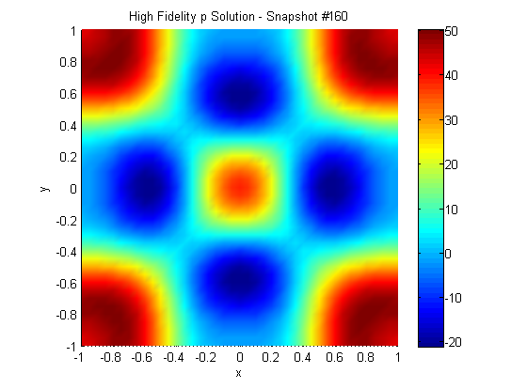
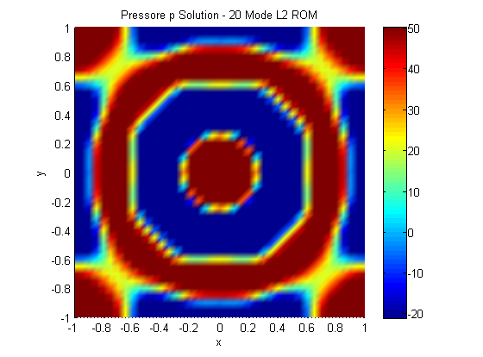
ROM instability problem
Stability can be a real problem for compressible flow ROMs!
A compressible fluid POD/Galerkin ROM might be stable for a given number of modes, but unstable for other choices of basis size (Bui-Tanh et al. 2007, Barone et al. 2009).
  Instability can manifest itself in different ways, e.g., blow-up during time-integration, spurious oscillations, ROM computes non-physical quantities.
Top right: FOM
\
Bottom right: ROM

Slide 33
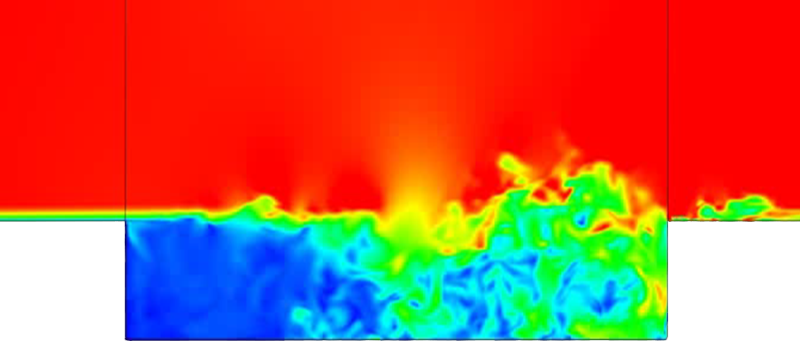
ROM instability problem
Stability can be a real problem for compressible flow ROMs!
A compressible fluid POD/Galerkin ROM might be stable for a given number of modes, but unstable for other choices of basis size (Bui-Tanh et al. 2007, Barone et al. 2009).
  Instability can manifest itself in different ways, e.g., blow-up during time-integration, spurious oscillations, ROM computes non-physical quantities.
There is no a priori stability guarantee for POD/Galerkin ROMs for compressible flow!
Top right: FOM
\
Bottom right: ROM

Slide 34
ROM instability problem
Stability can be a real problem for compressible flow ROMs!
A compressible fluid POD/Galerkin ROM might be stable for a given number of modes, but unstable for other choices of basis size (Bui-Tanh et al. 2007, Barone et al. 2009).
  Instability can manifest itself in different ways, e.g., blow-up during time-integration, spurious oscillations, ROM computes non-physical quantities.
There is no a priori stability guarantee for POD/Galerkin ROMs for compressible flow!
Stability of a ROM is commonly evaluated a posteriori – RISKY!
Top right: FOM
\
Bottom right: ROM

Slide 35
ROM instability problem
Instability can be due to:

Slide 36
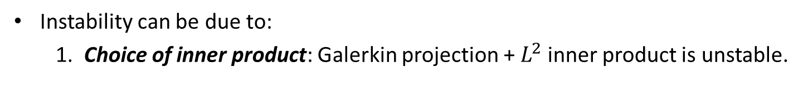
ROM instability problem
Instability can be due to:
  1. Choice of inner product: Galerkin projection + $L^{2}$ inner product is unstable.

Slide 37
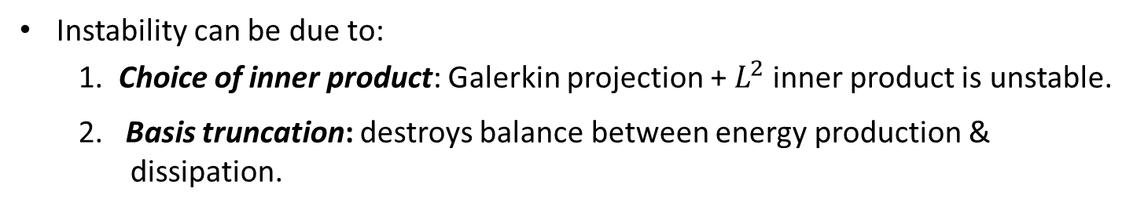
ROM instability problem
Instability can be due to:
  1. Choice of inner product: Galerkin projection + $L^{2}$ inner product is unstable.
  2. Basis truncation: destroys balance between energy production & hhhdissipation.

Slide 38
ROM instability problem
Instability can be due to:
  1. Choice of inner product: Galerkin projection + $L^{2}$ inner product is unstable.
  2. Basis truncation: destroys balance between energy production & hhhdissipation.
Some* remedies:
 | Continuous Projection | Discrete Projection
Change projection (a priori) | Energy inner products (Rowley et al., Serre et al., IKT et al.) | Energy inner products (Rowley, et al.), Petrov-Galerkin Projection (Carlberg et al.)
Change ROM equations (a posteriori) | Linear/nonlinear turbulence modeling (Iliescu, Borggaard, Xie, Wang, …) | Eigenvalue reassignment (IKT et al.)
Change ROM basis (a posteriori) | Basis rotation (Balajewicz, IKT, et al.) | Optimization-based right basis modification (Amsallem et al.)
* This is not a complete list!

Slide 39
ROM instability problem
Instability can be due to:
  1. Choice of inner product: Galerkin projection + $L^{2}$ inner product is unstable.
  2. Basis truncation: destroys balance between energy production & hhhdissipation.
Some* remedies:
 | Continuous Projection | Discrete Projection
Change projection (a priori) | Energy inner products (Rowley et al., Serre et al., IKT et al.) | Energy inner products (Rowley, et al.), Petrov-Galerkin Projection (Carlberg et al.)
Change ROM equations (a posteriori) | Linear/nonlinear turbulence modeling (Iliescu, Borggaard, Xie, Wang, …) | Eigenvalue reassignment (IKT et al.)
Change ROM basis (a posteriori) | Basis rotation (Balajewicz, IKT, et al.) | Optimization-based right basis modification (Amsallem et al.)
This talk is on a priori (intrusive) and a posteriori (non-intrusive) approaches for remedying ROM instability for POD/Galerkin ROMs.
* This is not a complete list!

Slide 40
Outline
 | Continuous Projection | Discrete Projection
Change projection (a priori) | Energy inner products (Rowley et al., Serre et al., IKT et al.) | Energy inner products (Rowley, et al.), Petrov-Galerkin Projection (Carlberg et al.)
Change ROM equations (a posteriori) | Linear/nonlinear turbulence modeling (Iliescu, Borggaard, Xie, Wang, …) | Eigenvalue reassignment (IKT et al.)
Change ROM basis (a posteriori) | Basis rotation (Balajewicz, IKT, et al.) | Optimization-based right basis modificatiOon (Amsallem)
Motivation.
Projection-based model order reduction.
3. Targeted application: compressible cavity flow.
4. Approaches for building a priori stable ROMs.
  (a) Energy-stable linearized compressible flow ROMs.
  (b) Energy-stable nonlinear compressible flow ROMs.
5. Approaches for stabilizing a posteriori unstable ROMs.
  (a) Eigenvalue reassignment (Linear Time-Invariant systems).
  (b) Basis rotation (nonlinear compressible flow).
Summary/perspectives.
7. Ongoing/future work.

Slide 41
Energy-stability

Slide 42
Energy-stability
Practical Definition: Numerical solution does not “blow up” in finite time.

Slide 43
Energy-stability
Practical Definition: Numerical solution does not “blow up” in finite time.
More Precise Definition: Numerical discretization does not introduce any spurious instabilities inconsistent with natural instability modes supported by the governing continuous PDEs.

Slide 44
Energy-stability
Practical Definition: Numerical solution does not “blow up” in finite time.
More Precise Definition: Numerical discretization does not introduce any spurious instabilities inconsistent with natural instability modes supported by the governing continuous PDEs.
Numerical solutions must maintain proper energy balance.

Slide 45
Energy-stability
Practical Definition: Numerical solution does not “blow up” in finite time.
More Precise Definition: Numerical discretization does not introduce any spurious instabilities inconsistent with natural instability modes supported by the governing continuous PDEs.
Numerical solutions must maintain proper energy balance.
Stability of ROM is intimately tied to choice of inner product for the Galerkin projection (Rowley et al., 2004; Barone & IKT, 2009; Serre et al., 2012).

Slide 46
Energy-stability
Practical Definition: Numerical solution does not “blow up” in finite time.
More Precise Definition: Numerical discretization does not introduce any spurious instabilities inconsistent with natural instability modes supported by the governing continuous PDEs.
Numerical solutions must maintain proper energy balance.
Stability of ROM is intimately tied to choice of inner product for the Galerkin projection (Rowley et al., 2004; Barone & IKT, 2009; Serre et al., 2012).
  Norm induced by inner product in which ROM is constructed should correspond to energy measure for system.

Slide 47
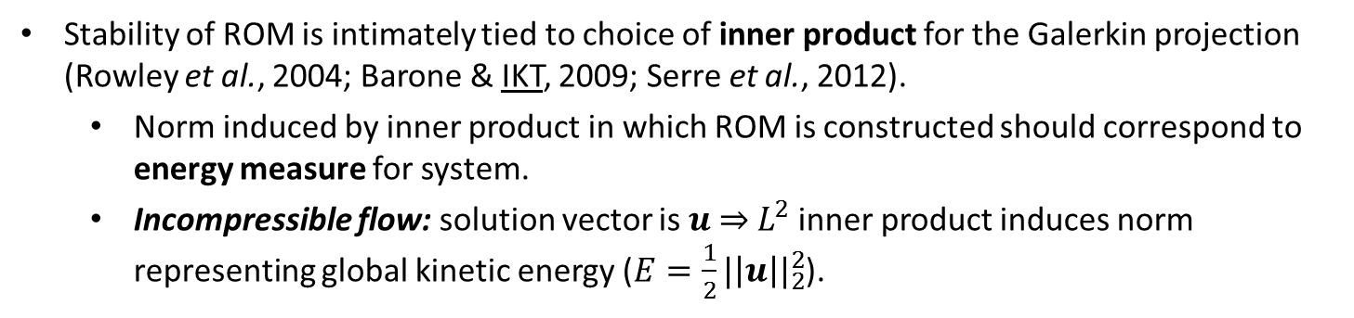
Energy-stability
Practical Definition: Numerical solution does not “blow up” in finite time.
More Precise Definition: Numerical discretization does not introduce any spurious instabilities inconsistent with natural instability modes supported by the governing continuous PDEs.
Numerical solutions must maintain proper energy balance.
Stability of ROM is intimately tied to choice of inner product for the Galerkin projection (Rowley et al., 2004; Barone & IKT, 2009; Serre et al., 2012).
  Norm induced by inner product in which ROM is constructed should correspond to energy measure for system.
  Incompressible flow: solution vector is $u$ $⇒$ $L^{2}$ inner product induces norm representing global kinetic energy ($E=\frac{1}{2}{|\left|u\right||}_{2}^{2}$).

Slide 48
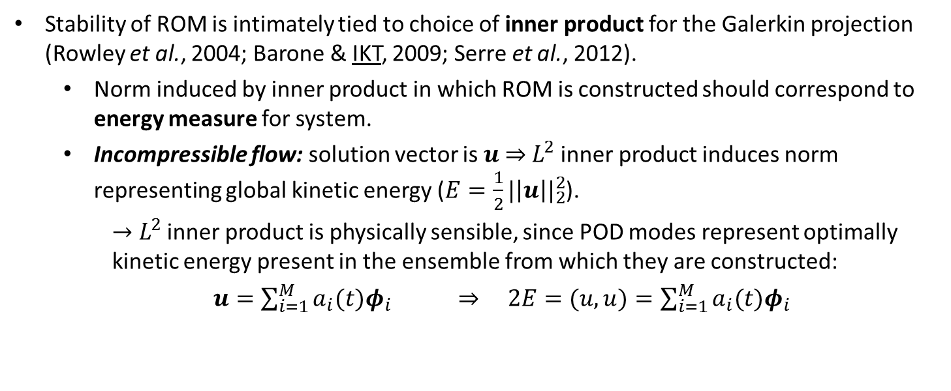
Energy-stability
Practical Definition: Numerical solution does not “blow up” in finite time.
More Precise Definition: Numerical discretization does not introduce any spurious instabilities inconsistent with natural instability modes supported by the governing continuous PDEs.
Numerical solutions must maintain proper energy balance.
Stability of ROM is intimately tied to choice of inner product for the Galerkin projection (Rowley et al., 2004; Barone & IKT, 2009; Serre et al., 2012).
  Norm induced by inner product in which ROM is constructed should correspond to energy measure for system.
  Incompressible flow: solution vector is $u$ $⇒$ $L^{2}$ inner product induces norm representing global kinetic energy ($E=\frac{1}{2}{|\left|u\right||}_{2}^{2}$).
    $→$ $L^{2}$ inner product is physically sensible, since POD modes represent optimally kinetic energy present in the ensemble from which they are constructed:
  $u=\sum_{i=1}^{M}{a_{i}(t)φ_{i}}$ $⇒$ $2E=(u,u)=\sum_{i=1}^{M}{a_{i}(t)φ_{i}}$

Slide 49
Energy-stability
Practical Definition: Numerical solution does not “blow up” in finite time.
More Precise Definition: Numerical discretization does not introduce any spurious instabilities inconsistent with natural instability modes supported by the governing continuous PDEs.
Numerical solutions must maintain proper energy balance.
Stability of ROM is intimately tied to choice of inner product for the Galerkin projection (Rowley et al., 2004; Barone & IKT, 2009; Serre et al., 2012).
  Norm induced by inner product in which ROM is constructed should correspond to energy measure for system.
  Incompressible flow: solution vector is $u$ $⇒$ $L^{2}$ inner product induces norm representing global kinetic energy ($E=\frac{1}{2}{|\left|u\right||}_{2}^{2}$).
    $→$ $L^{2}$ inner product is physically sensible, since POD modes represent optimally kinetic energy present in the ensemble from which they are constructed:
  $u=\sum_{i=1}^{M}{a_{i}(t)φ_{i}}$ $⇒$ $2E=(u,u)=\sum_{i=1}^{M}{a_{i}(t)φ_{i}}$
Not the case for compressible flow!

Slide 50
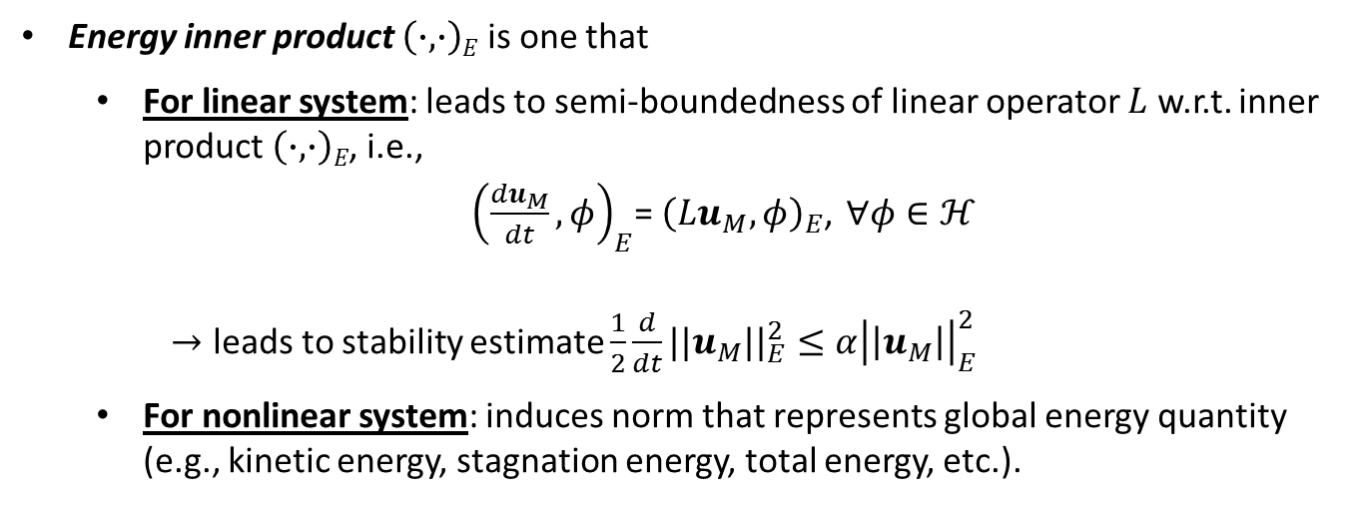
Energy-stability
Energy inner product $\left(∙,∙\right)E$ is one that
  For linear system: leads to semi-boundedness of linear operator $L$ w.r.t. inner product $\left(∙,∙\right)E$, i.e.,
  ${\left(\frac{du_{M}}{dt},φ\right)}_{E}$= ${\left(Lu_{M},φ\right)}_{E}$, $∀φ∈ℋ$
    $→$ leads to stability estimate $\frac{1}{2}\frac{d}{dt}{||u_{M}||}_{E}^{2}≤α{\left|\left|u_{M}\right|\right|}_{E}^{2}$
  For nonlinear system: induces norm that represents global energy quantity (e.g., kinetic energy, stagnation energy, total energy, etc.).

Slide 51
Energy-stability
Energy inner product $\left(∙,∙\right)E$ is one that
  For linear system: leads to semi-boundedness of linear operator $L$ w.r.t. inner product $\left(∙,∙\right)E$, i.e.,
  ${\left(\frac{du_{M}}{dt},φ\right)}_{E}$= ${\left(Lu_{M},φ\right)}_{E}$, $∀φ∈ℋ$
    $→$ leads to stability estimate $\frac{1}{2}\frac{d}{dt}{||u_{M}||}_{E}^{2}≤α{\left|\left|u_{M}\right|\right|}_{E}^{2}$
  For nonlinear system: induces norm that represents global energy quantity (e.g., kinetic energy, stagnation energy, total energy, etc.).
Practical implication of energy-stability analysis:
energy inner product ensures that any “bad” modes will not introduce spurious non-physical numerical instabilities into the Galerkin approximation.

Slide 52
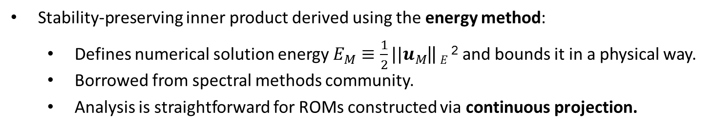
Energy-stability
Energy inner product $\left(∙,∙\right)E$ is one that
  For linear system: leads to semi-boundedness of linear operator $L$ w.r.t. inner product $\left(∙,∙\right)E$, i.e.,
  ${\left(\frac{du_{M}}{dt},φ\right)}_{E}$= ${\left(Lu_{M},φ\right)}_{E}$, $∀φ∈ℋ$
    $→$ leads to stability estimate $\frac{1}{2}\frac{d}{dt}{||u_{M}||}_{E}^{2}≤α{\left|\left|u_{M}\right|\right|}_{E}^{2}$
  For nonlinear system: induces norm that represents global energy quantity (e.g., kinetic energy, stagnation energy, total energy, etc.).
Practical implication of energy-stability analysis:
energy inner product ensures that any “bad” modes will not introduce spurious non-physical numerical instabilities into the Galerkin approximation.
Stability-preserving inner product derived using the energy method:
  Defines numerical solution energy $E_{M}≡\frac{1}{2}||u_{M}$|| $E$² and bounds it in a physical way.
  Borrowed from spectral methods community.
  Analysis is straightforward for ROMs constructed via continuous projection.

Slide 53
Outline
 | Continuous Projection | Discrete Projection
Change projection (a priori) | Energy inner products (Rowley et al., Serre et al., IKT et al.) | Energy inner products (Rowley, et al.), Petrov-Galerkin Projection (Carlberg et al.)
Change ROM equations (a posteriori) | Linear/nonlinear turbulence modeling (Iliescu, Borggaard, Xie, Wang, …) | Eigenvalue reassignment (IKT et al.)
Change ROM basis (a posteriori) | Basis rotation (Balajewicz, IKT, et al.) | Optimization-based right basis modificatiOon (Amsallem)
Motivation.
Projection-based model order reduction.
3. Targeted application: compressible cavity flow.
4. Approaches for building a priori stable ROMs.
  (a) Energy-stable linearized compressible flow ROMs.
  (b) Energy-stable nonlinear compressible flow ROMs.
5. Approaches for stabilizing a posteriori unstable ROMs.
  (a) Eigenvalue reassignment (Linear Time-Invariant systems).
  (b) Basis rotation (nonlinear compressible flow).
Summary/perspectives.
7. Ongoing/future work.
with: Matt Barone (SNL),
Srini Arunajatesan (SNL)

Slide 54

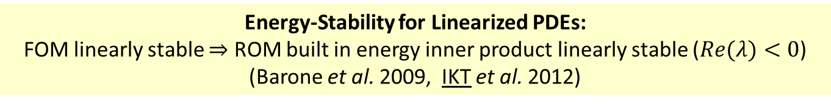

Linearized compressible flow equations
$${\dot{x}}_{N}={A_{N}x}_{N}$$
$${\dot{x}}_{M}={A_{M}x}_{M}$$
Energy-Stability for Linearized PDEs:
FOM linearly stable $⇒$ ROM built in energy inner product linearly stable ($Re(λ)<0$)
(Barone et al. 2009, IKT et al. 2012)

Slide 55
Linearized compressible flow equations
$${\dot{x}}_{N}={A_{N}x}_{N}$$
$${\dot{x}}_{M}={A_{M}x}_{M}$$
Energy-Stability for Linearized PDEs:
FOM linearly stable $⇒$ ROM built in energy inner product linearly stable ($Re(λ)<0$)
(Barone et al. 2009, IKT et al. 2012)
Linearized compressible Euler/Navier-Stokes equations are appropriate when a compressible fluid system can be described by small-amplitude perturbations about a steady-state mean flow.

Slide 56
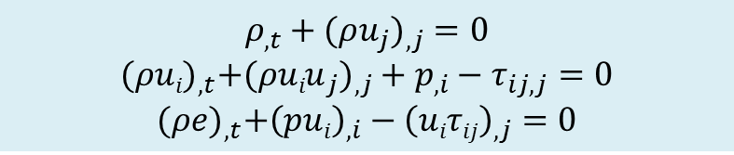
Linearized compressible flow equations
$${\dot{x}}_{N}={A_{N}x}_{N}$$
$${\dot{x}}_{M}={A_{M}x}_{M}$$
Energy-Stability for Linearized PDEs:
FOM linearly stable $⇒$ ROM built in energy inner product linearly stable ($Re(λ)<0$)
(Barone et al. 2009, IKT et al. 2012)
Full non-linear compressible flow equations
$$ρ_{,t}+({ρu_{j})}_{,j}=0$$
$${(ρui)}_{,t}+{(ρuiu}_{j})_{,j}+p_{,i}−τ_{ij,j}=0$$
$${(ρe)}_{,t}+{\left(pui\right)}_{,i}−{\left(uiτij\right)}_{,j}=0$$

Slide 57
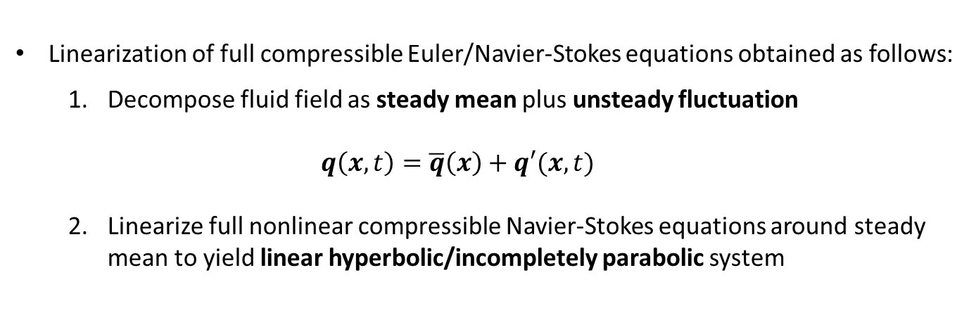
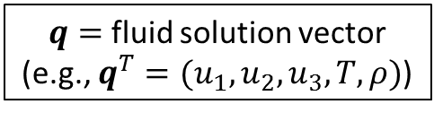

Linearized compressible flow equations
$${\dot{x}}_{N}={A_{N}x}_{N}$$
$${\dot{x}}_{M}={A_{M}x}_{M}$$
Energy-Stability for Linearized PDEs:
FOM linearly stable $⇒$ ROM built in energy inner product linearly stable ($Re(λ)<0$)
(Barone et al. 2009, IKT et al. 2012)
Full non-linear compressible flow equations
$$ρ_{,t}+({ρu_{j})}_{,j}=0$$
$${(ρui)}_{,t}+{(ρuiu}_{j})_{,j}+p_{,i}−τ_{ij,j}=0$$
$${(ρe)}_{,t}+{\left(pui\right)}_{,i}−{\left(uiτij\right)}_{,j}=0$$
Linearization of full compressible Euler/Navier-Stokes equations obtained as follows:
  Decompose fluid field as steady mean plus unsteady fluctuation
  $$q\left(x,t\right)=\overline{q}\left(x\right)+q′(x,t)$$
  Linearize full nonlinear compressible Navier-Stokes equations around steady mean to yield linear hyperbolic/incompletely parabolic system
$q=$ fluid solution vector (e.g., $q^{T}=(u_{1}, u_{2}, u_{3}, T, ρ)$)
  $$\dot{q′}+Ai\left(\overline{q}\right)\frac{∂q′}{∂x_{i}}−\frac{∂}{∂x_{j}}\left[Kij(\overline{q})\frac{∂q′}{∂x_{i}}\right]=0$$

Slide 58
Energy-stable ROMs for linearized
compressible flow
Linearized compressible Euler/Navier-Stokes equations are symmetrizable (Barone & IKT, 2009; IKT & Arunajatesan, 2012).

Slide 59
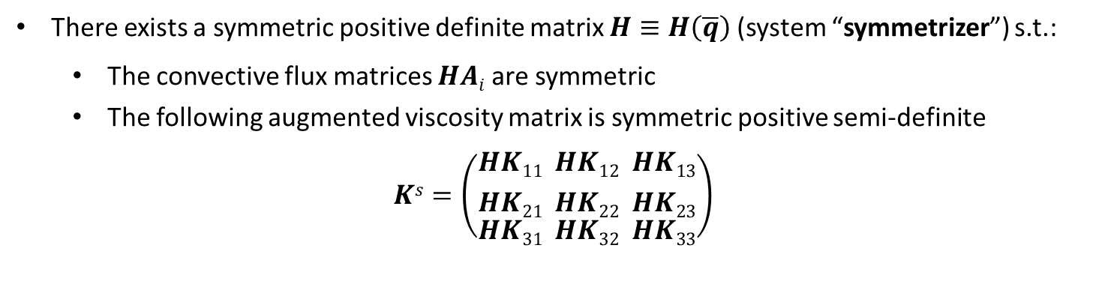
Energy-stable ROMs for linearized
compressible flow
Linearized compressible Euler/Navier-Stokes equations are symmetrizable (Barone & IKT, 2009; IKT & Arunajatesan, 2012).
There exists a symmetric positive definite matrix $H≡H\left(\overline{q}\right)$(system “symmetrizer”) s.t.:
  The convective flux matrices $HAi$ are symmetric
  The following augmented viscosity matrix is symmetric positive semi-definite
$$Ks=\left(\begin{aligned}{HK11 \atop HK21} \\ HK31\end{aligned}\begin{aligned}{ HK12 \atop HK22} \\ HK32\end{aligned}\begin{aligned}{ HK13 \atop HK23} \\ HK33\end{aligned}\right)$$

Slide 60
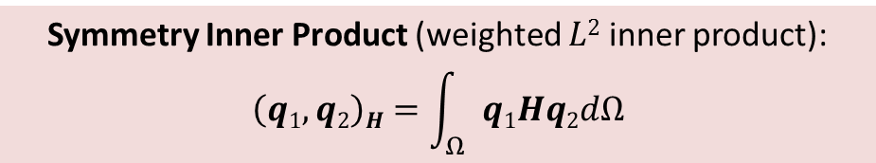
Energy-stable ROMs for linearized
compressible flow
Linearized compressible Euler/Navier-Stokes equations are symmetrizable (Barone & IKT, 2009; IKT & Arunajatesan, 2012).
There exists a symmetric positive definite matrix $H≡H\left(\overline{q}\right)$(system “symmetrizer”) s.t.:
  The convective flux matrices $HAi$ are symmetric
  The following augmented viscosity matrix is symmetric positive semi-definite
$$Ks=\left(\begin{aligned}{HK11 \atop HK21} \\ HK31\end{aligned}\begin{aligned}{ HK12 \atop HK22} \\ HK32\end{aligned}\begin{aligned}{ HK13 \atop HK23} \\ HK33\end{aligned}\right)$$
Symmetry Inner Product (weighted $L2$ inner product):
$$\left(q1,q2\right)H=\int_{Ω}{q1Hq2dΩ}$$

Slide 61
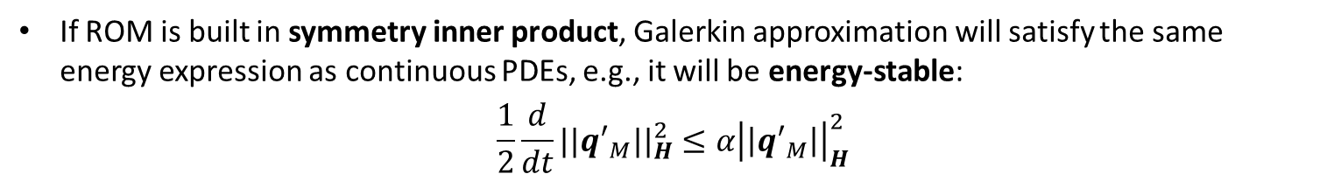
Energy-stable ROMs for linearized
compressible flow
Linearized compressible Euler/Navier-Stokes equations are symmetrizable (Barone & IKT, 2009; IKT & Arunajatesan, 2012).
There exists a symmetric positive definite matrix $H≡H\left(\overline{q}\right)$(system “symmetrizer”) s.t.:
  The convective flux matrices $HAi$ are symmetric
  The following augmented viscosity matrix is symmetric positive semi-definite
$$Ks=\left(\begin{aligned}{HK11 \atop HK21} \\ HK31\end{aligned}\begin{aligned}{ HK12 \atop HK22} \\ HK32\end{aligned}\begin{aligned}{ HK13 \atop HK23} \\ HK33\end{aligned}\right)$$
Symmetry Inner Product (weighted $L2$ inner product):
$$\left(q1,q2\right)H=\int_{Ω}{q1Hq2dΩ}$$
If ROM is built in symmetry inner product, Galerkin approximation will satisfy the same energy expression as continuous PDEs, e.g., it will be energy-stable:
$$\frac{1}{2}\frac{d}{dt}{||{q′}_{M}||}_{H}^{2}≤α{\left|\left|{q′}_{M}\right|\right|}_{H}^{2}$$

Slide 62

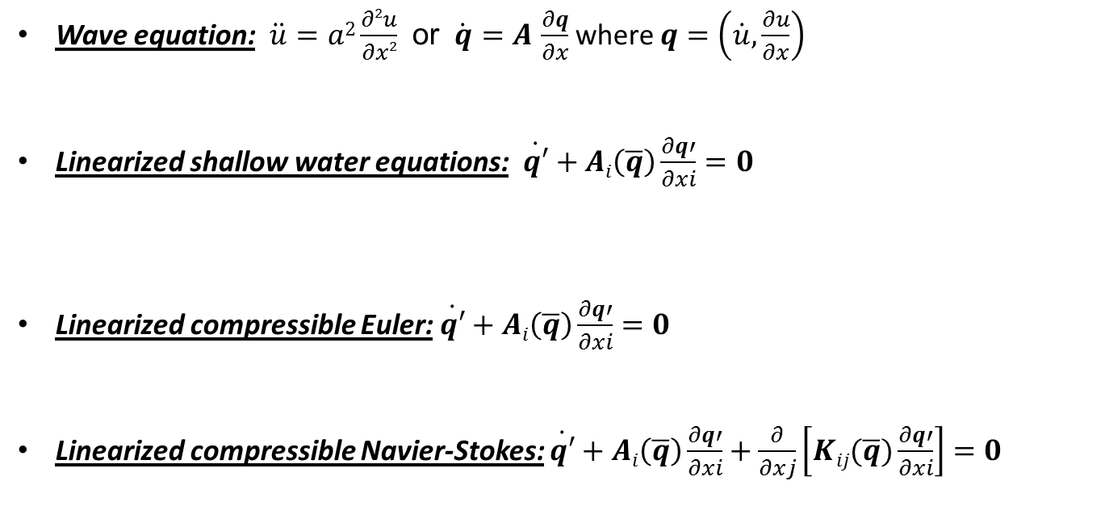
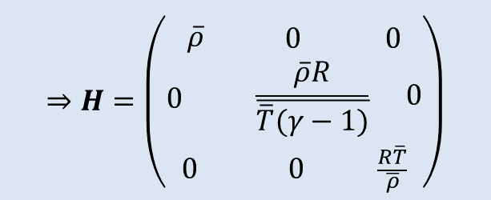

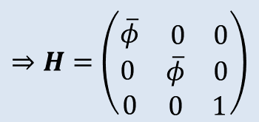
Symmetrizers for several hyperbolic/
incompletely parabolic systems
$$⇒H=\left(\begin{matrix}1 & 0 \\ 0 & a2\end{matrix}\right)$$
Wave equation: $\ddot{u}=a2\frac{∂2u}{∂x2}$ or $\dot{q}=A$ $\frac{∂q}{∂x}$ where $q=\left(\dot{u},\frac{∂u}{∂x}\right)$
Linearized shallow water equations: $\dot{q′}+Ai\left(\overline{q}\right)\frac{∂q′}{∂xi}=0$
Linearized compressible Euler: $\dot{q′}+Ai\left(\overline{q}\right)\frac{∂q′}{∂xi}=0$
  Linearized compressible Navier-Stokes: $\dot{q′}+Ai\left(\overline{q}\right)\frac{∂q′}{∂xi}+\frac{∂}{∂xj}\left[Kij(\overline{q})\frac{∂q′}{∂xi}\right]=0$
$$⇒H=\left(\begin{aligned} \\ \overline{φ}\begin{matrix} 0 & 0\end{matrix} \\ 0 \begin{matrix}\overline{φ} & 0\end{matrix} \\ 0 \begin{matrix}0 & 1\end{matrix}\end{aligned}\right)$$
$$⇒H=\left(\begin{aligned} \\ \overline{ρ}\begin{matrix} 0 & 0\end{matrix} \\ 0 \begin{matrix}α2γ\overline{ρ}2\overline{p} & \overline{ρ}α2\end{matrix} \\ \begin{matrix}0 & 0\end{matrix} \frac{(1+α2)}{γ\overline{p}}\end{aligned}\right)$$
$$⇒H=\left(\begin{aligned} \\ \overline{ρ}\begin{matrix} 0 & 0\end{matrix} \\ 0 \begin{matrix} \frac{\overline{ρ}R}{\overline{\overline{T}(γ−1)}} & 0\end{matrix} \\ \begin{matrix}0 & 0\end{matrix} \frac{R\overline{T}}{\overline{ρ}}\end{aligned}\right)$$
Barone & IKT, JCP, 2009.
IKT & Arunajatesan, WCCM X, 2012.
IKT et al., SAND report, 2014.

Slide 63
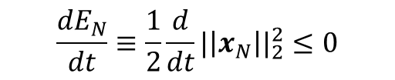




Discrete counterpart of symmetry-inner
product: Lyapunov inner product
Consider linear discrete (i.e., discretized in space) stable full order model
$$\dot{x}=Ax$$
Lyapunov function for this FOM: $V\left(x\right)= x^{T}Px$ where $P$ is the solution of the Lyapunov equation
$$A^{T}P+PA=−Q$$
S.p.d. solution to Lyapunov equation exists if $Q$ is s.p.d. and $A$ is stable.
There are solvers for solving the Lyapunov equation, e.g., lyap function in MATLAB control toolbox.
Discrete analog of symmetry inner product: Lyapunov inner product (Rowley et al., 2004):
$$\left(x_{1},x_{2}\right)P≡x_{1}^{T}Px_{2}$$
Can show: if ROM is constructed in Lyapunov inner product, it is energy-stable, i.e.,
$$\frac{{dE}_{N}}{dt}≡\frac{1}{2}\frac{d}{dt}{|\left|x_{N}\right||}_{2}^{2}≤0$$

Slide 64

Discrete counterpart of symmetry-inner
product: Lyapunov inner product
Consider linear discrete (i.e., discretized in space) stable full order model
$$\dot{x}=Ax$$
Lyapunov function for this FOM: $V\left(x\right)= x^{T}Px$ where $P$ is the solution of the Lyapunov equation
Intractable for large problems ($O(N^{3})$ops)!
$$A^{T}P+PA=−Q$$
S.p.d. solution to Lyapunov equation exists if $Q$ is s.p.d. and $A$ is stable.
There are solvers for solving the Lyapunov equation, e.g., lyap function in MATLAB control toolbox.
Discrete analog of symmetry inner product: Lyapunov inner product (Rowley et al., 2004):
$$\left(x_{1},x_{2}\right)P≡x_{1}^{T}Px_{2}$$
Can show: if ROM is constructed in Lyapunov inner product, it is energy-stable, i.e.,
$$\frac{{dE}_{N}}{dt}≡\frac{1}{2}\frac{d}{dt}{|\left|x_{N}\right||}_{2}^{2}≤0$$

Slide 65


Steps to obtain stable ROM in symmetry i.p.
Galerkin-project equations using symmetry inner product:
  $${\left(φ_{k},\frac{∂q_{M}′}{∂t}\right)}_{H}=−\int_{Ω}{φ_{k}H\left[Ai\frac{∂q_{M}′}{∂x_{i}}−\frac{∂}{∂x_{j}}\left[Kij\frac{∂q_{M}′}{∂x_{i}}\right]\right]dΩ}$$

Slide 66


Steps to obtain stable ROM in symmetry i.p.
Remark: Galerkin projection in symmetry inner product is equivalent to Petrov-Galerkin projection with $Ψ_{M}=HΦ_{M}.$
Galerkin-project equations using symmetry inner product:
  $${\left(φ_{k},\frac{∂q_{M}′}{∂t}\right)}_{H}=−\int_{Ω}{φ_{k}H\left[Ai\frac{∂q_{M}′}{∂x_{i}}−\frac{∂}{∂x_{j}}\left[Kij\frac{∂q_{M}′}{∂x_{i}}\right]\right]dΩ}$$
$$= Ψ_{M}^{T}$$

Slide 67

Steps to obtain stable ROM in symmetry i.p.
Remark: Galerkin projection in symmetry inner product is equivalent to Petrov-Galerkin projection with $Ψ_{M}=HΦ_{M}.$
Galerkin-project equations using symmetry inner product:
  $${\left(φ_{k},\frac{∂q_{M}′}{∂t}\right)}_{H}=−\int_{Ω}{φ_{k}H\left[Ai\frac{∂q_{M}′}{∂x_{i}}−\frac{∂}{∂x_{j}}\left[Kij\frac{∂q_{M}′}{∂x_{i}}\right]\right]dΩ}$$
Integrate second term by parts and apply boundary conditions weakly:
  $${\left(φ_{k},\frac{∂q_{M}′}{∂t}\right)}_{H}=−\int_{Ω}{{\left[φ_{k}HAi\frac{∂q_{M}′}{∂x_{i}}+\frac{∂φ_{k}}{∂x_{j}}HKij\frac{∂q_{M}′}{∂x_{i}}\right]dΩ+\int_{∂Ω}{φ_{k}H}Kij\frac{∂q_{M}′}{∂x_{i}}n_{j}dS}_{}}$$
Substitute BCs

Slide 68

Steps to obtain stable ROM in symmetry i.p.
Remark: Galerkin projection in symmetry inner product is equivalent to Petrov-Galerkin projection with $Ψ_{M}=HΦ_{M}.$
Galerkin-project equations using symmetry inner product:
  $${\left(φ_{k},\frac{∂q_{M}′}{∂t}\right)}_{H}=−\int_{Ω}{φ_{k}H\left[Ai\frac{∂q_{M}′}{∂x_{i}}−\frac{∂}{∂x_{j}}\left[Kij\frac{∂q_{M}′}{∂x_{i}}\right]\right]dΩ}$$
Integrate second term by parts and apply boundary conditions weakly:
  $${\left(φ_{k},\frac{∂q_{M}′}{∂t}\right)}_{H}=−\int_{Ω}{{\left[φ_{k}HAi\frac{∂q_{M}′}{∂x_{i}}+\frac{∂φ_{k}}{∂x_{j}}HKij\frac{∂q_{M}′}{∂x_{i}}\right]dΩ+\int_{∂Ω}{φ_{k}H}Kij\frac{∂q_{M}′}{∂x_{i}}n_{j}dS}_{}}$$
Substitute modal decomposition $q_{M}^{′}(x,t)=\sum_{i=1}^{M}{a_{M,i}(t)φ_{i}(x)}$to obtain an $M×M$ linear dynamical system of the form $\dot{x}M=AxM$.
Substitute BCs

Slide 69



Continuous projection implementation:
“Spirit” code
“Spirit” ROM Code = 3D parallel C++ POD/Galerkin test-bed ROM code that uses data-structures and eigensolvers from Trilinos to build energy-stable ROMs for compressible flow problems
$→$ stand-alone code that can be synchronized with any high-fidelity code!
POD modes defined using piecewise smooth finite elements.
Gauss quadrature rules of sufficient accuracy are used to compute exactly inner products with the help of the libmesh library.
Physics in Spirit:
  Linearized compressible Euler ($L2$, energy inner product).
  Linearized compressible Navier-Stokes ($L2$, energy inner product).
  Nonlinear isentropic compressible Navier-Stokes ($L2$, stagnation energy, stagnation enthalpy inner product).
  Nonlinear compressible Navier-Stokes ($L2$, energy inner product).
“SIGMA CFD” High-Fidelity Code = Sandia in-house finite volume flow solver derived from LESLIE3D (Genin & Menon, 2010), an LES flow solver originally developed in the Computational Combustion Laboratory at Georgia Tech.

Slide 70
Continuous projection implementation:
“Spirit” code
“Spirit” ROM Code = 3D parallel C++ POD/Galerkin test-bed ROM code that uses data-structures and eigensolvers from Trilinos to build energy-stable ROMs for compressible flow problems
$→$ stand-alone code that can be synchronized with any high-fidelity code!
POD modes defined using piecewise smooth finite elements.
Gauss quadrature rules of sufficient accuracy are used to compute exactly inner products with the help of the libmesh library.
Physics in Spirit:
  Linearized compressible Euler ($L2$, energy inner product).
  Linearized compressible Navier-Stokes ($L2$, energy inner product).
  Nonlinear isentropic compressible Navier-Stokes ($L2$, stagnation energy, stagnation enthalpy inner product).
  Nonlinear compressible Navier-Stokes ($L2$, energy inner product).
First, testing of ROMs for these physics
“SIGMA CFD” High-Fidelity Code = Sandia in-house finite volume flow solver derived from LESLIE3D (Genin & Menon, 2010), an LES flow solver originally developed in the Computational Combustion Laboratory at Georgia Tech.

Slide 71


Numerical results: random basis example
Uniform base flow: physically stable to any linear disturbance.
Each mode is random disturbance field that decays to 0 at domain boundaries.
Model problem for modes determined by numerical error: extreme case of “bad” modes.

Slide 72








Numerical results: 2D inviscid pressure pulse
Inviscid pulse in a uniform base flow.
High-fidelity simulation run on mesh with 3362 nodes, up to time $t = 0.01$ seconds.
200 snapshots of solution used to construct $M=20$ mode ROM in $L2$ and symmetry inner products.
$a_{M,i}(t)$vs.$(q’CFD,φi)$ for $i=1,2$
$L2$ROM
Symmetry ROM
$$a_{M,i}$$
$$a_{M,i}$$
$°{ a}_{M,1}$
$− (q’CFD,φ1)$
$°{ a}_{M,2}$
$$− (q’CFD,φ2)$$
$$t$$
$$t$$

Slide 73





Numerical results: 2D inviscid pressure pulse
Inviscid pulse in a uniform base flow (linear dynamics).
High-fidelity simulation run on mesh with 3362 nodes, up to time $t = 0.01$ seconds.
200 snapshots of solution used to construct $M=20$ mode ROM in $L2$ and symmetry inner products.
p’: High-fidelity
p’: Symmetry ROM
p’: $L2$ ROM
time of snapshot 10

Slide 74




Numerical results: 2D inviscid pressure pulse
Inviscid pulse in a uniform base flow (linear dynamics).
High-fidelity simulation run on mesh with 3362 nodes, up to time $t = 0.01$ seconds.
200 snapshots of solution used to construct $M=20$ mode ROM in $L2$ and symmetry inner products.
p’: High-fidelity
p’: Symmetry ROM
p’: $L2$ ROM
time of snapshot 0
time of snapshot 160

Slide 75
Outline
 | Continuous Projection | Discrete Projection
Change projection (a priori) | Energy inner products (Rowley et al., Serre et al., IKT et al.) | Energy inner products (Rowley, et al.), Petrov-Galerkin Projection (Carlberg et al.)
Change ROM equations (a posteriori) | Linear/nonlinear turbulence modeling (Iliescu, Borggaard, Xie, Wang, …) | Eigenvalue reassignment (IKT et al.)
Change ROM basis (a posteriori) | Basis rotation (Balajewicz, IKT, et al.) | Optimization-based right basis modificatiOon (Amsallem)
Motivation.
Projection-based model order reduction.
3. Targeted application: compressible cavity flow.
4. Approaches for building a priori stable ROMs.
  (a) Energy-stable linearized compressible flow ROMs.
  (b) Energy-stable nonlinear compressible flow ROMs.
5. Approaches for stabilizing a posteriori unstable ROMs.
  (a) Eigenvalue reassignment (Linear Time-Invariant systems).
  (b) Basis rotation (nonlinear compressible flow).
Summary/perspectives.
7. Ongoing/future work.
with: Matt Barone (SNL), Jeff Fike (SNL), Srini Arunajatesan (SNL)

Slide 76



Nonlinear compressible flow equations
Energy-Stability for Nonlinear PDEs:
ROM built in energy inner product will preserve stability of an equilibrium point at 0 for the governing nonlinear system of PDEs (Rowley et al., 2004; IKT et al., 2014).
Compressible isentropic Navier-Stokes equations (cold flows, moderate Mach #):
$$\frac{Dh}{Dt}+\left(γ−1\right)h∇∙u=0$$
$$\frac{Du}{Dt}+∇h −\frac{1}{Re}∆u =0$$
$h=$enthalpy
$u =$ velocity vector
$ρ=$ density
$T =$ temperature
$τ=$viscous stress tensor
Full compressible Navier-Stokes equations:
$$ρ\frac{Du}{Dt}+\frac{1}{γM2}∇\left(ρT\right)−\frac{1}{Re}∇∙τ =0$$
$$\frac{Dρ}{Dt}+ρ∇∙u =0$$
$$ρ\frac{DT}{Dt}+\left(γ−1\right)ρT∇∙u−\frac{γ}{PrRe}∇∙\left(κ∇T\right)−\left(\frac{γ\left(γ−1\right)M2}{Re}\right)∇u∙τ=0$$

Slide 77
Energy-stable ROMs for nonlinear compressible
flow: isentropic NS (Rowley et al., 2004)
In (Rowley et al., 2004), Rowley et al. showed that energy inner product for the compressible isentropic Navier-Stokes equations can be defined following a transformation of these equations.

Slide 78


Energy-stable ROMs for nonlinear compressible
flow: isentropic NS (Rowley et al., 2004)
In (Rowley et al., 2004), Rowley et al. showed that energy inner product for the compressible isentropic Navier-Stokes equations can be defined following a transformation of these equations.
Transformed compressible isentropic Navier-Stokes equations:
$c =$ speed of sound
($c2=(γ−1)h$)
$u =$ velocity
$$\frac{Dc}{Dt}+\frac{γ−1}{2}c∇∙u =0$$
$$\frac{Du}{Dt}+\frac{2}{γ−1}c∇c −\frac{1}{Re}∆u =0$$

Slide 79


Energy-stable ROMs for nonlinear compressible
flow: isentropic NS (Rowley et al., 2004)
In (Rowley et al., 2004), Rowley et al. showed that energy inner product for the compressible isentropic Navier-Stokes equations can be defined following a transformation of these equations.
Transformed compressible isentropic Navier-Stokes equations:
$c =$ speed of sound
($c2=(γ−1)h$)
$u =$ velocity
$$\frac{Dc}{Dt}+\frac{γ−1}{2}c∇∙u =0$$
$$\frac{Du}{Dt}+\frac{2}{γ−1}c∇c −\frac{1}{Re}∆u =0$$
Family of inner products:
$$\left(q1,q2\right)α=\int_{Ω}{\left(u1∙u2+\frac{2α}{γ−1}c1c2\right)dΩ}$$
$$α=\left\{\begin{aligned}1⇒\left|\left|q\right|\right|α=\text{stagnation} \text{enthalpy} \\ \frac{1}{γ}⇒\left|\left|q\right|\right|α=\text{stagnation} \text{energy}\end{aligned}\right.$$

Slide 80

Energy-stable ROMs for nonlinear compressible
flow: isentropic NS (Rowley et al., 2004)
In (Rowley et al., 2004), Rowley et al. showed that energy inner product for the compressible isentropic Navier-Stokes equations can be defined following a transformation of these equations.
Transformed compressible isentropic Navier-Stokes equations:
$c =$ speed of sound
($c2=(γ−1)h$)
$u =$ velocity
$$\frac{Dc}{Dt}+\frac{γ−1}{2}c∇∙u =0$$
$$\frac{Du}{Dt}+\frac{2}{γ−1}c∇c −\frac{1}{Re}∆u =0$$
If Galerkin projection step of model reduction is performed in $α$ inner product, then the Galerkin projection will preserve the stability of an equilibrium point at the origin (Rowley et al., 2004).
Family of inner products:
$$\left(q1,q2\right)α=\int_{Ω}{\left(u1∙u2+\frac{2α}{γ−1}c1c2\right)dΩ}$$
$$α=\left\{\begin{aligned}1⇒\left|\left|q\right|\right|α=\text{stagnation} \text{enthalpy} \\ \frac{1}{γ}⇒\left|\left|q\right|\right|α=\text{stagnation} \text{energy}\end{aligned}\right.$$

Slide 81
Energy-stable ROMs for nonlinear compressible
flow: full NS
Our work extends ideas in (Rowley et al., 2004) to full compressible N-S equations.
Requirement: transformation/inner product yields PDEs with only polynomial non-linearities.

Slide 82


Energy-stable ROMs for nonlinear compressible
flow: full NS
Our work extends ideas in (Rowley et al., 2004) to full compressible N-S equations.
Requirement: transformation/inner product yields PDEs with only polynomial non-linearities.
First, full compressible Navier-Stokes equations are transformed into the following variables:
$e=$internal energy
$a=\sqrt{ρ}$, $b=au$, $d=ae$

Slide 83



Energy-stable ROMs for nonlinear compressible
flow: full NS
Our work extends ideas in (Rowley et al., 2004) to full compressible N-S equations.
Requirement: transformation/inner product yields PDEs with only polynomial non-linearities.
First, full compressible Navier-Stokes equations are transformed into the following variables:
$e=$internal energy
$a=\sqrt{ρ}$, $b=au$, $d=ae$
Next, the following “total energy” inner product is defined:
$$\left(q1,q2\right)TE=\int_{Ω}{\left(b1∙b2+a1d2+a2d1\right)dΩ}$$
$→$ Norm induced by total energy inner product is the total energy of the fluid system:
$$\left|\left|q\right|\right|TE=\int_{Ω}{\left(ρe+\frac{1}{2}ρu_{i}u_{i}\right)}dΩ$$

Slide 84
Energy-stable ROMs for nonlinear compressible
flow: full NS
Our work extends ideas in (Rowley et al., 2004) to full compressible N-S equations.
Requirement: transformation/inner product yields PDEs with only polynomial non-linearities.
First, full compressible Navier-Stokes equations are transformed into the following variables:
If Galerkin projection step of model reduction is performed in total energy inner product, then the Galerkin projection will preserve the stability of an equilibrium point at the origin
(IKT et al., 2014)
$e=$internal energy
$a=\sqrt{ρ}$, $b=au$, $d=ae$
Next, the following “total energy” inner product is defined:
$$\left(q1,q2\right)TE=\int_{Ω}{\left(b1∙b2+a1d2+a2d1\right)dΩ}$$
$→$ Norm induced by total energy inner product is the total energy of the fluid system:
$$\left|\left|q\right|\right|TE=\int_{Ω}{\left(ρe+\frac{1}{2}ρu_{i}u_{i}\right)}dΩ$$

Slide 85
Energy-stable ROMs for nonlinear compressible
flow: full NS
Our work extends ideas in (Rowley et al., 2004) to full compressible N-S equations.
Requirement: transformation/inner product yields PDEs with only polynomial non-linearities.
First, full compressible Navier-Stokes equations are transformed into the following variables:
If Galerkin projection step of model reduction is performed in total energy inner product, then the Galerkin projection will preserve the stability of an equilibrium point at the origin
(IKT et al., 2014)
$e=$internal energy
$a=\sqrt{ρ}$, $b=au$, $d=ae$
Next, the following “total energy” inner product is defined:
$$\left(q1,q2\right)TE=\int_{Ω}{\left(b1∙b2+a1d2+a2d1\right)dΩ}$$
☺ Transformed equations have only polynomial non-linearities (projection of which can be computed in offline stage of MOR and stored).
$→$ Norm induced by total energy inner product is the total energy of the fluid system:
$$\left|\left|q\right|\right|TE=\int_{Ω}{\left(ρe+\frac{1}{2}ρu_{i}u_{i}\right)}dΩ$$

Slide 86
Energy-stable ROMs for nonlinear compressible
flow: full NS
Our work extends ideas in (Rowley et al., 2004) to full compressible N-S equations.
Requirement: transformation/inner product yields PDEs with only polynomial non-linearities.
First, full compressible Navier-Stokes equations are transformed into the following variables:
If Galerkin projection step of model reduction is performed in total energy inner product, then the Galerkin projection will preserve the stability of an equilibrium point at the origin
(IKT et al., 2014)
$e=$internal energy
$a=\sqrt{ρ}$, $b=au$, $d=ae$
Next, the following “total energy” inner product is defined:
$$\left(q1,q2\right)TE=\int_{Ω}{\left(b1∙b2+a1d2+a2d1\right)dΩ}$$
☺ Transformed equations have only polynomial non-linearities (projection of which can be computed in offline stage of MOR and stored).
☹ Transformation introduces higher order polynomial non-linearities for viscous case.
$→$ Norm induced by total energy inner product is the total energy of the fluid system:
$$\left|\left|q\right|\right|TE=\int_{Ω}{\left(ρe+\frac{1}{2}ρu_{i}u_{i}\right)}dΩ$$

Slide 87
Energy-stable ROMs for nonlinear compressible
flow: full NS
Our work extends ideas in (Rowley et al., 2004) to full compressible N-S equations.
Requirement: transformation/inner product yields PDEs with only polynomial non-linearities.
First, full compressible Navier-Stokes equations are transformed into the following variables:
If Galerkin projection step of model reduction is performed in total energy inner product, then the Galerkin projection will preserve the stability of an equilibrium point at the origin
(IKT et al., 2014)
$e=$internal energy
$a=\sqrt{ρ}$, $b=au$, $d=ae$
Next, the following “total energy” inner product is defined:
$$\left(q1,q2\right)TE=\int_{Ω}{\left(b1∙b2+a1d2+a2d1\right)dΩ}$$
☺ Transformed equations have only polynomial non-linearities (projection of which can be computed in offline stage of MOR and stored).
☹ Transformation introduces higher order polynomial non-linearities for viscous case.
  ☺ Efficiency of online stage of MOR can be recovered using hyper-reduction (e.g., DEIM, gappy POD).
$→$ Norm induced by total energy inner product is the total energy of the fluid system:
$$\left|\left|q\right|\right|TE=\int_{Ω}{\left(ρe+\frac{1}{2}ρu_{i}u_{i}\right)}dΩ$$

Slide 88


Continuous projection
Implementation: “Spirit” Code
“Spirit” ROM Code = 3D parallel C++ POD/Galerkin test-bed ROM code that uses data-structures and eigensolvers from Trilinos to build energy-stable ROMs for compressible flow problems
$→$ stand-alone code that can be synchronized with any high-fidelity code!
POD modes defined using piecewise smooth finite elements.
Gauss quadrature rules of sufficient accuracy are used to compute exactly inner products with the help of the libmesh library.
Physics in spirit:
  Linearized compressible Euler ($L2$, energy inner product).
  Linearized compressible Navier-Stokes ($L2$, energy inner product).
  Nonlinear isentropic compressible Navier-Stokes ($L2$, stagnation energy, stagnation enthalpy inner product).
  Nonlinear compressible Navier-Stokes ($L2$, energy inner product).
Now, testing of ROMs for these physics
“SIGMA CFD” High-Fidelity Code = Sandia in-house finite volume flow solver derived from LESLIE3D (Genin & Menon, 2010), a LES flow solver originally developed in the Computational Combustion Laboratory at Georgia Tech.

Slide 89


Numerical results: viscous laminar cavity
Viscous cavity problem at $Ma = 0.6$, $Re = 1500$(laminar regime).
High-fidelity simulation: DNS based on full nonlinear compressible Navier-Stokes equations with $99,408$nodes (right).
$500$ snapshots collected, every $∆tsnap = 1×{10}^{−4}$seconds.
Snapshots used to construct $M=5$ mode ROM for nonlinear compressible Navier-Stokes equations in $L2$ and total energy inner products.
$M=5$ mode POD bases capture $≈ 95\%$ of snapshot energy.
Figure above: viscous laminar cavity problem domain/mesh.

Slide 90




Numerical results: viscous laminar cavity
High-Fidelity
L2 ROM blows up; energy ROM remains stable.
ROM ($M=5$ modes) | Error ($L2$ norm)
Nonlinear $L2$ ROM | $$NaN$$
Total Energy ROM | $$5.52×{10}^{−2}$$
5 mode total energy ROM
Movie above: $u$-component of velocity
Figure right: pressure PSD at point on cavity wall

Slide 91
Numerical results: viscous laminar cavity
Future work: improving efficiency of total energy ROMs through incorporation of hyper-reduction (e.g., DEIM, gappy POD).
High-Fidelity
ROM ($M=5$ modes) | Error ($L2$ norm)
Nonlinear $L2$ ROM | $$NaN$$
Total Energy ROM | $$5.52×{10}^{−2}$$
5 mode total energy ROM
Movie above: $u$-component of velocity
Figure right: pressure PSD at point on cavity wall

Slide 92
Outline
 | Continuous Projection | Discrete Projection
Change projection (a priori) | Energy inner products (Rowley et al., Serre et al., IKT et al.) | Energy inner products (Rowley, et al.), Petrov-Galerkin Projection (Carlberg et al.)
Change ROM equations (a posteriori) | Linear/nonlinear turbulence modeling (Iliescu, Borggaard, Xie, Wang, …) | Eigenvalue reassignment (IKT et al.)
Change ROM basis (a posteriori) | Basis rotation (Balajewicz, IKT, et al.) | Optimization-based right basis modificatiOon (Amsallem)
Motivation.
Projection-based model order reduction.
3. Targeted application: compressible cavity flow.
4. Approaches for building a priori stable ROMs.
  (a) Energy-stable linearized compressible flow ROMs.
  (b) Energy-stable nonlinear compressible flow ROMs.
5. Approaches for stabilizing a posteriori unstable ROMs.
  (a) Eigenvalue reassignment (Linear Time-Invariant systems).
  (b) Basis rotation (nonlinear compressible flow).
Summary/perspectives.
7. Ongoing/future work.
with: Matt Barone (SNL), Srini Arunajatesan (SNL), Bart van Bloemen Waanders (SNL)

Slide 93

Stable ROMs for Linear Time-Invariant (LTI) systems
Attention restricted to Linear Time Invariant (LTI) systems
$$\dot{x}\left(t\right)=Ax\left(t\right)+Bu(t)$$
$y\left(t\right)=Cx\left(t\right)$
as a first step towards the more general nonlinear case.

Slide 94



Stable ROMs for Linear Time-Invariant (LTI) systems
Attention restricted to Linear Time Invariant (LTI) systems
$$\dot{x}\left(t\right)=Ax\left(t\right)+Bu(t)$$
$y\left(t\right)=Cx\left(t\right)$
as a first step towards the more general nonlinear case.
LTI Full Order Model (FOM)
$$\dot{x}\left(t\right)=Ax\left(t\right)+Bu\left(t\right)$$
$y\left(t\right)=Cx\left(t\right)$
LTI Reduced Order Model (ROM)
$${\dot{x}}_{M}\left(t\right)=A_{M}xM\left(t\right)+BMu\left(t\right)$$
$yM\left(t\right)=CMxM\left(t\right)$
$$AM=ΦTAΦ$$
$$BM=ΦTB$$
$$CM=CΦ$$

Slide 95

Stable ROMs for Linear Time-Invariant (LTI) systems
Attention restricted to Linear Time Invariant (LTI) systems
$$\dot{x}\left(t\right)=Ax\left(t\right)+Bu(t)$$
$y\left(t\right)=Cx\left(t\right)$
as a first step towards the more general nonlinear case.
LTI Full Order Model (FOM)
$$\dot{x}\left(t\right)=Ax\left(t\right)+Bu\left(t\right)$$
$y\left(t\right)=Cx\left(t\right)$
LTI Reduced Order Model (ROM)
$${\dot{x}}_{M}\left(t\right)=A_{M}xM\left(t\right)+BMu\left(t\right)$$
$yM\left(t\right)=CMxM\left(t\right)$
Problem: $A$ stable $⇏ AM$ stable!
$$AM=ΦTAΦ$$
$$BM=ΦTB$$
$$CM=CΦ$$

Slide 96



Stable ROMs for Linear Time-Invariant (LTI) systems
Attention restricted to Linear Time Invariant (LTI) systems
$$\dot{x}\left(t\right)=Ax\left(t\right)+Bu(t)$$
$y\left(t\right)=Cx\left(t\right)$
as a first step towards the more general nonlinear case.
LTI Full Order Model (FOM)
$$\dot{x}\left(t\right)=Ax\left(t\right)+Bu\left(t\right)$$
$y\left(t\right)=Cx\left(t\right)$
LTI Reduced Order Model (ROM)
$${\dot{x}}_{M}\left(t\right)=A_{M}xM\left(t\right)+BMu\left(t\right)$$
$yM\left(t\right)=CMxM\left(t\right)$
Problem: $A$ stable $⇏ AM$ stable!
$$AM=ΦTAΦ$$
$$BM=ΦTB$$
$$CM=CΦ$$
Solution:
Black box
Unstable ROM ($AM$ unstable)
Stabilization Algorithm
($AM ←$ $\tilde{A}M$)
Stable and Accurate ROM ($\tilde{A}M$ stable)

Slide 97




ROM stabilization via optimization-based
eigenvalue reassignment (IKT et al., 2014)
ROM Stabilization Optimization Problem
(Constrained Nonlinear Least Squares):
$$\begin{matrix}min \\ λiu\end{matrix}\sum_{k=1}^{K}{||yk−yMk||22}$$
$$s.t. Re\left(λiu\right)<0$$
Idea: modify ROM system s.t. $A_{M}$ is stable and discrepancy b/w ROM output $yM\left(t\right)$ and FOM output $y\left(t\right)$ is minimal.
(1)
Replace unstable
$AM$ with stable $\tilde{A}M$.
$λiu$ = unstable eigenvalues of original ROM matrix $AM$.
$yk =y(tk)=$ snapshot output at $tk$.
$yMk=$ $CM\left[\exp\left(tkAM\right)xM\left(0\right)+\int_{0}^{tk}{exp\{\left(tk−τ\right)AM\}BMu\left(τ\right)dτ}\right] =$ROM output at $tk$.

Slide 98

ROM stabilization via optimization-based
eigenvalue reassignment (IKT et al., 2014)
ROM Stabilization Optimization Problem
(Constrained Nonlinear Least Squares):
$$\begin{matrix}min \\ λiu\end{matrix}\sum_{k=1}^{K}{||yk−yMk||22}$$
$$s.t. Re\left(λiu\right)<0$$
Idea: modify ROM system s.t. $A_{M}$ is stable and discrepancy b/w ROM output $yM\left(t\right)$ and FOM output $y\left(t\right)$ is minimal.
(1)
Replace unstable
$AM$ with stable $\tilde{A}M$.
$λiu$ = unstable eigenvalues of original ROM matrix $AM$.
$yk =y(tk)=$ snapshot output at $tk$.
$yMk=$ $CM\left[\exp\left(tkAM\right)xM\left(0\right)+\int_{0}^{tk}{exp\{\left(tk−τ\right)AM\}BMu\left(τ\right)dτ}\right] =$ROM output at $tk$.
ROM stabilization optimization problem is small: $<O(M).$

Slide 99

ROM stabilization via optimization-based
eigenvalue reassignment (IKT et al., 2014)
ROM Stabilization Optimization Problem
(Constrained Nonlinear Least Squares):
$$\begin{matrix}min \\ λiu\end{matrix}\sum_{k=1}^{K}{||yk−yMk||22}$$
$$s.t. Re\left(λiu\right)<0$$
Idea: modify ROM system s.t. $A_{M}$ is stable and discrepancy b/w ROM output $yM\left(t\right)$ and FOM output $y\left(t\right)$ is minimal.
(1)
Replace unstable
$AM$ with stable $\tilde{A}M$.
$λiu$ = unstable eigenvalues of original ROM matrix $AM$.
$yk =y(tk)=$ snapshot output at $tk$.
$yMk=$ $CM\left[\exp\left(tkAM\right)xM\left(0\right)+\int_{0}^{tk}{exp\{\left(tk−τ\right)AM\}BMu\left(τ\right)dτ}\right] =$ROM output at $tk$.
ROM stabilization optimization problem is small: $<O(M).$
ROM stabilization optimization problem can be solved by standard optimization algorithms, e.g., interior point method.
  We use fmincon function in MATLAB’s optimization toolbox.
  We implement ROM stabilization optimization problem in characteristic variables $zM(t)=SM\text{−1}xM(t)$ where $AM=SMDMSM\text{−1}$.

Slide 100

ROM stabilization via optimization-based
eigenvalue reassignment
Algorithm
Diagonalize the ROM matrix $AM$: $AM=SMDMSM\text{−1}$.
Initialize a diagonal $M×M$ matrix $\tilde{D}M$. Set $j=1$.
for $i=1$ to $M$
  if $Re(D_{M} (i,i)<0)$, set $\tilde{D}M(i,i)=D_{M}(i,i).$
  else, set $\tilde{D}M(i,i)=λju$.
Increment $j←j+1$.
Solve the optimization problem (1) for the eigenvalues $\{λju\}$ using an optimization algorithm (e.g., interior point method).
Evaluate $\tilde{D}M$ at the solution of the optimization problem (1).
Return the stabilized ROM system, given by $AM←\tilde{A}M=SM\tilde{D}MSM\text{−1}$.

Slide 101

ROM stabilization via optimization-based
eigenvalue reassignment
Algorithm
Diagonalize the ROM matrix $AM$: $AM=SMDMSM\text{−1}$.
Initialize a diagonal $M×M$ matrix $\tilde{D}M$. Set $j=1$.
for $i=1$ to $M$
  if $Re(D_{M} (i,i)<0)$, set $\tilde{D}M(i,i)=D_{M}(i,i).$
  else, set $\tilde{D}M(i,i)=λju$.
Increment $j←j+1$.
Solve the optimization problem (1) for the eigenvalues $\{λju\}$ using an optimization algorithm (e.g., interior point method).
Evaluate $\tilde{D}M$ at the solution of the optimization problem (1).
Return the stabilized ROM system, given by $AM←\tilde{A}M=SM\tilde{D}MSM\text{−1}$.
Solution to optimization problem (1) may not be unique.
Can solve (1) for real or complex-conjugate pair eigenvalues:
  $λju∈ℝ$ s.t. constraint $λju<0$.
  $λju$= $λjur+i$ $λjuc$, $λ_{j+1}u$= $λjur−i$ $λjuc$ $∈ℂ$where $λjur,λjuc$ $∈ℝ$ s.t. constraint $λjur<0$.

Slide 102



Numerical results: electrostatically actuated beam benchmark
FOM = 1D model of electrostatically actuated beam.
Application of model: microelectromechanical systems (MEMS) devices such as electromechanical radio frequency (RF) filters.
1 input corresponding to periodic on/off switching, 1 output, initial condition $x(0)=0N$.
Second order linear semi-discrete system of the form:
$$M\ddot{x}\left(t\right)+E\dot{x}\left(t\right)+Kx\left(t\right)=Bu\left(t\right)$$
$y\left(t\right)=Cx\left(t\right)$
Matrices $M$, $E$, $K$, $B$, $C$ specifying the problem downloaded from the Oberwolfach ROM repository*.
2nd order linear system re-written as 1st order LTI system for purpose of analysis/model reduction.
FOM is stable.
* Oberwolfach ROM benchmark repository: http://simulation.uni-freiburg.de/downloads/benchmark.

Slide 103



Numerical results: electrostatically actuated
beam benchmark
$M=17$ POD/Galerkin ROM constructed from $K=1000$snapshots up to time $t=0.05$.
$M=17$ POD/Galerkin ROM has 4 unstable eigenvalues (all real).
  Two options for ROM stabilization optimization problem:
    Option 1: Solve for $λ1,λ2,λ3,λ4∈ℝ$ s.t. the constraint $λ1,λ2,λ3,λ4<0$.
    Option 2: Solve for $λ1+$ $λ2i$, $λ1−λ2i$, $λ3$ $+$ $λ4i$,$λ3$ $−λ4i∈ℂ$ s.t. the constraint
    $$λ1,λ3<0.$$
Initial guess for fmincon interior point method: $λ1=λ2=λ3=λ4=−1$.
ROM | $$\frac{\sqrt{\sum_{k=1}^{K}{|\left|yk −yMk\right||2}2}}{\sqrt{\sum_{k=1}^{K}{|\left|yk\right||2}2}}$$
Unstabilized POD | $$NaN$$
Optimization Stabilized POD (Real Poles) | 0.0194
Optimization Stabilized POD (Complex-Conjugate Poles) | 0.0205
Balanced Truncation | $$1.370e−6$$

Slide 104

Consistency?
One can show that $\tilde{A}M$ from the algorithm on the previous slide is given by:
$$\tilde{A}M=AM−BCKC$$
for a specific $BC$ and $KC$ (IKT et al. 2014).

Slide 105

Consistency?
One can show that $\tilde{A}M$ from the algorithm on the previous slide is given by:
$$\tilde{A}M=AM−BCKC$$
for a specific $BC$ and $KC$ (IKT et al. 2014).
Modifying system as $AM←\tilde{A}M$ can be viewed as adding a linear “controller” to the system:
$${\dot{x}}_{M}\left(t\right)=A_{M}xM\left(t\right)+BMu\left(t\right)+BCuC\left(t\right)$$
$yM\left(t\right)=CMxM\left(t\right)$
where $uC(t)=−KCxM(t)$.

Slide 106

Consistency?
One can show that $\tilde{A}M$ from the algorithm on the previous slide is given by:
$$\tilde{A}M=AM−BCKC$$
for a specific $BC$ and $KC$ (IKT et al. 2014).
Modifying system as $AM←\tilde{A}M$ can be viewed as adding a linear “controller” to the system:
$${\dot{x}}_{M}\left(t\right)=A_{M}xM\left(t\right)+BMu\left(t\right)+BCuC\left(t\right)$$
$yM\left(t\right)=CMxM\left(t\right)$
where $uC(t)=−KCxM(t)$.
Deficiencies of approach:
  ROM is inconsistent with FOM.
  Efficient extensions to nonlinear case are unclear.

Slide 107
Consistency?
One can show that $\tilde{A}M$ from the algorithm on the previous slide is given by:
$$\tilde{A}M=AM−BCKC$$
for a specific $BC$ and $KC$ (IKT et al. 2014).
Modifying system as $AM←\tilde{A}M$ can be viewed as adding a linear “controller” to the system:
$${\dot{x}}_{M}\left(t\right)=A_{M}xM\left(t\right)+BMu\left(t\right)+BCuC\left(t\right)$$
$yM\left(t\right)=CMxM\left(t\right)$
where $uC(t)=−KCxM(t)$.
Deficiencies of approach:
  ROM is inconsistent with FOM.
  Efficient extensions to nonlinear case are unclear.
Next section of talk (basis rotation): method for modifying a posteriori an unstable ROM that maintains consistency (and is applicable to nonlinear problems).

Slide 108
Outline
 | Continuous Projection | Discrete Projection
Change projection (a priori) | Energy inner products (Rowley et al., Serre et al., IKT et al.) | Energy inner products (Rowley, et al.), Petrov-Galerkin Projection (Carlberg et al.)
Change ROM equations (a posteriori) | Linear/nonlinear turbulence modeling (Iliescu, Borggaard, Xie, Wang, …) | Eigenvalue reassignment (IKT et al.)
Change ROM basis (a posteriori) | Basis rotation (Balajewicz, IKT, et al.) | Optimization-based right basis modificatiOon (Amsallem)
Motivation.
Projection-based model order reduction.
3. Targeted application: compressible cavity flow.
4. Approaches for building a priori stable ROMs.
  (a) Energy-stable linearized compressible flow ROMs.
  (b) Energy-stable nonlinear compressible flow ROMs.
5. Approaches for stabilizing a posteriori unstable ROMs.
  (a) Eigenvalue reassignment (Linear Time-Invariant systems).
  (b) Basis rotation (nonlinear compressible flow).
Summary/perspectives.
7. Ongoing/future work.
with: Maciej Balajewicz (UIUC),
Earl Dowell (Duke)

Slide 109


Extreme model reduction
Most realistic applications (e.g., high Re compressible cavity): basis that captures $>$99% snapshot energy is required to accurately reproduce snapshots.
  $→$ leads to $M$ >$O(1000)$except for toy problems and/or low-fidelity models.
Higher order modes are in general unreliable for prediction, so including them in the basis is unlikely to improve the predictive capabilities of a ROM.
Figure (right) shows projection error for POD basis constructed using 800 snapshots for cavity problem.
Dashed line = end of snapshot collection period.
We are looking for an approach that enables extreme model reduction:
ROM basis size is $O(10)$ or $O(100)$.

Slide 110
Mode truncation instability
Projection-based MOR necessitates truncation.

Slide 111
Mode truncation instability
Projection-based MOR necessitates truncation.
POD is, by definition and design, biased towards the large, energy producing scales of the flow (i.e., modes with large POD eigenvalues).

Slide 112
Mode truncation instability
Projection-based MOR necessitates truncation.
POD is, by definition and design, biased towards the large, energy producing scales of the flow (i.e., modes with large POD eigenvalues).
Truncated/unresolved modes are negligible from a data compression point of view (i.e., small POD eigenvalues) but are crucial for the dynamical equations.

Slide 113
Mode truncation instability
Projection-based MOR necessitates truncation.
POD is, by definition and design, biased towards the large, energy producing scales of the flow (i.e., modes with large POD eigenvalues).
Truncated/unresolved modes are negligible from a data compression point of view (i.e., small POD eigenvalues) but are crucial for the dynamical equations.
For fluid flow applications, higher-order modes are associated with energy dissipation

Slide 114
Mode truncation instability
Projection-based MOR necessitates truncation.
POD is, by definition and design, biased towards the large, energy producing scales of the flow (i.e., modes with large POD eigenvalues).
Truncated/unresolved modes are negligible from a data compression point of view (i.e., small POD eigenvalues) but are crucial for the dynamical equations.
For fluid flow applications, higher-order modes are associated with energy dissipation
$⟹$ low-dimensional ROMs can be inaccurate and unstable.

Slide 115
Mode truncation instability
Projection-based MOR necessitates truncation.
POD is, by definition and design, biased towards the large, energy producing scales of the flow (i.e., modes with large POD eigenvalues).
Truncated/unresolved modes are negligible from a data compression point of view (i.e., small POD eigenvalues) but are crucial for the dynamical equations.
For fluid flow applications, higher-order modes are associated with energy dissipation
$⟹$ low-dimensional ROMs can be inaccurate and unstable.
For a low-dimensional ROM to be stable and accurate, the truncated/unresolved subspace must be accounted for.

Slide 116
Mode truncation instability
Projection-based MOR necessitates truncation.
POD is, by definition and design, biased towards the large, energy producing scales of the flow (i.e., modes with large POD eigenvalues).
Truncated/unresolved modes are negligible from a data compression point of view (i.e., small POD eigenvalues) but are crucial for the dynamical equations.
For fluid flow applications, higher-order modes are associated with energy dissipation
$⟹$ low-dimensional ROMs can be inaccurate and unstable.
For a low-dimensional ROM to be stable and accurate, the truncated/unresolved subspace must be accounted for.
Turbulence Modeling
(traditional approach)
Subspace Rotation
(our approach)

Slide 117

Governing equations and ROM
3D compressible Navier-Stokes equations in primitive specific volume form:
$$ζ_{,t}+ζ_{,j}u_{j}−ζu_{j,j}=0$$
$$u_{i,t}+u_{i,j}u_{j}+ζp_{,i}−\frac{1}{Re}ζτ_{ij,j}=0$$
$$p_{,t}+u_{j}p_{,j}+γu_{j,j}p−\left(\frac{γ}{PrRe}\right){\left(κ{\left(pζ\right)}_{,j}\right)}_{,j}−\left(\frac{γ−1}{Re}\right)u_{i,j}τ_{ij}=0$$
[PDEs]
(2)
Notes:
Add equation numbers (1) and (2)!

Slide 118


Governing equations and ROM
3D compressible Navier-Stokes equations in primitive specific volume form:
$$ζ_{,t}+ζ_{,j}u_{j}−ζu_{j,j}=0$$
$$u_{i,t}+u_{i,j}u_{j}+ζp_{,i}−\frac{1}{Re}ζτ_{ij,j}=0$$
$$p_{,t}+u_{j}p_{,j}+γu_{j,j}p−\left(\frac{γ}{PrRe}\right){\left(κ{\left(pζ\right)}_{,j}\right)}_{,j}−\left(\frac{γ−1}{Re}\right)u_{i,j}τ_{ij}=0$$
[PDEs]
(2)
POD discretization $\left(q(x,t)≈\sum_{i=1}^{M}{a_{i}\left(t\right)φ_{i}(x)}\right)+$Galerkin projection applied to (2) yields a system of $M$ coupled quadratic ODEs:
[ROM]
$$\frac{da}{dt}=C+La+\left[a^{T}Q^{(1)}a+a^{T}Q^{(2)}a+⋯+a^{T}Q^{(M)}a\right]T$$
(3)
where $C∈ℝ^{M}, L∈ℝ^{M×M}$ and $Q^{(i)}$ $∈ℝ^{M×M}$ for all $i=1,…,M.$
Notes:
Add equation numbers (1) and (2)!

Slide 119
Traditional linear eddy-viscosity approach
to account for modal truncation
Dissipative dynamics of truncated higher-order modes are modeled using an additional linear term:
$$\frac{da}{dt}=C+La+\left[a^{T}Q^{\left(1\right)}a+a^{T}Q^{\left(2\right)}a+⋯+a^{T}Q^{\left(M\right)}a\right]T$$

Slide 120
Traditional linear eddy-viscosity approach
to account for modal truncation
Dissipative dynamics of truncated higher-order modes are modeled using an additional linear term:
$$\frac{da}{dt}=C+\left(L+L_{ν}\right)a+\left[a^{T}Q^{\left(1\right)}a+a^{T}Q^{\left(2\right)}a+⋯+a^{T}Q^{\left(M\right)}a\right]T$$

Slide 121

Traditional linear eddy-viscosity approach
to account for modal truncation
Dissipative dynamics of truncated higher-order modes are modeled using an additional linear term:
$$\frac{da}{dt}=C+\left(L+L_{ν}\right)a+\left[a^{T}Q^{\left(1\right)}a+a^{T}Q^{\left(2\right)}a+⋯+a^{T}Q^{\left(M\right)}a\right]T$$
$L_{ν }$is designed to decrease magnitude of positive eigenvalues and increase magnitude of negative eigenvalues of $L+L_{ν}$(for stability).

Slide 122

Traditional linear eddy-viscosity approach
to account for modal truncation
Dissipative dynamics of truncated higher-order modes are modeled using an additional linear term:
$$\frac{da}{dt}=C+\left(L+L_{ν}\right)a+\left[a^{T}Q^{\left(1\right)}a+a^{T}Q^{\left(2\right)}a+⋯+a^{T}Q^{\left(M\right)}a\right]T$$
$L_{ν }$is designed to decrease magnitude of positive eigenvalues and increase magnitude of negative eigenvalues of $L+L_{ν}$(for stability).
Disadvantages of this approach:
  Additional term destroys consistency between ROM and Navier-Stokes equations.
  Calibration is necessary to derive optimal $L_{ν }$and optimal value is flow dependent.
  Inherently a linear model $→$cannot be expected to perform well for all classes of problems (e.g., nonlinear).

Slide 123
Proposed new approach for modal truncation: basis rotation
Instead of modeling truncation via additional linear term, model the truncation a priori by “rotating” the projection subspace into a more dissipative regime

Slide 124

Proposed new approach for modal truncation: basis rotation
Instead of modeling truncation via additional linear term, model the truncation a priori by “rotating” the projection subspace into a more dissipative regime
Illustrative example
Standard approach: retain only the most energetic POD modes, i.e., $φ_{1},φ_{2}$, $φ_{3}.$
Proposed approach: choose some higher order basis modes to increase dissipation, i.e., ${a1φ}_{1}+{b1φ}_{6}+{c1φ}_{8},{a2φ}_{2}+{b2φ}_{11}+{c2φ}_{18},a3φ_{3}+{b3φ}_{21}+{c3φ}_{28}.$

Slide 125



Proposed new approach for modal truncation: basis rotation
Instead of modeling truncation via additional linear term, model the truncation a priori by “rotating” the projection subspace into a more dissipative regime
Illustrative example
Standard approach: retain only the most energetic POD modes, i.e., $φ_{1},φ_{2}$, $φ_{3}.$
Proposed approach: choose some higher order basis modes to increase dissipation, i.e., ${a1φ}_{1}+{b1φ}_{6}+{c1φ}_{8},{a2φ}_{2}+{b2φ}_{11}+{c2φ}_{18},a3φ_{3}+{b3φ}_{21}+{c3φ}_{28}.$
More generally: approximate the solution using a linear superposition of $M+P$ (with $P>0$) most energetic modes:
${\tilde{φ}}_{i}=\sum_{j=1}^{M+P}{X_{ij}}φ_{j}$, $i=1,…,M,$
(4)
where $φ∈ℝ^{\left(M+P\right)×M}$is an orthonormal ($X^{T}X=I_{M×M}$) “rotation” matrix.

Slide 126

Goals of proposed new approach to account for modal truncation
Find $X$ such that:
  New modes $\tilde{φ}$ remain good approximations of the flow
  $→$ minimize the “rotation” angle, i.e., minimize $\left\|X−I_{\left(M+P\right),M}\right\|F$
  New modes produce stable and accurate ROMs.
    $→$ ensure appropriate balance between energy production and energy dissipation.

Slide 127

Goals of proposed new approach to account for modal truncation
Find $X$ such that:
  New modes $\tilde{φ}$ remain good approximations of the flow
  $→$ minimize the “rotation” angle, i.e., minimize $\left\|X−I_{\left(M+P\right),M}\right\|F$
  New modes produce stable and accurate ROMs.
    $→$ ensure appropriate balance between energy production and energy dissipation.

Slide 128

Goals of proposed new approach to account for modal truncation
Find $X$ such that:
  New modes $\tilde{φ}$ remain good approximations of the flow
  $→$ minimize the “rotation” angle, i.e., minimize $\left\|X−I_{\left(M+P\right),M}\right\|F$
  New modes produce stable and accurate ROMs.
    $→$ ensure appropriate balance between energy production and energy dissipation.

Slide 129

Goals of proposed new approach to account for modal truncation
Find $X$ such that:
  New modes $\tilde{φ}$ remain good approximations of the flow
  $→$ minimize the “rotation” angle, i.e., minimize $\left\|X−I_{\left(M+P\right),M}\right\|F$
  New modes produce stable and accurate ROMs.
    $→$ ensure appropriate balance between energy production and energy dissipation.
Once $X$ is found, the result is a system of the form (3) with:
$Q_{}^{(i)}jk$ $←\sum_{s,q,r=1}^{M+P}{X_{si}Q_{}^{(s)}qr}X_{qr}X_{rk}, L$ $←X^{T}LX$, $C$ $←X^{T}C^{∗}$

Slide 130


Minimal subspace rotation
Trace minimization problem on the Stiefel manifold:
$${minimize}_{X∈𝒱_{\left(M+P\right),M}} −tr\left(X^{T}I_{\left(M+P\right)×M}\right)$$
$$subject to tr\left(X^{T}LX\right)=η$$
(5)
$𝒱_{\left(M+P\right),M}∈\left\{X∈ℝ^{\left(M+P\right)×M}:X^{T}X=I_{M}, P>0\right\}$ is the Stiefel manifold.
  Constraint is traditional linear eddy-viscosity closure model ansatz $→$ involves overall balance between linear energy production and dissipation / vanishing of averaged total power ($=tr(X^{T}LX)$ $+$ energy transfer).
    $η∈ℝ$: proxy for the balance between linear energy production and energy dissipation (calculated iteratively using modal energy).
Equation (5) is solved efficiently offline using the method of Lagrange multipliers (Manopt MATLAB toolbox).
See (Balajewicz, IKT, Dowell, 2016) and Appendix slide for Algorithm.

Slide 131
Accounting for modal truncation: remarks
Proposed approach may be interpreted as an a priori consistent formulation of the eddy-viscosity turbulence modeling approach.

Slide 132

Accounting for modal truncation: remarks
Proposed approach may be interpreted as an a priori consistent formulation of the eddy-viscosity turbulence modeling approach.
Advantages of proposed approach:
  Retains consistency between ROM and Navier-Stokes equations $→$ no additional turbulence terms required.

Slide 133

Accounting for modal truncation: remarks
Proposed approach may be interpreted as an a priori consistent formulation of the eddy-viscosity turbulence modeling approach.
Advantages of proposed approach:
  Retains consistency between ROM and Navier-Stokes equations $→$ no additional turbulence terms required.
  Inherently a nonlinear model $→$ should be expected to outperform linear models.

Slide 134

Accounting for modal truncation: remarks
Proposed approach may be interpreted as an a priori consistent formulation of the eddy-viscosity turbulence modeling approach.
Advantages of proposed approach:
  Retains consistency between ROM and Navier-Stokes equations $→$ no additional turbulence terms required.
  Inherently a nonlinear model $→$ should be expected to outperform linear models.
  Works with any basis and Petrov-Galerkin projection.

Slide 135

Accounting for modal truncation: remarks
Proposed approach may be interpreted as an a priori consistent formulation of the eddy-viscosity turbulence modeling approach.
Advantages of proposed approach:
  Retains consistency between ROM and Navier-Stokes equations $→$ no additional turbulence terms required.
  Inherently a nonlinear model $→$ should be expected to outperform linear models.
  Works with any basis and Petrov-Galerkin projection.
Disadvantages of proposed approach:
  Off-line calibration of free parameter $η$ is required.

Slide 136

Accounting for modal truncation: remarks
Proposed approach may be interpreted as an a priori consistent formulation of the eddy-viscosity turbulence modeling approach.
Advantages of proposed approach:
  Retains consistency between ROM and Navier-Stokes equations $→$ no additional turbulence terms required.
  Inherently a nonlinear model $→$ should be expected to outperform linear models.
  Works with any basis and Petrov-Galerkin projection.
Disadvantages of proposed approach:
  Off-line calibration of free parameter $η$ is required.
  Stability cannot be proven like for incompressible case.

Slide 137


Numerical results: low Re number cavity
Flow over square cavity at Mach 0.6, Re = 1453.9, Pr = 0.72 $⇒M=4$ ROM (91% snapshot energy).
Above: domain and mesh for viscous channel driven cavity problem.

Slide 138



Numerical results: low Re number cavity
-- standard ROM (M=4)
$−$stabilized ROM (M=P=4)
$−$DNS
Figure (a) shows evolution of modal energy. Standard ROM is unstable.
Figure (b) shows phase plot of first and second temporal basis $a1(t)$ and $a2\left(t\right).$Stabilized ROM computes stable limit cycle; standard ROM computes unstable spiral.
Figure (c) is an illustration of the stabilizing rotation matrix. Rotation is small: $\frac{\left\|X−I_{\left(M+P\right),M}\right\|F}{M}=0.188, X≈I_{\left(M+P\right),M}$

Slide 139


Numerical results: low Re number cavity
-- standard ROM (M=4)
$−$stabilized ROM (M=P=4)
$−$DNS
Pressure power spectral density (PSD) at location $x=\left(2,−1\right).$

Slide 140

Numerical results: moderate Re number cavity
Flow over square cavity at Mach 0.6, Re = 5452.1, Pr = 0.72 $⇒M=20$ ROM (71.8% snapshot energy).
Above: domain and mesh for viscous channel driven cavity problem.

Slide 141



Numerical results: moderate Re number cavity
-- standard ROM (M=20)
$−$stabilized ROM (M=P=20)
$−$DNS
Figure (a) shows evolution of modal energy. Stabilized ROM energy closer to FOM.
Figure (b) illustrates stabilizing rotation matrix. Rotation is small:$\frac{\left\|X−I_{\left(M+P\right),M}\right\|F}{M}=0.038, X≈I_{\left(M+P\right),M}$

Slide 142



Numerical results: moderate Re number cavity
$−$stabilized ROM (M=P=20)
$−$DNS
Figures show pressure cross PSD of of $p(x1,t)$ and $p(x2,t)$ where $x1=\left(2,−0.5\right),$ $x2=\left(0,−0.5\right).$ Left: power; right: phase lag.
Power and phase lag at fundamental frequency, and first two super harmonics are predicted accurately using the fine-tuned ROM ($∆ =$ stabilized ROM, $=$DNS)

Slide 143


Future work (basis rotation)
Application to higher Reynolds number problems.
Extension of the proposed approach to problems with generic nonlinearities, where the ROM involves some form of hyper-reduction (e.g., DEIM, gappy POD).
Extension of the method to minimal-residual-based nonlinear ROMs.
Extension of the method to predictive applications, e.g., problems with varying Reynolds number and/or Mach number.
Selecting different goal-oriented objectives and constraints in our optimization problem:
$${minimize}_{X∈𝒱_{\left(M+P\right),M}} f(X)$$
$$subject to g(X,L)=0$$
e.g.,
  Maximize parametric robustness:
        $f=\sum_{i=1}^{k}{β_{i}\left\|U^{∗}\left(μ_{i}\right)X−U^{∗}\left(μ_{i}\right)\right\|}F$.
  ODE constraints: $g= \left\|a\left(t\right)−a^{∗}(t)\right\|.$

Slide 144
Outline
Motivation.
Projection-based model order reduction.
3. Targeted application: compressible cavity flow.
4. Approaches for building a priori stable ROMs.
  (a) Energy-stable linearized compressible flow ROMs.
  (b) Energy-stable nonlinear compressible flow ROMs.
5. Approaches for stabilizing a posteriori unstable ROMs.
  (a) Eigenvalue reassignment (Linear Time-Invariant systems).
  (b) Basis rotation (nonlinear compressible flow).
Summary/perspectives.
7. Ongoing/future work.

Slide 145
Summary/perspectives
 | Continuous Projection | Discrete Projection
Change projection (a priori) | Energy inner products (Rowley et al., Serre et al., IKT et al.) | Energy inner products (Rowley, et al.), Petrov-Galerkin Projection (Carlberg et al.)
Change ROM equations (a posteriori) | Linear/nonlinear turbulence modeling (Iliescu, Borggaard, Xie, Wang, …) | Eigenvalue reassignment (IKT et al.)
Change ROM basis (a posteriori) | Basis rotation (Balajewicz, IKT, et al.) | Optimization-based right basis modification (Amsallem et al.)
Energy inner product + continuous projection
  Pros: consistent, inner product known analytically in closed form.
  Cons: inner product is problem specific, expensive for nonlinear problems, BC implementation important for stability.
Eigenvalue reassignment
  Pros: black-box, easy-to-solve offline optimization problem
  Cons: inconsistent, work required to extend to nonlinear and predictive problems.
Basis rotation
  Pros: black-box, consistent, works with any basis, applicable to nonlinear flow problems.
  Cons: work required to extend to generic nonlinear PDEs.

Slide 146
Outline
Motivation.
Projection-based model order reduction.
3. Targeted application: compressible cavity flow.
4. Approaches for building a priori stable ROMs.
  (a) Energy-stable linearized compressible flow ROMs.
  (b) Energy-stable nonlinear compressible flow ROMs.
5. Approaches for stabilizing a posteriori unstable ROMs.
  (a) Eigenvalue reassignment (Linear Time-Invariant systems).
  (b) Basis rotation (nonlinear compressible flow).
Summary/perspectives.
7. Ongoing/future work.

Slide 147
Ongoing/future work
Extension of basis rotation approach to problems with generic nonlinearities and LSPG ROMs [with Maciej Balajewicz (UIUC)].

Slide 148

Ongoing/future work
Extension of basis rotation approach to problems with generic nonlinearities and LSPG ROMs [with Maciej Balajewicz (UIUC)].
Implementation of Least-Squares Petrov-Galerkin (LSPG) ROMs within SPARC finite volume flow solver and Albany* open-source multi-physics code [with Jeff Fike (SNL), Payton Lindsay (SNL), Kevin Carlberg (SNL)].
* https://github.com/gahansen/Albany.

Slide 149
Ongoing/future work
Extension of basis rotation approach to problems with generic nonlinearities and LSPG ROMs [with Maciej Balajewicz (UIUC)].
Implementation of Least-Squares Petrov-Galerkin (LSPG) ROMs within SPARC finite volume flow solver and Albany* open-source multi-physics code [with Jeff Fike (SNL), Payton Lindsay (SNL), Kevin Carlberg (SNL)].
Introduction of energy-based constraints (e.g., Clausius-Duhem inequality) into ROMs [with Kevin Carlberg (SNL), Danielle Maddix (Stanford), Margot Gerritsen (Stanford)].
* https://github.com/gahansen/Albany.

Slide 150
Ongoing/future work
Extension of basis rotation approach to problems with generic nonlinearities and LSPG ROMs [with Maciej Balajewicz (UIUC)].
Implementation of Least-Squares Petrov-Galerkin (LSPG) ROMs within SPARC finite volume flow solver and Albany* open-source multi-physics code [with Jeff Fike (SNL), Payton Lindsay (SNL), Kevin Carlberg (SNL)].
Introduction of energy-based constraints (e.g., Clausius-Duhem inequality) into ROMs [with Kevin Carlberg (SNL), Danielle Maddix (Stanford), Margot Gerritsen (Stanford)].
Extension of filtering and LES-ROMs to compressible flow problems [with Traian Iliescu (VT), Xuping Xie (ORNL), Kevin Carlberg (SNL)].
* https://github.com/gahansen/Albany.

Slide 151
Ongoing/future work
Extension of basis rotation approach to problems with generic nonlinearities and LSPG ROMs [with Maciej Balajewicz (UIUC)].
Implementation of Least-Squares Petrov-Galerkin (LSPG) ROMs within SPARC finite volume flow solver and Albany* open-source multi-physics code [with Jeff Fike (SNL), Payton Lindsay (SNL), Kevin Carlberg (SNL)].
Introduction of energy-based constraints (e.g., Clausius-Duhem inequality) into ROMs [with Kevin Carlberg (SNL), Danielle Maddix (Stanford), Margot Gerritsen (Stanford)].
Extension of filtering and LES-ROMs to compressible flow problems [with Traian Iliescu (VT), Xuping Xie (ORNL), Kevin Carlberg (SNL)].
Improvement of previous techniques for time-predictive problems.
* https://github.com/gahansen/Albany.

Slide 152
Ongoing/future work
Extension of basis rotation approach to problems with generic nonlinearities and LSPG ROMs [with Maciej Balajewicz (UIUC)].
Implementation of Least-Squares Petrov-Galerkin (LSPG) ROMs within SPARC finite volume flow solver and Albany* open-source multi-physics code [with Jeff Fike (SNL), Payton Lindsay (SNL), Kevin Carlberg (SNL)].
Introduction of energy-based constraints (e.g., Clausius-Duhem inequality) into ROMs [with Kevin Carlberg (SNL), Danielle Maddix (Stanford), Margot Gerritsen (Stanford)].
Extension of filtering and LES-ROMs to compressible flow problems [with Traian Iliescu (VT), Xuping Xie (ORNL), Kevin Carlberg (SNL)].
Improvement of previous techniques for time-predictive problems.
Hybrid ROM-FOMs via domain-decomposition-based coupling methods.
  A. Mota, I. Tezaur, C. Alleman. "The Schwarz alternating method in solid mechanics", Comput. Meth. Appl. Mech. Engng. 319 (2017), 19-51.
* https://github.com/gahansen/Albany.

Slide 153
Ongoing/future work
Extension of basis rotation approach to problems with generic nonlinearities and LSPG ROMs [with Maciej Balajewicz (UIUC)].
Implementation of Least-Squares Petrov-Galerkin (LSPG) ROMs within SPARC finite volume flow solver and Albany* open-source multi-physics code [with Jeff Fike (SNL), Payton Lindsay (SNL), Kevin Carlberg (SNL)].
Introduction of energy-based constraints (e.g., Clausius-Duhem inequality) into ROMs [with Kevin Carlberg (SNL), Danielle Maddix (Stanford), Margot Gerritsen (Stanford)].
Extension of filtering and LES-ROMs to compressible flow problems [with Traian Iliescu (VT), Xuping Xie (ORNL), Kevin Carlberg (SNL)].
Improvement of previous techniques for time-predictive problems.
Hybrid ROM-FOMs via domain-decomposition-based coupling methods.
  A. Mota, I. Tezaur, C. Alleman. "The Schwarz alternating method in solid mechanics", Comput. Meth. Appl. Mech. Engng. 319 (2017), 19-51.
More info: www.sandia.gov/~ikalash
Thank you!
* https://github.com/gahansen/Albany.

Slide 154
References
D. Amsallem, C. Farhat. Stabilization of projection-based reduced order models. IJNME (2011).
M. Balajewicz, E. Dowell. Stabilization of projection-based reduced order models of the Navier-Stokes equation. Nonlinear Dynamics 70 (2), 1619-1632 (2012).
M. Balajewicz, I. Tezaur, E. Dowell. Minimal subspace rotation on the Stiefel manifold for stabilization and enhancement of projection-based reduced order models for the compressible Navier-Stokes equations. JCP 321 224-241 (2016).
M. Barone, I. Kalashnikova, D. Segalman, H. Thornquist. Stable Galerkin reduced order models for linearized compressible flow. JCP 228 (6) 1932-1946 (2009).
K. Carlberg, C. Farhat, J. Cortial, D. Amsallem. The GNAT method for nonlinear modele reduction: effective implementation and application to computational fluid dynamics and turbulent flows. JCP 242 623-647 (2013).
I. Kalashnikova, M.F. Barone. On the Stability and Convergence of a Galerkin Reduced Order Model (ROM) of Compressible Flow with Solid Wall and Far-Field Boundary Treatment. IJNME 83 1345-1375 (2010).
I. Kalashnikova, B.G. van Bloemen Waanders, S. Arunajatesan, M.F. Barone. Stabilization of Projection-Based Reduced Order Models for Linear Time-Invariant Systems via Optimization-Based Eigenvalue Reassignment. Comput. Meth. Appl. Mech. Engng. 272 (2014) 251-270.
I. Kalashnikova, S. Arunajatesan, M. Barone, B. van Bloemen Waanders, J. Fike. Reduced order modeling for prediction and control of large-scale systems. Sandia Tech Report (2014).
C. Rowley, T. Colonius, R. Murray. Model reduction for compressible flows using POD and Galerkin projection. Physica D 189 (1) 115-129 (2004).
G. Serre, P. Lafon, X. Gloerfelt, C. Bailly. Reliable reduced order models for time-dependent linearized Euler equations. JCP 231 (15) 5176-5194 (2012).

Slide 155





Careers at Sandia
Students: please consider Sandia and other national labs as a potential employer for summer internships and when you graduate!
Sandia is a great place to work!
  Lots of interesting problems that require fundamental research in mathematics/computational science and impact mission-critical applications.
  Great work/life balance!
Sandia has openings for:
  Summer internships.
  Post docs.
  Named post doc fellowships (von Neumann, Truman, Hruby).
  Staff.
Sandia has two locations:
  Albuquerque, NM.
  Livermore, CA.
Please see: www.sandia.gov/careers and/or email me: ikalash@sandia.gov about opportunities.

Slide 156




Appendix: Connection to Lyapunov stability
$${\dot{x}}_{N}=f_{N}\left(x_{N}\right),{ x}_{N}∈ℝ^{N}$$
Lyapunov stability: if there exists a Lyapunov function $V$ such that
  $V>0$ (positive definite), and
  $\frac{dV}{dt}=\frac{dV}{dx}f(x)≤0$
in $B_{r}(x_{s})$, then $x_{s}$ is locally stable in the sense of Lyapunov.
Energy stability: Let denote the system energy. If
$E_{N}≡\frac{1}{2}||x_{N}$||²
$$\frac{dE_{N}}{dt}≤0$$
is energy-stable.
Remark: the system energy $E_{N}$ satisfies the definition of a Lyapunov function!

Slide 157






Appendix: Symmetry (continuous) vs. Lyapunov
(discrete) inner product
Symmetry Inner Product
(Continuous)
Lyapunov Inner Product
(Discrete)
$$\left(q1,q2\right)H≡\int_{Ω}{q1Hq2dΩ}$$
$$\left(x_{1},x_{2}\right)P≡x_{1}^{T}Px_{2}$$
For linear systems:
For linear systems:
  $$\dot{q′}+Ai\left(\overline{q}\right)\frac{∂q′}{∂x_{i}}+\frac{∂}{∂x_{j}}\left[Kij(\overline{q})\frac{∂q′}{∂x_{i}}\right]=0$$
$$\dot{x}=Ax$$
Defined for unstable systems, but stability of ROM not guaranteed.
Induced by Lyapunov function for system.
Equation-specific ($⟹$ embedded algorithm).
Known analytically in closed form.
Undefined for unstable systems.
Induced by Lyapunov function for system.
Black-box.
Computed numerically by solving Lyapunov equation ($O(N^{3})$ops).
Intractable for large problems!

Slide 158

Appendix: Accounting for modal truncation
Stabilization algorithm: returns stabilizing rotation matrix $X$.
SAND2016-6345 C

Slide 159



Appendix: Numerical results: low Re number cavity
Standard ROM ($M=4$)
Stabilized ROM ($M=P=4$)
DNS
$u$-velocity at time of final snapshot for low Reynolds number cavity. Left: FOM, middle: standard ROM, right: stabilized ROM.

Slide 160



Appendix: Numerical results: moderate Re number cavity
Standard ROM ($M=20$)
Stabilized ROM ($M=p=$20)
DNS
$u$-velocity at time of final snapshot for low Reynolds number cavity. Left: FOM, middle: standard ROM, right: stabilized ROM.

Slide 161


Appendix: CPU times
Tables gives CPU times (CPU-hours) for offline and online computations
Procedure | Low Re Cavity | Moderate Re Cavity
FOM # of DOF | 288,250 | 243,750
Time-integration of FOM | 72 hrs | 179 hrs
Basis construction (size $M+P$ ROM) | 0.88 hrs | 3.44 hrs
Galerkin projection (size $M+P$ ROM) | 5.44 hrs | 14.8 hrs
Stabilization | 14 sec | 170 sec
ROM # of DOF | 4 | 20
Time-integration of ROM | 0.16 sec | 0.83 sec
Online computational speed-up | 1.6e6 | 7.8e5
offline
online
Stabilization is fast ($O$(sec) or $O$(min)).
Significant online computational speed-up!

