Slide 1
Approaches for Building Stable Projection-Based Reduced Order Models
1
Irina Kalashnikova¹, Matthew F. Barone², Jeffrey A. Fike³,
Srinivasan Arunajatesan², Bart G. van Bloemen Waanders⁴
¹Computational Mathematics Department, Sandia National Laboratories, Albuquerque, NM, USA.
²Aerosciences Department, Sandia National Laboratories, Albuquerque NM, USA.
³Component Science & Mechanics Department, Sandia National Laboratories, Albuquerque, NM, USA.
⁴Optimization and UQ Department, Sandia National Laboratories, Albuquerque, NM, USA.
Reduced-Order Modeling (ROM) Workshop
Livermore, CA
Thursday, August 7, 2014
SAND2014-16583PE
Sandia National Laboratories is a multi-program laboratory managed and operated by Sandia Corporation, a wholly owned subsidiary of Lockheed Marin Corporation, for the U.S. Department of Energy’s National Security Administration under contract DE-AC04-94AL85000.

Slide 2
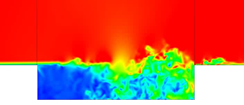
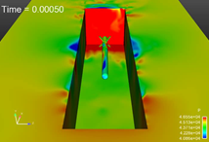
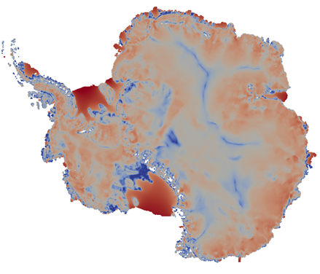
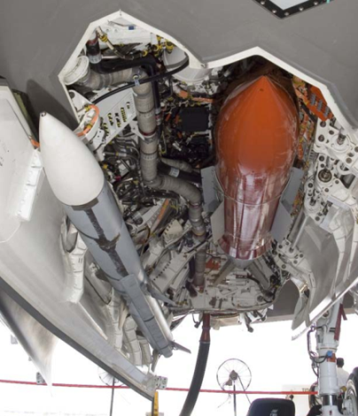
2
Motivation
Despite improved algorithms and powerful supercomputers, “high-fidelity” models are often too expensive for use in a design or analysis setting.
Application areas in which this situation arises:
Compressible captive-carry (center 1500): LES can take weeks because very fine meshes and long times are required.
Ice sheet modeling (center 1400): Bayesian inference of high-dimensional basal sliding field at ice bedrock is too large to solve using conventional methods (MCMC) without ROM (dimension reduction).
Antarctica Ice Sheet Example
Measured output: surface velocity
Unknown input: basal sliding coefficient at bedrock

Slide 3



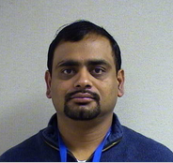
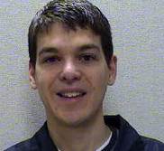
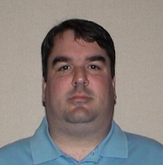
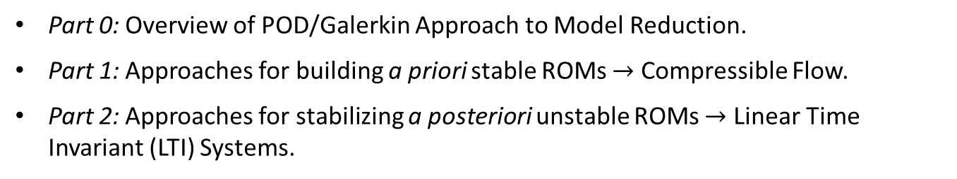
3
Outline
Part 0: Overview of POD/Galerkin Approach to Model Reduction.
Part 1: Approaches for building a priori stable ROMs $→$ Compressible Flow.
Part 2: Approaches for stabilizing a posteriori unstable ROMs $→$ Linear Time Invariant (LTI) Systems.
This work was done as a part of I. Kalashnikova’s early career LDRD project entitled “Reduced Order Modeling for Prediction and Control of Large Scale Systems” (FY12-FY14)
[follow-up work from FY07-FY09 LDRD project led by M. Barone entitled
“Reduced Order Modeling for Fluid/Structure Interaction”]
Key Research Team Members (left to right): I. Kalashnikova (1442), B. van Bloemen Waanders (1441),
S. Arunajatesan (1515), M. Barone (1515), J. Fike (1526)

Slide 4
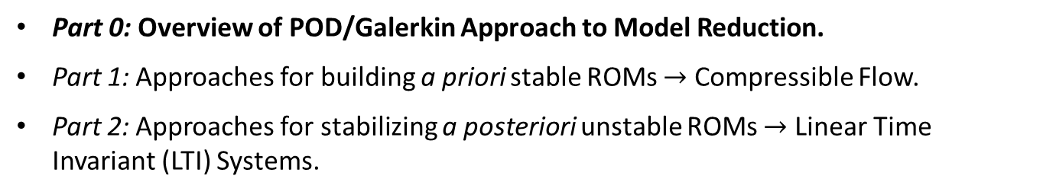
3
Outline
Part 0: Overview of POD/Galerkin Approach to Model Reduction.
Part 1: Approaches for building a priori stable ROMs $→$ Compressible Flow.
Part 2: Approaches for stabilizing a posteriori unstable ROMs $→$ Linear Time Invariant (LTI) Systems.
This work was done as a part of I. Kalashnikova’s early career LDRD project entitled “Reduced Order Modeling for Prediction and Control of Large Scale Systems” (FY12-FY14)
[follow-up work from FY07-FY09 LDRD project led by M. Barone entitled
“Reduced Order Modeling for Fluid/Structure Interaction”]
Key Research Team Members (left to right): I. Kalashnikova (1442), B. van Bloemen Waanders (1441),
S. Arunajatesan (1515), M. Barone (1515), J. Fike (1526)

Slide 5
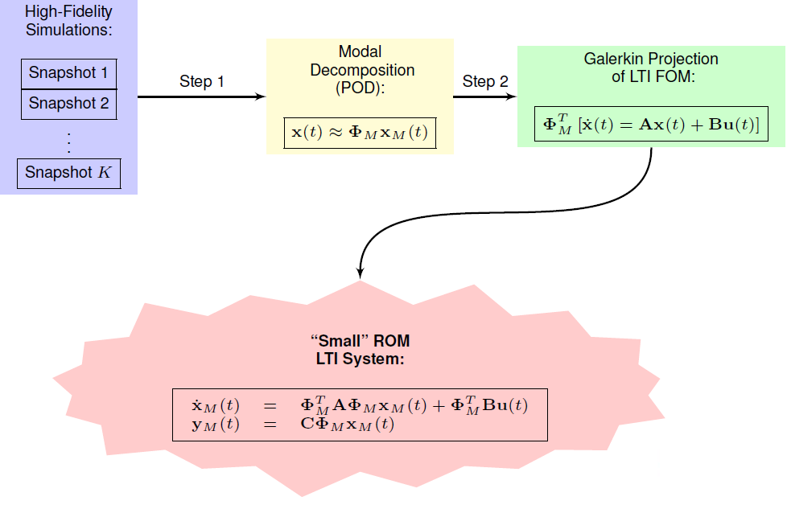
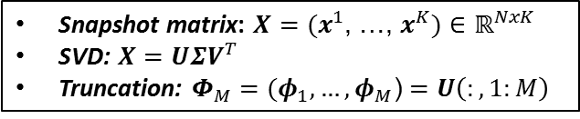
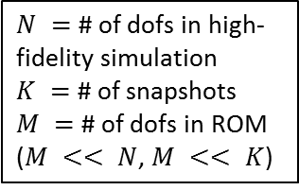
4
Proper Orthogonal Decomposition (POD)/
Galerkin Method to Model Reduction
Snapshot matrix: $X=(x^{1}$, …, $x^{K})$ $∈ℝ^{NxK}$
SVD: $X=UΣV^{T}$
Truncation: $Φ_{M}=(φ_{1}, …, φ_{M}$) $=U\left(:,1:M\right)$
$N =$ # of dofs in high-fidelity simulation
$K =$ # of snapshots
$M =$ # of dofs in ROM
($M << N$, $M << K$)

Slide 6
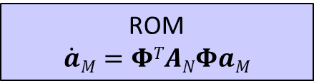
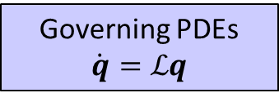
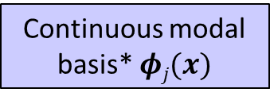
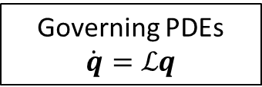
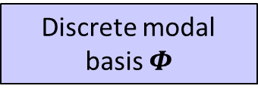
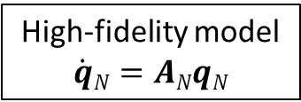
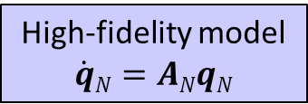
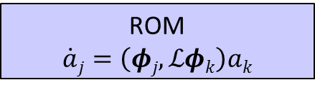
5
Continuous vs. Discrete Galerkin
Projection
Continuous Projection
Discrete Projection
Governing PDEs
$$\dot{q}=ℒq$$
Governing PDEs
$$\dot{q}=ℒq$$
If PDEs are linear or have polynomial non-linearities, projection can be calculated in offline stage of MOR.
High-fidelity model
$$\dot{q}N=ANqN$$
High-fidelity model
$$\dot{q}N=ANqN$$
Continuous modal basis* $φj(x)$
Discrete modal basis $Φ$
Projection of governing PDEs (numerical integration)
Projection of HF model (matrix operation)
Part 1 of talk.
ROM
$$\dot{a}j=\left(φj,ℒφk\right)ak$$
Part 2 of talk.
ROM
$$\dot{a}M=ΦTANΦaM$$
* Continuous functions space is defined using finite elements.

Slide 7
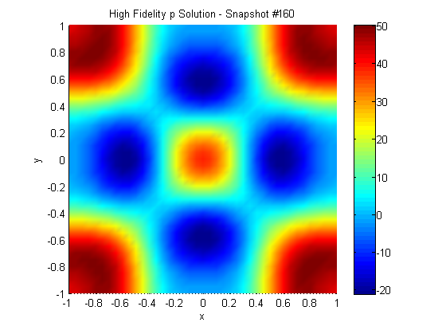
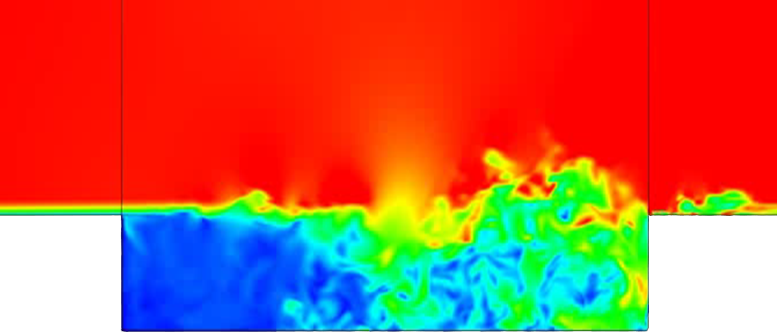
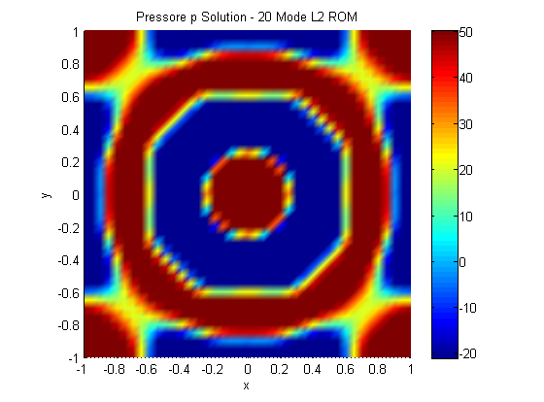
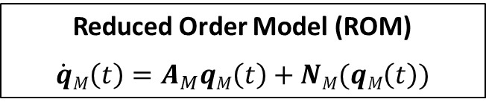
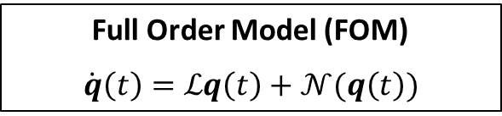

6
Stability Issues of POD/Galerkin ROMs
Full Order Model (FOM)
$$\dot{q}\left(t\right)=ℒq\left(t\right)+𝒩(q\left(t\right))$$
Reduced Order Model (ROM)
$$\dot{q}M\left(t\right)=A_{M}qM\left(t\right)+NM(qM\left(t\right))$$
Problem: FOM stable $⇏$ ROM stable!
There is no a priori stability guarantee for POD/Galerkin ROMs.
Stability of a ROM is commonly evaluated a posteriori – RISKY!
Instability of POD/Galerkin ROMs is a real problem in some applications…
Top right: FOM
\
Bottom right: ROM
…e.g., compressible flows, high-Reynolds number flows.

Slide 8
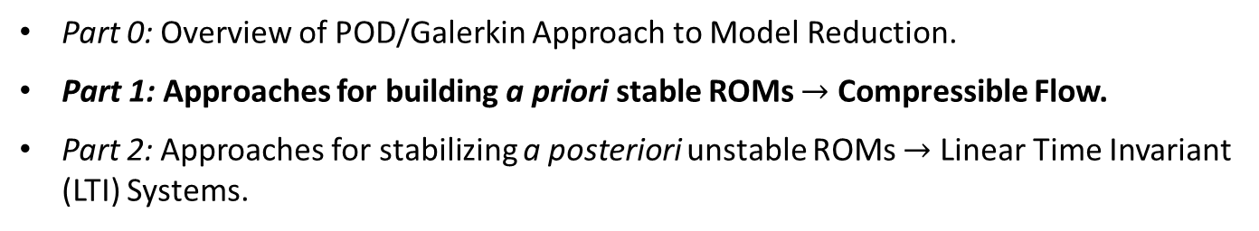
7
Outline
Part 0: Overview of POD/Galerkin Approach to Model Reduction.
Part 1: Approaches for building a priori stable ROMs $→$ Compressible Flow.
Part 2: Approaches for stabilizing a posteriori unstable ROMs $→$ Linear Time Invariant (LTI) Systems.
This work was done as a part of I. Kalashnikova’s early career LDRD project entitled “Reduced Order Modeling for Prediction and Control of Large Scale Systems” (FY12-FY14)
[follow-up work from FY07-FY09 LDRD project led by M. Barone entitled
“Reduced Order Modeling for Fluid/Structure Interaction”]
Key Research Team Members (left to right): I. Kalashnikova (1442), B. van Bloemen Waanders (1441),
S. Arunajatesan (1515), M. Barone (1515), J. Fike (1526)

Slide 9
8
Energy-Stability
Practical Definition: Numerical solution does not “blow up” in finite time.
More Precise Definition: Numerical discretization does not introduce any spurious instabilities inconsistent with natural instability modes supported by the governing continuous PDEs.
Numerical solutions must maintain proper energy balance.
Stability of ROM is intimately tied to choice of inner product for the Galerkin projection.
Stability-preserving inner product derived using the energy method:
  Bounds numerical solution energy in a physical way.
  Borrowed from spectral methods community.
  Analysis is straightforward for ROMs constructed via continuous projection.
Practical implication of energy-stability analysis:
energy inner product ensures that any “bad” modes will not introduce spurious non-physical numerical instabilities into the Galerkin approximation.

Slide 10
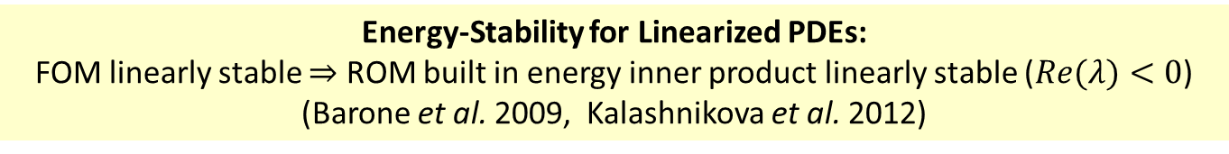
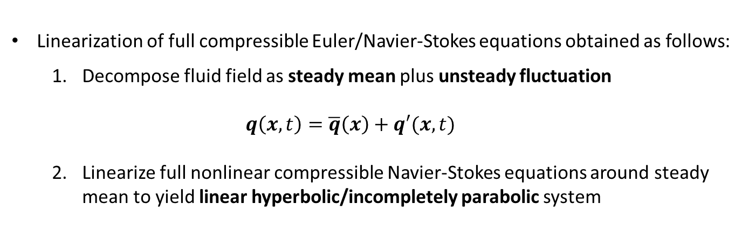

9
Linearized Compressible Flow
Equations
Energy-Stability for Linearized PDEs:
FOM linearly stable $⇒$ ROM built in energy inner product linearly stable ($Re(λ)<0$)
(Barone et al. 2009, Kalashnikova et al. 2012)
Linearized compressible Euler/Navier-Stokes equations are appropriate when a compressible fluid system can be described by small-amplitude perturbations about a steady-state mean flow.
Linearization of full compressible Euler/Navier-Stokes equations obtained as follows:
  Decompose fluid field as steady mean plus unsteady fluctuation
  $$q\left(x,t\right)=\overline{q}\left(x\right)+q′(x,t)$$
  Linearize full nonlinear compressible Navier-Stokes equations around steady mean to yield linear hyperbolic/incompletely parabolic system
  $$\dot{q′}+Ai\left(\overline{q}\right)\frac{∂q′}{∂xi}+\frac{∂}{∂xj}\left[Kij(\overline{q})\frac{∂q′}{∂xi}\right]=0$$

Slide 11
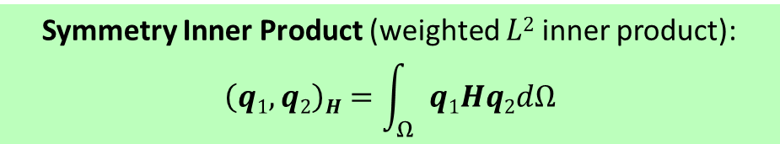
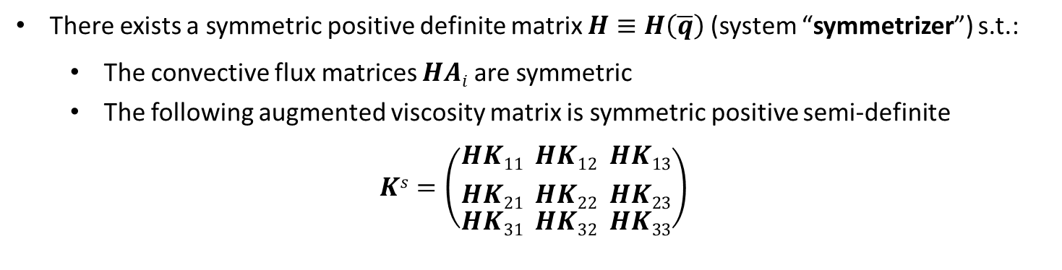
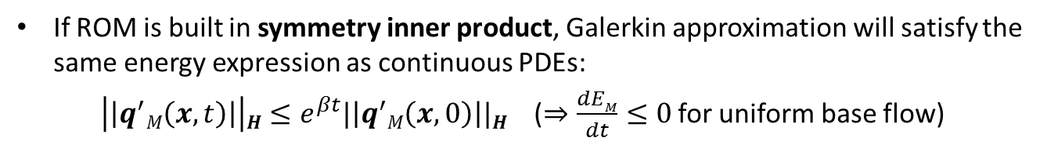
10
Energy-Stable ROMs for Linearized
Compressible Flow
Linearized compressible Euler/Navier-Stokes equations are symmetrizable (Barone & Kalashnikova, 2009; Kalashnikova & Arunajatesan, 2012).
There exists a symmetric positive definite matrix $H≡H\left(\overline{q}\right)$(system “symmetrizer”) s.t.:
  The convective flux matrices $HAi$ are symmetric
  The following augmented viscosity matrix is symmetric positive semi-definite
$$Ks=\left(\begin{aligned}{HK11 \atop HK21} \\ HK31\end{aligned}\begin{aligned}{ HK12 \atop HK22} \\ HK32\end{aligned}\begin{aligned}{ HK13 \atop HK23} \\ HK33\end{aligned}\right)$$
Symmetry Inner Product (weighted $L2$ inner product):
$$\left(q1,q2\right)H=\int_{Ω}{q1Hq2dΩ}$$
If ROM is built in symmetry inner product, Galerkin approximation will satisfy the same energy expression as continuous PDEs:
$\left|\left|q^{′}M\left(x,t\right)\right|\right|H≤e^{βt}|\left|q^{′}M\left(x,0\right)\right||H$ ($⇒\frac{dEM}{dt}≤0$ for uniform base flow)

Slide 12

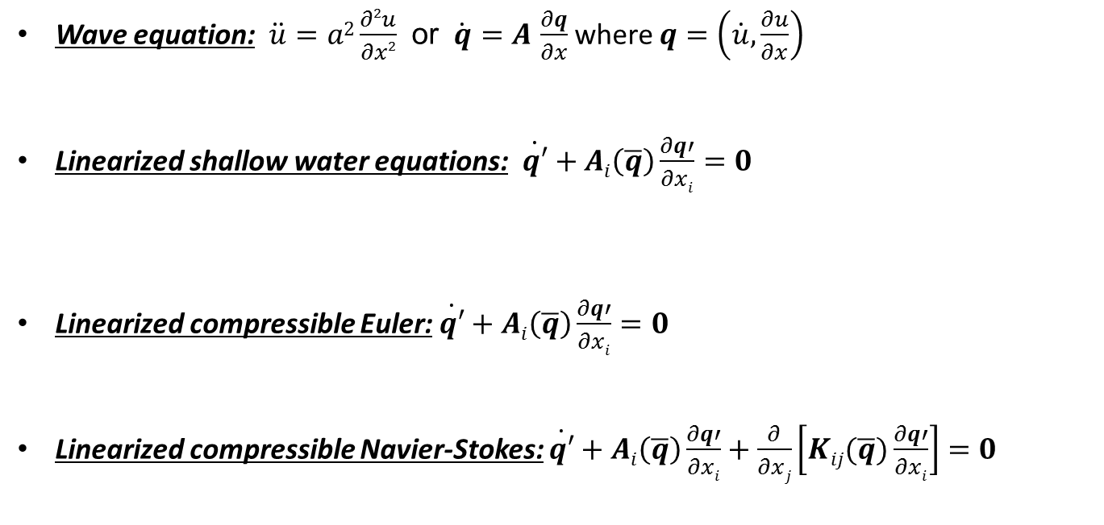
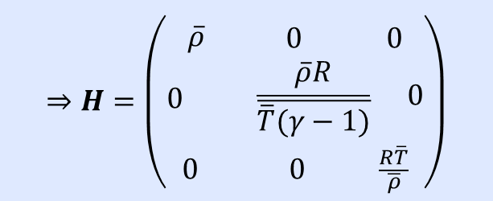

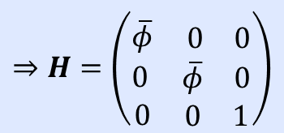
11
Symmetrizers for Several Hyperbolic/
Incompletely Parabolic Systems
$$⇒H=\left(\begin{matrix}1 & 0 \\ 0 & a2\end{matrix}\right)$$
Wave equation: $\ddot{u}=a2\frac{∂2u}{∂x2}$ or $\dot{q}=A$ $\frac{∂q}{∂x}$ where $q=\left(\dot{u},\frac{∂u}{∂x}\right)$
Linearized shallow water equations: $\dot{q′}+Ai\left(\overline{q}\right)\frac{∂q′}{∂xi}=0$
Linearized compressible Euler: $\dot{q′}+Ai\left(\overline{q}\right)\frac{∂q′}{∂xi}=0$
  Linearized compressible Navier-Stokes: $\dot{q′}+Ai\left(\overline{q}\right)\frac{∂q′}{∂xi}+\frac{∂}{∂xj}\left[Kij(\overline{q})\frac{∂q′}{∂xi}\right]=0$
$$⇒H=\left(\begin{aligned} \\ \overline{φ}\begin{matrix} 0 & 0\end{matrix} \\ 0 \begin{matrix}\overline{φ} & 0\end{matrix} \\ 0 \begin{matrix}0 & 1\end{matrix}\end{aligned}\right)$$
$$⇒H=\left(\begin{aligned} \\ \overline{ρ}\begin{matrix} 0 & 0\end{matrix} \\ 0 \begin{matrix}α2γ\overline{ρ}2\overline{p} & \overline{ρ}α2\end{matrix} \\ \begin{matrix}0 & 0\end{matrix} \frac{(1+α2)}{γ\overline{p}}\end{aligned}\right)$$
$$⇒H=\left(\begin{aligned} \\ \overline{ρ}\begin{matrix} 0 & 0\end{matrix} \\ 0 \begin{matrix} \frac{\overline{ρ}R}{\overline{\overline{T}(γ−1)}} & 0\end{matrix} \\ \begin{matrix}0 & 0\end{matrix} \frac{R\overline{T}}{\overline{ρ}}\end{aligned}\right)$$
Barone & Kalashnikova, JCP, 2009.
Kalashnikova & Arunajatesan, WCCM X, 2012.
Kalashnikova et al., SAND report, 2014.

Slide 13
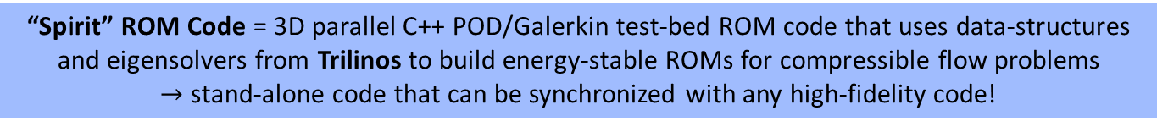
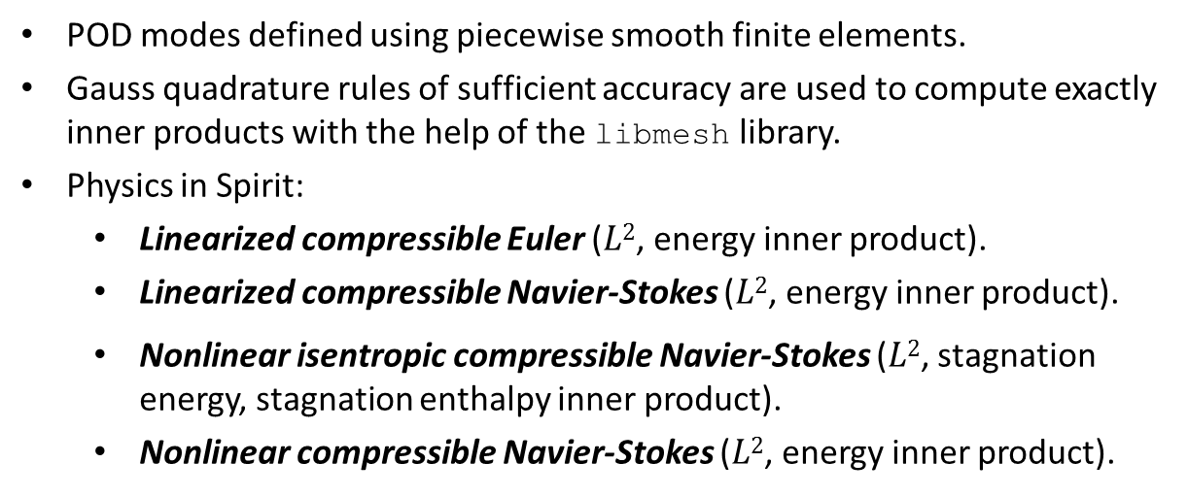
12
Continuous Projection
Implementation: “Spirit” Code
“Spirit” ROM Code = 3D parallel C++ POD/Galerkin test-bed ROM code that uses data-structures and eigensolvers from Trilinos to build energy-stable ROMs for compressible flow problems
$→$ stand-alone code that can be synchronized with any high-fidelity code!
POD modes defined using piecewise smooth finite elements.
Gauss quadrature rules of sufficient accuracy are used to compute exactly inner products with the help of the libmesh library.
Physics in Spirit:
  Linearized compressible Euler ($L2$, energy inner product).
  Linearized compressible Navier-Stokes ($L2$, energy inner product).
  Nonlinear isentropic compressible Navier-Stokes ($L2$, stagnation energy, stagnation enthalpy inner product).
  Nonlinear compressible Navier-Stokes ($L2$, energy inner product).
First, testing of ROMs for these physics
“SIGMA CFD” High-Fidelity Code = Sandia in-house finite volume flow solver derived from LESLIE3D (Genin & Menon, 2010), an LES flow solver originally developed in the Computational Combustion Laboratory at Georgia Tech.

Slide 14
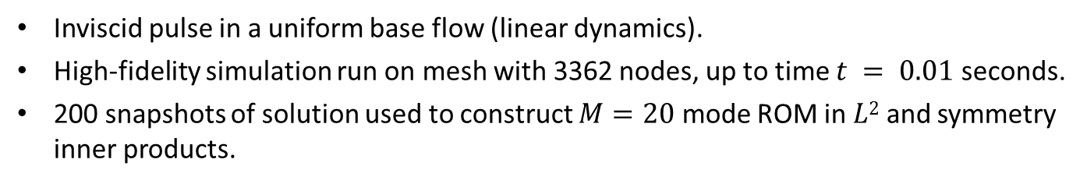


13
Numerical Experiment: 2D Inviscid
Pressure Pulse
Inviscid pulse in a uniform base flow (linear dynamics).
High-fidelity simulation run on mesh with 3362 nodes, up to time $t = 0.01$ seconds.
200 snapshots of solution used to construct $M=20$ mode ROM in $L2$ and symmetry inner products.
$x_{M,i}(t)$vs.$(q’CFD,φi)$ for $i=1,2$
$L2$ROM
Symmetry ROM

Slide 15

14
Numerical Experiment: 2D Inviscid
Pressure Pulse (cont’d)
Inviscid pulse in a uniform base flow (linear dynamics).
High-fidelity simulation run on mesh with 3362 nodes, up to time $t = 0.01$ seconds.
200 snapshots of solution used to construct $M=20$ mode ROM in $L2$ and symmetry inner products.
p’: High-fidelity
p’: Symmetry ROM
p’: $L2$ ROM
time of snapshot 0
time of snapshot 160

Slide 16
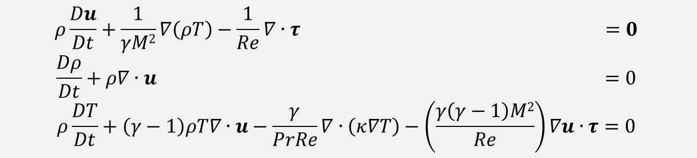
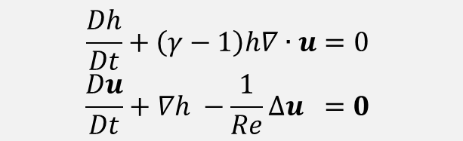
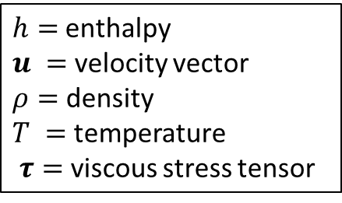
15
Nonlinear Compressible Flow Equations
Energy-Stability for Nonlinear PDEs:
ROM built in energy inner product will preserve stability of an equilibrium point at 0 for the governing nonlinear system of PDEs (Rowley, 2004; Kalashnikova et al., 2014).
Compressible isentropic Navier-Stokes equations (cold flows, moderate Mach #):
$$\frac{Dh}{Dt}+\left(γ−1\right)h∇∙u=0$$
$$\frac{Du}{Dt}+∇h −\frac{1}{Re}∆u =0$$
$h=$enthalpy
$u =$ velocity vector
$ρ=$ density
$T =$ temperature
$τ=$viscous stress tensor
Full compressible Navier-Stokes equations:
$$ρ\frac{Du}{Dt}+\frac{1}{γM2}∇\left(ρT\right)−\frac{1}{Re}∇∙τ =0$$
$$\frac{Dρ}{Dt}+ρ∇∙u =0$$
$$ρ\frac{DT}{Dt}+\left(γ−1\right)ρT∇∙u−\frac{γ}{PrRe}∇∙\left(κ∇T\right)−\left(\frac{γ\left(γ−1\right)M2}{Re}\right)∇u∙τ=0$$

Slide 17
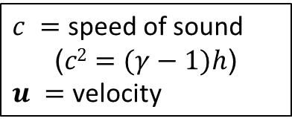
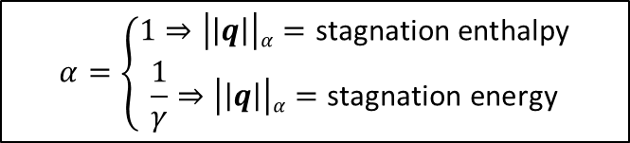
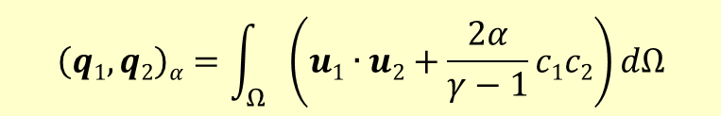
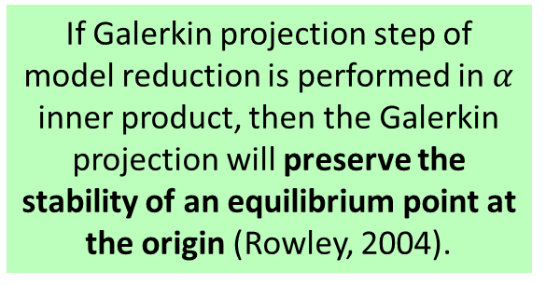
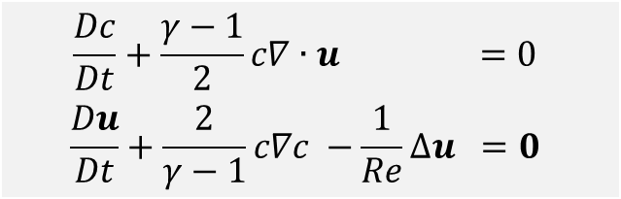
16
Energy-Stable ROMs for Nonlinear
Compressible Flow (Isentropic NS)
In (Rowley, 2004), Rowley et al. showed that energy inner product for the compressible isentropic Navier-Stokes equations can be defined following a transformation of these equations.
Transformed compressible isentropic Navier-Stokes equations:
$c =$ speed of sound
($c2=(γ−1)h$)
$u =$ velocity
$$\frac{Dc}{Dt}+\frac{γ−1}{2}c∇∙u =0$$
$$\frac{Du}{Dt}+\frac{2}{γ−1}c∇c −\frac{1}{Re}∆u =0$$
If Galerkin projection step of model reduction is performed in $α$ inner product, then the Galerkin projection will preserve the stability of an equilibrium point at the origin (Rowley, 2004).
Family of inner products:
$$\left(q1,q2\right)α=\int_{Ω}{\left(u1∙u2+\frac{2α}{γ−1}c1c2\right)dΩ}$$
$$α=\left\{\begin{aligned}1⇒\left|\left|q\right|\right|α=\text{stagnation} \text{enthalpy} \\ \frac{1}{γ}⇒\left|\left|q\right|\right|α=\text{stagnation} \text{energy}\end{aligned}\right.$$

Slide 18
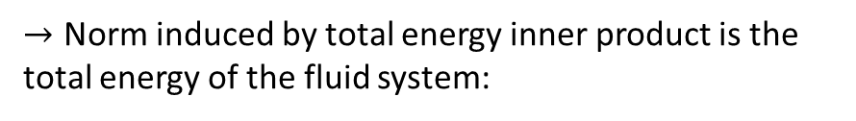
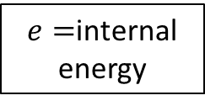

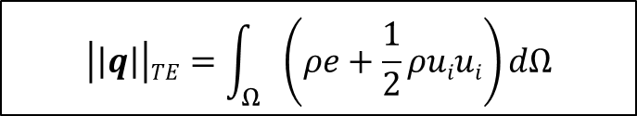
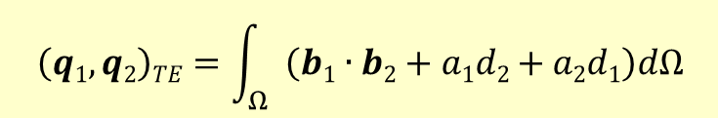
17
Energy-Stable ROMs for Nonlinear
Compressible Flow (Full NS)
Our recent work extends ideas in (Rowley, 2004) to full compressible N-S equations.
Requirement: transformation/inner product yields PDEs with only polynomial non-linearities.
First, full compressible Navier-Stokes equations are transformed into the following variables:
If Galerkin projection step of model reduction is performed in total energy inner product, then the Galerkin projection will preserve the stability of an equilibrium point at the origin
(Kalashnikova et al., 2014)
$e=$internal energy
$a=\sqrt{ρ}$, $b=au$, $d=ae$
Next, the following “total energy” inner product is defined:
$$\left(q1,q2\right)TE=\int_{Ω}{\left(b1∙b2+a1d2+a2d1\right)dΩ}$$
☺ Transformed equations have only polynomial non-linearities (projection of which can be computed in offline stage of MOR and stored).
☹ Transformation introduces higher order polynomial non-linearities for viscous case.
  ☺ Efficiency of online stage of MOR can be recovered using interpolation (e.g., DEIM, gappy POD).
$→$ Norm induced by total energy inner product is the total energy of the fluid system:
$$\left|\left|q\right|\right|TE=\int_{Ω}{\left(ρe+\frac{1}{2}ρuiui\right)}dΩ$$

Slide 19

18
Continuous Projection
Implementation: “Spirit” Code
“Spirit” ROM Code = 3D parallel C++ POD/Galerkin test-bed ROM code that uses data-structures and eigensolvers from Trilinos to build energy-stable ROMs for compressible flow problems
$→$ stand-alone code that can be synchronized with any high-fidelity code!
POD modes defined using piecewise smooth finite elements.
Gauss quadrature rules of sufficient accuracy are used to compute exactly inner products with the help of the libmesh library.
Physics in spirit:
  Linearized compressible Euler ($L2$, energy inner product).
  Linearized compressible Navier-Stokes ($L2$, energy inner product).
  Nonlinear isentropic compressible Navier-Stokes ($L2$, stagnation energy, stagnation enthalpy inner product).
  Nonlinear compressible Navier-Stokes ($L2$, energy inner product).
Now, testing of ROMs for these physics
“SIGMA CFD” High-Fidelity Code = Sandia in-house finite volume flow solver derived from LESLIE3D (Genin & Menon, 2010), a LES flow solver originally developed in the Computational Combustion Laboratory at Georgia Tech.

Slide 20


19
Numerical Experiment: Viscous Laminar
Cavity
Viscous cavity problem at $M = 0.6$, $Re = 1500$(laminar regime).
High-fidelity simulation: DNS based on full nonlinear compressible Navier-Stokes equations with $99,408$nodes (right).
$500$ snapshots collected, every $∆tsnap = 1×{10}^{−4}$seconds.
Snapshots used to construct $M=5$ mode ROM for nonlinear compressible Navier-Stokes equations in $L2$ and total energy inner products.
$M=5$ mode POD bases capture $≈ 99\%$ of snapshot energy.
Figure above: viscous laminar cavity problem domain/mesh.

Slide 21



29
Numerical Experiment: Viscous Laminar Cavity (cont’d)
Ongoing work: understanding effects of boundary conditions on ROM stability/accuracy.
High-Fidelity
ROM ($M=5$ modes) | Error ($L2$ norm)
Nonlinear $L2$ ROM | $$NaN$$
Total Energy ROM | $$5.52×{10}^{−2}$$
5 mode total energy ROM
Future work: improving efficiency of total energy ROMs through incorporation of interpolation (e.g., DEIM, gappy POD).
Figure above: $u$-component of velocity as a function of time $t$

Slide 22

21
Outline
Part 0: Overview of POD/Galerkin Approach to Model Reduction.
Part 1: Approaches for building a priori stable ROMs $→$ Compressible Flow.
Part 2: Approaches for stabilizing a posteriori unstable ROMs $→$ Linear Time Invariant (LTI) Systems.
This work was done as a part of I. Kalashnikova’s early career LDRD project entitled “Reduced Order Modeling for Prediction and Control of Large Scale Systems” (FY12-FY14)
[follow-up work from FY07-FY09 LDRD project led by M. Barone entitled
“Reduced Order Modeling for Fluid/Structure Interaction”]
Key Research Team Members (left to right): I. Kalashnikova (1442), B. van Bloemen Waanders (1441),
S. Arunajatesan (1515), M. Barone (1515), J. Fike (1526)

Slide 23







22
Stable ROMs for Linear Time
Invariant Systems
Attention restricted to Linear Time Invariant (LTI) systems
$$\dot{x}\left(t\right)=Ax\left(t\right)+Bu(t)$$
$y\left(t\right)=Cx\left(t\right)$
as a first step towards the more general nonlinear case.
LTI Full Order Model (FOM)
$$\dot{x}\left(t\right)=Ax\left(t\right)+Bu\left(t\right)$$
$y\left(t\right)=Cx\left(t\right)$
LTI Reduced Order Model (ROM)
$${\dot{x}}_{M}\left(t\right)=A_{M}xM\left(t\right)+BMu\left(t\right)$$
$yM\left(t\right)=CMxM\left(t\right)$
Problem: $A$ stable $⇏ AM$ stable!
Solution:
Black box
Unstable ROM ($AM$ unstable)
Stabilization Algorithm
($AM ←$ $\tilde{A}M$)
Stable and Accurate ROM ($\tilde{A}M$ stable)

Slide 24




23
ROM Stabilization via Optimization-
Based Eigenvalue Reassignment
ROM Stabilization Optimization Problem
(Constrained Nonlinear Least Squares):
$$\begin{matrix}min \\ λiu\end{matrix}\sum_{k=1}^{K}{||yk−yMk||22}$$
$$s.t. Re\left(λiu\right)<0$$
Idea: modify ROM system s.t. $A_{M}$ is stable and discrepancy b/w ROM output $yM\left(t\right)$ and FOM output $y\left(t\right)$ is minimal.
(1)
Replace unstable
$AM$ with stable $\tilde{A}M$.
$λiu$ = unstable eigenvalues of original ROM matrix $AM$.
$yk =y(tk)=$ snapshot output at $tk$.
$yMk=$ $CM\left[\exp\left(tkAM\right)xM\left(0\right)+\int_{0}^{tk}{exp\{\left(tk−τ\right)AM\}BMu\left(τ\right)dτ}\right] =$ROM output at $tk$.
ROM stabilization optimization problem is small: $<O(M).$
ROM stabilization optimization problem can be solved by standard optimization algorithms, e.g., interior point method.
  We use fmincon function in MATLAB’s optimization toolbox.
  We implement ROM stabilization optimization problem in characteristic variables $zM(t)=SM\text{−1}xM(t)$ where $AM=SMDMSM\text{−1}$.

Slide 25


24
ROM Stabilization via Optimization-
Based Eigenvalue Reassignment (cont’d)
Algorithm
Diagonalize the ROM matrix $AM$: $AM=SMDMSM\text{−1}$.
Initialize a diagonal $M×M$ matrix $\tilde{D}M$. Set $j=1$.
for $i=1$ to $M$
  if $Re(DM(i,i)<0)$, set $\tilde{D}M(i,i)=DM(i,i).$
  else, set $\tilde{D}M(i,i)=λju$.
Increment $j←j+1$.
Solve the optimization problem (1) for the eigenvalues $\{λju\}$ using an optimization algorithm (e.g., interior point method).
Evaluate $\tilde{D}M$ at the solution of the optimization problem (1).
Return the stabilized ROM system, given by $AM←\tilde{A}M=SM\tilde{D}MSM\text{−1}$.
Solution to optimization problem (1) may not be unique.
Can solve (1) for real or complex-conjugate pair eigenvalues:
  $λju∈ℝ$ s.t. constraint $λju<0$.
  $λju$= $λjur+i$ $λjuc$, $λ_{j+1}u$= $λjur−i$ $λjuc$ $∈ℂ$where $λjur,λjuc$ $∈ℝ$ s.t. constraint $λjur<0$.

Slide 26


25
Numerical Results: Electrostatically
Actuated Beam Benchmark
FOM = 1D model of electrostatically actuated beam.
Application of model: microelectromechanical systems (MEMS) devices such as electromechanical radio frequency (RF) filters.
1 input corresponding to periodic on/off switching, 1 output, initial condition $x(0)=0N$.
Second order linear semi-discrete system of the form:
$$M\ddot{x}\left(t\right)+E\dot{x}\left(t\right)+Kx\left(t\right)=Bu\left(t\right)$$
$y\left(t\right)=Cx\left(t\right)$
Matrices $M$, $E$, $K$, $B$, $C$ specifying the problem downloaded from the Oberwolfach ROM repository*.
2nd order linear system re-written as 1st order LTI system for purpose of analysis/model reduction.
FOM is stable.
* Oberwolfach ROM benchmark repository: http://simulation.uni-freiburg.de/downloads/benchmark.

Slide 27


26
Numerical Results #2: Electrostatically
Actuated Beam Benchmark (cont’d)
$M=17$ POD/Galerkin ROM constructed from $K=1000$snapshots up to time $t=0.05$.
$M=17$ POD/Galerkin ROM has 4 unstable eigenvalues (all real).
  Two options for ROM stabilization optimization problem:
    Option 1: Solve for $λ1,λ2,λ3,λ4∈ℝ$ s.t. the constraint $λ1,λ2,λ3,λ4<0$.
    Option 2: Solve for $λ1+$ $λ2i$, $λ1−λ2i$, $λ3$ $+$ $λ4i$,$λ3$ $−λ4i∈ℂ$ s.t. the constraint
    $$λ1,λ3<0.$$
Initial guess for fmincon interior point method: $λ1=λ2=λ3=λ4=−1$.
ROM | $$\frac{\sqrt{\sum_{k=1}^{K}{|\left|yk −yMk\right||2}2}}{\sqrt{\sum_{k=1}^{K}{|\left|yk\right||2}2}}$$
Unstabilized POD | $$NaN$$
Optimization Stabilized POD (Real Poles) | 0.0194
Optimization Stabilized POD (Complex-Conjugate Poles) | 0.0205
Balanced Truncation | $$1.370e−6$$

Slide 28
27
Summary & Future Work
Part 1: Approaches for building a priori stable ROMs (for Compressible Flow using Continuous Projection)
It is shown that the choice of inner product for the Galerkin projection step is crucial to stability of the ROM.
  For linearized compressible flow, Galerkin projection in the “symmetry” inner product leads to a ROM that is energy-stable for any choice of basis.
  For nonlinear compressible flow, an inner product that induces the total energy of the fluid system is developed. A ROM constructed in this inner product will preserve the stability of an equilibrium point at 0 for the system.
Ongoing/future work: improving efficiency of total energy ROMs through interpolation (e.g., DEIM, gappy POD); incorporating BCs into Spirit code.
Part 2: Approaches for stabilizing a posteriori unstable ROMs (for Linear Time Invariant, or LTI, Systems).
A new ROM stabilization approach that modifies a posteriori an unstable ROM LTI system by changing the system’s unstable eigenvalues is proposed.
In the proposed stabilization algorithm, a constrained nonlinear least squares optimization problem for the ROM eigenvalues is formulated to minimize error in ROM output.
  Future work: extension to nonlinear problems and predictive applications.

Slide 29

28
Acknowledgements
This work was funded by the Laboratories’ Directed Research and Development (LDRD) Program at Sandia National Laboratories.
Special thanks to: Prof. Lou Cattafesta (FSU) and Prof. Karen Willcox (MIT) for useful discussions that led to some of the ideas presented in Part 2 of the talk.
Thank You! Questions?
ikalash@sandia.gov
http://www.sandia.gov/~ikalash
Some references on these ideas:
I. Kalashnikova, S. Arunajatesan, M.F. Barone, B.G. van Bloemen Waanders, J.A. Fike. Reduced Order Modeling for Prediction and Control of Large-Scale Systems. Sandia National Laboratories Report, SAND No. 2014-4693 (2014).
I. Kalashnikova, B.G. van Bloemen Waanders, S. Arunajatesan, M.F. Barone. "Stabilization of Projection-Based Reduced Order Models for Linear Time-Invariant Systems via Optimization-Based Eigenvalue Reassignment". Comput. Meth. Appl. Mech. Engng. 272 (2014) 251-270.
M.F. Barone, I. Kalashnikova, D.J. Segalman, H. Thornquist. Stable Galerkin reduced order models for linearized compressible flow. J. Comput. Phys. 288: 1932-1946, 2009.

Slide 30
29
References
I. Kalashnikova, B.G. van Bloemen Waanders, S. Arunajatesan, M.F. Barone. "Stabilization of Projection-Based Reduced Order Models for Linear Time-Invariant Systems via Optimization-Based Eigenvalue Reassignment". Comput. Meth. Appl. Mech. Engng. 272 (2014) 251-270.
M.F. Barone, I. Kalashnikova, D.J. Segalman, H. Thornquist. Stable Galerkin reduced order models for linearized compressible flow. J. Comput. Phys. 288: 1932-1946, 2009.
C.W. Rowley, T. Colonius, R.M. Murray. Model reduction for compressible flows using POD and Galerkin projection. Physica D. 189: 115-129, 2004.
G. Serre, P. Lafon, X. Gloerfelt, C. Bailly. Reliable reduced-order models for time-dependent linearized Euler equations. J. Comput. Phys. 231(15): 5176-5194, 2012.
B. Bond, L. Daniel, Guaranteed stable projection-based model reduction for indefinite and unstable linear systems, In: Proceedings of the 2008 IEEE/ACM International Conference on Computer-Aided Design, 728–735, 2008.
D. Amsallem, C. Farhat. Stabilization of projection-based reduced order models. Int. J. Numer. Methods Engng. 91 (4) (2012) 358-377.
F. Genin and S. Menon. Studies of shock/turbulent shear layer interaction using large-eddy simulation. Computers and Fluids, 39 800–819 (2010).
I. Kalashnikova, B.G. van Bloemen Waanders, S. Arunajatesan, M.F. Barone. "Stabilization of Projection-Based Reduced Order Models for Linear Time-Invariant Systems via Optimization-Based Eigenvalue Reassignment". Comput. Meth. Appl. Mech. Engng. 272 (2014) 251-270.

Slide 31
30
References (cont’d)
Z. Wang, I. Akhtar, J. Borggaard, T. Iliescu. Proper orthogonal decomposition closure models for turbulent flows: a numerical comparison. Comput. Methods Appl. Mech. Engrg. 237-240:10-26, 2012.
I. Kalashnikova, S. Arunajatesan, M.F. Barone, B.G. van Bloemen Waanders, J.A. Fike. Reduced Order Modeling for Prediction and Control of Large-Scale Systems. Sandia National Laboratories Report, SAND No. 2014-4693 (2014).
I. Kalashnikova, S. Arunajatesan. A Stable Galerkin Reduced Order Model (ROM) for Compressible Flow, WCCM-2012-18407, 10th World Congress on Computational Mechanics (WCCM X), Sao Paulo, Brazil (2012).
K. Carlberg, C. Bou-Mosleh, C. Farhat. Efficient nonlinear model reduction via a least-squares Petrov-Galerkin projection and compressive tensor approximations. Int. J. Numer. Meth. Engng. 86 (2) 155-181 (2011).
S. Chaturantabut, D.C. Sorensen. Discrete empirical interpolation for nonlinear model reduction. Technical Report TR09-05, Department of Computational and Applied Mathematics, Rice University (2009).
I. Kalashnikova, B.G. van Bloemen Waanders, S. Arunajatesan, M.F. Barone. "Stabilization of Projection-Based Reduced Order Models for Linear Time-Invariant Systems via Optimization-Based Eigenvalue Reassignment". Comput. Meth. Appl. Mech. Engng. 272 (2014) 251-270.

Slide 32
31
References (cont’d)
The MathWorks, Inc., Optimization Toolbox User’s Guide, 1990-2008.
NICONET ROM benchmark repository: www.icm.tu-bs.de/NICONET/benchmodred.html.
Oberwolfach ROM benchmark repository: http://simulation.uni-freiburg.de/downloads/benchmark.

Slide 33

32
Appendix: Stability Preserving ROM Approaches Literature Review
Approaches for building stability-preserving POD/Galerkin
ROMs found in the literature fall into two categories:
Part 1
of talk.
1. ROMs which derive a priori a stability-preserving model reduction framework (usually specific to an equation set).
  ROMs based on projection in special ‘energy-based’ (not $L2$) inner products, e.g., Rowley et al. (2004), Barone & Kalashnikova et al. (2009), Serre et al. (2012).
2. ROMs which stabilize an unstable ROM through an a posteriori post-processing stabilization step applied to the algebraic ROM system.
  Approaches in which an optimization problem that stabilizes an unstable ROM is formulated and solved, e.g., Amsallem et al. (2012), Bond et al. (2008), Kalashnikova et al. (2014).
  ROMs with increased numerical stability due to inclusion of ‘stabilizing’ terms in the ROM equations, e.g., Wang et al. (2012).
Can have an
intrusive implementation
Part 2
of talk.
Can have
inconsistencies between ROM and FOM physics

Slide 34



33
Appendix: Lyapunov Inner Product (Discrete
Counterpart of Symmetry Inner Product)
Symmetry inner product has a discrete project counterpart!
Consider a linear semi-discrete (i.e., discretized in space) stable FOM:
$$\dot{x}\left(t\right)=Ax(t)$$
The Lyapunov function for the above system is $V(x) = xTPx$where P is the solution of the following Ricatti equation:
$$ATP+PA=−Q$$
  SPD solution to this Ricatti equation exists if $A$ is stable and $Q$ is SPD.
  The solution to this Ricatti equation can be obtained using the MATLAB control toolbox:
  P=lyap(A’, Q, [], speye(n,n));
Discrete analog of symmetry inner product: Lyapunov inner product
$$(x1,x2)P≡x1TPx2$$
Can show that if the ROM is constructed in the Lyapunov inner product, then:
$$\frac{dEM}{dt}≡\frac{1}{2}\frac{d}{dt}\left|\left|xM\right|\right|22≤0$$

Slide 35





34
Appendix: Electrostatically Actuated Beam
Benchmark (fmincon performance)
Current Function Value
 | Real Poles | Complex-Conjugate Poles
# upper bound constraints | 4 | 2
# iterations | 60 | 31
# function evaluations | 64 | 32
$|∇L|$ at convergence (1st order optimality) | 2.27e-7 | 8.43e-7
1.23598
Current Function Value
First-Order Optimality
First-Order Optimality
1.13229
2.26927e-07
8.43228e-07

Slide 36
35
Appendix: Electrostatically Actuated Beam Benchmark (CPU Times)
Model | Operations | CPU time (sec)
FOM | Time-Integration | 7.10e4
ROM – offline stage | Snapshot collection (FOM time-integration) | 7.10e4
 | Loading of matrices/snapshots | 5.17
 | POD | 1.09e1
 | Projection | 2.55e1
 | Optimization | 8.79e1
ROM – online stage | Time-integration | 6.78
To offset total pre-process time of ROM (time required to run FOM to collect snapshots, calculate the POD basis, perform the Galerkin projection, and solve the optimization problem (1)), the ROM would need to be run 1e4 times (due to large CPU time of FOM).
Solution of optimization problem is very fast: takes ~1.5 minute to complete.

Slide 37




36
Appendix: Electrostatically Actuated
Beam Benchmark (Eigenvalues)
Unstable Eigenvalues
$$λ6=16,053$$
$$λ12=48.985$$
$$λ14=12.650$$
$$λ17=0.05202$$
Stabilized Eigenvalues (Real) | Stabilized Eigenvalues (Complex Conjugates)
$$λ6=−7,043,505$$ | $$λ6=−106,976+551.77i$$
$$λ12=−35.364$$ | $$λ12=−106,976−551.77$$
$$λ14=−153,033$$ | $$λ14=−2954.1−1244.7i$$
$$λ17=−99,175$$ | $$λ17=−2954.1+1244.7i$$

