Slide 1
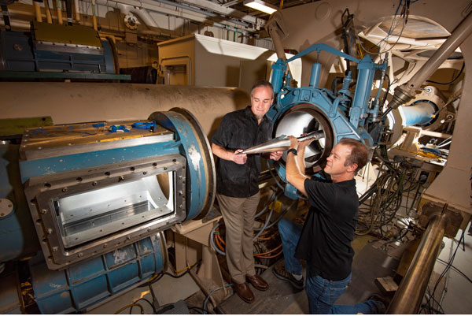
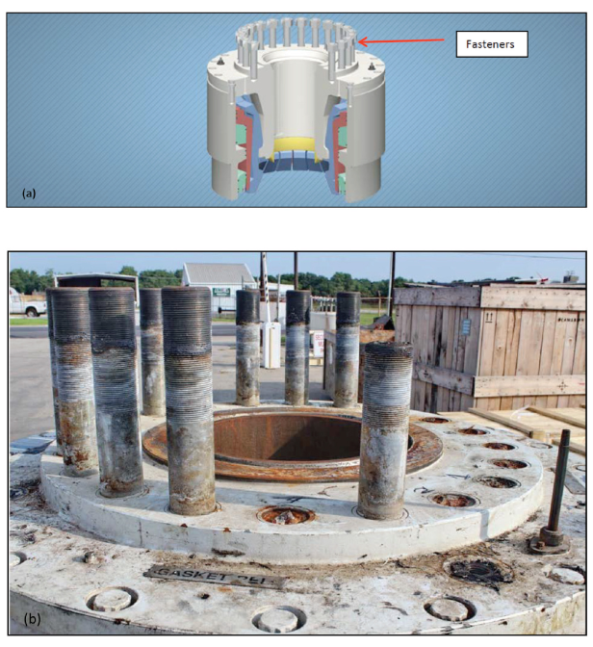
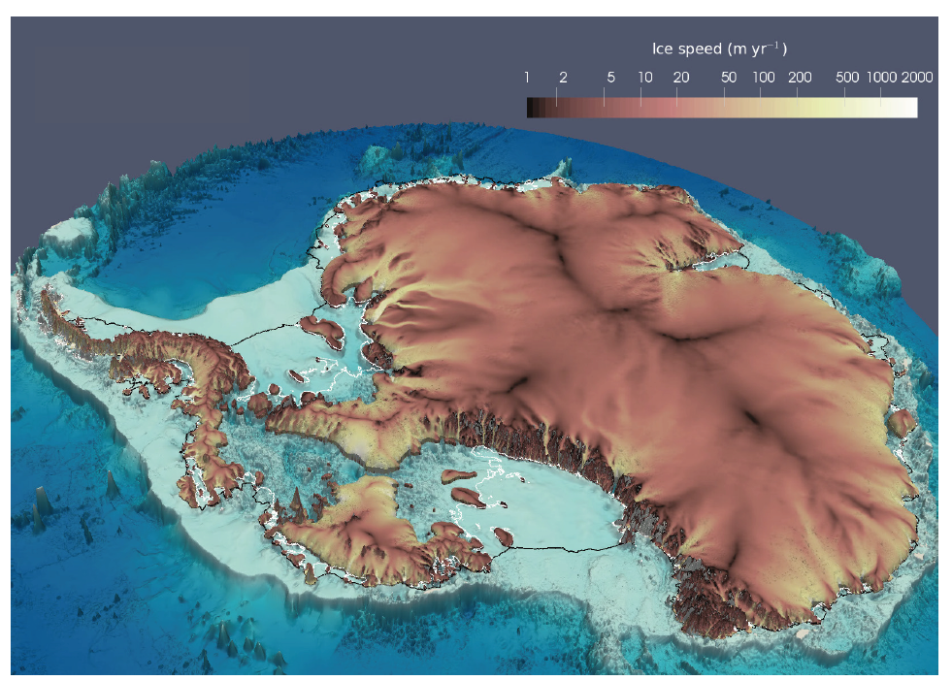

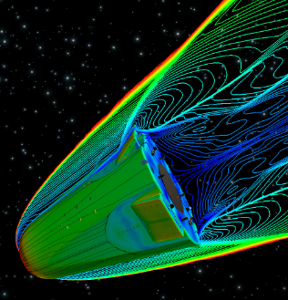
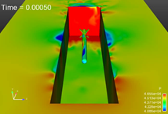
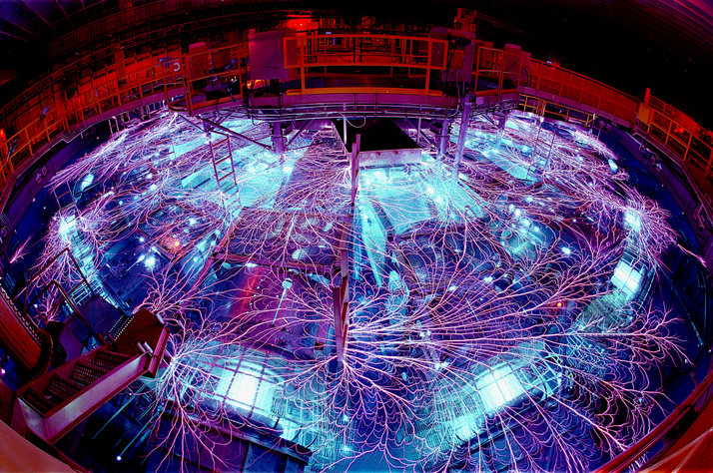
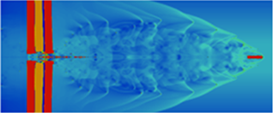
Irina Tezaur
Quantitative Modeling & Analysis Department
Computational modeling & simulation of complex multi-scale/multi-physics problems benefiting DOE nuclear weapons, national security & climate missions.
Ice Sheet and Climate Modeling
Multi-Scale Methods for System/ Component Failure Analyses
Shock Multi-Physics for Z-Machine Implosion and Advanced Armor Simulations
Model Order Reduction of Captive-Carry and Re-Entry Environments
SAND2019-13465 PE

Slide 2
Backup Slides

Slide 3
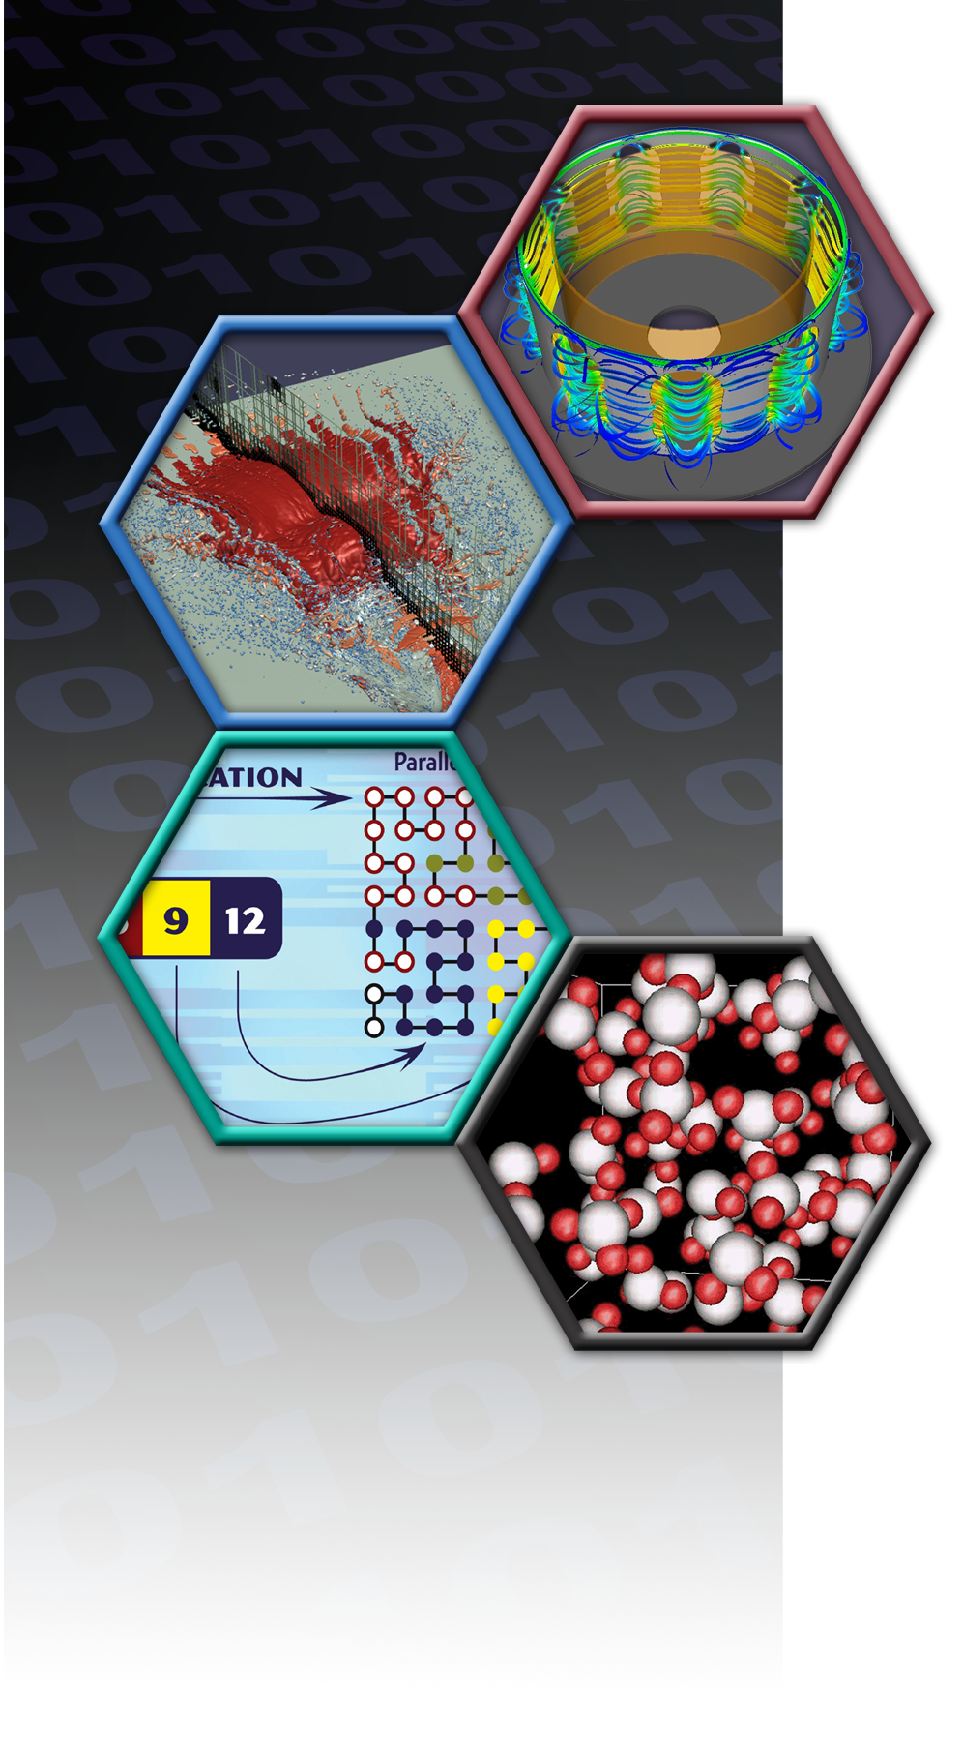
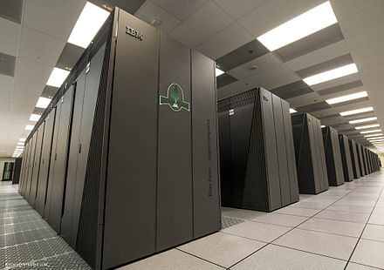
Computational Modeling & Simulation
Computational/mathematical modeling & simulation can replace and/or enhance laboratory/field experiments, which can be costly and time-consuming.
It allows one to explore and evaluate multiple configuration settings for engineering designs, and predict possible future scenarios of interest worldwide (e.g., disease outbreaks, climate change).
Computer simulations can provide actionable information to support public policy and decision making.
Image from SNL’s Center for Computing Research (CCR) homepage

Slide 4
Model Order Reduction of the Captive-Carry and Re-Entry Environments
Data-driven approach that speeds up simulations, which can take weeks even when run on massively parallel supercomputers
Enables real-time design quantification and uncertainty quantification
Complements experimental work performed in Sandia’s wind tunnels.

Slide 5

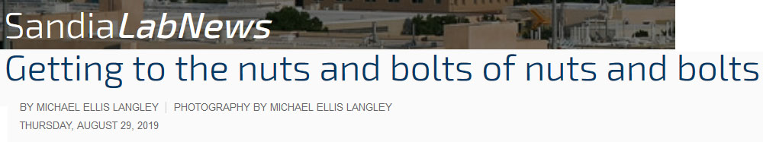
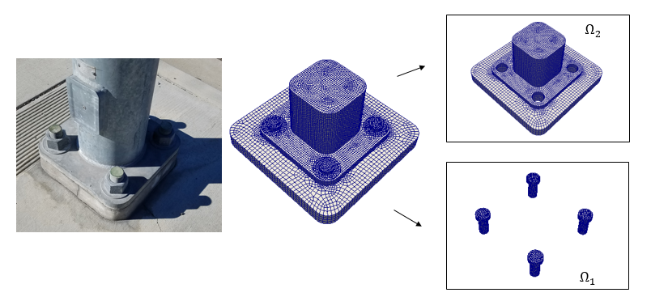
Multi-Scale Methods for System/Component Failure Analyses
Small-scale defects can lead to large-scale structural failure (left).
Simulating multiple scales is very challenging!
Roof failure of Boeing 737 aircraft due to fatigue cracks.
“Plug-and-play” multi-scale simulation framework reduces simulation time from months to weeks and enables exploration of many failure scenarios.
Components held together by fasteners

Slide 6
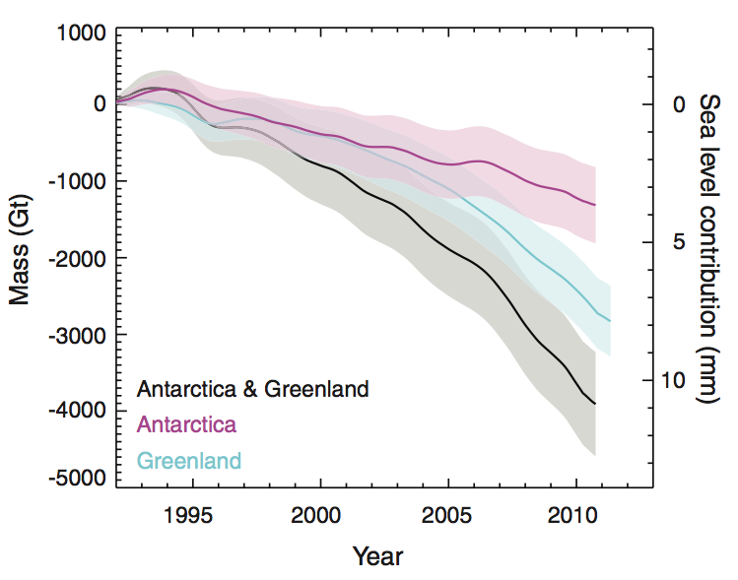

Ice Sheet & Climate Modeling
Most likely SLR by 2100: 0.8-1m
(2014 IPCC AR)
Motivation: 2007 IPCC AR declined to include estimates of future sea-level rise from ice sheet dynamics due to deficiencies in ice sheet models.
We are developing a next-generation ice model that will provide actionable predictions of 21st century sea-level rise and supports national security missions as part of DOE Energy Exascale Earth System Model (E3SM).
Related work involves detecting Arctic tipping points due to climate change using the E3SM and data-driven (machine-learned) models.

