Slide 1

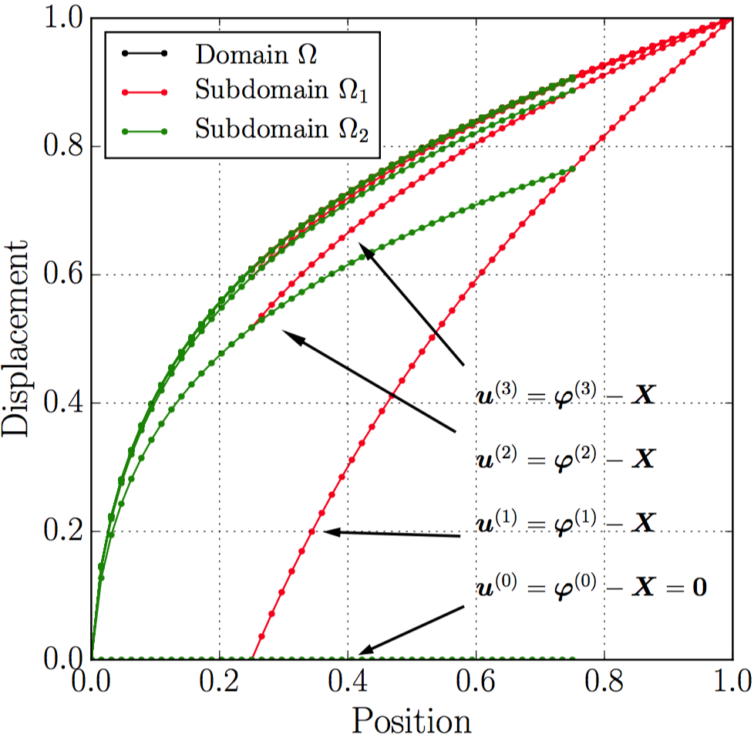
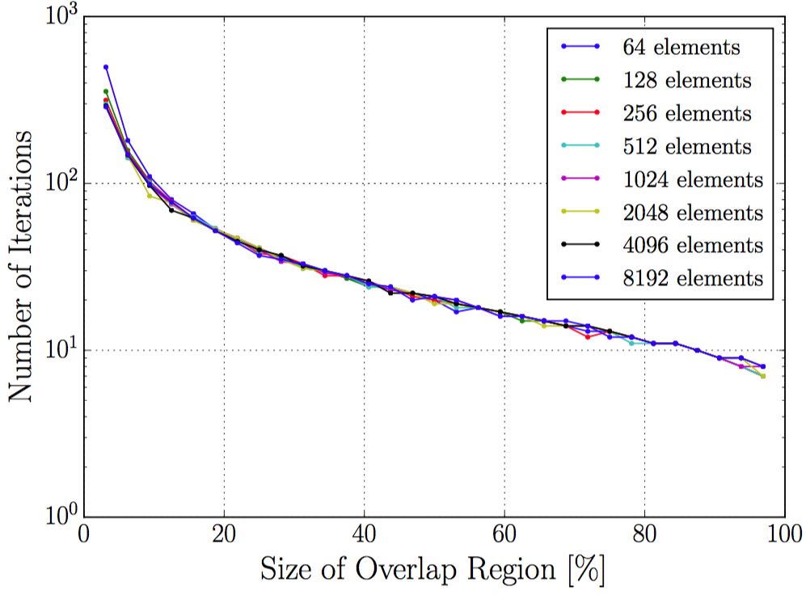
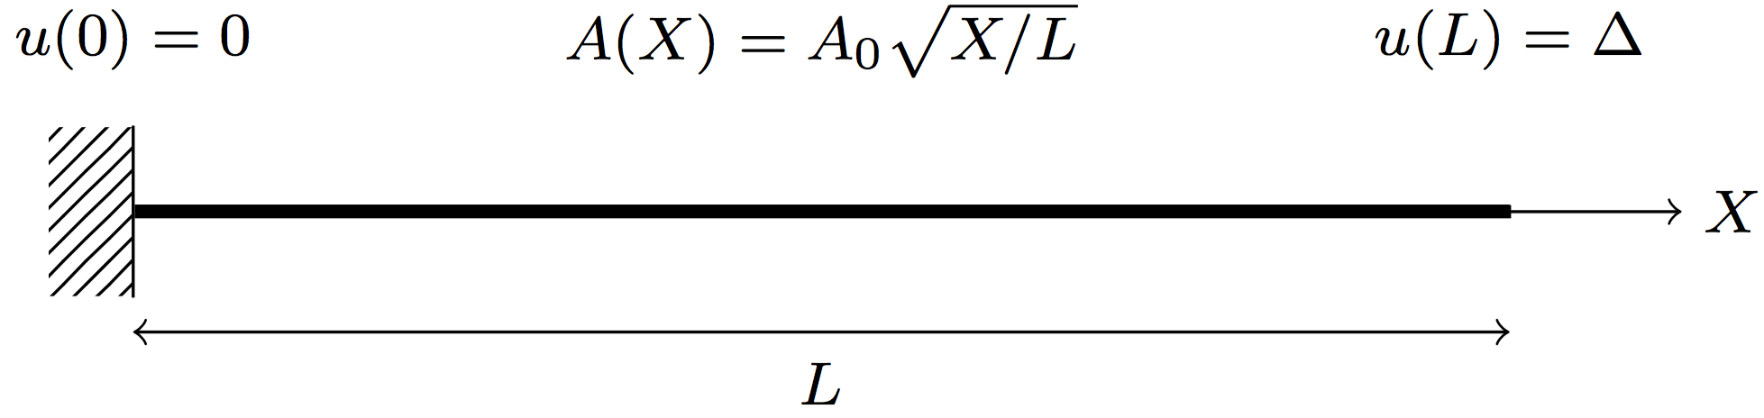
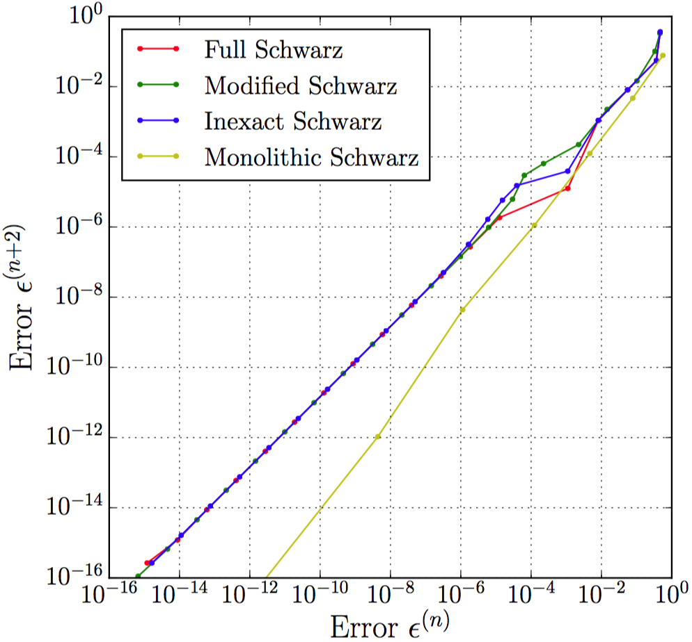
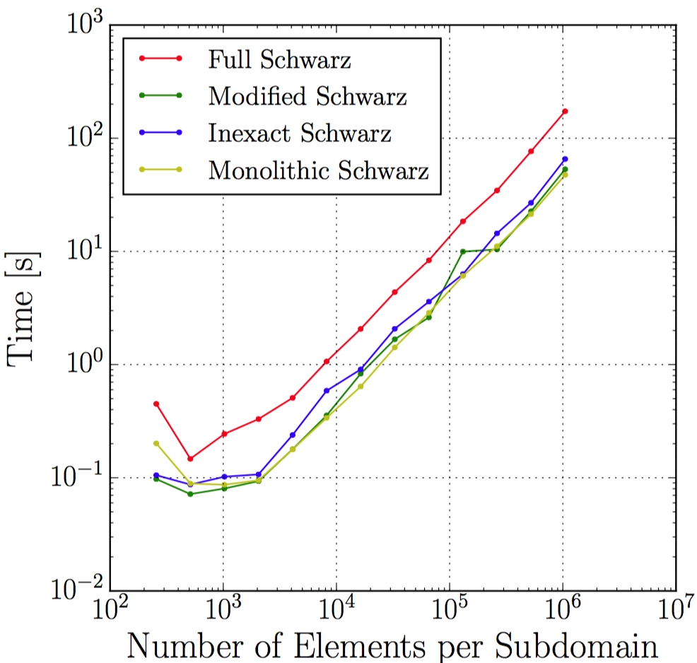
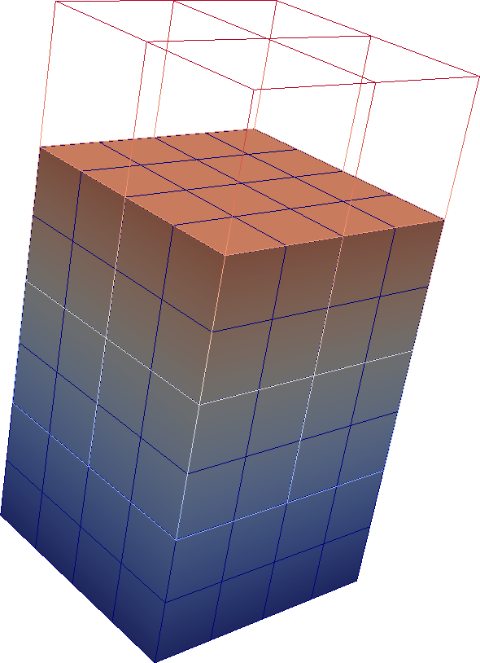
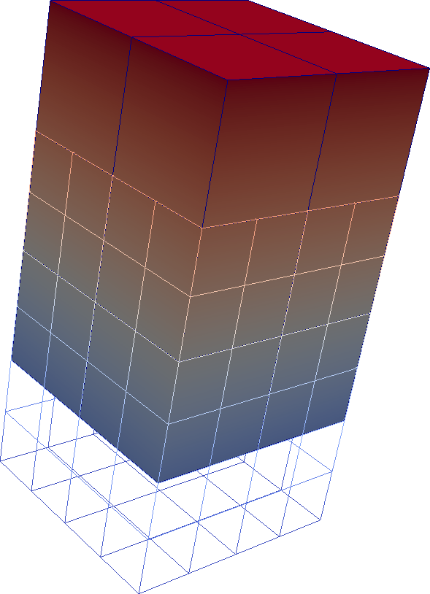
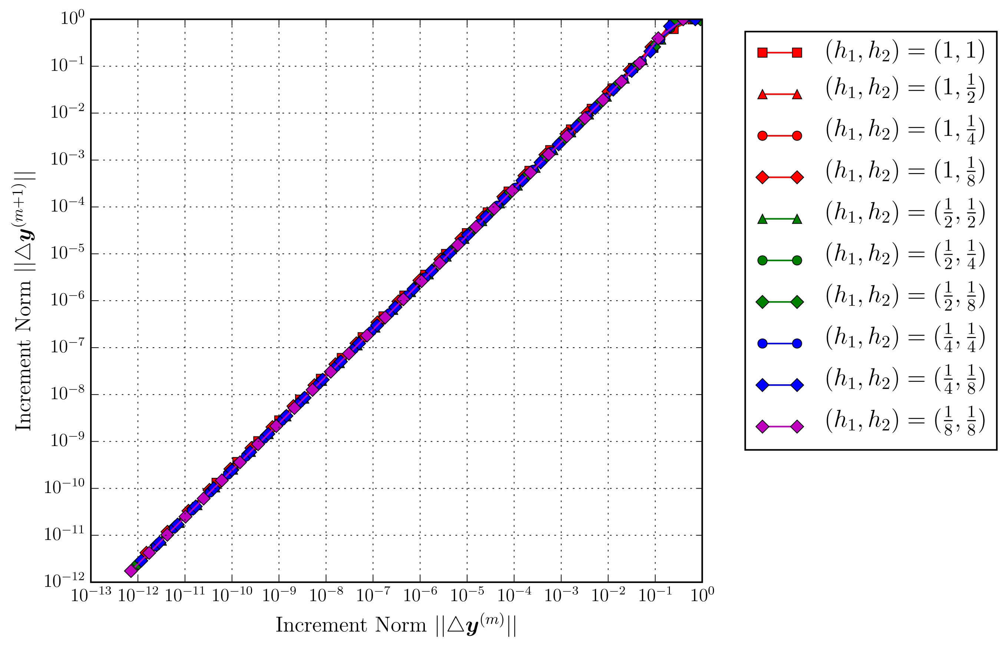
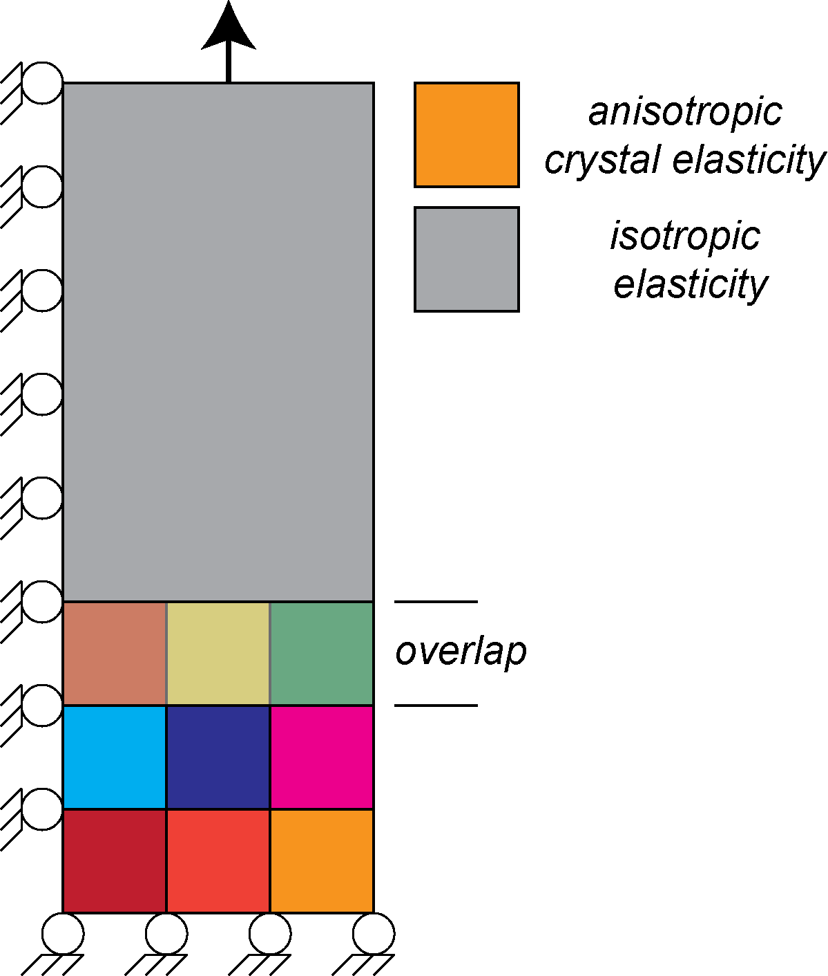
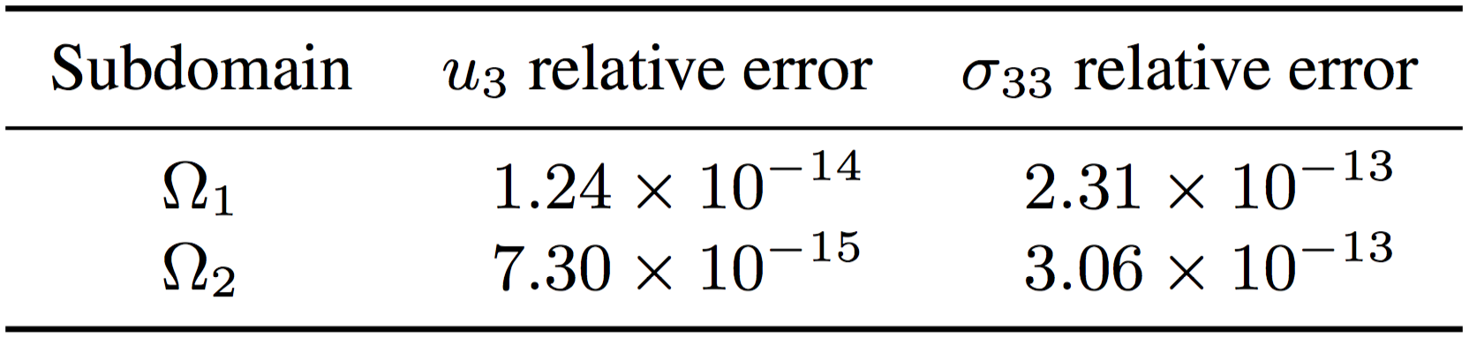
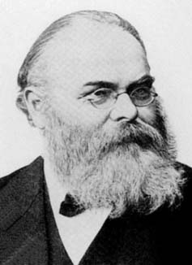
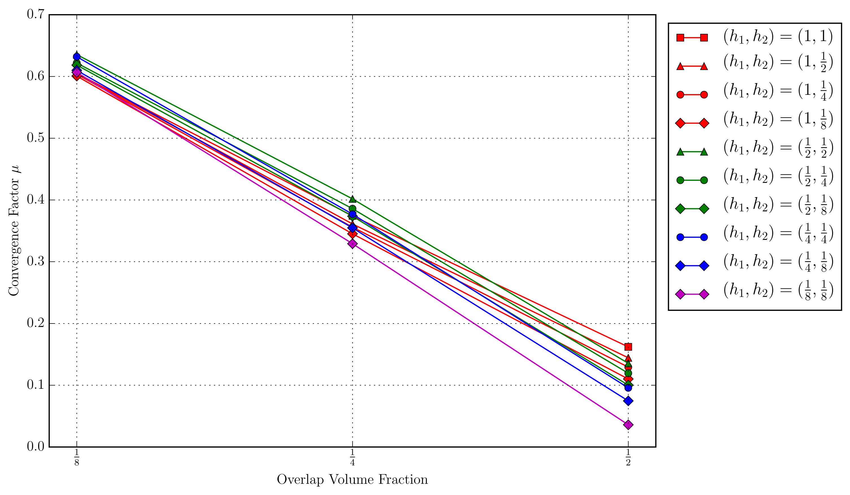
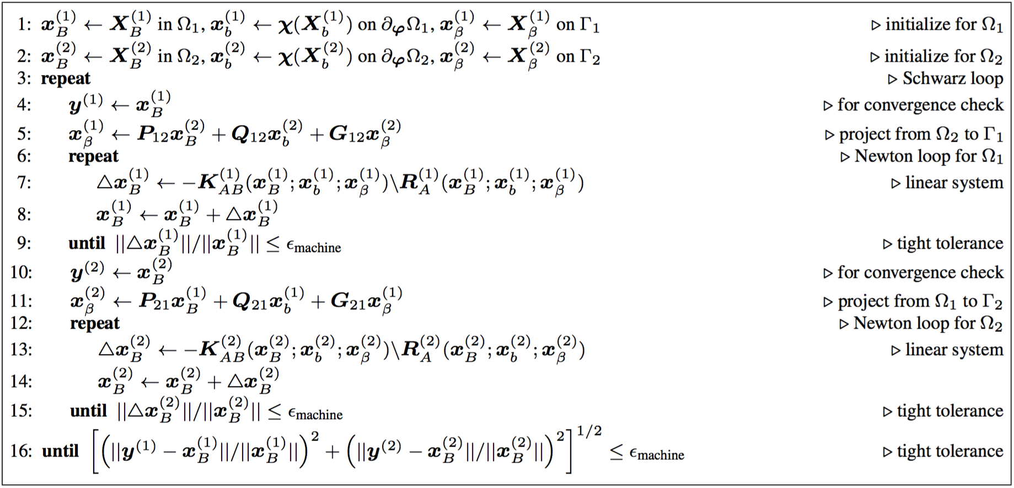
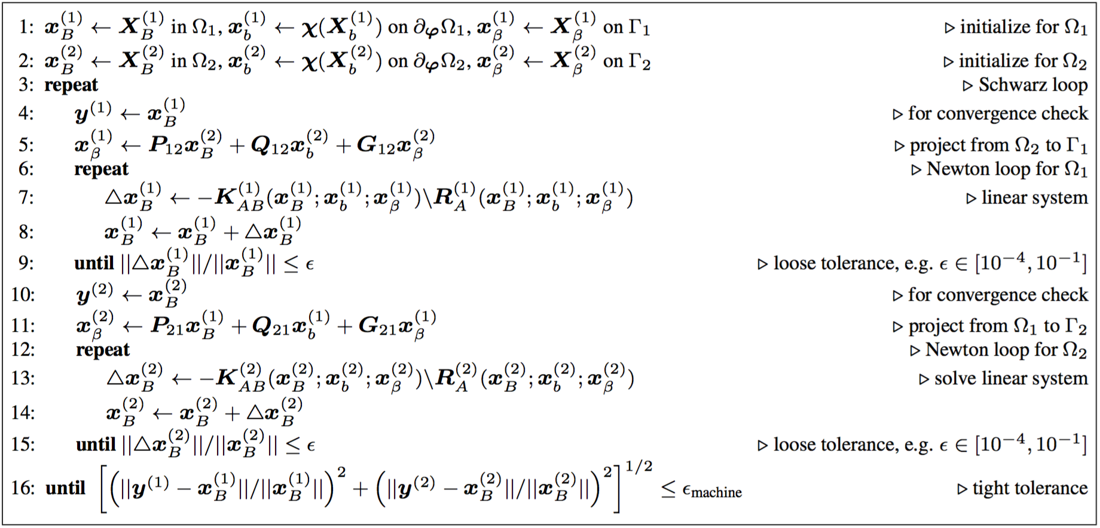
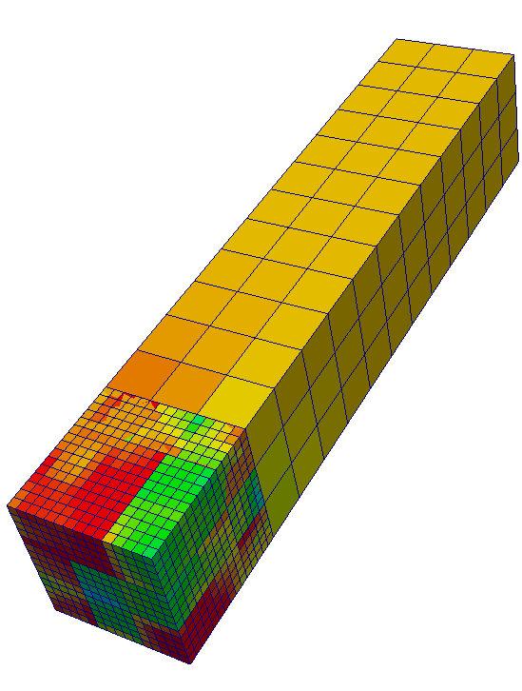
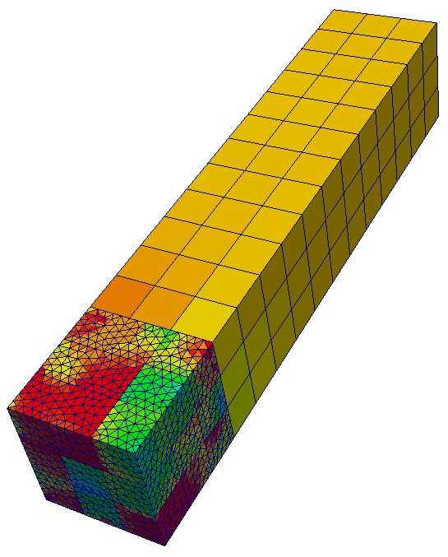
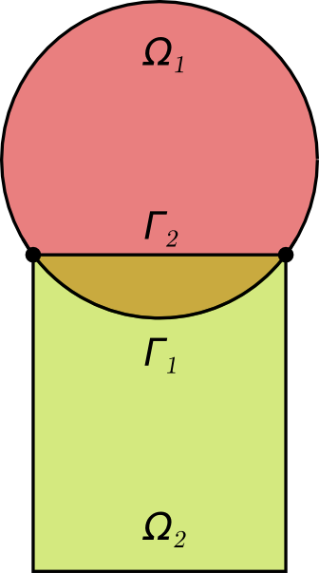
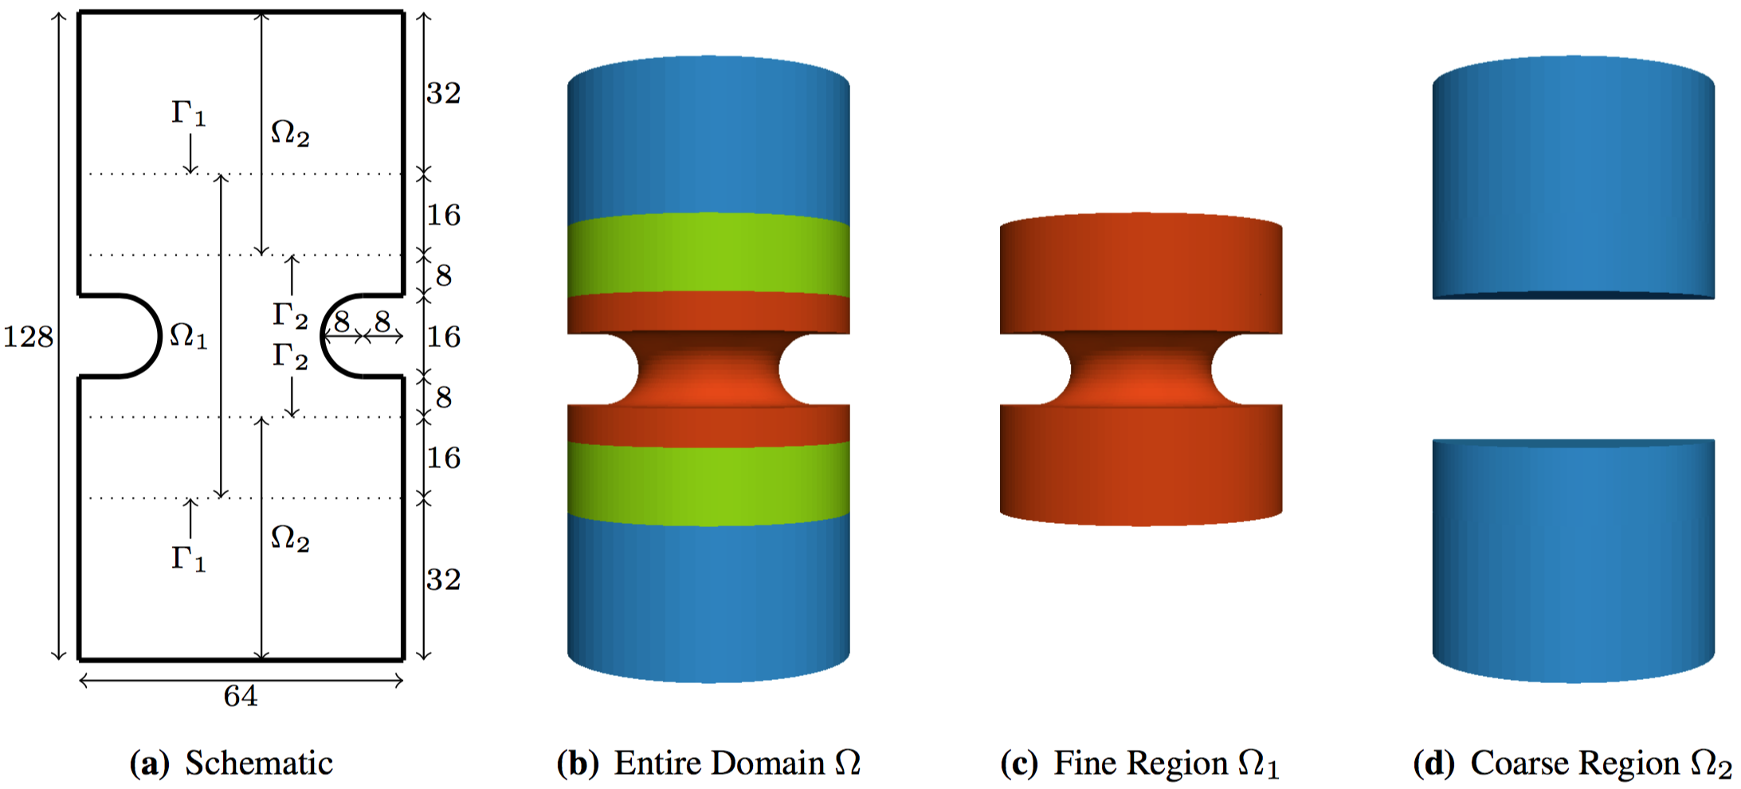
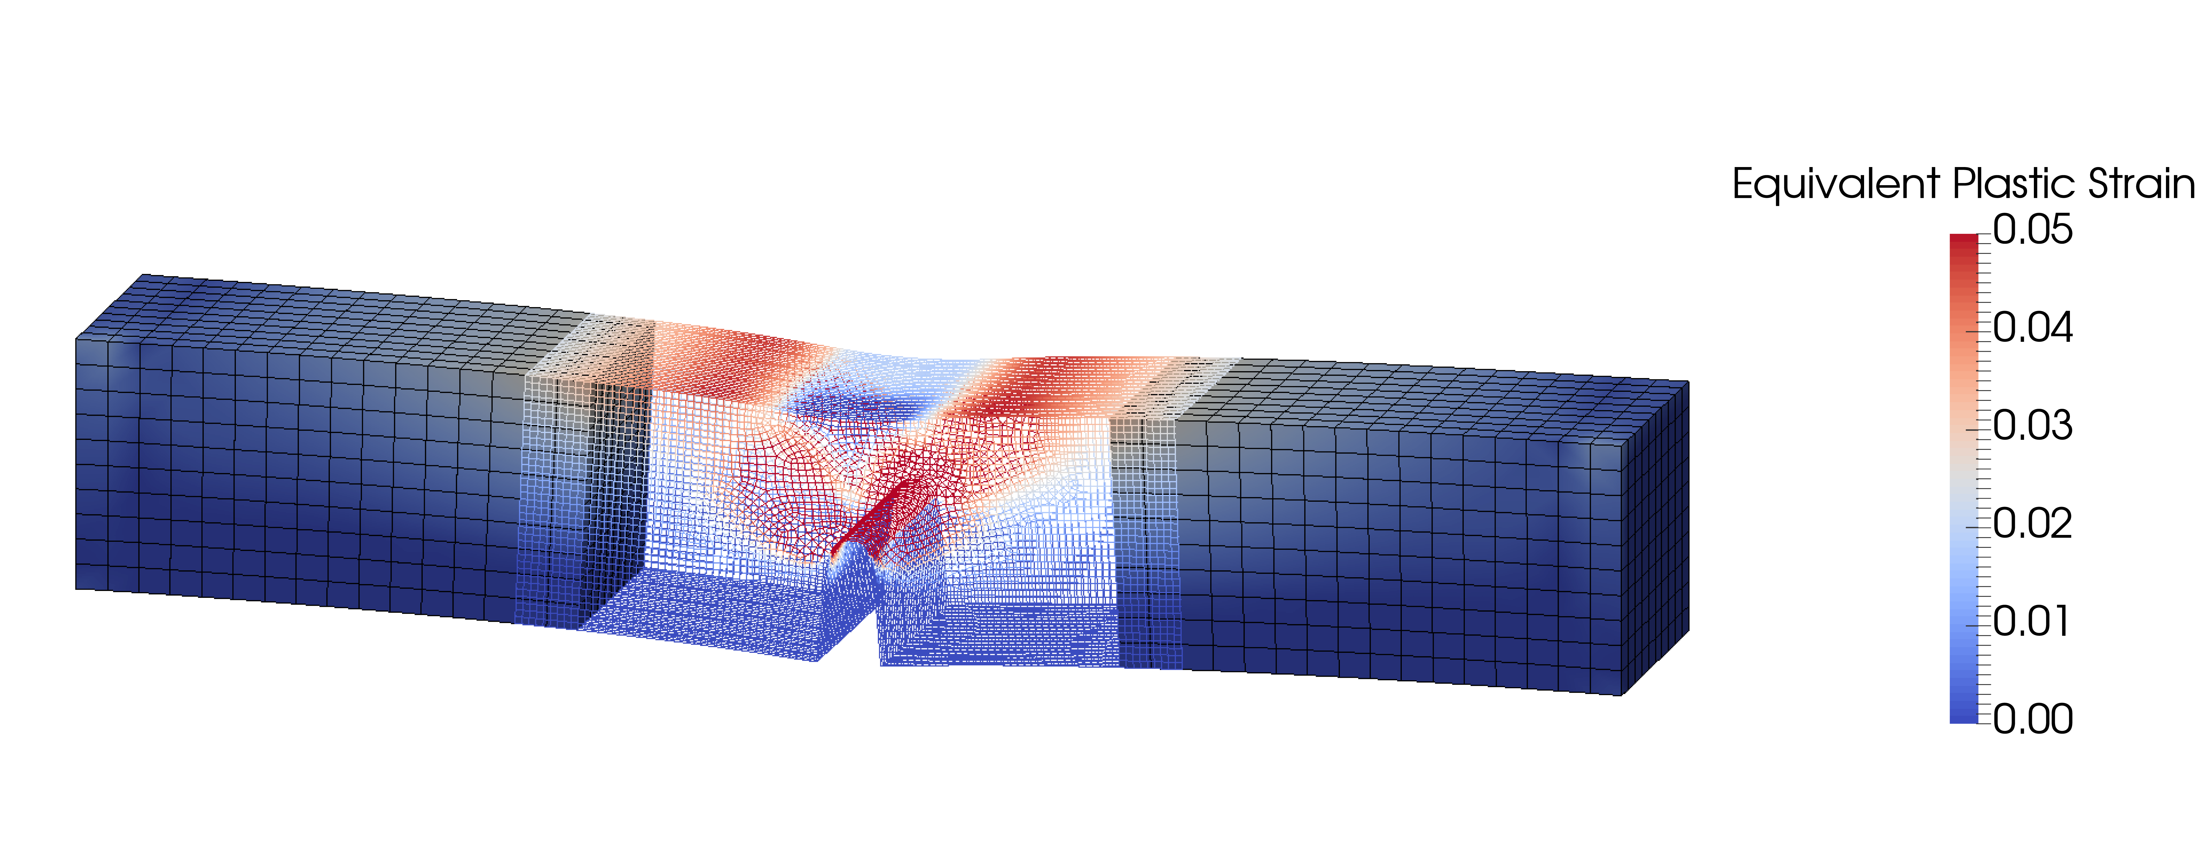
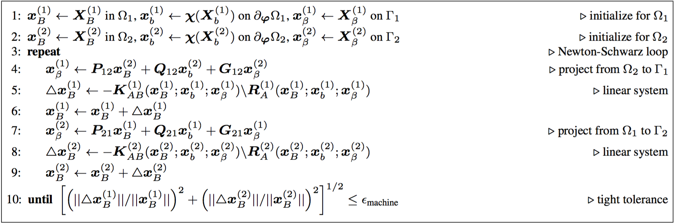
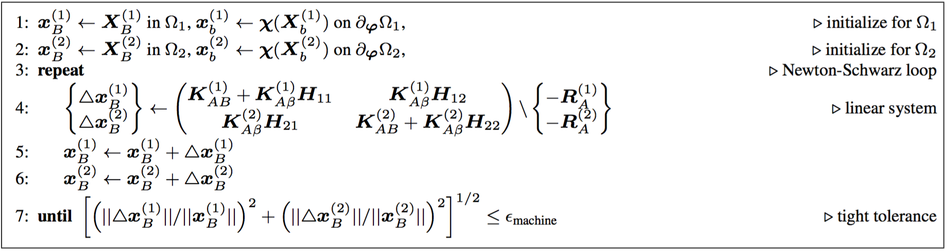
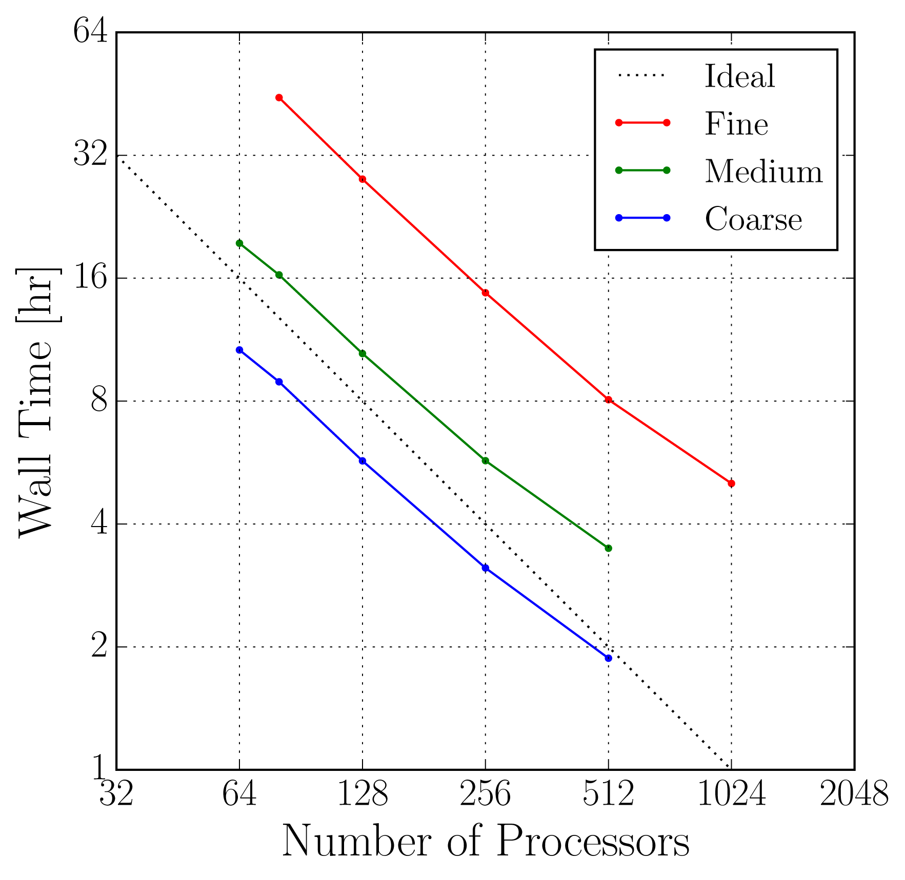
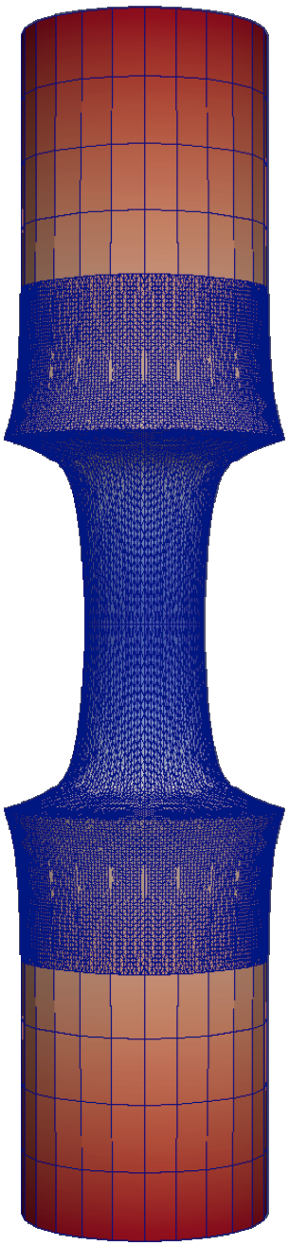
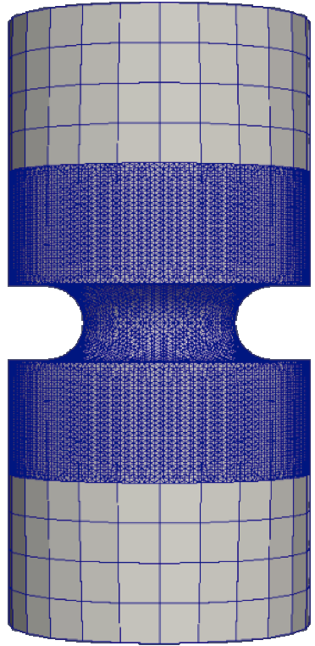
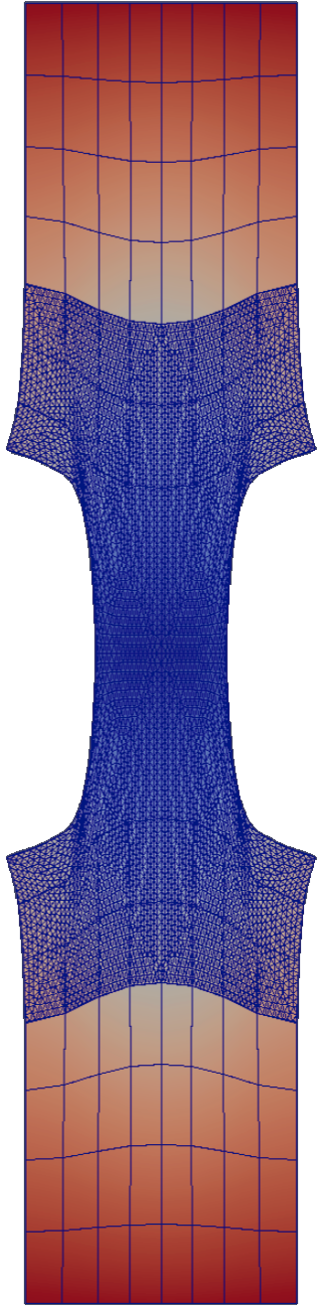
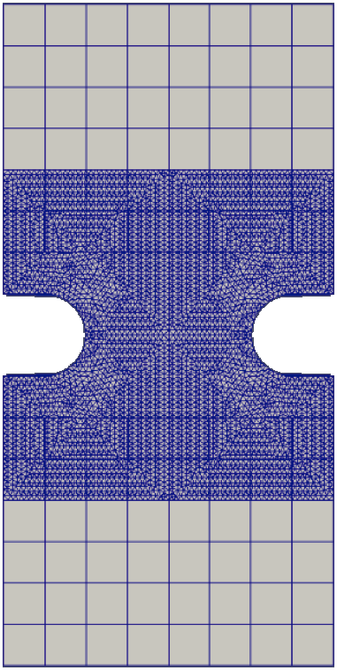
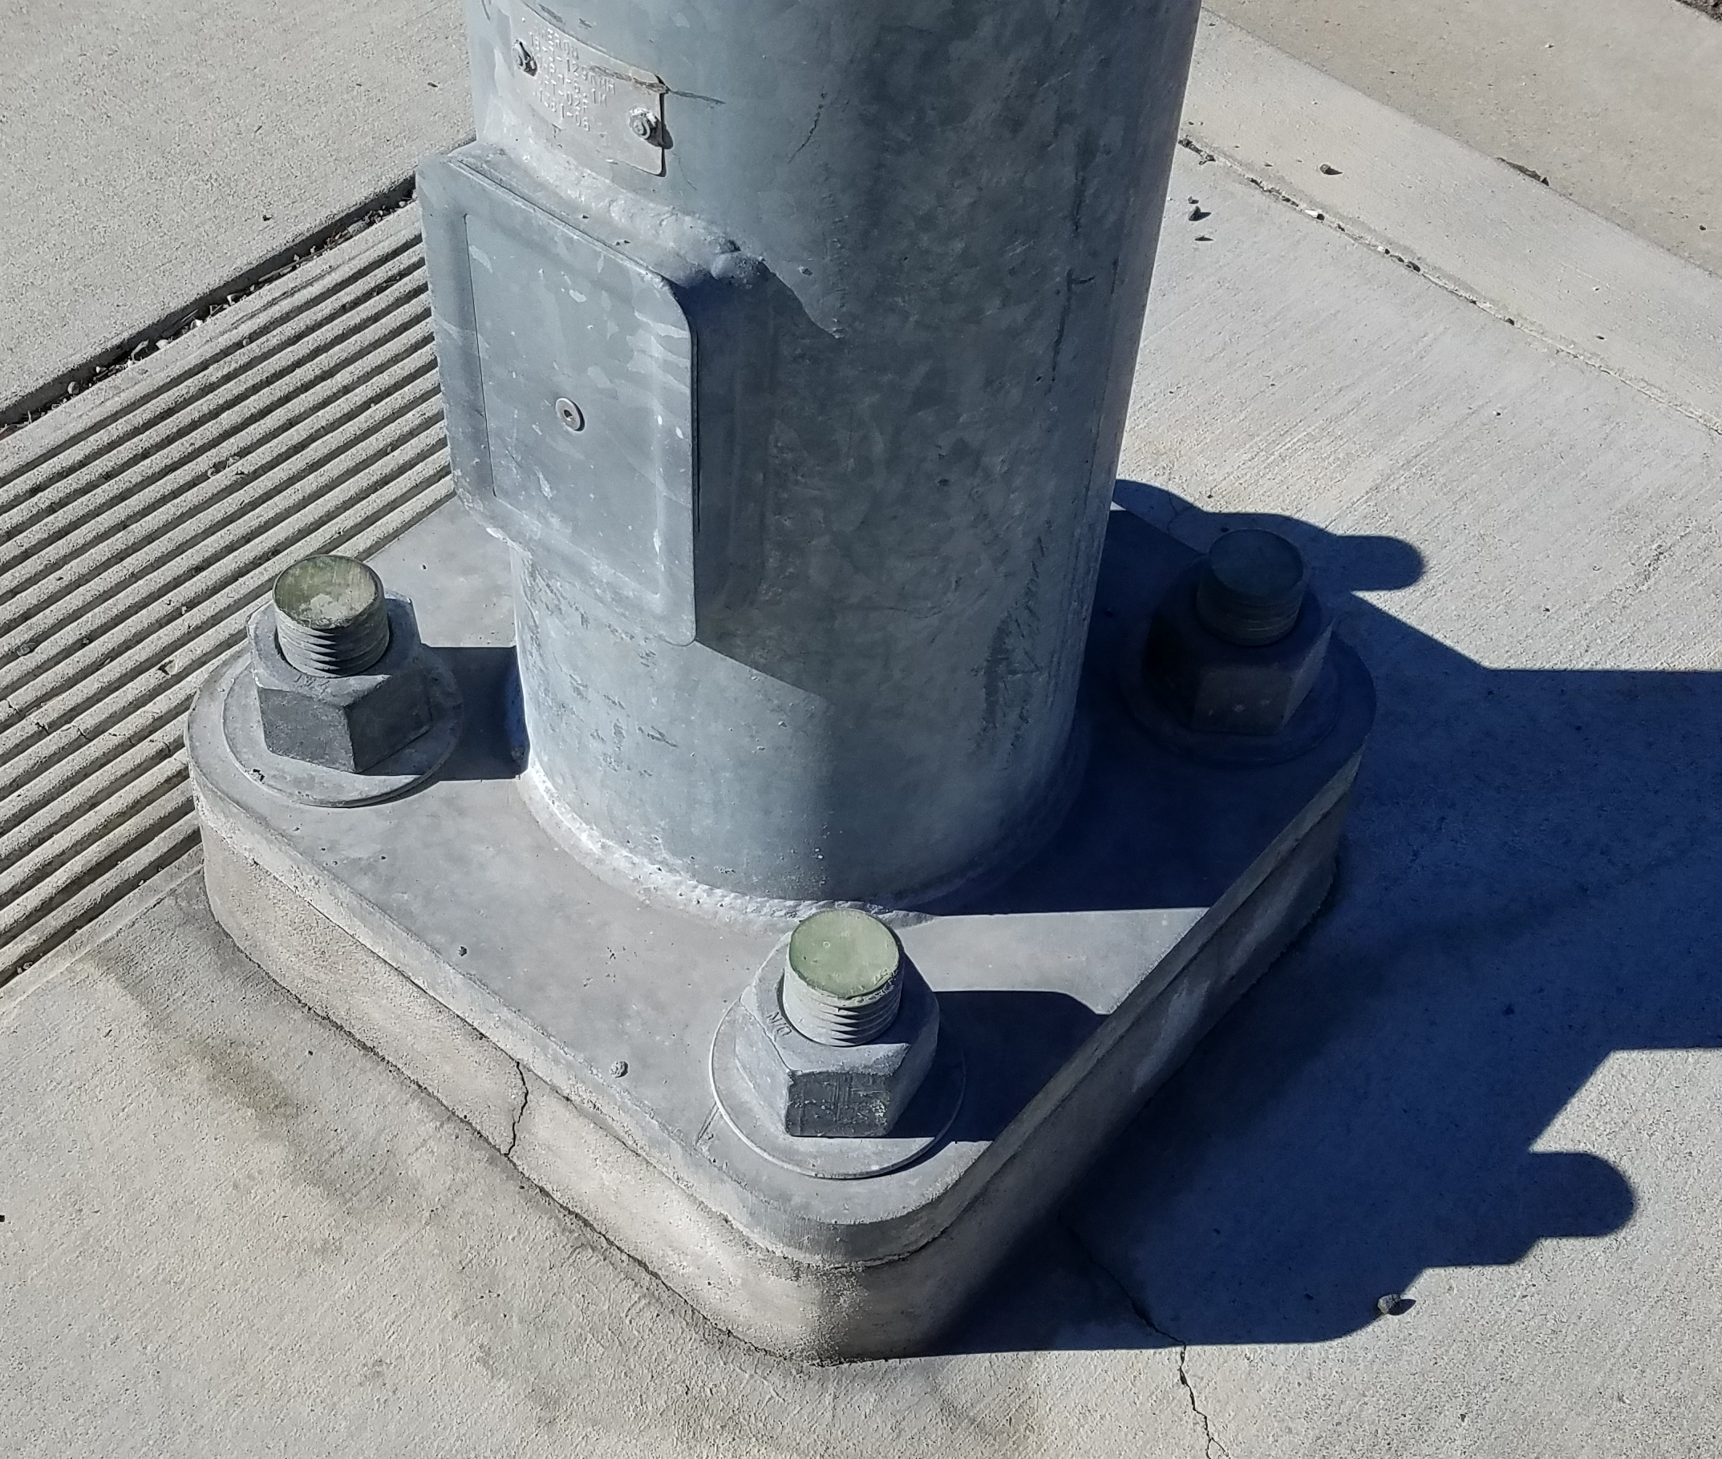
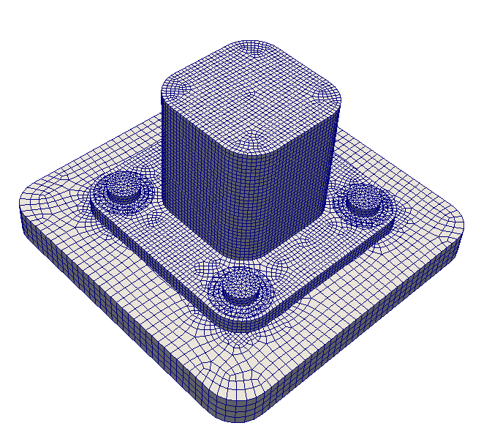
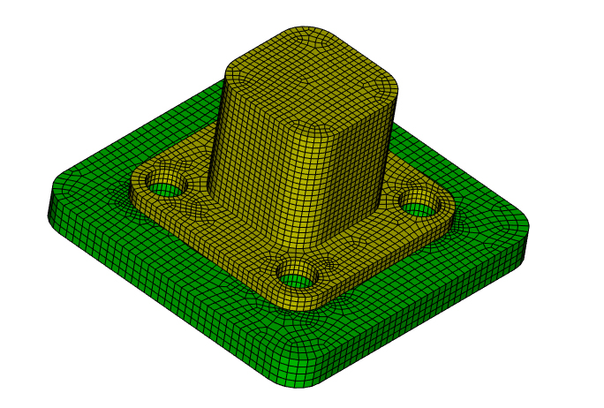
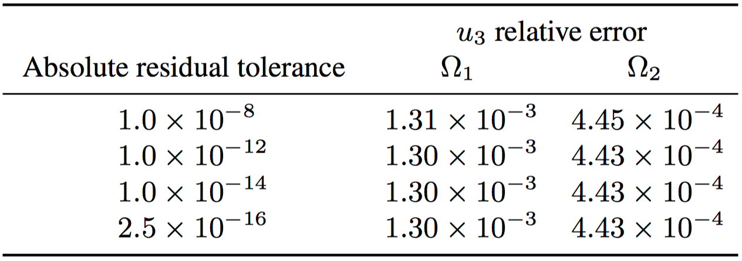
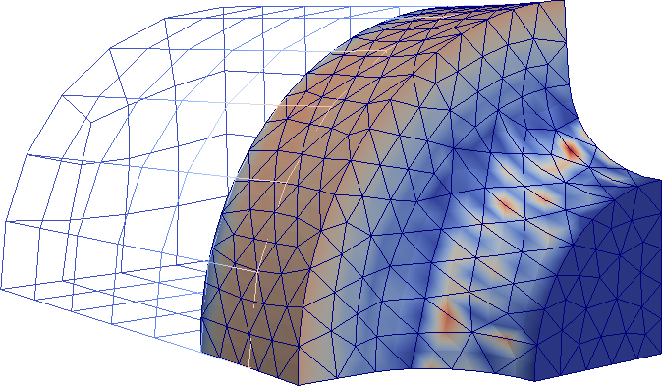
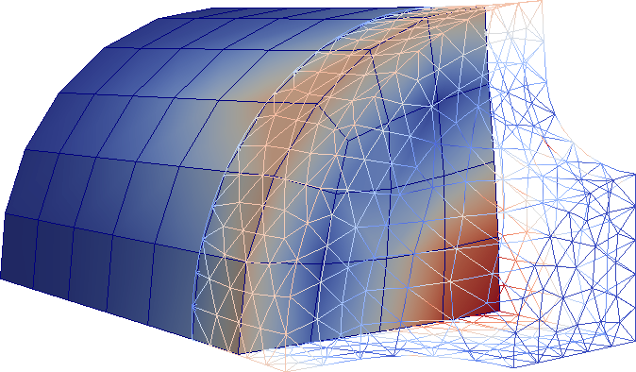
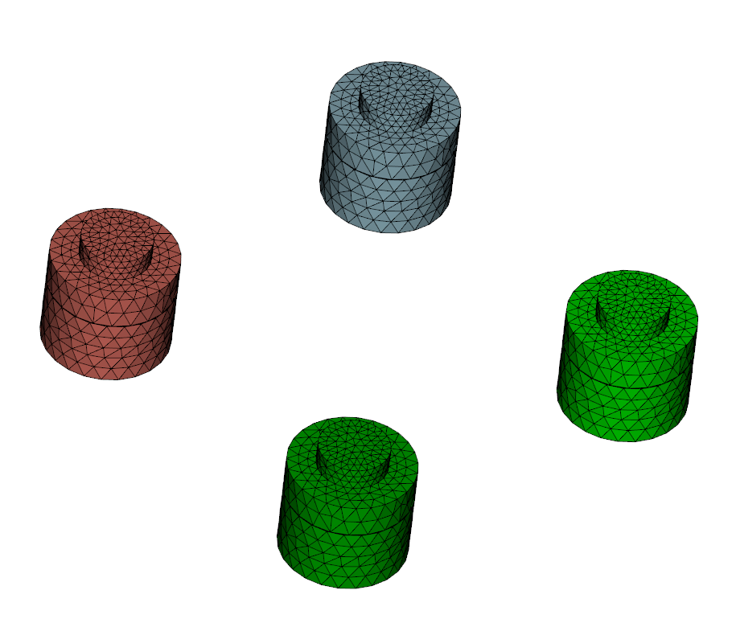
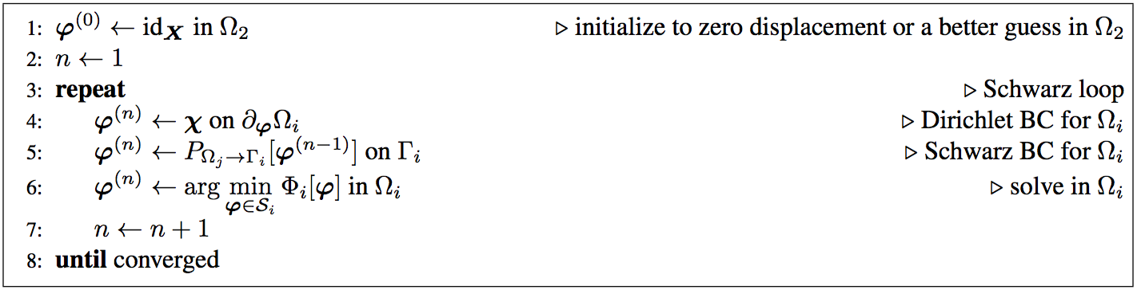
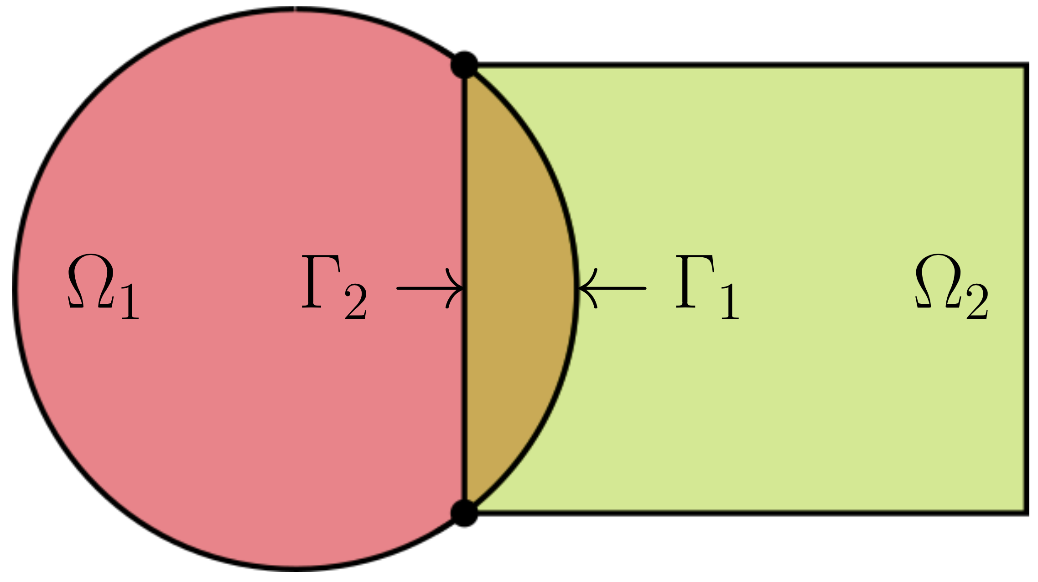
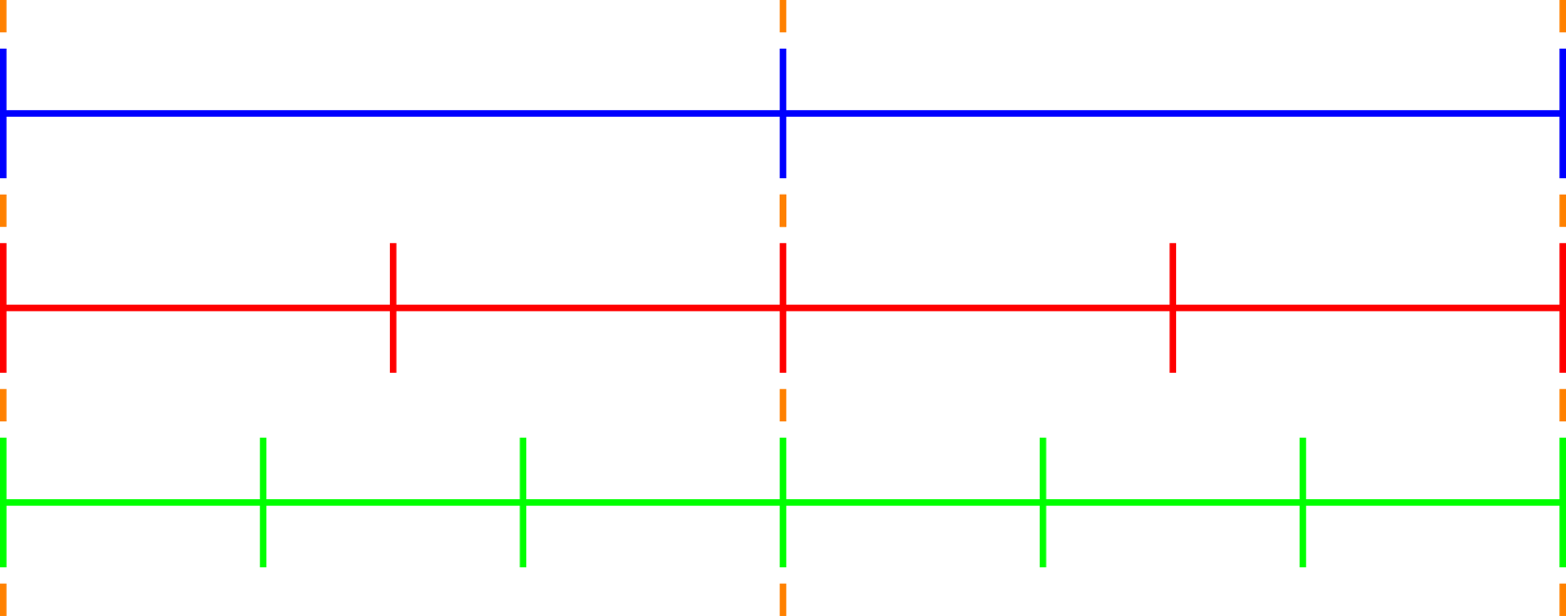
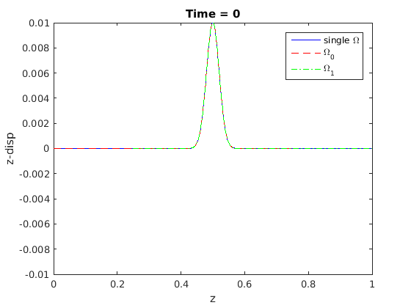
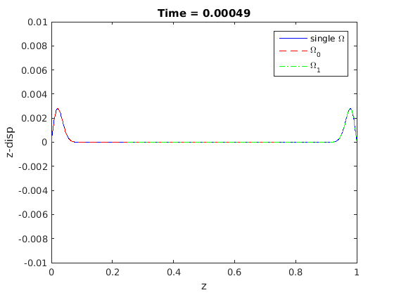
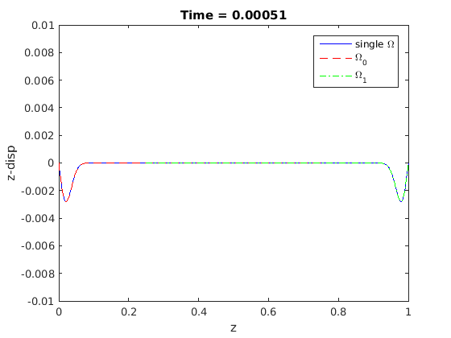
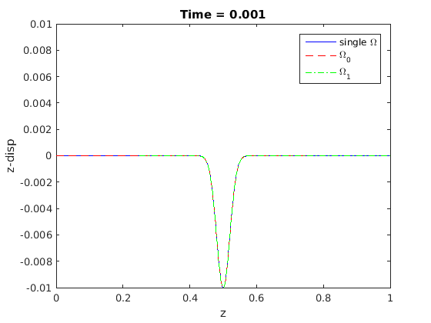
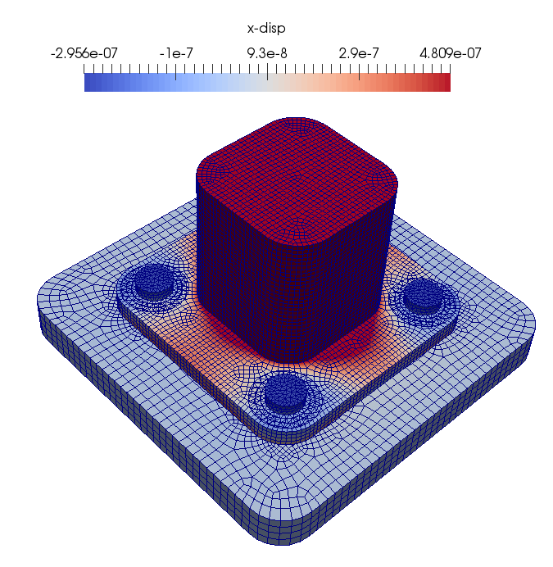
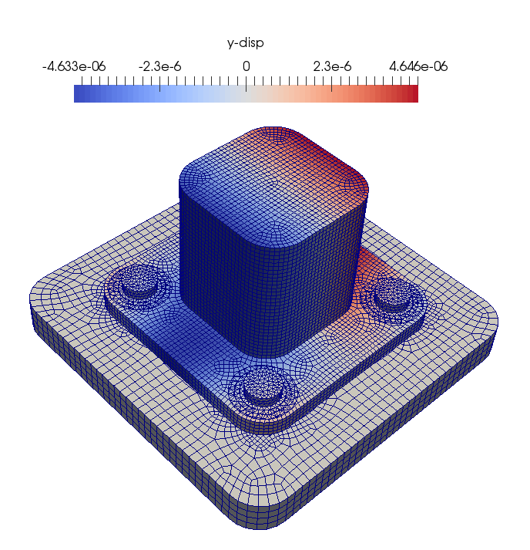
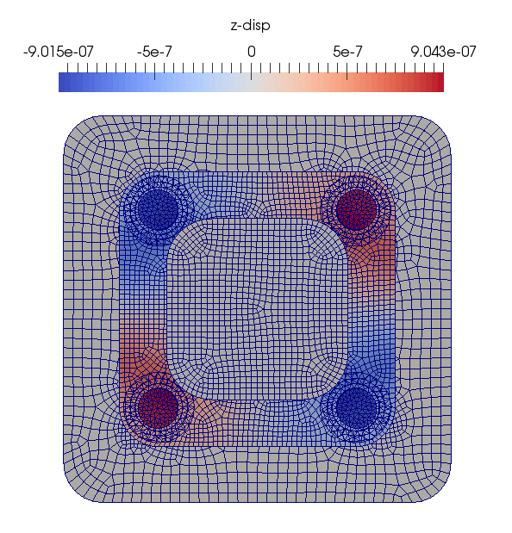


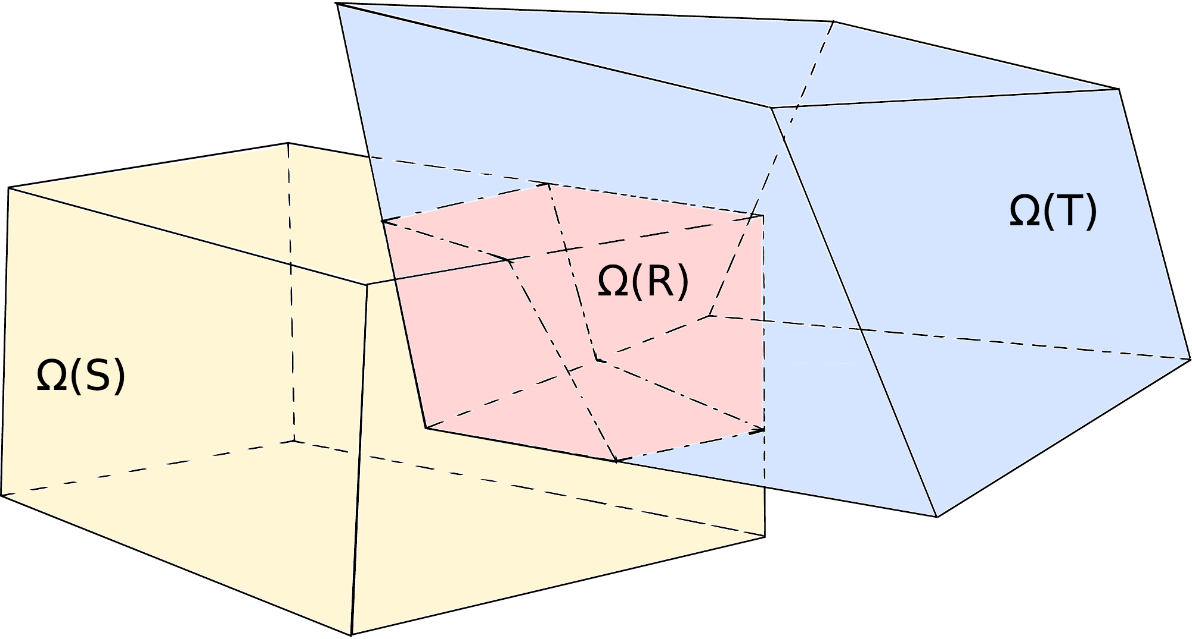








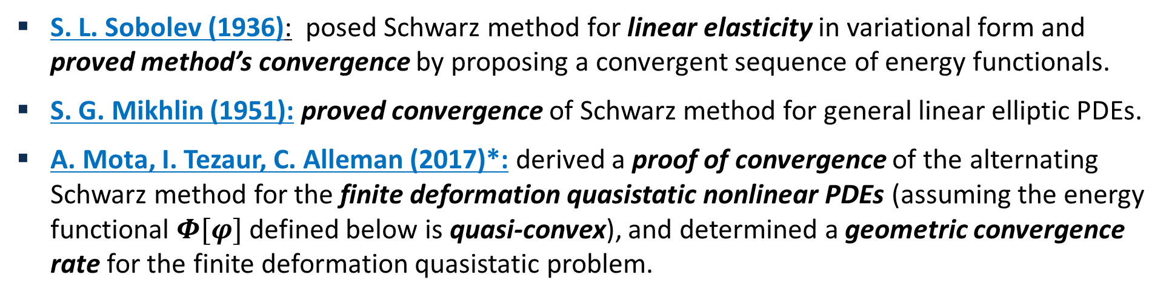


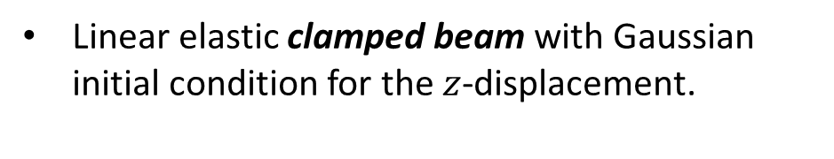







The Schwarz Alternating Method for Concurrent Multiscale Coupling in Solid Mechanics
Alejandro Mota¹, Irina Tezaur², Coleman Alleman¹
Beam geometry that is clamped on both sides and has a Gaussian initial condition for the z-displacement.
Motivation for Concurrent Multiscale Coupling
Proof of Convergence for Finite-Deformation Solid Mechanics
Numerical Results: Quasistatics
Large scale structural failure frequently originates from small scale phenomena such as defects, microcracks, inhomogeneities and more, which grow quickly in unstable manner.
Failure occurs due to tightly coupled interaction between small scale (stress concentrations, material instabilities, cracks, etc.) and large scale (vibration, impact, high loads and other perturbations).
Using the Schwarz alternating as a discretization method for PDEs is natural idea with a sound theoretical foundation.
Foulk’s Singular Bar
S. L. Sobolev (1936): posed Schwarz method for linear elasticity in variational form and proved method’s convergence by proposing a convergent sequence of energy functionals.
S. G. Mikhlin (1951): proved convergence of Schwarz method for general linear elliptic PDEs.
A. Mota, I. Tezaur, C. Alleman (2017)*: derived a proof of convergence of the alternating Schwarz method for the finite deformation quasistatic nonlinear PDEs (assuming the energy functional $Φ[φ]$ defined below is quasi-convex), and determined a geometric convergence rate for the finite deformation quasistatic problem.
Roof failure of Boeing 737 aircraft due to fatigue cracks. From imechanica.org
1D bar with area proportional to square root of length with strong singularity on left end of bar and simple hyperelestic material model with no damage.
Test case goals: explore viability of 4 variants of Schwarz alternating method, test convergence (expect faster convergence in less iterations w/ increased overlap).
Concurrent multiscale methods are essential for understanding and prediction of behavior of engineering systems when a small scale failure determines the performance of the entire system.
Surface flaw in pressure vessel: interacts with microstructure, which may or may not lead to failure.
$Φ\left[φ\right]= \int_{B}{W\left(F,Z,T\right) dV−}\int_{B}{B∙φ dV}$-$\int_{∂_{T}B}{\overline{T}∙φ dS}$
$$∇∙P+B=0$$
Cuboid
Rubik’s Cube
* A. Mota, I. Tezaur, C. Alleman. "The Schwarz Alternating Method in Solid Mechanics", Comput. Meth. Appl. Mech. Engng. 319 (2017), 19-51.
Two distinct bodies, the component scale & the microstructural scale, are coupled iteratively with alternating Schwarz
Schwarz Alternating Method for Domain Decomposition
(a) $Ω_{1}$
(b) $Ω_{2}$
Proposed in 1870 by H. Schwarz for solving Laplace PDE on irregular domains.
Four Variants of Schwarz Alternating Method for Quasistatics
Coupling of two cuboids with square base w/ Neohookean-type material model.
Schwarz alternating method converges linearly.
There is faster linear convergence with increasing overlap volume fraction.
$$∆y^{(m+1)}≤μ∆y^{(m)}$$
Simple idea: if the solution is known in regularly shaped domains, use those as pieces to iteratively build a solution for the more complex domain.
Full Schwarz
Inexact Schwarz
Basic Schwarz Algorithm
H. Schwarz (1843 – 1921)
axial
stress
component
scale
Initialize:
Solve PDE by any method on Ω₁ w/ initial guess for Dirichlet BCs on Γ₁.
Iterate until convergence:
Solve PDE by any method (can be different than for Ω₁) on Ω₂ w/ Dirichlet BCs on Γ₂ that are the values just obtained for Ω₁.
Solve PDE by any method (can be different than for Ω₂) on Ω₁ w/ Dirichlet BCs on Γ₁ that are the values just obtained for Ω₂.
Notched Cylinder
microstructural
scale
Requirement for convergence: $Ω_{1}⋂{ Ω}_{2}≠∅$
Laser Weld
Modified Schwarz
Monolithic Schwarz
(a) Schematic showing geometry and domain decomposition
(b) Equivalent plastic strain: plastic deformation concentrated at top of notch.
(a) Schematic
(b) Entire domain $Ω$
(c) Fine region $Ω_{1}$
(d) Coarse region $Ω_{2}$
Isotropic elasticity & J2 plasticity with linear isotropic hardening.
3 subdomains.
50% reduction in problem size.
Near perfect strong scaling.
Schwarz alternating method most commonly used as a preconditioner for Krylov iterative methods to solve linear algebraic equations.
Notched cylinder stretched along its axial direction, Neohookean-type material model.
Coupling of fine tetrahedral mesh (near notch) with coarse hexahedral mesh.
Novel idea: using the Schwarz alternating as a discretization method for solving multi-scale partial differential equations (PDEs).
Least-intrusive variant: by-passes Schwarz iteration, no need for block solver.
Bolted Joint
Schwarz Alternating Method for Dynamics
$$Ω_{2}$$
Schwarz Alternating Method for Multiscale Coupling
In the literature, Schwarz method is applied to dynamics by using space-time discretizations – unfeasible given design of our current codes and size of simulations.
Our extension of Schwarz coupling to dynamics uses a governing time stepping algorithm that controls time integrators within each domain.
Can use different integrators (e.g., implicit, explicit) with different time steps in each domain.
Relative errors
Pseudo-code for Quasistatics:
(a) $Ω_{1}$
(b) $Ω_{2}$
$$Ω_{1}$$
Numerical Results: Dynamics
Multi-scale problem of practical scale: coupling 85K composite tet 10 element mesh (bolts, $Ω_{1}$) with 56K hex element mesh (parts, $Ω_{2}$).
Neohookean material model: steel bolts and base, remaining parts are aluminum.
Lateral displacement load applied at top: applies compression to 2 bolts, tension to remaining 2.
Controller time stepper
Time integrator for Ω₁
Time integrator for Ω₂
Clamped Beam
Advantages:
Coupling introduces no dynamic artifacts & energy is conserved throughout simulation!
Conceptually very simple.
Allows the coupling of regions with different non-conforming meshes, different element types, and different levels of refinement.
Information is exchanged among two or more regions, making coupling concurrent.
Different solvers can be used for the different regions.
Different material models can be coupled provided that they are compatible in the overlap region.
Simplifies the task of meshing complex geometries for the different scales.
$x$-displacement
$y$-displacement
$z$-displacement
Implementation within Albany Finite Element Code
Component-based design for rapid development of capabilities.
Extensive use of libraries from the open-source Trilinos project.
Use of the Phalanx package to decompose complex problem into simpler problems with managed dependencies.
Use of the Sacado package for automatic differentiation.
Use of Teko package for block preconditioning.
Performance portability to GPUs and KNLs via Kokkos.
Parallel implementation of Schwarz uses the Data Transfer Kit (DTK).
https://github.com/gahansen/Albany
Linear elastic clamped beam with Gaussian initial condition for the $z$-displacement.
https://github.com/trilinos/trilinos
Torsion
Relative errors are O(1%) w.r.t. reference solution for composite tet 10 - hex coupling.
Acknowledgements: Support for this work was received through the DOE ASC program at SNL. The writers wish to acknowledge J. Foulk, G. Hansen, J. Ostien, A. Salinger and D. Ibanez for their contributions to this work.
Nonlinear elastic bar subjected to high degree of torsion.
Dynamic Schwarz method is used to couple two regions of the bar using different mesh resolutions, different element types, and different time integration schemes, once more without introducing any dynamic artifacts.
¹ Mechanics of Materials Department, Sandia National Laboratories, Livermore, CA USA.
² Extreme Scale Data Science & Analytics, Sandia National Laboratories, Livermore, CA USA.
$$Ω_{0}$$
https://github.com/ORNL-CEES/DataTransferKit
$$Ω_{1}$$
SAND2018-1489C

