Slide 1
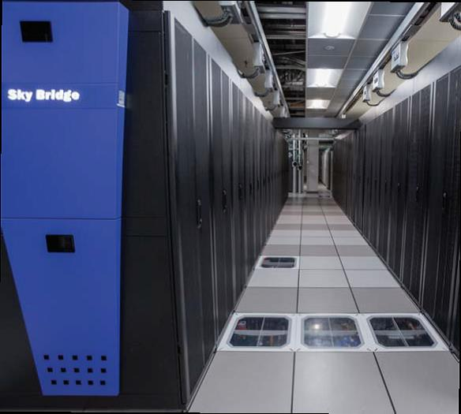
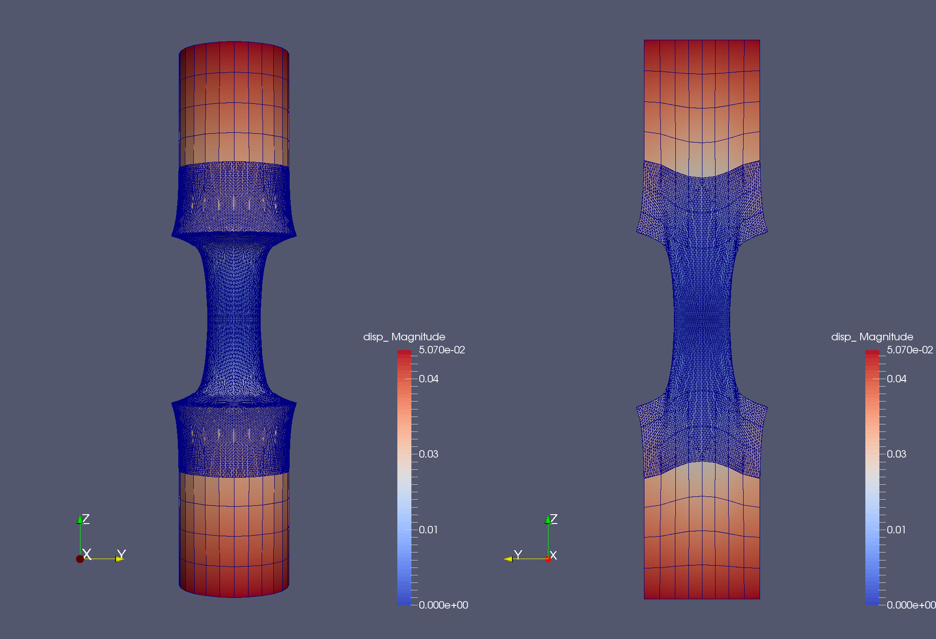
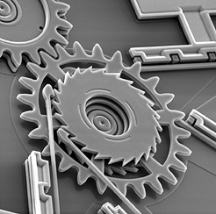
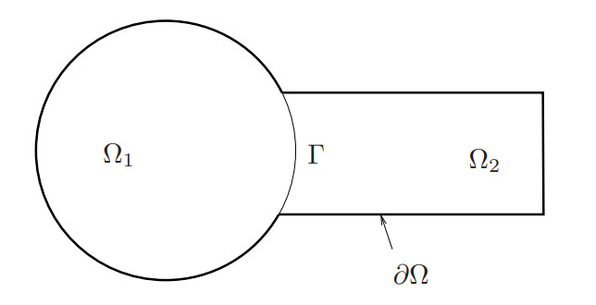
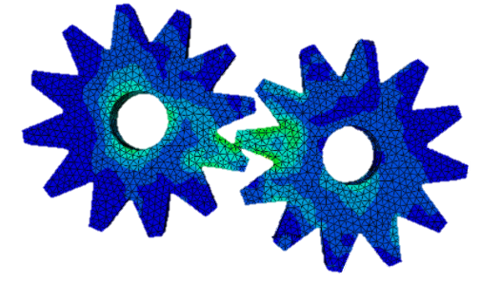
The Schwarz Alternating Method for Multi-Scale Coupling and Contact in Solid Mechanics
Alejandro Mota¹, Irina Tezaur¹, Jonathan Hoy²
¹Sandia National Laboratories, ²University of Southern California
PANACM 2021
November 9-12, 2021
SAND2021-12680C

Slide 2
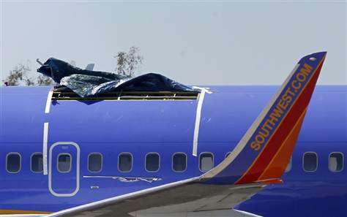
Motivation
Large scale structural failure frequently originates from small scale phenomena (e.g, defects, microcracks, inhomogeneities), which grow quickly in unstable manner
  Concurrent multi-scale methods are essential to capture correctly the multi-scale behavior!
  Stable, accurate and robust methods for simulating mechanical contact (touching surfaces, sliding, tightened bolts, impact) are equally important!
Above: roof failure of Boeing 737 aircraft due to fatigue cracks. From imechanica.org
Existing methods for contact enforcement (penalty, Lagrange multiplier, augmented Lagrangian) suffer from poor performance!
  Long simulation times
  Lack of accuracy
  Lack of robustness
This talk: new approach for simulating multi-scale mechanical contact using the Schwarz alternating method.
Above: gears in contact within MEMS device. From sandia.gov/media

Slide 3
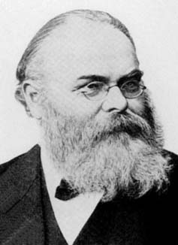
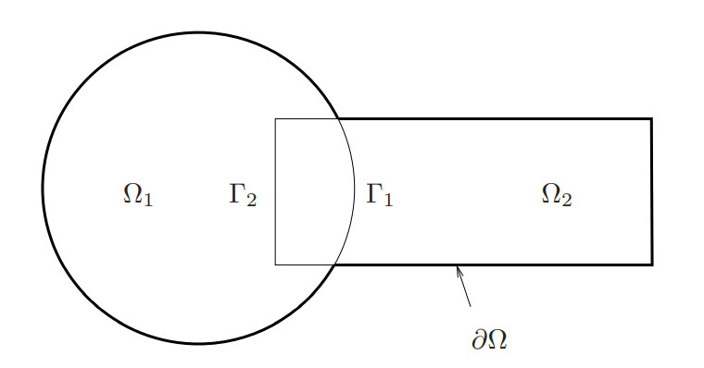
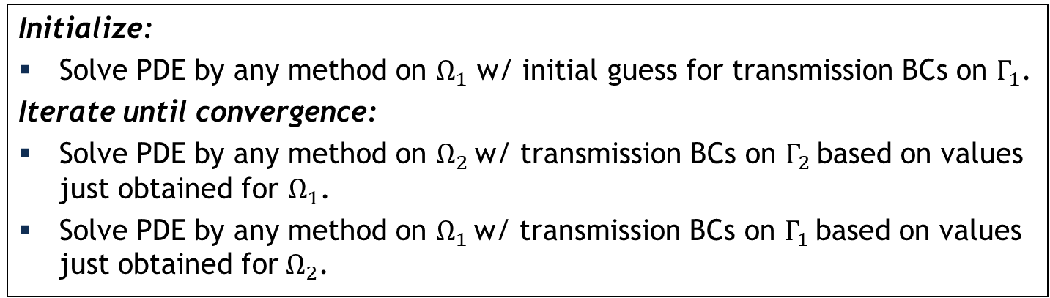
Schwarz Alternating Method for Domain Decomposition
Proposed in 1870 by H. Schwarz for solving Laplace PDE on irregular domains.
Crux of Method: if the solution is known in regularly shaped domains, use those as pieces to iteratively build a solution for the more complex domain.
H. Schwarz (1843–1921)
Basic Schwarz Algorithm
overlapping
Initialize:
Solve PDE by any method on $Ω_{1}$ w/ initial guess for transmission BCs on $Γ_{1}$.
Iterate until convergence:
Solve PDE by any method on $Ω_{2}$ w/ transmission BCs on $Γ_{2}$ based on values just obtained for $Ω_{1}$.
Solve PDE by any method on $Ω_{1}$ w/ transmission BCs on $Γ_{1}$ based on values just obtained for $Ω_{2}$.
non-overlapping
²Lions, 1990. ³Zanolli et al., 1987.

Slide 4

Schwarz Alternating Method for Domain Decomposition
Proposed in 1870 by H. Schwarz for solving Laplace PDE on irregular domains.
Crux of Method: if the solution is known in regularly shaped domains, use those as pieces to iteratively build a solution for the more complex domain.
H. Schwarz (1843–1921)
Basic Schwarz Algorithm
overlapping
Initialize:
Solve PDE by any method on $Ω_{1}$ w/ initial guess for transmission BCs on $Γ_{1}$.
Iterate until convergence:
Solve PDE by any method on $Ω_{2}$ w/ transmission BCs on $Γ_{2}$ based on values just obtained for $Ω_{1}$.
Solve PDE by any method on $Ω_{1}$ w/ transmission BCs on $Γ_{1}$ based on values just obtained for $Ω_{2}$.
Overlapping Schwarz: convergent with all-Dirichlet transmission BCs¹ if $Ω_{1}⋂{ Ω}_{2}≠∅$.
Non-overlapping Schwarz: convergent with Robin-Robin² or alternating Neumann-Dirichlet³ transmission BCs.
¹Schwarz, 1870; Lions, 1988.
²Lions, 1990. ³Zanolli et al., 1987.

Slide 5
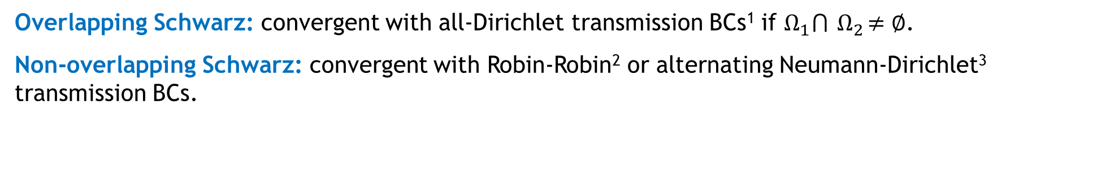
Schwarz Alternating Method for Domain Decomposition
Proposed in 1870 by H. Schwarz for solving Laplace PDE on irregular domains.
Crux of Method: if the solution is known in regularly shaped domains, use those as pieces to iteratively build a solution for the more complex domain.
H. Schwarz (1843–1921)
Basic Schwarz Algorithm
Initialize:
Solve PDE by any method on $Ω_{1}$ w/ initial guess for transmission BCs on $Γ_{1}$.
Iterate until convergence:
Solve PDE by any method on $Ω_{2}$ w/ transmission BCs on $Γ_{2}$ based on values just obtained for $Ω_{1}$.
Solve PDE by any method on $Ω_{1}$ w/ transmission BCs on $Γ_{1}$ based on values just obtained for $Ω_{2}$.
non-overlapping
Overlapping Schwarz: convergent with all-Dirichlet transmission BCs¹ if $Ω_{1}⋂{ Ω}_{2}≠∅$.
Non-overlapping Schwarz: convergent with Robin-Robin² or alternating Neumann-Dirichlet³ transmission BCs.
z: convergent with Robin-Robin² or alternating Neumann-Dirichlet³ transmission BCs.
¹Schwarz, 1870; Lions, 1988.
²Lions, 1990. ³Zanolli et al., 1987.
²Lions, 1990. ³Zanolli et al., 1987.

Slide 6
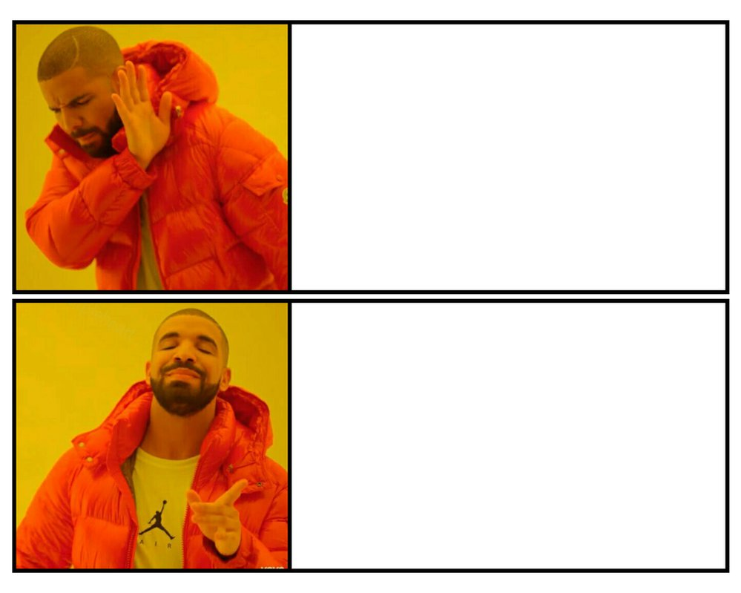
How We Use the Schwarz Alternating Method
6
AS A PRECONDITIONER FOR THE LINEARIZED SYSTEM
AS A SOLVER FOR THE COUPLED
FULLY NONLINEAR PROBLEM

Slide 7
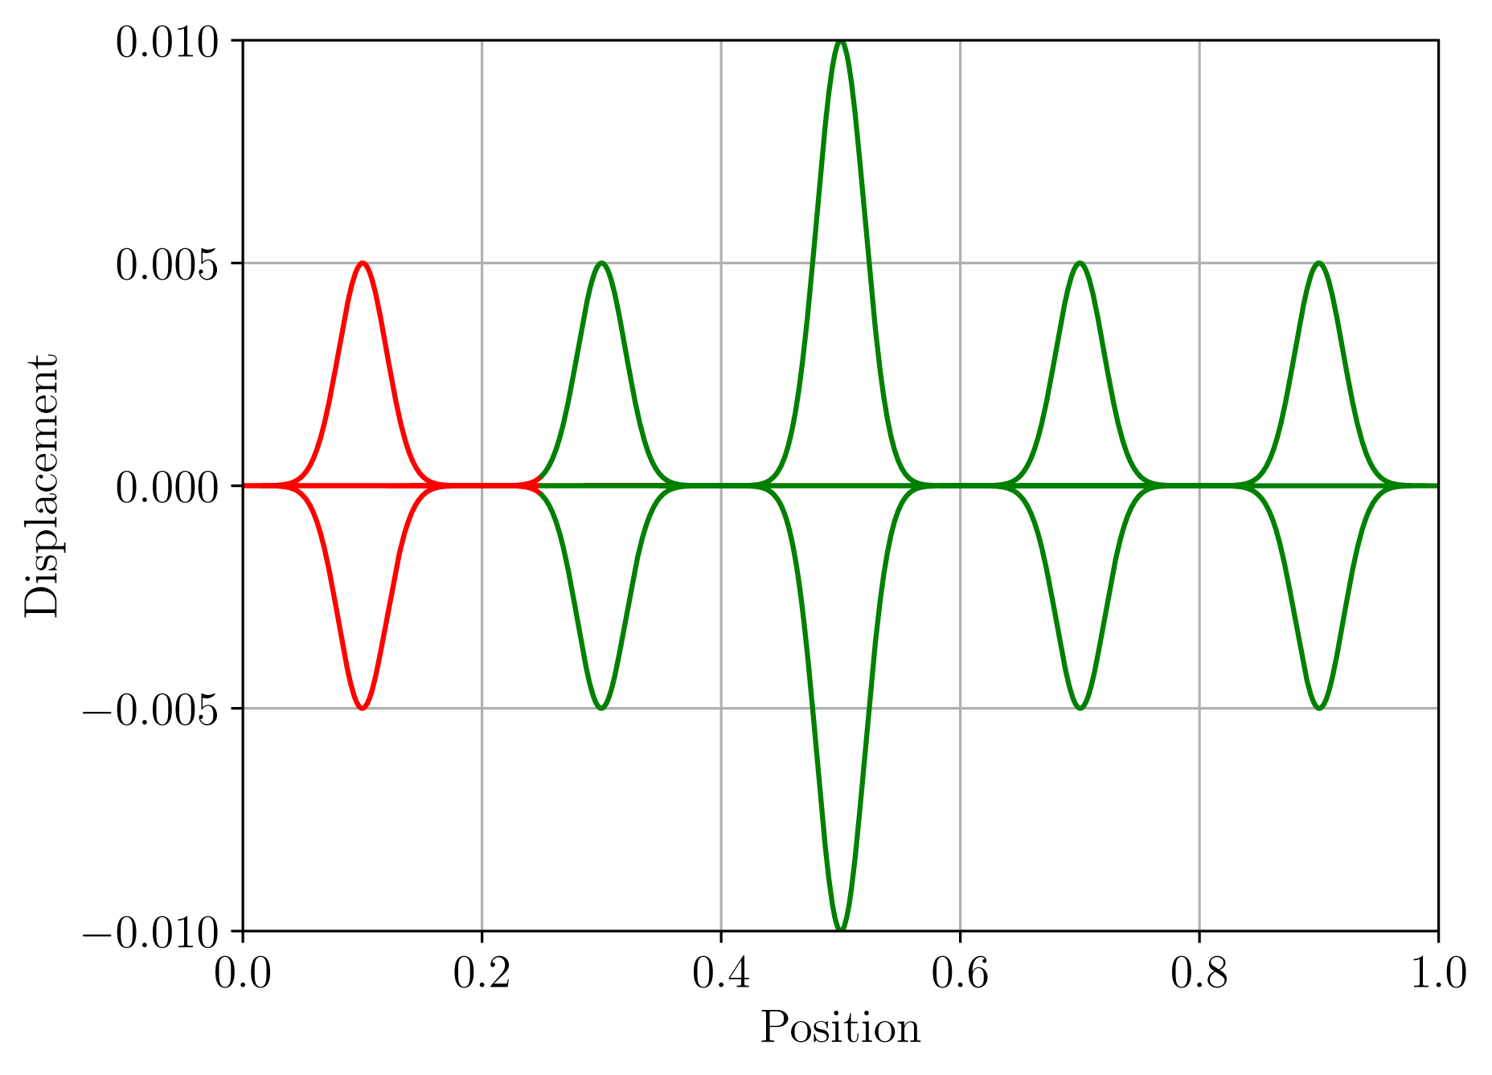
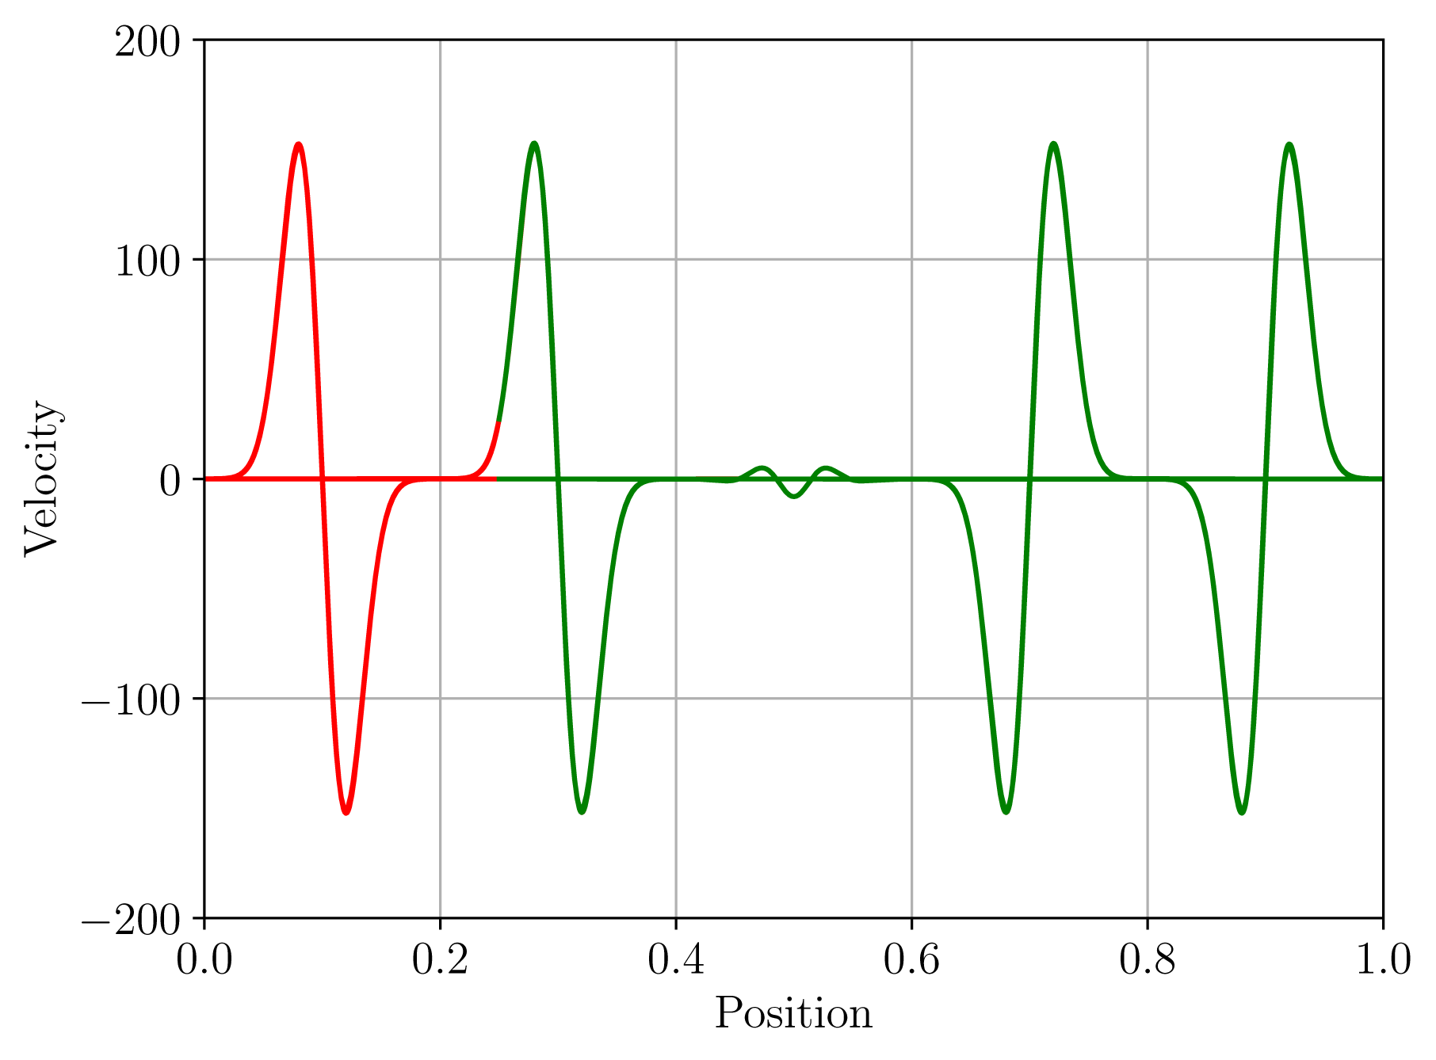
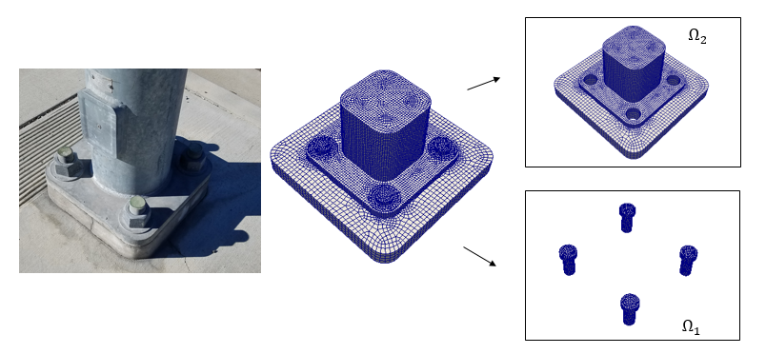


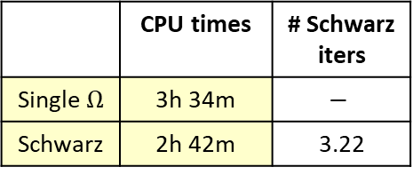
Overlapping Schwarz for Multi-scale Coupling in Solid Mechanics
The Schwarz alternating method has been developed/implemented for concurrent multi-scale quasistatic & dynamic modeling in Sandia’s Albany/LCM and Sierra/SM codes.
Displacement
Velocity
Coupling is concurrent (two-way)
No nonphysical artifacts and theoretical convergence properties¹
“Plug-and-play” framework: couples different meshes, element types, solvers, integrators
Easy to implement in existing HPC codes, and scalable, fast, robust
 | CPU times | # Schwarz iters
Single $Ω$ | 3h 34m | $$−$$
Schwarz | 2h 42m | 3.22
¹Mota et al., 2017; Mota et al., 2021.

Slide 8
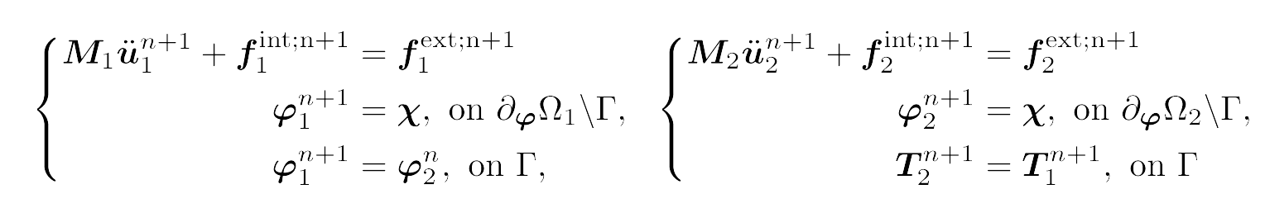






Non-Overlapping Schwarz Formulation for Contact Mechanics
Before contact: simulation proceeds as usual
Key idea: a contact problem can be viewed as coupled problem while 2+ bodies are in contact
$$Ω_{1}$$
$$Ω_{2}$$
Detection of contact: proximity search and application of contact conditions to determine contact
Overlap condition: triggered when two or more objects/domains have begun to overlap/penetrate each other
Push condition: triggered when both of the following properties hold
  Compression: the tractions at the interface are compressive
  Sustainability: there was contact in the previous time step
$$Ω_{1}$$
$$Ω_{2}$$
Enforcement of contact: alternating Schwarz iteration with Dirichlet-Neumann transmission BCs
$$Ω_{1}$$
$$Ω_{2}$$
Notes:
Key idea: the contact problem can be viewed as a coupled problem while the 2+ bodies are in contact

Slide 9
Non-Overlapping Schwarz Formulation for Contact Mechanics
Before contact: simulation proceeds as usual
There are no contact constraints!
Contact constraints replaced with BCs applied iteratively at contact boundaries.
$$Ω_{1}$$
$$Ω_{2}$$
Detection of contact: proximity search and application of contact conditions to determine contact
Overlap condition: triggered when two or more objects/domains have begun to overlap/penetrate each other
Push condition: triggered when both of the following properties hold
  Compression: the tractions at the interface are compressive
  Sustainability: there was contact in the previous time step
$$Ω_{1}$$
$$Ω_{2}$$
Enforcement of contact: alternating Schwarz iteration with Dirichlet-Neumann transmission BCs
$$Ω_{1}$$
$$Ω_{2}$$
Notes:
Key idea: the contact problem can be viewed as a coupled problem while the 2+ bodies are in contact

Slide 10
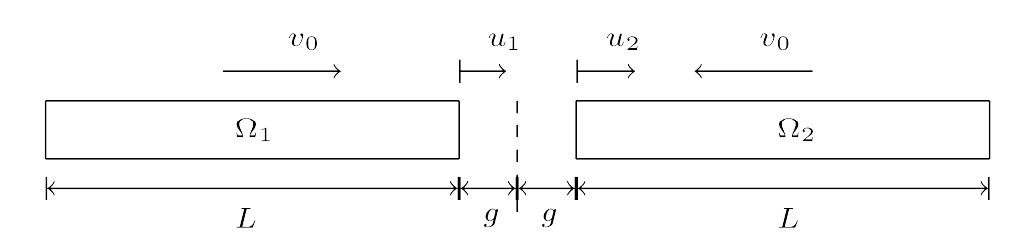
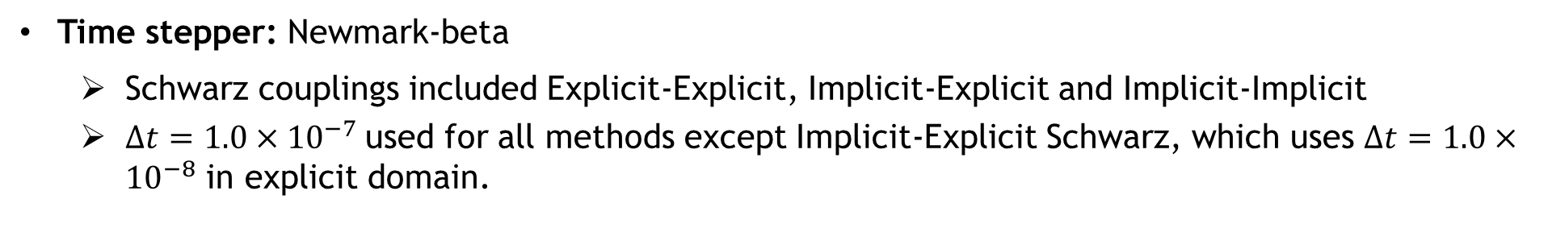
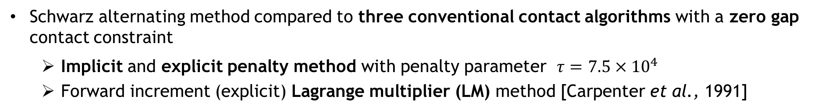
Numerical Results: 1D Impact Problem¹
Impact of two 1D identical linear elastic prismatic rods discretized using $N_{x}=200$ linear elements with exact analytic solution [Carpenter et al., 1991]
Schwarz alternating method compared to three conventional contact algorithms with a zero gap contact constraint
  Implicit and explicit penalty method with penalty parameter $τ=$ $7.5×{10}^{4}$
  Forward increment (explicit) Lagrange multiplier (LM) method [Carpenter et al., 1991]
Time stepper: Newmark-beta
  Schwarz couplings included Explicit-Explicit, Implicit-Explicit and Implicit-Implicit
  $Δt=1.0×{10}^{−7}$used for all methods except Implicit-Explicit Schwarz, which uses $Δt=1.0×{10}^{−8}$ in explicit domain.
¹Hoy et al., 2021; Mota et al. (in prep), 2021.

Slide 11
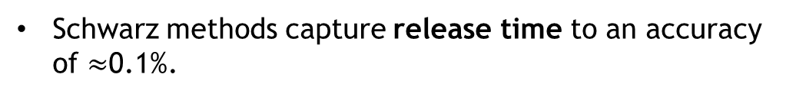
Numerical Results: 1D Impact Problem¹
Contact point position: of the right-most node of left bar ($Ω_{1}$) as a function of time
Penalty methods overpredict contact point location between impact and release times
Explicit LM method under-predicts release time
Schwarz methods capture release time to an accuracy of $≈$0.1%.
¹Hoy et al., 2021; Mota et al. (in prep), 2021.

Slide 12
Numerical Results: 1D Impact Problem¹
Mass-averaged velocity: of the left bar ($Ω_{1}$) as a function of time
Similar conclusions can be drawn from mass-averaged velocity
Schwarz variants calculate mass-averaged velocity to a sufficiently greater accuracy than any of the conventional methods, especially near the time of release
¹Hoy et al., 2021; Mota et al. (in prep), 2021.

Slide 13
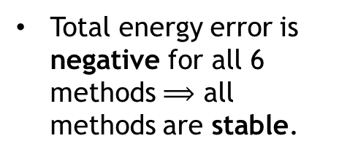
Numerical Results: 1D Impact Problem¹
Total energy relative error: for the left bar ($Ω_{1}$) as a function of time
Total energy error is negative for all 6 methods $⟹$ all methods are stable.
Total energy should be conserved for this problem
All three conventional methods exhibit total energy loss of up to 9% following contact.
Unlike conventional contact methods, Schwarz achieves an error of at most 0.25% in the total energy!
  Explicit-Explicit Schwarz gives most accurate total energy, followed by Implicit-Implicit Schwarz and Implicit-Explicit Schwarz
¹Hoy et al., 2021; Mota et al. (in prep), 2021.

Slide 14
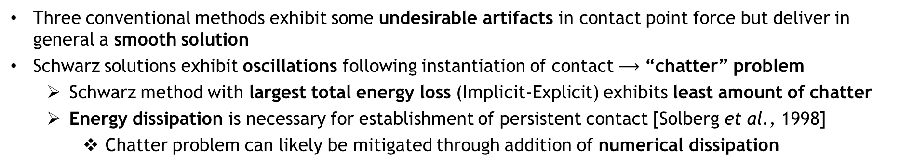
Numerical Results: 1D Impact Problem¹
Contact point force: for the left bar ($Ω_{1}$) as a function of time
¹Hoy et al., 2021; Mota et al. (in prep), 2021.
Three conventional methods exhibit some undesirable artifacts in contact point force but deliver in general a smooth solution
Schwarz solutions exhibit oscillations following instantiation of contact $⟶$ “chatter” problem
  Schwarz method with largest total energy loss (Implicit-Explicit) exhibits least amount of chatter
  Energy dissipation is necessary for establishment of persistent contact [Solberg et al., 1998]
    Chatter problem can likely be mitigated through addition of numerical dissipation
Notes:
Chatter = loss/subsequent reestablishment of contact

Slide 15
Summary & Future Work
Summary:
The Schwarz alternating method was shown to be an effective multi-scale coupling method in solid mechanics
The Schwarz alternating method has shown promise as a novel technique for simulating multi-scale mechanical contact
  Contact constraints are replaced with transmission BCs applied iteratively on contact boundaries
  Schwarz method delivers substantially more accurate solution than conventional contact approaches in contact point displacement, mass-averaged velocity, impact time, release time, and kinetic, potential total energies
  An unfortunate consequence of the method’s ability to conserve energy so well appears to be the introduction of chatter in contact point velocity and force.
Ongoing/future work:
Introduction of dissipation and/or numerical relaxation to mitigate chatter problem
Introduction of additional or alternate contact constraints into Schwarz formulation
Comparison to conventional contact formulations with zero gap rate constraint
Implementation/evaluation of the Schwarz alternating method in multi-D
  Requires the development of operators for consistent transfer of contact traction BCs using concept of prolongation/restriction

Slide 16
References
H. Schwarz, Uber einen Grenzubergang durch alternierendes verfahren, Vierteljahrsschriftder Naturforschenden Gesellschaft in Zurich, 15 (1870), pp. 272–286.
P.L. Lions. “On the Schwarz alternating method I.” In: 1988, First International Symposium on Domain Decomposition methods for Partial Differential Equations, SIAM, Philadelphia.
P. L. Lions, On the Schwarz alternating method III: A variant for nonoverlapping subdomains, in Third International Symposium on Domain Decomposition Methods for Partial Differential Equations, T. F. Chan, R. Glowinski, J. P´eriaux, and O. B. Widlund, eds., Society for Industrial and Applied Mathematics, 1990, pp. 202–223
P. Zanolli, Domain decomposition algorithms for spectral methods, CALCOLO, 24 (1987), pp. 201–240.
A. Mota, I. Tezaur, and C. Alleman, The Schwarz alternating method, Comput. Meth. Appl. Mech. Engng., 319 (2017), pp. 19–51.
A. Mota, I. Tezaur, and G. Phlipot, The Schwarz alternating method for transient solid dynamics, Int. J. Numer. Meth. Engng. (under review).
N. J. Carpenter, R. L. Taylor, and M. G. Katona, Lagrange constraints for transient finite element surface contact, International journal for numerical methods in engineering, 32 (1991), pp. 103–128.
J. Hoy, I. Tezaur, A. Mota. The Schwarz alternating method for multi-scale contact mechanics. CSRI Summer Proceedings 2021 (in press).
A. Mota, I. Tezaur, J. Hoy. The Schwarz alternating method for multi-scale contact mechanics. Mathematical & Computational Applications (MCA) (in prep).
J. M. Solberg and P. Papadopoulos, A finite element method for contact/impact, Finite Elements in Analysis and Design, 30 (1998), pp. 297–311.
I. Tezaur, T. Voth, J. Niederhaus, J. Robbins, and J. Sanchez, An extended finite element method (XFEM) formulation for multi-material Eulerian solid mechanics in the Alegra code (in preparation).

Slide 17
Start of Backup Slides

Slide 18
Motivation
Large scale structural failure frequently originates from small scale phenomena (e.g, defects, microcracks, inhomogeneities), which grow quickly in unstable manner
  Concurrent multiscale methods are essential to capture correctly the multiscale behavior!
  Stable, accurate and robust methods for simulating mechanical contact (touching surfaces, sliding, tightened bolts, impact) are equally important!
Above: roof failure of Boeing 737 aircraft due to fatigue cracks. From imechanica.org
Two-step process to the computational simulation of contact:
Proximity search: computer science problem, has received much attention due to importance in video game development ☺
Contact enforcement step: existing methods (penalty, Lagrange multiplier, augmented Lagrangian) suffer from poor performance ☹
  Long simulation times ☹
  Lack of accuracy ☹
  Lack of robustness ☹
Above: gears in contact within MEMS device. From sandia.gov/media
This talk.

Slide 19
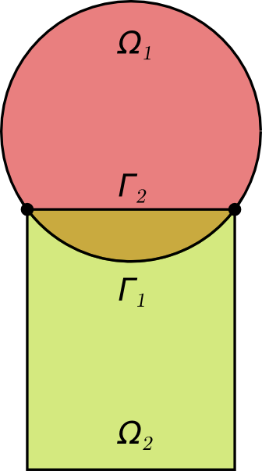
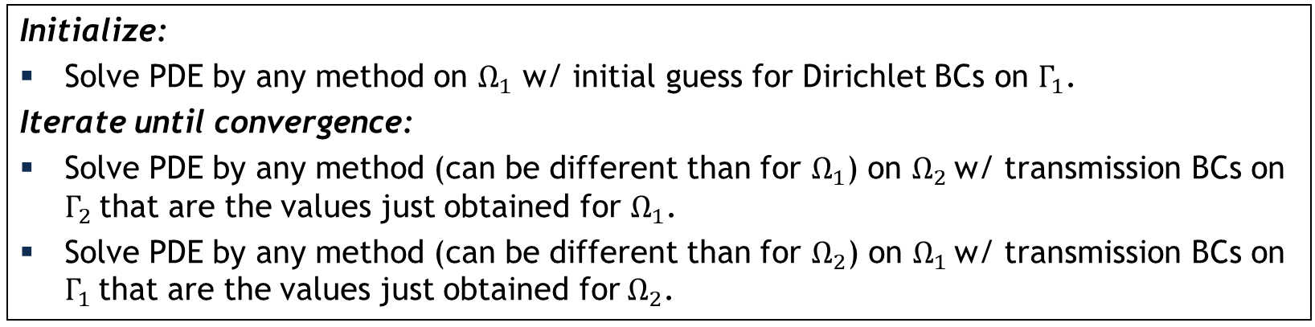
Schwarz Alternating Method for Domain Decomposition
Proposed in 1870 by H. Schwarz for solving Laplace PDE on irregular domains.
Crux of Method: if the solution is known in regularly shaped domains, use those as pieces to iteratively build a solution for the more complex domain.
H. Schwarz (1843 – 1921)
Basic Schwarz Algorithm
Initialize:
Solve PDE by any method on $Ω_{1}$ w/ initial guess for Dirichlet BCs on $Γ_{1}$.
Iterate until convergence:
Solve PDE by any method (can be different than for $Ω_{1}$) on $Ω_{2}$ w/ transmission BCs on $Γ_{2}$ that are the values just obtained for $Ω_{1}$.
Solve PDE by any method (can be different than for $Ω_{2}$) on $Ω_{1}$ w/ transmission BCs on $Γ_{1}$ that are the values just obtained for $Ω_{2}$.
Schwarz alternating method most commonly used as a preconditioner for Krylov iterative methods to solve linear algebraic equations.
Novel idea: using the Schwarz alternating as a discretization method for solving multi-scale partial differential equations (PDEs).

Slide 20
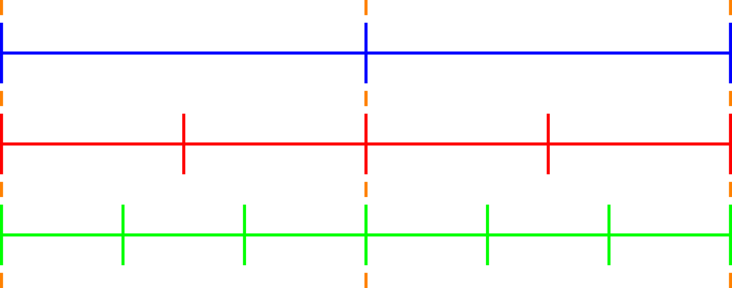
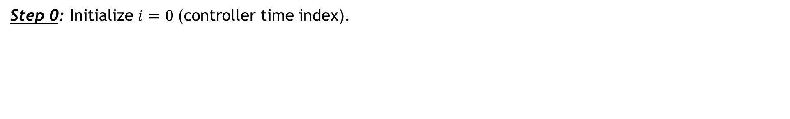


Enforcement of Contact via Alternating Schwarz
$$T_{0}$$
$$T_{1}$$
Key idea: a contact problem can be viewed as coupled problem while 2+ bodies are in contact
Controller time stepper
Time integrator for Ω₁
Time integrator for Ω₂
Step 0: Initialize $i=0 \text{(}\text{controller} \text{time} \text{index}\text{).}$

Slide 21
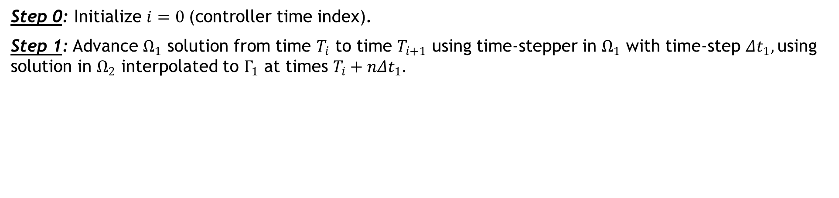


Enforcement of Contact via Alternating Schwarz
$$T_{0}$$
$$T_{1}$$
Key idea: a contact problem can be viewed as coupled problem while 2+ bodies are in contact
Controller time stepper
Time integrator for Ω₁
Time integrator for Ω₂
Integrate using ${Δt}_{1}$
Interpolate from $Ω_{2}$ to $Γ_{1}$
Step 0: Initialize $i=0 \text{(}\text{controller} \text{time} \text{index}\text{).}$
Step 1: Advance $Ω_{1}$ solution from time $T_{i}$ to time $T_{i+1}$ using time-stepper in $Ω_{1}$ with time-step ${Δt}_{1},$using solution in $Ω_{2}$ interpolated to $Γ_{1}$ at times $T_{i}+n{Δt}_{1}.$

Slide 22
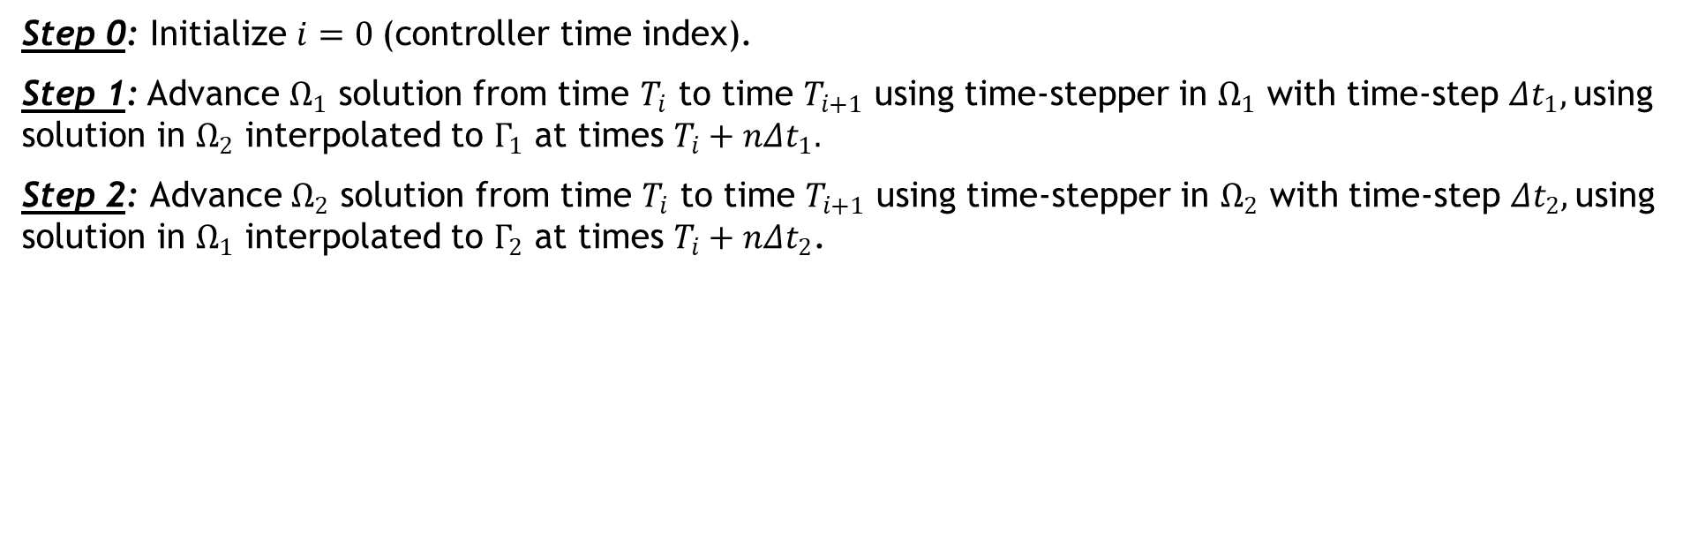


Enforcement of Contact via Alternating Schwarz
$$T_{0}$$
$$T_{1}$$
Key idea: a contact problem can be viewed as coupled problem while 2+ bodies are in contact
Controller time stepper
Time integrator for Ω₁
Time integrator for Ω₂
Interpolate from $Ω_{1}$ to $Γ_{2}$
Integrate using ${Δt}_{2}$
Step 0: Initialize $i=0 \text{(}\text{controller} \text{time} \text{index}\text{).}$
Step 1: Advance $Ω_{1}$ solution from time $T_{i}$ to time $T_{i+1}$ using time-stepper in $Ω_{1}$ with time-step ${Δt}_{1},$using solution in $Ω_{2}$ interpolated to $Γ_{1}$ at times $T_{i}+n{Δt}_{1}.$
Step 2: Advance $Ω_{2}$ solution from time $T_{i}$ to time $T_{i+1}$ using time-stepper in $Ω_{2}$ with time-step ${Δt}_{2},$using solution in $Ω_{1}$ interpolated to $Γ_{2}$ at times $T_{i}+n{Δt}_{2}$.

Slide 23
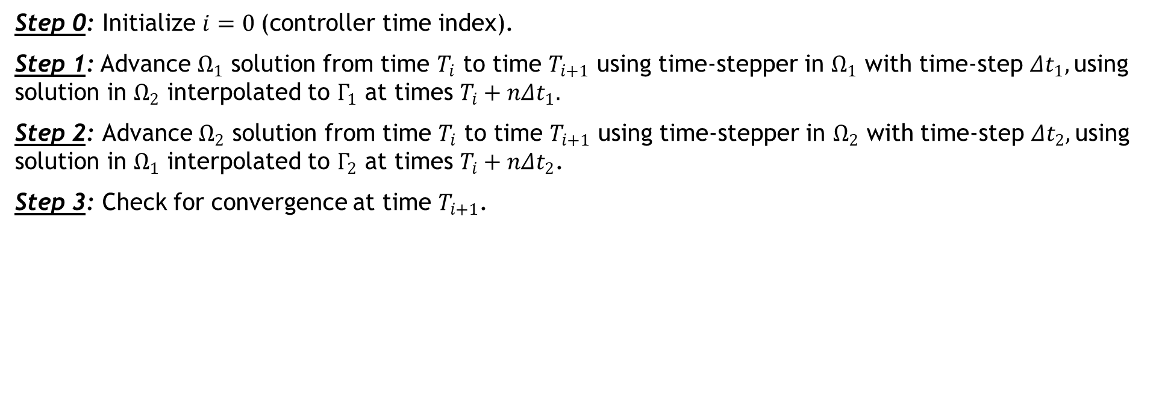
Enforcement of Contact via Alternating Schwarz
$$T_{0}$$
$$T_{1}$$
Key idea: a contact problem can be viewed as coupled problem while 2+ bodies are in contact
Controller time stepper
Time integrator for Ω₁
Time integrator for Ω₂
Step 0: Initialize $i=0 \text{(}\text{controller} \text{time} \text{index}\text{).}$
Step 1: Advance $Ω_{1}$ solution from time $T_{i}$ to time $T_{i+1}$ using time-stepper in $Ω_{1}$ with time-step ${Δt}_{1},$using solution in $Ω_{2}$ interpolated to $Γ_{1}$ at times $T_{i}+n{Δt}_{1}.$
Step 2: Advance $Ω_{2}$ solution from time $T_{i}$ to time $T_{i+1}$ using time-stepper in $Ω_{2}$ with time-step ${Δt}_{2},$using solution in $Ω_{1}$ interpolated to $Γ_{2}$ at times $T_{i}+n{Δt}_{2}$.
Step 3: Check for convergence at time $T_{i+1}$.

Slide 24
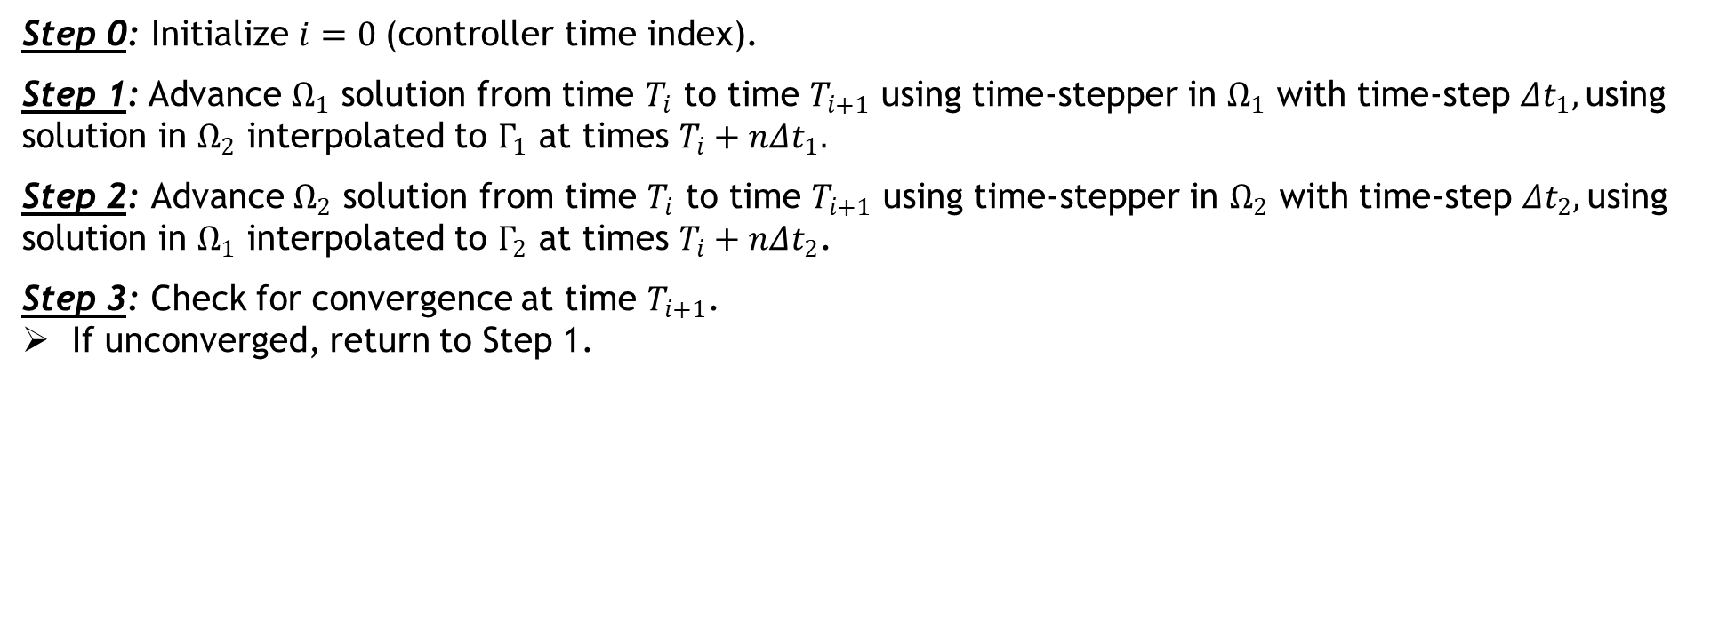

Enforcement of Contact via Alternating Schwarz
$$T_{0}$$
$$T_{1}$$
Key idea: a contact problem can be viewed as coupled problem while 2+ bodies are in contact
Controller time stepper
Time integrator for Ω₁
Time integrator for Ω₂
Integrate using ${Δt}_{1}$
Interpolate from $Ω_{2}$ to $Γ_{1}$
Step 0: Initialize $i=0 \text{(}\text{controller} \text{time} \text{index}\text{).}$
Step 1: Advance $Ω_{1}$ solution from time $T_{i}$ to time $T_{i+1}$ using time-stepper in $Ω_{1}$ with time-step ${Δt}_{1},$using solution in $Ω_{2}$ interpolated to $Γ_{1}$ at times $T_{i}+n{Δt}_{1}.$
Step 2: Advance $Ω_{2}$ solution from time $T_{i}$ to time $T_{i+1}$ using time-stepper in $Ω_{2}$ with time-step ${Δt}_{2},$using solution in $Ω_{1}$ interpolated to $Γ_{2}$ at times $T_{i}+n{Δt}_{2}$.
Step 3: Check for convergence at time $T_{i+1}$.
If unconverged, return to Step 1.
Notes:
Controller time-stepper – defines global dTs at which subdomains are synchronized

Slide 25

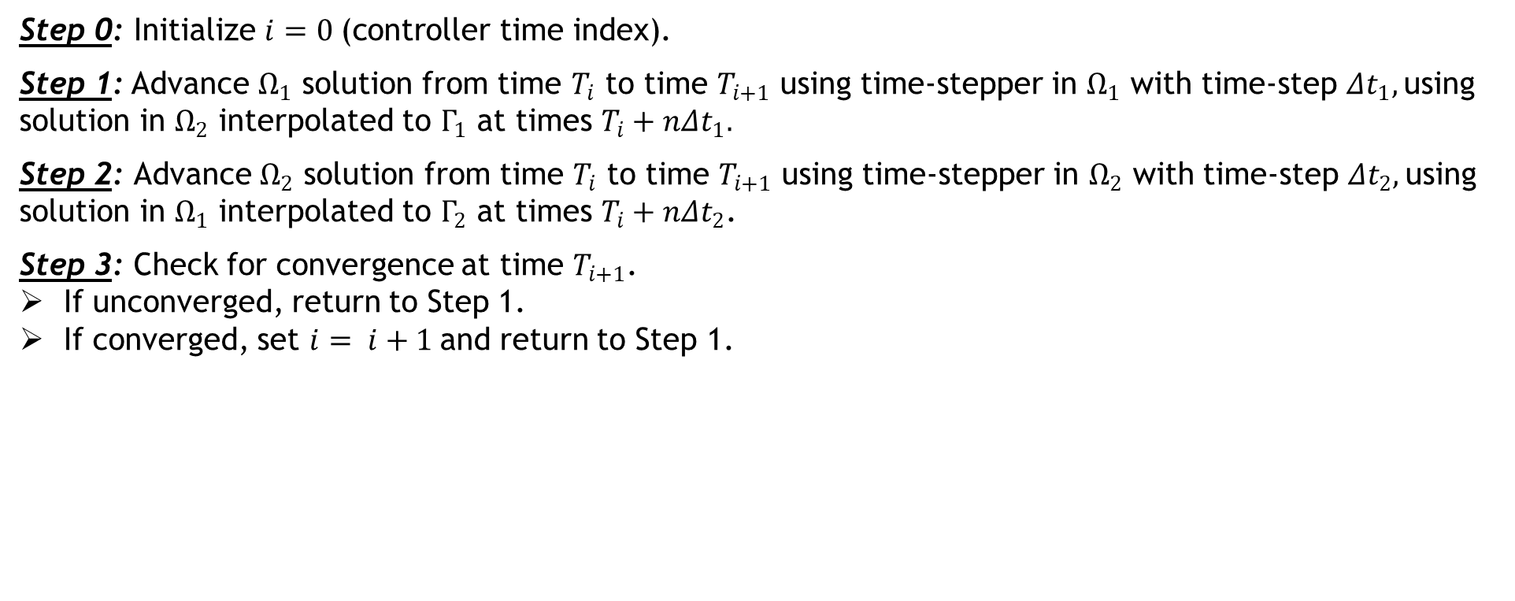

Enforcement of Contact via Alternating Schwarz
$$T_{0}$$
$$T_{1}$$
$$T_{2}$$
Key idea: a contact problem can be viewed as coupled problem while 2+ bodies are in contact
Controller time stepper
Time integrator for Ω₁
Time integrator for Ω₂
Integrate using ${Δt}_{1}$
Interpolate from $Ω_{2}$ to $Γ_{1}$
Step 0: Initialize $i=0 \text{(}\text{controller} \text{time} \text{index}\text{).}$
Step 1: Advance $Ω_{1}$ solution from time $T_{i}$ to time $T_{i+1}$ using time-stepper in $Ω_{1}$ with time-step ${Δt}_{1},$using solution in $Ω_{2}$ interpolated to $Γ_{1}$ at times $T_{i}+n{Δt}_{1}.$
Step 2: Advance $Ω_{2}$ solution from time $T_{i}$ to time $T_{i+1}$ using time-stepper in $Ω_{2}$ with time-step ${Δt}_{2},$using solution in $Ω_{1}$ interpolated to $Γ_{2}$ at times $T_{i}+n{Δt}_{2}$.
Step 3: Check for convergence at time $T_{i+1}$.
If unconverged, return to Step 1.
If converged, set $i= i+1$and return to Step 1.
Can use different integrators with different time steps within each domain!

Slide 26
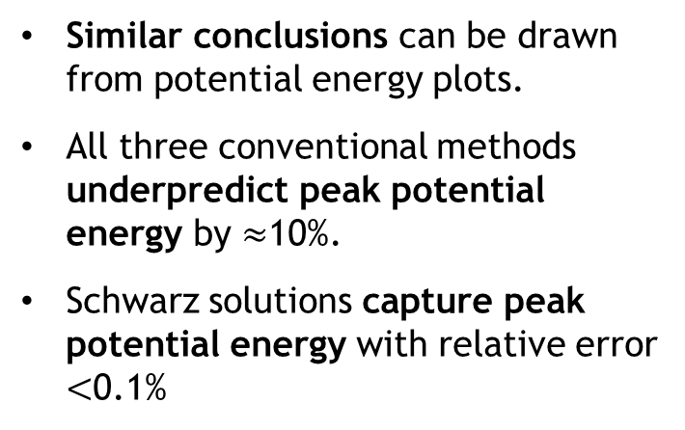
Numerical Results: 1D Impact Problem¹
Potential energy: for the left bar ($Ω_{1}$) as a function of time
Similar conclusions can be drawn from potential energy plots.
All three conventional methods underpredict peak potential energy by $≈$10%.
Schwarz solutions capture peak potential energy with relative error $<$0.1%
¹Hoy et al., 2021; Mota et al. (in prep), 2021.

Slide 27
Numerical Results: 1D Impact Problem¹
Potential energy: for the left bar ($Ω_{1}$) as a function of time
Similar conclusions can be drawn from potential energy plots.
All three conventional methods underpredict peak potential energy by $≈$10%.
Schwarz solutions capture peak potential energy with relative error $<$0.1%
¹Hoy et al., 2021; Mota et al. (in prep), 2021.

Slide 28
Numerical Results: 1D Impact Problem¹
Contact point velocity: for the left bar ($Ω_{1}$) as a function of time
Similar results are seen in the contact point velocity
It may be possible to reduce amount of chatter in Schwarz solutions by introducing numerical dissipation into the method.
¹Hoy et al., 2021; Mota et al. (in prep), 2021.
Notes:
Chatter = loss/subsequent reestablishment of contact

Slide 29
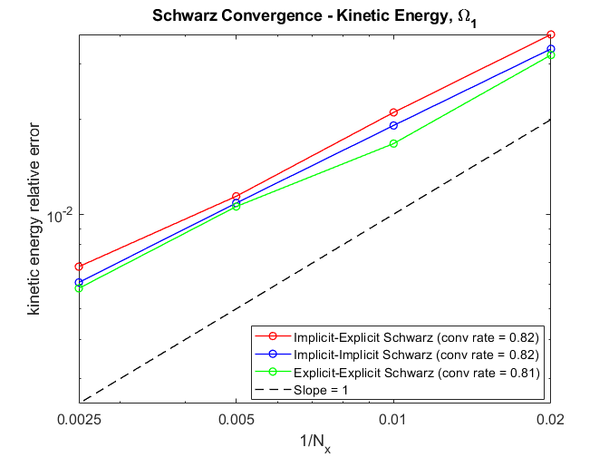
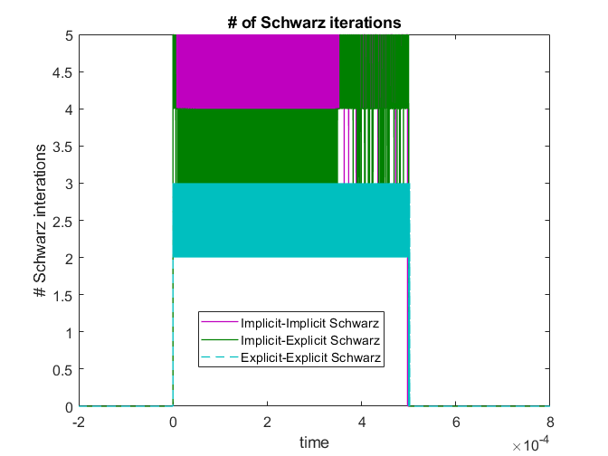
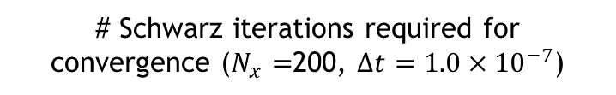
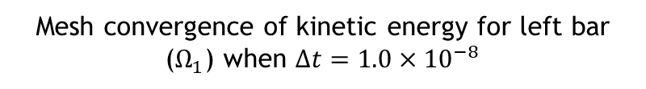
Numerical Results: 1D Impact Problem¹
Convergence of Schwarz methods
Mesh convergence of kinetic energy for left bar ($Ω_{1}$) when $Δt=1.0×{10}^{−8}$
# Schwarz iterations required for convergence ($N_{x}=$200, $Δt=1.0×{10}^{−7}$)
Convergence rates are comparable to published results [Tezaur et al., 2021]
At most 5 Schwarz iterations are needed for convergence
  Explicit-Explicit Schwarz variant requires fewest # iterations for convergence
¹Hoy et al., 2021; Mota et al. (in prep), 2021.
Notes:
Chatter = loss/subsequent reestablishment of contact

