Slide 1
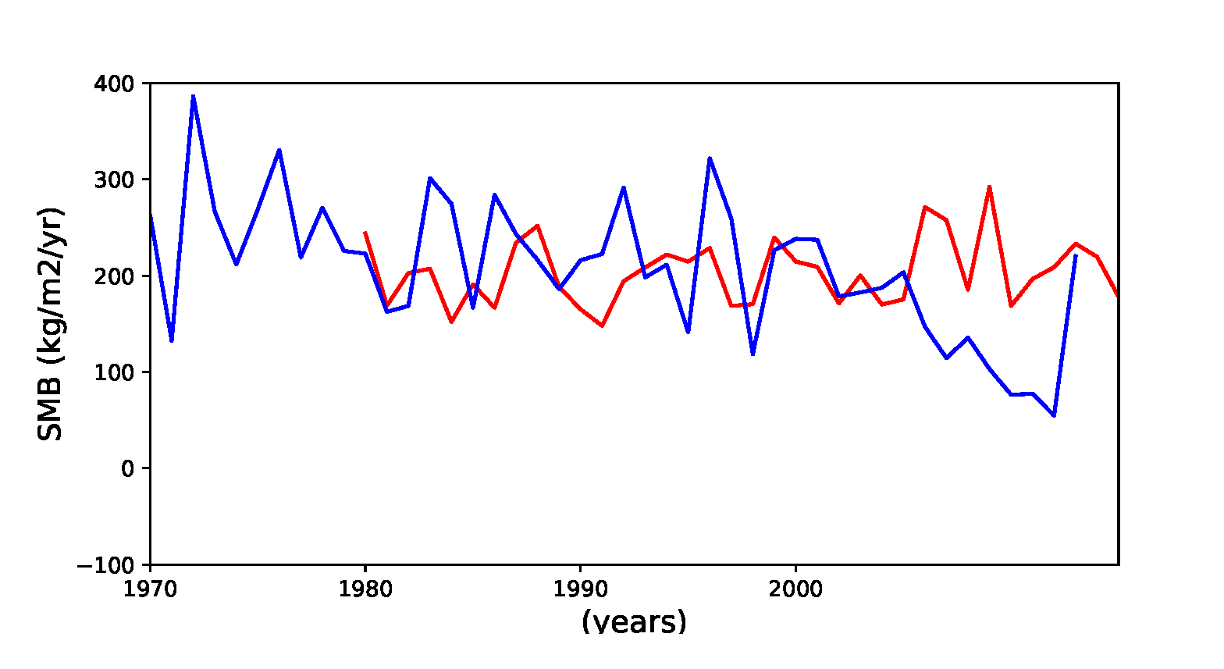
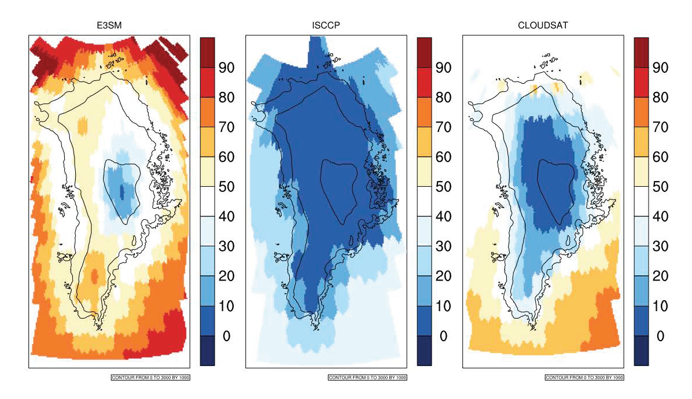
Probabilistic Sea-Level Projections from Ice Sheet and Earth System Models (ProsPect):
Ice Sheet Model Optimization, V&V, and UQ
Maur Perego, Juliane, Katherine J. Evans, Joseph H. Kennedy, John Jakeman, Irina Tezaur
BISICLES - Dan
BISICLES - Dan
BISICLES - Dan
Verification & Validation
Application of LIVVkit to E3SM v1 release model
Near term tasks:
Develop E3SM-MALI to produce SMB
develop better masking of MALI within E3SM
Profile and V&V BISICLES performance using LIVV
Optimization (Mauro, Juliane?)
UQ (John, Irina)
Connections to initial state development
Connections to UQ capabilities
Synergistic activities;
initMIP
GriOOS
ACIOS-ECP review committee
V&V mini at SIAM MPE
For additional information, contact:
Staff Member
Title
Institution or Organization
(555) 555-1234
staff.member@email.gov
climatemodeling.science.energy.gov

