Slide 1
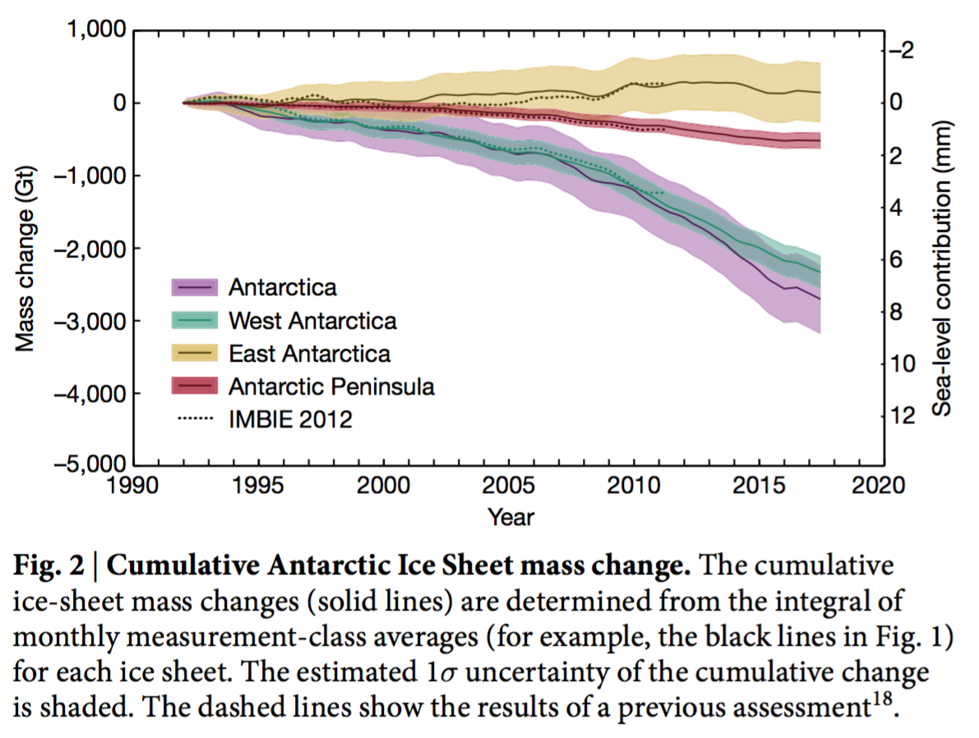
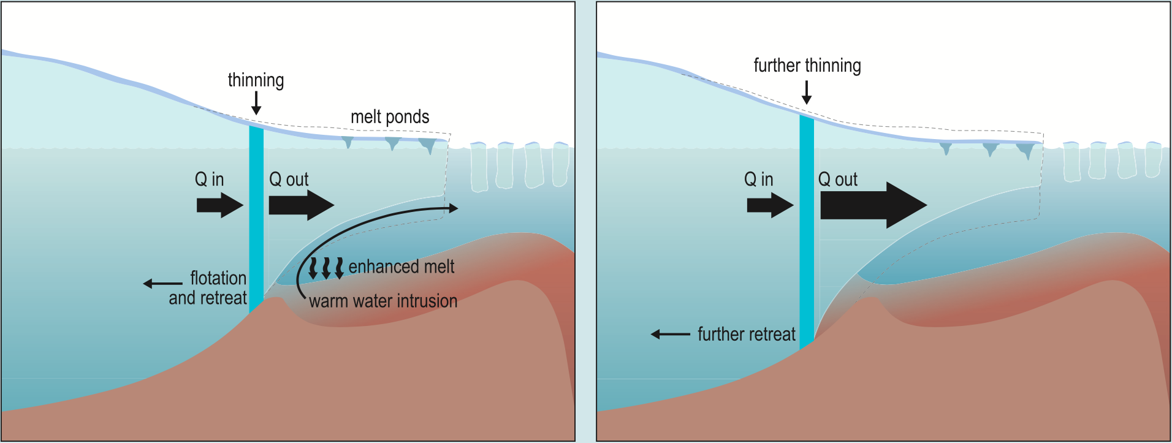
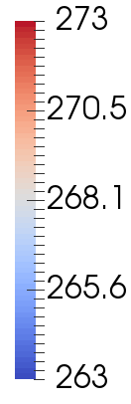
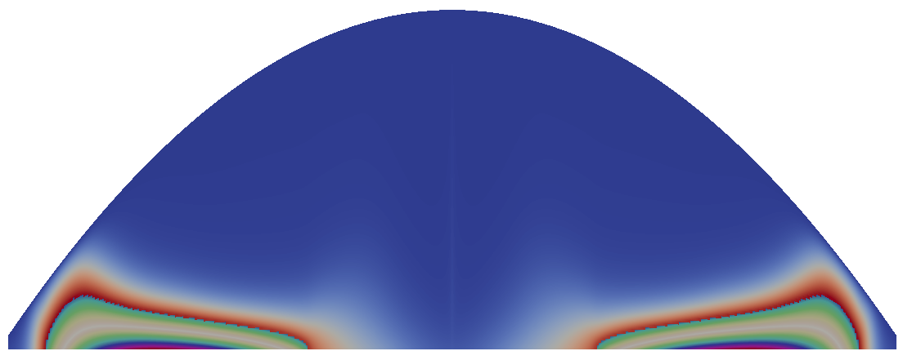
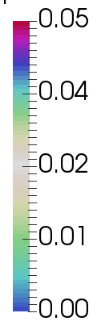
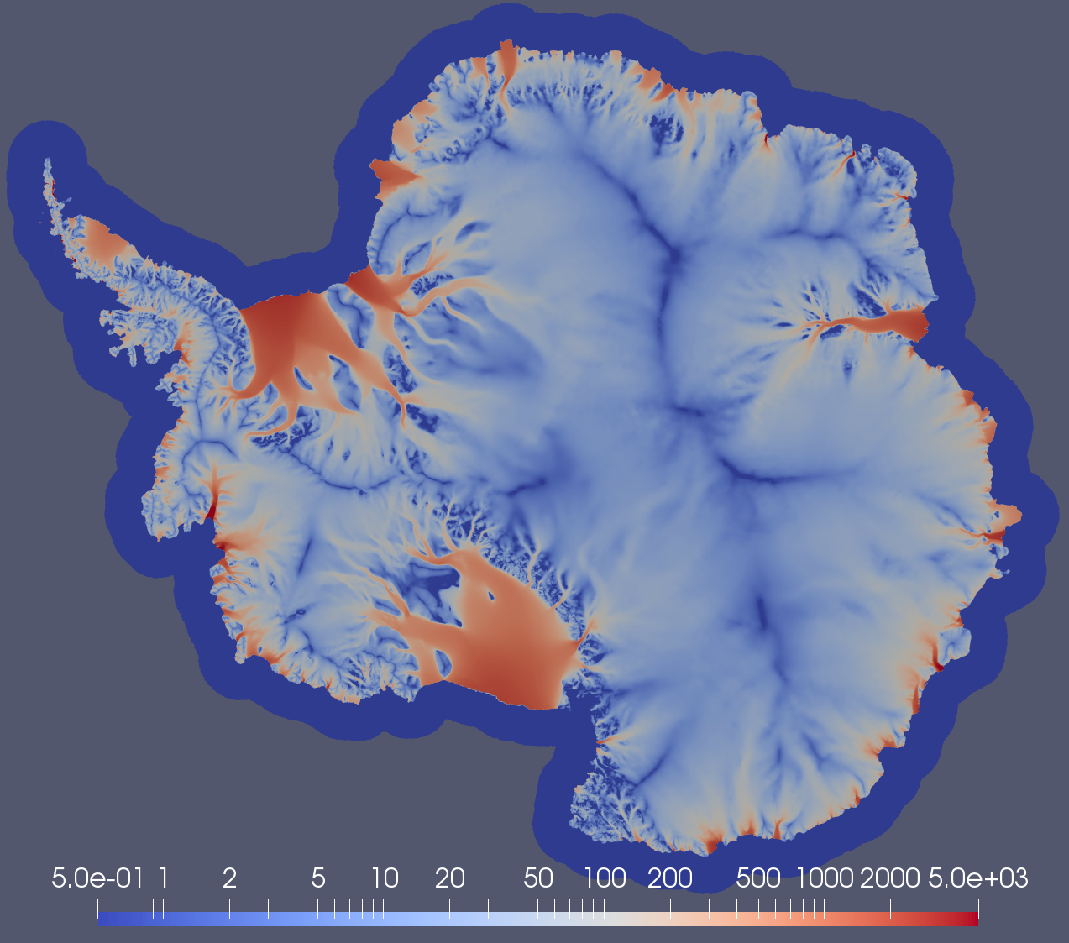
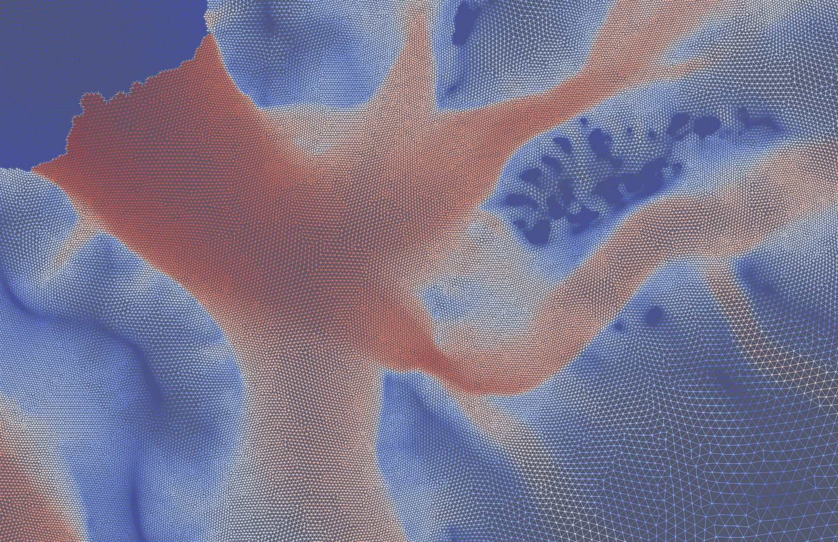
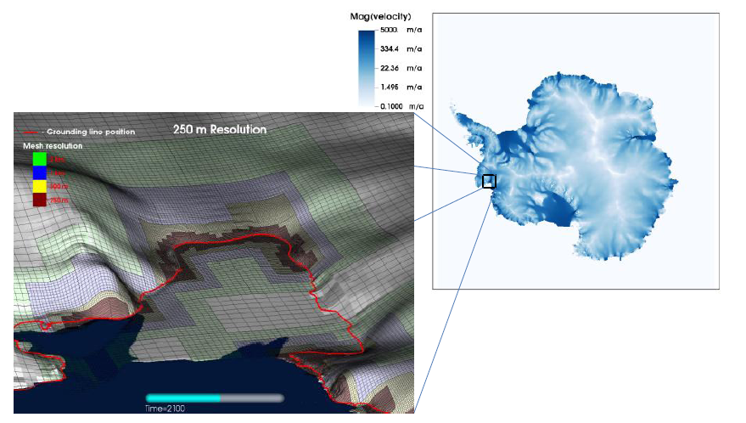
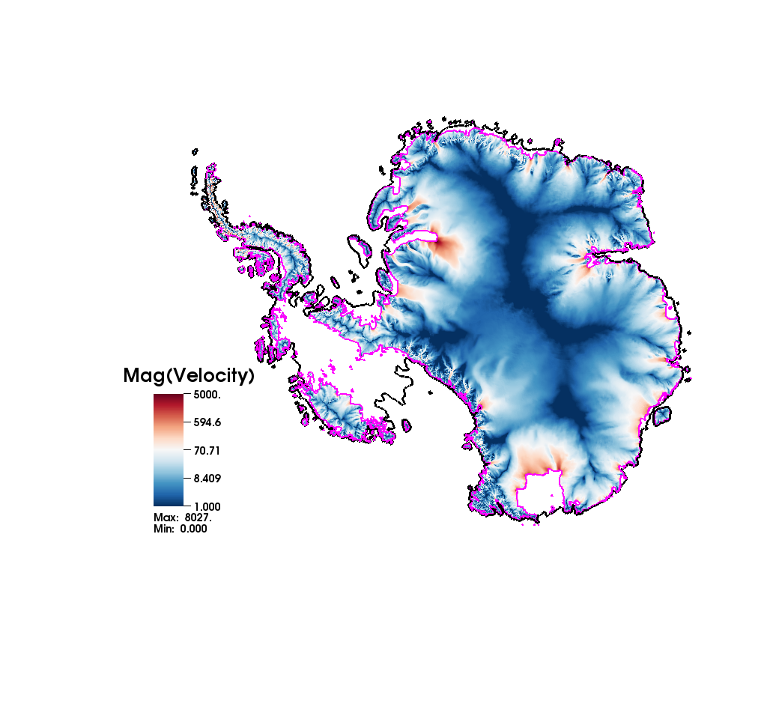
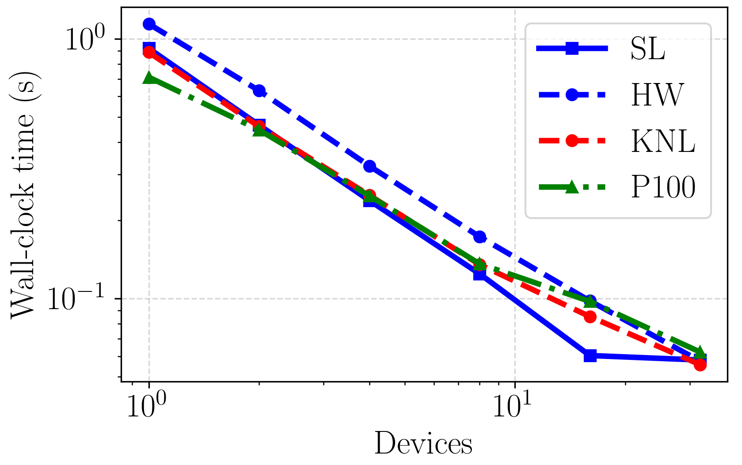
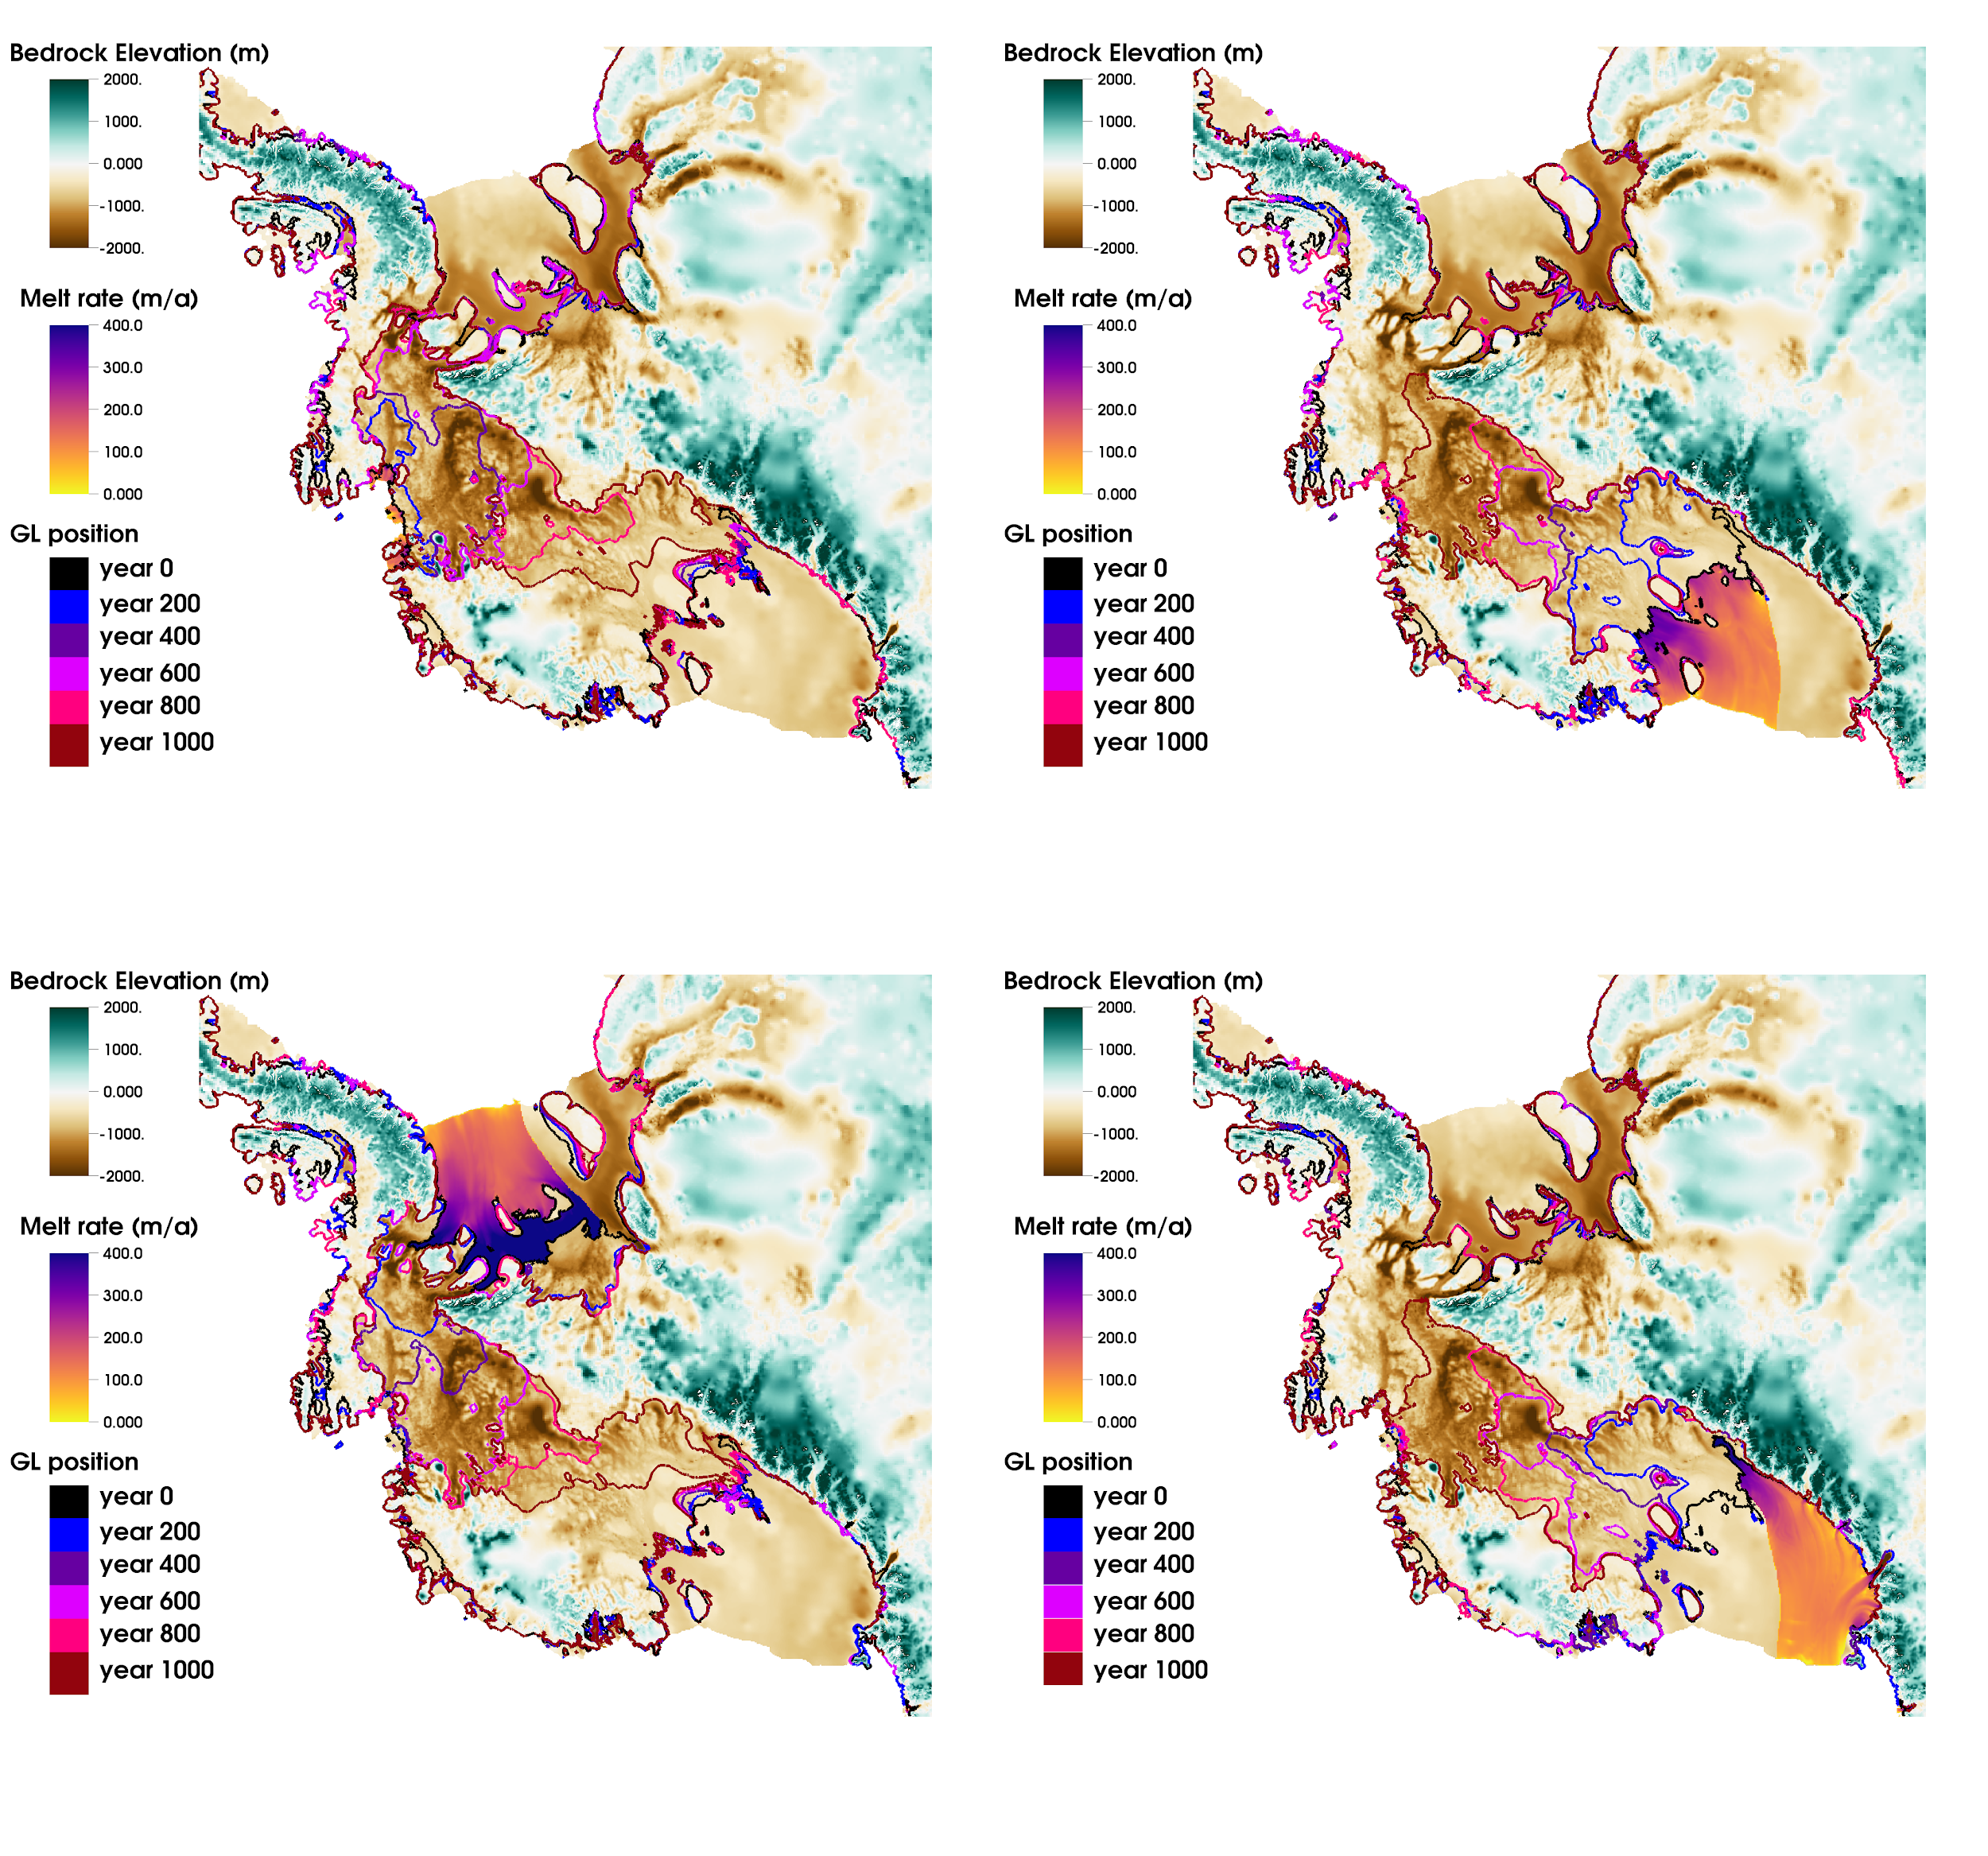
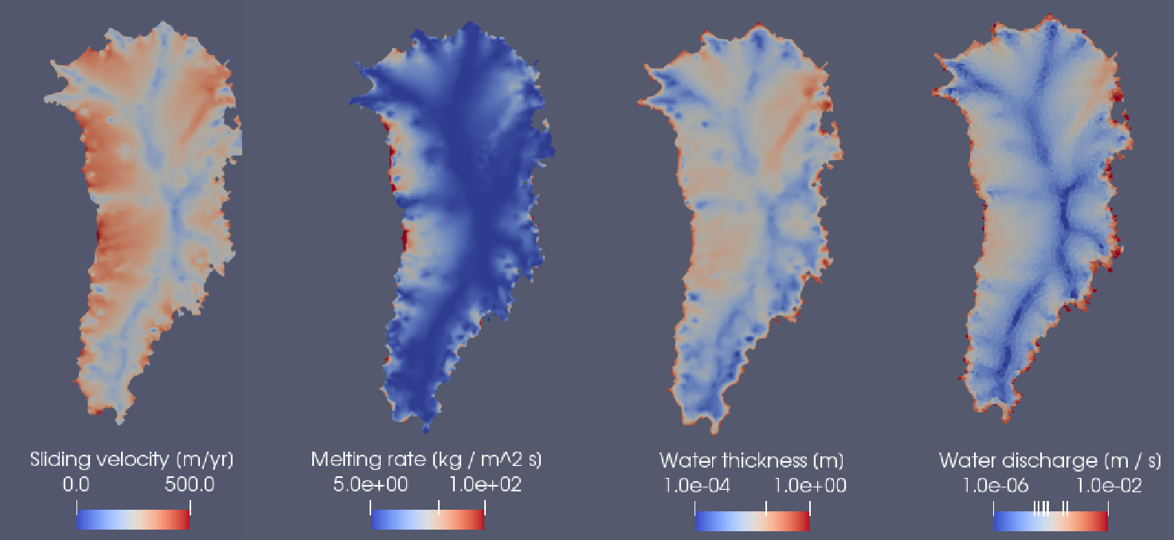
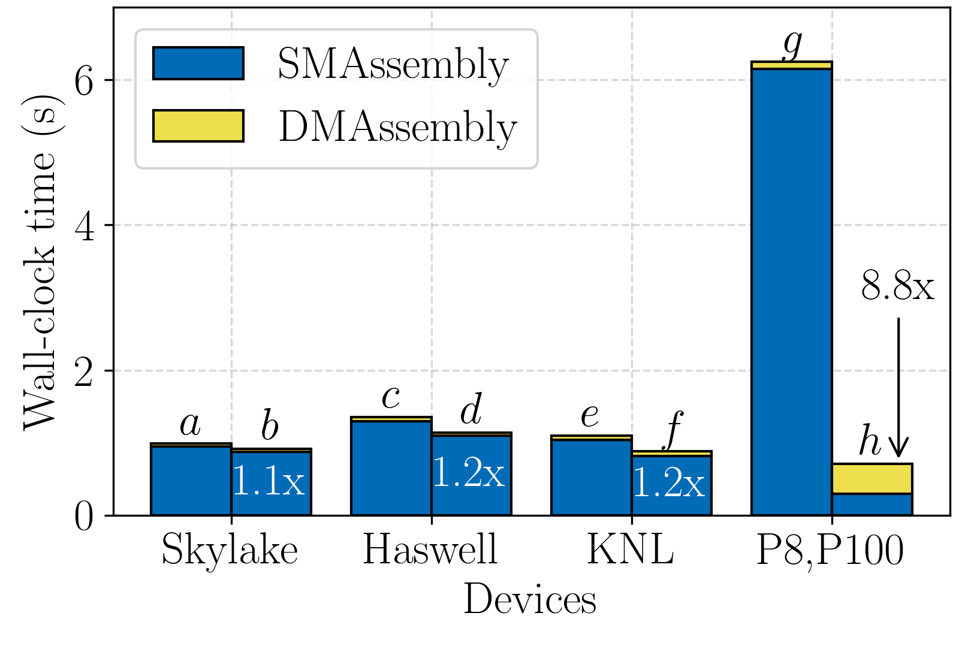
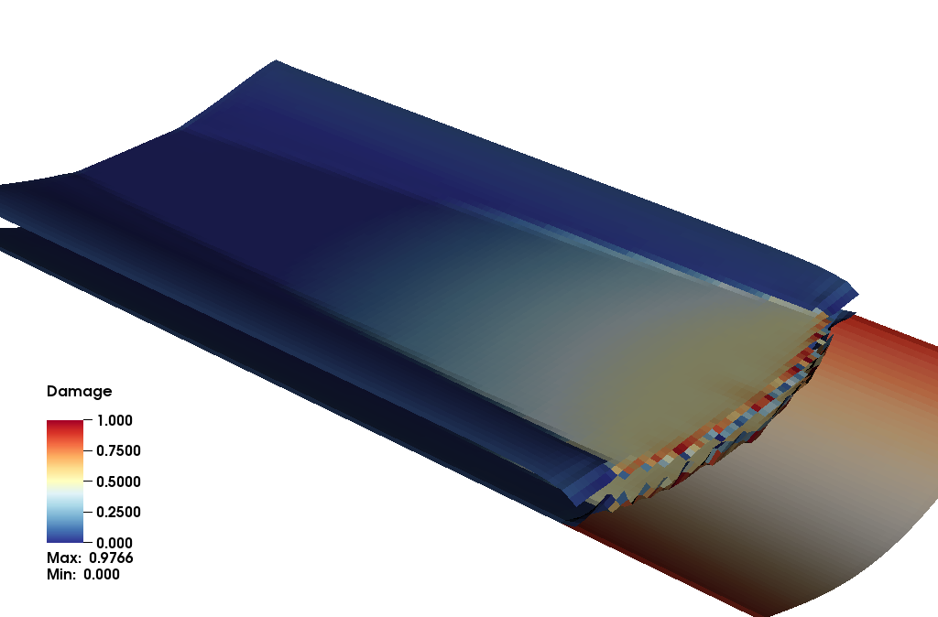
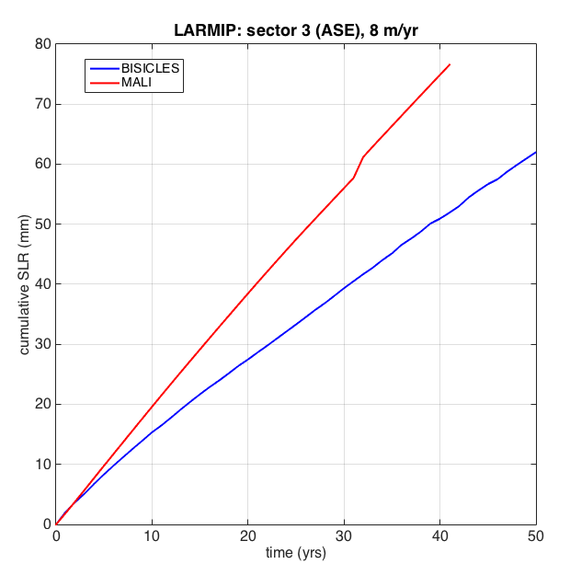
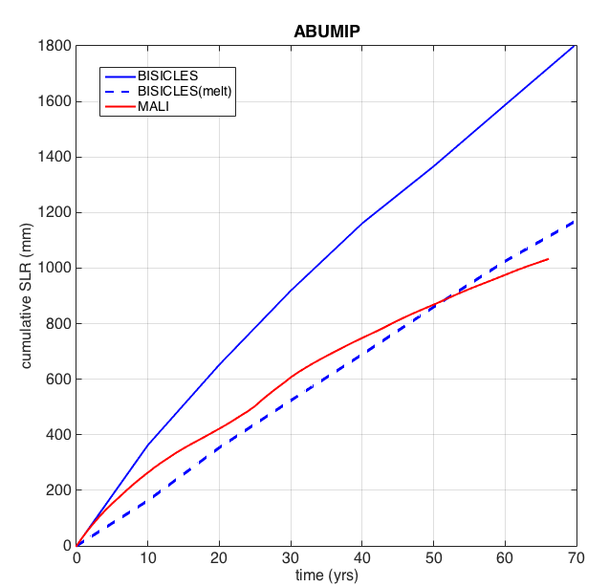
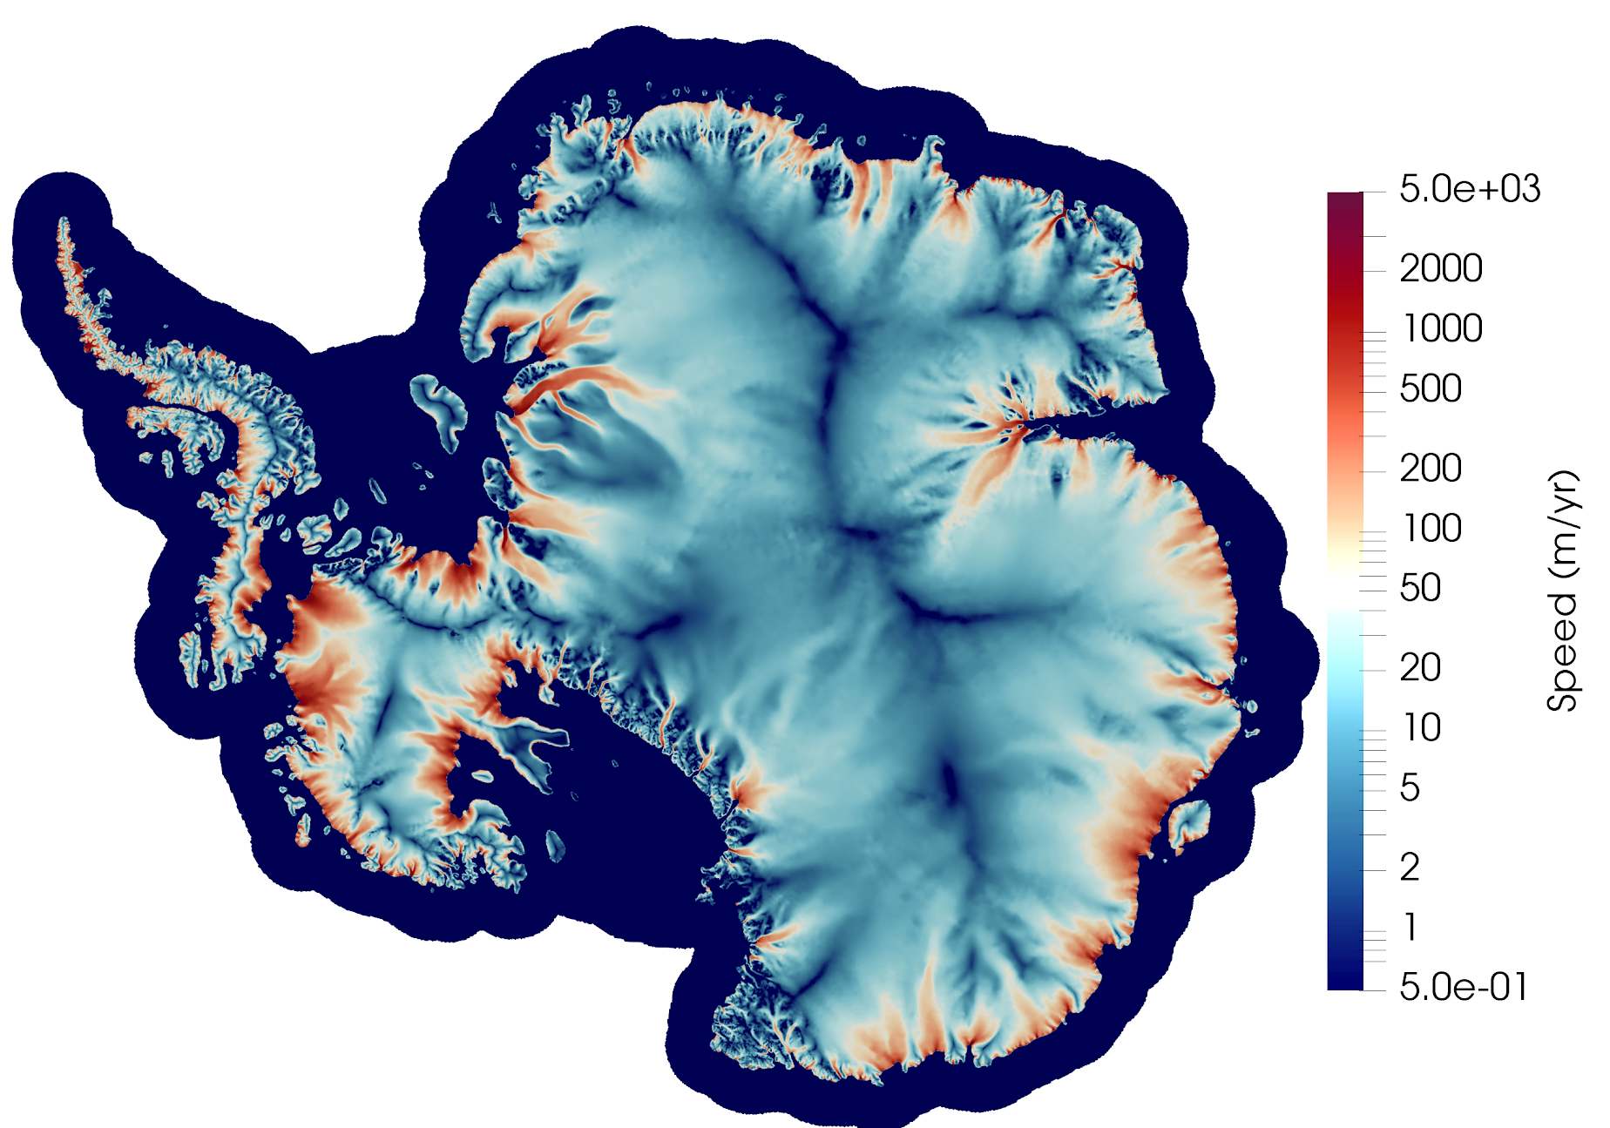
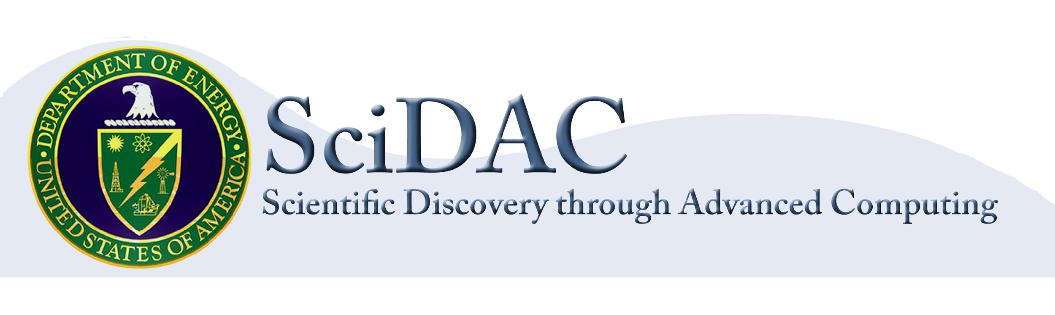
Probabilistic Sea-Level Projections from Ice Sheet and Earth System Models
1: Ice Sheet Model Development and Applications
BISICLES - Dan
Background & Introduction
The MALI Ice Sheet Model
BISICLES - Dan
(below) Observed Antarctica mass loss.
Sea-level rise from shrinking glaciers and ice sheets is increasing. Observed acceleration in the contribution from Greenland and Antarctica (right) is a concern, particularly for West Antarctica where the ice sheet’s geometric configuration is unstable to small perturbations (below).
The MALI ice sheet model (Hoffman et al., 2018) is built using the Model for Prediction Across Scales (MPAS) software framework (Ringler et al., 2013), for developing variable resolution Earth system model components, and the Albany multi-physics code base (Salinger et al., 2016), which makes use of Trilinos solver libraries (Heroux et al, 2005). Currently, the Albany component of MALI solves a 3D, first-order approximation to the Stokes-flow equations for ice flow and is also used for optimization and initialization (other features are in development, see below). The MPAS component of MALI currently handles mass and energy conservation, a range of nominal model physics options (e.g., iceberg calving), and coupling to E3SM.
(left) A small change in flux at the ice sheet grounding line (e.g., from increased ice shelf melting) results in a positive feed- back of increasing flux and retreat.
ProSPect will address DOE ice sheet (ISM) and Earth system model (ESM) limitations that prevent accurate sea-level
projections. Focus areas include (1) missing or inadequate model physics, (2) missing ISM and ESM coupling, (3) coupled ISM and ESM initialization methods, and (4) probabilistic sea-level projections.
(below) Modeled Antarctic ice sheet surface velocity optimized to observed surface velocities (see Poster #2, “Optimization”) on variable resolution mesh (~20-1 km). Zoom at right shows details of velocity field and mesh resolution in region of Filchner ice shelf.
Improved physics: enthalpy-based thermo-mechanical model
To improve time stepping performance and data assimilation, we are working on a new, finite element implementation of temperature that is implicitly coupled with the flow model.
T [K]
water porosity [%]
1.5 km
BISICLES - Dan
200 km
temperate ice
The BISICLES Ice Sheet Model
(left) BISICLES-computed Antarctic ice velocity field. (inset) close-up of the Pine Island Glacier showing local mesh refinement near grounding line (red line)
Performance Portability
(above) Temperature superposed with water porosity in temperate ice.
AMR for Ice Sheets:
Substantial evidence indicates that very fine (O(1km) or finer) model resolution is required to sufficiently resolve ice dynamics near the grounding line (GL) – the point at which ice transitions from grounded ice sheets to floating ice shelves. Such fine resolution is impractical for entire continental-scale ice sheets.
At the same time, there are large relatively quiescent regions for which such fine resolution represents a waste of resources.
The DOE SciDAC-funded BISICLES model uses adaptive mesh refinement (AMR) to dynamically place fine resolution only where needed as the solution evolves, making it an ideal tool for exploring ice sheet response to marine forcing which may entail GL retreats over hundreds of kilometers.
Built on the Chombo framework, BISICLES is a robust, scalable high-order ice sheet model (ISM) currently exploring Antarctic response to a wide range of likely and extreme climate forcing using sufficient resolution to accurately capture the relatively fine-scale dynamics of the ice in ice streams and near GLs.
In SciDAC4, we are improving BISICLES in several directions:
Incorporating more-realistic physics, including new ice damage and calving models (a major source of sensitivity and un-
certainty in current models).
Incorporating an AMR model to better represent subglacial hydrology, including channel formation.
With FASTMath, developing improved model representation of complex GL and ice margin geometries.
Continued robustness, scalability, and portability improvements.
In order to have MALI run efficiently on next generation architectures we focus on the performance portability of the finite element assembly (FEA) phase, that accounts for approximately half of computational cost of a land ice simulation.
(right) Strong scalability showing that FEA performs efficiently on latest CPU/GPU architectures: SkyLake (SL), Haswell (HW), Knights Landing (KNL) and Tesla P100 GPU.
Improved physics: subglacial hydrology
(below) Preliminary Greenland ice sheet experiment.
To explicitly model the lubricating effects of water flow at the glacier bed and its evolution, we are developing a new finite element implementation of subglacial hydrology, which features englacial porosity, sediment storage, and nonlinear diffusion. The model has been verified with manufactured solutions and provides reasonable results when applied to low- resolution, realistic geometries.
(left) Wall-clock time for FEA for different architectures and settings. Shared (blue) and distributed (yellow) memory assembly.
Device configurations: a: 24 MPI, b: 24 (MPI+2OMPI),
c: 16 MPI, d: 16 (MPI+2OMP),
d: 68 MPI, f: 68 (MPI+4OMP),
g: 8 MPI, h: 1 (MPI+GPU)
(right) 1000-year GL evolution for selected regional ice shelf collapse scenarios, computed using BISICLES (submitted to Nature Communications)
Ice Sheet Model Intercomparisons
Cumulative sea-level rise (mm) simulated by BISICLES and MALI for LARMIP (left) and ABUMIP (right), which explore sensitivity to large ice shelf melt perturbations and the removal of all floating ice shelves, respectively.
BISICLES - Dan
BISICLES and MALI are participating in international model intercomparison experiments (“MIPs”) targetting improved under- standing of ice sheet sensitivity to extreme climate forcing. In addition to providing visibility for DOE’s efforts within the broader community, MIPs provide useful benchmarks for future model development (e.g., the impact of new physics and computational performance enhancements) and a platform for quantifying ice sheet model structural uncertainty.
(left) BISICLES- computed ice damage in idealized ice stream/ice calving simulation.
(Left) Snapshots of Antarctic ice sheet evolution during the ABUMIP experiment. MALI surface velocity ~70 years after ice shelf removal (far left) and BISICLES surface velocity 500 years after ice shelf-removal (near left), with black and magenta lines showing initial and final grounding line positions (respectively).
Project Members: Stephen Price (PI; LANL), Esmond Ng (PI; LBNL), Xylar Asay-Davis (LANL), Jeremy Bassis (UM), Darin Comeau (LANL), Katherine Evans (ORNL), Matthew Hoffman (LANL), John Jakeman (SNL), Joseph Kennedy (ORNL), Dan Martin (LBNL), Juliane Muller (LBNL), Mauro Perego (SNL), Mark Petersen (LANL), Andrew Salinger (SNL), Georg Stadler (NYU), Irina Tezaur (SNL), Raymond Tuminaro (SNL), Brian Van Straalen (LBNL)
https://doe-prospect.github.io/

