Slide 1
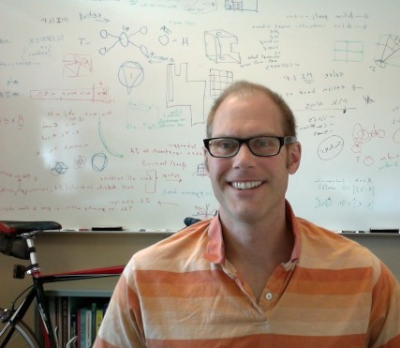
Deterministic Linear Time for Maximal Poisson-Disk Sampling using Chocks without Rejection or Approximation
SGP 6 July 2022
Sandia National Laboratories is a multimission laboratory managed and operated by National Technology & Engineering Solutions of Sandia, LLC, a wholly owned subsidiary of Honeywell International Inc., for the U.S. Department of Energy’s National Nuclear Security Administration under contract DE-NA0003525.
SAND2022-8831 C
Scott A. Mitchell
sandia.gov/~samitch
20 minutes

Slide 2
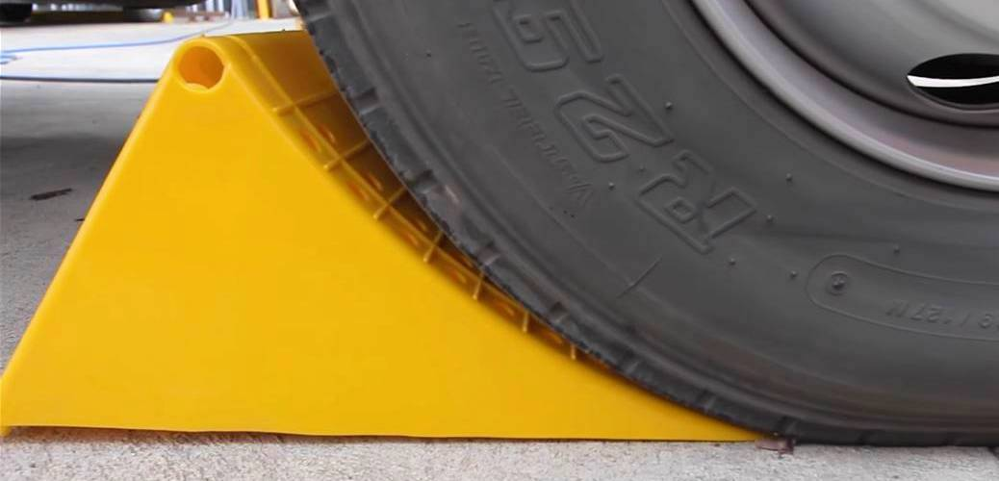
Deterministic Linear Time for Maximal Poisson-Disk Sampling using Chocks without Rejection or Approximation
What’s new?
  Chock geometry
  Uniform sampling within a chock
    Enabled by inverse transform of area formula
  Best-possible worst-case time
  MPS algorithm
Area
chock
5 Newton’s iterations
circle
ray
chock
chock
tangent

Slide 3
Poisson-disk Sampling ⟹ Dart Throwing Algorithm time of arrival order of arrival
Poisson: points arrive at constant mean rate
  Defined by process
  Insert random disks, build set X
  Disks don’t contain another sample
  Poisson: points arrive at constant mean rate
    Dart throwing equivalent output: unbiased order or arrival
Ω
x₄?
Poisson-process time:
Dart order of arrival:

Slide 4
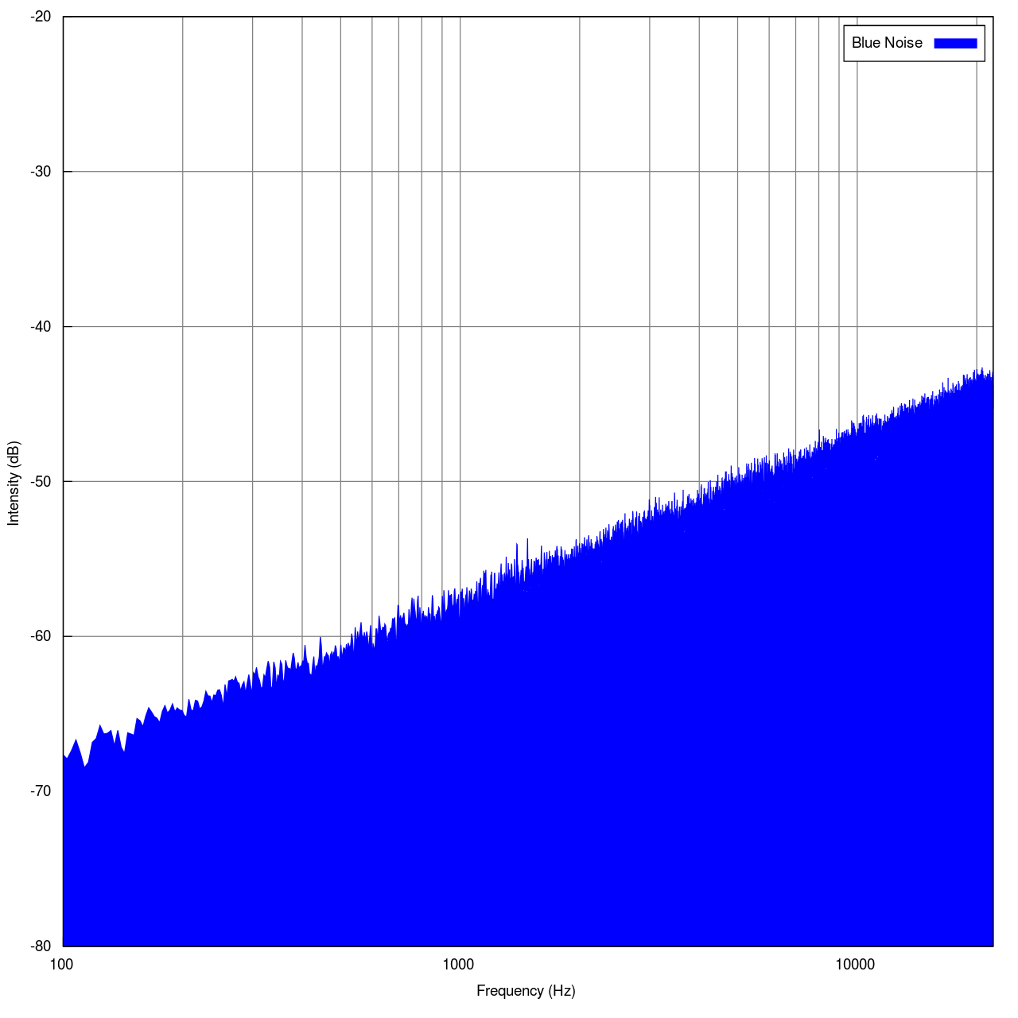
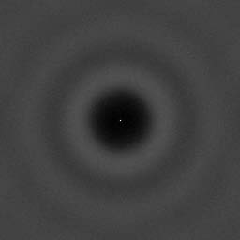
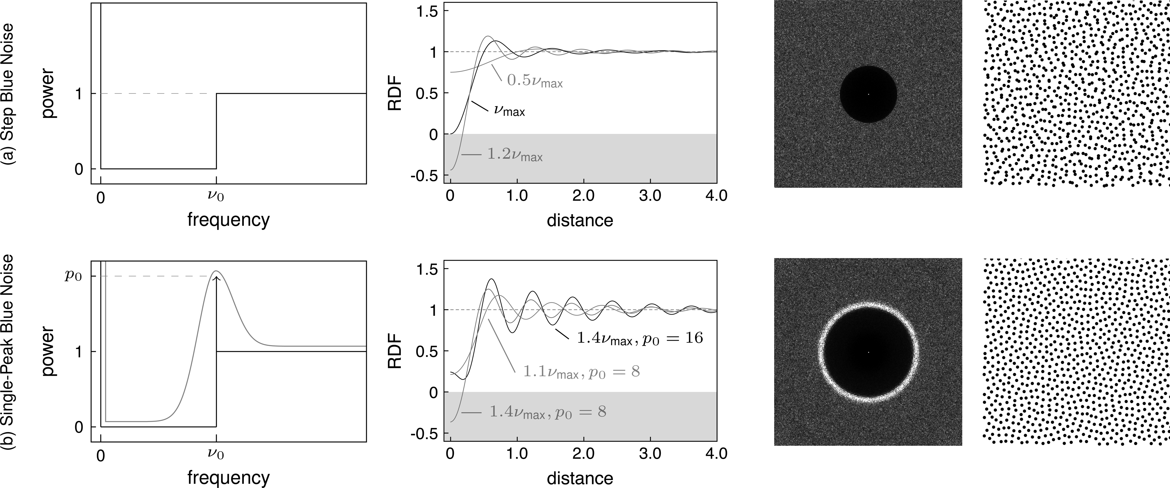
Definition or Process?
Which would you rather have?
Definition of desired output
  Sorted order
    So you can discover quicksort
Process to obtain it (e.g. algorithm)
  Bubblesort algorithm O( n² )
Another example:
  Ax=b
  Gaussian Elimination O( n³ )
Blue-noise is a desired output
Fourier transform of a distribution
  Def. power density
  increases 3.01 dB per octave
  (density proportional to f )
  over a finite frequency range.
  In computer graphics,
  "blue noise" is loosely any noise
  with minimal low frequency components and
  no concentrated spikes in energy. [Wikipedia]
Poisson-disk Sampling is a process
for generating a distribution
  Output resembles blue-noise, but is not same
  What is the definition of its output?
  I don’t know, but it looks like this:
Blue Noise
Poisson-disk
Blue Noise
[DH06a]
[HSD13]
Oscillating rings

Slide 5
Poisson-disk Sampling vs. Blue Noise
Graphics community history
  Early claim that distribution of human retina receptors was Poisson-disk
  When looking at images (e.g. stippling), Blue-noise
    Randomness avoids aliasing artifacts
    Separation provides efficiency, no redundant samples
  Dart throwing process produces the same points as the Poisson-disk process
      Simple algorithm
      Output close-enough to blue-noise
    Not saturation in finite runtime.
      Fix: only generate samples from the uncovered subdomain

Slide 6
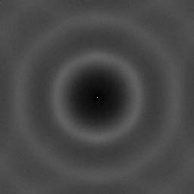
Scalloped Sectors
ScallopMDS, “Using Scalloped Sectors to Generate Poisson-disk Sampling Patterns” SIGGRAPH 2006.
Advancing front
  Next disk distance [r, 2r] from a prior disk
  Never here,
  so not Poisson-disk process
Brighter rings
Figures from their paper
Poisson-disk
Scallop-disk
not Poisson-disk output

Slide 7
Scalloped Sectors
ScallopMDS, “Using Scalloped Sectors to Generate Poisson-disk Sampling Patterns” SIGGRAPH 2006.
Advancing front
  Next disk distance [r, 2r] from a prior disk
  Never here,
  so not Poisson-disk process
Brighter rings
Figures from their paper
Poisson-disk
Scallop-disk
not Poisson-disk output
[HSD13]
“Step Blue Noise” = real blue noise

Slide 8
Scalloped Sectors
ScallopMDS, “Using Scalloped Sectors to Generate Poisson-disk Sampling Patterns” SIGGRAPH 2006.
Advancing front
  Next disk distance [r, 2r] from a prior disk
  Inverse transform sampling
    Given an area formula for a shape
    Invert it to generate samples uniformly by area
  Uniform-random by area from a sector
    Area formula
      Integral over 6 trig and 2 inverse trig functions
      And 2 variations
    Inverse area transform
      Binary search over area integral
      O( M(b) (b + log b )) × time for integral
        M(b) = time for b-bit multiplication
DeterminsticMPS
  True Poisson-disk pattern
  Uniform-random by area of a chock
    Area formula
      1 trig function
    Inverse area transform
      5 Newton’s iterations for 15 digits of accuracy
        For higher precision, double precision each iteration
      O( M(b) log b )
chock
5 Newton’s iterations

Slide 9
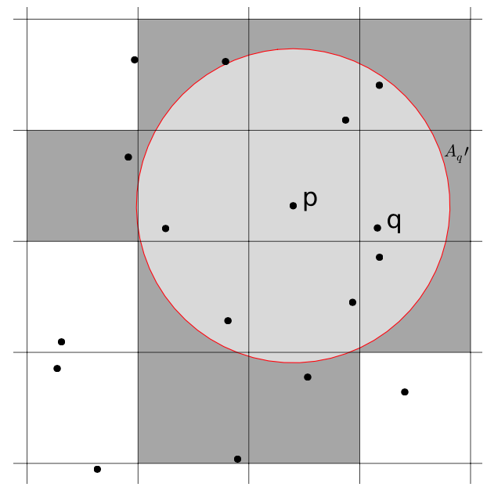
GridInner: Linear-time Poisson-disk patterns. Jones&Karger, 2011
GridInner Algorithm
  Background grid
  Each square gets candidate sample
    Random expovariate time
  Candidates earlier than neighbors accepted
    In any order, congruent to Poisson-disk process
    Covered neighbors are resampled
      Uncovered scooped-square
      Time += expovariate in remaining grid-square area
    Repeat until domain is covered
  Congruent to Poisson-disk process
What’s not to love?
Resampling implementation
  Disks approximated by s-sided polygons
  Subtract polygon from square
  Triangulate
  Pick a triangle
  Pick sample in triangle
How many sides do we need?
  b-bits of accuracy, need gap = 2^{O(-b)}
  gap = 1 – cos(𝛑/s) = O(sides⁻²)
  sides = 2^{O(b)}
gap

Slide 10
DeterministicMPS (this paper)
Fix: use chocks to exactly represent uncovered area
  Not polygonal approximation
Trim chocks
  Split to ensure they don’t overlap
Triangulate remainder
  Ear clipping

Slide 11
DetermisticMPS
Resampling in constant time, exact up to numerical precision

Slide 12
Simple Maximal Poisson-Disk Sampling
SimpleMPS, “A Simple Algorithm for Maximal Poisson-Disk Sampling in High Dimensions,” Eurographics 2012.
Equivalent to dart-throwing process, identical output
  Guarantees saturation
  Runtime & memory, empirically
Other extreme from DeterministicMPS
  Approximate uncovered regions by squares
  Geometric computations as coarse (and fast!) as possible
  Rejections occur
darts
SimpleMPS Algorithm
divide domain into cubes
while ∃cubes, and diagonal > machine precision
do (k × #cubes) times:
pick a cube
pick sample from cube
if distance(sample, prior samples) > r
accept sample
discard cube
refine cubes
discard covered cubes
refine
darts
refine
Notes:
simple mps
saturation
runtime
describe algorithm
what's not to love?

Slide 13
Simple Maximal Poisson-Disk Sampling
SimpleMPS, “A Simple Algorithm for Maximal Poisson-Disk Sampling in High Dimensions,” Eurographics 2012.
Equivalent to dart-throwing process, identical output
  Guarantees saturation
  Runtime & memory, empirically
Worst case
darts
darts
all missed!
refine
refine
all missed!
darts
darts
refine
refine to machine precision, no more misses
Notes:
simple mps
saturation
runtime
describe algorithm
what's not to love?

Slide 14
DeterministicMPS relationship summary
GridInner
  Samples from subset of uncovered
    Disk-square geometry construction
    Triangulate
  No rejections
  Exponential complexity in accuracy
  of subset matching true domain and
  true Poisson-disk sampling
ScallopMDS
  Samples from subset of uncovered
    Subset never matches true domain
    Not Poisson-disk sampling
  No rejections
  Inverse area transform
    Linear complexity in numerical accuracy
Read paper, Background other MPS
  It’s excellent, but don’t take my word for it,
  take the reviewers ☺
DeterministicMPS
  No rejections
  Samples exactly from uncovered
  Log complexity in numerical accuracy
SimpleMPS
  Samples from superset of uncovered
  Rejections occur
  Exponential worst-case

Slide 15
Practical Matters
Verified true MPS output
Efficiency in practice
  100k samples / second
    Order of magnitude faster than all other
    maximal Poisson-disk methods compared
    except SimpleMPS is 2-3× faster!
Open source
  https://github.com/samitch/DeterministicMPS
  Free for any use
  No dependencies. No libraries. Nothing. Just say “no”
  Replicates paper figures
Code size
  Relatively large due to geometric computations
  Chock sampling itself small, few dozen lines.

Slide 16
Open Problems
DeterminsticMPS
  Embedded surfaces
  3D
  Need new inverse area transforms
Can you prove
  Throw darts into a domain, then
  constant fraction accepted?
  Serial: SimpleMPS provable expected runtime
  Parallel: PixelPie provable expected constant
Step blue-noise and non-uniform distributions
  Currently
    Posteriori optimization, slow
    Priori placement
      Use chocks to avoid rejections and approximations
      Complexity?
        Quickly varying distribution = increased #neighbors

Slide 17
Thank you!
“Il semble que la perfection soit atteinte non quand il n'y a plus rien à ajouter, mais quand il n'y a plus rien à retrancher.”
“Perfection is achieved, not when there is nothing more to add, but when there is nothing left to take away.”
― Antoine de Saint-Exupéry, Airman's Odyssey
Open source
  https://github.com/samitch/DeterministicMPS
  Free for any use
chock
circle
ray
chock
tangent

