Slide 1
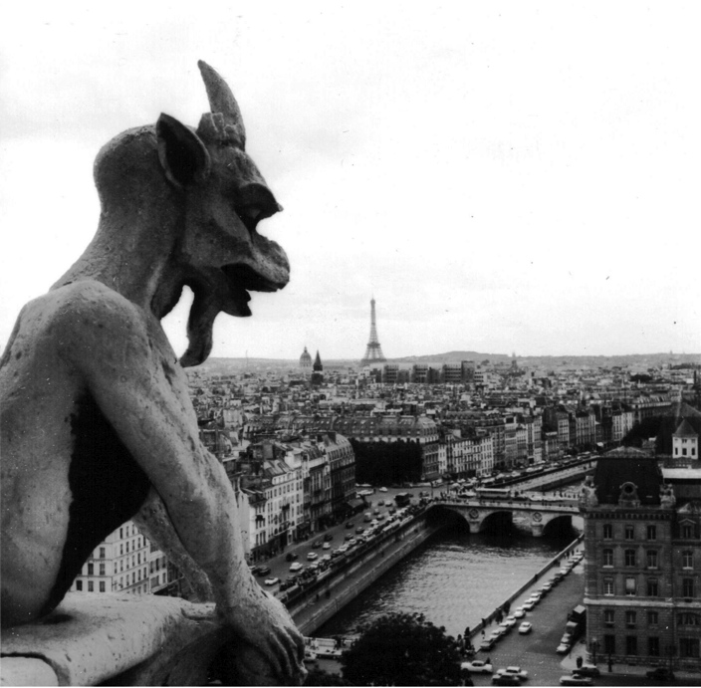
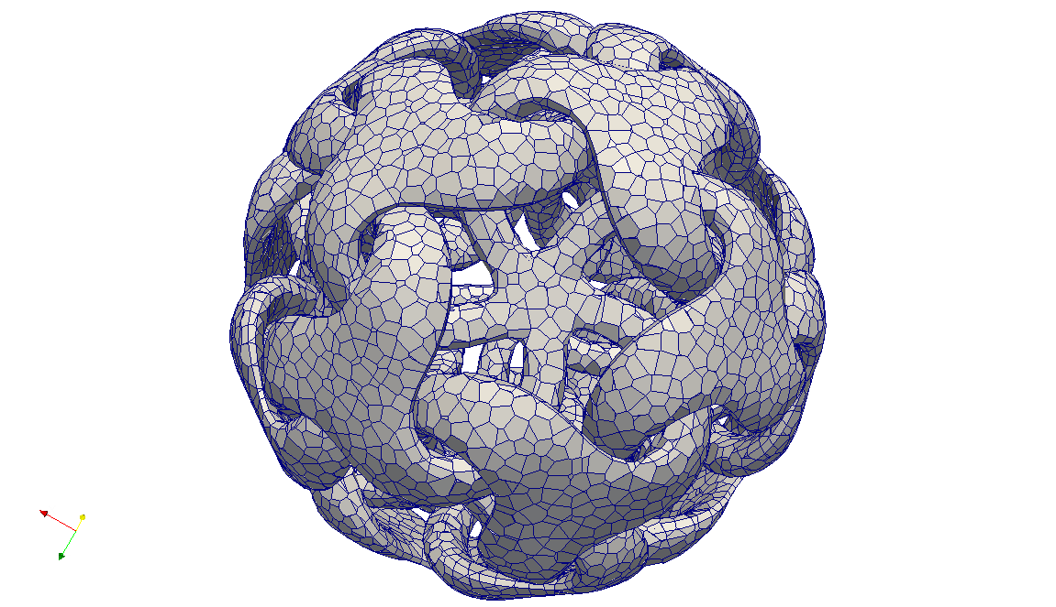

Uniform Random Voronoi Meshes
Notre Dame de Paris, Gargoyle, by FreiGurita (1968)
+two other 2011 papers
Mohamed S. Ebeida & Scott A. Mitchell (speaker)
20th International Meshing Roundtable
Paris, France
Sandia is a multiprogram laboratory operated by Sandia Corporation, a Lockheed Martin Company,
for the United States Department of Energy’s National Nuclear Security Administration
under contract DE-AC04-94AL85000.
Notes:
<25 min gross talk slot – aim for 20 min talk + questions>
Great to be back at IMR.
Also thank John Owen’s group at UC Davis, and
Vitus Leung, Pat Knupp, and Joe Bishop and Mario Martinez

Slide 2
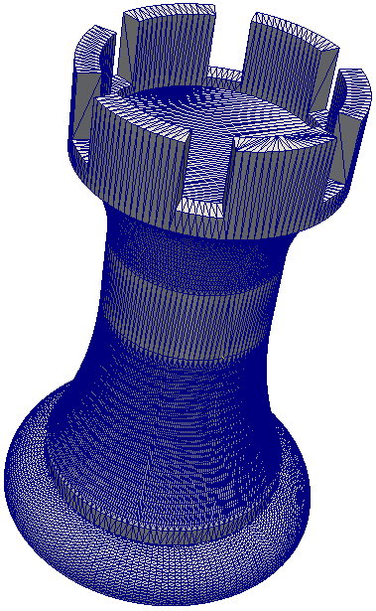
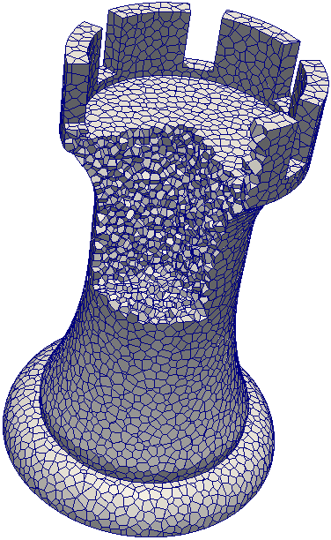
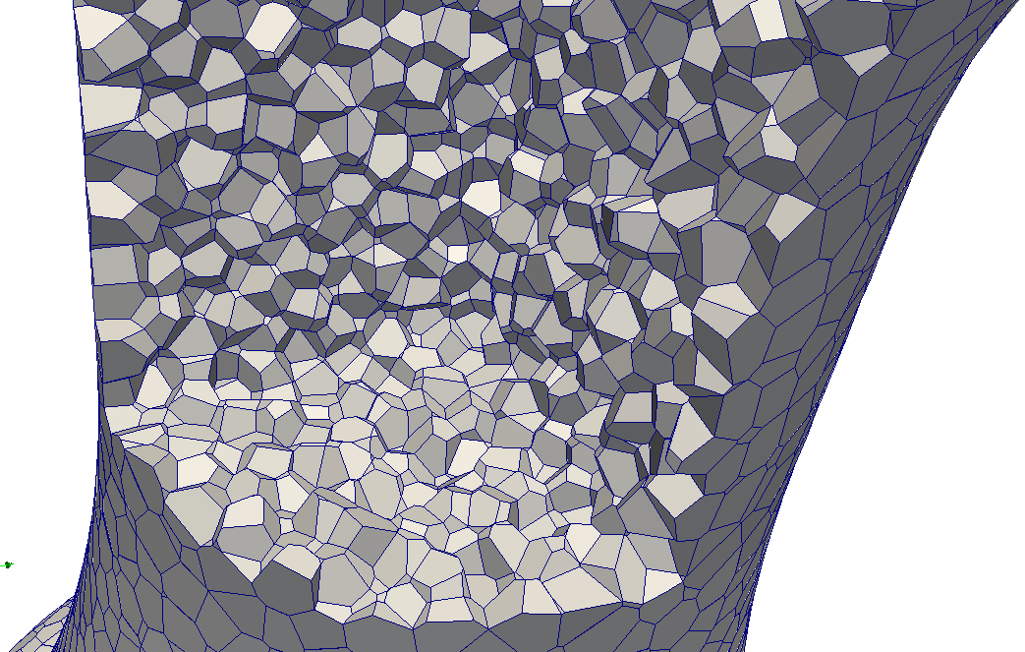
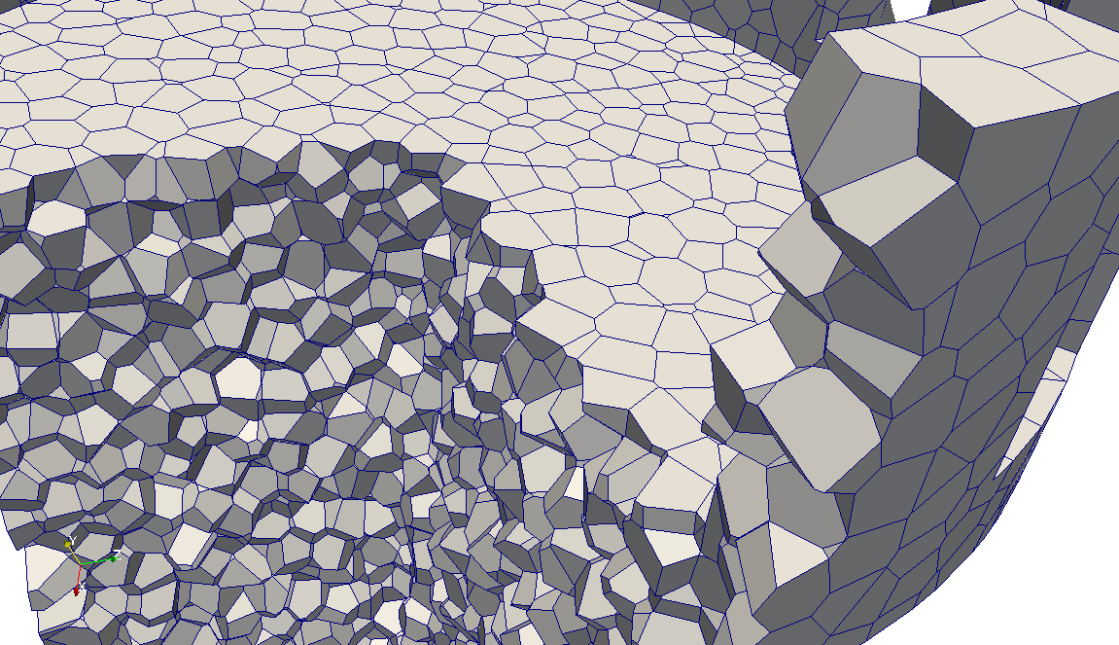
Summary
Random Polyhedral Meshing
  Generate random points using the maximal Poisson-disk process
    Points placed on reflex boundary features, but not concave or flat features
    Contrast to primal methods
  Symbolically split points (not in paper)
  Construct Voronoi cells
    Bounding box, cut by boundary and Voronoi planes
      Bounding box works because cells have bounded size
    Small edges collapsed
Get
  Voronoi mesh of convex polyhedral cells
  Bounded cell aspect ratio and facet dihedrals
  Random orientation of mesh edges
    Needed for fracture mechanics where cracks are restricted to edges

Slide 3
Maximal Poisson-Disk Sampling (MPS)
What is MPS?
  Dart-throwing
  Insert random points into a domain, build set X
    With the “Poisson” process
Ω
x₄?
Notes:
MPS is a hot topic in computer graphics, but not many people have heard of it around here, so let me start from the beginning and define it.

Slide 4
Statistical Process ≠ Algorithm
Algorithm progress
sliver regions

Slide 5
“Efficient maximal Poisson-disk sampling”
First provably correct, time- space-optimal algorithm.
Mohamed S. Ebeida, Anjul Patney, Scott A. Mitchell,
Andrew Davidson, Patrick M. Knupp, and John D. Owens.
ACM Transactions on Graphics (Proc. SIGGRAPH 2011), 30(4), 2011.
r
Background grid of squares (cubes…) for locality
Everything is O(1)
Sid Meier’s Civilization Template

Slide 6
Efficient maximal Poisson-disk sampling
Algorithm
without selecting from
entire domain
  Phase I
  Throw darts in squares
    Pick square uniformly
    Pick point in square uniformly
  Phase II
  Throw darts in polygons slivers
    Pick sliver weighted by area
    Pick point in sliver uniformly
hit
miss
  E(n) throws proof idea
    Hit/miss ratio =
    Voronoi cell area ratio > constant.
  In practice, use flat implicit
  octree in d>2

Slide 7
Also Triangular Meshes
“Efficient and good Delaunay meshes from random points.”
Mohamed S. Ebeida, Scott A. Mitchell, Andrew A. Davidson, Anjul Patney,
Patrick M. Knupp, and John D. Owens.
Computer-Aided Design, 2011. Proc. 2011 SIAM Conference on
Geometric and Physical Modeling (GD/SPM11).
Reverse cause-effect
  Delaunay Refinement:
  Insert circle-centers to kill large Delaunay circles
    Maximal sample results
  MPS: Insert points randomly to maximally sample
    Small Delaunay circles result
  Nearly identical angle bounds either way
    Delaunay circle-centers can be ignored!
Simple algorithm for covering the boundary randomly
  Complicated geometric proof
Cover the boundary
with random disks

Slide 8
“Efficient” for MPS, scales great, but how fast?
Delaunay refinement
  Points from deterministic process - fast
MPS
  Points from strict unbiased random process – slow
But once points are generated we’re as fast as Triangle, and our GPU code is 2x faster
MPS GPU (est)
Triangle point generation (estimate)

Slide 9
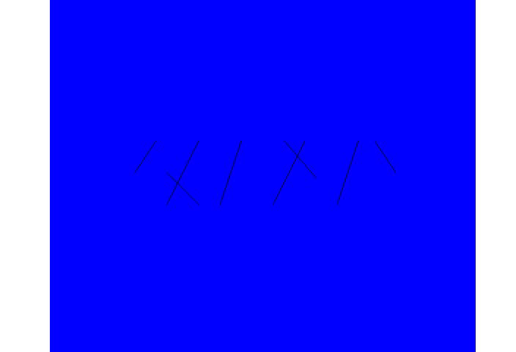
What is MPS good for?
  Fracture mechanics simulations
    Fractures occur on Voronoi cell boundaries
      Mesh variation material strength variation
        Ensembles of simulations
      Unbiased sampling gives realistic cracks
        Edge orientations are uniform random
    Domains: non-convex, internal boundaries
Fracture Simulations
Courtesy of
Joe Bishop (SNL)
Impact
Joe Bishop, SNL org 1500
Fracture simulation
Need random meshes because
cracks are along edges

Slide 10
Alternatives
Voronoi Mesher
  CVT Centroidal Voronoi Tessellation
    Seed = cell’s center of mass
    Via iterative adjustment of seed location
    Good shaped cells, but “biased”, regular mesh
    Target app: fracture simulations with fracture along mesh edges
Primal meshers
  Miller: maximal disk packings for bounded edge-radius tet meshes
  Shimada and Gossard Bubble meshes
    Force network, insertion and removal

Slide 11
IMR paper algorithm!
Random Polyhedral Meshing
  Generate random points using the maximal Poisson-disk process
    Points placed on reflex boundary features, but not concave or flat features
    Contrast to primal methods
  Symbolically split points (not in paper)
  Construct Voronoi cells
    Bounding box, cut by boundary and Voronoi planes
      Bounding box works because cells have bounded size
    Small edges collapsed
Get
  Voronoi mesh of convex polyhedral cells
  Bounded cell aspect ratio and facet dihedrals
  Random orientation of mesh edges
    Needed for fracture mechanics where cracks are restricted to edges

Slide 12
Boundary Sampling
Maximally sample
  Points interior to domain, not on boundary…
  …unless we have to:
    Reflex features require special care, not sharp ones
      “Reflex” includes 2-sided facets
    Not the dual of a body-fitted primal mesh
      Better (not constant 90°) dihedrals at boundary
Goal: cells align with boundary features, cells are convex
Sufficient: every point on a reflex face is closest to a sample from that reflex feature (or sub-facet)
  Sqrt(2) denser sampling on reflex feature
x
x
x
x
x
x
x
x
x
x
x
x
x
x
x
x
x
x
x
x
x
x
x
r disk-free
domain
interior
x
x
x
x
x
x
x
x
x
x
x
x
x
x
x
x
x
x
x
x
x
x
x
x
x
x
x
x
domain
interior
x
x
x
x
x
x
x
x
x
p
x
x
x
x
r_{e} maximality
x
x
x
x
x
x
x
x
x
x
x
Reflex face (line, plane, …)
x
x
x
x
x
x
x
x
x
x
x

Slide 13
Bonus: Convex Cells
Paper: star-shaped cells at reflex faces
Clipping by boundary
  By prior page only non-reflex (convex) boundary features affect interior samples
  Intersection of convex Voronoi cell w/ convex boundary = convex clipped cell
Symbolic duplication of reflex samples
x
x
x

Slide 14
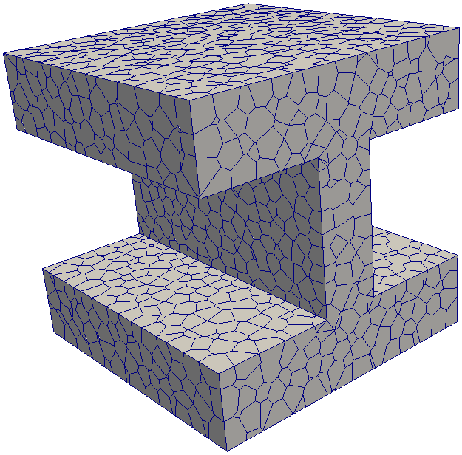
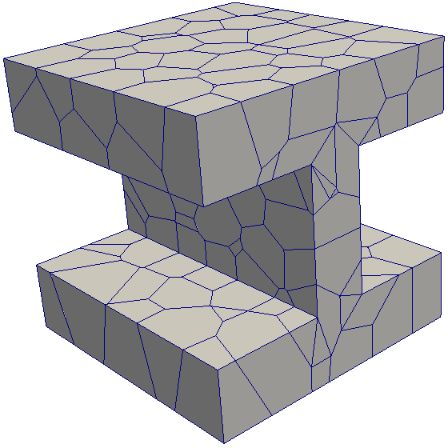
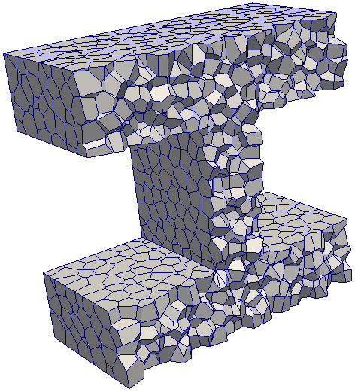
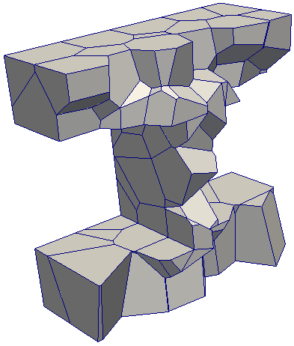
Voronoi Quality
Provable facet dihedral angle bounds
Provable cell aspect ratios

Slide 15
Quality proof idea
Voronoi:
  “Maximality” bounds the maximum distance from
  Voronoi cell seed to its vertices
  = Delaunay vertex to circle center
  “Disk-free” bounds the minimum distance between
  two seeds
  = a Delaunay edge
Delaunay triangle angles:
Voronoi facet dihedral angles:
as Chew 89

Slide 16
Aspect Ratio Proofs
(star-shaped cells)
Aspect ratio
  Circumscribed sphere radius < r (from maximality)
  Inscribed sphere radius > some factor r (from disk-free)
  If cell is interior: r/2
Clipped by one facet: r/4
Facets of one edge
Facets of one vertex
Disjoint facets: feature size fs

Slide 17
Interior cells

Slide 18
Interior cells

Slide 20
Observed
Aspect Ratio
inradius
star-shaped cells
outradius
A = inradius /
outradius

Slide 21
Quality plots
Dihedral Angles
If we sampled all domain faces
then all angles would be 90°
Recall proofs idea:
Distance from seed to
cell vertex bounded above by maximality
cell facet distance bounded below by disk-free

Slide 22
Quality: what’s missing?
Work in progress:
Short edges
  Collapsed, leading to non-planar faces
  OK for Joe Bishop fracture simulation but not ideal
Voronoi facet aspect ratio bounds
  Smoothing or sample insertion constraints may fix
90° facet dihedrals between samples on reflex faces. (Recall no samples on other faces)
  Small random perpendicular offsets may fix
x
x
x
x
x
x
x
x
x
x
x
x
x
x
x
x

Slide 23
Conclusions
w/ Patney, Davidson, Owens (UC Davis)
w/ Knupp, Bishop, Martinez, Leung (SNL)
1. Maximal Poisson-disk sampling point clouds
    Essence: First provable maximal, bias-free,
    O(n) space, E(n log n ) time
    Impact: Graphics hot topic (texture synthesis). Ensemble calculations for V&V
  2. Triangular meshes
    Essence: Provable quality bounds from
    random points
    Impact: Seismic simulations
  3. Voronoi meshes
    Essence: NOT the dual of a boundary-fitted triangulation
    Impact: Fracture simulations
  Efficient Maximal Poisson-Disk Sampling.
  Ebeida, Patney, Mitchell, Davidson, Knupp & Owens.
  SIGGRAPH 2011. ACM Transactions on Graphics.
  Efficient and Good Delaunay Meshes From Random Points. Ebeida, Mitchell, Davidson, Patney, Knupp & Owens.
  SIAM Conference on Geometric and Physical Modeling.
  J Computer-Aided Design special issue.
  Uniform Random Voronoi Meshes.
  Ebeida & Mitchell.
  International Meshing Roundtable, Oct 2011.

Slide 24
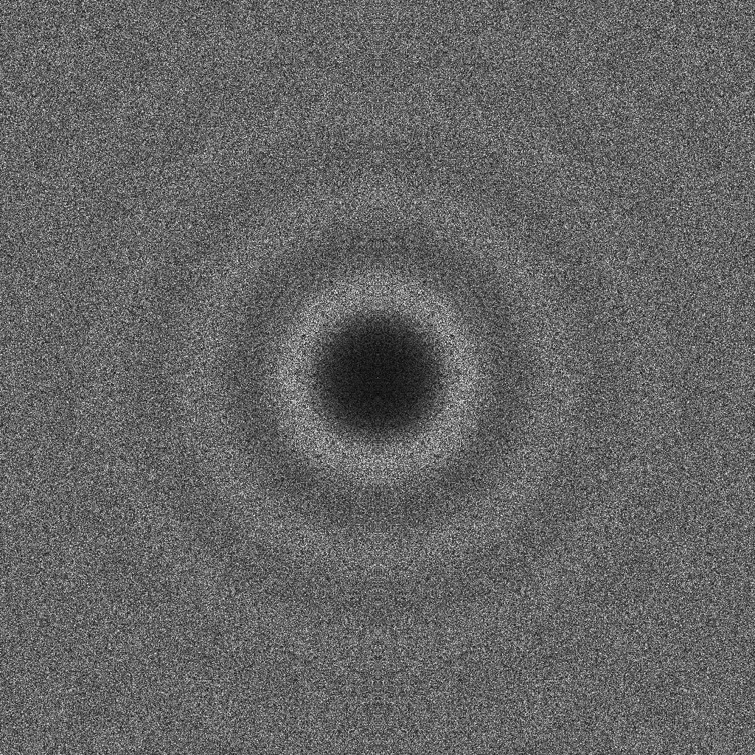
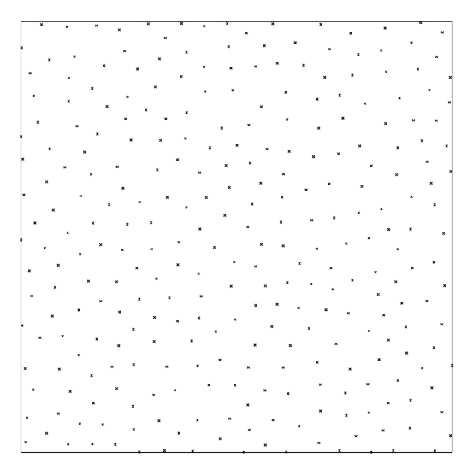
Community should consider using maximal samples for mesh points… even if Poisson-disk process isn’t important
  Better sizing control.
  Never O(n²)
    To do: study element count and grading vs. Delaunay refinement.

