Slide 1




Nonoverlapping Grid-aligned Rectangle Placement for High Value Areas
Stephen Rowe, Christopher Valicka, Scott Mitchell and Simon Zou
Mississippi River courtesy wikipedia
Sandia National Labs: Systems Mission Engineering,
Information Systems Analysis Center, and Center for Computing Research
CCCG 2017, Ottawa
Thursday 27 July 2017, 13:30-13:50, Session 4B in TB 340
20 minutes elapsed (<17 + transition and questions)
This material is based upon work supported by the U.S. Department of Energy, Office of Science,
Office of Advanced Scientific Computing Research (ASCR), Applied Mathematics Program.
Sandia National Laboratories is a multi-mission laboratory managed and operated by National Technology and
Engineering Solutions of Sandia, LLC., a wholly owned subsidiary of Honeywell International, Inc., for the
U.S. Department of Energy's National Nuclear Security Administration under contract DE-NA-0003525.
Notes:
Fraction of work…

Slide 2
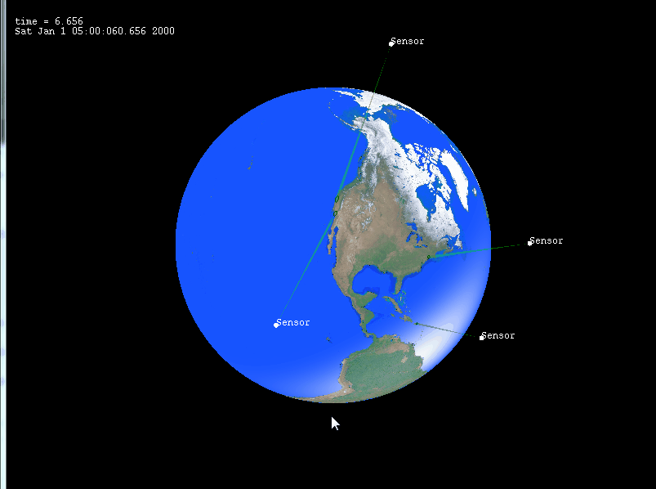
Goal: introduce remote sensing and scheduling geometric problems to CCCG
Sandia National Labs Team:
  Stephen Rowe, Christopher Valicka, Simon Zou
    Systems Mission Engineering and
    Information Systems Analysis Center
      Schedule a collection of satellites to monitor
      Earth over time
  Scott Mitchell
    Center for Computing Research
      Applied Math, CS, far from applications
  2-year “LDRD” project to connect the Centers, math/CS approach to applied problem
    U.S. law, labs can “tax” 6% of funds-in to use for discretionary research
In same way, goal of paper is to connect CCCG
to this problem area
  Chris Valicka knows problem area well,
  regrets could not come to CCCG and discuss more
  Scott can connect you

Slide 3
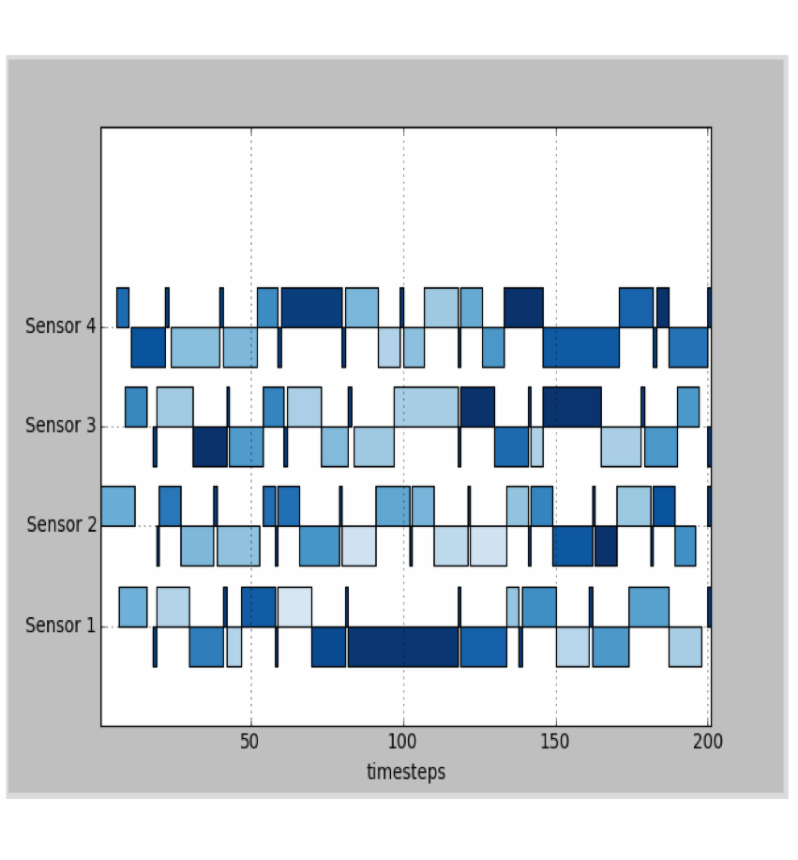
Context: Remote Sensing
Constellation Planning
Problem:
  Manage a collection of satellites scheduled to monitor locations in space and time
Challenges:
  Sensors highly flexible, not captured in scheduling models
  Schedules underutilize expensive sensors
Approach
  Mixed-Integer Program (MIP)
  for constellation scheduling
  Subproblems modeled as MIP
    Easy integration into larger
    problem

Slide 4
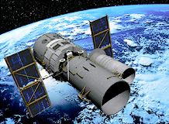
  Complications
  Heterogeneous aperture, evolving view location

Slide 5
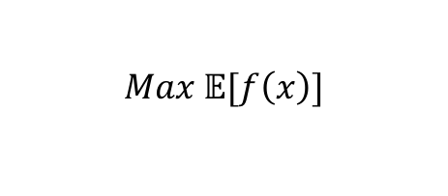
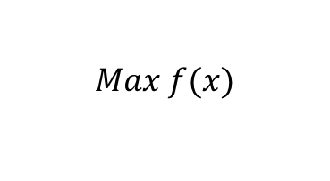
Complications
Satellites
  Stochastics
    Uncertainty – weather, new things to monitor or changed priorities
      Efficient consideration of alternative schedules
      Timely schedule generation
Stochastic model
MIP
Schedule
Evaluate Scenario 1
10am-3pm
p₁ = 1/3
Evaluate Scenario 3
2pm-7pm
p₁ = 1/3
Evaluate Scenario 2
12pm-5pm
p₁ = 1/3
$$Max f(x)$$
$$Max 𝔼[f\left(x\right)]$$
Schedule
Evaluate

Slide 6
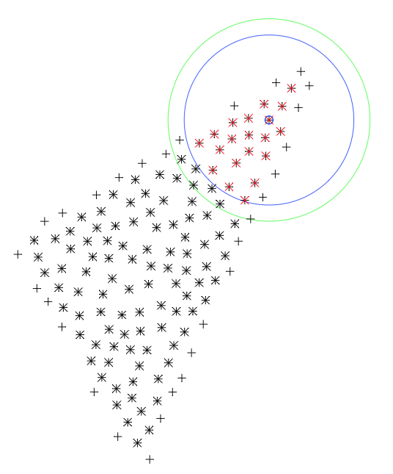
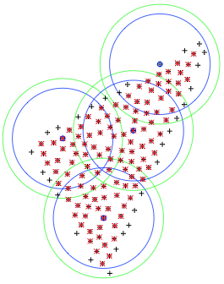
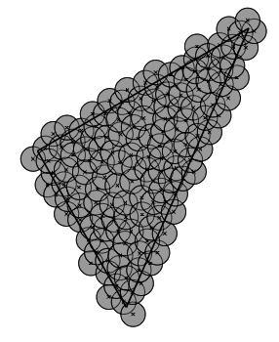

Scheduling Subproblem: “Footprint” Mosaic
(within one footprint is CCCG paper)
  Cover a region of interest ROI with as few pictures (footprints) as possible
    Multiple footprint shapes, non-convex, general ROI
  Solution
    Convert geometric problem to discrete problem, ammenble to MIP
    Sample ROI
      Set of coverage points inside ROI must be contained in some footprint
      Set of placement points, perhaps outside ROI, where camera can be centered
    For each placement point x camera type, determine coverage points well-within footprint
      Coverage points well-within -> entire ROI, including gaps between coverage points, are within footprints
      Implement by signed distance from point to polygon boundary, rather than offset polygon, for simplicity
    MIP
      Min #footprints (or their cost)
      s.t. all coverage points are covered
      decision variables: is a footprint centered at a placement point, and which type?
Solution with 4
sensor footprints
Constrain every
sample is covered (blue).
-> Provably the whole
domain is covered (green).
Dense disk sampling around ROI
Sensing here covers
these points.

Slide 7
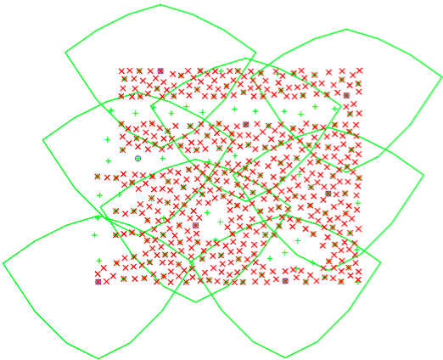
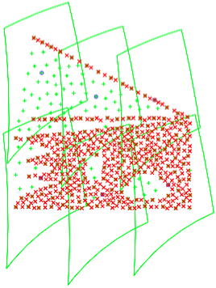
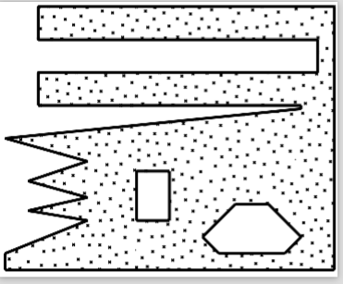
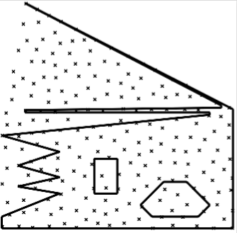
Examples

Slide 8
Others
Sariel Har-Peled
  Described our approach
Karen Daniels
  Consider footprints pinned by corners of ROI
  Software shared
Overall, appears understudied in CG
  art gallery different

Slide 9
Note on complexity
Traditional computational geometry measures of complexity, such as #sides of polygon, are small and not the limiting factor
Runtime bottleneck is MIP
Any geometric solution can speed up the overall process,
  simplifying the MIP
  avoiding (or reducing the number of ) MIPS needing to be considered

Slide 10
Subfootprint Problem Statement
Subject of CCCG Paper ☺
  Within Footprint, areas of extra interest, devote extra bandwidth
  Hardware capabilities
    Grid in sensor screen space, pixels grouped into square “chips”
      chips have differing values
    Define K rectangle subfootprints, different shapes, non-overlap
    Each subfootprint gets the same bandwidth, regardless of #chips
Monitor the Mississippi River
Figure courtesy Wikipedia

Slide 11
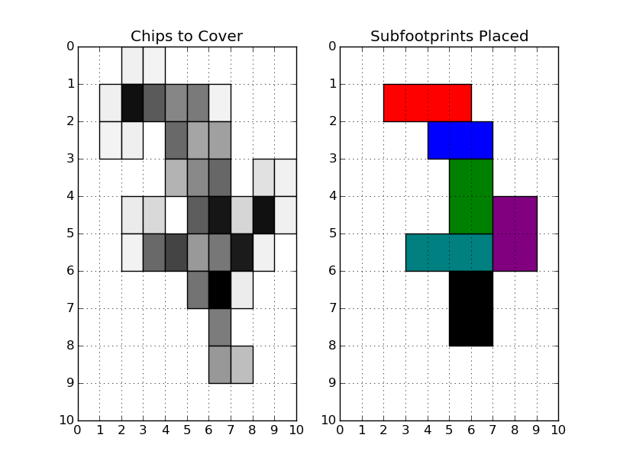
Subfootprint Problem Description
  Each subfootprint gets same bandwidth, regardless of #chips
    max value covered s.t. bandwidth per covered chip > B
    (equiv s.t. for k subfeet, max subfoot size)
    min bandwidth s.t. high-value chips covered
    … future work, other variants, rich problem space in general
  Degrees of freedom
    Number of subfootprints, 1..K (solve for each)
    Different shape rectangles: 1x4, 2x2, 4x1 (1x3)
    Shift *footprint* to make high priority pixels easier to cover, e.g. lumped into a single ”chip”

Slide 12
Subfootprint Solution Outline
Given a pixel-shift
  Exact solution via MIP
  Runtime too long to consider all shifts!
Explore pixel-shifts
  For all shifts
    compute fast greedy heuristic solution
  Cluster shifts by the similarity of their heuristic solutions
    For each cluster, find exemplar shift with highest greedy value, solve MIP on it
      Recall context of contingency planning:
      a set of dissimilar solution may be useful

Slide 13


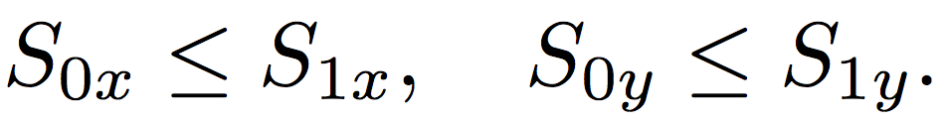
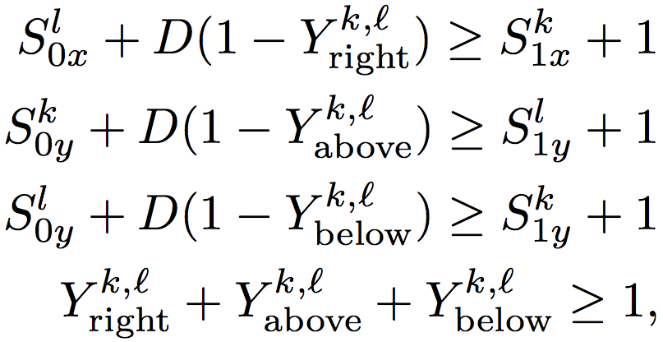
Exact MIP, given a pixel-shift
(efficiency: avoid redundant degrees of freedom)
Max covered value, s.t. K fixed, max subfoot size
Domain discrete MxN grid
Subfootprint defined by four variables
  lower left, upper right corners:
Order subfootprints 1..K by lex min corner
Variant 1 Non-overlap, D const
non-overlap:
k lies entirely in 1 of 4 half-spaces
l
Y_{above}
may be 1
k
l
Problem: can’t compute area with
only linear constraints
l

Slide 14
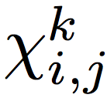
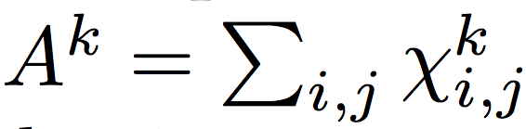
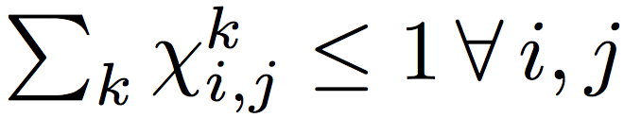
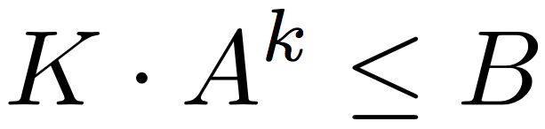
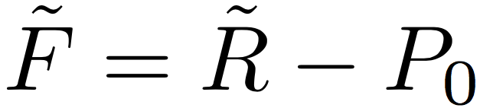
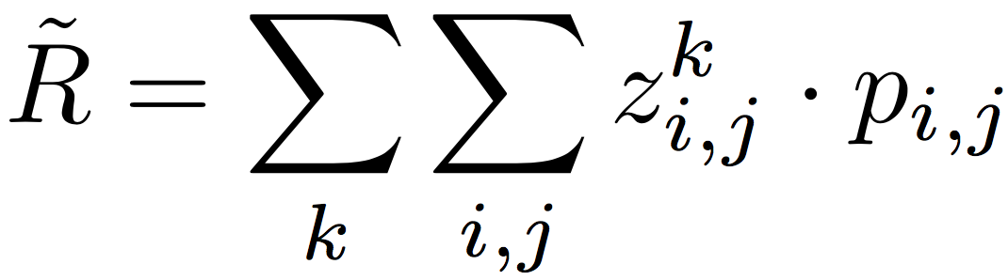
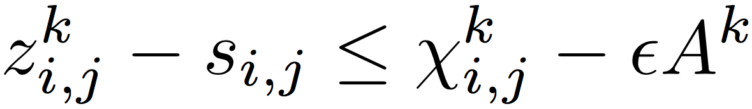
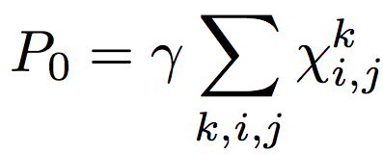
Exact MIP, given a pixel-shift
Problem: can’t compute area with only linear constraints
Variant 2
  Decision vars
    = 1 iff chip (i,j) in subfootprint k (several equations with slack vars)
Simple, but many binary variables, slow runtime, minutes
  Area
  Non-overlap
  Bandwidth constraint
  Objective
  R rewards value of covered chips
  z ≈ x rewards high value chips
  being in small subfootprints
  (gets more bandwidth)
  P penalizes covering zero-value chips

Slide 15
Greedy Explore pixel-shifts
  Solving MIP for for all shifts is intractable
  For all shifts:
    fast greedy heuristic, fixed K
      Iteratively consider all rectangle shapes with A < B/K
      Choose rectangle covering maximum sum of value
      subject to non-overlap prior rectangles
  Hypothesis
    comparing two pixel shifts,
    similarity of greedy
    correlates to similarity of opt
    Which chips are covered
    How chips are covered
greedy
spread out
optimal
compact

Slide 16
Cluster shifts
  Cluster shifts by the similarity of greedy solutions
  k-means cluster centers by distance
    first center = shift w/ highest greedy solution
    next center = shift w/ max min distance to all prior centers
  Distance defined by an approx Wasserstein distance:
  D’ = sum of work to translate layout A to B
    Chip D’(c₁,c₂) = L₁(c₁,c₂)
    Subfoot D’(A_{i}, B_{j}) = sum D’(c_{A},c_{B}), greedy pair chips
    Layout D’(A,B) = sum_{i,j} D’(A_{i},B_{j})
      for each pair, match closest
    work( translate entire layout ) = 0
  Cluster is “Voronoi cell” of its center,
  set of shifts closer to it than any other center

Slide 17
Select Greedy Exemplars for MIP
  Cluster shifts by distance
    Cluster exemplar by value = best greedy layout
    Compute MIP on exemplars, take best one
  Evidence that clusters capture qualitatively (geometric) layout differences, and are about the same within a cluster
Within a cluster
greedy and MIP (optimal)
corelate well
Between clusters, difference
between greedy and MIP (optimal)
varies significantly

Slide 18
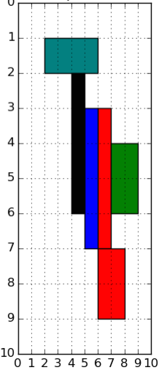
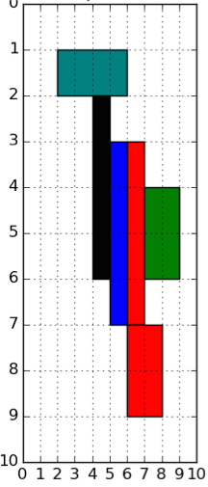
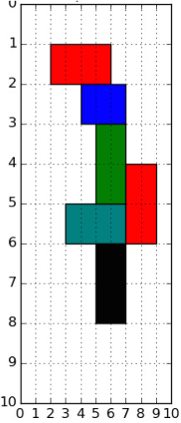
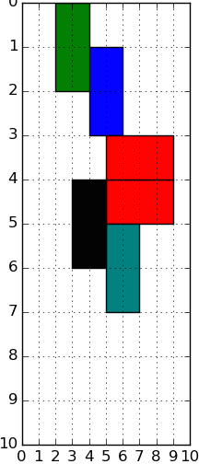
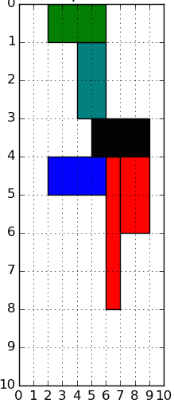
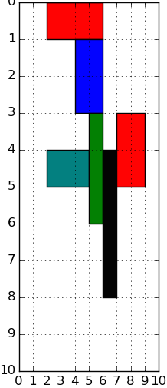
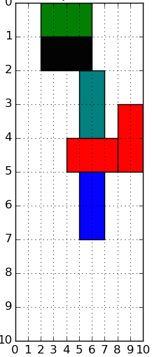
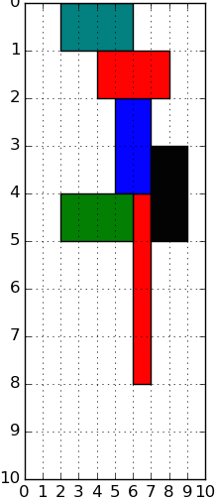
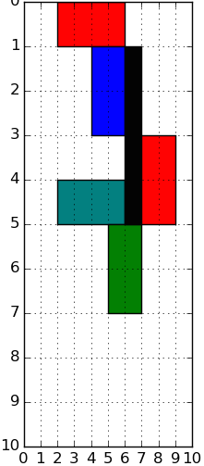
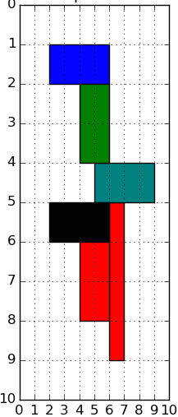
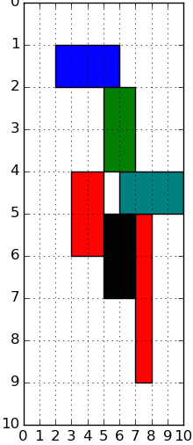
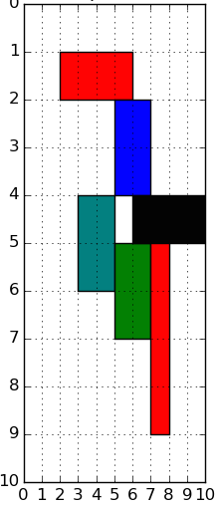
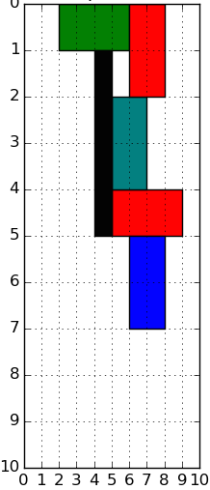

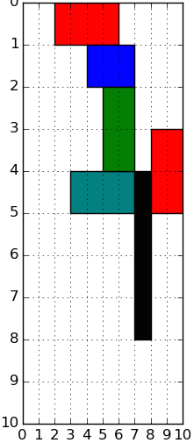
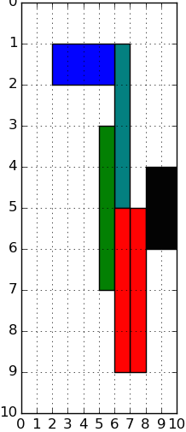
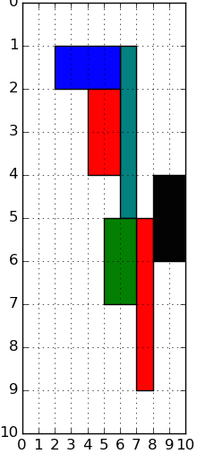

Examples center (greedy), exemplar (greedy), opt-exemplar (MIP)
=
1
2
3
c
e
o
c
e
o
c
e
o
4
5
=
=
6

Slide 19
Software
Github GeoPlace
  https://github.com/cgvalic/GeoPlace
  contains software for footprint and subfootprint

Slide 20
Future work
Pareto-optimal maximize chip coverage while minimizing bandwidth
Many other geometric subproblems arise in remote sensing / satellite
  contact cgvalic@sandia.gov or samitch@sandia.gov

