Slide 1

Simple and Fast Interval Assignment
Using Nonlinear and Piecewise Linear Objectives
Scott A. Mitchell
Computing Research
Sandia National Laboratories
International Meshing Roundtable
October 2013
20 minute talk, 5 minute questions
Sandia is a multiprogram laboratory operated by Sandia Corporation, a Lockheed Martin Company,
for the United States Department of Energy’s National Nuclear Security Administration
under contract DE-AC04-94AL85000.
Notes:
Fraction of work…

Slide 2
Outline
Problem definition
  a few simple examples of why it is hard
    tradeoffs needed
    may be infeasible
  an infeasible example
Prior approaches
  Linear constraints – good
  Linear objective – not so much IMHO, depending on setting
    Tam & Armstrong concentrates deviations
    Lex min max is slow series of problems
New solution
  Cubic Objective
  Piecewise linear to get integer solution
  Implemented

Slide 3
Interval Assignment Summary
New nonlinear objective function
Finesse integer constraints using
L₁ minimization of convex
piecewise linear approximation
  adapt piecewise, slope
  heuristics for constraint interactions
I just relax bend tilt & wave! ☺
First known improvement to FEM interval assignment structure since 1997 lexicographic min-max
  Lots of people write new constraints for new schemes, but this is first change to objective (except Graphics community solving related-but-different problem using MIQP)
Implemented in MeshKit, using IPOPT
  scales to thousands of surfaces in nuclear reactor core models
  1997-2013, Cubit runs lex min-max for every quad and hex mesh
  New solution may migrate to Cubit, as Cubit includes MeshKit library

Slide 4
Interval Assignment (IA)
Problem Definition
Set the number of mesh edges on each curve,
such that the owning surfaces and volumes
can be meshed according to their schemes.
  compatible interface meshes, e.g. for parallel
  quad and hex meshing
    triangle and tet meshes have trivial constraints
d
f
b
a
map
pave
g
a=b+c
d=e
b+c+f+g+h=even number
all variables integer (e.g. a=4, b=2.5, c=1.5 is not valid)
c
e
h

Slide 5
Why is Interval Assignment Hard?
What’s the problem?
  hex meshing is a global problem
  quad meshing is a global problem
    for the same reasons,
    but with much weaker constraints
Integrality makes it much harder.
  Discrete problem
  Combinatorial algorithms needed
Unstructured quad meshing:
Each chord enters the quad mesh an even number of times (0 or 2)
so we need an even number of mesh edges on the boundary.
(necessary and topologically sufficient)
Unstructured hex meshing:
Each chord enters the hex mesh an even number of times (0 or 2)
so we need an even number of quads on the boundary.
Plus contractible loops must be even.
(necessary and topologically sufficient)
Sweep
same quad mesh
connectivity front and back
Map
same curve mesh connectivity
top and bottom. e.g. 3 edges

Slide 6
Interval Assignment by linear constraints is old
Popular to define constraints for new meshing schemes.
Little change to
objective function form
in FEM community
1997—this paper
(But active area in Graphics 2009+)
Interval assignment problem form
Linear constraints, linear objective
  Tam & Armstrong 1993
Linear constraints, lexicographic min-max objective
  Mitchell 1997
Fluid flow matching
  Muller-Hanneman 1997
Linear constraints, quadratic objective
  Bommes et al. 2009+
Interval assignment constraints
Volumes with holes
  Shepherd et al.
Midpoint subdivision
Paver
Submapping
Skew control
Automatic Scheme selection
  White & Tautges 2000

Slide 7
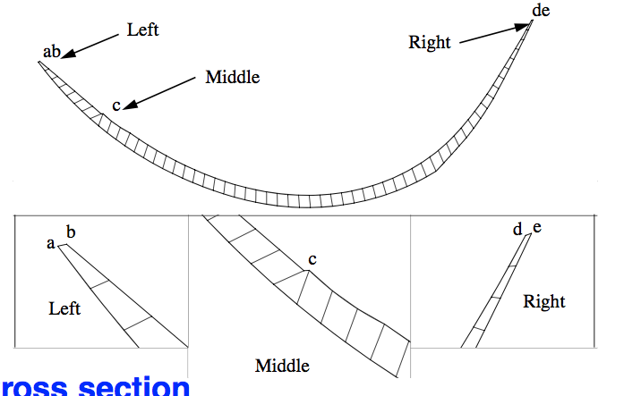
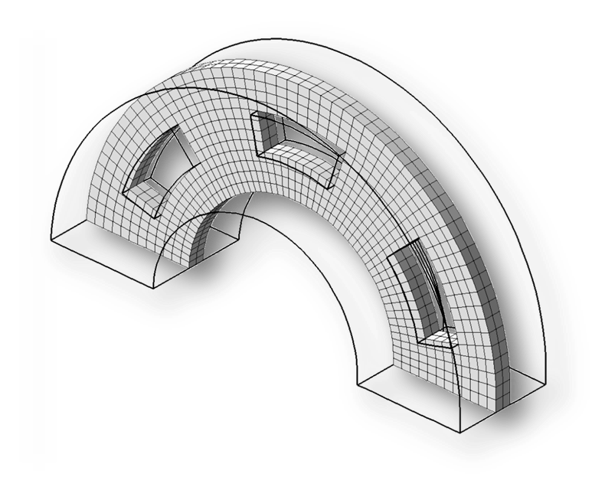
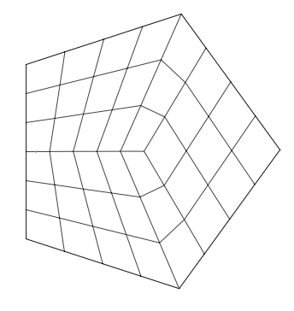
Local Constraints
curve has at least one edge
x >= 1
Each surface has local constraints
  depending on scheme (structure)
  depending on user desires (sizing, skew)
map
d
b
Goodyear tire
pave
e
a
submap
Edge length at least 0.1:
X <= 4
submap
c
d – e + a + b = c
e <= d + 1
a < c
e < a OR ...
a
b
midpoint subdivision
side1 = a+b
side2 = c+d
side3 = e
side1 <= side2 + side3
side2 <= side1 + side3
side3 <= side2 + side3
e
c
Eloi Ruiz-Gironés
d
holes line up, smaller than outside

Slide 8
Mixed-Integer Linear Constraints
Constraints are linear, no high powers such as x² = y³
Coefficients are typically 1.
Sum-even modeled with artificial variable, 2-coefficient
  sum(x_{i})=even ⬄ sum(x_{i}) = 2z : z is integer
Expressed in matrix form
Inequality and equality are equivalent
  Ax ≥ b ⬄ Ax + y = b, y ≥ 0
  Ax = b ⬄ Ax ≤ b and Ax ≥ b

Slide 9
Benefits of Linear Constraints
Feasible region (space of solutions) is convex (possibly unbounded)
we have efficient solution algorithms (especially for linear objective)
  Not so easy for integer solutions
  Unless coefficients are cooperative!
f’
x*
2^{v} nearby integer
points. v=#curves

Slide 10
Global Infeasibility
The global IA problem may be infeasible, meaning no solution exists,
even when each surface can be meshed in isolation.

Slide 11
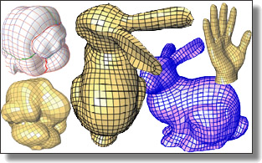
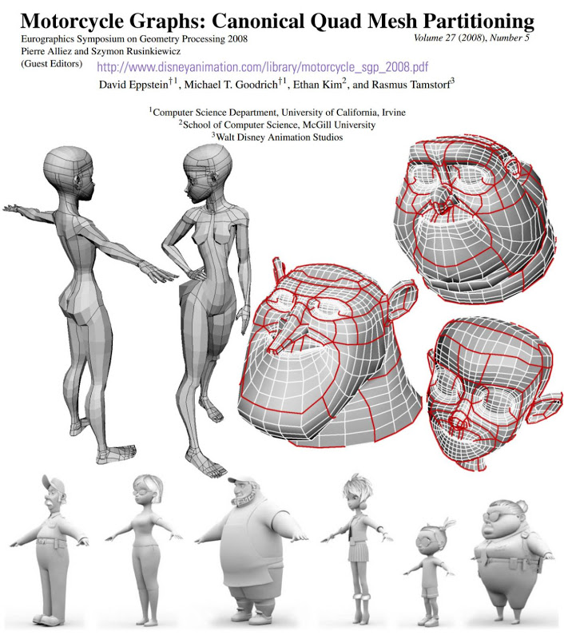
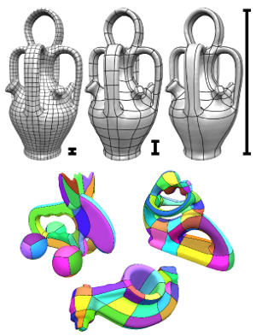
Graphics has discovered quad meshes
State of the Art in Quad Meshing
Eurographics STARS 2012
Designing Quadrangulations with Discrete Harmonic Forms
Yiying Tong, Pierre Alliez, David Cohen-Steiner, and Mathieu Desbrun
ACM/EG Symposium on Geometry Processing 2006, pp. 201-210
Mostly structured quads
on smooth curved surfaces
Key issue is placement
of irregular nodes
Integer-Grid Maps for Reliable Quad Meshing
David Bommes, Marcel Campen, Hans-Christian Ebke, Pierre Alliez, Leif Kobbelt
SIGGRAPH 2013
Disney Animation
(Pixar uses triangles)

Slide 12

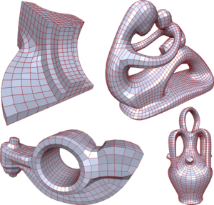
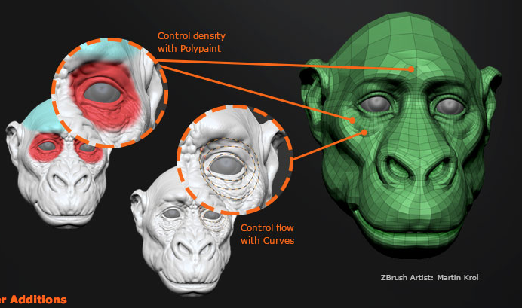
Graphics has discovered quad meshes including the need for interval assignment
Solved with mixed-integer linear-constraint optimization, series of problems
The placement of irregular nodes is included in the optimization problems
commercial
version
Mixed-Integer Quadrangulation.
David Bommes, Henrik Zimmer, and Leif Kobbelt.
ACM Trans. Graph. (TOG), 28(3):77:1–77:10, July 2009.

Slide 13
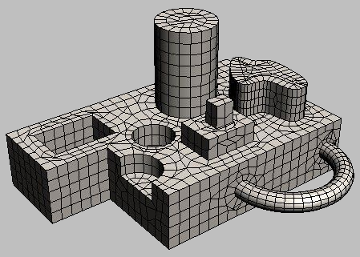
Objectives: user specified sizes
Goal g for each interval
  about g
    each mesh edge should be
    about 0.1 inches long
  exactly g (not implemented currently)
    I want exactly 8 intervals here
  at least g
    I need at least 6 here
Achieving all of these g, and constraints, may not be possible.
  How do you measure deviations? Relative values?
Autodesk
g = length / 0.1
x ≈ g
g = 8
x = g
g = 6
x ≥ g

Slide 14
What’s good about linear objectives?
Optimal solutions occur at corners, easy to find.
  if constraint coefficients cooperate, corners are integer solutions. Integer solution for free!
f’
x*

Slide 15
What’s wrong with linear objectives?
All the deviations are concentrated
  L₁ minimization leads to sparsity in the solution
  not a big deal if deviations are small
  could be a big deal if deviations are large
Linear Objectives
min sum w₁n₁ + w₂n₂ + w₃p₃
Non-Linear Objectives
x₁
x₃
x₂
g₁ = 9
g₂ = 9
g₃ = 18
x₁ = g₁ - n₁
x₂ = g₂ - n₂
x₃ = g₃ + p₃
min sum f(x_{i},g_{i})
f ≈ (g_{i}/x_{i}) ³ + (x_{i}/g_{i}) ³
w₃ > w₁ = w₂
no x₁ x₂ tradeoff
for most solvers
w₃ < w₁ = w₂
or
lex min max (w₁n₁, w₂n₂, w₃p₃)

Slide 16
My Solutions to spread out deviations
1997 Lexicographic min max
solve series of linear programs, one per variable = slow.
  Minimize maximum x_{i}-g_{i}. Fix that x_{i} at a nearby integer value, check feasibility, remove it from equations.
    minimize maximum remaining x_{i}-g_{i}, repeat
  Weighted deviations, relative size
    min max p_{i}(x_{i}-g_{i} >0) + n_{i}(g_{i} - x_{i} >0),
    where p_{i} = 1/g_{i} n_{i} = 1.3/g_{i}
  i.e. assigning x=10 for g=5, is as bad as x=20 for g=10
Today, cubic objective (L₃)
  A small series of nearby problems to get integer
  About the same solution as lex min max,
  depending on problem size
    L∞vs. L₃ norm
lex min max (w₁n₁, w₂n₂, w₃p₃)
min sum f(x_{i},g_{i})
f ≈ (g_{i}/x_{i}) ³ + (x_{i}/g_{i}) ³

Slide 17
Cubic Objective
Good: directly measures relative change, (g->x: 4->8 is as bad as 4->2)
Good: no lexicographic min max, single optimization solve spreads deviations
Good: convex objective (plus convex constraints)
local optimum is the global optimum
Bad: non-linear objective requires slower algorithms than a linear one,
but the difference is less today than in 1997

Slide 18
Cubic Objective Solution
Non-integer solution usually
(later problem definitions fix)
min sum f(x_{i},g_{i})
f = (g_{i}/x_{i}-1) ³ or (x_{i}/g_{i}-1) ³
4.5
19
4.5
6.4
6.4
12.8
19
min F = (x₁/4.5 - 1) ³ + (x₁/4.5 - 1) ³ + (19/x₃-1) ³
minimum when F’ = 0 (or extremes x_{i}=1, etc.)
sum of slopes = 0
6.4
I have spread out the
deviations, made the major
compromises
12.8
relaxed
6.4

Slide 19
Piecewise Linear Objective
Good: restores integer solutions for free (often)
Bad: explicit variable for every single unit interval = expensive time, memory
Bend at integer points <-> corner at every integer
in the higher-dimensional linear problem
where each unit interval is a dimension.

Slide 20
Adaptive Piecewise Linear Objective
For efficiency, just add the bends (pieces) as needed
4.5
6.4
19
12.8
4.5
relaxed
6.4
Delta variable for each interval [k,k+1]
linear slope = weight = f(k+1) – f(k)
Create three intervals:
around relaxed x*, beyond it, below it
Solve min sum weighted deltas (linear)
Add more deltas if solution beyond k+1, repeat
*Notional. For the problem on the left the solution is 6,6,12.
A long chain of surfaces from the long curve might lead to the behavior on the left column.

Slide 21
Adaptive Piecewise Linear Objective
Add the bends (pieces) as needed
Start with two bends, so relaxed solution is in a trough
to avoid unbounded solutions right away

Slide 22
Tilt to Break Non-integer Ties
Break non-integer ties by tweaking the weights (of the deltas),
an additive factor to the slope of the objective.
Randomization helps avoid cases where, say, many variables to the right
gang up to motivate a non-integer solution on the left.
Scaling heuristics needed when goals or deviations vary widely,
else small goal variables are left at non-integer values.
Numerical tolerance issue with solvers
6.4
12.8
relaxed
e.g.
6.4
6.5
=
constraint
13
no tilts
6.5
6
12
after tilts
6

Slide 23
Last Resort, Waves to Force Integrality
unstuck ½ (fractional) integer values
6.5
e.g.
13
no tilts
6.5
x=sum of edges, need an even number
constrain g < 0.001
6
13
after waves
g(x)
7
x
Bad: breaks convexity, local minima are not global minima
IPOPT has limited global optimization capabilities
Better, in progress: bends and tilts for sum-even variables

Slide 24
Scaling stress tests
scaling by curves
scaling by faces
Time for an integer solution is only a small multiple
of the time for the relaxed solution.
In contrast, Lex min max grows quadratic+ in problem size
Runtime about O(c^{1.5}) for c variables.

Slide 25
Robustness stress tests
Problems needing tilts to get integer solutions
“radish”
Split curves provide more degrees of freedom:
more tilts are needed to remove fractional values.
Only a few tilts are necessary,
tilt for each split curve in the chain is simultaneous.

Slide 26
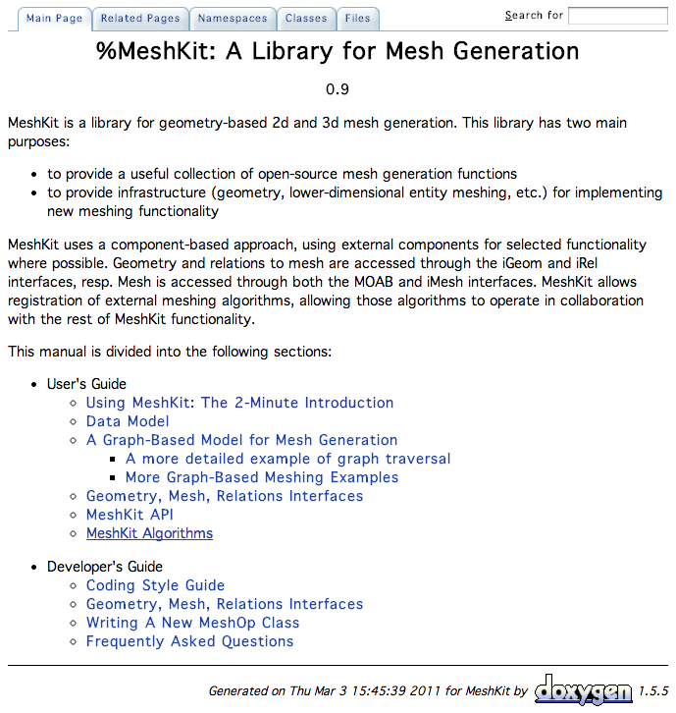
Availability and Status
MeshKit algorithm implementation
  Open source
    http://gnep.mcs.anl.gov:8010/meshkit/
  Well defined API
  IPOPT optimization library is free
    MA27 linear algebra library is free
    but you have to download it yourself
    HSL (formerly the Harwell Subroutine Library). A collection of Fortran codes for large scale scientific computation. http://www.hsl.rl.ac.uk, 2011.
    Includes MA27. IPOPT special instructions at http://www.hsl.rl.ac.uk/ipopt/
To do:
  Robustness and quality testing on large models
  Tilt for sum-even constraints
    better than just waves

Slide 27
Alternatives
Why bother with the nonlinear solver?
  it is fast, uses little memory
  but maybe you don’t have one
Skip the relaxed cubic-objective phase
  start with piecewise linear adaptive bends
  efficiency would depend on numerics, how far the optimal solution is to the initial goals

Slide 28
Alternatives
Why sum-of-cubes objective function?
  Any power in [2, infinity] is possible.
    Lex Min Max from 1997 is a form of L_infinity
    The lower the power, the bigger the worst deviation, but the fewer number of curves need to change
  Experimental. I tried powers of 2, 3, and 4.
    2 concentrated deviations too much
    4 spread deviations out too much in some contrived cases
    This was just my opinion
  Some other power may be better, depending on what a “typical” model is for you.

Slide 29
Interval Assignment Summary
New nonlinear objective function
Finesse integer constraints using
L₁ minimization of convex
piecewise linear approximation
  adapt piecewise, slope
  heuristics for constraint interactions
I just relax bend tilt & wave! ☺
First known improvement to FEM interval assignment structure since 1997 lexicographic min-max
  Lots of people write new constraints for new schemes, but this is first change to objective (except Graphics community solving related-but-different problem using MIQP)
Implemented in MeshKit, using IPOPT
  scales to thousands of surfaces in nuclear reactor core models
  1997-2013, Cubit runs lex min-max for every quad and hex mesh (that meshes the boundary first)
  New solution may migrate to Cubit, as Cubit includes MeshKit library

Slide 30
Thanks
It takes a village to make me successful
Thanks to Tim Tautges for suggesting and supporting this project
Thanks to Tim Tautges, Rajeev Jain, for MeshKit
Thanks to Carl Laird, for IPOPT
Thanks to David Bommes for Graphics quads via mixed-integer quadratic programming
This work was funded under the auspices of the Nuclear Energy Advanced Modeling and Simulation (NEAMS) program of the U.S. Department of Energy Office of Nuclear Energy, U.S. Department of Energy. Partial support for this work was provided through Scientific Discovery through Advanced Computing (SciDAC) program funded by U.S. Department of Energy, Office of Science, Advanced Scientific Computing Research. Sandia National Laboratories is a multi-program laboratory managed and operated by Sandia Corporation, a wholly owned subsidiary of Lockheed Martin Corporation, for the U.S. Department of Energy’s National Nuclear Security Administration under contract DE-AC04-94AL85000.
Is the government still shut down?
Will mesh for food.

