Slide 1

Exploring High Dimensional Spaces with Hyperplane Sampling
Appeared in journal
ACM Transactions on Graphics
January 2014
Speaker: Scott A. Mitchell
Sandia is a multiprogram laboratory operated by Sandia Corporation, a Lockheed Martin Company,
for the United States Department of Energy’s National Nuclear Security Administration
under contract DE-AC04-94AL85000.
Notes:
POF = probability of failure
Keep dart throwing game

Slide 2
Major Points of Presentation
Connection to techniques, and applications, from fields besides UQ
Concepts
  Hyperplane sampling
    motivation, capture small thin regions
  Formula for changing point sampling to flat sampling
  Unbiased – provable
  Variance – experiments, efficiency
    hyperplane intersection with the object needs to be computable, efficient
    volume estimation experiments
      efficiency
      dart type
  Framework
    function averaging, integration
    finding a point with a function value (e.g. outside disks)
  Three applications
    Volume estimation
      function integration
    Generate a well-spaced point sampling a.k.a. Relaxed MPS
      find domain points with function values
    Depth of field with antialiasing
      function integration

Slide 3
Motivation
Recall Mohamed Ebeida’s Talk

Slide 4
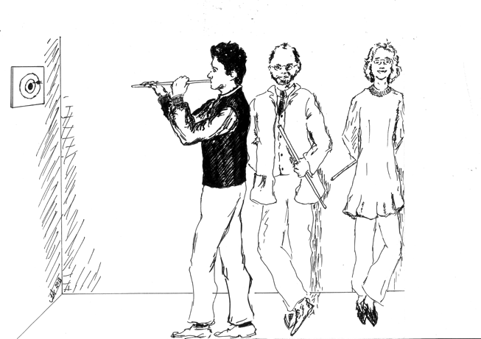
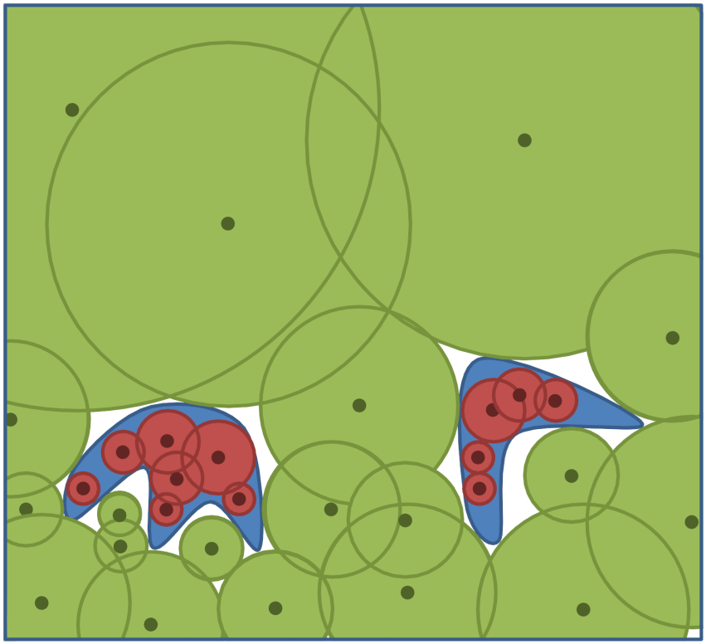
Integration, Optimization and UQ
Mohamed Ebeida
Scott Mitchell
Laura Swiler
Sampling for
  Integration
  Uncertainty Quantification
  Global Optimization
  Surrogates
“Puff and Darts” game,
circa 1902, courtesy FCIT.
“POF Darts” researchers hard at work, circa 2013.
Probablity Of Failure (POF) Darts
Bridge Collapse safety calculations
  Dimensions: temperature, load, time of day, material strength, age…
  Run a simulation at a point,
  Disk radius = how far from failure you are
    Need more samples outside disks
    Overlap is inefficient, but OK
  Union Volume estimates failure probability
    Or integrate parameter distributions over the volume if non-uniform.

Slide 5
Reliability calculations
  Identify and measure tiny failure
  subspaces in a vast parametric space
    10+ dimensions (parameters)
    <10⁻⁶ PoF (small volume region)
    Expensive simulations – faster surrogate
  POF-Darts was adaptive sampling
  (to find small regions with particular properties)
  This talk is mainly about uniform sampling of regions
  (to measure them)
Approach
  Other sampling methods based on statistics and analysis
  We borrow Computational Geometry, Graphics concepts:
    line searches
    sample-neighborhoods, geometric balls
    functional integration

Slide 6
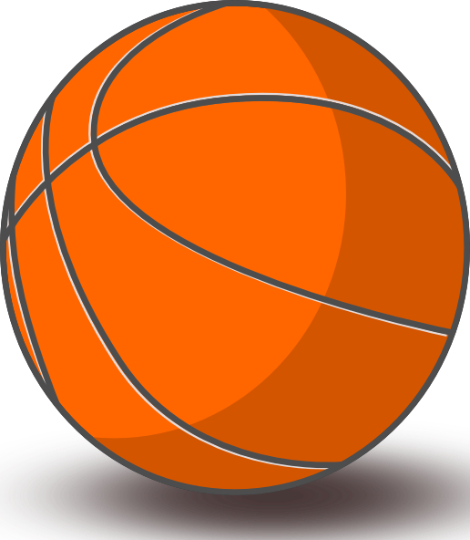

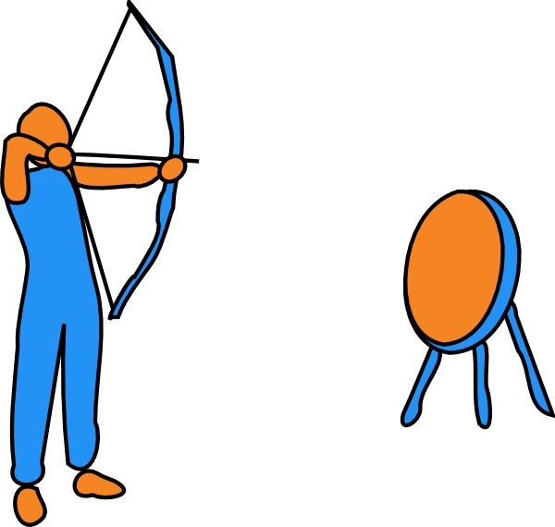
Intuition
Who’s going to hit the target (orange )?
point sampling
line sampling
line sampling
coin-shaped target
same volume, more surface
public domain clip art
Clker.com

Slide 7
More precisely d=20, PoF = 10⁻⁶ (uniform distributions throughout talk)
all parameters equal
16 parameters don’t matter
4 parameters matter
ditto and tilted
domain
(½)⁵
(½)⁵
1/2
failure
1 in 10⁶ points
2 in 10⁶ axis lines
hit failure region
1 in 10⁶ points
7 in 10⁶ axis lines
hit failure region
1 in 10⁶ points
30 in 10⁶ axis lines
hit failure region
  Lines are more likely to hit than points
    better if coin-like (bigger surface area)
    better if tilted (surface area subtended by each line)
  Intersection length is more information than binary point inside/outside
    Planes are even better, hyperplanes...

Slide 8
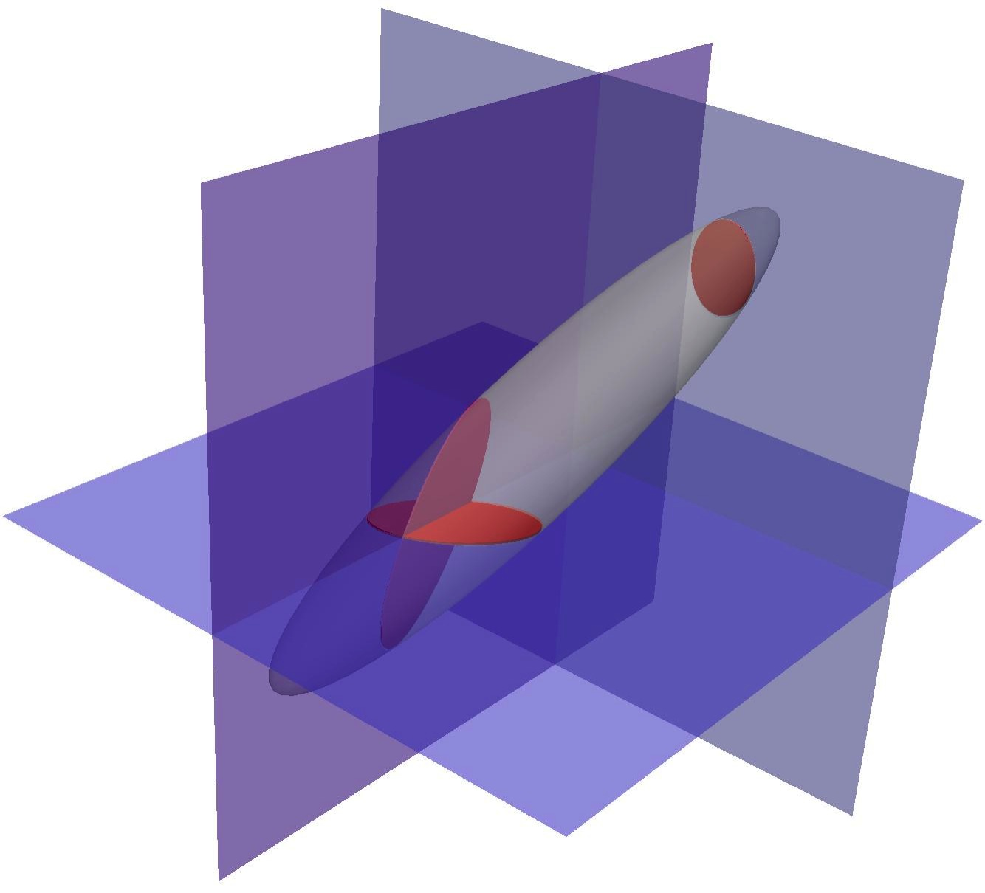
Hyperplane sampling to hit regions
99 points
6 line darts
1 plane dart
Lines, hyperplanes, are more likely to intersect these regions,
and they give more information
But they are more expensive.
Is it worth it?
The point of our paper is to answer “yes.”

Slide 9
Approach, definitions

Slide 10
k-d Dart
k-dimensional hyperplanes (flats)
  k free coordinates
  d-k fixed coordinates
dart = (d choose k) flats, one for every possible axis-aligned orientation
  free coordinates (orientations) deterministically uniform
  fixed coordinates (positions) uniform random,
  identically and independently distributed
one 1-d dart in a 2-d domain
= two 1-d lines: x-aligned, y-aligned

Slide 11
k-d darts are unbiased
  I.e. the mean estimate is the true mean
Because each flat is unbiased
  because uniform point sampling of a height function is unbiased
f=0
f=1
Dfixed
height f_{Dfixed}
Dfree

Slide 12
Variance? Efficiency?
We have no formal proof for the variance
Test problem:
  estimating the volume of an ellipsoid
  known analytic volume.
Results: variance is well behaved
  dropping as 1/number_of_samples^2
  dropping by k

Slide 13
Mean error reduction by 1 / # samples^2
Vary 10-d domain aspect ratio, orientation; k-dart-dimension. lower error for higher-k darts
coin-like
error needle ≈ coin > ball with bigger volume, small efffect
needle-like
k
slope 1/2
axis-aligned object
randomly oriented object
k
object orientation doesn’t matter very much
Notes:
As k increases, the error goes down
top row
Needles and coins with 1-axis stetched did about the same
Points+ did better for the ball, because it had bigger volume.
bottom row
Object orientation had little effect

Slide 14
Estimate/true volume histograms for 1 million darts
Vary 10-d domain aspect ratio, orientation; k-dart-dimension normal-like, sharper peaks for higher-k darts
coin-like
needle-like
k
Squish matters a little bit, but volume matters much more.
We did 1-axis short, 1-axis long. Squish farther?
axis-aligned object
randomly oriented object
object orientation unaligned with axes helps a little, but not much
Notes:
histograms, constant number of samples
sharper for increased k, consistent with more information per sample
Squish, orientation, tiny effect compared to volume

Slide 15
Trends by k
Conclusion
Higher k darts = less error, less variance
  Because each dart gives more information
Use a higher k if
  You can compute its intersection with the object
  And that computation is not too much slower

Slide 16
Sample-Orientation Effects?
Axis-aligned flats just as accurate as randomly oriented darts...
Mean error by #samples
...and faster and simpler.
Axis-aligned best.
Histogram of estimate, 1 million samples
coin-like
needle-like
black=point samples
red=axis-aligned,
one per direction
blue=random orientation,
independent
green=random orientation,
one per orthogonal
axis-aligned object
randomly
oriented object
Notes:
(top line is points)
aligned-darts better, for aligned objects
aligned-darts same as randomly oriented darts, for randomly oriented objects

Slide 17
Dart orientation effects
Conclusion
(d choose k) orthogonal flats
deterministically ≈ randomly
  perhaps because we used so many samples.
  random simpler?
axis-aligned provides
  good quality answers
  simple, fast, through parameter substitution
Use random-axis orientations, of independent flats
2nd
p=1/2
deterministic
random
1st
≈
p=1/2

Slide 18
Application 1 of 3
Volume Estimation
LHS patterns
More interesting functions

Slide 19
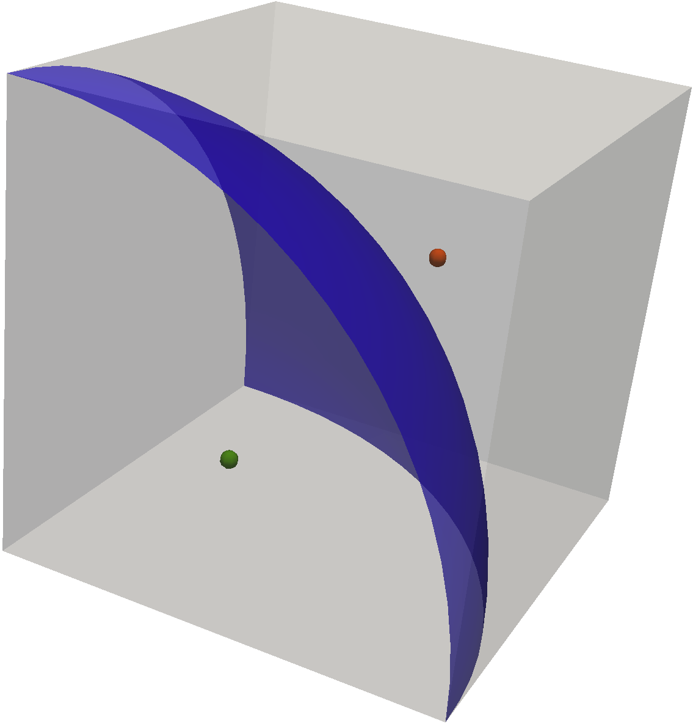
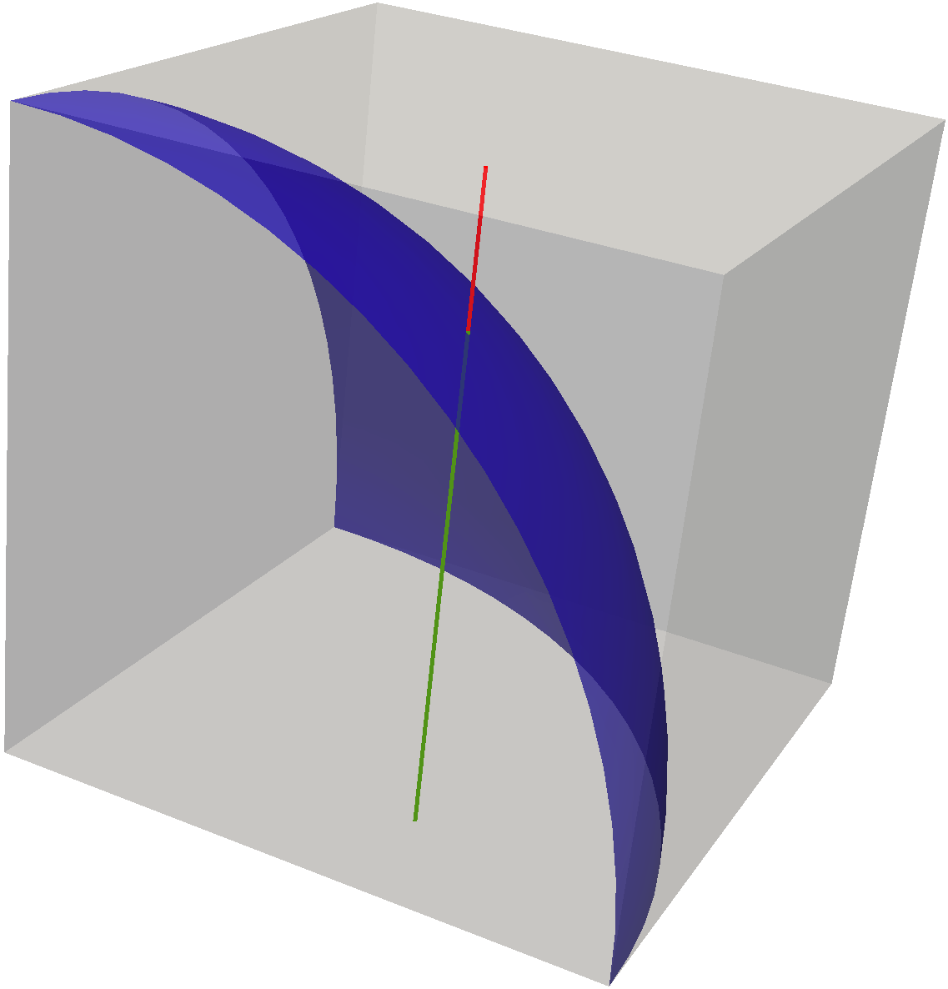
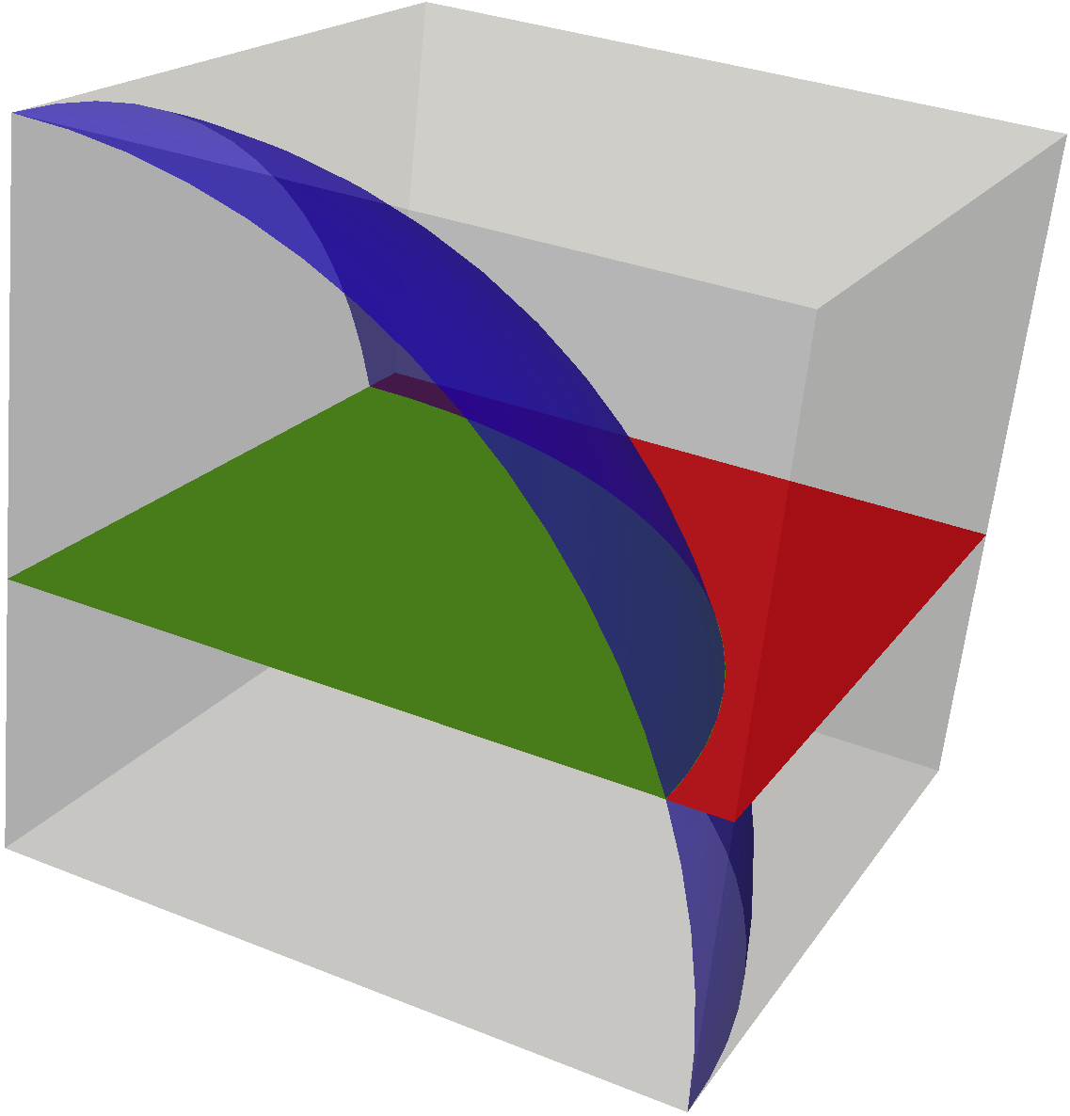
Volume Estimation Speedup
3-d ball, simple analytic
0-d
Algorithm: average lengths of lines (area of planes) inside sphere.
Why did this work so well?
1-d
2-d

Slide 20
Volume Estimation Speedup
Circular Parabola
i.e. 2d domain
1E-5 analytic value
speedup
Notes:
lines vs. points
more speedup the more accurate you want your answer
more speedup in low dimensions than high,
because lines reduce problem by 1-d,
and d/(1-d) is a more significant fraction in low-d than high-d

Slide 21
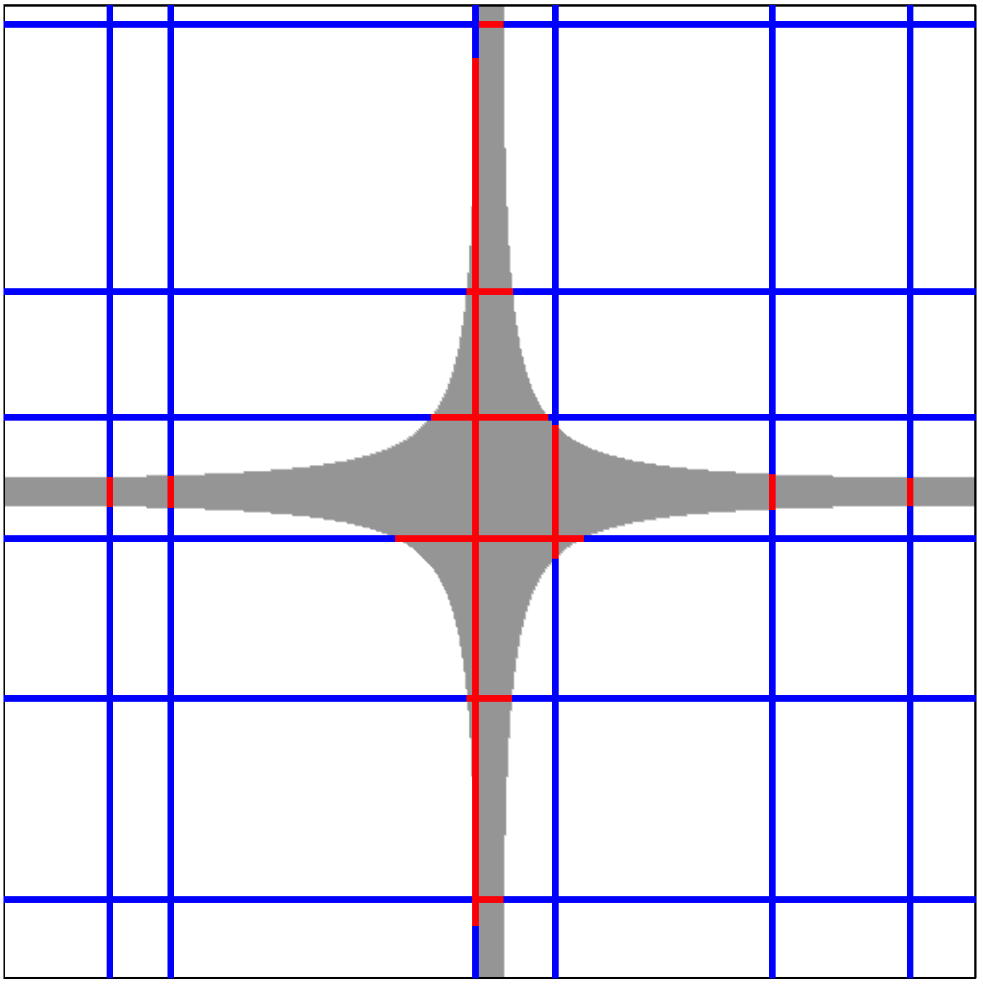
Volume Estimation Speedup
Planar Cross
i.e. 2d domain
1E-5 analytic value
Estimate volume of y(x) < 0
Notes:
Ultimate coin-like shape, every line intersects

Slide 22
Application 2 of 3
Well-spaced points
Use line sampling to generate a point sampling,
of a type popular in Graphics texture mapping

Slide 23
Maximal Poisson-Disk Sampling
Defined as the limit distribution of a statistical “dart-throwing” process
  Random disks arive with Poisson-distributed arrival times, equivalent to random arrival order:
Ω
x₄?

Slide 24
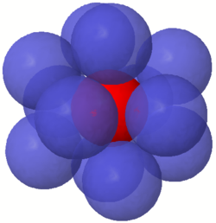
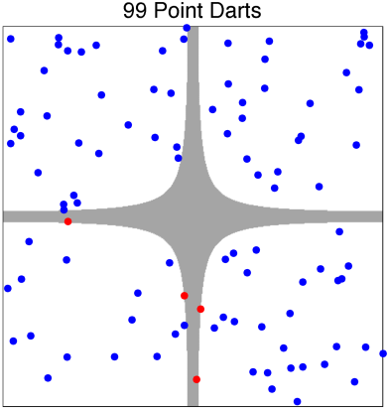
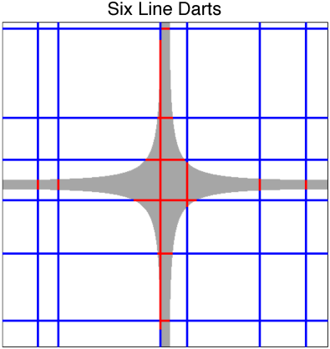
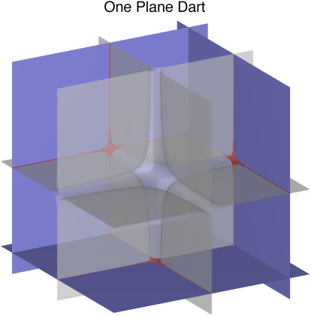
Main Challenge of Solving MPS in Higher Dimensions (Curse-Of-Dimensionality)
It is too expensive to build the uncovered regions
  or even an approximation to them
Curse of dimensionality
  Natural: Kissing Number grows exponentially with dimension
  Artificial: Grid based methods (state of the art) to retrieve neighbors, and track remaining voids
    grid size is 2^d
Generalization of Sampling Entities
  k-d darts: Random sampling using hyperplanes
  → void capturing, integration and UQ

Slide 25
k-d Dart based
Relaxed Poisson-Disk Sampling
Dart-based
  search space using lines, planes, ...
Relaxed
  stop after many successive dart fails
  expected uncovered volume is small

Slide 26
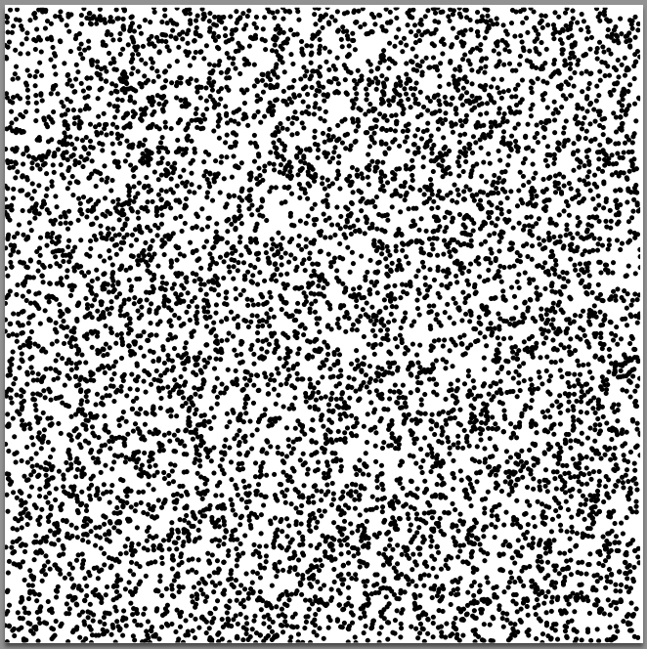

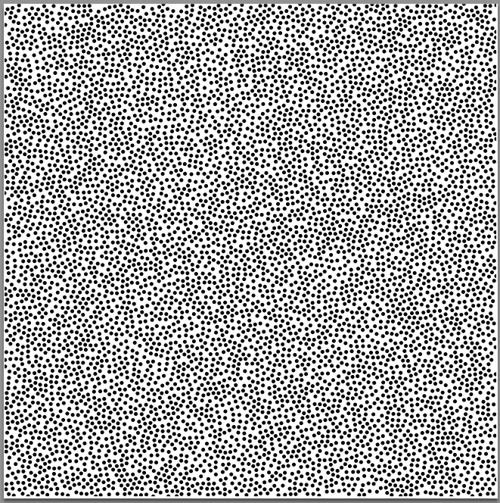
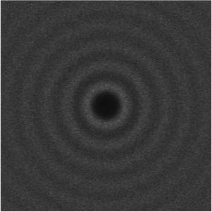
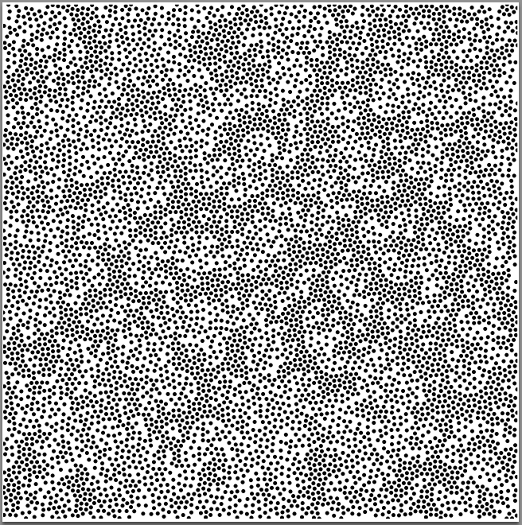
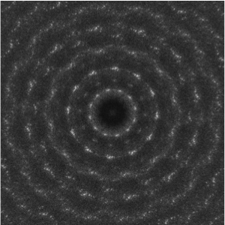
Spectral Quality Evaluation of Point Sets
White noise
Maximal
Poisson
Disks
Maximal
Correlated
Disks

Slide 27
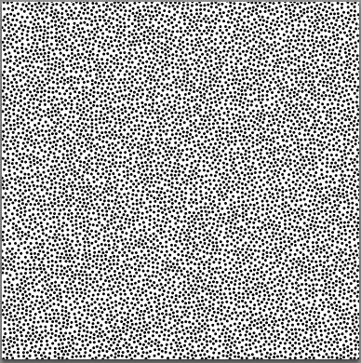
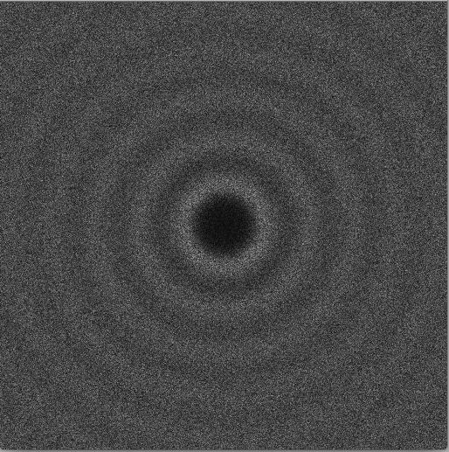
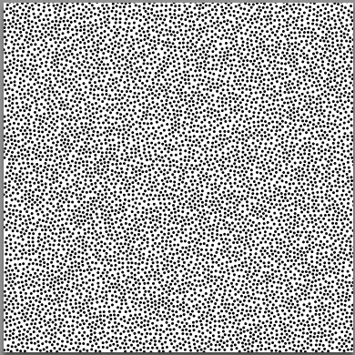
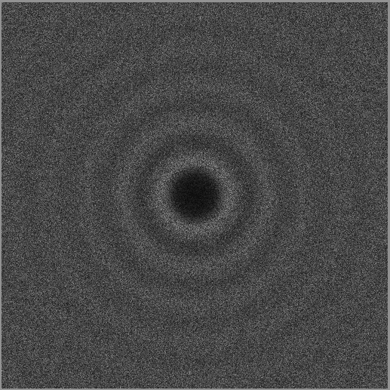
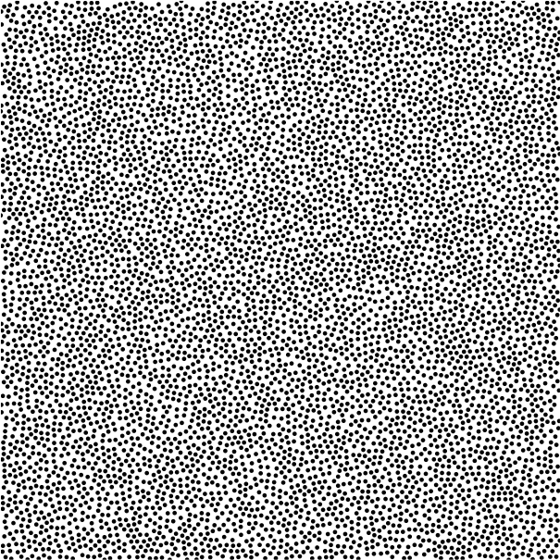
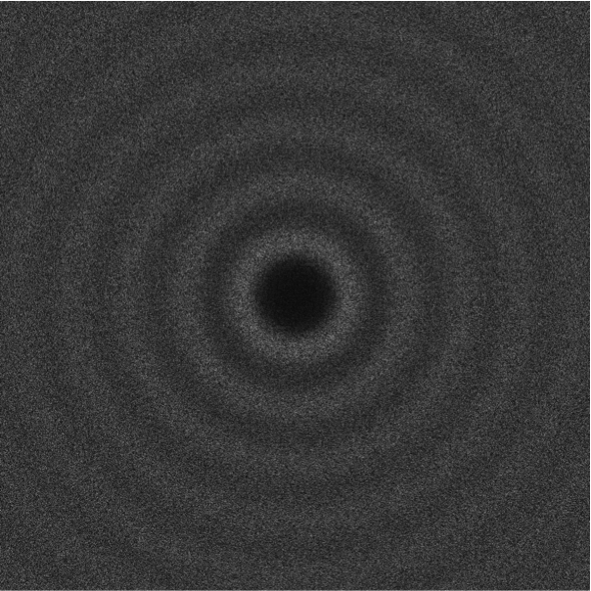
MPS vs. line-dart vs. point-dart
Can you tell them apart?
distance non-uniformity
angular non-uniformity
line darts
point darts
true MPS

Slide 28
k-d Dart Relaxed MPS Properties
line darts add disks faster
than point darts
line darts are faster or slower than MPS in d=4,
depending on relaxed maximality
Simple MPS requires 2^{d} memory, intractable in d>6
but line-darts are linear memory
better quality
line darts produce fewer large gaps
than point darts

Slide 29
Application 3 of 3
Graphics, depth of field blur
Integration

Slide 30

Graphics Application
Depth of Field Sampling
Pixar’s Toy Story 3
blurred
far from lens
focal plane
Depth-of-Field blur
requires many point samples
per pixel !
movie frame rendering is overnight, not realtime,
as many simulation and UQ studies
Notes:
Because our eyes have lenses we can only see one distance clearly at a time
Is this a defect?
Putting this into movies makes them seem more realistic
clues us to object depth
clues us to where director wants our attention (opening scene of Avitar)

Slide 31
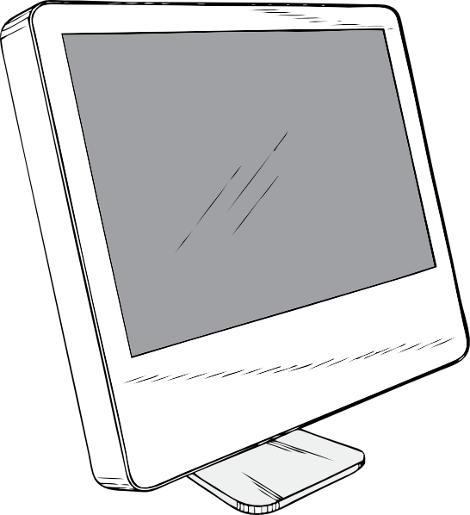
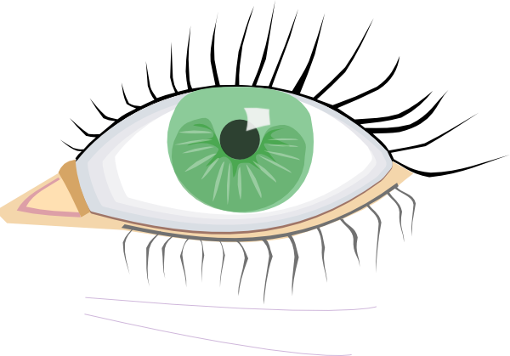

Line-sampling for
Depth of Field Blur
  Solution: point sampling
  For every (a,b) pixel
  4-d: (u,v) lens plane, (x,y) scene space
    z scene space is dependent
  (u,v) lens
  (a,b) pixel
  (x,y,z) scene
Solution: our algorithm
  Lines sample and compute
  occlusion depth (decision)
  color contribution (integration)
  For each pixel,
  1 Dart =
  4 axis-aligned sample lines in (u, v, x, y)
    1 varied u, fixed x, y, v
    1 varied v, fixed x, y, u
    1 varied x, fixed y, u, v
    1 varied y, fixed x, u, v

Slide 32
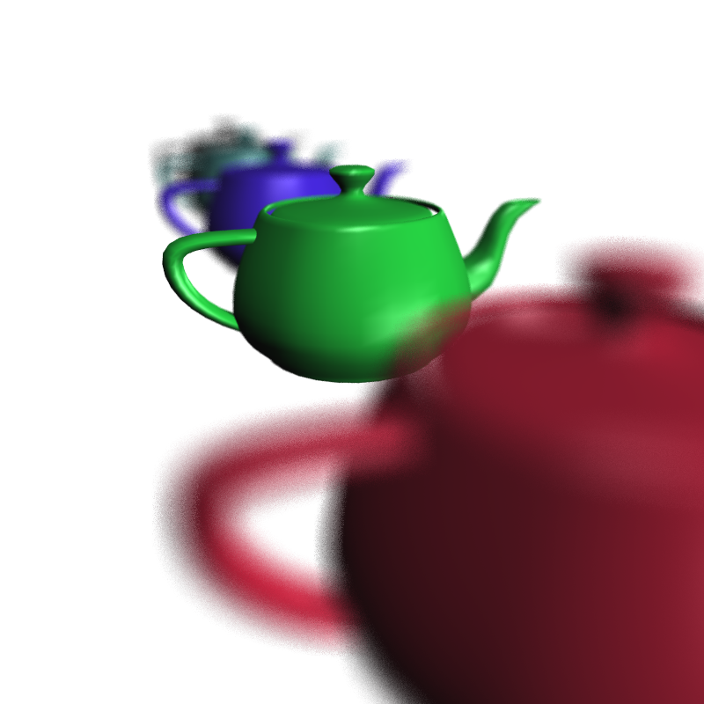


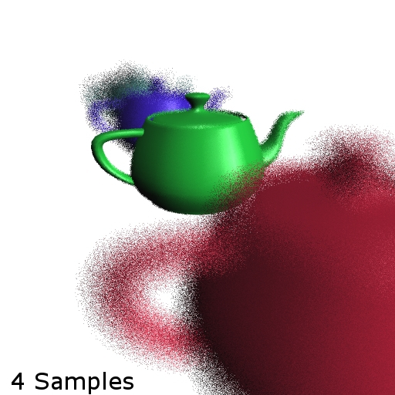


Blur, line-darts vs. point samples
4 lines
16 lines
30 lines
4 points
64 points
256 points

Slide 33

16 lines / pixel
256 points /pixel
2x runtime
1024 points /pixel
8x runtime
Notes:
16 lines faster than 1024 points
16 lines better quality than 256 points

Slide 34
Summary
Any point-sampling algorithm depending on function averages can be converted to a line-sampling algorithm
  Including indicator functions e.g. volume estimation
f=0
f=1
Dfixed
height
f_{Dfixed}
  Need to evaluate function along a flat (line)
  Efficiency depends on evaluation speed
    This is the challenge for practical k-dimensional flats
  Axis-aligned flats (lines)
    efficient and random-enough
Application variants
  Generate a well-spaced disk packing
    Although line samples are not uniform by area,
    effect on output distribution is unoticable.
  Depth of Field blur
    Intrusive line-sampling
    Efficient function integration without artifacts

Slide 35
Extra stuff

Slide 36
Heilmeier’s Catechism
What is the problem, why is it hard?
  Uncertainty quantification, small failure regions in vast spaces, expensive functions
How is it solved today?
  Many sampling methods based on statistics and analysis
What is the new technical idea; why can we succeed now?
  Borrowing Computational Geometry, Graphics concepts:
    line searches
    sample-neighborhoods, geometric balls
    functional integration
What is the impact if successful?
  Increased convergence rates, fewer parallel simulations

Slide 37
a computational geometer’s view
Space for All Point Sampling Methods
Process randomness is a hidden axis,
merely a means to obtain spatial randomness.
Spatial
Randomness
uniform-random coordinates
MPS
jittering
Dimension
sifting
off-centers
two-radii MPS
Delaunay refinement
maximal Poisson-disk sampling
Opt-β, spatially-varying MPS
injection
Geometric Density
bubble mesh
joint position and sample optimization
optimization
CVT
Discrete Density

Slide 38
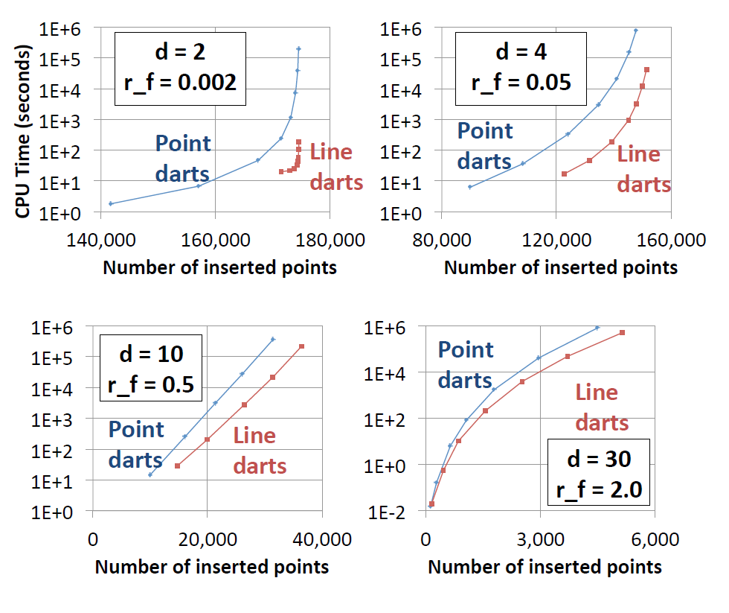
k-d Darts for Solving MPS

