Slide 1
Understanding How Choices Change Clusterings:
Geometric Comparison of Popular
Mixture Model Distances
Scott A. Mitchell
http://www.cs.sandia.gov/~samitch
Computer Science and Informatics Department (1415)
Sandia National Laboratories
Sandia is a multiprogram laboratory operated by Sandia Corporation, a Lockheed Martin Company,
for the United States Department of Energy’s National Nuclear Security Administration
under contract DE-AC04-94AL85000.

Slide 2
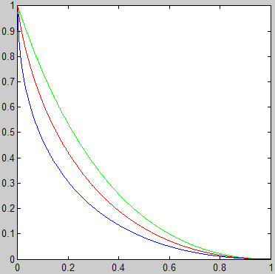
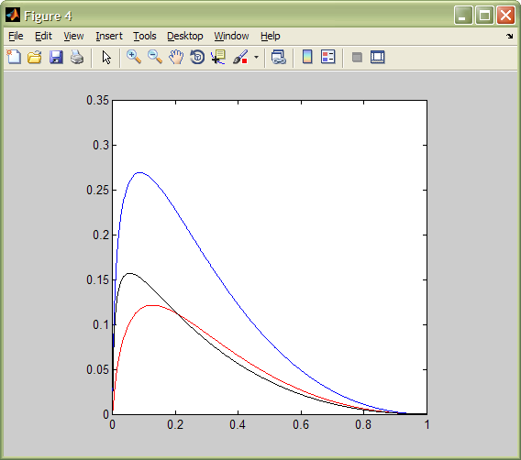
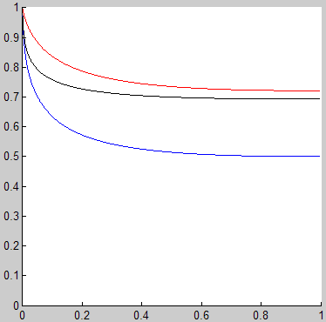
Preview Summary
Z functions
χ² - H_{s}²
(blue)
Difference in Z functions
χ²
(green)
=
=
Z(z)
(Z₁ – Z₂)
JS - H_{s}²
(black)
JS
(red)
≥
H_{s}²
(blue)
χ² – JS
(red)
≥
≤
≤
z
z
Ratio of Z functions
χ² / JS (red)
1,0
JS / H_{s}² (black)
u=1
Z₂ / Z₁
χ² / H_{s}² (blue)
u=.7
Z(z)
u= 0.4
Q(q)
q=1, z=0
q=c₁, z=c₂
p=1
p=1.5
0,0
q=0, z=1
p= 0.6
1,1
z

Slide 3
Outline
Application context
Distances
3d plots
Algebraic reformulation as Z, Q
Ratios
Worst-case difference construction

Slide 4
Text Document Clustering at Sandia
Problem: given a pile of documents, categorize them
so you only have to read one category
to identify outliers not in any category
Term Tokenization
Dataflow
Feature Extraction
Example Software:
Prototype-2 from Network Grand Challenge LDRD
Document
Ingestion
Part of
Speech Tagging
Visualization/Presentation
Document
Clustering
Entity
Extraction
Example: How strange is my technical paper, the one I’m giving this talk on?
Google Scholar search “mixture model geometry”, get 529,000 hits, save them all to local disk
Throw out “the”, “and”, “however” to de-noise. Stem “geometrical”, “geometry”, to “geometry”.
Identify grammar, to help answer “expository or framing?”
Identify authors, institutions, to help identify relationships.
Each document is a bag of “words”, unordered
Source Credit: Danny Dunlavy

Slide 5
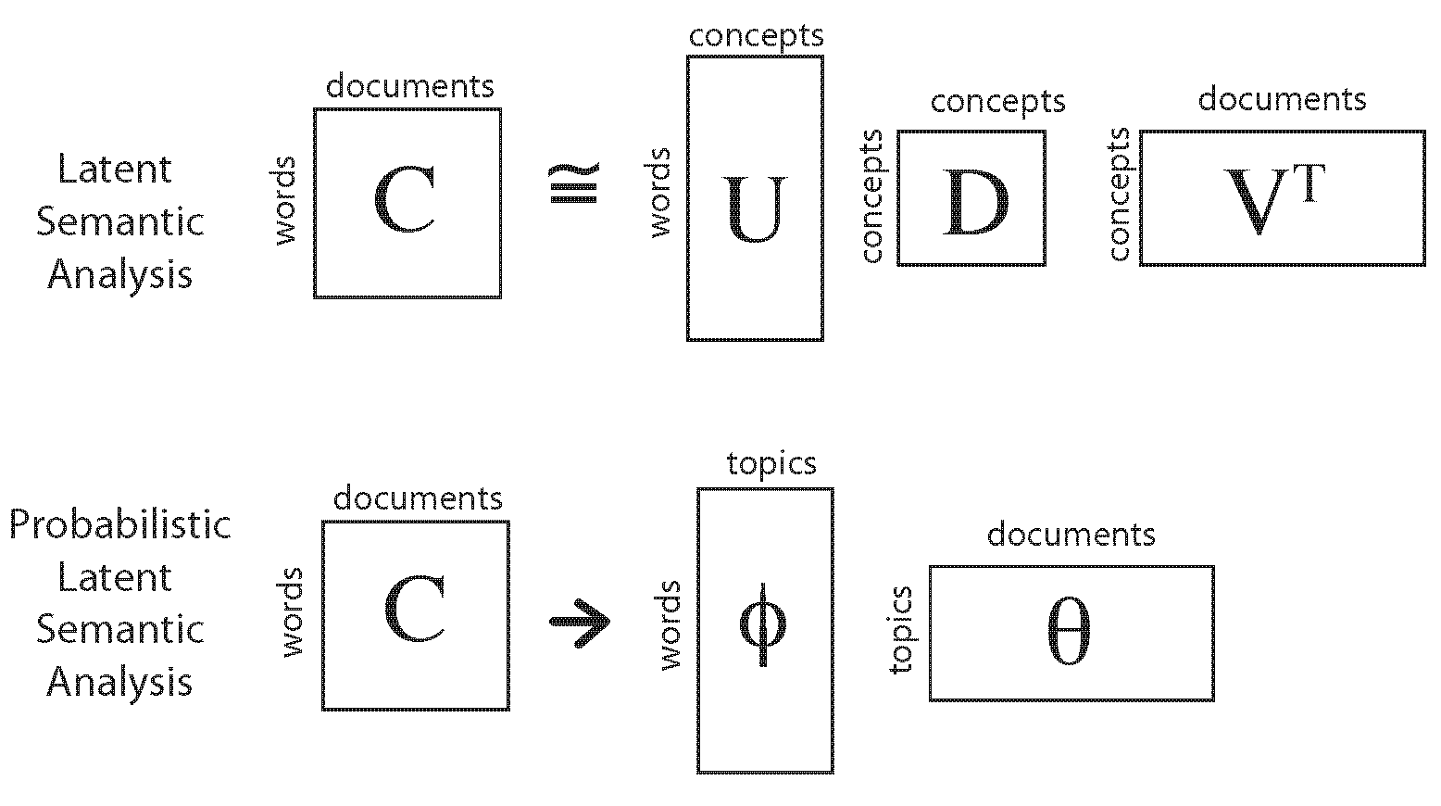
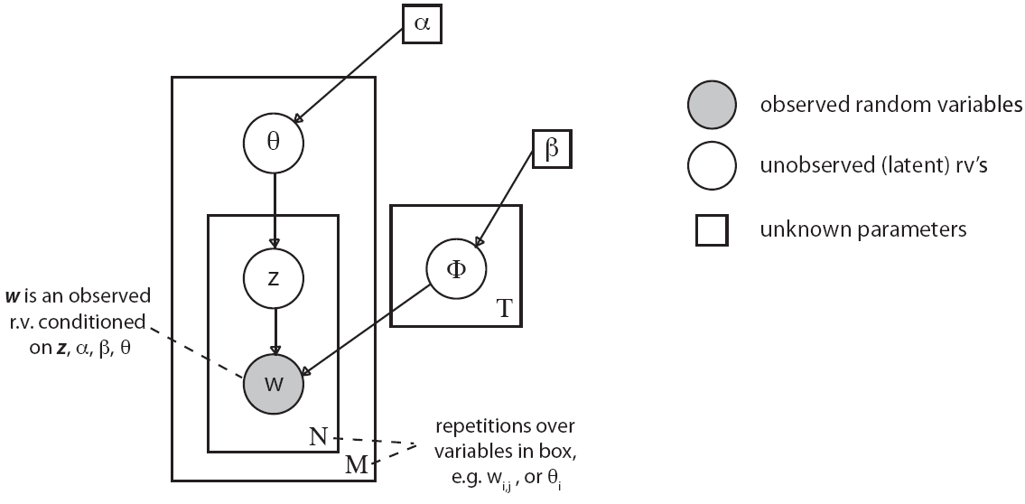
Term Tokenization
Reduce word-space to feature-space
e.g. 20,000 dimensions to 50
Feature Extraction
Document
Ingestion
Part of
Speech Tagging
Visualization/Presentation
Document
Clustering
Entity
Extraction
Source Credit: David G. Robinson

Slide 6
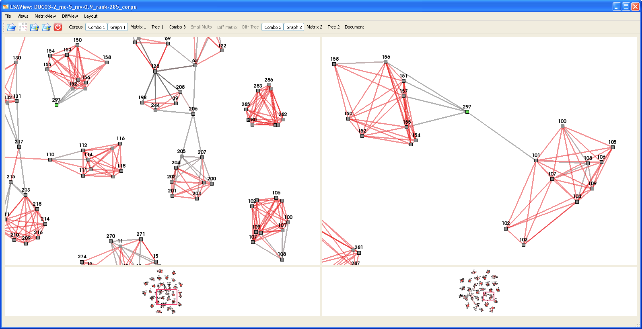
Term Tokenization
Cluster points
Pick distance function
Pick distance threshold
Build a graph,
with an edge between documents x,y if distance(x,y) < threshold
Look at the graph
Feature Extraction
Document
Ingestion
Part of
Speech Tagging
Visualization/Presentation
Document
Clustering
Entity
Extraction
This or That?
What happens if I tweak one of the 50+ knobs on this Frankenstein? Why? Predictable changes?
What does it all mean?
Need coherent research program. Distances are one puzzle piece.

Slide 7
Which Distance?
Criteria
  Reproduce ground truth?
    What ground truth? Journal I sent my paper to? Expert opinion?
  Stability of outcome?
    stability ≠ accuracy
  Use the one this application area always uses?
    Maybe not such a bad idea: leverage insight, one knob at a time comparisons
  Information theory?
    “I think entropy is relevant and this distance measures it”
Let’s try something else
  Does it even matter? When do two distance functions give a different ordering to points?
  Geometry and algebra

Slide 8
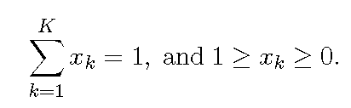
Generality
“Documents” could be any pile of data
“Words” could be any discrete categorical features you care about
“Graphs” could have more structure: filtered simplicial complexes;
or less: proximity to cluster center
Any dimension K – typically > 50
e.g. documents in 50-d concept space, or concepts in 20,000-d wordspace
Applications
  Cluster cyber-traffic based on header features, content analysis.
Specialization
Bivariate distances
  Not convoluting document-in-conceptspace with concept-in-wordspace.
  Not univariate measure of points.
  Not univariate measure of partition as Graph Entropy (Berry, Phillips)
Distances between points which are mixture models
sometimes distances project to positive part of sphere S₊
S₊
T
x
T:
x
S
contrast to LSA on S

Slide 9
Outline
Application context
Distances
  properties
3d plots
Algebraic reformulation as Z, Q
Ratios
Worst-case difference construction

Slide 10
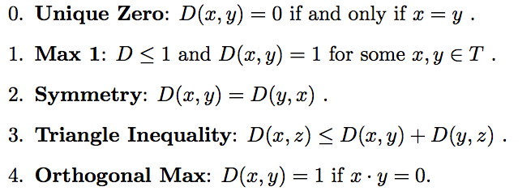
Distance Properties
100’s of distances to choose from.
Bivariate: D(x,y). Not D(x). Not D(partition).
Where variants exist, pick the ones with
Most won’t satisfy 3.

Slide 11
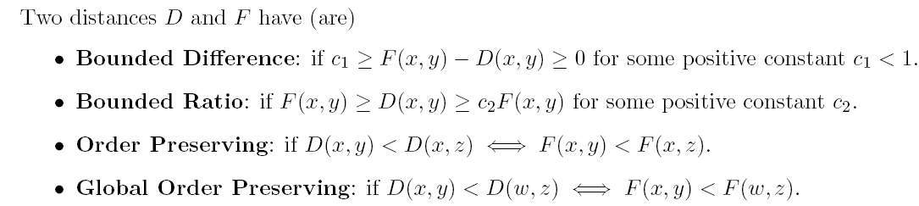
Iter-Distance Properties
What matters is ordering of points, level-set shape
same level sets → same clusterings
stronger
Stronger properties don’t hold, but we’ll see how they don’t.
  Max 1, Bounded Ratio c₂ → Bounded Difference c₁ = 1-c₂
  but we’ll show smaller c₁
y
y
x
z
w
z
x
Global order preserving:
D₁ D₂ agree which of (x,y) and (w,z) is smaller
Local order preserving:
D₁ D₂ agree which of {y,z} is closer to x

Slide 12
Outline
Application context
Distances
  properties
  the distances
3d plots
Algebraic reformulation as Z, Q
Ratios
Worst-case difference construction

Slide 13
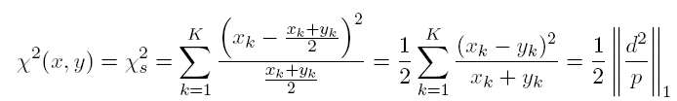
Chi-Squared χ²
Base
Problems
  unbounded as y→0, no Max 1
  unsymmetric
Fix (a.k.a Trianglar Discrimination)
View: f(x,0) = x, const x+y, x, head-on, iso-curves
  fig 1, 2, 3
expected = midpoint if same distribution

Slide 14
Chi-Squared χ²
Componentwise
Algebraic Properties
Q
  p = x+y; d = x-y; q = d/p
  p in [0,2]; d,q in [0,1]
Z
  u = max(x,y); v = min(x,y); z = u/v
  u,v,z in [0,1]
  revisit figures 1,2,3
Further study: f-divergence, Csiszár(1967), Dragomir(1980+) RGMIA

Slide 15
Chi-Squared χ²
Componentwise Geometric Interpretation
labels are lengths of segments, except points o, o′, o′′
geometrically: D( ) = (r / r’) D(o) = (p/1) D(o) = p Q(q)/2
also works for p > 1
1,0
o′
Q
u=1
r′
o
u=.7
Z(z)
r
u= 0.4
Q(q)
q=1, z=0
q=c₁, z=c₂
p=1
p=1.5
0,0
q=0, z=1
p= 0.6
1,1
1
0
z
geometrically: D( ) = (s / s’) D(o) = (u / 1) D(o) = u/2 Z(z)
0
o′′
1
u
v
o′
z
o
u
Z
v
o′′
1
o
r′′
0
r
0
1

Slide 16
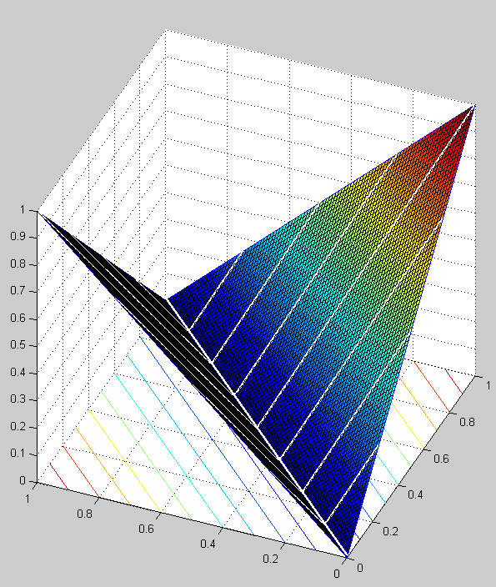
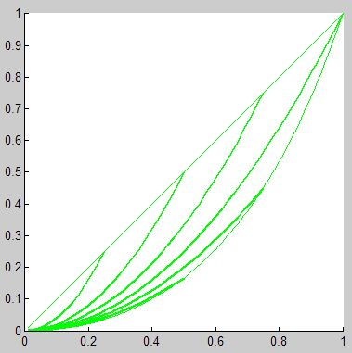
Chi-Squared χ²
Q curves
Z same
Compare to Euclidean, function of d only, no p dependence
Chi-Squared
iso-p lines, plus y=0, x=1
d ≤ p
E_{us} surface, contour lines, and x+y=c lines
p=1
p=3/4
q vs. Q(q)
D(x,y)
pq vs. pQ(q)
y
x
d=x-y

Slide 17

Jenson-Shannon (same form as χ²)
Kullback-Leibler
  measures entropy, information theoretic
  non-symmetric
  unbounded
Jenson-Shannon Fix
  x=0…
  x=y…
  One of the terms can be negative, but JS ≥ 0, Unique Zero holds
    stronger, factor as Chi-Squared
Figure 4

Slide 18
Hellinger
Hellinger
  H satisfies Triangle Inequality, H² doesn’t
  x=0…
  x=y…
    Factor as Chi-Squared, JS
Performs well for certain applications (Kegelmeyer, Robinson favorites)

Slide 19
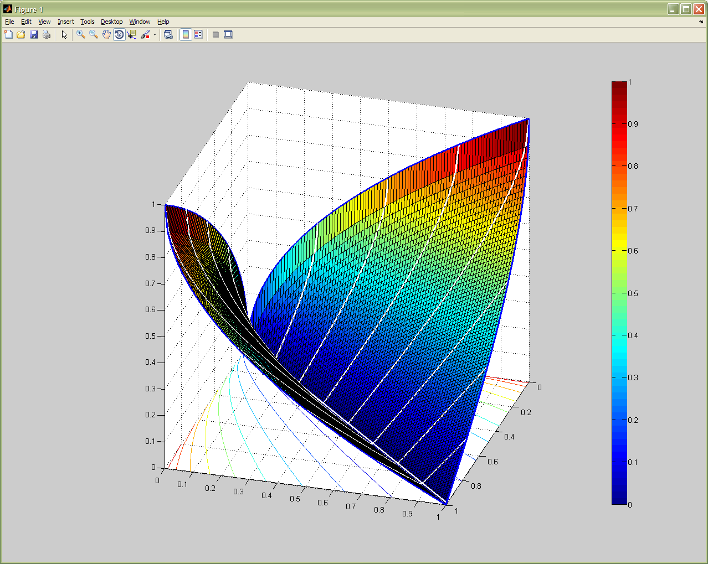
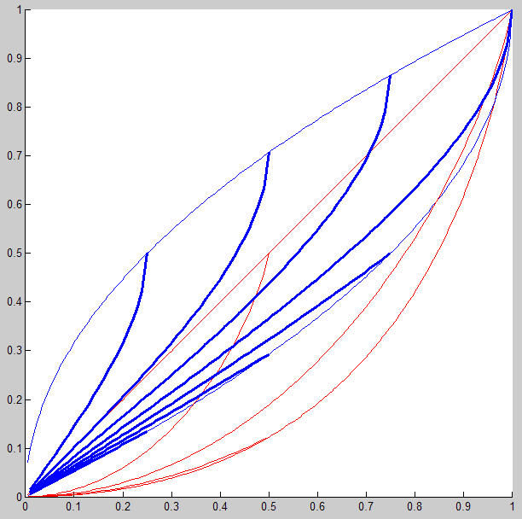
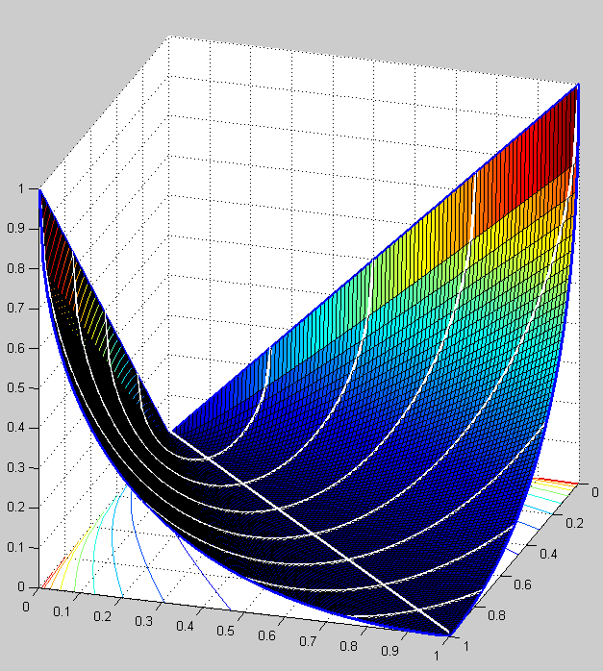
H
H_{s} surface, contour lines, and x+y=c lines
Figure 5
H and JS
y
x
H_{s} (blue) and JS_{s}(red) vs. (x-y) for (x+y)=c, x=1 or y=0
C√=H_{s}² surface, contour lines, and x+y=c lines
y=0
y=0
x+y=3/4
x+y=1
x=1
H²
x=1
x+y=1/2
x+y=5/4
x+y=1
x
x+y=1/4
x+y=3/2
y
x+y=1/2
x+y=7/4
x+y=3/2
x
(x-y)

Slide 20
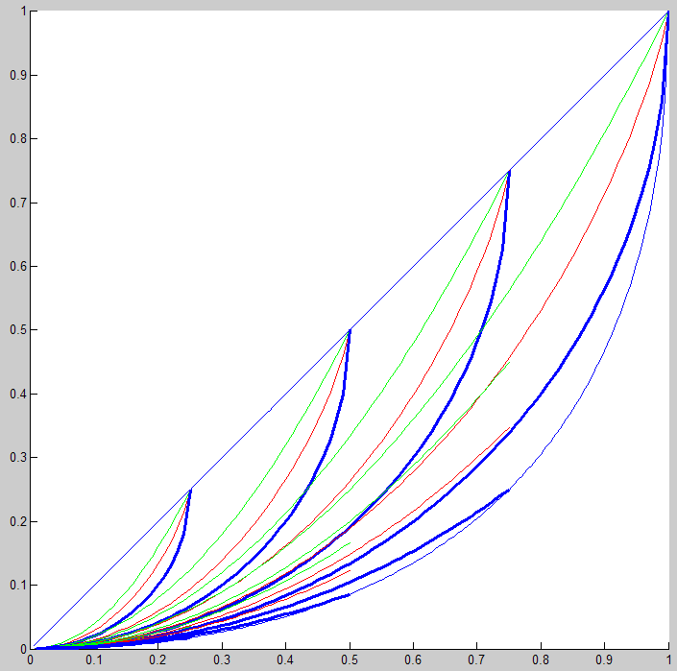
1D Q plots, χ², JS, H²
Chi²_{s} (green) ≥ JS_{s}(red) ≥ H²_{s} (blue) vs. (x-y)
for (x+y)=c, x=1, or y=0
p=1 Chi²_{s} = Euclidean²)
(x-y)

Slide 21
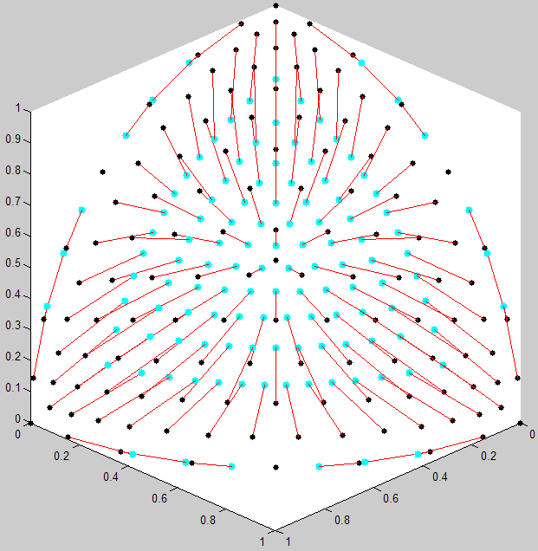
Hellinger and Cosine
Euclidean and Cosine
Add animation fig
Hellinger projects to sphere using square-root, then takes Euclidean distance
Hellinger and Euclidean projections to
3-sphere, and difference between them.
x

Slide 22
Geodesic Distance?
Suggest Geodesic distance on sphere G over
  More convex than H (or E), barely satisfies triangle inequality
  G(x,z)=G(x,y)+G(y,z) for y=λx+(1-λ)z
  strict inequality for other y
C, E, G are global order preserving, over both

Slide 23
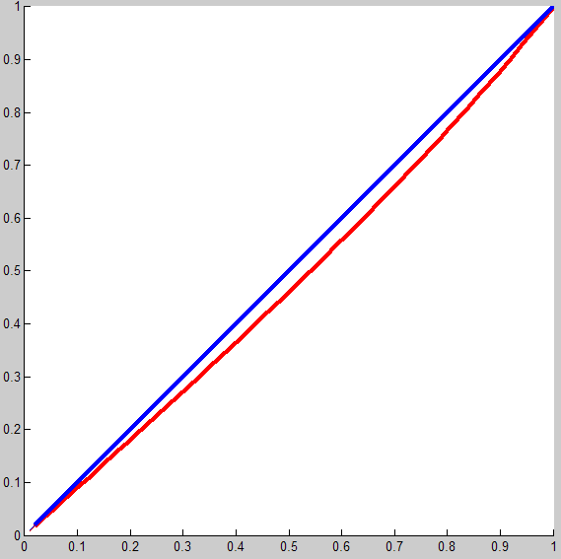
Euclidean and Geodesic (norm)
E_{us} surface, contour lines, and x+y=c lines
E_{us} (blue) and G_{us}(red) vs. (x-y)
y
x
(x-y)

Slide 24
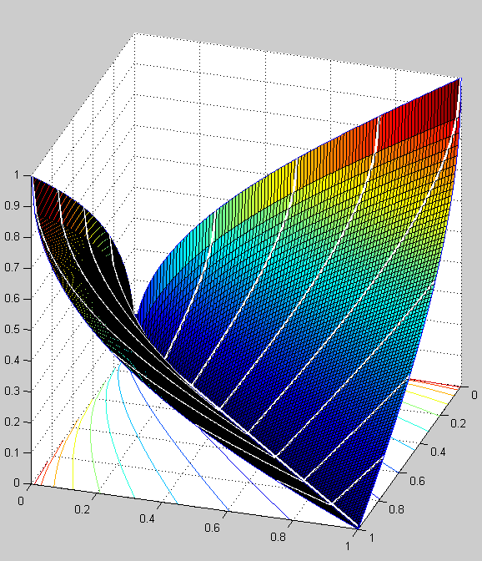
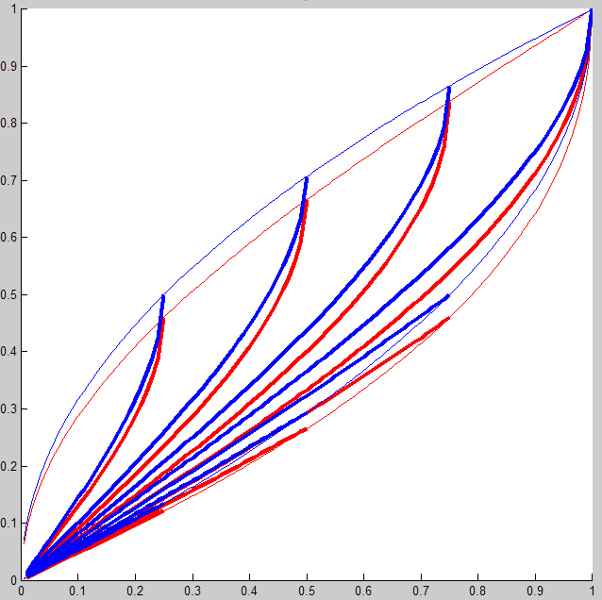
Hellinger and Geodesic (root)
left is visually indistinguishable from Hs, so skip it
G_{√s} surface, contour lines, and x+y=c lines
H_{s} (blue) and G_{√s}(red) vs. (x-y) for (x+y)=c, x=1 or y=0
y=0
y=0
x=1
x=1
y
x
(x-y)

Slide 25
Outline
Application context
Distances
3d plots
Algebraic reformulation as Z, Q
Ratios
Worst-case difference construction

Slide 26
3d plots for selected x points
3
0,0,1
x=[1,0,0]
  fig 6: H², JS, Chi²
  fig 7: H, H², E shortcomings
    No ortho-max for E
  fig 8: H, H², E_{u}
X=[1,1,0]/2
  fig 9: H², JS, Chi²
  fig 10: H, H², E_{u}
X=[1,1,1]/3
  fig 11: H², JS, Chi²
  fig 12: H, H², E_{u}
X=[0.2 0.3 0.5]
  fig 13: H², JS, Chi²
  fig 14: H, H², E_{u}
X=[0.89, 0.1 0.01] - sharp upturns
  fig 15: H², JS, Chi²
  fig 16: H, H², E_{u}
S₊
T
1,0,0
0,1,0
1
2

Slide 27
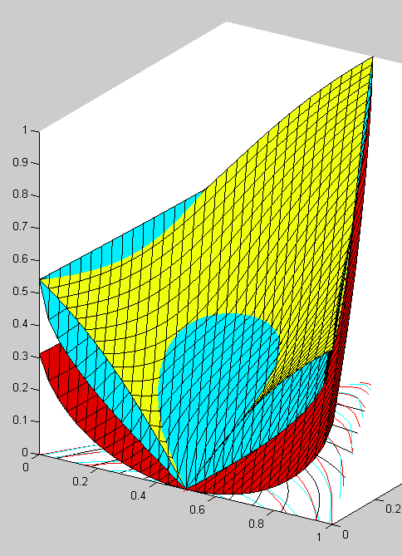
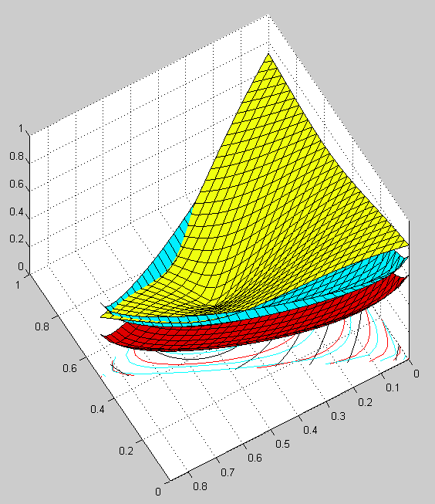
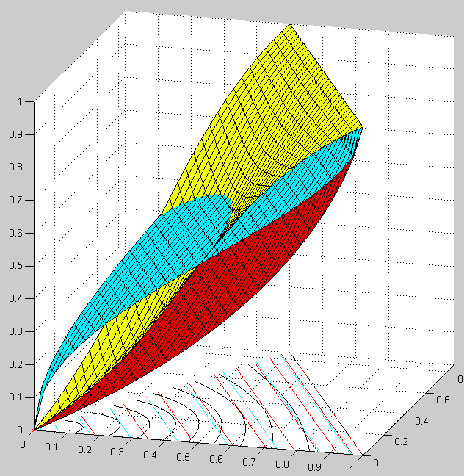
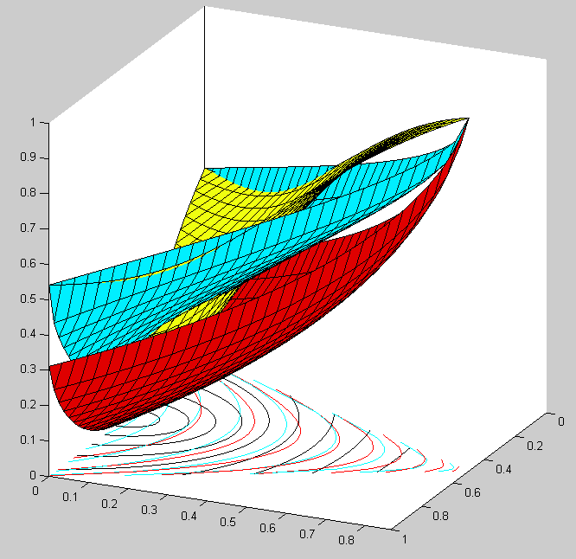
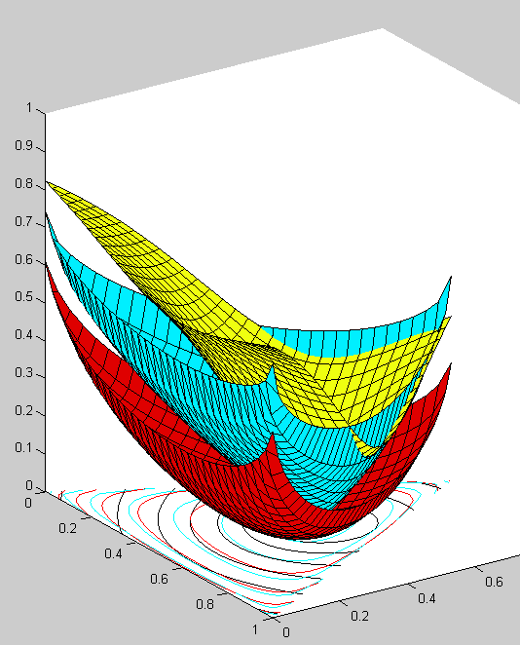
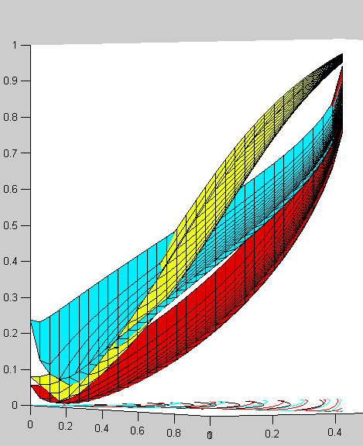
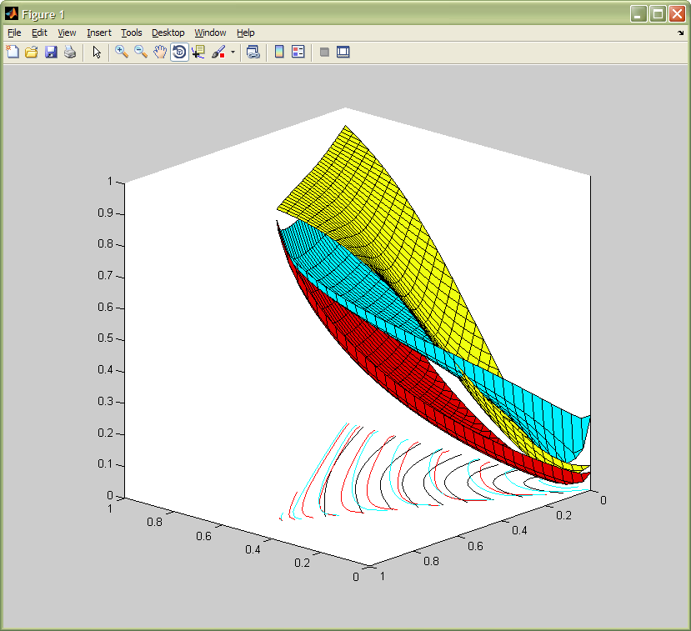
3-dimensional distances using Euclidean_{u}(yellow, contours black) Hellinger(blue) and JS(orange)
Illustrate qualitative difference between Euclidean and the other two
curved contours are from Euclidean
least-curved contours are from Euclidean
rounded contours are Euclidean
3-dimensional mixture model distances using Euclidean_{u}(yellow + black contours), Hellinger_{s}(blue) and JS_{s}(red)
Distances
from (.5,.5,0)
Distances
from (1,0,0)
Distances
from (.2,.3,.5)
(0,0,1)
(0,0,1)
(1,0,0)
(1,0,0)
(0,1,0)
(1,0,0)
(0,0,1)
(0,0,1)
(1,0,0)
(0,0,1)
(0,1,0)
(1,0,0)
(0,1,0)
(0,1,0)
Distances
from (.89,.1,.01)
Static backup
(0,1,0)
(0,0,1)
(0,0,1)
(1,0,0)
(1,0,0)
(0,1,0)

Slide 28
Outline
Application context
Distances
3d plots
Algebraic reformulation as Z, Q, W
Ratios
Worst-case difference construction

Slide 29
Algebraic Forms, Q, Z for X, JS, H2
Q fn
Q series
Z fn
=
=
≥
≥
≤
≤
Q
0
1
z
Z
o′
u
r′
v
o′′
o
r′′
o
r
r
0
1

Slide 30
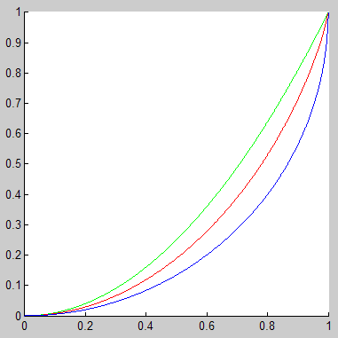
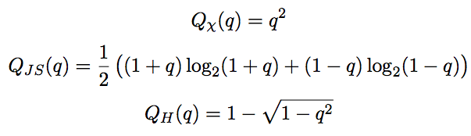
Q fn
Q functions
χ²
(green)
Q(q)
JS
(red)
Recall
Q fn
    p=x+y d=|x-y| q=d/p
H_{s}²
(blue)

Slide 31
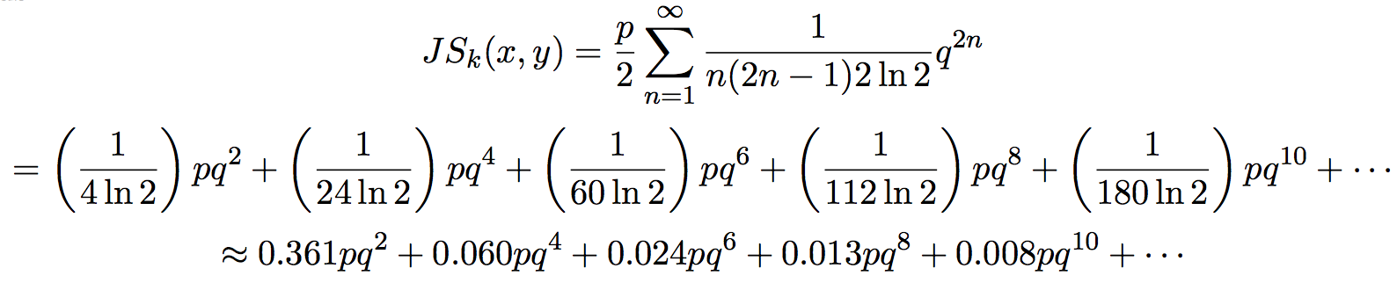
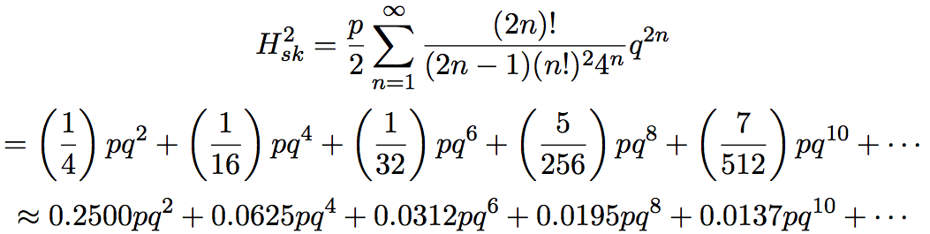
Q fn series
Q functions
χ²
(green)
Q(q)
JS
(red)
H_{s}²
(blue)
q

Slide 32
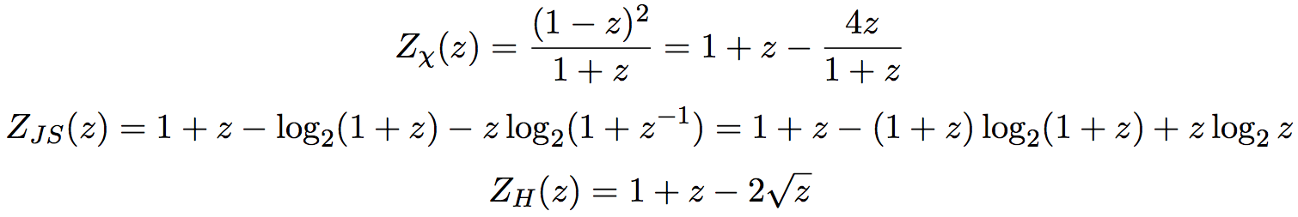
Z fn
Z functions
χ²
(green)
Z(z)
JS
(red)
Recall
Z fn
    u=max(x,y) v=min(x,y) z=v/u
H_{s}²
(blue)
z

Slide 33
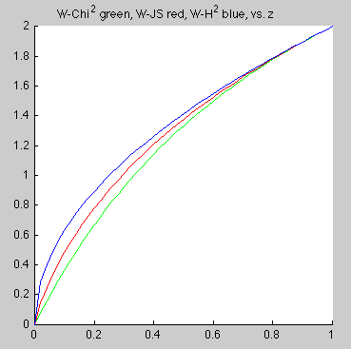
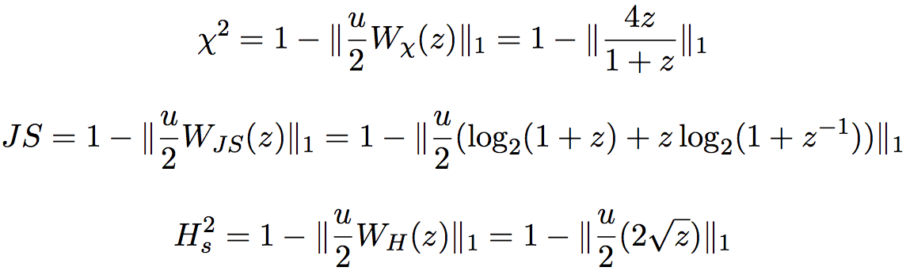
W fn
W functions
H_{s}²
(blue)
W(z)
χ²
(green)
Z_{f} =1+z+… for all f
  u(1+z) = u+v and ||u+v||₁ = 2
  Not componentwise equality
JS
(red)
z
Z functions
χ²
(green)
Z(z)
JS
(red)
H_{s}²
(blue)
z

Slide 34
Outline
Application context
Distances
3d plots
Algebraic reformulation as Z, Q, W
Ratios
Worst-case difference construction

Slide 35
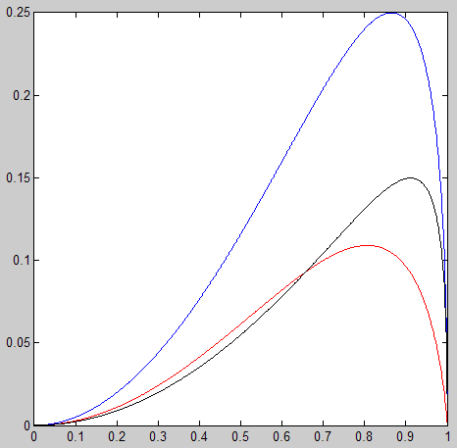
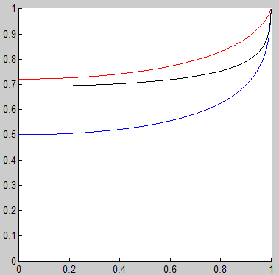
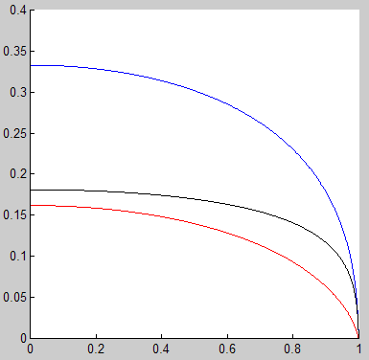
Q functions
Difference in Q functions
χ² - H_{s}²
(blue)
χ²
(green)
JS - H_{s}²
(black)
Q plots
Q(q)
JS
(red)
(Q₁ – Q₂)
χ² - JS
(red)
H_{s}²
(blue)
q
q
Ratio of Q functions
Relative difference in Q functions
χ² / JS (red)
χ² and H_{s}² (blue)
JS / H_{s}² (black)
Q₂ / Q₁
χ² / H_{s}² (blue)
(Q₁ – Q₂) / (Q₁ + Q₂)
JS and H_{s}² (black)
χ² and JS (red)
q
q

Slide 36
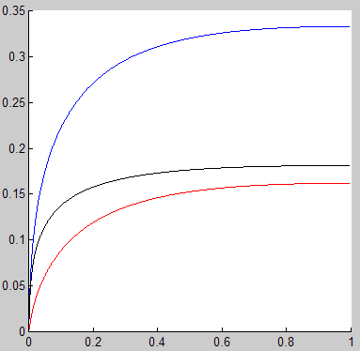
Z functions
Difference in Z functions
χ² - H_{s}²
(blue)
χ²
(green)
Z plots
Z(z)
JS - H_{s}²
(black)
(Z₁ – Z₂)
JS
(red)
H_{s}²
(blue)
χ² – JS
(red)
z
z
Ratio of Z functions
Relative difference in Z functions
χ² and H_{s}² (blue)
related by
q = (1-z)/(1+z)
p=(u/2)(1+z)
χ² / JS (red)
JS / H_{s}² (black)
χ² / H_{s}² (blue)
JS and H_{s}² (black)
Z₂ / Z₁
(Z₁ – Z₂) / (Z₁ + Z₂)
χ² and JS (red)
z
z

Slide 37
Selected theorems
Z-increasing <≈> Q-decreasing
Z, Q monotonic
Z₁/Z₂, Q₁/Q₂ ratios monotonic
Z, Q differences 1 unique max, 1 inflection pt

Slide 38
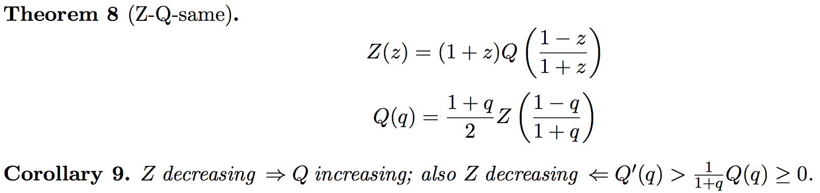
Z-Q Equivalence
1
0
z
u
o′′
v
o′
o
0
1
Z_{f} actually are decreasing (lots of algebra, derivates, L’Hopital’s rule)

Slide 39
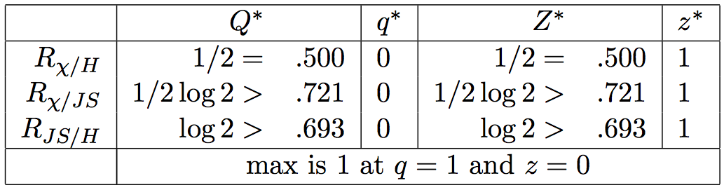
Z-Q Ratios
Thm:
Proof from componentwise
Ratio of Q functions
Ratio of Z functions
Proof from leading term of series, or
directly from functional forms
χ² / JS (red)
χ² / JS (red)
JS / H_{s}² (black)
JS / H_{s}² (black)
Q₂ / Q₁
Z₂ / Z₁
χ² / H_{s}² (blue)
χ² / H_{s}² (blue)
Key feature is large flat section.
This appears new.
q
z

Slide 40
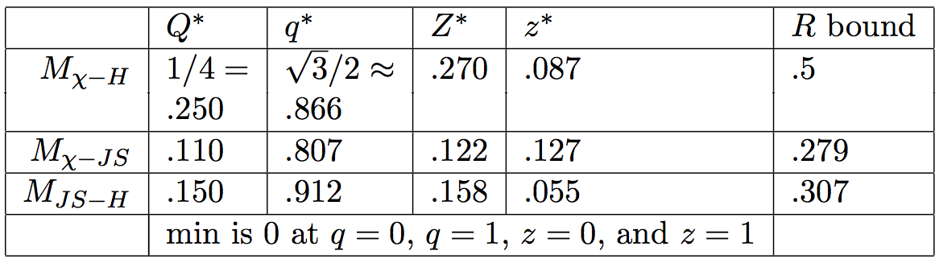
Z-Q Differences
No closed form except upper left
Difference in Q functions
Difference in Z functions
χ² - H_{s}²
(blue)
χ² - H_{s}²
(blue)
JS - H_{s}²
(black)
JS - H_{s}²
(black)
(Q₁ – Q₂)
(Z₁ – Z₂)
χ² - JS
(red)
χ² – JS
(red)
q
z

Slide 41
Outline
Application context
Distances
3d plots
Algebraic reformulation as Z, Q, W
Ratios
Worst-case difference construction

Slide 42
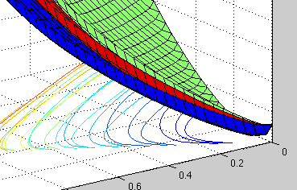
Contours
The contours looked similar?
Not local-order preserving
  Exploits different ratios for
  small z vs. moderate z
  x=[0.89, 0.1, 0.01]
  y=[0.9, 0, 0.01]
  z=[0.65, 0.35, 0]
  w=[0.6, 0.4, 0]
w
z
x
y

Slide 43
Worst-Case Construction
Find points x,y,z, such that D₁(x,y)=D₁(x,z) but D₂ gives the most different answer
Relies on
  Large K dimension
  Zero component to get small z ratios
  Moderately similar components to get moderate z ratios
    Implies Distance is small

Slide 44
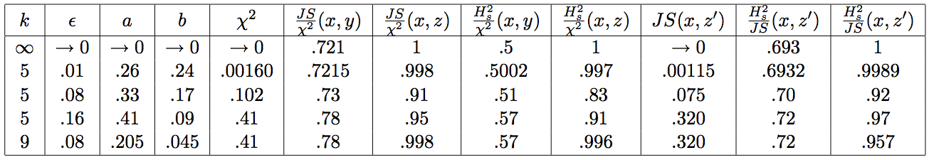
Near worst-case
Doesn’t have to be very extreme
Still relies on a zero component, but small dim k, large epsilon

Slide 45
Main Observations
Z functions
χ² - H_{s}²
(blue)
Difference in Z functions
χ²
(green)
=
=
Z(z)
(Z₁ – Z₂)
JS - H_{s}²
(black)
JS
(red)
≥
≥
H_{s}²
(blue)
χ² – JS
(red)
≤
≤
z
z
Ratio of Z functions
χ² / JS (red)
1,0
JS / H_{s}² (black)
u=1
Z₂ / Z₁
χ² / H_{s}² (blue)
u=.7
Z(z)
u= 0.4
Q(q)
q=1, z=0
q=c₁, z=c₂
p=1
p=1.5
0,0
q=0, z=1
p= 0.6
1,1
z

Slide 46
Conclusion
Insight into what distances do differently
What’s new / novel?
  Geometric analysis, pictures!
  Ratio monotonicity, difference analysis
  Algebraic limits probably known, but references hard to chase
Future
  Clustering case study on real data
  Hellinger square-root projection study
  Other families of distances
    Compound distances, Earth Mover’s
    Partition/cluster metrics
  Affect of norms other than 1-norm (triangle inequality)?
  SNL needs program in understanding effects of text-analysis pipeline knobs.

Slide 47
Notes:
h-and-g

Slide 48
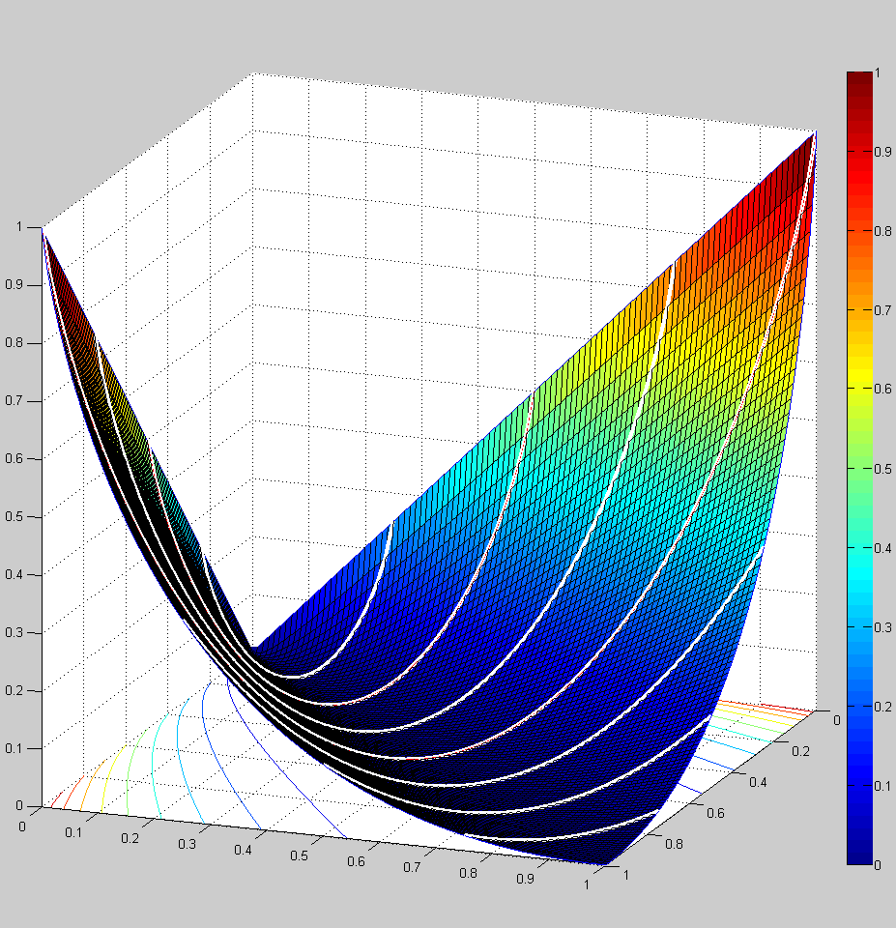
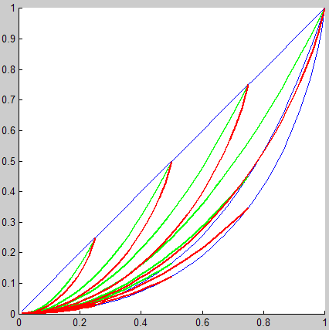
JS_{s} surface, contour lines, and x+y=c lines
Chi²_{s} (green) ≥ JS_{s}(red) vs. (x-y) for (x+y)=c
Chi²_{s} (blue) ≥ JS_{s}(blue) vs. (x-y) for x=1 or y=0
y=0 (blue) →JS_{s} = Chi²_{s} = Euclidean = x
y=0
x=1 (blue): Chi²_{s} ≥JS_{s}
x+y=1 (here Chi²_{s} = Euclidean²)
distance
x+y=1/4
x+y=1/2
x+y=3/4
x=1
x+y=3/4
x+y=5/4
x+y=1
x+y=5/4
x+y=1/2
(x-y)=0
x+y=3/2
x+y=1/4
x+y=3/2
x+y=7/4
y
x
x+y=7/4
(x-y)

Slide 49
H_{s} surface, contour lines, and x+y=c lines
H_{s} (blue) and JS_{s}(red) vs. (x-y) for (x+y)=c, x=1 or y=0
y=0
y=0
x+y=3/4
x+y=1
x=1
x=1
x+y=1/2
x+y=5/4
x+y=1
x+y=1/4
x+y=3/2
y
x+y=1/2
x+y=7/4
x+y=3/2
(x-y)
x

Slide 50
C√=H_{s}² surface, contour lines, and x+y=c lines
Chi²_{s} (green) ≥ JS_{s}(red) ≥ H²_{s} (blue) vs. (x-y)
for (x+y)=c, x=1, or y=0
y
x
(x-y)

Slide 51
for late-start summary quad chart
Euclidean
Hellinger
Jensen-Shannon
distances
from (.89,.1,.01)
(0,1,0)
(0,0,1)
(1,0,0)
Sharp upturn on lower right shows H & JS
emphasize high ratios of point coordinates.

Slide 52
S₊
2
T
1
S
Two-dimensional mixture models T, unit sphere S, and positive part of unit sphere S₊. Coordinate axis 1 and 2.
x
Point x on T projected to S₊ under normalization and square-root.

Slide 53
3
0,0,1
S₊
T
1,0,0
0,1,0
1
2

Slide 54
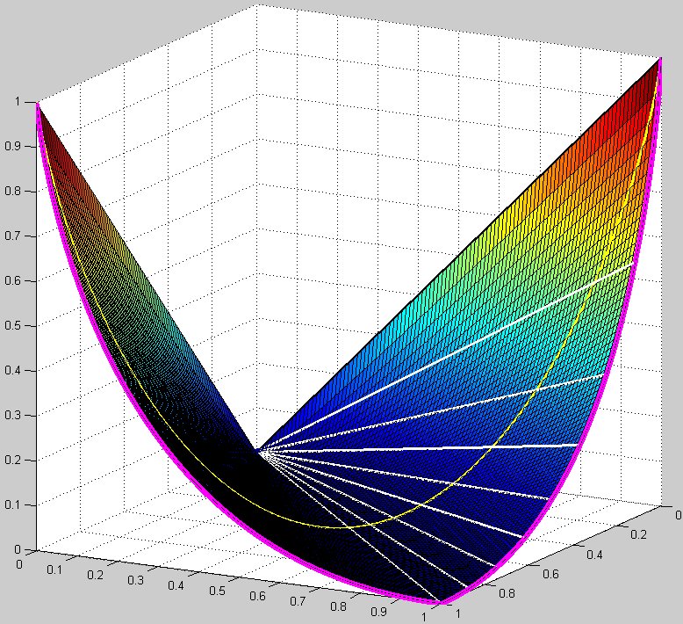
JS
q = 1 ↔ z = 0
x+y = 1 ↔ Q(q)
u=x=1 ↔ Z(z)
q = 1/3 ↔ z = 1/2
q = 0 ↔ z = 1
y
x

Slide 55
1,0
u=1
u=.7
r′
o′
labels are lengths of segments, except points o, o’
geometrically: D( ) = (r / r’) D(o) = (p/1) D(o) = p Q(q)/2
also works for p > 1
u= 0.4
Q(q)
Z(z)
o
q=1, z=0
r
q=c₁, z=c₂
p=1
p=1.5
0,0
q=0, z=1
p= 0.6
1,1
1
0
z
0
u
o′′
1
v
o′
z
o
u
labels are lengths of segments, except points o, o’
geometrically: D( ) = (s / s’) D(o) = (u / 1) D(o) = u/2 Z(z)
v
o′′
0
1
o
r′′
r
0
1

