Slide 1


Delaunay quadrangulation by two-coloring vertices or
How to turn a triangle mesh into a quad one with no global problems
Scott A. Mitchell, Mohammed Amr Mohammed,
Ahmed Hassan Mahmoud, Mohamed Salah Ebeida
Computing Research, Sandia National Labs
23rd International Meshing Roundtable (IMR23)
London, 15 Oct 2014
11:30-11:55am Wed, 20 minutes
Alexandria
University
Sandia is a multiprogram laboratory operated by Sandia Corporation, a Lockheed Martin Company,
for the United States Department of Energy’s National Nuclear Security Administration
under contract DE-AC04-94AL85000.
Notes:
I’m Scott and the lucky one who will give the talk, and I did the proofs, but
most of the original ideas are by Mohamed Ebeida in the anchor position, who is also here at the IMR
The hard work of implementation and figuring out what works best in practice was done by Mohammed Amr and Ahmed Hassan while they were undergraduates at Alexandria University in Egypt.

Slide 2
Outline
Algorithm on one page
Two-coloring idea
  Contrast to Triangle Pairing
  Even-sided polygons
  Templates for provable quality (appendix on website)
    Fixing by constrained incircle refinement
      QTran
    Constrained median refinement
(Random Algorithm)
  Well-spacedness properties, achieved by
  Delaunay refinement triangulation as input
  MPS (sphere packing) for provable quality triangulation
    center director asks Mohamed, “can you do this for quad meshes?” no, but two years later...
  Generating multi-class blue noise
  Ideal spacing
  Heuristics for better quality
Example meshes
  Dare to show raw output, before cleanup
Advancing Front Algorithm
  Row, column, repeat. Reseed.
Conclusions
  Three centers: Circumcenter, Incenter, Centroid
    orthocenter feeling left out
  Some quad meshes are not two-colorable
  Not for hex meshes

Slide 3
Convert tri mesh to quads
One-slide Algorithm
Generate (or given) well-spaced points
Delaunay triangulate
Color points red or blue
  intersperse colors
Discard red-red and blue-blue edges
Quads mostly
  good quality, some large angles
6, 8, 10 sided polygons sometimes
  constrained incircle refinement
  median template for reflex quads
All quads with provable quality
Coloring and position heuristics
improve quality in practice
Notes:
I’m taking the unusually approach of telling you the whole algorithm first, because part of the beauty of the result is its simplicity

Slide 4
Convert tri mesh to quads
One-slide Algorithm
Generate (or given) well-spaced points
Delaunay triangulate
Color points red or blue
  intersperse colors
Discard red-red and blue-blue edges
Quads mostly
  good quality, some large angles
6, 8, 10 sided polygons sometimes
  constrained incircle refinement
  median template for reflex quads
All quads with provable quality
Coloring and position heuristics
improve quality in practice
Notes:
I’m taking the unusually approach of telling you the whole algorithm first, because part of the beauty of the result is its simplicity

Slide 5
Convert tri mesh to quads
One-slide Algorithm
Generate (or given) well-spaced points
Delaunay triangulate
Color points red or blue
  intersperse colors
Discard red-red and blue-blue edges
Quads mostly
  good quality, some large angles
6, 8, 10 sided polygons sometimes
  constrained incircle refinement
  median template for reflex quads
All quads with provable quality
Coloring and position heuristics
improve quality in practice
Notes:
I’m taking the unusually approach of telling you the whole algorithm first, because part of the beauty of the result is its simplicity

Slide 6
Why does this work?
Any planar quad mesh can be two-colored
  converse, convert a two-colored graph into quads
Two-coloring makes even-sided cells
  4, 6, 8, 10...
Any triangulation of 6+ polygon
with monochromatic edges
has a monochromatic triangle
  avoid or remove mono-triangles for all quads
Input tri good quality
  template quads good quality
  (proofs in 8 page appendix, available online)
    http://www.cs.sandia.gov/~samitch/papers/delaunayquadproof.pdf
    google: mitchell sandia. click on papers
This is the only hexagon
triangulation using only
red edges,
since every blue vertex must
be in an ear

Slide 7
Incircle refinement details
halves angles
shorter but bounded edges
2n-gon has n-2 mono-triangles
  6 -> 1
  8 -> 2
  10 -> 3...
adjacent mono-triangles OK
makes a red quad
Compare to Q-TRAN

Slide 8
Pairing different than two-coloring
(unless all-quad without refinement)
The stuck configurations are very different
*
*
*
Two isolated
Unpaired triangles
All-quad
Perfect Matching <-> Two-coloring
6-sided polygon
Vertex Two-colorings
Triangle Maximal Matchings
2n-sided polygons,
containing mono-triangles
Isolated, left-over
triangles
All-quads
immediately
Notes:
There has been a lot of good work on triangle matching.
Why isn’t this a solved problem?

Slide 9
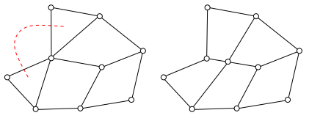
Why two-coloring vertices?
Why not matching triangles?
OK, it works and is different. Why would you want to use it?
Locality!
must make a change
Coloring
Pairing
Impossible topology
for
pairing or coloring
local template
deterministic, provable quality
global refine chords
steering heuristics
Blossom-quad
local refinements
good (best?) triangle pairing algorithm
Notes:
There has been a lot of good work on triangle matching.
Why isn’t this a solved problem?

Slide 10
Why two-coloring vertices?
Why not matching triangles?
want a change
Coloring
Pairing
swap diagonal
cascade of swaps
local changes have global scope
alternative is local refinements
star neighborhood of starred vertices
+ local changes have local scope

Slide 11
Why two-coloring vertices?
Why not matching triangles?
Matching triangles
  + match for quad quality
  slow
    - global matching alg
    - quadratic runtime
  rare isolated tri (unmatched)
    tri 1->3 quad refine
    + fixed vertices
    - global propagation
  + alternative local refine
  (complicated, several rules)
  local pair swap
  global cascade
  global difficulties
Two-coloring vertices
  colors don’t measure quality
  + fast
    + local coloring alg
    + near linear runtime
  rare isolated tri (monchromatic)
    tri 1->3 tri refine
    - adds vertices
    + no propagation
  + local color flip
  local change
  + local difficulties
“-” means a negative feature
“+” means a positive feature

Slide 12
Interval Assignment Interpretation
Two-coloring is a local assignment
  ensures even-number of boundary edges
  inherent global constraint for quad meshes
Now let’s use coloring for spatial positions

Slide 13
Back to the algorithm
Generate (or given) well-spaced points
Delaunay triangulate
Color points red or blue
  intersperse colors
Discard red-red and blue-blue edges
Quads mostly
  good quality, some large angles
6, 8, 10 sided polygons sometimes
  constrained incircle refinement
  median template for reflex quads
All quads with provable quality
Coloring and positions improve
quality in practice
We can take any Packing
or Delaunay Refinement triangulation and
two-color vertices arbitrarily.
We can do better!

Slide 14
Sphere packing, better control than Delaunay Refinement
Delaunay Refinement
  build quality, packing results
  If triangle has bad quality
    Then add a point
  On termination, we have a sphere packing
MPS
  build packing, quality results
  If packing is not maximal
    Then add a point
  On termination, the Delaunay triangulation will have good quality.
Equivalent in theory
  bad quality = empty sphere is large (non-maximal)
  compared to edge length (empty-disk)
What is MPS? Sphere packing, output of
  Insert random points
    With “Poisson” process, and rejection
Ω
x₄?
Provable angle bounds by Central Angle Theorem
We claim in practice, sphere packing
has better (direct) spacing control
sphere packing algorithms are practical, our 2011-2013 work
see Dafna Talmor thesis for quality theory

Slide 15
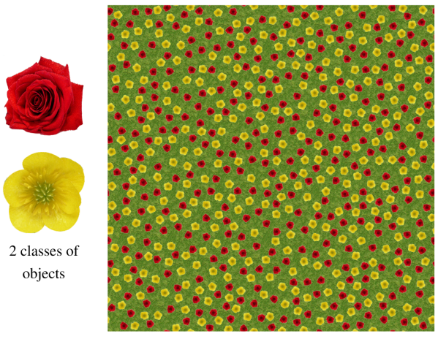
Reducing the Frequency of Mono-tris
Sphere Packing with Two Colors
no red points
Blue-blue farther than blue-red
Mono-triangles less likely
can fit opposite
color inside
no blue points
discard long diagonals
for square-like quads

Slide 16
Reducing the Frequency of Mono-tris
Two-radii Plus Color Switching
no red points
Color switching works even better!
if mono-tri, change color of one vertex
no blue points
Ratio 2.5 works well,
> sqrt(2) square diagonal
no switching
switching, stubborn 2%

Slide 17
Resolving Stubborn Mono-tris
Circumcircle Delaunay Refinement
Removes the mono-tri
Rare cases produce another mono-tri,
requiring more refinement...

Slide 18
Avoiding Reflex Quad
median
Median-refinement template is provably good
  but not that good, 10-174 degrees
Practical alternative
  remove vertices and resample locally
  works every time in practice
offset
median
1/5
30°
15°
15°
30°
120°
60°
45°
45°
worst case:
incircle followed by reflex refine

Slide 19
Heuristic Summary
Reduce frequency of mono-tris
  Two-color multiclass sampling with radii ratio 2.5
  Color switching
Resolve mono-tris
  Delaunay incircle refinement
Avoid reflex quads
  Local resampling
Traditional cleanup may also be applied post-process
  we provide ok quality, convex-element starting point

Slide 20
Curved Surfaces
Mesh Size may Vary
coarse
slowly varying
sizing function
fine

Slide 21
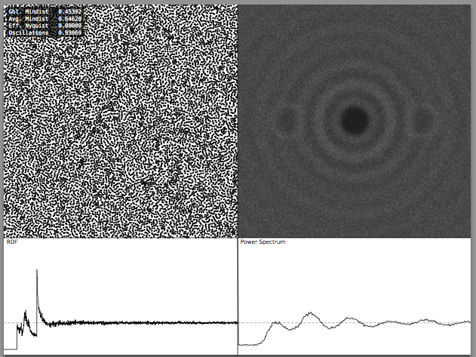
Fourier Spectrum
Some graphics applications
rely on random positions
to avoid artifacts
vertex-vertex
distances
Fourier transform

Slide 22
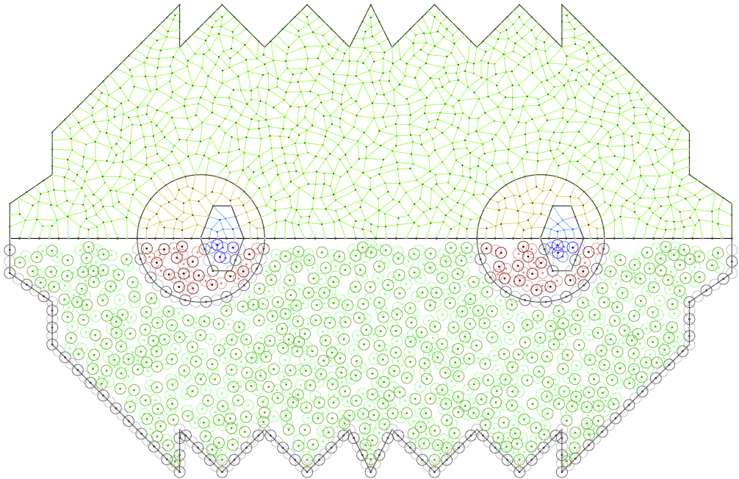
Random
reflected image
produce mesh above
disks below

Slide 23
Structured
reflected image
produce mesh above
disks below

Slide 24
Advancing Front for Structured
Advance front
  columns, rows of disks set spacing and color
  fill front collision zones by random algorithm
domain boundary

Slide 25
Advancing Front for Structured
Advancing Front for Structured
add blue disks
centered at intersections of
large blue circles
no blue points allowed
in blue shaded
This is the closest we can place blue disks
and not violate the blue-blue separation distance

Slide 26
Advancing Front for Structured
add red disks
centered at intersections of
large red circles

Slide 27
no red points
some gaps arise because
some red and blue disks would
violate the separation distances,
don’t add those
no blue points
some gaps arise
from diverging fronts
e.g. large blue circles didn’t intersect

Slide 28
typically
one fewer disk per layer
on each front
pyramid-like termination

Slide 29
horizontal advancement
can continue vertical advancement

Slide 30
fill large gaps with random algorithm
small gaps are provably OK
Most gaps are where fronts collide

Slide 31
Sharp Corners
Add opposite-colored midpoint
on mono-edges
exploit alternating boundary colors

Slide 32
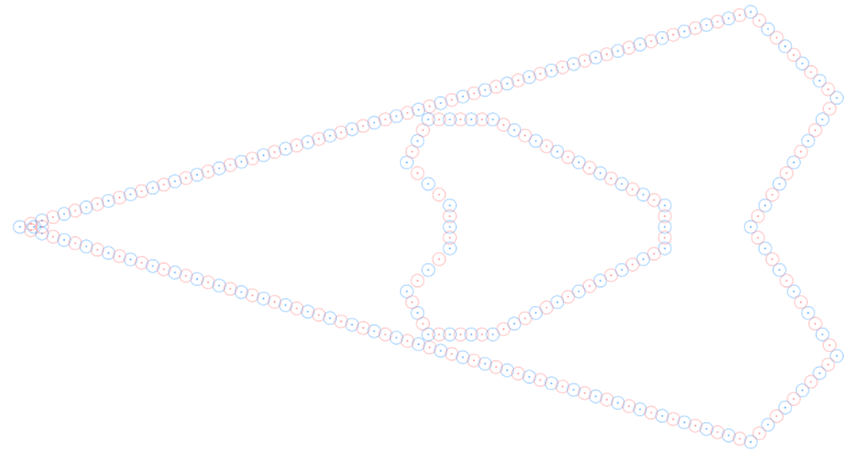
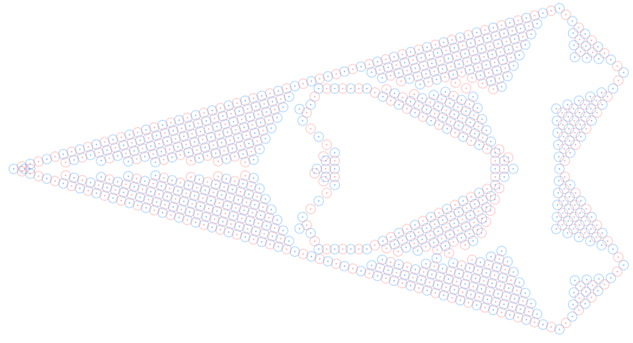
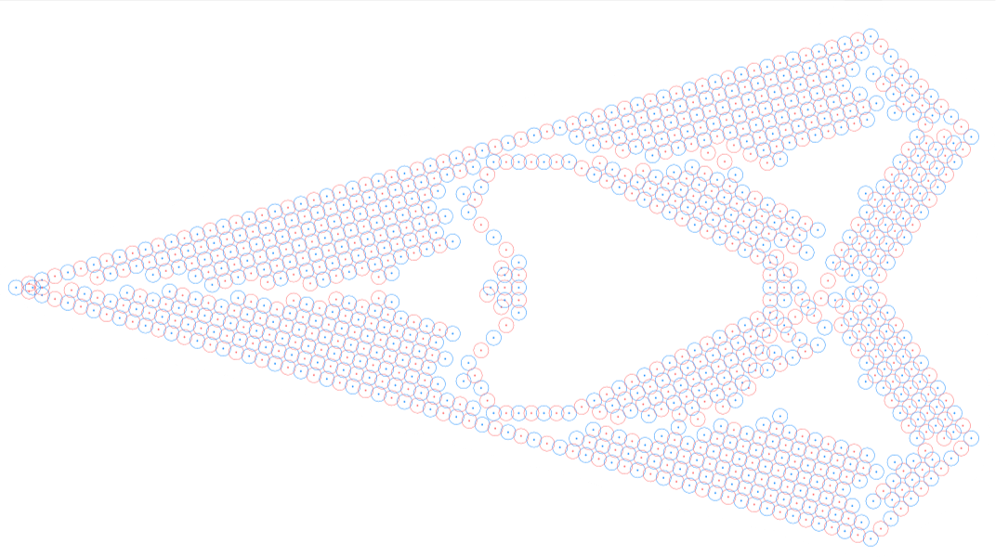
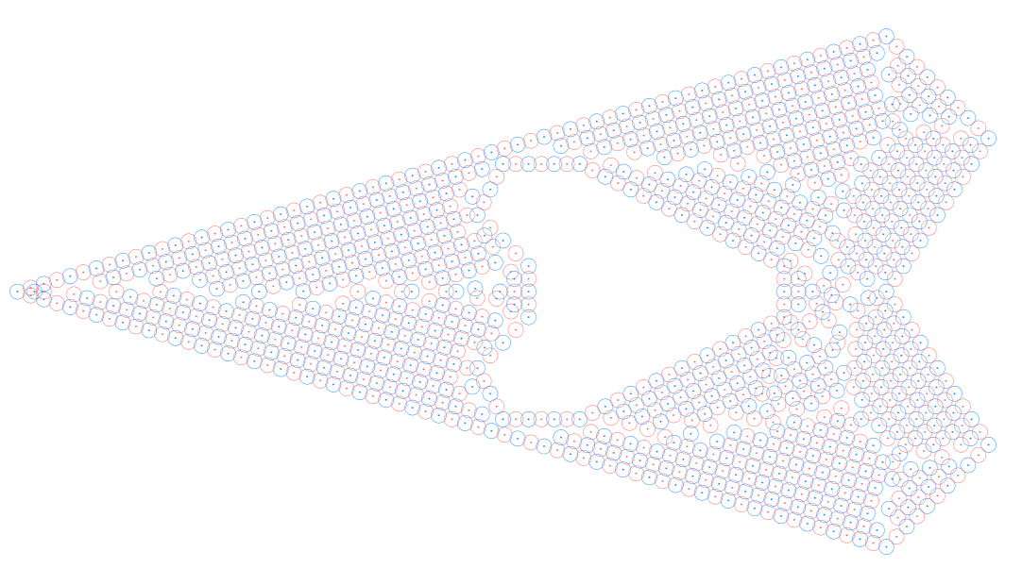
Adv. Front Wedge
(example of a coarser mesh
than the disk pictures)

Slide 33
Bimba
random

Slide 34
Bimba
adv. front

Slide 35
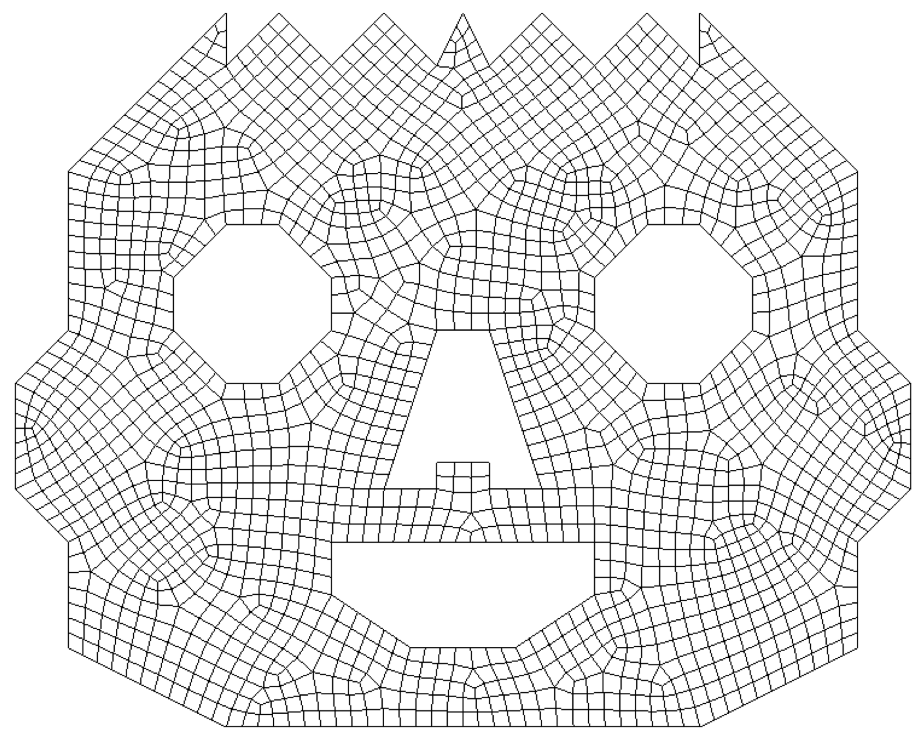
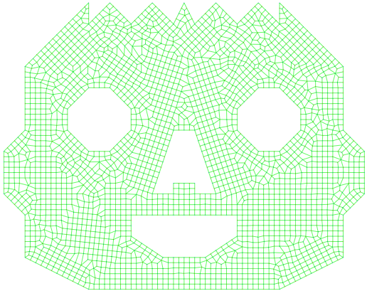
Qualitative comparison to a production code
Cubit paver
Two-color adv. front
no cleanup

Slide 36
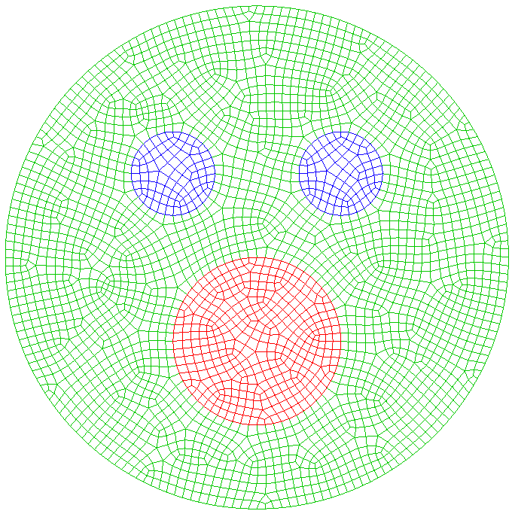
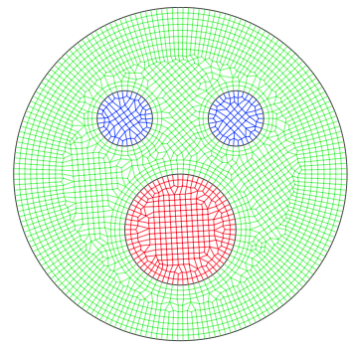
Qualitative comparison to a production code
angles
aspect ratio
Cubit paver
Two-color “biased” adv. front
no cleanup

Slide 37
Closing Thoughts
B
Three centers: Circumcenter, Incenter, Centroid
A_{b}
Incenter for mono-tris
template
Circumcenter for mono-tris
heuristic
c
a
M_{c}
M_{a}
D
a/2
c/2
M
A_{c}
a/5
M_{b}
C
A
b/2
b
Centroid (median)
for reflex quads
median
Orthocenter feeling
left out
offset
median
1/5
deviantArt Free Ai Vector Smiley Pack
by MathieuBerenguer

Slide 38
Closing Thoughts
We create two-colorable quad meshes
  For non-disk domain topologies,
  some given quad meshes are not two-colorable
odd-cycle of edges
non-disk domain topology
?
?

Slide 39
Closing thoughts
  Can we create hex meshes by coloring?
    no.
    2d, a chain of edges of even length -> 2n-gon
    3d, a chain of edges of even length
    != edge cycles bounding hexes
    Pairings: combine tets to form hexes?
    Closest idea: graphics and meshing literature on 3d cross-fields and connecting hex-duals
  Can we create hex meshes by coloring?
    no.

Slide 40
Reasonable Extensions
Questions
  Varying-size advancing front?
  How fast can we vary the size?
    Bounds for two-radii DT known

Slide 41
Summary
Three key ideas
  Graph theory, two-coloring of vertices
  Random sphere-packings (better control than Delaunay refine)
  Advancing front
Features
  Robust
  Simple
  Local
  Provable quality
  Heuristics for good quality in practice
  What more do you want?
Quality is reasonable before cleanup
  someone could build a production tool based on this
  add traditional cleanup

