Slide 1





Sifted Disks
reducing the number of sample points
retaining randomness
improving quality
Mohamed S. Ebeida
Ahmed H. Mahmoud - Muhammad A. Awad - Mohammed A. Mohammed Scott A. Mitchell
Alexander Rand - John D. Owens
7!
Sandia
National
Laboratories
Alexandria
University
presenter = Scott
Eurographics 2013
Sandia is a multiprogram laboratory operated by Sandia Corporation, a Lockheed Martin Company,
for the United States Department of Energy’s National Nuclear Security Administration
under contract DE-AC04-94AL85000.
Notes:
Takes a village to make me successful
Mohamed Ebeida, lead author with me at Sandia National Laboratories
Spends saturdays mentoring undergrad students at Alexandria, his undergrad
Mohamed – his idea
Alexandria -- implementation
Me – algorithmic correctness proofs
Alexander Rand – quality measurements and relationships
John - graphics prof at UC Davis, Ebeida’s PhD there

Slide 2
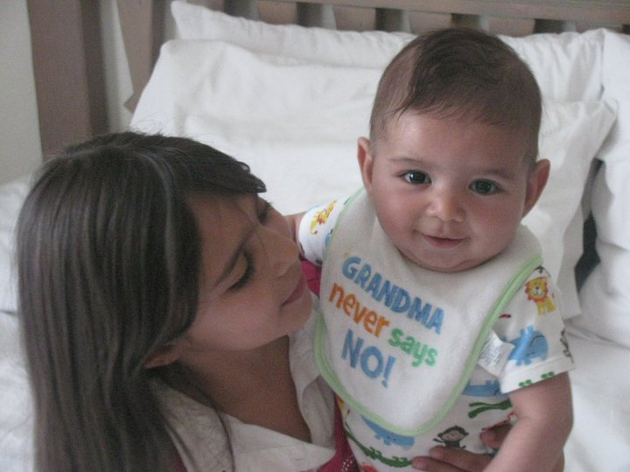
Mohamed Ebeida’s (first author’s) kids, in full color
Omar
Meera

Slide 3
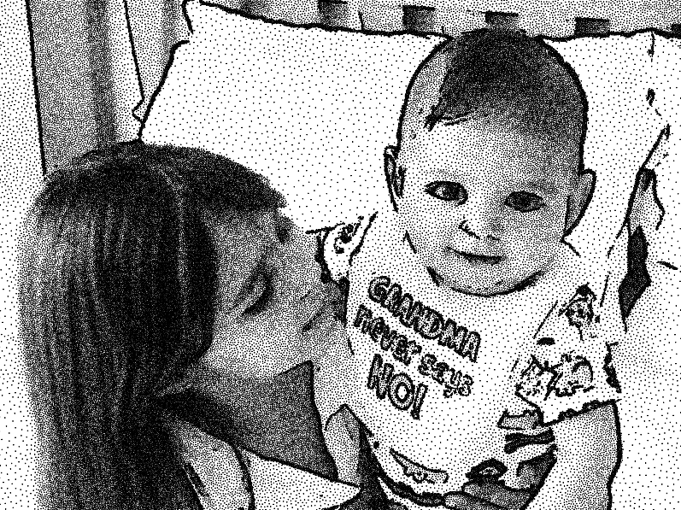
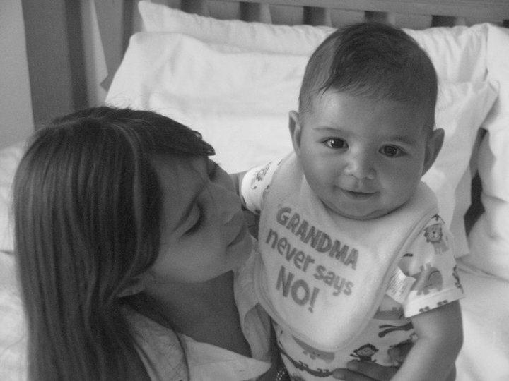
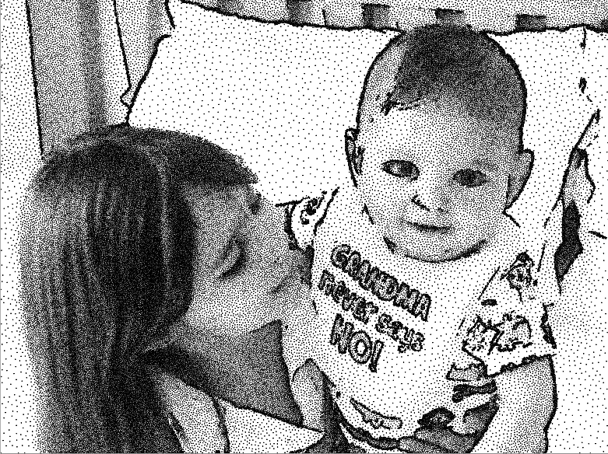
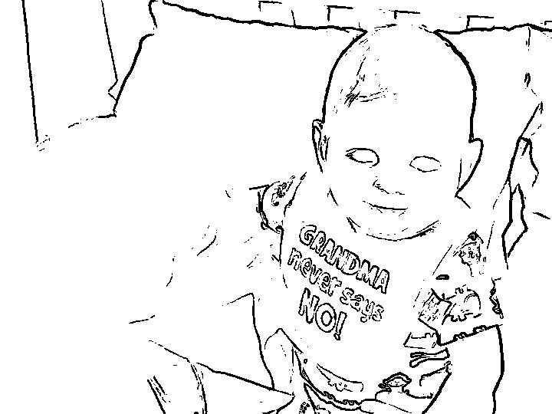
Application
1. grayscale -> sizing function for
2. Stippling via
Maximal
Poisson-Disk
Sampling
3.
Sift points
Replace 2 for 1.
Respect original
sizing function.
Fewer points
Minimal quality loss
Universally lighter, but features still distinct
edge-detect

Slide 4
Overview
Input: point sample distribution
Poisson disks, Delaunay Refinement
  Sizing function
    Adheres approximately
Observe: other distributions also respect sizing function,
might be smaller
Process
  Replace points 2-for-1
  Adhere to sizing function
Result
  Goal 1: Fewer points --- how many?
  Goal 2: Retained randomness --- surprise!

Slide 5
Input point sets – improve them
Sifting points from
DR Delaunay Refinement
ODR Delaunay Refinement w/ Off-centers
MPS Maximal Poisson-disk Sampling
DR – Delaunay Refinement
new disk
center of large empty dual circle
MPS – Maximal Poisson-disk Sampling
new disk
global uniform random locations
outside prior disks

Slide 6
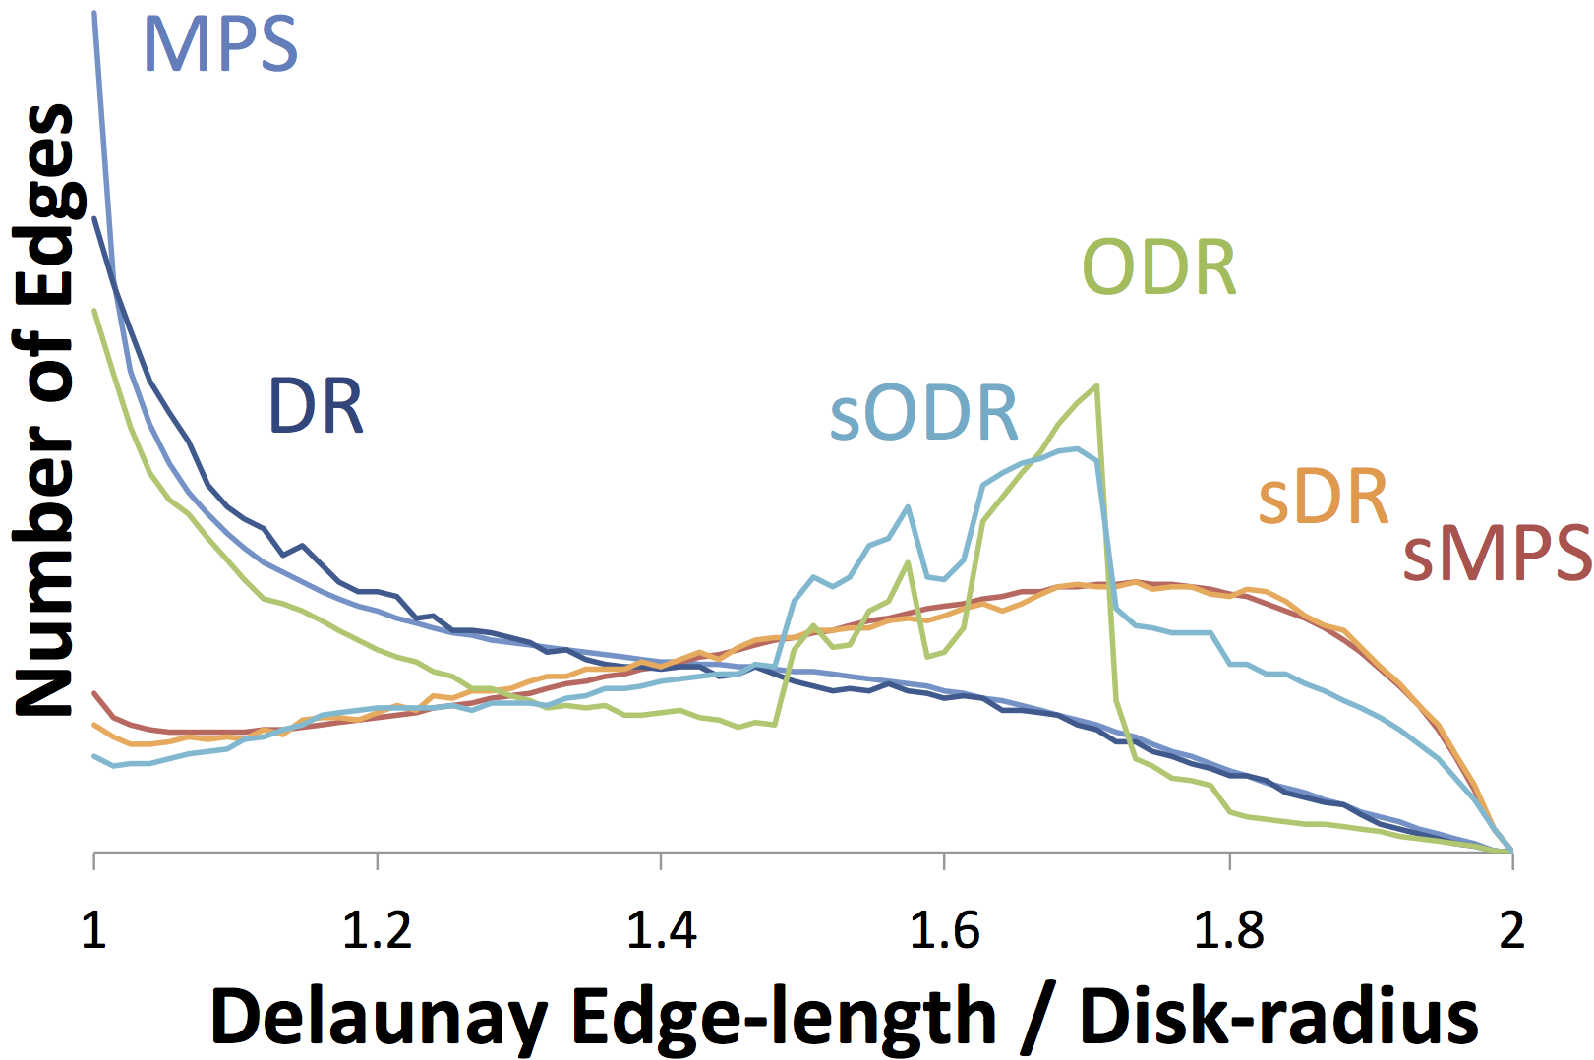
Problem
Painting Yourself Into a Corner
MPS
MPS, DR
easy to introduce a small gap that later forces
  distance = r + eps
  dense sampling
DR
1
gap
←→
disk later
many || edge || ≈ r
2

Slide 7
DR Solution off-centers DR (ODR)
move disk
towards short edge
DR
gap
←→
disk later
ODR
no gap
fewer || edge || ≈ r
many 1.6 r

Slide 8
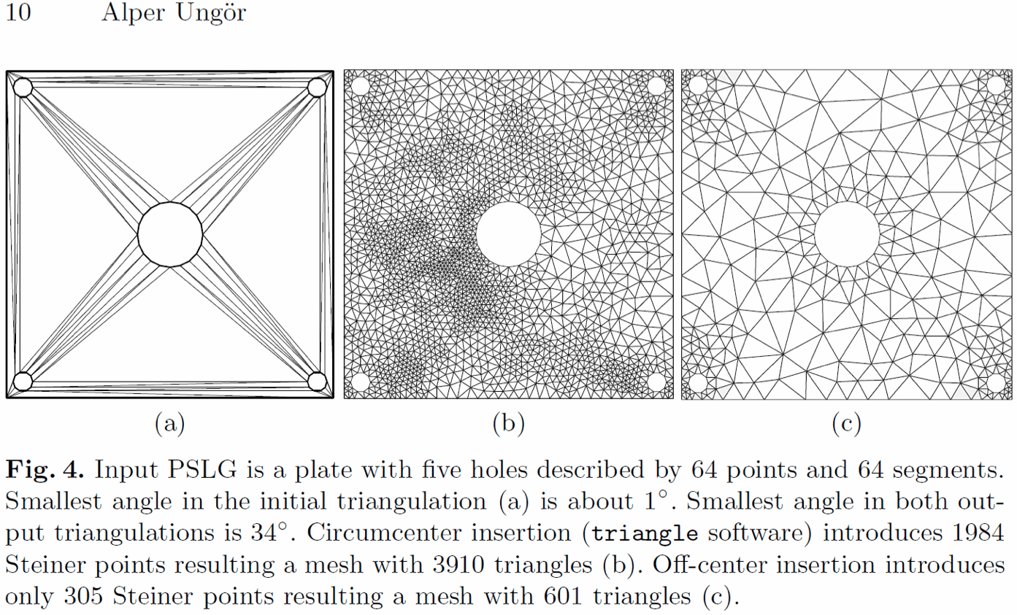
Offcenters reduces density… by a lot for non-uniform sizing functions
But we will focus on
r = 1, uniform
“Off-centers: A new type of Steiner points for computing size-optimal quality-guaranteed Delaunay triangulations”
(a) input
(b) DR
(c) ODR

Slide 9
Our MPS-like Solution: Sifting
Post-process
For all pairs of points with overlapping disks
  Try to replace 2-for-1
  (Replacing changes the set of overlapping pairs)
Quit when no pair can be replaced
replaced

Slide 10
Sifting Algorithm
Gather Boundary Disks
1. Gather disks overlapping P
  (Q)
Sort by angle around P (Q)
P
Q
P
Q
2. Stitch lists together
  Replace Q in ListP by ListQ
3. Remove duplicate disks

Slide 11
Sifting Algorithm
Winnow Non-Bounding Disks
Remove disks not bounding the white area
  Test consecutive disks in list, see if left point of intersection is inside next disk
bounding me?
  In-circle test speeds up intersection point test by 3x
  technical for non-constant radius, details in paper ☺

Slide 12
Sifting Algorithm
Exclusion – Inclusion Disks
  A new disk will cover all the white area
    iff it covers all the corners of intersection
    Reason: because disks are convex
  Need replacement disk
    Outside all sample disks
    Inside all dual corner disks
Is there a common intersection?

Slide 13
Sifting Algorithm
Search for Random Location – Using “Simple MPS”
  Problem: find random point that is
    Outside all sample disks
    Inside all dual corner disks
Simple MPS Algorithm Details
Initialize
bounding box of purple corners
subdivide into squares - diagonal about radius
Sample C | #square times |
pick a square
pick a point p in the square
keep p if out-blue & in-purple
success!
Refine all squares
center inside a blue circle - delta? Discard
center outside a purple circle + delta? Discard
Repeat with refined squares
No squares? No replacement exists
in
out
  Solution
    Simple MPS [Ebeida et al. Eurographics 2012]
    extended for purple inclusion disks
    Flat quadtree
      approximates acceptable region
in?
success
out?
!out then discard 
!in then discard 

Slide 14
How Well Did We Do?
Goal 1: Number of points = density

Slide 15
Sifting Improves All
Uniform Test Distributions
Sifting improves, MPS, DR and further improves ODR
MPS
sMPS
Sift->
DR
sDR

Slide 16
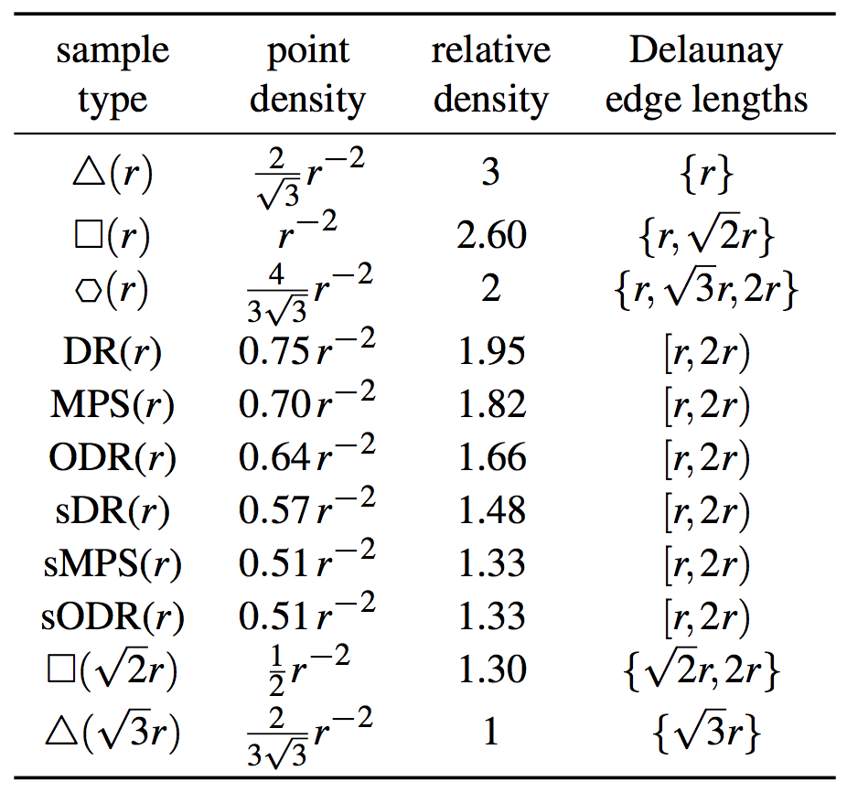
Sifting reduces number of points by ≈25%
density bracketed by non-random tilings
densest possible
r edge length
input
r circumcircles
both
sifted
sparsest possible

Slide 17
Sifting changes triangulation edge lengths, angles, Voronoi cell squish
Removes most of the short edges
adds long edges

Slide 18
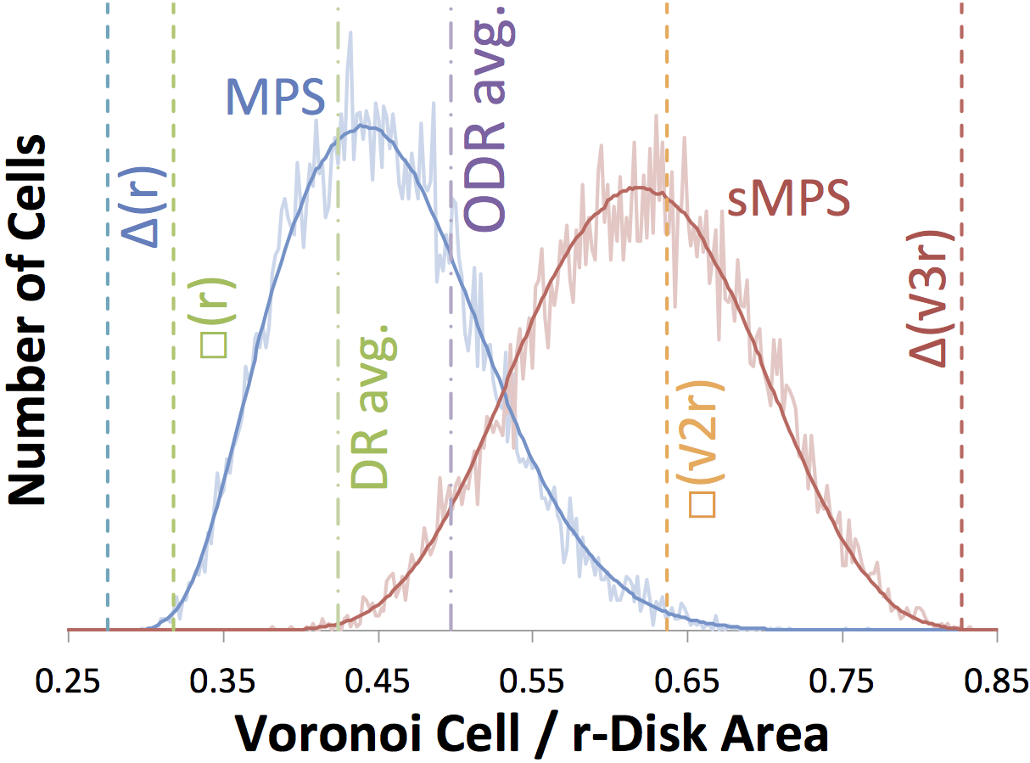
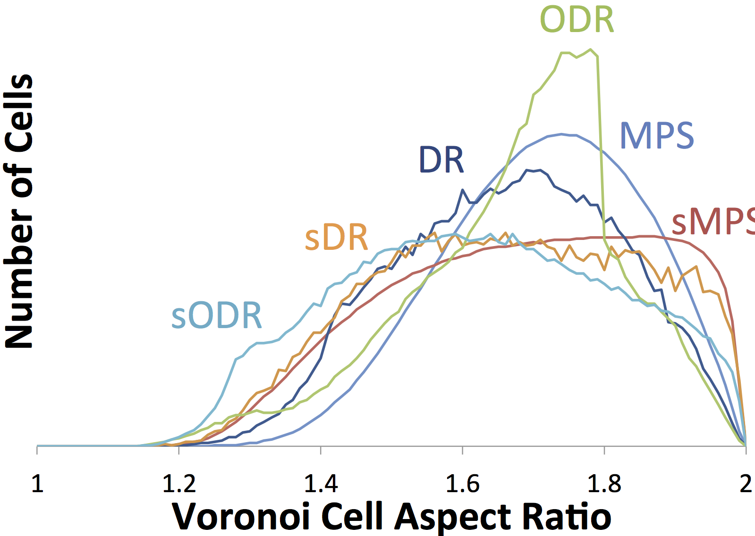
Sifting changes triangulation edge lengths, angles, Voronoi cell squish
shifts Voronoi cell area distribution
spreads Voronoi cell aspect ratio
dense
sparse
round
cells
stretched
cells

Slide 19
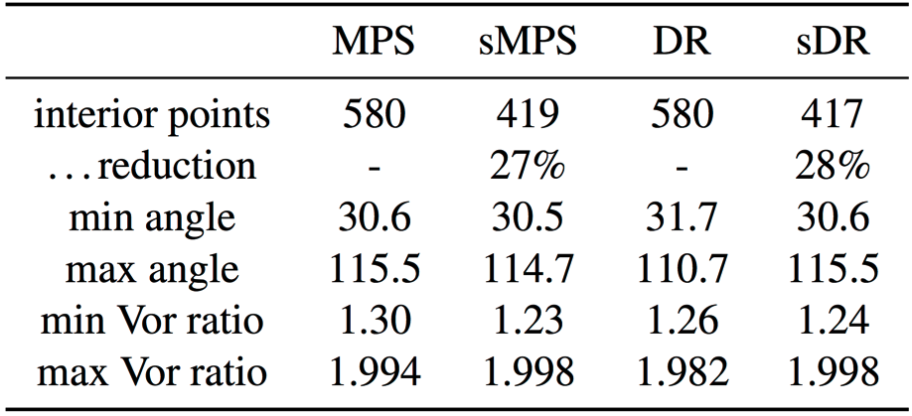
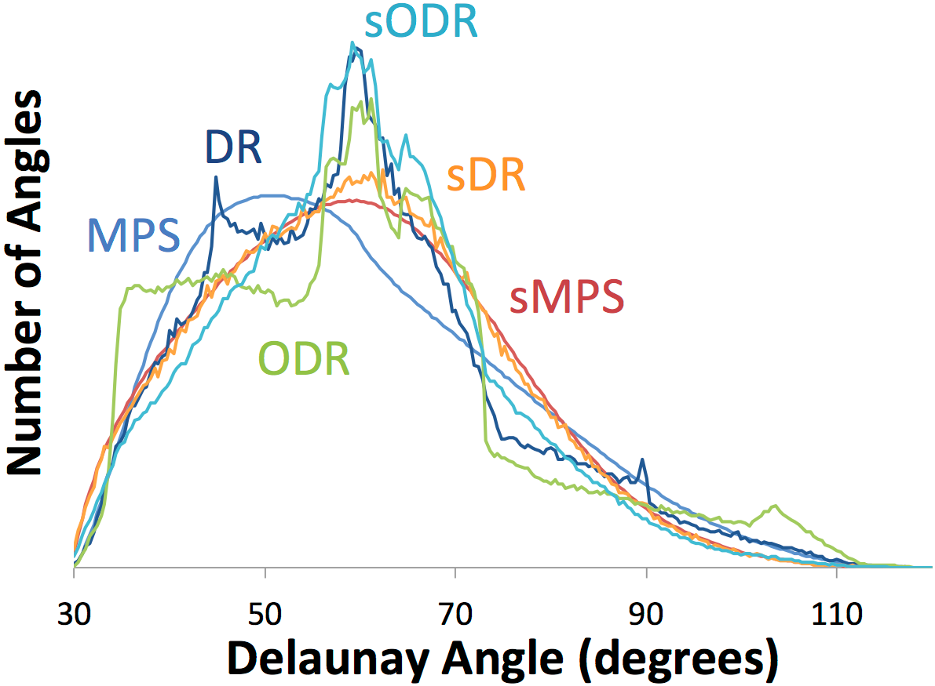
Sifting changes triangulation edge lengths, angles, Voronoi cell squish
changes angle distributions
extremes the same, 25% fewer points
angles are related to Voronoi aspect ratio …

Slide 20
How Well Did We Do?
Goal 2: Randomness

Slide 21
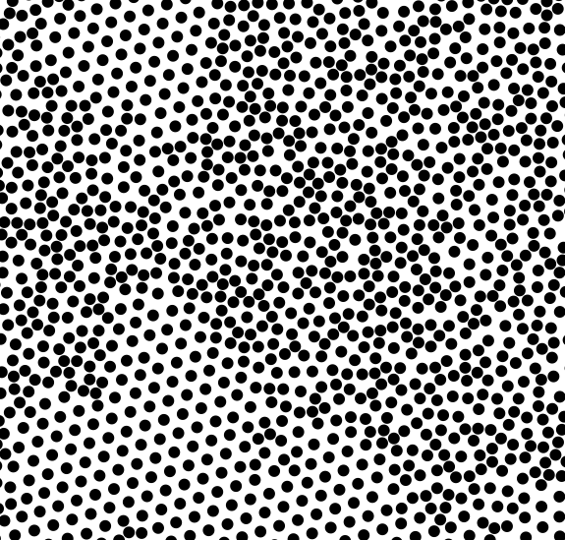
DR and ODR
Sometimes Appear Random
Many control parameters
  Which circle (off) center to insert next?
Start with random-looking
DR, ODR
Not these!
ODR

Slide 22
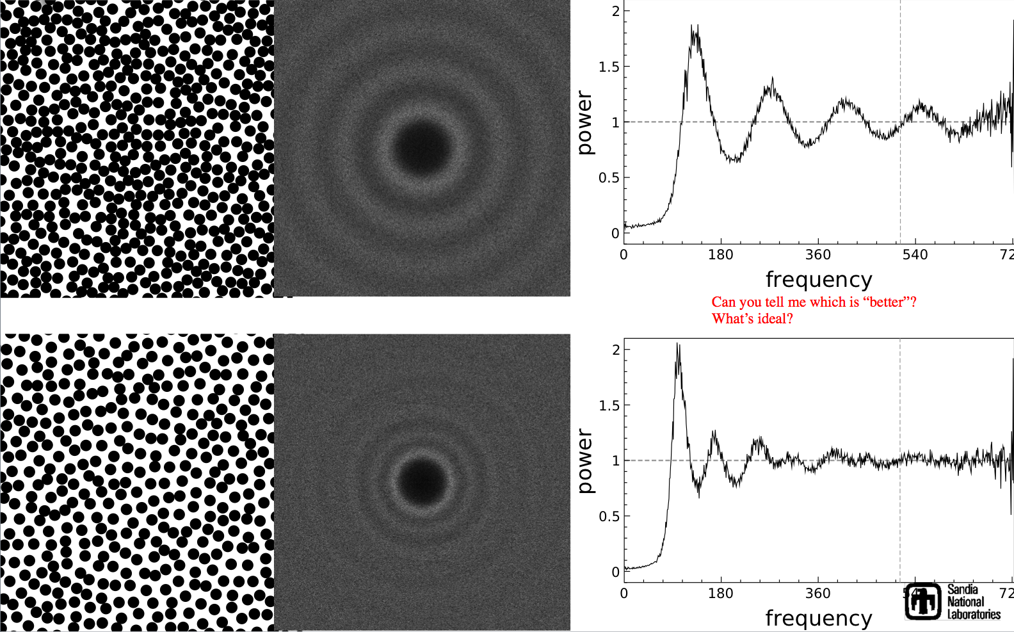
Sifting Retains Randomness
Surprise! But not identical.
MPS
MPS
Can you tell me which is “better”?
What’s ideal?
sMPS

Slide 23
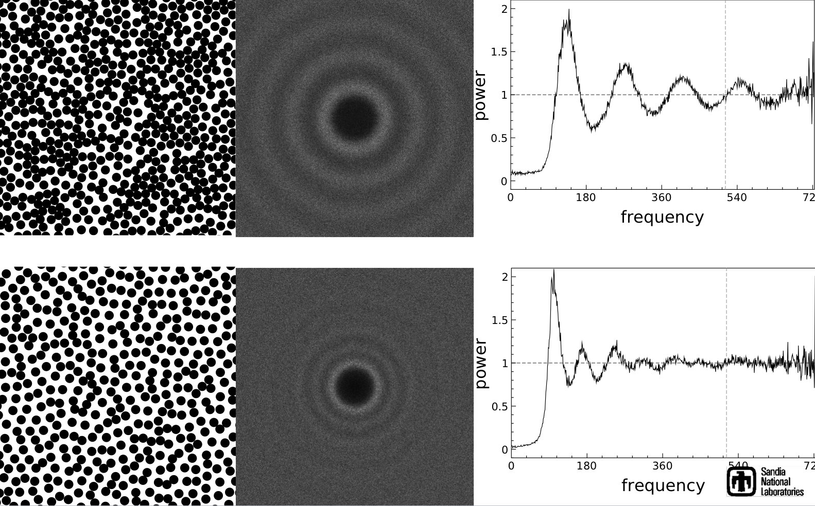
Sifting (introduces?) Randomness
Surprise! But not identical.
DR
DR
Can you tell me which is “better”?
What’s ideal?
sDR

Slide 24
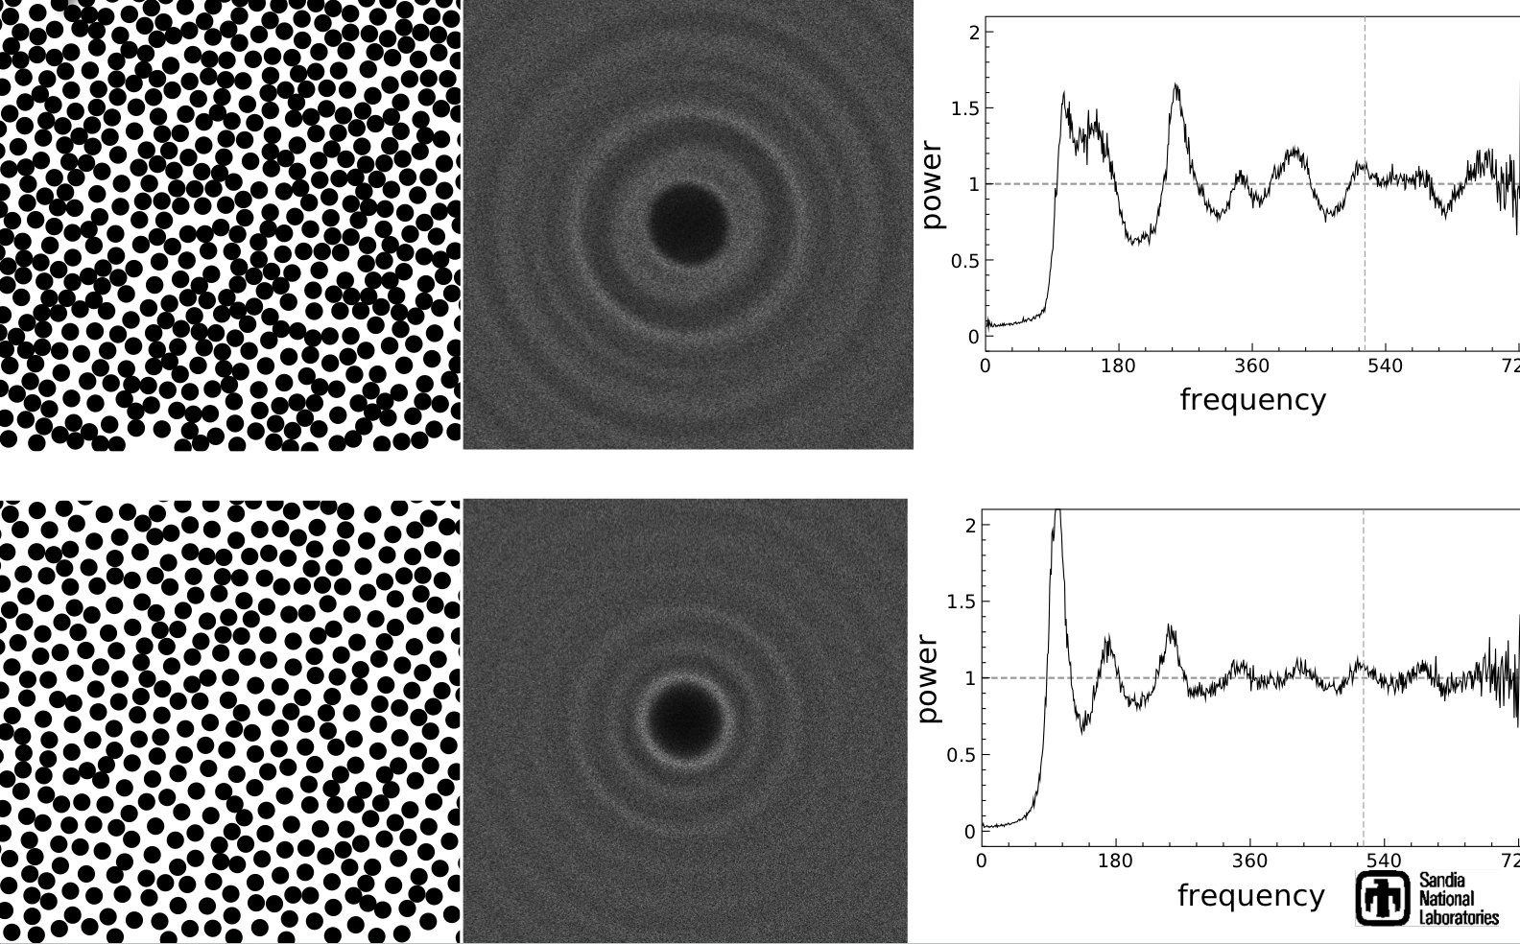
Sifting (introduces?) Randomness
Surprise! But not identical.
ODR
ODR
Can you tell me which is “better”?
What’s ideal?
sODR

Slide 25
Original distribution doesn’t seem to matter much
sMPS
sDR
sDR
sDR density 1.48
sMPS density 1.33
sODR density 1.33

Slide 26
What’s happening?
Gets less dense but never gets close to “converging” to a structured mesh
  No pair can be replaced by one.
    Stuck at a globally random configuration
  A triple can be replaced by two? Would we want to?
MPS
sMPS
3
2
1.8
1.3
1
density

Slide 27
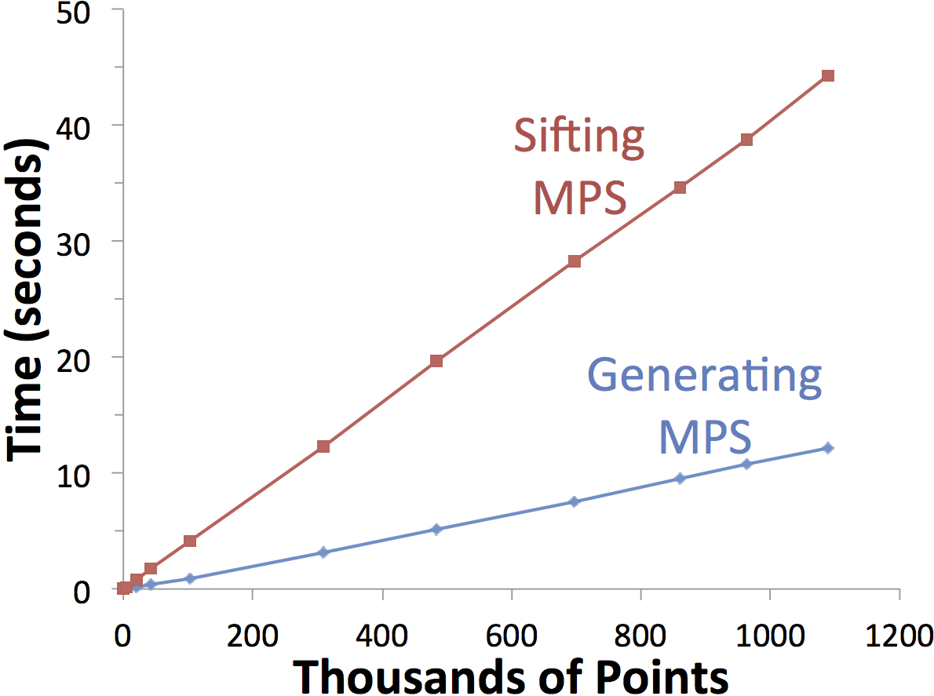
Time and Memory
Effectively Linear
Sifting 4x slower than generating MPS
  but done offline…
  ≈ 1.5 million / minute on CPU

Slide 28
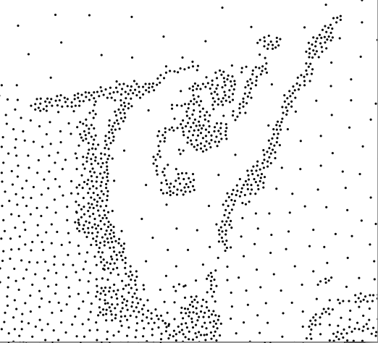
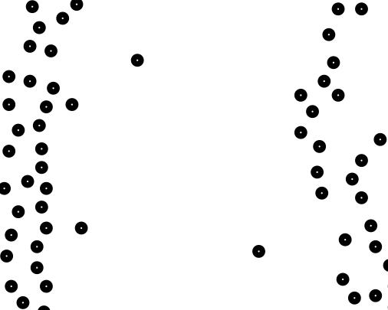
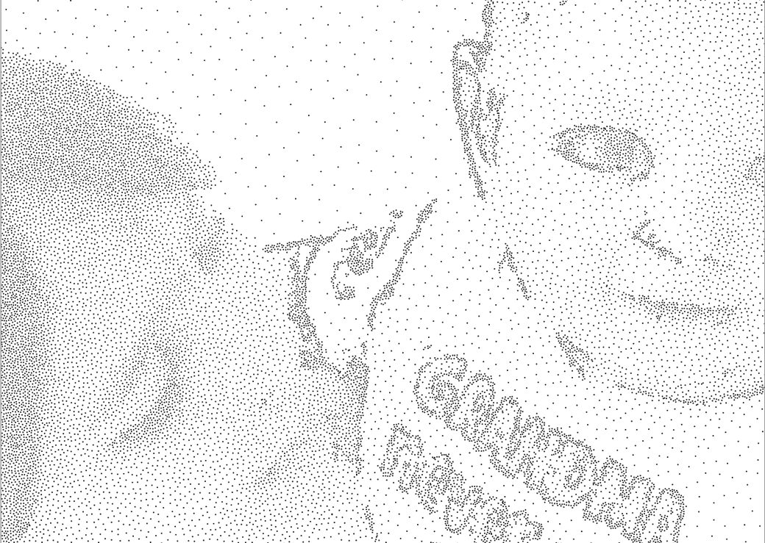
Beyond Uniform
Prior explanation constant radius
Spatially varying radii
  Theory
    Maximum rate of change L
    L = 1, 1/2
  Stippling application
    L exceeds theory limit, still works
    Disk radius ratio = 10
grayscale sizing function, high contrast
abrupt density changes

Slide 29
Beyond 2d
Prior was all 2d
  Higher dimensions
    Seems straightforward to implement
      Too many purple points for d>5? 6? Kissing number ≈ 3^{d}
    Effectiveness unknown

Slide 30
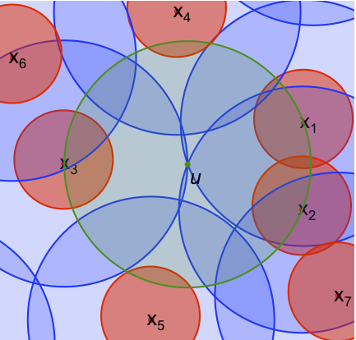
Bonus Thought how I think about sampling
Variable Radii MPS
(two-radii variant)
Mitchell et al.
CCCG 2012

Slide 31
Summary
Sifting (replace 2-for-1) points
  Reduces the number of points
  Retains randomness and quality
  Poisson-disk sampling as a subroutine - resample
To do
  Theory for rapidly varying sizing function, L >> 1
  High dimensions
  Generate a sparser distribution to begin with

Slide 32
Representative image for website
Sifted Disks

