Slide 1
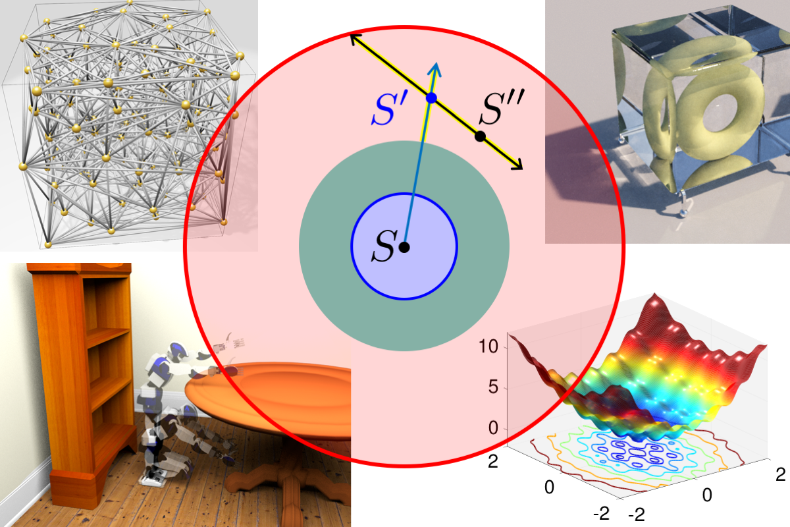


Primal-Dual Mesh Optimization with Mathematical Foundations
Scott A. Mitchell¹
Patrick M. Knupp²
¹Sandia National Laboratories
²Dihedral
Abstract
Preliminary Results
Potential Impact
We investigate math and algorithms for primal-dual meshing and quality improvement.
We study the mathematics of dual Voronoi polyhedral, error bounds, and high dimensional spaces. We develop optimization and resampling algorithms.
Discovered
Why optimizing HOT behaves badly
What heuristics are trying to avoid
・ Bad local min collapse elements ・ Holes in inversion barriers ・ Steep gradients ・ Dubious extrapolation
Enable full potential of modern discretization techniques
Better meshes for DEC, mimetic FEM, etc.
Open general-purpose mesh-improvement library
Useful for many types of simulations. No other open-source capabilities exist.
Meshes optimized for multi-physics simulations
Faster stockpile analysis with polyhedral-element simulations
Mathematical understanding of primal-dual energy metrics
Enabled new metric design that should behave better under optimization.
Near-Future
Actually optimize and resample for new metric, tune for efficiency.
Extend to weighted meshes ⎯ challenging due to units and scales.
Demonstrate well-centered resampling for metrics closely-tied to simulation error.
Future work: tie results to simulation practice.
How connected are theoretical error bounds and actual simulation error?
Better off optimizing some other metric?
Do coarser meshes and worse quality suffice in practice?
Motivation
Primal-dual (well-centered) meshes appear in Discrete Exterior Calculous (DEC) formulations and compatible discretizations of PDE’s. Primal and dual elements are geometrically orthogonal, and ideal for orthogonal physics: e.g. divergence-curl ocean-flow phenomena.
Optimizing HOT collapses triangles!
(0,1)
Input
min
min
(8,0)
Delaunay triangulation (black) and
dual Voronoi polygons (gray).
Primal edge ⇔ dual Voronoi edge .
Primal triangle ⇒ dual a half-edge of .
(0,-1)
Better extrapolation alone creates only partial barriers
Two local minima,
both collapse triangles!
error
error
HOT energy depends on and .
HOT bounds the discretization error of Ax=b. Diagonalization of Hodge-star operator creates error, depending on how well-centered the mesh is, e.g. distance from blue vertex a to blue triangle’s barycenter
Synergy
Renewed FY19-22 with new climate synergy, partner Darren Engwirda
Jigsaw for E3SM climate coastal meshing
HOT primal-dual and Voronoi crust inform creating near-coast ocean meshes.
Surface meshes aligned with depth contours for down-slope flow from melt
Extend HOT analysis and metrics to E3SM Mimetic Optimized Discretizations (MOD)
Discover if MOD has same limitations as HOT
Design well-behaved objectives with certified mathematical properties.
New algorithms to optimize objectives, not ad hoc operators.
We designed HOT to overcome the shortcomings of HOT
・ Better under optimization・ Still reduces discretization error
DEC
Discrete
Exterior
Calculus
Better extrapolation and nonlinear scaling
Create full barriers to inversion (collapse)
Preserve good-minima locations
matrix
References
HOT: Hodge-star Optimized Triangulations
Meshes Optimized for Discrete Exterior Calculus [tech report 2017]
Spoke-Darts for High-Dimensional Blue Noise Sampling, [ACM TOG 2018]
Fast Approximate Union Volume in High Dimensions with Line Samples [tech report 2018]
Sphere Sampling for Meshing & Reconstruction with Delaunay & Voronoi Cells [GIDS Workshop, 2018]
A Constrained Resampling Strategy for Mesh Improvement [CGF 2017]
A Seed Placement Strategy for Conforming Voronoi Meshing [CCCG 2017]
Sampling Conditions for Conforming Voronoi Meshing by the VoroCrust Algorithm [SoCG 2018]
VoroCrust: Clipping-Free Voronoi Meshing [manuscript]
State-of-art weakness
HOT energy is good at evaluating quality, bad at optimizing it
Undesirable local minima
Heuristics and preconditioning common
Under-explore space of possible meshes
Quality Improvement by Resampling Node Positions
General framework [CGF 2017, GIDS 2018]
Multiple objectives, none degrade.
Nodes relocated, inserted, deleted, within local feasible space.
Satisfy a quality threshold, not optimize quality. Thresholds are barriers.
Stuck in bad local minimum is possible, but rare.
Eliminate obtuse angles:
triangle well-centered in dual cell
Dual Voronoi meshes are valued independent of the primal. Voronoi cells boast mathematical properties, e.g. convex and flat facets, and fill space efficiently.
Polyhedral Voronoi cells enable fracture mechanics (Labs), and fluid flow (industry).
Approach
ASCR Team members:
Scott A. Mitchell (SNL)
Patrick Knupp (Dihedral)
Synergistic partner:
Darren Engwirda (Columbia University)
Recent Team members:
M. Deakin (Sandia -> UBC),
S. Mousley McKay (UIUC)
Additional co-authors:
A. Abdelkader (UMD), M. A. Awad (UC Davis),
C. L. Bajaj (UT Austin), M. S. Ebeida (SNL),
A. H. Mahmoud (UC Davis), D. Manocha (UNC),
J. D. Owens (UC Davis), C. Park (UNC),
A. Patney (NVIDIA), A. A. Rushdi (SNL, Northrop
Grumman), L. P. Swiler (SNL), and L. Wei (HKU).
Mathematical depth in computational geometry, sampling, and mesh optimization.
Error-bounds drive mesh objectives, but functional landscapes may challenge gradient-based optimization: e.g. curved troughs, steep gradients, and singularities.
        Resampling is robust even over poorly-behaved metrics, and requires no gradients. Reliably navigate steep and narrow domains to get out of bad local minima.
  Quality optimization: error-bounds are redesigned into well-behaved metrics.
  Fast convergence once re-sampling gets near desirable minima.
Sampling & optimization weights and positions simultaneously.
Fully-coupled resampling and optimization.
Partner for specialized ocean climate domain shapes, boundaries, and sizing.
High Dimensional Sampling
Finesse curse of dimensionality [TOG 2018] by
Line-samples
Implicit advancing-front
Output with provable saturation, blue-noise distribution
Efficient union-volume estimation [tech report 2018]
Scalable High-dimensional Sampling
Voronoi Crust Dual-Polyhedral Meshing.
Math & algorithms for polyhedral meshing and surface reconstruction [CCCG 2017, SoCG 2018, GIDS 2018].
Sufficient conditions for provably correct output.
Sandia National Laboratories is a multimission laboratory managed and operated by National Technology and Engineering Solutions of Sandia, LLC, a wholly owned subsidiary of Honeywell International, Inc., for the U.S. Department of Energy’s National Nuclear Security Administration under contract DE-NA0003525.
SAND2019-0802 D

