Slide 1
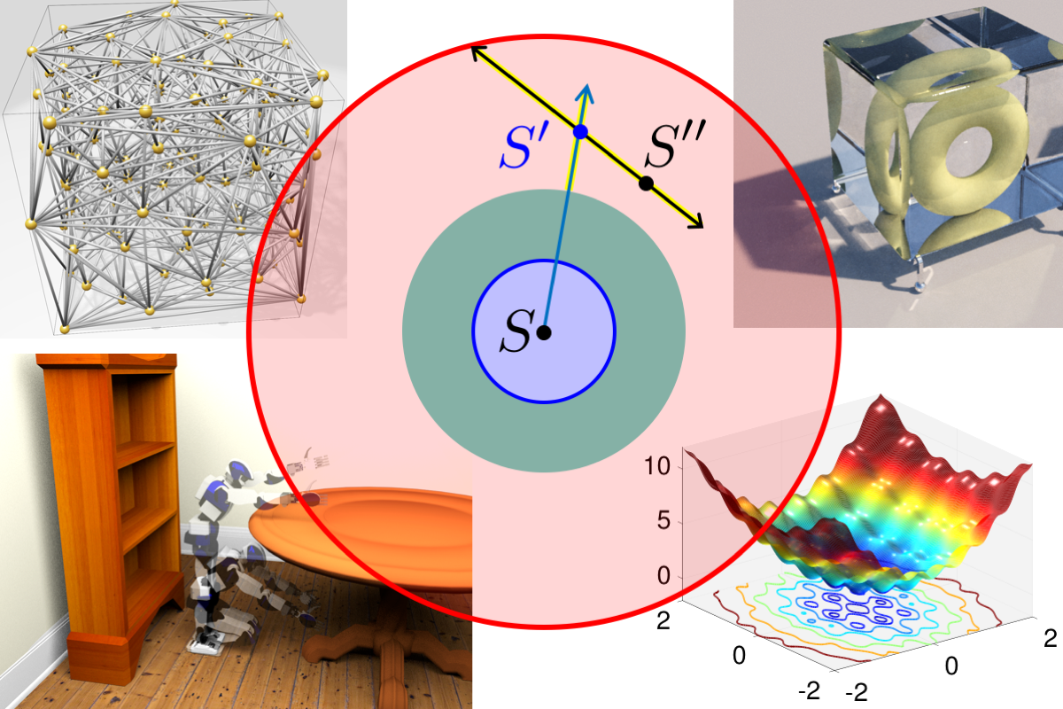
Primal-Dual Mesh Optimization with Mathematical Foundations
Scott A. Mitchell¹
Patrick M. Knupp²
¹Sandia National Laboratories
²Dihedral
Goal: primal (triangle) & dual (Voronoi) quality simultaneously
Mathematical advances:
Analyzed Hodge-Optimized Triangulation (HOT) mesh-quality metric
HOT poorly-behaved under optimization
Designed new metric with good optimization behavior
Planned: unique primal-dual mesh improvement library
Edge collapse motivated by HOT triangle inversion
Tightly coupled resampling & optimization
Position & weight improvement in single step
DEC
Discrete
Exterior
Calculus
matrix
Discretization error < HOT energy(primal-dual σ-*σ)
New synergy: Darren Engwirda E3SM Jigsaw meshing
      Apply Primal-Dual and dual-only Voronoi crust
      concepts to generate coastal meshes for ocean flow
      Extend HOT analysis and metric design to E3SM’s operators
      Mimetic Optimized Discretizations (MOD)
      Practical effects of mesh optimization in simulation
error
error
Scalable High-dimensional Sampling
Scalable sampling algorithms
Finesse curse of dimensionality by
line-samples
implicit advancing-front
Provable saturation, blue-noise distribution
References
Meshes Optimized for Discrete Exterior Calculus [tech report 2017]
Spoke-Darts for High-Dimensional Blue Noise Sampling, [ACM TOG 2018]
Fast Approximate Union Volume in High Dimensions with Line Samples [tech report 2018]
Sphere sampling for meshing & reconstruction with Delaunay & Voronoi Cells [GIDS Workshop, 2018]
A Constrained Resampling Strategy for Mesh Improvement [CGF 2017]
A Seed Placement Strategy for Conforming Voronoi Meshing [CCCG 2017]
Sampling conditions for conforming Voronoi meshing by the VoroCrust algorithm [SoCG 2018]
VoroCrust: Clipping-Free Voronoi Meshing [manuscript]
Co-authors: A. Abdelkader (UMD), M. A. Awad (UC Davis), C. L. Bajaj (UT Austin), M. S. Ebeida (SNL), P. M. Knupp (Dihedral), A. H. Mahmoud (UC Davis), D. Manocha (UNC), S. A. Mitchell (SNL), S. Mousley McKay (UIUC), J. D. Owens (UC Davis), C. Park (UNC), A. Patney (NVIDIA), A. A. Rushdi (SNL/Northrop Grumman), L. P. Swiler (SNL) and L. Wei (HKU).
SAND2019-0853 PE

