Slide 1



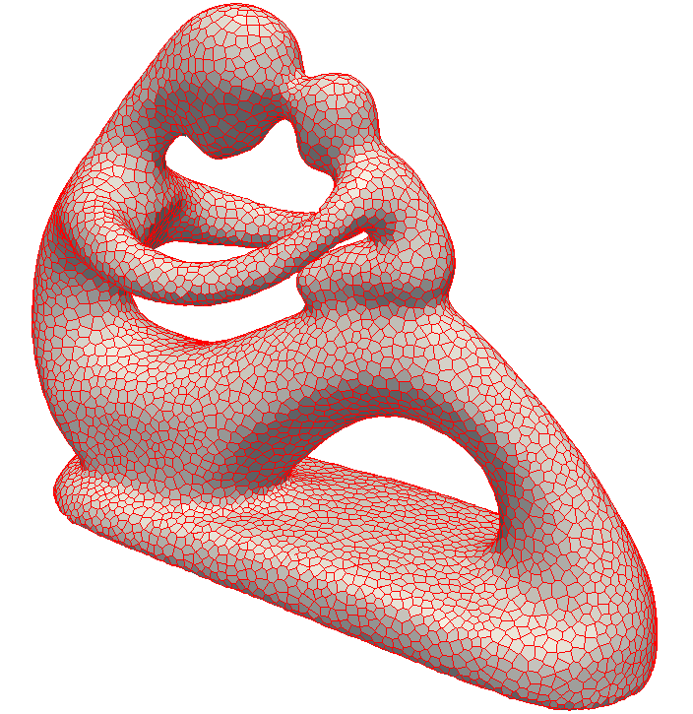
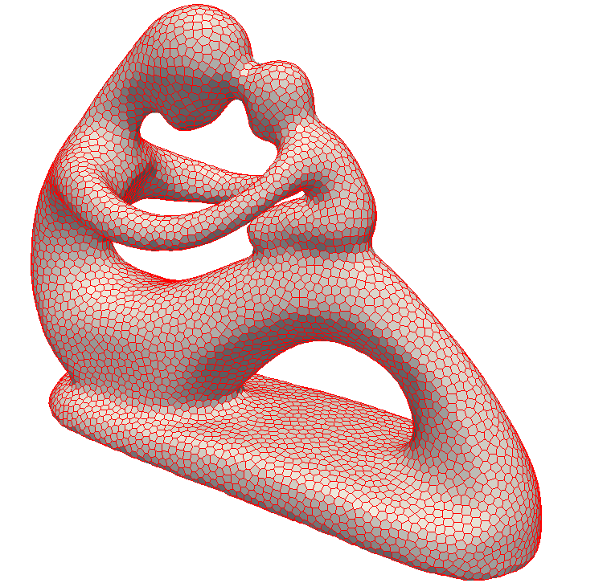
Improving spatial coverage while preserving blue noise
Mohamed S. Ebeida¹
M. A. Awad², X. Ge³, A. H. Mahmoud², S. A. Mitchell¹, P.M. Knupp¹, and L. -Y. Wei⁴
¹Sandia National Laboratories, ²Alexandria University,
³Ohio-State Univ, ⁴University of Hong Kong
Siam Conference on Geometric and Phsyical Modeling
November, 13th 2013

Slide 2
Point Sets: Well-spaced
r_{c = coverage}
farthest distance from
domain point to sample point
r_{c}
r_{f = free}
shortest distance between
sample points
r_{f}/2
r_{f}
Well-spaced =
  Farthest Voronoi vertex (coverage) not much farther than closest Delaunay neighbor (free)
  Measured by Voronoi cell aspect ratio (A) or beta = r_{c} / r_{f}
  beta <= 1 is often the goal for uniform distributions

Slide 3

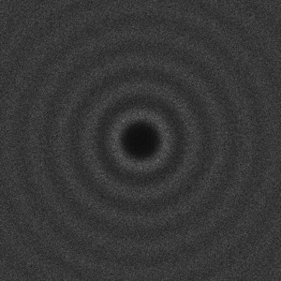
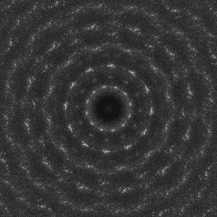
Point Sets: Random
Random
with no
constraints
(white noise)
Random with minimum separation
(blue noise)
r_{f} = r_{c}
Correlated
Points
r_{f} = r_{c}

Slide 4
Why Do We Care?!
Applications for Random Well Spaced point Sets

Slide 5
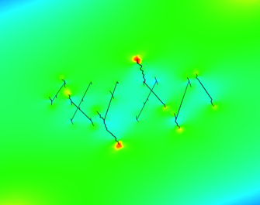
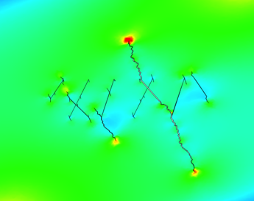
Provably Good Meshing
  Physics simulations
    Voronoi mesh, cell = points closest to a sample
    Fractures occur on Voronoi cell boundaries
      Mesh variation models material strength variation
      CVT, regular lattices give unrealistic cracks
        Unbiased sampling gives realistic cracks
    Ensembles of simulations
    Domains: non-convex, internal boundaries
Courtesy of
Joe Bishop (SNL)
Seismic Simulations
maximal helps Δ quality

Slide 6
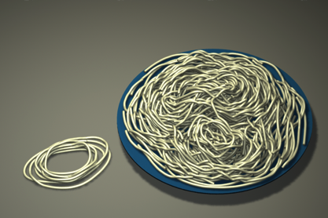
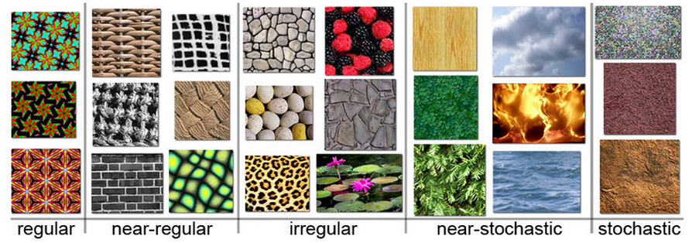
Motivating from Modern Graphics:
Texture Synthesis
Real-time environment exploration. Games! Movies!
Algorithm to create output image from input sample
  Arbitrary size
  Similar to input
  No visible seams, blocks
  No visible, regular repeated patterns
  examples from wikipedia:
Spaghetti
Li Yi Wei
SIGGRAPH 2011

Slide 7
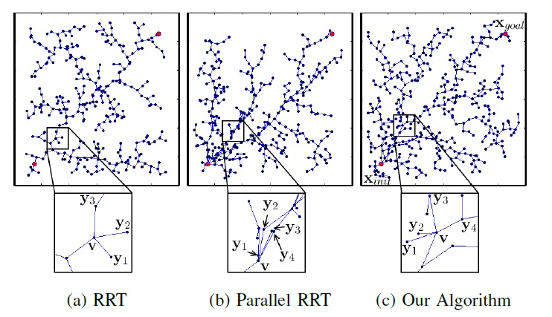
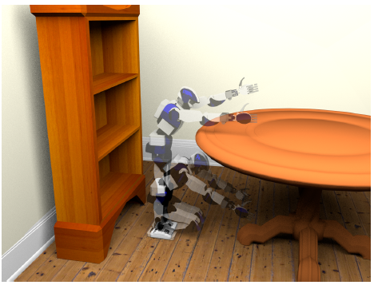
Robot Motion Planning
Real time motion planning 23 DOF
Precomputed Well-Spaced points directs parallel tree expansion and enables real-time motion planning in higher dimensions
Pictures and results provided by: Chonhyon Park (Dinesh’s group)

Slide 8
  That was the applications!
…
Now for the algorithms!
How can we generate a random well spaced point set?

Slide 9
… So We Need to Generate Random Well-Spaced Points.
But How?!! → Maximal Poisson-Disk Sampling (MPS)
What is MPS?
  Insert random points into a domain, build set X
Disk-free condition
Bias-free condition
Ω
x₄?
Maximal condition

Slide 10
Simple Problem?!
My initial thoughts (2010):
Generate a bunch of disks in a box, sounds too
simple with minor impact!
Probably I will forget about it after this project.
I was Completely wrong!

Slide 11




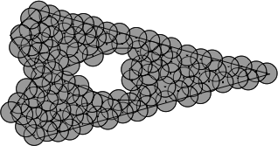
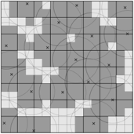
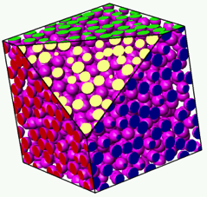
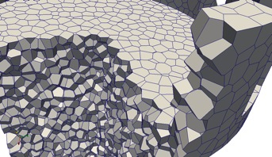
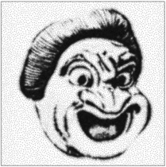
Main Published Results
First E(n log n) algorithm with provably correct output
  Efficient Maximal Poisson-Disk Sampling,
  Ebeida, Patney, Mitchell, Davidson, Knupp, Owens,
  SIGGRAPH 2011
Simpler, less memory, provably correct, faster in practice but no run-time proof
  A Simple Algorithm for Maximal Poison-Disk Sampling in High Dimensions,
  Ebeida, Mitchell, Patney, Davidson, Owens
  Eurographics 2012
Voronoi Meshes
  Sites interior, close to domain boundary are OK, not the dual of a body-fitted Delaunay Mesh
  Uniform Random Voronoi Meshes
  Ebeida, Mitchell
  IMR 2011
Delaunay Meshes
  Protect boundary with random balls
  Efficient and Good Delaunay Meshes from Random Points
  Ebeida, Mitchell, Davidson, Patney, Knupp, Owens
  SIAM GD/SPM 2011 → Computer Aided Design
MPS with varying radii
  Adaptive and Hierarchical Point Clouds
  Variable Radii Poisson-disk sampling
  Mitchell, Rand, Ebeida, Bajaj
  CCCG 2012

Slide 12


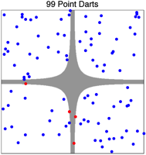
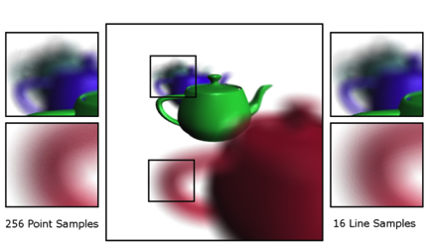
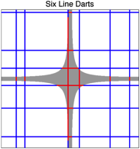
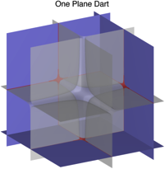
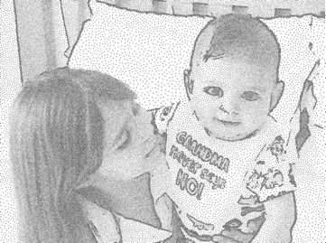
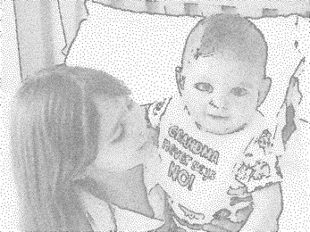
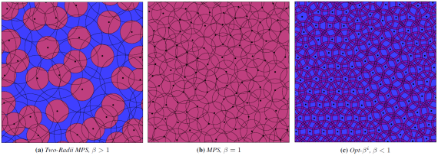
Main Published Results
Simulation of Propagating fractures
  Mesh Generation for modeling and simulation of carbon sequestration processes
  Ebeida, Knupp, Leung, Bishop, Martinez
  SciDAC 2011
Hyperplanes for integration, MPS and UQ
  K-d darts,
  Ebeida, Patney, Mitchell, Dalbey, Davidson, Owens,
  TOG “to appear”
Rendering using line darts
  High quality parallel depth of field using line samples,
  Tzeng, Patney, Davidson, Ebeida, Mitchell, Owens
  HPG 2012
Reducing Sample size while respecting sizing function
  A simple algorithm that replaces 2 disks with one while maintaining coverage and conflict conditions
  Sifted Disks
  Ebeida, Mahmoud, Awad, Mohammad, Mitchell, Rand, Owens
  EG 2013
MPS with improved Coverage
  Using r_{c} < r_{f}
  Improving spatial coverage while preserving blue noise
  Ebeida, Awad, Ge, Mahmoud, Mitchell, Knupp, Wei
  SIAM GD/SPM 2013 → Computer Aided Design

Slide 13
Prior Results: CCCG’11
How fast can radii vary?
If varies slowly
  bounded # neighbors for disk conflict checks <->
  bounded-angle DT
If shrink too fast
  Unbounded # neighbors
  Infinite run-time
  Zero angles in triangulation
α
Still big, OK
α
Vanishing radius,
infinite neighbors

Slide 14
Q. How fast can it vary?
A. Depends how Conflict is defined.
L is Lipschitz constant: f(x)-f(y) < L |x-y|
Four common
methods
in Graphics
new
new
old
old
Prior:
new candidate disk center inside an old prior disk
Bigger:
small disk center inside big disk center
Smaller:
big disk center inside small disk center
new
new
Bigger is stricter than
Sphere packing:
½ radius disks overlap
distance: sum(r(x),r(y))/2
old
old
Current:
old prior disk center inside a new candidate disk

Slide 15
Prior Results: CCCG’11
Decoupling coverage and conflict-free radii
Disk coverage radius larger than free radius
  R_{c} > R_{f} (yellow > green)
New disks must cover some unique uncovered area
  Else maximal (limit) distribution would be the same
  Contrast to Hard-core Strauss disc process:
  coverage disks are observed, no effect on process
Process:
New candidate point uniform at random
(f) Rejected if center inside a small green disk
(c) Accepted if its yellow disk covers some white area
OK, covers some white
Alg:
Only generate points in an outer approximation
to regions satisfying (c) and (f) in the first place.
reject, inside a green disk
reject, yellow already covered

Slide 16
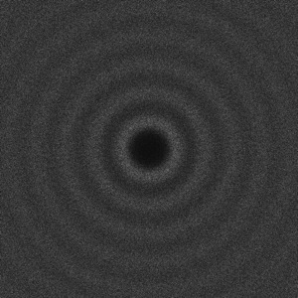
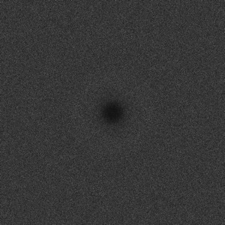

Two-radii MPS output
Classic MPS
R_{f} = R_{c}
Two-radii MPS
2 R_{f} = R_{c}
R_{f} = min center dist
R_{c} =max Vor dist
Uniform
R = 0
non-maximal

Slide 17
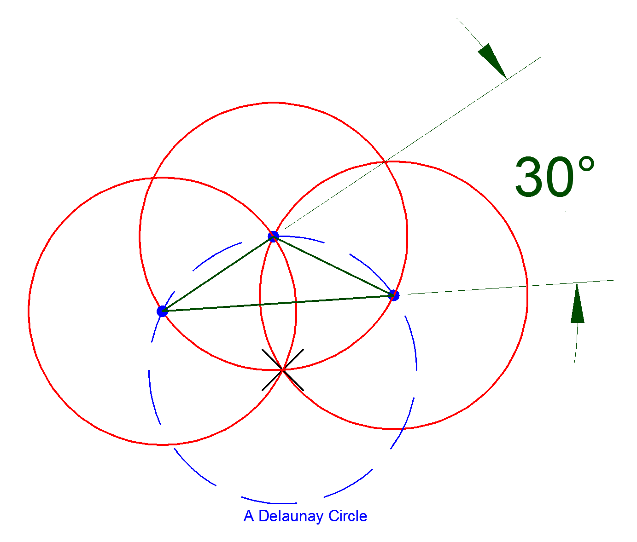
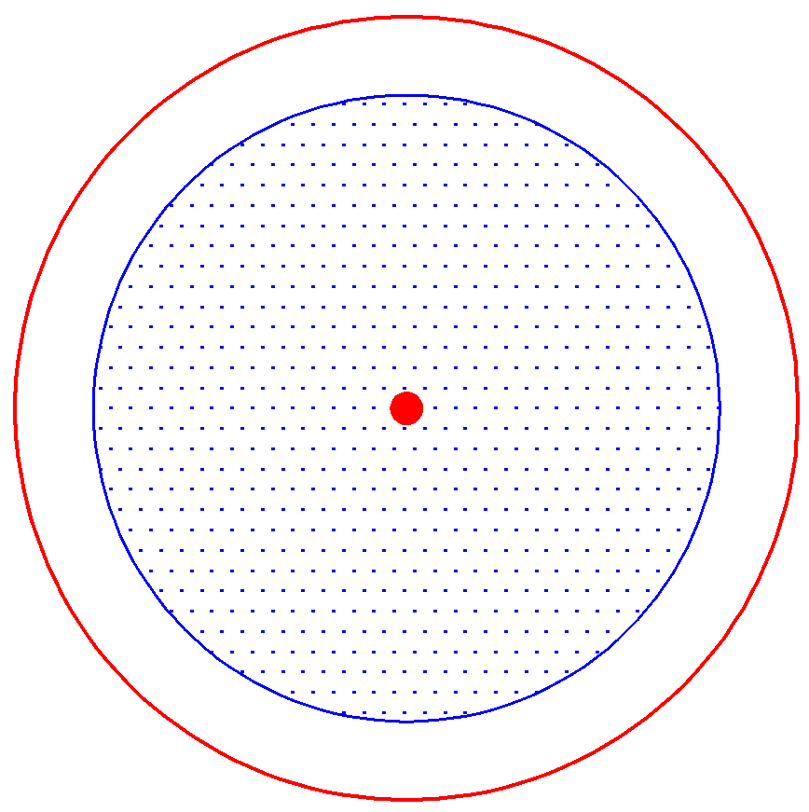
This Research: Improving spatial coverage
r_{c} > r_{f} increase randomness while degrading mesh quality
Here we try the opposite direction r_{f} < r_{c}
Question:
Can we decouple coverage radius
from disk-free radius such r_c < r_f ?

Slide 18
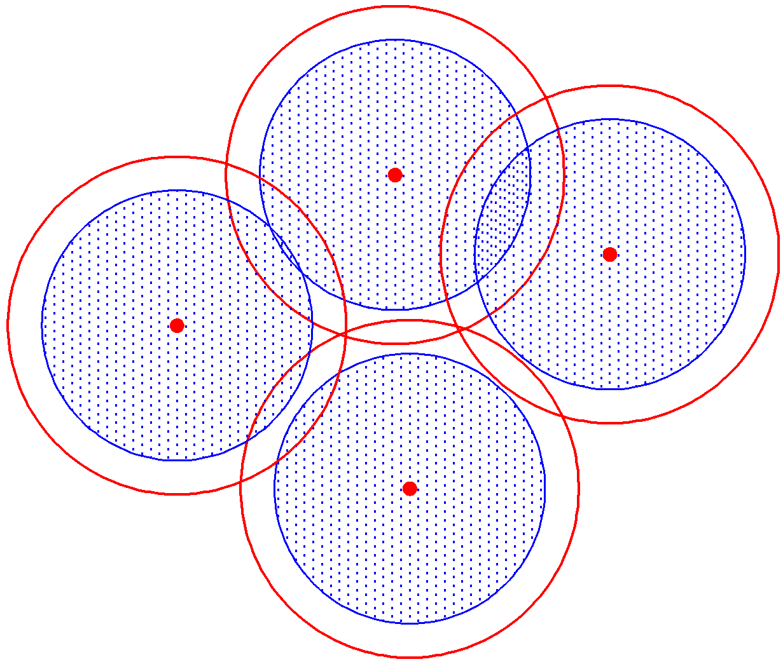
Current Research: Sparse MPS (under preparation)
Answer: Yes, If the algorithm doesn’t lead to configurations
Like this.
Unfortunately!
Vey hard to achieve
via sampling due to
global constraints
Impact of solution:
A tune-up parameter
to trade randomness
For better space coverage
e.g. better mesh quality

Slide 19
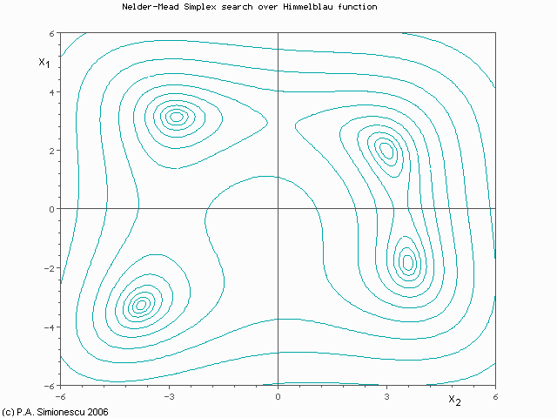
Our poor-man’s solution
Generate an MPS as usual and relocate points to optimize beta directly using Nelder Mead
Four rules for relocating a point:
Reflection
Expansion
Contraction
Reduction

Slide 20
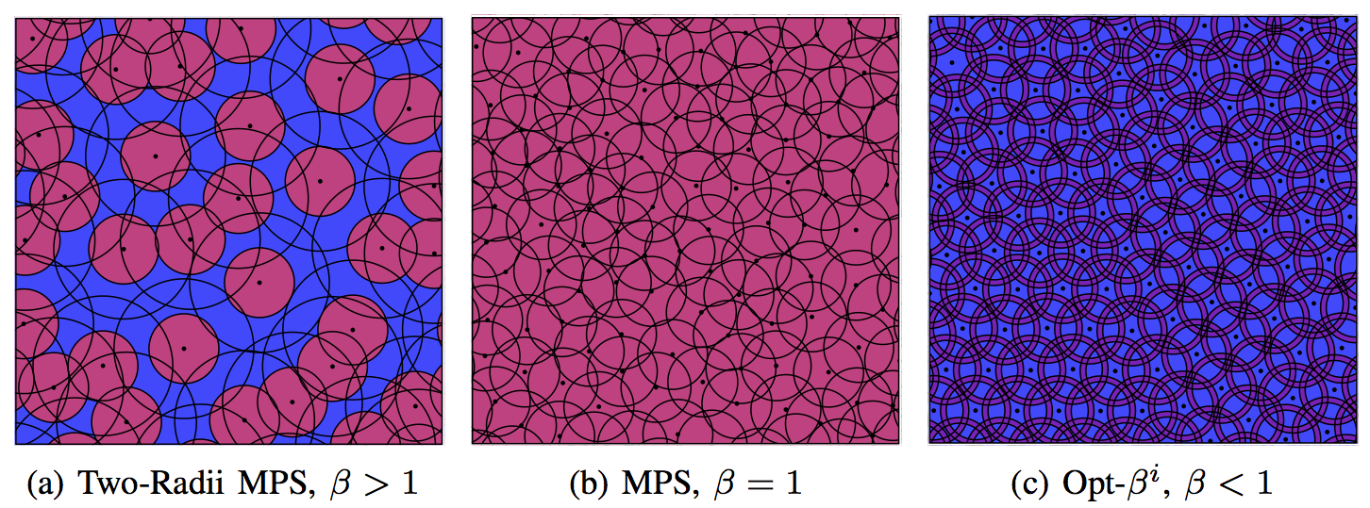
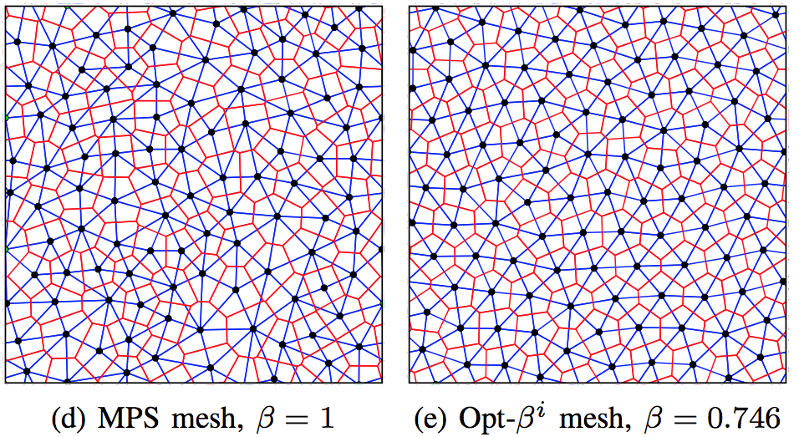
Results

Slide 21
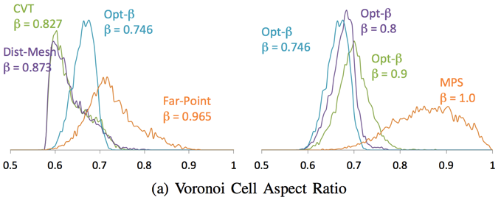
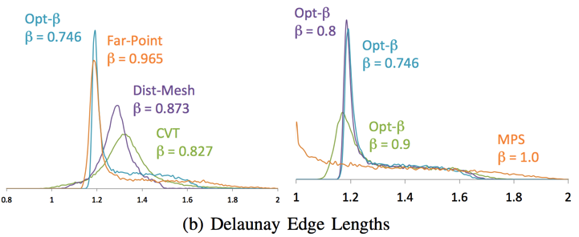
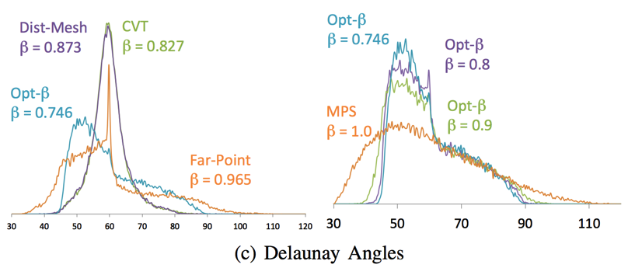
Results: Impact on Mesh Quality

Slide 22
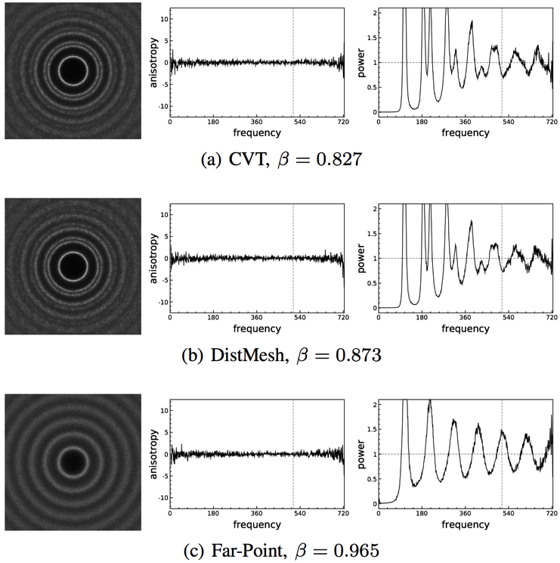
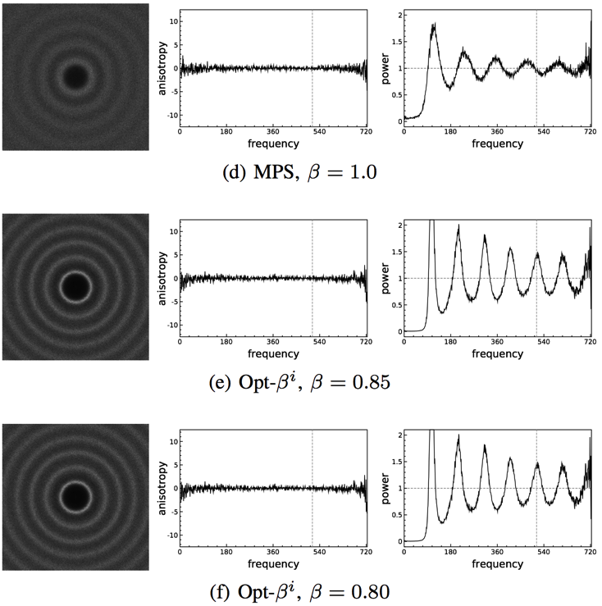
Impact on Noise

Slide 23
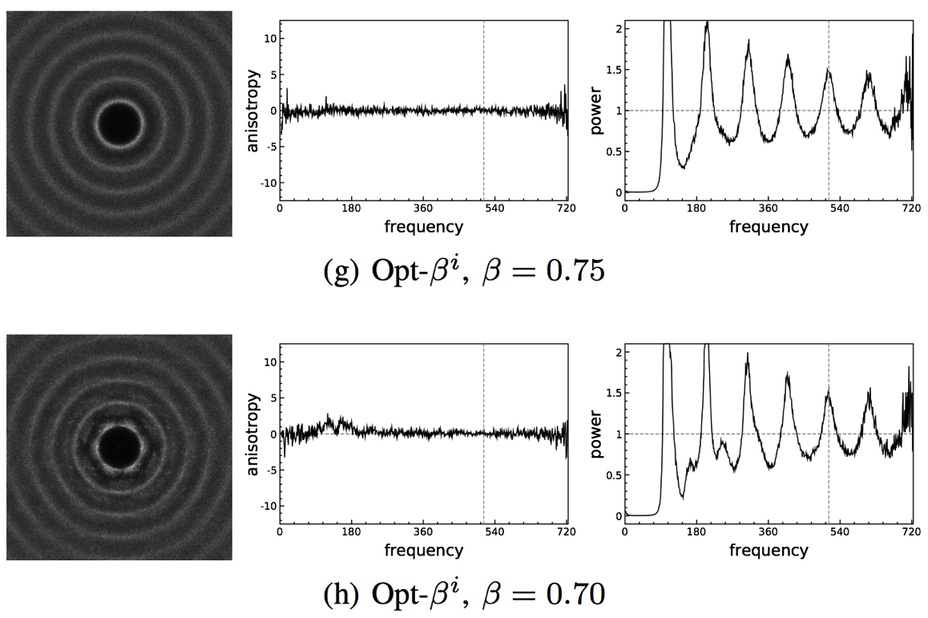
Impact on Noise

Slide 24
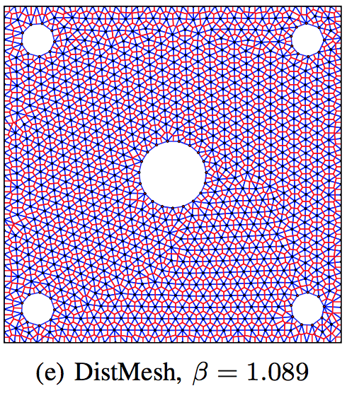
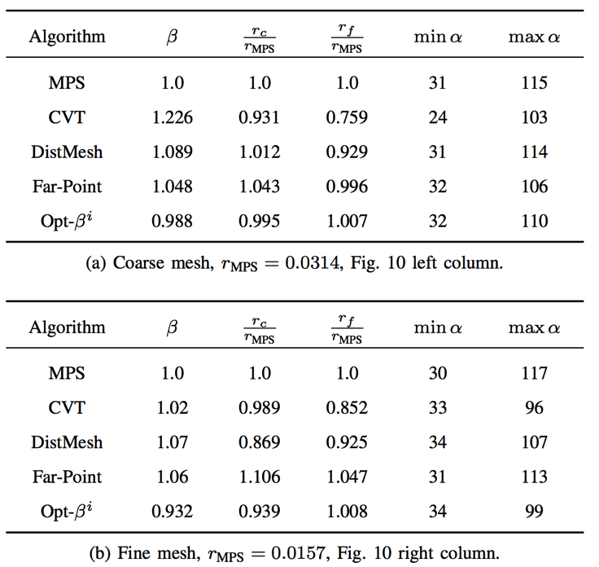
Results: Non-convex domains

Slide 25
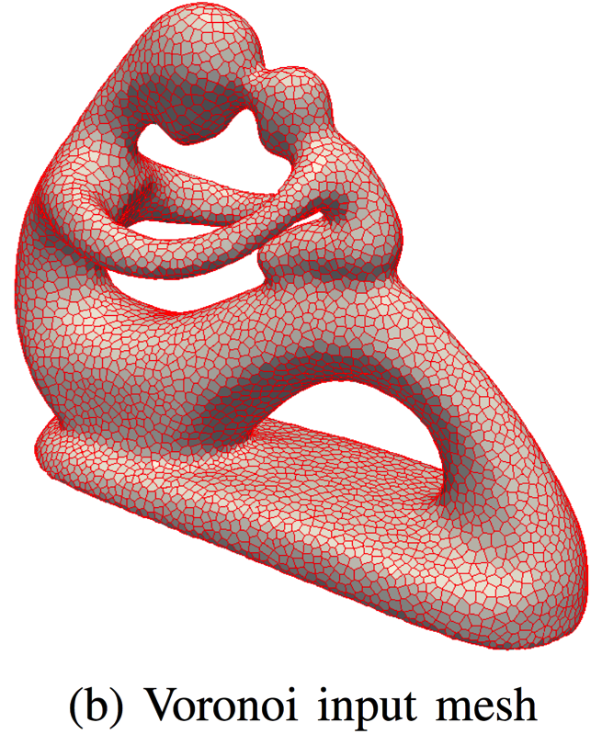
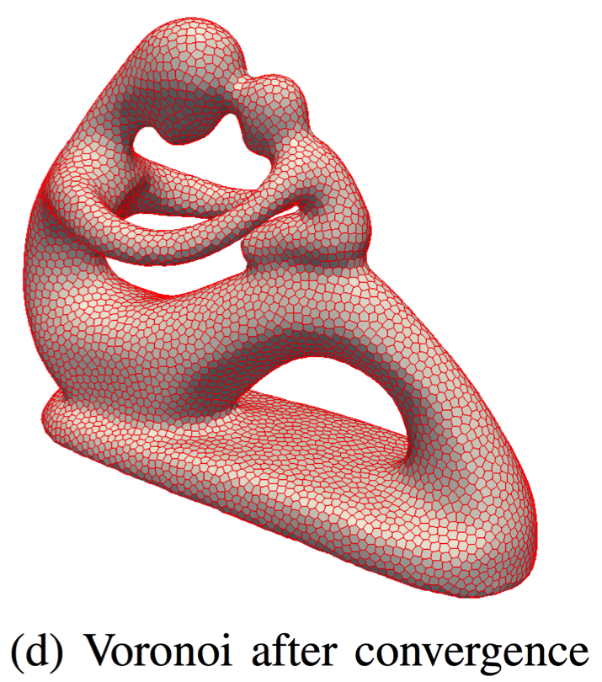
Results: Curved Surfaces

Slide 26
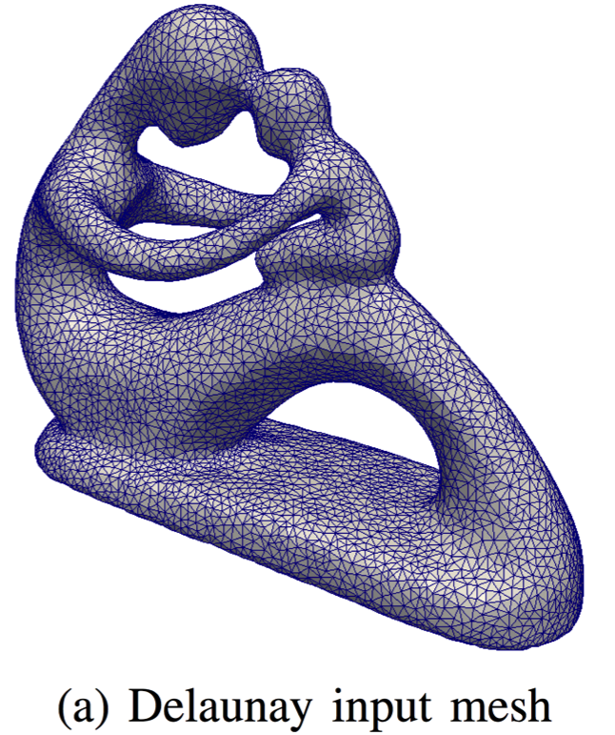
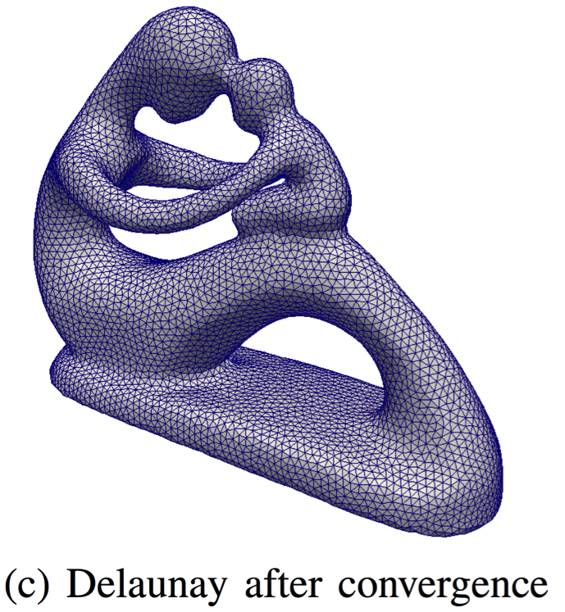
Results: Curved Surfaces

Slide 27
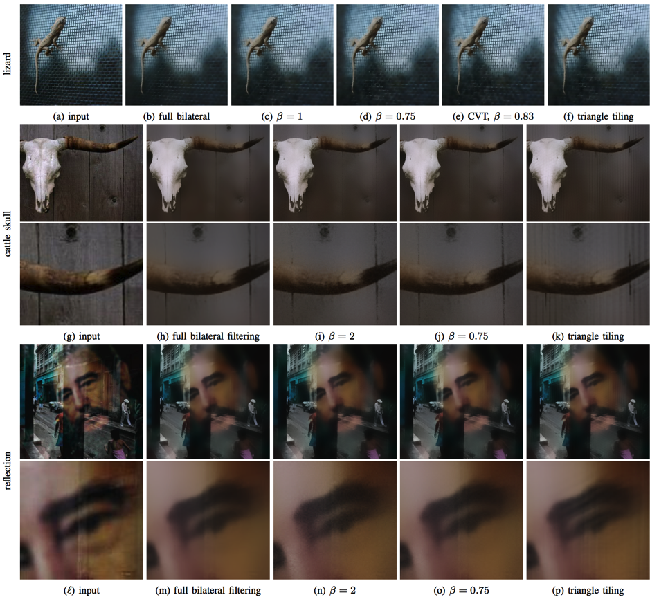
Results: Impact on bilateral filtering
Sub-sampling accelerated bilateral filtering. β = 0.75 achieves the right balance between uniformity (reducing noise) and randomness (avoiding aliasing). Notice the noisier results with less uniform sampling (β = 2.0) and more aliasing with more regular sampling (CVT and triangle tiling). For the skull and reflection cases, we show both the whole images and partial zoom-ins.

Slide 28
Summary and Future Work
This paper introduced a Well-spaced Blue-noise Distribution WBD, with β = r_{c}/r_{f} measuring coverage uniformity or well-spacedness.
We proposed the Opt-β algorithm to change a random point set to a WBD; blue noise is preserved up to β ≈ 0.75.
Extension to higher dimensions esp. impact on slivers is our next step
Investigate sampling solutions to the Sparse MPS problem.

Slide 29

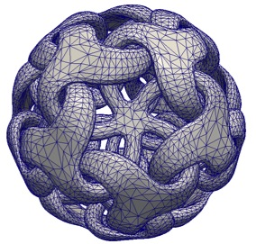
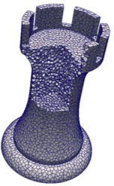
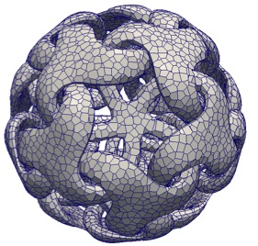

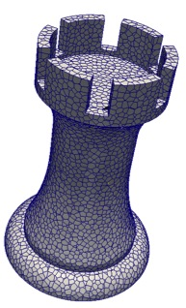

Thanks! … Questions?

