Slide 1
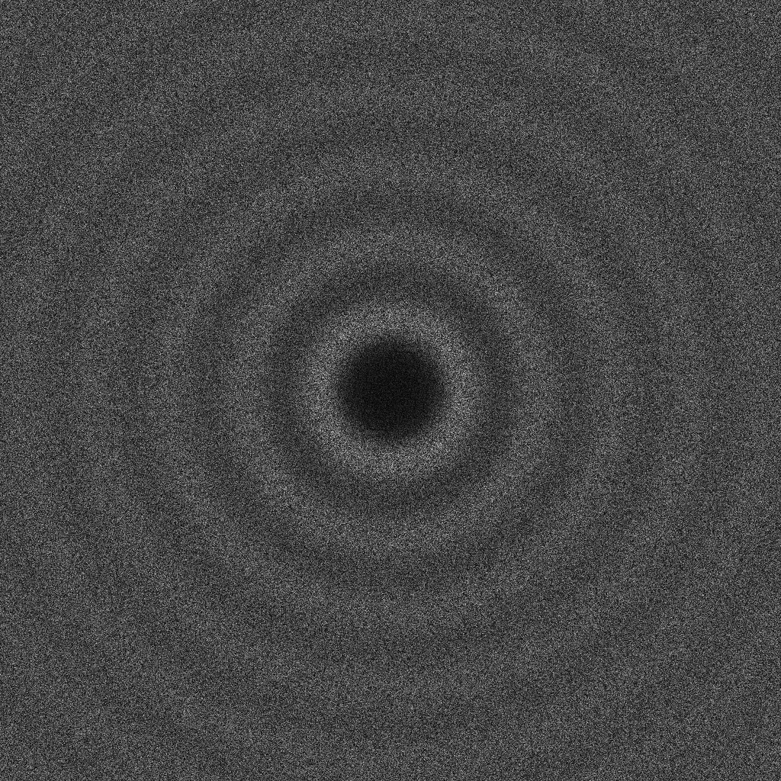
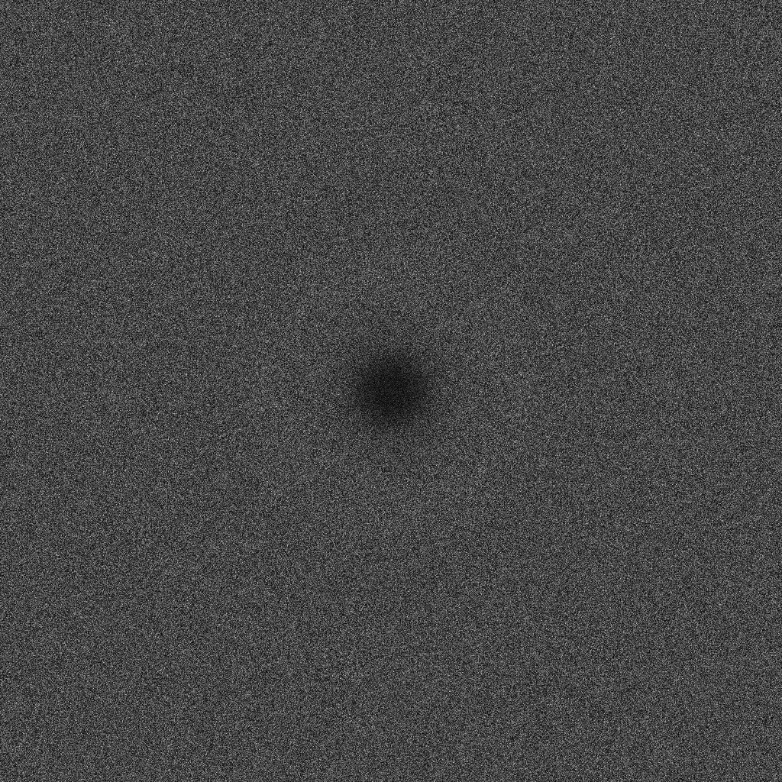
Variable Radii Poisson-Disk Sampling
FF
Scott A. Mitchell, Alexander Rand, Mohamed S. Ebeida, Chandrajit Bajaj
Session 4B, Thursday Aug 9, 11:30-11:50
Maximal Poisson-Disk Sampling is a particular statistical
process for generating separated-yet-dense point clouds
      Similar-yet-different from Delaunay Refinement and sphere packings
      better output properties for certain apps
Motivation
  Hot topic in Computer Graphics
    for texture synthesis
  Voronoi meshes for fracture mechanics
Two Contributions
  Lipschitz conditions for
  spatially varying radii
    Necessary condition for certain Graphics algs to work
  New two-radii definition
  decoupled coverage and
  inhibition radii
    Better “blue noise”
    More random refinements
Classic MPS
coverage
x
exclusion
Two-radii MPS

