Slide 1
Well-Spaced Random Point Sets for Sampling and Meshing maybe next year:
Random Hyperplane Sampling
(not well spaced)
Scott A. Mitchell
www.cs.sandia.gov/~samitch
(or Google Mitchell Sandia)
2013 Summer Seminar Series
June 2013
3-4pm CERL/140

Slide 2
Abstract
Well-Spaced Random Point Sets for Sampling and Meshing
Computational geometry is interesting to me because it combines both discrete and continuous objects, and both math and algorithms. I also like it because I can draw pictures to understand what I'm doing. Specifically I'll talk about the work we've done over the past couple of years on point clouds with random positions. We made up the term separated-yet-dense to describe sets of sample points such that no two points of the set are too close to one another, but any other point of the domain is close to some sample point. Computer Graphics has been obsessed with a particular way of generating these kind of point clouds, by selecting points sequentially and spatially uniformly at random. This way is important because it avoids visual artifacts in texture synthesis. Computational Geometry has been obsessed with a different way of generating these kinds of point clouds, by selecting them sequentially and deterministically, by selecting the domain point that is furthest away from the point cloud so far. Nearby points are attached together to generate a finite element mesh. The advantage of this approach is it is faster, and is easier to analyze. We've been coming up with algorithms that combine features of both approaches. Some have theory guarantees, and some are simpler and work better in practice. We have both computer graphics and mesh generation applications, and we've even started using random lines to efficiently solve some uncertainty quantification problems.

Slide 3
Computational Geometry is Great
Computational Geometry and Computer Graphics are great
  discrete and continuous objects
  math and algorithms
  draw pictures
Computational Geometry usually focuses on theory
Computer Graphics usually focuses on practicality and applications
Well-spaced point sets, with random positions
Computer Graphics does it one way
Computational Geometry another
Combine the ideas: proofs from geometry, efficiency and apps from graphics.

Slide 4
Outline
What is Maximal Poisson Disk Sampling MPS?
  Graphics stippling and texture synthesis use
Polygonal approximation algorithm (paper1)
  Something provable
Eurographics algorithm (paper2)
  Simpler, better in practice, scales to high dim
Define mesh, Delaunay triangulation, Voronoi diagram
MPS for triangle meshing (paper3)
MPS for dual Voronoi meshing (paper4)
Variable radius, space and time
Darts, QMU, … won’t get to

Slide 5
Q. How many of you saw a version of this talk last year?

Slide 6
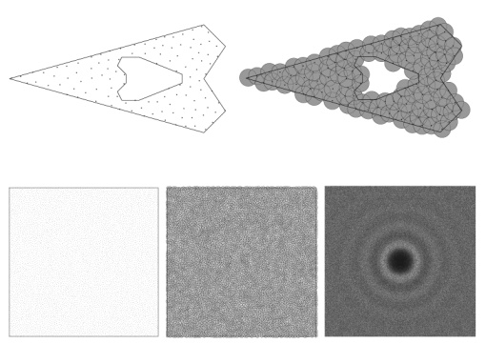
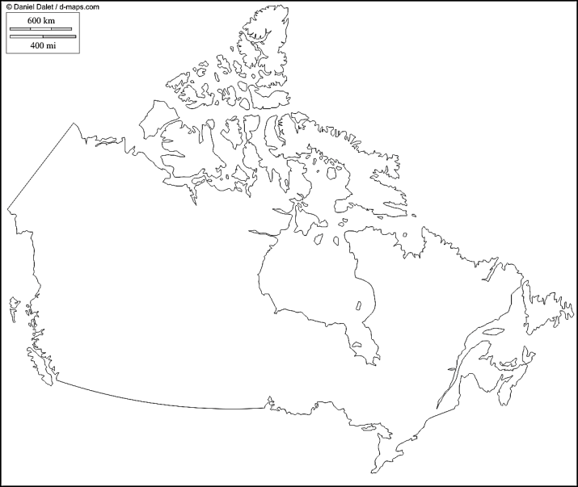
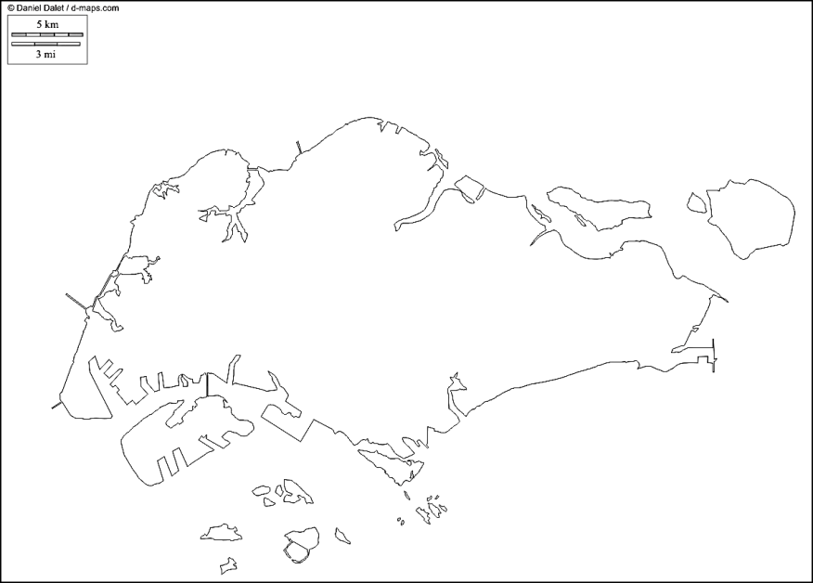
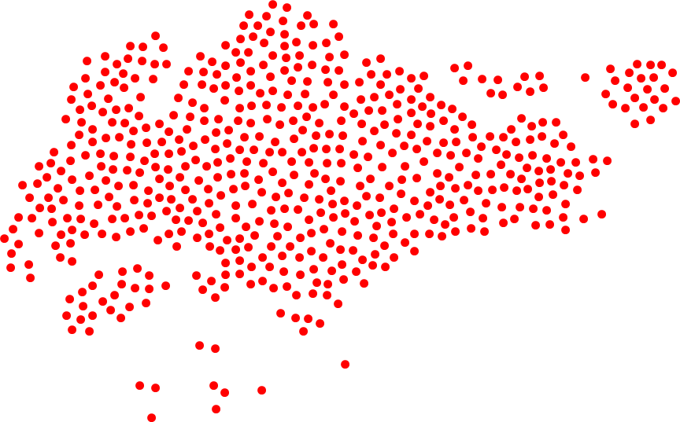

Efficient Maximal Poisson-Disk Sampling
http://d-maps.com/
CPU
GPU
Mohamed S. Ebeida, Anjul Patney, Scott A. Mitchell, Andrew A. Davidson, Patrick M. Knupp, John D. Owens
Sandia National Laboratories, University of California, Davis
Scott - presenter
SIGGRAPH2011 – conference of 10,000 people
Sandia is a multiprogram laboratory operated by Sandia Corporation, a Lockheed Martin Company,
for the United States Department of Energy’s National Nuclear Security Administration
under contract DE-AC04-94AL85000.
Notes:
I’m talking about uniformly sampling a domain with a random dense packing, as Singapore, rather than Canada with “voids” and a “bias” towards a region

Slide 7
Maximal Poisson-Disk Sampling
What is MPS?
  Dart-throwing
  Insert random points into a domain, build set X
    With the “Poisson” process
Ω
x₄?

Slide 8
MPS a.k.a.
Statistical processes
  Hard-core Strauss disc processes
    Non-overlap: inhibition distance r₁
    cover domain: disc radius r₂
Nature
  Trees in a forest
    Variable disk diameter = tree size
    Points are tree trunks
    Disks are tree leaves or roots
  Given satellite pictures (non-maximal)
    How many trees are there?
    How much lumber?
Random sphere packing
  Non-overlapping r/2 disks
  Atoms in a liquid, crystal
New Mexico
mountains
British Columbia

Slide 9
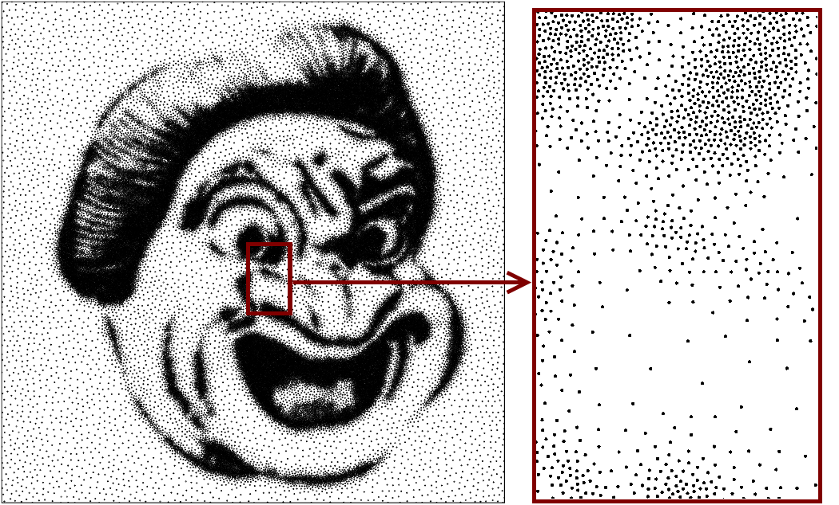
Motivation from Static Graphics
Stippling: images from dots, as newsprint

Slide 10
(Brush) Stroke-Based Rendering
CG artistic effect to mimic physical media
Images from Aaron Hertzmann, Stroke-Based Rendering

Slide 11
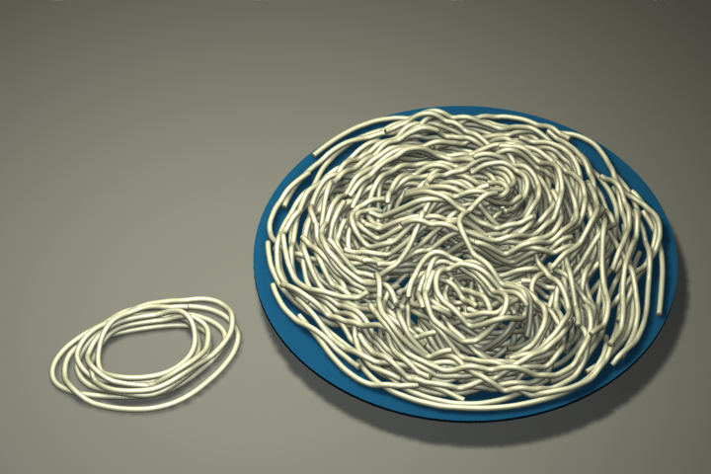
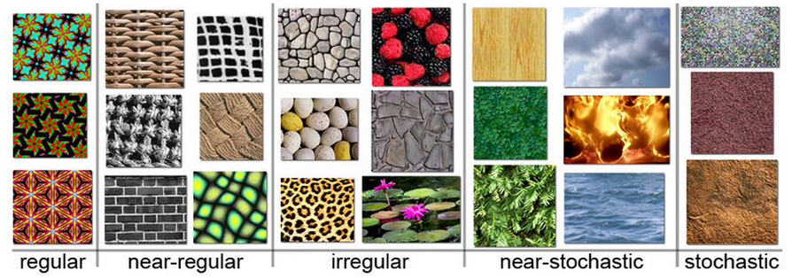
Motivating from Modern Graphics:
Texture Synthesis
Real-time environment exploration. Games! Movies!
Algorithm to create output image from input sample
  Arbitrary size
  Similar to input
  No visible seams, blocks
  No visible, regular repeated patterns
  examples from Wikipedia:
Spaghetti
Li Yi Wei
SIGGRAPH 2011

Slide 12
What is MPS good for?
Humans are very good at noticing patterns,
even ones that aren’t there
  Patternicity: Finding Meaningful Patterns in Meaningless Noise, Scientific American Dec 2008
  Cognition issues…side exploration
  Our eyes sensitive to patterns
  Randomness hides imperfections
    stare at dry-wall in your house sometime,
    try to find the seams
  Unbiased process leads to points with
    No visible patterns between distant points.

Slide 13
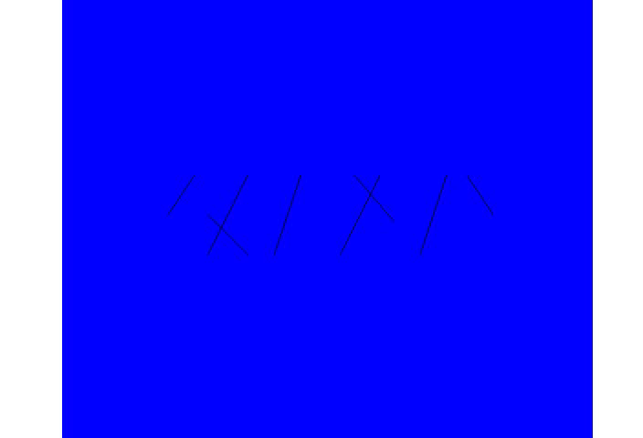
What is MPS good for?
Sandia cares about Games and Movies? training…
  Physics simulations
    Voronoi mesh, cell = points closest to a sample
    Fractures occur on Voronoi cell boundaries
      Mesh variation material strength variation
      Regular lattices give unrealistic cracks
        Unbiased sampling gives realistic cracks
    Ensembles of mesh simulations
      local variations, same global properties
      alt. to mesh convergence study
Fracture Simulations
Courtesy of
Joe Bishop (SNL)
Seismic Simulations
maximal helps Δ quality

Slide 14
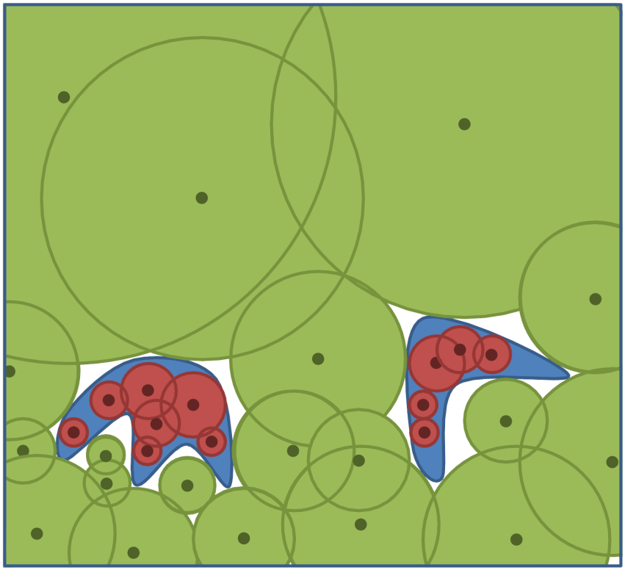
What is MPS good for?
Sampling for
  Integration
  Uncertainty Quantification
Probablity Of Failure (POF) Darts
Bridge Collapse safety calculations
  Dimensions: temperature, load, time of day, material strength, age…
  Run a simulation at a point,
  Disk radius = how far from failure you are
    Need more samples outside disks
    Overlap is inefficient, but OK
  Union Volume estimates failure probability
    Or integrate parameter distributions over the volume if non-uniform.

Slide 15
Algorithm for MPS
Classic algorithm
  Throw a point, check if disk overlaps, keep/reject
  Fast at first, but slows due to small uncovered area left.
  Can’t get maximal.
quadtree
advancing front
Speedup by targeting just the uncovered area
Common issues
  Not strictly “unbiased” process
  Not maximal: dependent on finite precision
  Memory or run-time complexity
  Ours was first provably bias-free, maximal,
  E(n log n) time O(n) space

Slide 16
Algorithm
Background square grid
  Square diagonal = r
  Build pool of cells C :
Phase I: quickly cover most of the domain
  Pick a square from pool
  Pick point in square
  If point uncovered (likely)
    Keep point
    Remove square from pool
  Repeat a|C| times
Initial Pool C
End of Phase I: white cells with a point

Slide 17
Algorithm
Target remaining uncovered area
Construct square \ disks
  Polygon easy surrogate for arc-gon
Replace pool of squares by polygons
Phase II: repeat
  Pick polygon from pool
    Weighted by its area
  Pick point in polygon
  If uncovered
    Keep point
    Remove polygon from pool
    Update nearby polygons
Works well because
  Voids are scattered
  Small arc-gons are well approximated by polygons
End of Phase I: white cells with a point
Start of Phase II: dark cells not-covered

Slide 18
Complexity Proofs Sketch
WTS constant time & space per point
  Everything is local, and constant size
#squares = θ(#points_in_sample)
Sid Meier Civilization template
  21 nearby squares, 0 or 1 disks per square
    By geometry, ≤ 4 voids per cell
    By geometry, ≤ 9 (8?) disks bounding a void
Constant time to check if point is uncovered
Polygons are constant size, time to build
Four voids

Slide 19
Complexity Proofs Sketch
Constant work per generated point,
but what about the rejected (covered) points?
  Phase I, O(|C|) throws
  Phase II
  Via weighted Voronoi cell of a circle
    Constant curvature and number of edges
covered fraction of polygon
uncovered arcgon

Slide 20
GPU
Rejection sampling is great on a GPU
  Nothing to communicate for a rejected candidate sample!

Slide 21
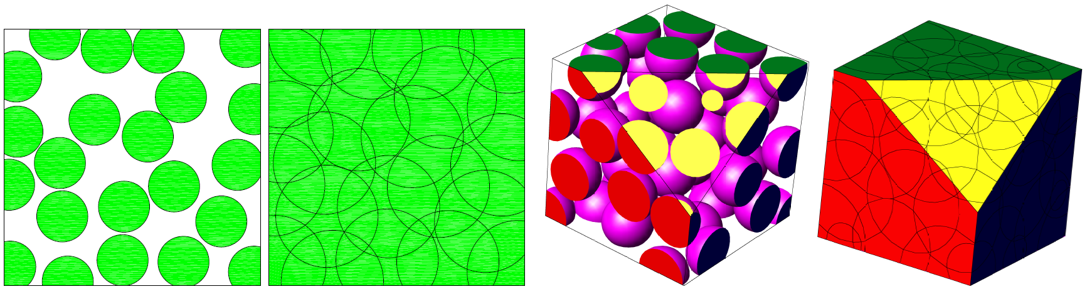

A Simple Algorithm for
Maximal Poisson-Disk Sampling
in High Dimensions
Mohamed S. Ebeida, Scott A. Mitchell, Anjul Patney, Andrew A. Davidson, and John D. Owens
presenter = Scott
Eurographics 2012
Sandia is a multiprogram laboratory operated by Sandia Corporation, a Lockheed Martin Company,
for the United States Department of Energy’s National Nuclear Security Administration
under contract DE-AC04-94AL85000.
Notes:
I’m talking about uniformly sampling a domain with a random dense packing, as Singapore, rather than Canada with “voids” and a “bias” towards a region

Slide 22
Our Algorithm - Basics
“Make everything as simple as possible, but not simpler.” – A. Einstein
  Datastructure:
    Squares contain uncovered area
    Dispense with polygonal constructions
Throw darts
  Pick square, pick point in square
  If dart is outside nearby circles
    Accept dart as sample
    Delete square
Refine all squares
  Discard subsquares covered by single disks
Repeat
darts
refine
darts
refine

Slide 23
Level Limit?
one uncovered
point
(or is it covered?
let’s look closer…)
Problem
  Small voids require infinite refinement
Solution: [Wei08], [BWWM10
  Stop early
  to avoid memory blow-up
Solution: Us
  Small voids happen
  rarely on average so
  Refine all squares periodically in lock step
    Refine to finite-precision
    Memory is fine in practice
    Benefit: maximal
…

Slide 24
Algorithm – outer loop parameters
Tuning parameter choices: A, B
  Cº = number initial cells
  C^{i} = number current squares
How many throws before refining?
Throws = A | C^{i} |
How big does array C need to be
to hold all the refined grid cells?
C = B | Cº |
Big A ⬅➔more time, smaller memory B

Slide 25

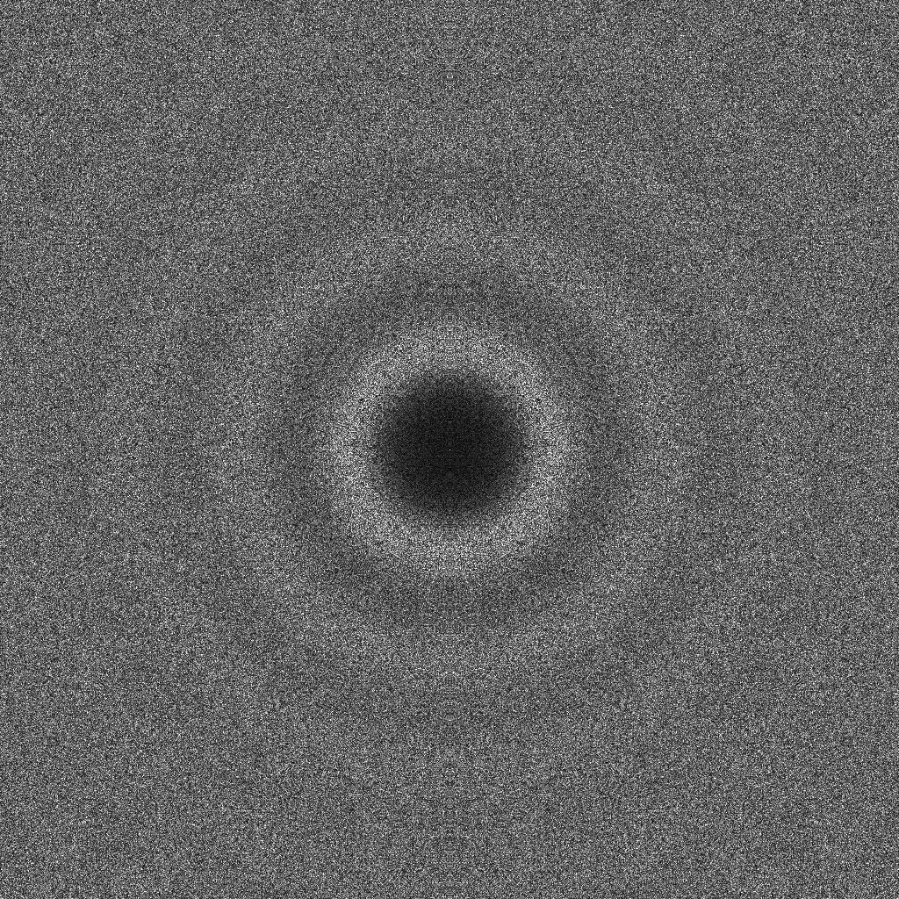
Output Quality Measures
Parallel Sample – Polygon Algorithm
Provably correct bias-free, maximal up to precision
10k pts
Rings from
inhibition
radius
Fourier spectrum

Slide 26
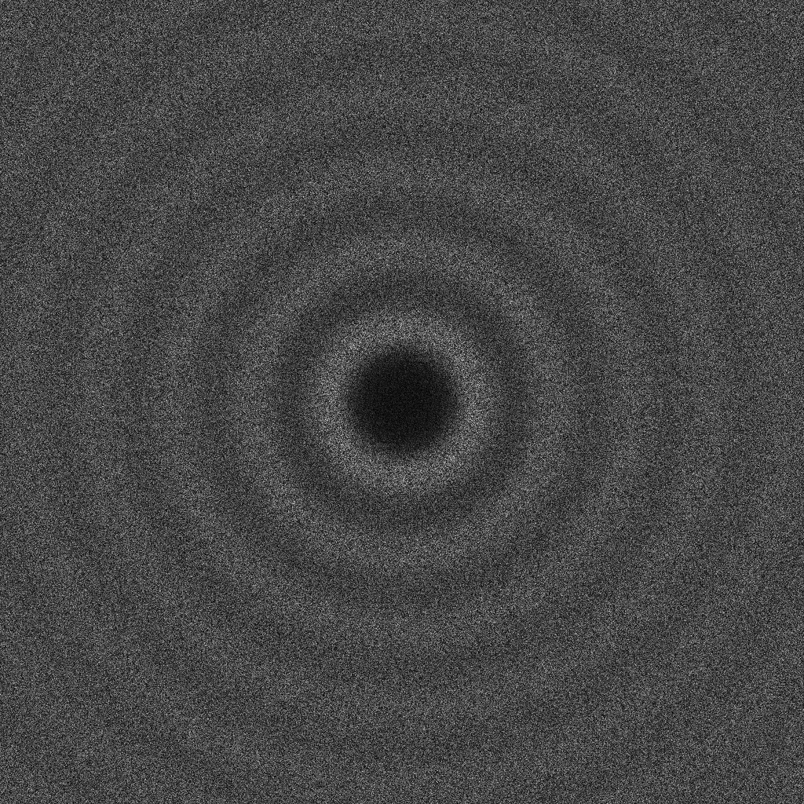
  Output Quality Measures
  Parallel Sample – Quadtree Algorithm Point
  Provably correct bias-free, maximal up to precision
Experiments
confirm
(GPU)

Slide 27
Definition or Process?
Which would you rather have?
Definition of desired result
Process to obtain it (e.g. algorithm)

Slide 28
Definition or Process?
Which would you rather have?
Definition of desired result
  sorted order
    so you can discover quicksort
Process to obtain it (e.g. algorithm)
  Bubblesort algorithm

Slide 29
“Unbiased” Opinion
Unbiased as a description of (serial) process
  insertion probability independent of location
Unbiased as a description of outcome
  pairwise distance spectra, blue noise
  But not described analytically
Unbiased process leads to unbiased outcome,
but so might other processes
Ω
x_{i}?

Slide 30
Meshing and Triangulation Background
Connect those sample points!

Slide 31
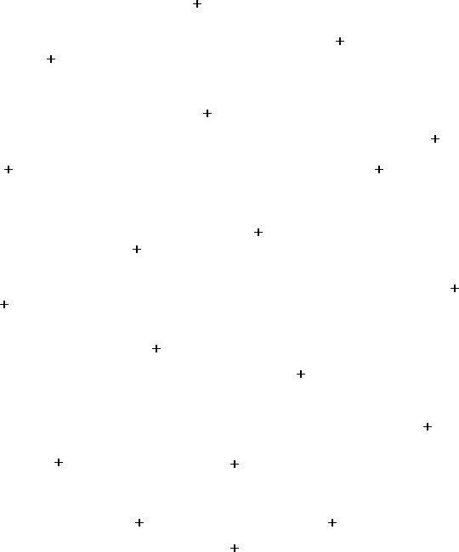
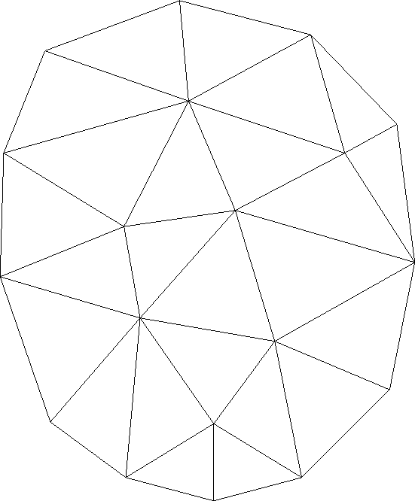
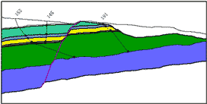
Meshing and Triangulation
Triangulating: point cloud -> triangles
  Fixed input point positions
Meshing: boundary representation -> points and triangles
  freedom to put the points where you want
  Subdivide input curves into edges, surfaces into triangles

Slide 32
Delaunay Triangulation
Special role for both triangulating and meshing
Given 4 points, two choices of diagonal edge
Exactly one pair of circumcircles will be empty
Maximizes minimum angle
For more than four points, can check/flip locally to achieve global lexicographic max min angle

Slide 33
Voronoi Diagram
Region closer to that vertex than any other
perpendicular
bisectors
circumcircle
centers
Voronoi vertices are (locally) farthest domain points
from any black point

Slide 34
Well-spaced (Gary Miller)
r_{c}
r_{f}/2
r_{f}
Well-spaced =
  Farthest Voronoi vertex not much farther than closest Delaunay neighbor
  Measured by Voronoi cell aspect ratio, or beta = r_{c} / r_{f}
  beta = 1 is often the goal achieved by algorithms

Slide 35
Angles in DT of MPS
Random avoids structure, but plays no role in quality guarantees
DT of maximal Poisson-disk sampling or any sphere packing
Well-spaced
  Every domain point is covered by a disk,
  in particular every circumcenter
    Largest empty circumcircle <-> maximality
    Longest edge is at most the circumcircle’s diameter, |e| ≤ 2R
  No disk contains another point
    Shortest edge <-> at least disk radius, |e| ≥ R
  Central Angle theorem, ancient Greek
    sin α ≥ |e| / 2R
    α ≥ 30° (hence α ≤ 120°)

Slide 36
Quick Quiz
Which came first,
  Delaunay Triangulation or Voronoi Diagram?

Slide 37
Voronoi Diagrams
Descartes 1644
  quadratic forms
John Snow 1854
  Broad Street pump, Soho, cholera
  Data outlier
Boris Delaunay 1934 paper

Slide 38
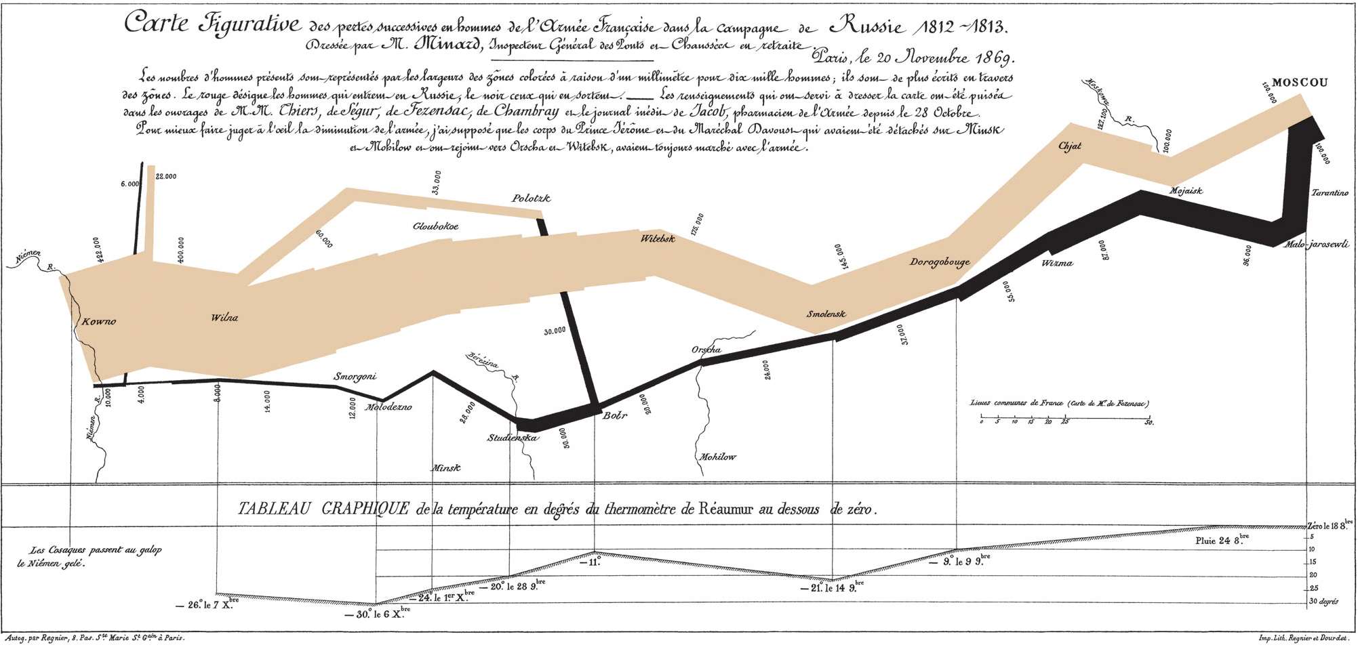
Quick Quiz
What does this, the most famous multidimensional display diagram in history, have to do with it?
  Hint, how do you pronounce “Delaunay?”

Slide 39
Voronoi-Delaunay People
Georgy Voronoy, 1908
Boris Delaunay, 1934 paper, lived 1890-1980
Both Russian citizens and published in French
  Advisor and student, Delaunay named Voronoi diagrams after his advisor who worked on them
  Mountain climber (top 3 in Russia)

Slide 40
SIAM GD/SPM 2011

Slide 41
Example meshes

Slide 42
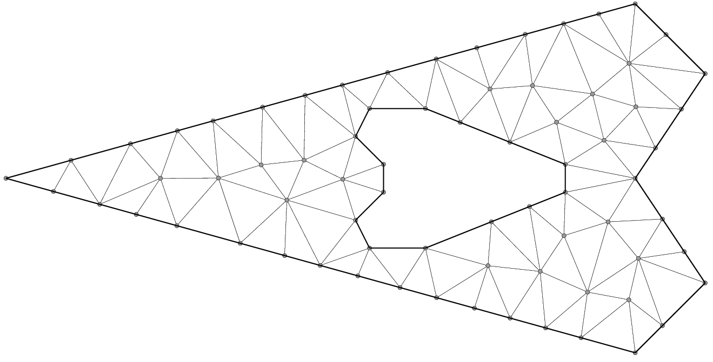
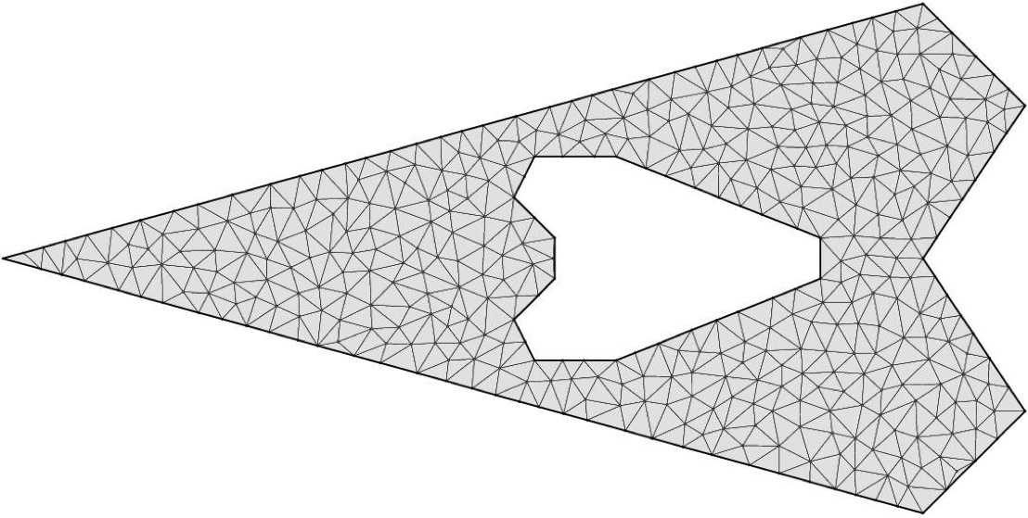
Example Meshes

Slide 44
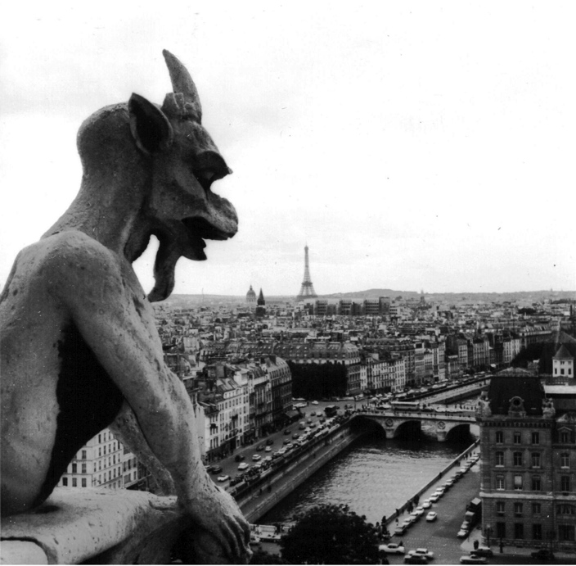
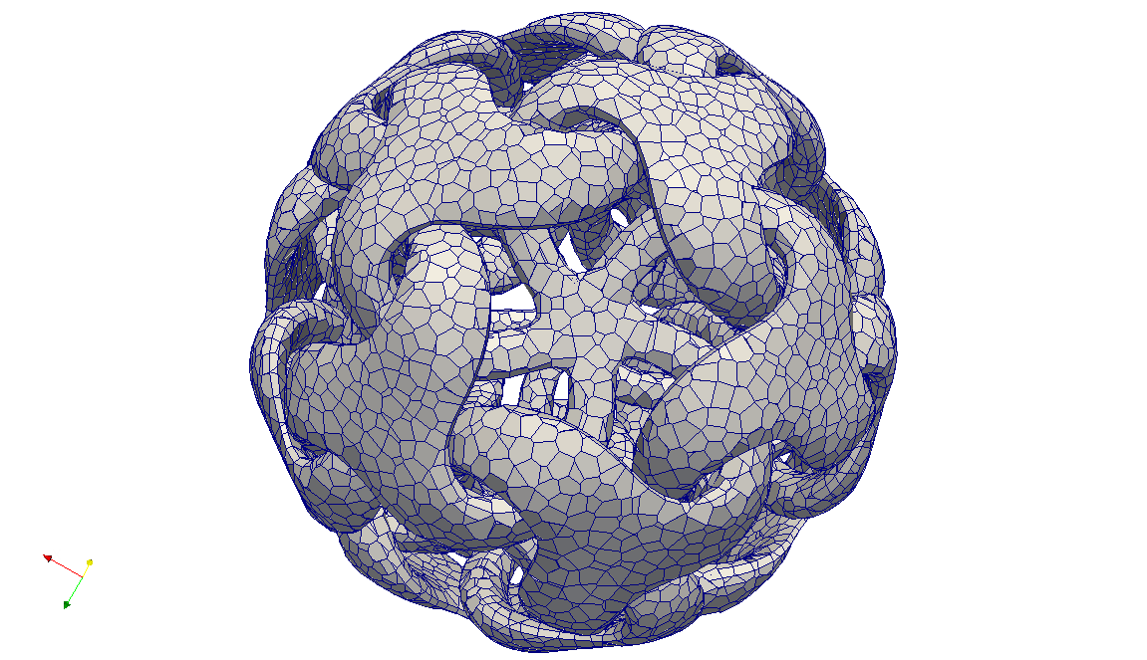
Uniform Random Voronoi Meshes
Notre Dame de Paris, Gargoyle, by FreiGurita (1968)
+two other 2011 papers
Mohamed S. Ebeida & Scott A. Mitchell (speaker)
20th International Meshing Roundtable
Paris, France
Sandia is a multiprogram laboratory operated by Sandia Corporation, a Lockheed Martin Company,
for the United States Department of Energy’s National Nuclear Security Administration
under contract DE-AC04-94AL85000.
Notes:
<25 min gross talk slot – aim for 20 min talk + questions>
Great to be back at IMR.
Also thank John Owen’s group at UC Davis, and
Vitus Leung, Pat Knupp, and Joe Bishop and Mario Martinez

Slide 45
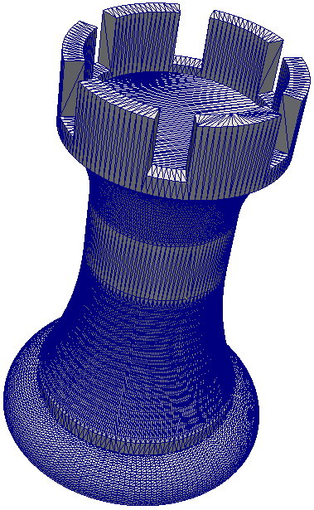
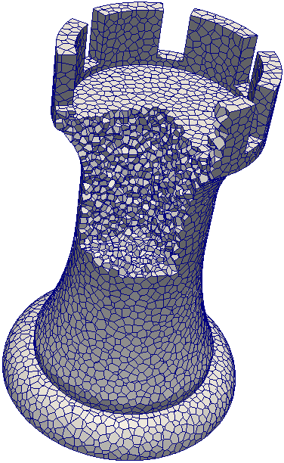
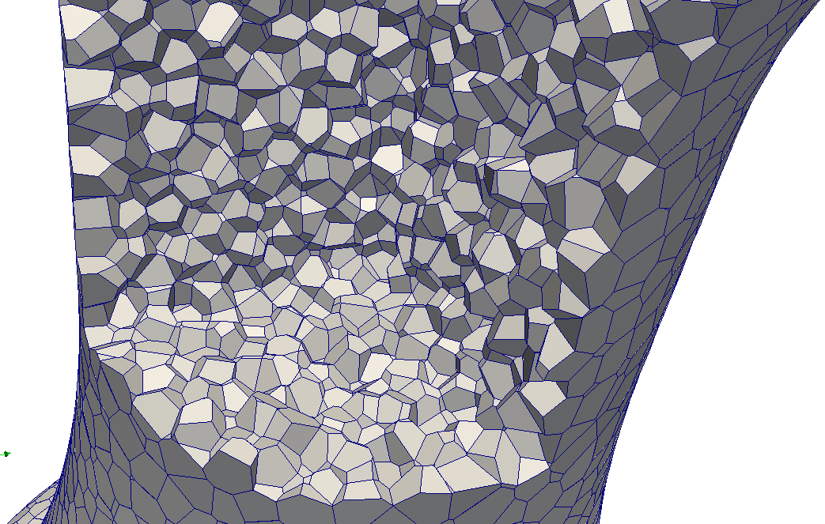
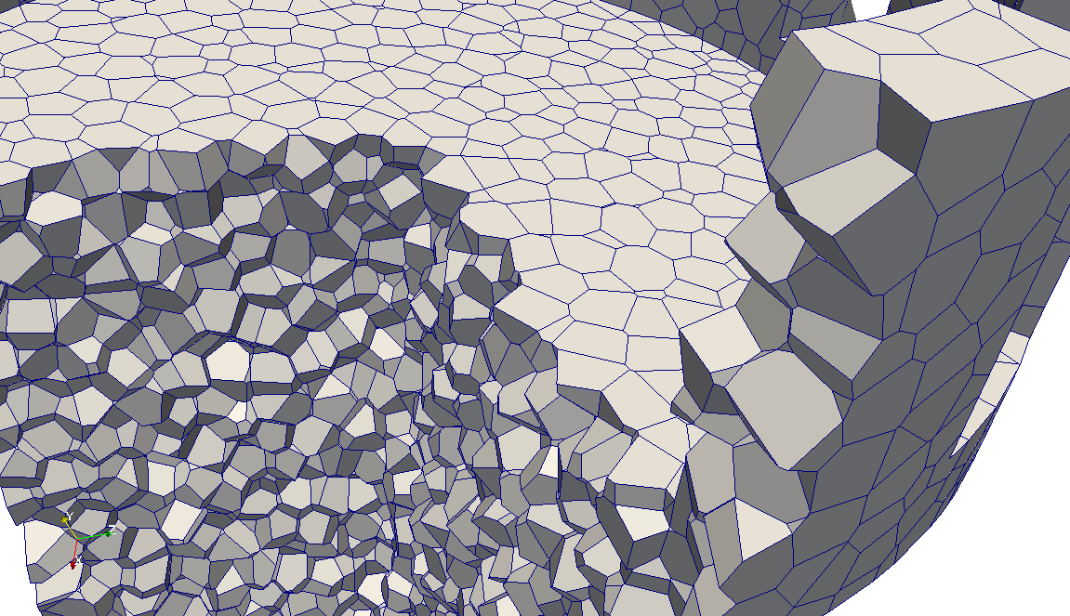
Uniform Random Voronoi Meshes summary
Random Polyhedral Meshing
  Generate random points using the maximal Poisson-disk process
    Points placed on reflex boundary features, but not concave or flat features
    Contrast to primal methods
  Symbolically split points
  Construct Voronoi cells
    Bounding box, cut by boundary and Voronoi planes
      Bounding box works because cells have bounded size
    Small edges collapsed
Get
  Voronoi mesh of convex polyhedral cells
  Bounded cell aspect ratio and facet dihedrals
  Random orientation of mesh edges
    Needed for fracture mechanics where cracks are restricted to edges

Slide 46
Boundary Pre-Processing
What about the domain boundary?
  For triangle meshes, need to represent it
  Subdivide it into edges (2d, 3d…), with points on the boundary
Randomly sample in 1 less dimension
Easy to get distances in [R,2R]

Slide 47
Boundary Sampling
Voronoi meshes
  Points interior to domain, not on boundary…
  …unless we have to:
    Reflex features require special care, not sharp ones
      “Reflex” includes 2-sided facets
    Not the dual of a body-fitted primal mesh
      Better (not constant 90°) dihedrals at boundary
Goal: cells align with boundary features, cells are convex
Sufficient: every point on a reflex face is closest to a sample from that reflex feature (or sub-facet)
  Sqrt(2) denser sampling on reflex feature
x
x
x
x
x
x
x
x
x
x
x
x
x
x
x
x
x
x
x
x
x
x
x
r disk-free
domain
interior
x
x
x
x
x
x
x
x
x
x
x
x
x
x
x
x
x
x
x
x
x
x
x
x
x
x
x
x
domain
interior
x
x
x
x
x
x
x
x
x
p
x
x
x
x
r_{e} maximality
x
x
x
x
x
x
x
x
x
x
x
Reflex face (line, plane, …)
x
x
x
x
x
x
x
x
x
x
x

Slide 48
Bonus: Convex Cells
Paper: star-shaped cells at reflex faces
Clipping by boundary
  By prior page only non-reflex (convex) boundary features affect interior samples
  Intersection of convex Voronoi cell w/ convex boundary = convex clipped cell
Symbolic duplication of reflex samples
x
x
x

Slide 49
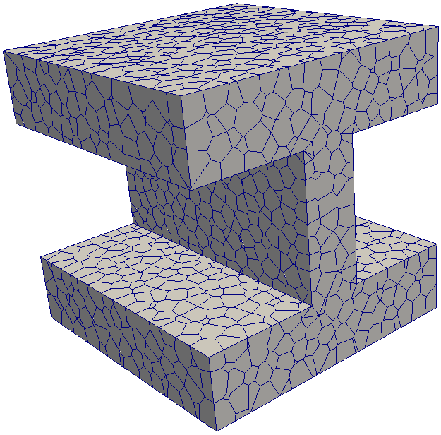
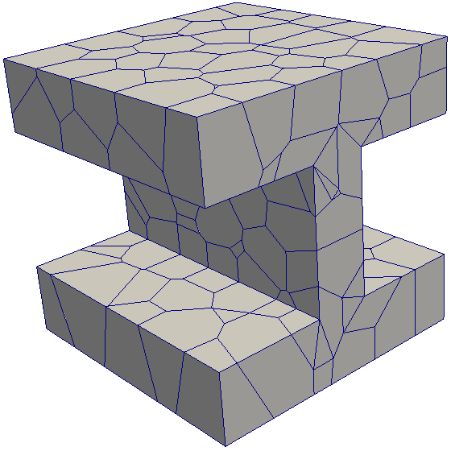
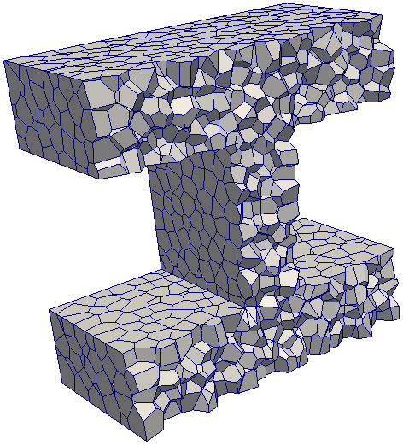
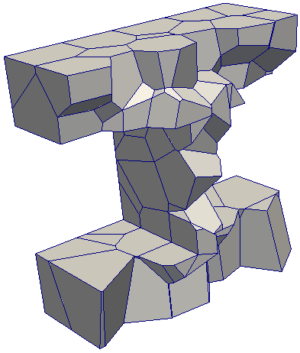
Voronoi Quality
Provable facet dihedral angle bounds
Provable cell aspect ratios

Slide 50
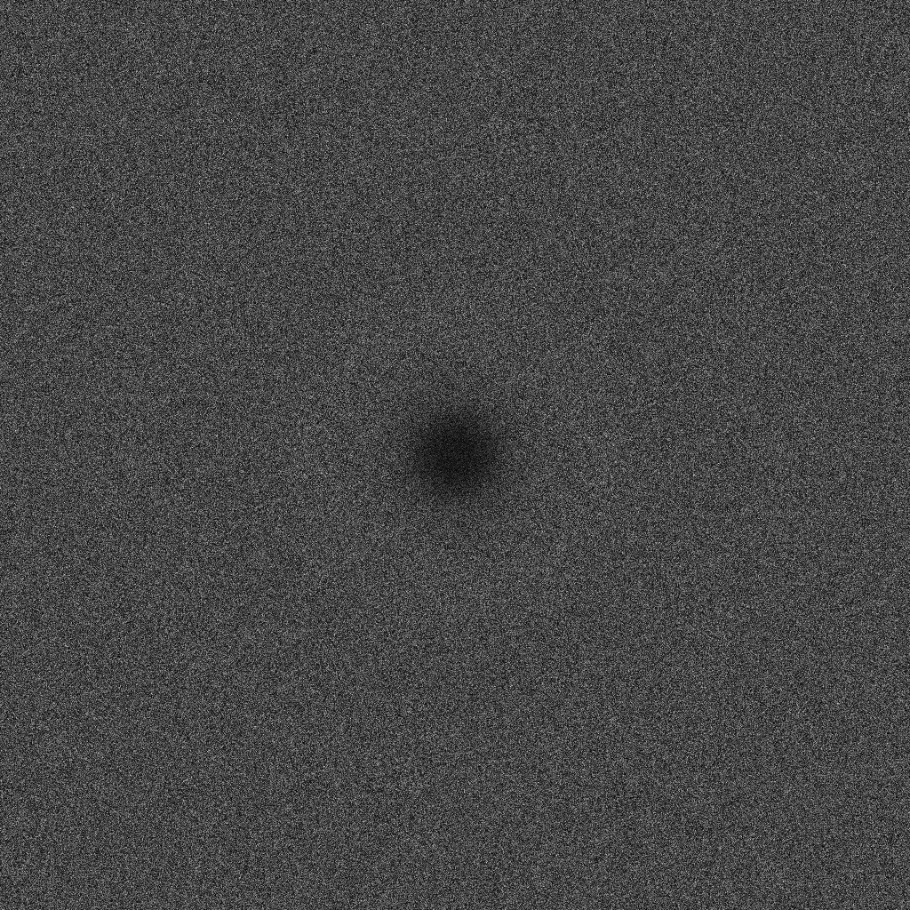
What is the real goal?
Classic MPS – a lot of effort to get maximal
coverage
Two-radii MPS [CCCG 2012]
x
exclusion

Slide 51
Hierarchical by shrinking radius
Discrete steps
Continuously
Coverage radius (blue) larger than inhibition radius (red)

Slide 52
Spatially-Variable radius MPS

Slide 53
How fast can it vary?
Where L is Lipschitz constant: f(x)-f(y) < L |x-y|

Slide 54
Improving a Point Set Distribution

Slide 55



Sifted Disks
reducing the number of sample points
retaining randomness
improving quality
Mohamed S. Ebeida
Ahmed H. Mahmoud - Muhammad A. Awad - Mohammed A. Mohammed Scott A. Mitchell
Alexander Rand - John D. Owens
7!
Sandia
National
Laboratories
Alexandria
University
presenter = Scott
Eurographics 2013
Sandia is a multiprogram laboratory operated by Sandia Corporation, a Lockheed Martin Company,
for the United States Department of Energy’s National Nuclear Security Administration
under contract DE-AC04-94AL85000.
Notes:
Takes a village to make me successful
Mohamed Ebeida, lead author with me at Sandia National Laboratories
Spends Saturdays mentoring undergrad students at Alexandria, his undergrad
Mohamed – his idea
Alexandria -- implementation
Me – algorithmic correctness proofs
Alexander Rand – quality measurements and relationships
John - graphics prof at UC Davis, Ebeida’s PhD there

Slide 56
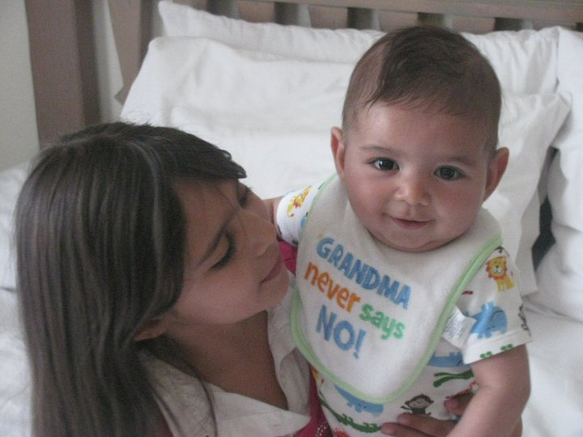
Mohamed Ebeida’s (first author’s) kids, in full color
Omar
Meera

Slide 57
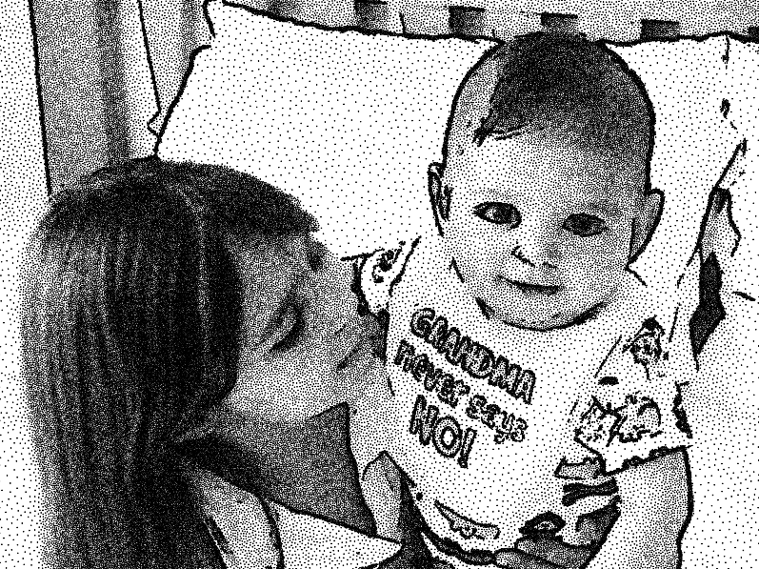
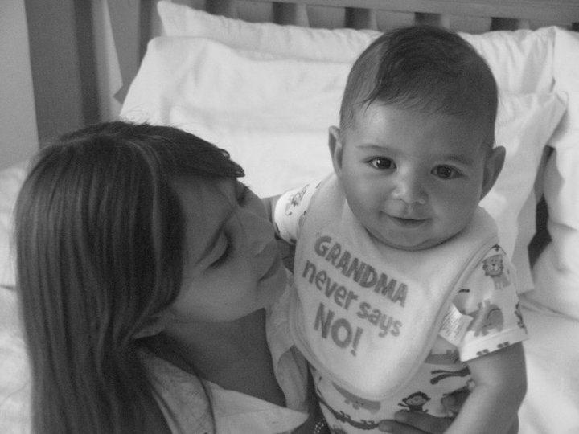
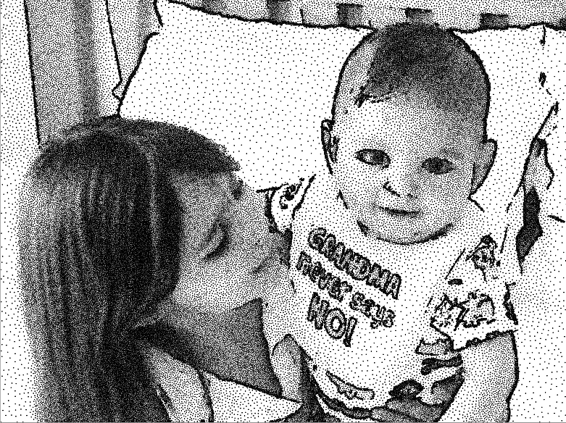
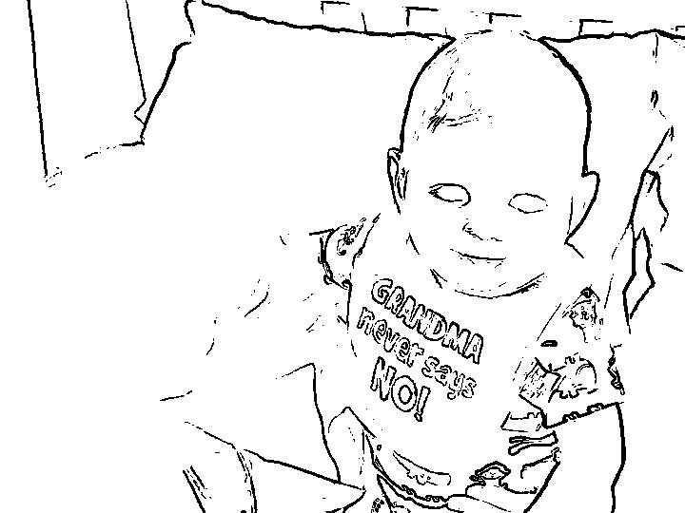
Application
1. grayscale -> sizing function for
2. Stippling via
Maximal
Poisson-Disk
Sampling
3.
Sift points
Replace 2 for 1.
Respect original
sizing function.
Fewer points
Minimal quality loss
Universally lighter, but features still distinct
edge-detect

Slide 58
Input point sets – improve them
Sifting points from
DR Delaunay Refinement
ODR Delaunay Refinement w/ Off-centers
MPS Maximal Poisson-disk Sampling
DR – Delaunay Refinement
new disk
center of large empty dual circle
MPS – Maximal Poisson-disk Sampling
new disk
global uniform random locations
outside prior disks

Slide 59
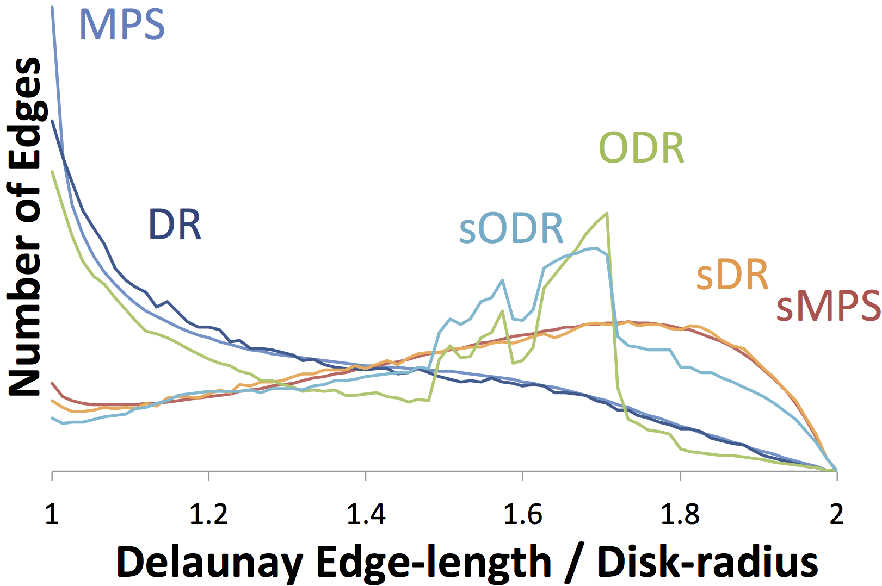
Problem
Painting Yourself Into a Corner
MPS
MPS, DR
easy to introduce a small gap that later forces
  distance = r + eps
  dense sampling
DR
1
gap
←→
disk later
many || edge || ≈ r
2

Slide 60
DR Solution – during generation off-centers DR (ODR)
move disk
towards short edge
DR
gap
←→
disk later
ODR
no gap
fewer || edge || ≈ r
many 1.6 r

Slide 61
Our MPS-like Solution: Sifting
Post-process
For all pairs of points with overlapping disks
  Try to replace 2-for-1
  (Replacing changes the set of overlapping pairs)
Quit when no pair can be replaced
replaced

Slide 62
Sifting changes triangulation edge lengths, angles, Voronoi cell squish
Removes most of the short edges
adds long edges

Slide 63
What’s happening?
Gets less dense but never gets close to “converging” to a structured mesh
  No pair can be replaced by one.
    Stuck at a globally random configuration
  A triple can be replaced by two? Would we want to?
MPS
sMPS
3
2
1.8
1.3
1
density

Slide 64
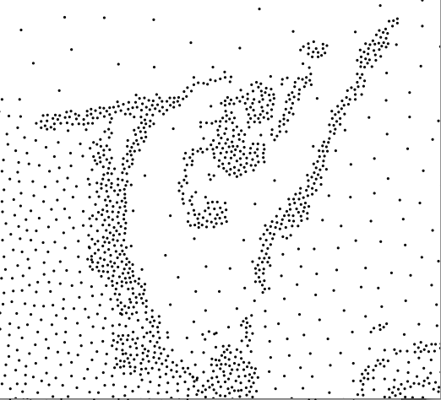
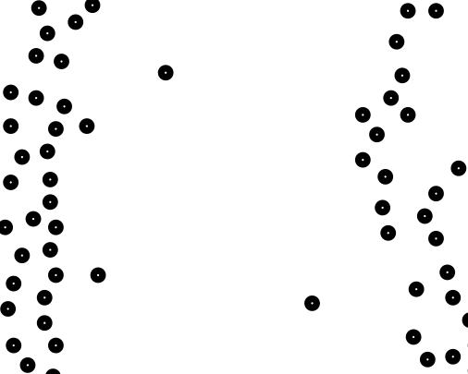
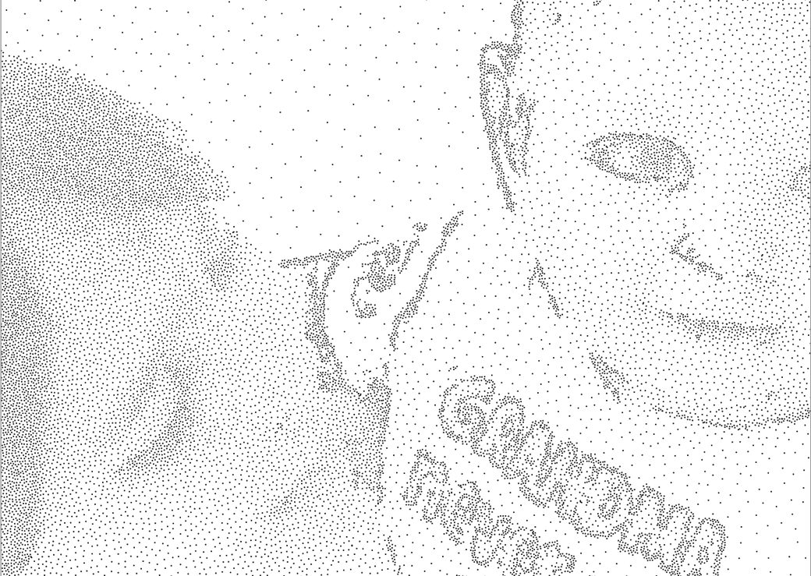
Beyond Uniform
Prior explanation constant radius
Spatially varying radii
  Theory
    Maximum rate of change L
    L = 1, 1/2
  Stippling application
    L exceeds theory limit, still works
    Disk radius ratio = 10
grayscale sizing function, high contrast
abrupt density changes

Slide 65
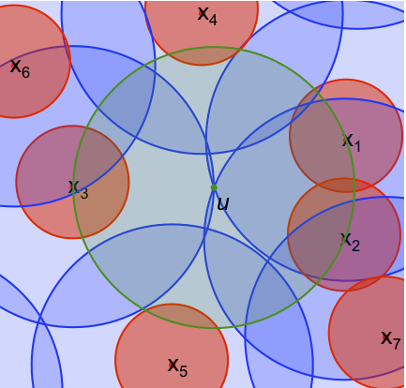
Bonus Thought how I think about sampling
Variable Radii MPS
(two-radii variant)
Mitchell et al.
CCCG 2012

