Slide 1
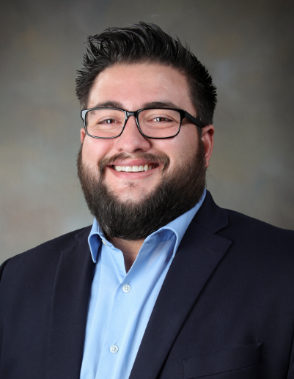
FY2022 Q3 Small Business Forum Sandia’s Commitment to Cybersecurity
Presented by
Paul Sedillo Manager, Small Business Program
Tuesday, April 12, 2022
SAND2022-2833 O

Slide 2
Welcome to Sandia’s Business Forum
Agenda:
Welcome and Introductions
Todays’ Topic: Cybersecurity Posture
  Fundamental Cybersecurity Concepts
  Advanced Cybersecurity Concepts
Final Comments
Disclaimer – The training provided by Spartan Cyber Security LLC does not reflects the views of Sandia or Sandia’s cybersecurity methods. The training being provided is geared towards all business, not just ones pursuing federal contracting.

Slide 3
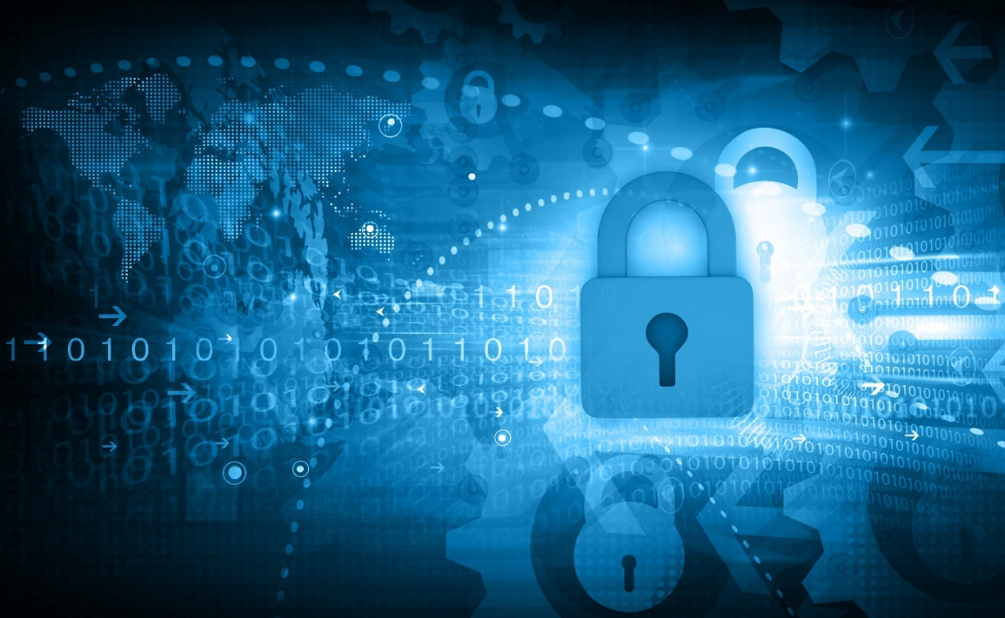
Sandia on Cybersecurity
In today’s world, all businesses need to be actively thinking about cybersecurity, investing in it.
Your business’s success depends on it!

Slide 4

Sandia on Cybersecurity
In today’s interconnected world, we all depend on each other:
from both a business perspective
and a security perspective.

Slide 5
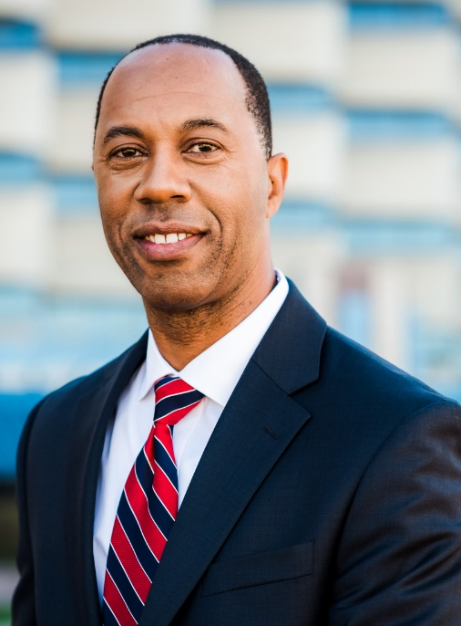
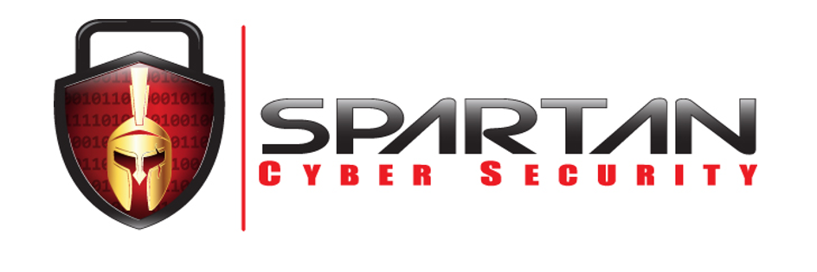
CYBERSECURITY
POSTURE
Raphael Warren, BG (RET)
President/CEO Spartan Cyber Security, LLC

Slide 6
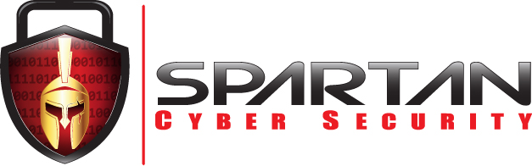
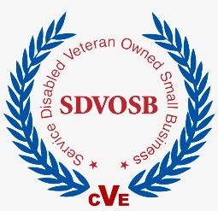
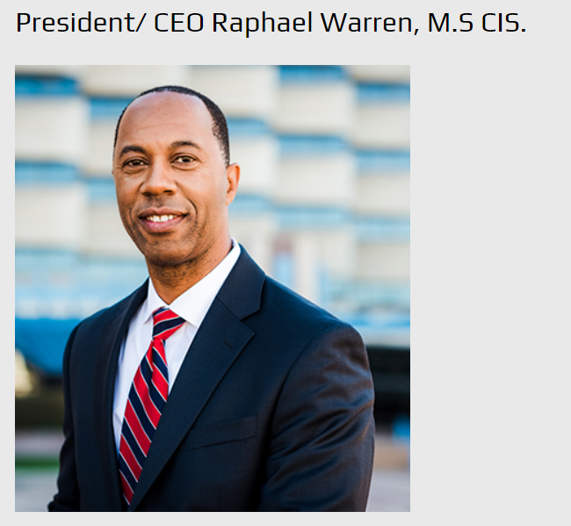
Brigadier General Raphael Warren (ret) has over 25 years of military and civilian Information technology experience and credentials. He holds the highest levels of security clearances and is nationally recognized for his expertise in Cyber Security and the development of Cyber Security teams. Brig. Gen. Warren has been intimately involved in the development of a new breed of Military Cyber warriors. To that extent, he has been officer in charge of the Army National Guard Cyber Shield Cyber training events. Brig. Gen. Warren has also attended training at the prestigious FBI Academy.
Brig. Gen. Warren has been special assistant to NGB (National Guard Bureau) Cyber Division Chief where he has been instrumental in the development of the core skill sets of military Cyber Warriors. Brig. Gen. Warren was sent on special assignment to observe the SANS training events on behalf of NGB Army Cyber Division Chief.
Brig. Gen. Warren worked with civilian entities, Federal and State government on numerous committees to develop Cyber operation contingency plans. He spent over five years as a Federal Agent and subsequently continued his federal civilian career
Brig. Gen. Warren seized the opportunity to work with the new and fast-growing company, Worldcom. He served as the Senior IT Systems Administrator Manager and helped build global communication solutions. As health care automation was experiencing a sea change, Brig. Gen. Warren took a position as Director of Network engineering for a national hospital engineering projects and worked for the largest public service company in New Mexico.
RWARREN@SPARTAN-CS.COM
WWW.SPARTAN-CS.COM
505.639.3883

Slide 8
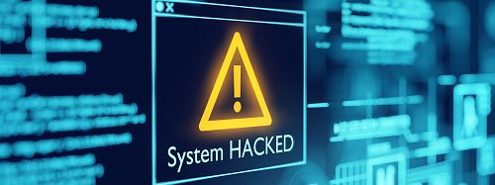
Albuquerque Public School Cyber Attack

Slide 9
THE TWO TYPES OF ORGANIZATION
First - Those that have suffered a Cyber attack
Second - Those that don’t know they have been attacked

Slide 10
THREAT VS VULNERABILITY VS RISK
Cyber threats are circumstances or events with the potential to cause harm by way of their outcome.
Vulnerabilities are weaknesses in a system. Vulnerabilities make threats possible.
Risks are confused with threats, there is a nuanced difference between the two — a risk refers to combination of a threat’s probability and a threat’s loss/impact.
risk = threat probability x potential loss
Notes:
Lets talk about what they enemy is doing. Lets define a few terms and the best way to that is in contrast and relationship to each other.
We will compare Cyber Threats vs Vulnerabilities vs Risks
Cyber threats are circumstances or events with the potential to cause harm by way of their outcome. A few examples of common threats include an attacker steal secret cookie recipe data, Political activist Ddos on your website. Administrator accidentally wiping a work system
Or even extreme weather like a storm that makes your roof leak and destroys you IT equipment. Threat have threat actors. The criminal.
Vulnerabilities are to weaknesses in a system. Vulnerabilities make threats possible and potentially even more dangerous. A system could be exploited through a single vulnerability, for example, a single SQL injection vulnerability could provide an attacker with full-control over sensitive data, or, an attacker could chain several exploits together, exploiting more than one vulnerability in order to exploit a system.
Risks are confused with threats, there is a nuanced difference between the two — a risk refers to combination of a threat’s probability and a threat’s loss/impact (usually in monetary terms, however, it should be noted that quantifying a breach is extremely difficult). Essentially, this translates to the following.
risk = threat probability x potential loss

Slide 11
CYBERCRIME COST
If it were measured as a country, then cybercrime — which is predicted to inflict damages totaling $6 Trillion USD globally in 2021 — would be the world’s third-largest economy after the U.S. and China.
Cybersecurity Ventures expects global cybercrime costs to grow by 15 percent per year over the next five years, reaching $10.5 Trillion USD annually by 2025, up from $3 Trillion in 2015. This represents the greatest transfer of economic wealth in history, risks the incentives for innovation and investment, is exponentially larger than the damage inflicted from natural disasters in a year, and will be more profitable than the global trade of all major illegal drugs combined.

Slide 12
PHISHING? – SPEAR PHISHING? – WHALING?
I know who you are because I know what you say on social media.
I know who your are because I know your circle of friends.

Slide 13
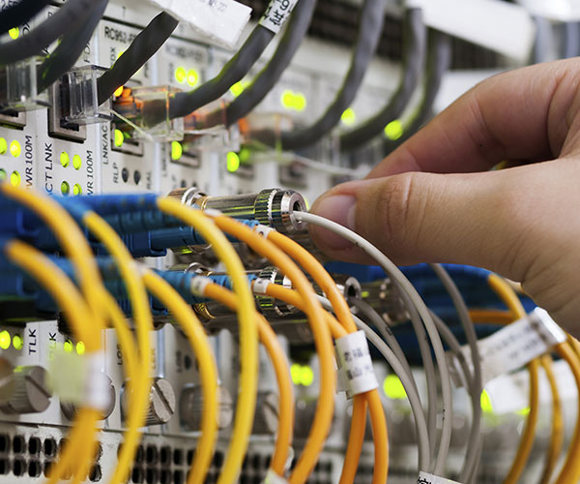
FUNDAMENTAL CYBERSECURITY CONCEPTS

Slide 14
CYBERSECURITY PRINCIPLES IN A NUT SHELL
PATCH MANAGEMENT
WEB FILTERING
EMAIL FILTERING
BACKUPS
ACCESS CONTROL
ANTIVIRUS
ADMIN PRIVILEDGE

Slide 15
PATCH MANAGEMENT
A patch is a set of changes to a computer program or its supporting data designed to update, fix, or improve it. This includes fixing security vulnerabilities and other bugs, with such patches usually being called bugfixes or bug fixes. Patches are often written to improve the functionality, usability, or performance of a program. The majority of patches are provided by software vendors for operating system and application updates.

Slide 16
WEB FILTERING
Web content filtering is part of Web protection capabilities in Microsoft Defender for Endpoint. It enables your organization to track and regulate access to websites based on their content categories. Many of these websites, while not malicious, might be problematic because of compliance regulations, bandwidth usage, or other concerns.

Slide 17
EMAIL FILTERING
When you enable email filtering, you allow the software to independently analyze incoming emails for red flags that signal spam/phishing content and automatically move those emails to a separate folder.
Most major email providers have spam filters built in that move questionable emails to a "Junk" or "Spam" folder. Sometimes, these folders have a setting enabled that automatically deletes all emails in this folder after a specified period.
Spam emails are usually more of an annoyance because they're trying to sell you a product or persuade you into taking some type of action like donating to a cause.
On the other hand, phishing emails pose more of a danger to the security of your personal information. Phishing emails seek to steal your personal information for malevolent means.

Slide 18
ACCESS CONTROL
In the fields of physical security and information security, access control (AC) is the selective restriction of access to a place or other resource, while access management describes the process. The act of accessing may mean consuming, entering, or using. Permission to access a resource is called authorization.

Slide 19
ANTIVIRUS
Antivirus software/anti-malware, is a computer program used to prevent, detect, and remove malware. Antivirus software protects users from malicious browser helper objects, browser hijackers, ransomware, keyloggers, backdoors, rootkits, trojan horses, worms, malicious LSPs, dialers, fraud tools, adware, spyware, malicious URLs, spam, scam and phishing attacks, online identity, online banking attacks, social engineering techniques, advanced persistent threat, and botnet DDoS attacks.

Slide 20
ADMIN PRIVILEDGE
Administrative privileges are the ability to make major changes to a system, typically an operating system. It can also mean large software programs such as a database management system.
Administrators can make changes to the system’s configuration, add and remove programs, access any file and manage other users on the system. Administrative users typically must authenticate themselves before performing major changes. Windows uses UAC (User Account Control) to ask users to confirm an administrative task.

Slide 21
BACKUPS
 | FULL | INCREMENTAL | DIFFERENTIAL
Description: | copies the entire data set | full backup + changes since the previous backup | full backup + changes since the full backup
Backup time: | time-consuming | fast to back up | faster than a full backup but slower than an incremental
Recovery time: | fast recovery | slow recovery | faster than incremental but slower than full
Storage space: | requires a lot of storage space | requires less storage space | requires less storage space than a full backup, but more than an incremental
Bandwidth: | uses a lot of bandwidth | uses less bandwidth | uses less bandwidth than a full backup, but more than an incremental backup

Slide 22
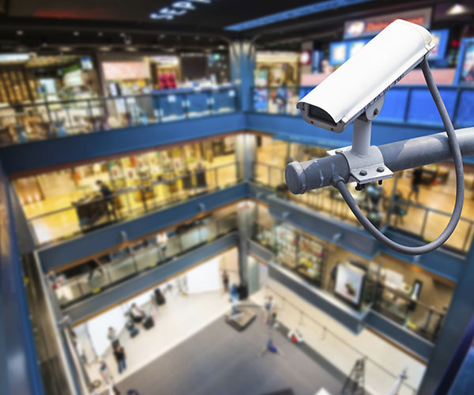
ADVANCED CYBERSECURITY CONCEPTS

Slide 23
WHAT IS NIST 800-171?
NIST 800-171 refers to National Institute of Standards and Technology Special Publication 800-171, which governs Controlled Unclassified Information (CUI) in Non-Federal Information Systems and Organizations. It is essentially a set of standards that define how to safeguard and distribute material deemed sensitive but not classified.

Slide 24
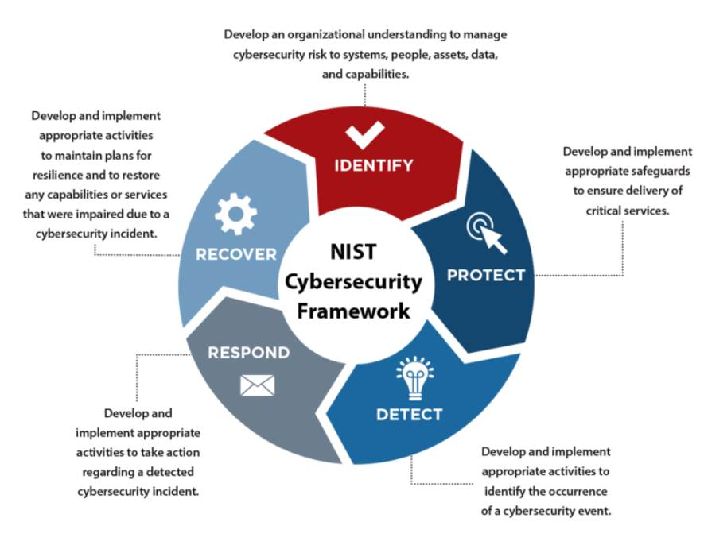
FRAMEWORK CORE
Identify
Protect
Detect
Respond
Recover

Slide 25
THE 14 FUNDAMENTAL AREAS OF NIST 800-171
Contractors who need access to Controlled Unclassified Information (CUI) must implement and verify compliance and create security protocols for 14 key areas.
Access Control
Awareness & Training
Audit & Accountability
Configuration Management
Identification & Authentication
Incident Response
Maintenance
Media Protection
Personnel Security
Physical Protection
Risk Assessment
Security Assessment
System & Communication Protection
System & Information Integrity

Slide 26
1 ACCESS CONTROL
Requirements 22 Objectives 48
Access control policies (e.g., identity- or role-based policies, control matrices, and cryptography) control access between active entities or subjects (i.e., users or processes acting on behalf of users) and passive entities or objects (e.g., devices, files, records, and domains) in systems.
Questions to Ask Yourself?
1: Does the company use passwords?
2: Does the company have an authentication mechanism?
3: Does the company require users to logon to gain access?
4: Are account requests authorized before system access is granted?

Slide 27
2 AWARENESS & TRAINING
Requirements 3 Objectives 6
Organizations determine the content and frequency of security awareness training and security awareness techniques based on the specific organizational requirements and the systems to which personnel have authorized access.
Questions to Ask Yourself?
1: Do all users, managers, and system administrators receive initial and annual training commensurate with their roles and responsibilities?
2: Does the training also address awareness of the need for operations security?

Slide 28
3 AUDIT & ACCOUNTABILITY
Requirements 9 Objectives 20
Organizations consider logging for traceability including results from monitoring of account usage, remote access, wireless connectivity, mobile device connection, communications at system boundaries, configuration settings, physical access, nonlocal maintenance, use of maintenance tools, temperature and humidity, equipment delivery and removal, system component inventory, use of mobile code, and use of VoIP.
Questions to Ask Yourself?
1: Can the company uniquely trace and hold accountable users responsible for unauthorized actions?
2: Does the system protect audit information and audit tools from unauthorized access, modification, and deletion?

Slide 29
4 CONFIGURATION MANAGEMENT
Requirements 9 Objectives 35
Organization establishes and maintains baseline configurations for systems and system components including for system communications and connectivity. Baseline configurations are documented, formally reviewed, and agreed-upon sets of specifications for systems or configuration items within those systems.
Questions to Ask Yourself?
1: Are baseline configurations updated as needed to accommodate security risks or software changes?
2: Are deviations from baseline configurations documented?

Slide 30
5 IDENTIFICATION & AUTHENTICATION
Requirements 11 Objectives 14
Common device identifiers include media access control (MAC), Internet Protocol (IP) addresses, or device-unique token identifiers. Typically, individual identifiers are the user names associated with the system accounts assigned to those individuals.
Questions to Ask Yourself?
1: Are initial passwords randomly generated strings provided via a password reset mechanism to each employee?
2: Is the password reset upon first use?
3: Do all passwords follow best practice of at least 12 characters, and require a mix of upper and lowercase letters, numbers, and special characters?

Slide 31
6 INCIDENT RESPONSE
Requirements 3 Objectives 11
Organization effective incident handling capability includes coordination among many organizational entities including mission/business owners, system owners, authorizing officials, human resources offices, physical and personnel security offices, legal departments, operations personnel, procurement offices, and the risk executive.
Questions to Ask Yourself?
1: Is there a company incident response policy which specifically outlines requirements for handling of incidents involving CUI (Confidential Unclassified Information)?
2: Is an incident handling capability implemented for security incidents that include preparation, detection and analysis, containment, eradication, and recovery?

Slide 32
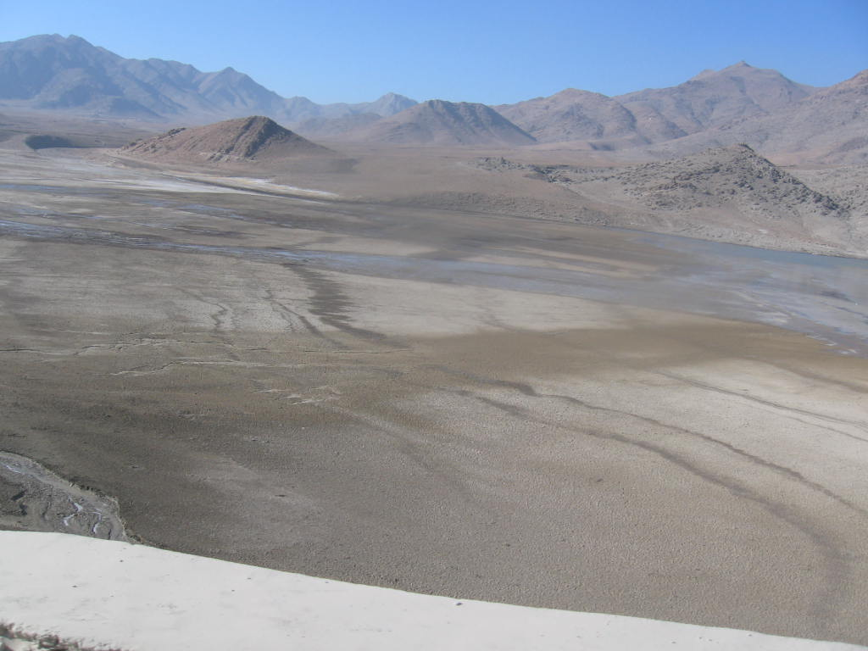
GAS PIPELINE, SEWAGE AND WATER
- Days down
- People affected
- Home many states

Slide 33
7 MAINTENANCE
Requirements 6 Objectives 4
Organization addresses the information security aspects of the system maintenance program and applies to all types of maintenance to any system component (including hardware, firmware, applications) conducted by any local or nonlocal entity.
Questions to Ask Yourself?
1: Are all activities of maintenance personnel (who do not normally have access to a system) monitored?
2: Are media that are provided by authorized maintenance personnel (and not normal systems administrators/owners) for troubleshooting, diagnostics, or other maintenance run through an anti-virus/anti-malware/anti-spyware program prior to use in the company's information system?

Slide 34
8 MEDIA PROTECTION
Requirements 9 Objectives 6
Organizations determine the appropriate sanitization methods, recognizing that destruction may be necessary when other methods cannot be applied to the media requiring sanitization. Sanitization techniques, including clearing, purging, cryptographic erase, and destruction, prevent the disclosure of information to unauthorized individuals when such media is released for reuse or disposal.
Questions to Ask Yourself?
1: Is all managed data storage erased, encrypted, or destroyed using mechanisms to ensure that no usable data is retrievable?
2: Is accountability for system media maintained during transport outside controlled areas?

Slide 35
9 PERSONNEL SECURITY
Requirements 2 Objectives 2
Personnel security screening (vetting) activities involve the evaluation/assessment of individual’s conduct, integrity, judgment, loyalty, reliability, and stability (i.e., the trustworthiness of the individual) prior to authorizing access to organizational systems containing CUI.
Questions to Ask Yourself?
1: Are individuals requiring access screened before access is granted?
2: Does the company disable information system access prior to employee termination or transfer?

Slide 36
10 PHYSICAL PROTECTION
Requirements 6 Objectives 10
Organizations determine the strength of authorization credentials needed. Limiting physical access to equipment may include placing equipment in locked rooms or other secured areas and allowing access to authorized individuals only, and placing equipment in locations that can be monitored by organizational personnel.
Questions to Ask Yourself?
1: Are keys, combinations, and other physical access devices secured?
2: Has the facility/building manager designated building areas as "sensitive" and designed physical security protections (including guards, locks, cameras, card readers, etc.) to limit physical access to the area to only authorized employees?
3: Are visitors provided escorts and monitored?

Slide 37
11 RISK ASSESSMENT
Requirements 3 Objectives 6
Organization risk assessments consider threats, vulnerabilities, likelihood, and impact to organizational operations, organizational assets, and individuals based on the operation and use of organizational systems.
Questions to Ask Yourself?
1: Are changes in use or infrastructure documented and assessed?
2: Is vulnerability scanning performed? i.e. Nessus

Slide 38
12 SECURITY ASSESSMENT
Requirements 4 Objectives 10
An organization system security plans (SSP) relate security requirements to a set of security controls. System security plans also describe, at a high level, how the security controls meet those security requirements, but do not provide detailed, technical descriptions of the design or implementation of the controls.
Questions to Ask Yourself?
1: Has a periodic (e.g., annual) security assessment been conducted to ensure that security controls are implemented correctly and meet the security requirements?
2: Is the assessment conducted by an independent security auditor/consultant?

Slide 39
13 SYSTEMS & COMMUNICATION PROTECTION
Requirements 16 Objectives 25
Organization monitors and controls communications at the external boundary of the system and at key internal boundaries within the system. Connects to external networks or information systems only through managed interfaces consisting of boundary protection devices arranged in accordance with an organizational security architecture.
Questions to Ask Yourself?
1: Are physical or logical controls used to separate user functionality from system management-related functionality (e.g., to ensure that administration [e.g., privilege] options are not available to general users)?
2: Does the system deny network traffic by default and allow network traffic by exception?

Slide 40
14 SYSTEMS & INFORMATION INTEGRITY
Requirements 7 Objectives 13
Organizations identify systems that are affected by announced software and firmware flaws including potential vulnerabilities resulting from those flaws and report this information to designated personnel with information security responsibilities. Security-relevant updates include patches, service packs, hot fixes, and anti-virus signatures.
Questions to Ask Yourself?
1: Are system flaws identified, reported, and corrected within company-defined time periods?
2: Does the company perform all security-relevant software updates (patching, service packs, hot fixes, and anti-virus signature additions) in response to identified system flaws and vulnerabilities within the timeframe specified in policy or within the system security plan?

Slide 41
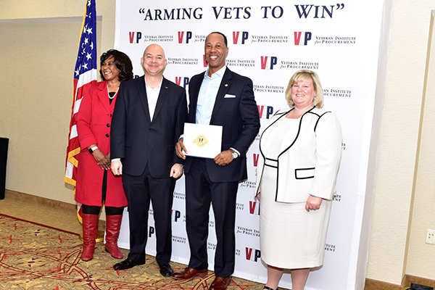
THANK YOU!
RWARREN@SPARTAN-CS.COM
WWW.SPARTAN-CS.COM
505.639.3883

Slide 42
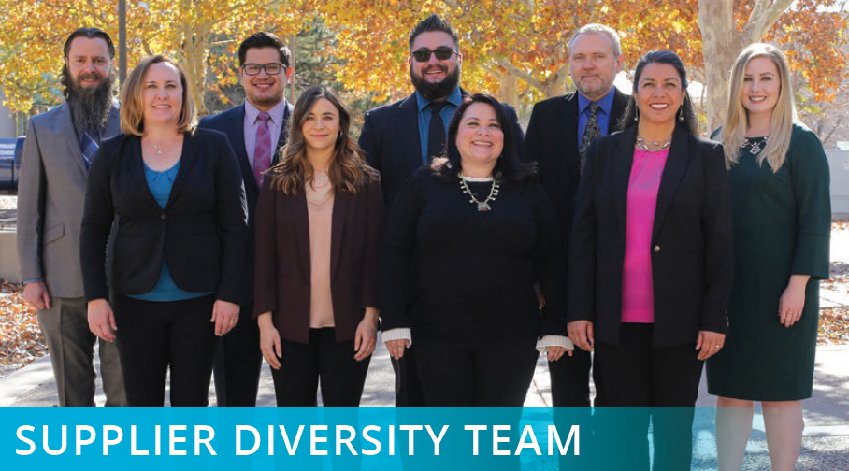

Closing Remarks – Supplier Diversity Team

Slide 43

Thank you for your time!
Additional Questions?
supplier@sandia.gov

